Slide 1
CI/CD RECOVERY ENGINE
RepoClaw
Barath Ganesh SP
Anirudh ST
C Nambi Narayana
Chanakya DA
RV College of Engineering
Deterministic Build Recovery
with Full Forensic Observability
Heuristic
Bounded
Secure
20+ Failure Signatures
Max 3 Repair Cycles
512MB / 1 Core Sandbox
Hackathon Submission 2025

Slide 2
THE PROBLEM
Broken builds block everything.
⏱
🤖
🔄
Hours of manual triage
AI agents hallucinate patches
Proactive tools miss the moment
Developers grep logs, search Stack Overflow, and guess at fixes — all while the pipeline is blocked.
LLM-generated code fixes introduce new bugs and lack auditability — a liability in production pipelines.
Dependabot keeps deps fresh, but when a build is already broken, no tool reactively diagnoses and repairs it.
RepoClaw is the missing reactive layer: deterministic, auditable, and sandboxed.

Slide 3
SOLUTION
RepoClaw: Infrastructure-Grade CI Recovery
1
2
3
4
5
6
7
8
Clone Repo
Detect Build System
Attempt Build
Classify Failure
Select Policy
Apply Mutation
Rebuild & Validate
Provenance Record
Heuristic-First
Policy-Driven Repair
Bounded Retry Loop
20+ regex patterns classify failures before any LLM is consulted. Tiered match strengths ensure confidence.
Each error class maps to a static repair policy with declared mutation surfaces, safety class, and rollback rules.
Max 3 cycles with material-mutation detection prevents synthetic repetition and infinite loops.

Slide 4
ARCHITECTURE
FRONTEND
Key Design Decisions
React / Vite CI Console
🔍
Heuristics first — LLM only for UNKNOWN class, capped at 0.75 match strength
BACKEND ENGINE
Node.js Recovery Orchestrator
🔒
LLMs never generate code patches — repair is always a lookup, not generation
CLASSIFIER
Heuristic Pattern Matcher (20+ sigs)
📋
Every mutation surface, safety class, and rollback rule is statically declared
POLICY TABLE
🐳
Docker enforces memory, CPU, PID, and privilege limits — no sandbox escape
Static Repair Strategy Registry
DOCKER SANDBOX
📜
Full forensic provenance: failure class → strategy → mutation → exit code
512MB · 1 Core · PID 256 · no-new-priv

Slide 5
REPAIR POLICIES
Failure Class
Repair Strategy
Mutation Surface
Safety
MISSING_DEPENDENCY
Append to install command
install_command
SAFE
DEPENDENCY_CONFLICT
Inject legacy peer deps flag
install_flags
SAFE
BUILD_SCRIPT_MISSING
Inject package.json placeholder
package_json
CONSTRAINED
TYPESCRIPT_CONFIG_FAILURE
Generate minimal tsconfig
tsconfig_json
CONSTRAINED
TYPESCRIPT_FAILURE
Relax tsc strictness flags
tsconfig_strict
SAFE
RUNTIME_VERSION_MISMATCH
Strip engine constraint
package_engines
CONSTRAINED
PYTHON_NATIVE_TOOLCHAIN
Force binary-only wheels
pip_flags
CONSTRAINED
Language Support:
Node.js
Python
Go
Rust
Java

Slide 6
CI CONSOLE DASHBOARD
● ● ●
compiler output — /sandbox/build
Recovery Provenance
$ npm install
Failure Classification
DEPENDENCY_CONFLICT
npm warn ERESOLVE: peer dep conflict detected
npm ERR! code ERESOLVE
npm ERR! peer react@"^17" from package-a
Match Strength
0.92 (heuristic)
[RepoClaw] Failure classified: DEPENDENCY_CONFLICT
Strategy Applied
inject_legacy_peer_deps
[RepoClaw] Match strength: 0.92 | Source: heuristic
[RepoClaw] Applying policy: inject_legacy_peer_deps
Mutation Surface
install_flags
$ npm install --legacy-peer-deps
added 847 packages in 14.2s
Safety Class
SAFE
$ npm run build
> webpack --mode production
✓ Build succeeded. Exit code: 0
Rebuild Exit Code
0 — Passed ✓
RECOVERY COMPLETE · Cycle 1 of 3 · Duration: 32.4s · Mutations Applied: 1
Sandbox Execution Policy
512MB Memory · 1 CPU Core · PID 256 · no-new-privileges · Read-only mounts

Slide 7
COMPETITIVE DIFFERENTIATION
Capability
Dependabot
AI Coding Agents
RepoClaw ✓
Reactive to broken builds
✗
✓
✓
Deterministic (no LLM in hot path)
✓
✗
✓
Full audit trail / provenance
✗
✗
✓
Sandboxed execution
N/A
✗
✓
No hallucinated patches
✓
✗
✓
Multi-language support
✓
✓
✓
Bounded retry (no infinite loops)
N/A
✗
✓
"RepoClaw is not Dependabot. It's not an AI agent. It's the reactive, auditable layer that neither provides."

Slide 8
DEMO & LOCAL SETUP
Run RepoClaw in 3 Steps
Demo Scenario
1
Pre-warm sandbox
URL Input:
docker pull node:20-alpine
file:///c:/…/RepoClaw/test-repos/demo-conflict
Navigate to http://localhost:5173/ → paste URL → click Analyze
2
Start backend engine
npm install && npm start
Watch in real-time:
→ Compiler log streaming live in terminal panel
3
Launch frontend console
→ Failure class & match strength appear instantly
cd frontend && npm install && npm run dev
→ Policy selection with mutation surface displayed
→ Rebuild exit code in provenance record
Prerequisites: Node.js v20+ · Docker Desktop (running)

Slide 9
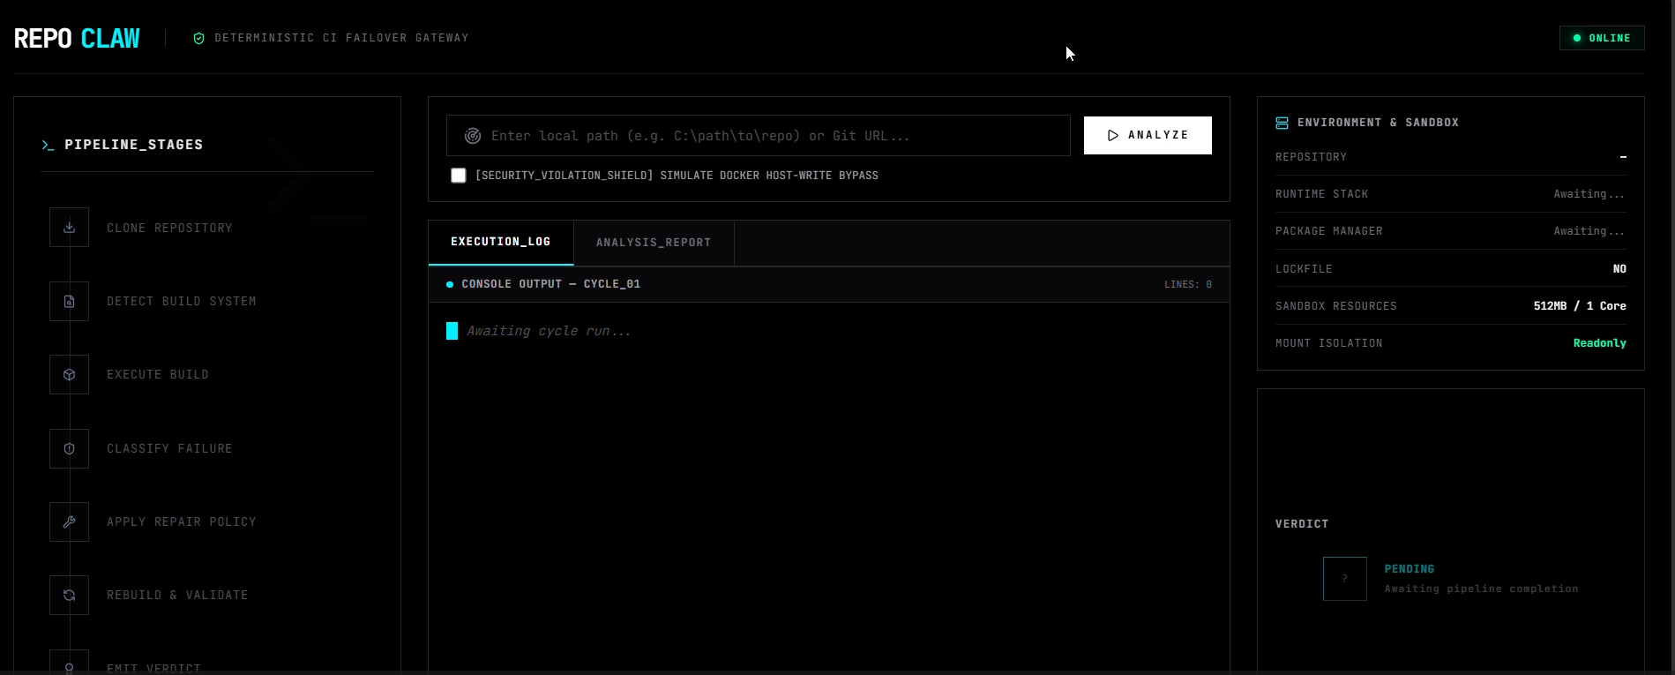
SNAPSHOTS
Run RepoClaw in 3 Steps
Demo Scenario
1
Pre-warm sandbox
URL Input:
docker pull node:20-alpine
file:///c:/…/RepoClaw/test-repos/demo-conflict
Navigate to http://localhost:5173/ → paste URL → click Analyze
2
Start backend engine
npm install && npm start
Watch in real-time:
→ Compiler log streaming live in terminal panel
3
Launch frontend console
→ Failure class & match strength appear instantly
cd frontend && npm install && npm run dev
→ Policy selection with mutation surface displayed
→ Rebuild exit code in provenance record
Prerequisites: Node.js v20+ · Docker Desktop (running)

Slide 10
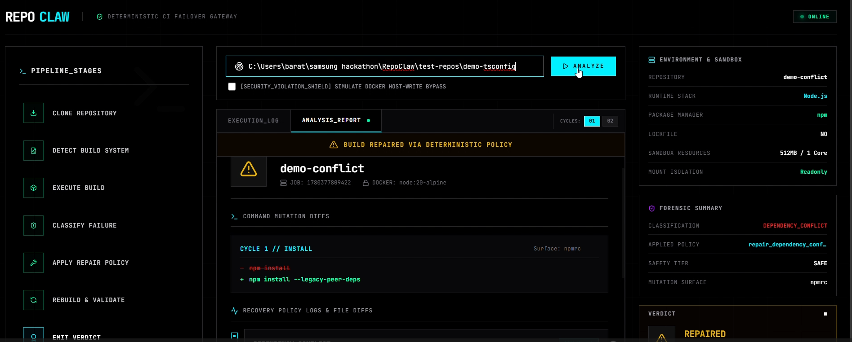
SNAPSHOTS
Run RepoClaw in 3 Steps
Demo Scenario
1
Pre-warm sandbox
URL Input:
docker pull node:20-alpine
file:///c:/…/RepoClaw/test-repos/demo-conflict
Navigate to http://localhost:5173/ → paste URL → click Analyze
2
Start backend engine
npm install && npm start
Watch in real-time:
→ Compiler log streaming live in terminal panel
3
Launch frontend console
→ Failure class & match strength appear instantly
cd frontend && npm install && npm run dev
→ Policy selection with mutation surface displayed
→ Rebuild exit code in provenance record
Prerequisites: Node.js v20+ · Docker Desktop (running)

Slide 11
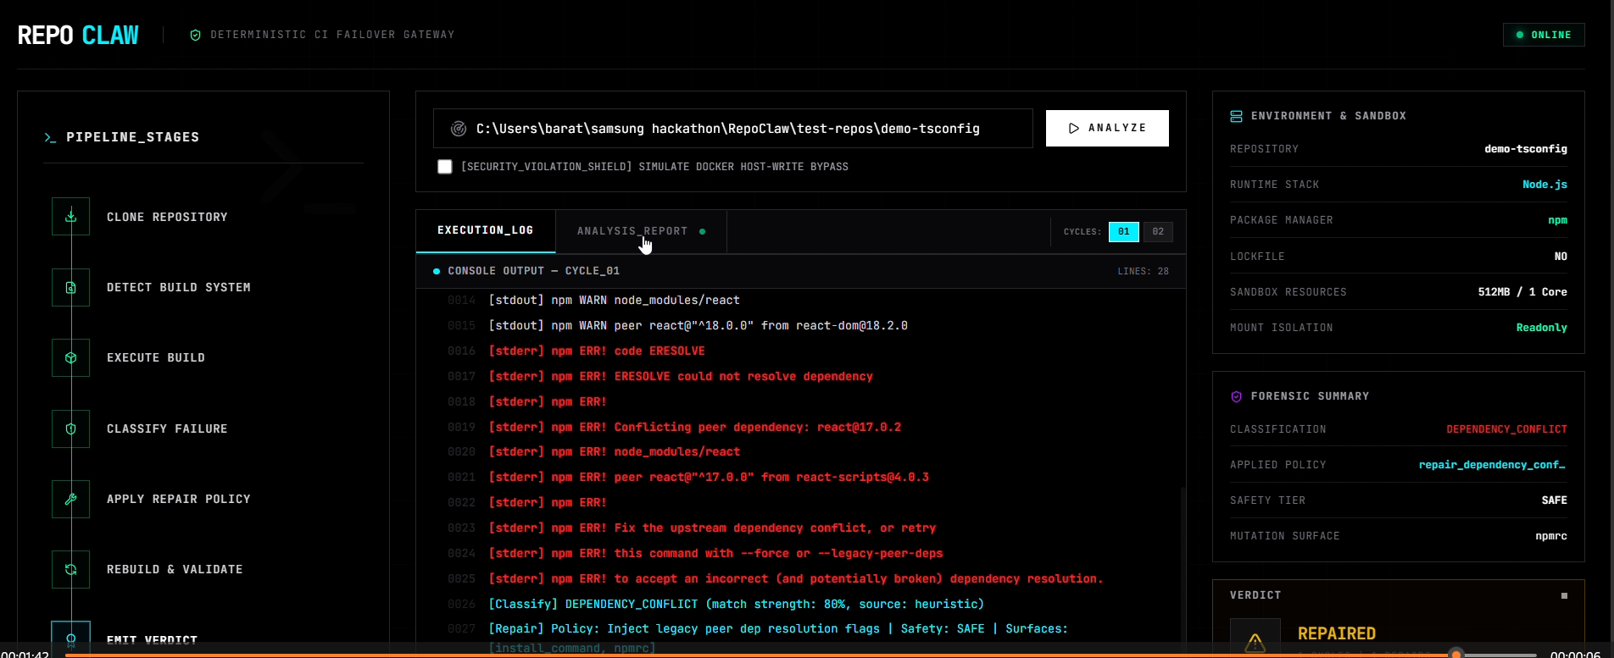
SNAPSHOTS
Run RepoClaw in 3 Steps
Demo Scenario
1
Pre-warm sandbox
URL Input:
docker pull node:20-alpine
file:///c:/…/RepoClaw/test-repos/demo-conflict
Navigate to http://localhost:5173/ → paste URL → click Analyze
2
Start backend engine
npm install && npm start
Watch in real-time:
→ Compiler log streaming live in terminal panel
3
Launch frontend console
→ Failure class & match strength appear instantly
cd frontend && npm install && npm run dev
→ Policy selection with mutation surface displayed
→ Rebuild exit code in provenance record
Prerequisites: Node.js v20+ · Docker Desktop (running)

Slide 12
RepoClaw
Thank You
Questions? Let's run the demo.
Deterministic Build Recovery
Engine & CI Console
20+
3
✓ Heuristic-first — no LLM in the repair hot path
Failure Signatures
Max Repair Cycles
✓ Bounded, auditable retry with provenance record
7
0
✓ Docker sandbox with strict resource enforcement
Auto-Repair Classes
LLM Patches Applied
✓ Full forensic observability from failure to fix
Stack: Node.js · React · Vite · Docker · PptxGenJS
RepoClaw · Hackathon 2025 · Deterministic CI Recovery

