Slide 1

Modified Euler-Frobenius Polynomials with application to
Sampled Data Model
Sciamanna Daniele
Rotondi Simone

Slide 2
Outline
Introduction
Euler-Frobenius Polynomials
  Standard
  Modified
Preliminary definitions
  Multiple Integrations
  Zero Dynamics
Applications
Conclusions
Sciamanna Daniele
Rotondi Simone

Slide 3
Why?
Euler-Frobenius Polynomials are widely used in math and they play a key role in many engeneering areas.
They appears in in sampled-data models both in linear and non linear systems, polynomial interpolation and splines.
With the evolution of Standard to Modified Euler-Frobenius Polynomials we are trying to find a unified framework to identify the zeroes in the sampled-data models
Sciamanna Daniele
Rotondi Simone

Slide 4
Standard Euler-Frobenius polynomials
Sciamanna Daniele
Rotondi Simone

Slide 5
Modified Euler-Frobenius polynomials
Sciamanna Daniele
Rotondi Simone

Slide 6
Preliminar(1): Multiple integration
Define:
And in the special case:
Sciamanna Daniele
Rotondi Simone

Slide 7
Preliminar(2): Zero-dynamics
Internal Dynamics
when input and initial conditions are chosen to make output
identically zero
Sciamanna Daniele
Rotondi Simone

Slide 8
Implementations Outline
Partial zero-order hold
  System of integrators
  Linear system
  Affine nonlinear system
Piecewise Constant generalised hold
  System of integrators
  Linear system
  Affine nonlinear system
Pure time-delay
  System of integrators
  Linear system
  Affine nonlinear system
Sciamanna Daniele
Rotondi Simone

Slide 9
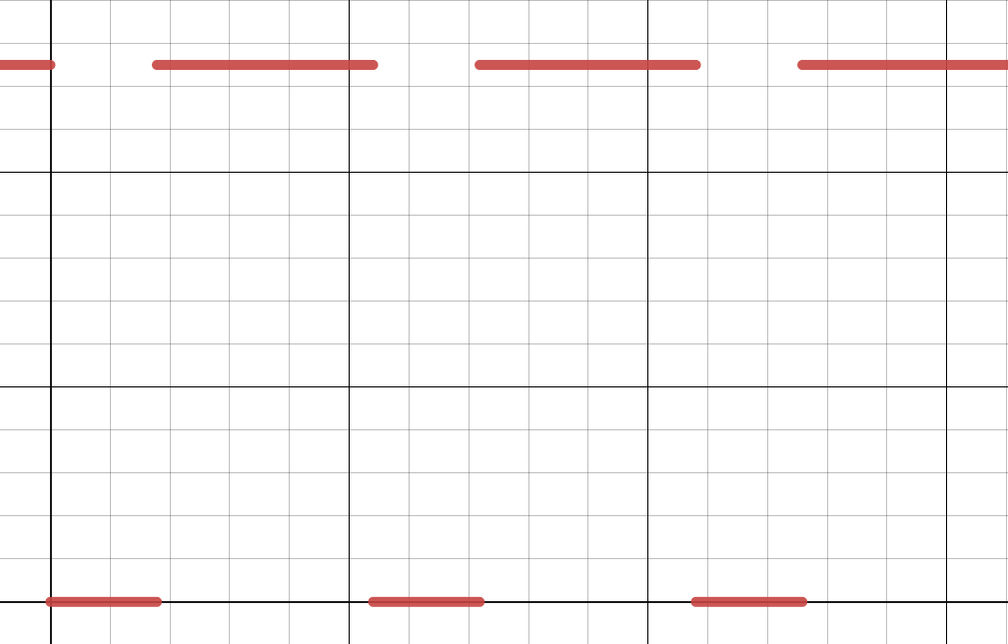
Partial zero-order hold
Sciamanna Daniele
Rotondi Simone

Slide 10
Pzoh: Chained Integrator
Sciamanna Daniele
Rotondi Simone

Slide 11
Pzoh: General Linear Sys
Sciamanna Daniele
Rotondi Simone

Slide 12
Sciamanna Daniele
Rotondi Simone

Slide 13
Sciamanna Daniele
Rotondi Simone

Slide 14
Sciamanna Daniele
Rotondi Simone

