Slide 1
Module #6: Experimental Considerations

Slide 2
Topics
Data Requirements for Experimental/Analytical Substructuring
Which approach can you use?
Its like regular modal testing, but harder
Some specific considerations for FBS and CMS
Transmission Simulator Method
Technique for creating experimental models that addresses several common issues encountered in experimental dynamic substructuring
Notes:
Mention a disclaimer that I personally am more familiar with experimental work for CMS, not FBS. There is a lot of overlap in what you have to keep in mind for both, but how I think of these things is going to be from a more CMS point of view. Steve and Andreas are more familiar with doing testing from the FBS side, so they can chime in if there are any question that I’m ill equipped to handle.
This slide is probably unnecessary

Slide 3
Data Requirements for Experimental/Analytical Substructuring

Slide 4
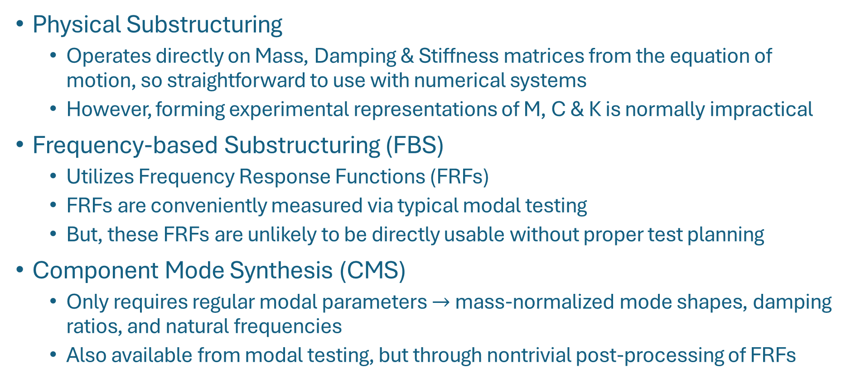
Which Approach Can We Use?
Physical Substructuring
Operates directly on Mass, Damping & Stiffness matrices from the equation of motion, so straightforward to use with numerical systems
However, forming experimental representations of M, C & K is normally impractical
Frequency-based Substructuring (FBS)
Utilizes Frequency Response Functions (FRFs)
FRFs are conveniently measured via typical modal testing
But, these FRFs are unlikely to be directly usable without proper test planning
Component Mode Synthesis (CMS)
Only requires regular modal parameters $→$ mass-normalized mode shapes, damping ratios, and natural frequencies
Also available from modal testing, but through nontrivial post-processing of FRFs

Slide 5
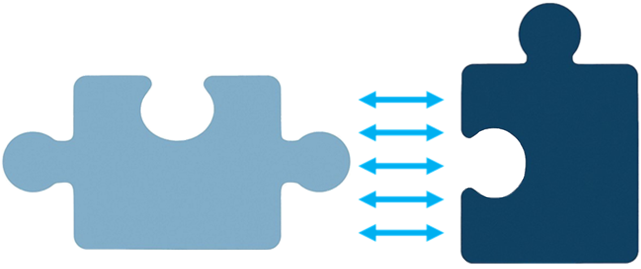
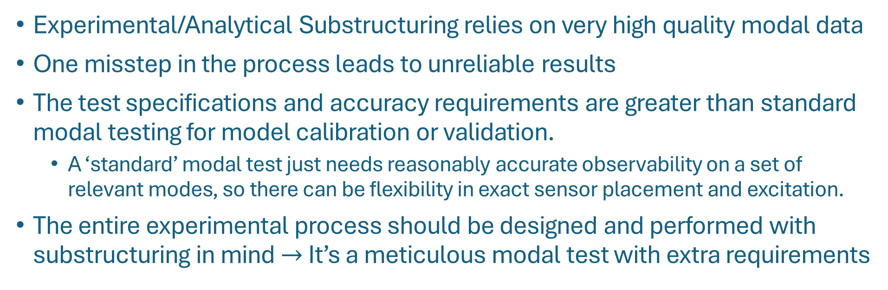
Substructuring Requires Meticulous Modal Testing
Experimental/Analytical Substructuring relies on very high quality modal data
One misstep in the process leads to unreliable results
The test specifications and accuracy requirements are greater than standard modal testing for model calibration or validation.
A ‘standard’ modal test just needs reasonably accurate observability on a set of relevant modes, so there can be flexibility in exact sensor placement and excitation.
The entire experimental process should be designed and performed with substructuring in mind $→$ It’s a meticulous modal test with extra requirements

Slide 6
General Modal Testing Pitfalls
Notes:
A Few Things to Keep In Mind:
Sensor Selection, Sensor Bookkeeping, Test Setup & Post-Processing
These are important in regular modal testing, but especially so when characterizing a subsystem experimentally for substructuring

Slide 7
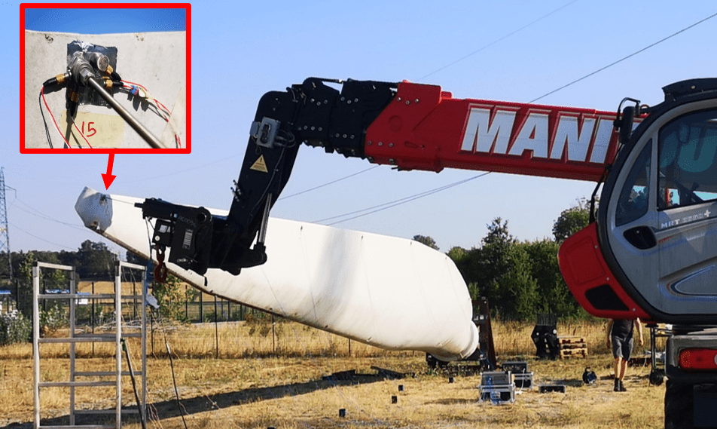
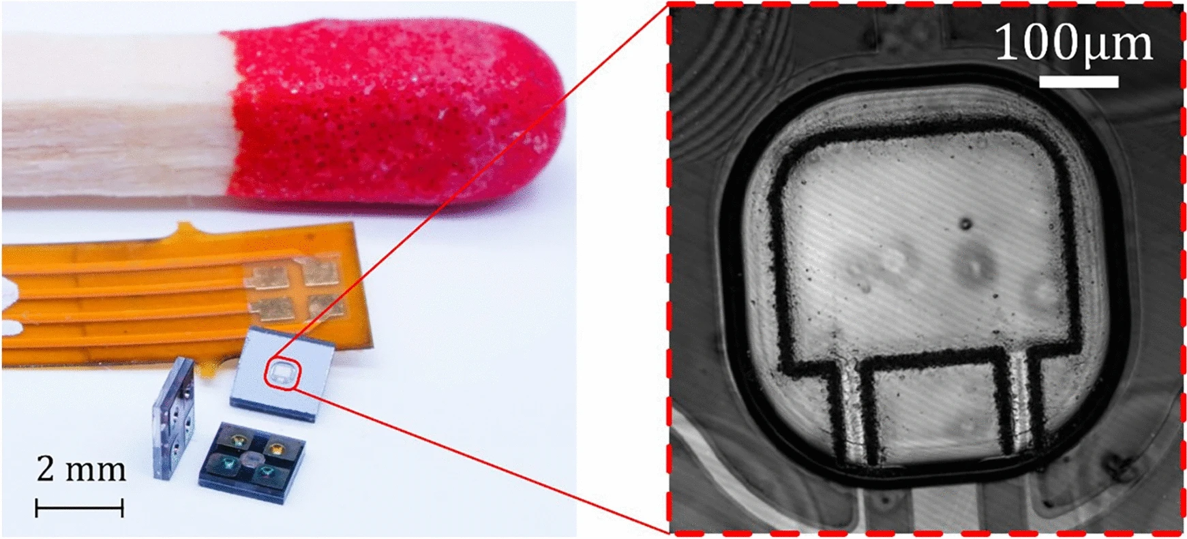
General Modal Testing Pitfalls
Sensor Selection:
What is an appropriate sensitivity for measuring the test article response?
Are mass loading effects from the sensor or cabling a concern? Do you need a noncontact measurement instead?
For force input, impact hammer or modal shaker? Something else?
Massive test setup of a wind turbine blade with all relevant modes under 25 Hz
Micro scale MEMS silicon cantilever resonator with a 52kHz first mode
https://www.vicoter.it/index.php/modal-analysis-of-a-20-meters-long-wind-turbine-blade/?lang=en
https://www.nature.com/articles/s41598-025-90976-3
Notes:
Could alternatively use Sandia images of a test of something big, and that image we have of the small spring on a penny

Slide 8
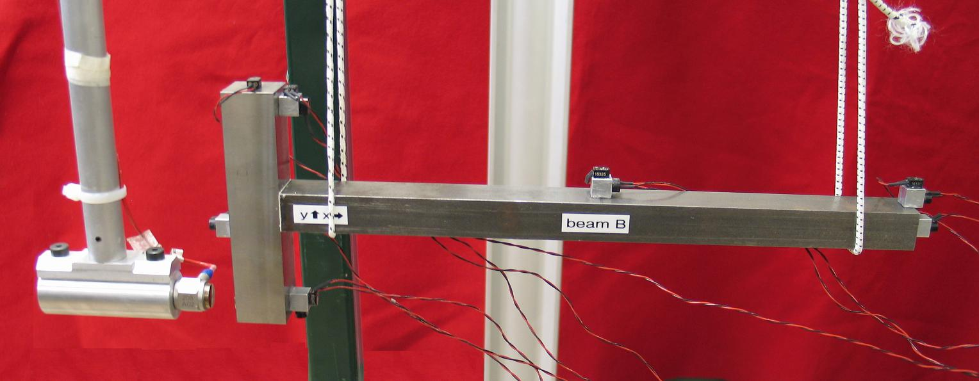
General Modal Testing Pitfalls
Sensor Bookkeeping:
How accurately do you know the sensor locations and orientation?
Keep a comprehensive record of sensor DOF numbering, direction and sign
Ensure sensor sensitivity values are correct and accurate

Slide 9
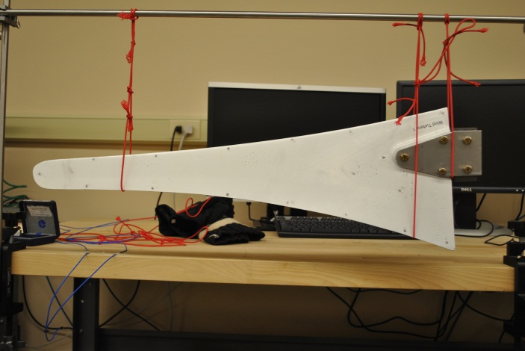
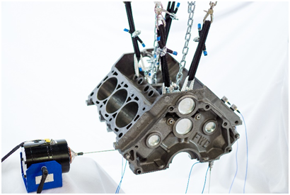
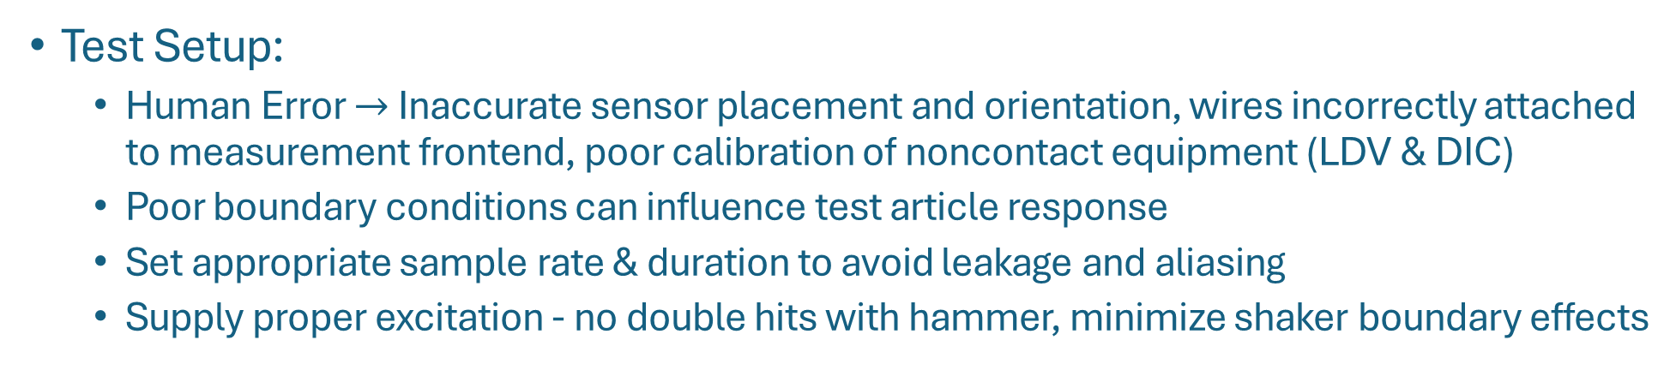
General Modal Testing Pitfalls
Test Setup:
Human Error $→$ Inaccurate sensor placement and orientation, wires incorrectly attached to measurement frontend, poor calibration of noncontact equipment (LDV & DIC)
Poor boundary conditions can influence test article response
Set appropriate sample rate & duration to avoid leakage and aliasing
Supply proper excitation - no double hits with hammer, minimize shaker boundary effects
https://www.crystalinstruments.com/modal-shaker-testing-using-periodic-random-excitation

Slide 10
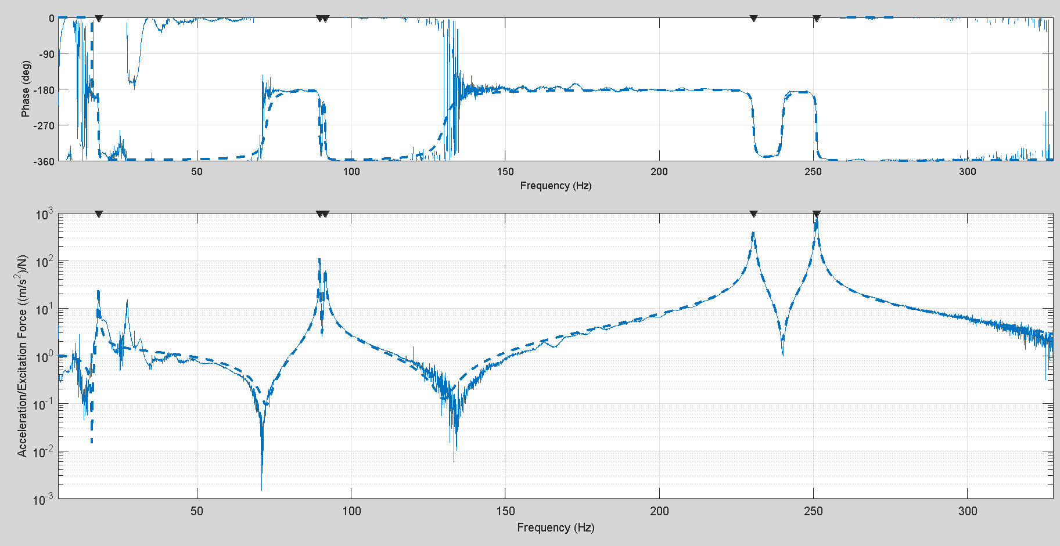
General Modal Testing Pitfalls
Post Processing:
Ensure accurate local coordinate system conversions, if needed
Take care when inferring data from FRFs via curve fitting, VPT or expansion.
Notes:
Replace with a better plot

Slide 11
Testing Guidelines Specifically for Substructuring

Slide 12
General Substructuring Test Guidelines
Measurement Sensors are vitally important to all substructuring endeavors
Response measurements are required at all connection locations
All constraint DOF must align and coincide between the joining subsystems
Connection DOF may be in a location that is difficult to instrument and/or excite
Rotational measurement sensors are rare, and are usually bulky when available
Notes:
FBS: effects mass lines. CMS: effects mass normalization of mode shapes.

Slide 13


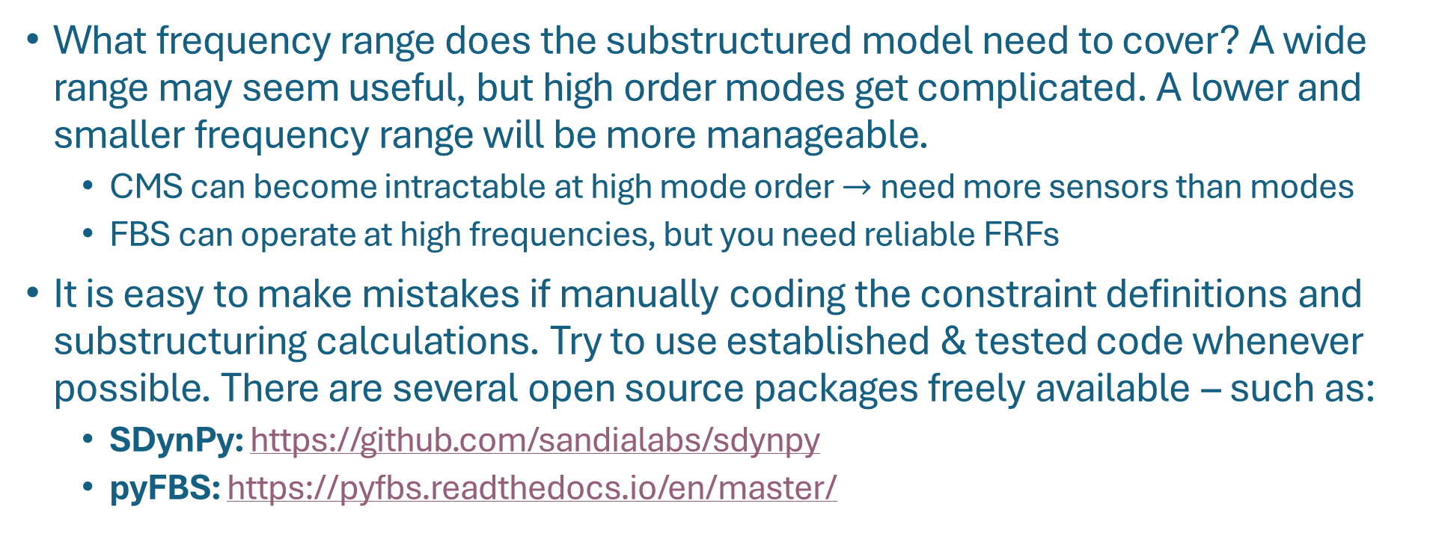
General Substructuring Test Guidelines
What frequency range does the substructured model need to cover? A wide range may seem useful, but high order modes get complicated. A lower and smaller frequency range will be more manageable.
CMS can become intractable at high mode order $→$ need more sensors than modes
FBS can operate at high frequencies, but you need reliable FRFs
It is easy to make mistakes if manually coding the constraint definitions and substructuring calculations. Try to use established & tested code whenever possible. There are several open source packages freely available – such as:
SDynPy: https://github.com/sandialabs/sdynpy
pyFBS: https://pyfbs.readthedocs.io/en/master/
Notes:
Add photos of hammer and shaker?

Slide 14
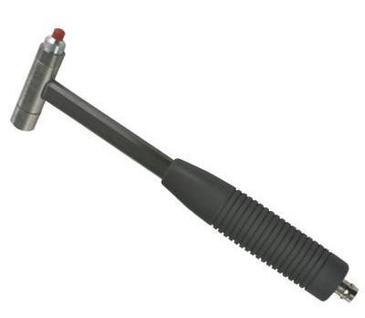
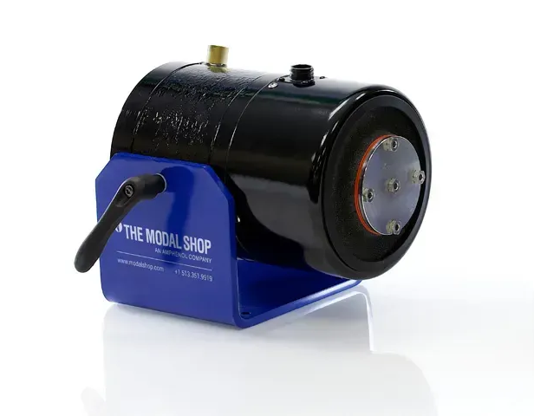
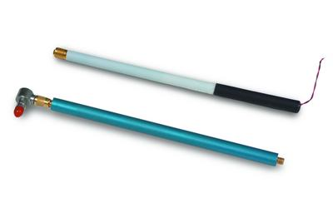
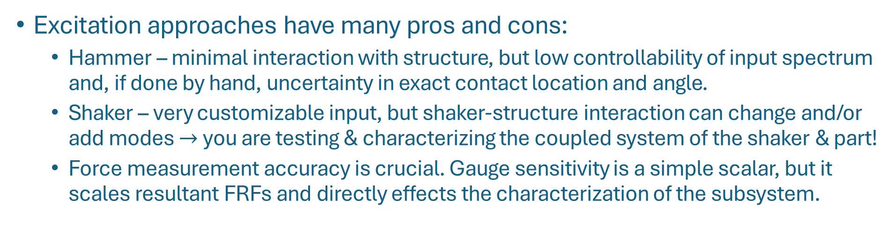
General Substructuring Test Guidelines
Excitation approaches have many pros and cons:
Hammer – minimal interaction with structure, but low controllability of input spectrum and, if done by hand, uncertainty in exact contact location and angle.
Shaker – very customizable input, but shaker-structure interaction can change and/or add modes $→$ you are testing & characterizing the coupled system of the shaker & part!
Force measurement accuracy is crucial. Gauge sensitivity is a simple scalar, but it scales resultant FRFs and directly effects the characterization of the subsystem.
https://pwmi.lv/vibration-test-shaker-modal-shop-2075e/
https://www.pcb.com/products?model=086c03
https://www.pcb.com/products?m=086e80
Notes:
Add photos of hammer and shaker?

Slide 15
General Substructuring Test Guidelines
Use Rigid Body Checks to catch errors!
In a test with free boundary conditions, excite the structure in 3 orthogonal directions
Low frequency operating shapes extracted from each direction should resemble rigid body motion. DOF moving against that are likely either incorrectly mounted or labeled.
If available, use analytical rigid body modes to compute comparable drive point FRFs to the test. The low frequency mass lines should roughly agree.
Attempt the substructuring calculations initially only with rigid body information
If all subsystems are free and have complete rigid body information, the substructured result should also be a complete set of rigid information.
CMS: compute the modal parameters and look for a set of low natural frequencies with rigid shapes
FBS: Check the resultant mass lines for consistency with the subsystems and for signs of elastic response
A non-rigid result would indicate issues with the constraint definitions and/or the rigid body information
Use as a diagnostic tool to catch bookkeeping errors, sensor orientation issues, or inconsistencies in the subsystem rigid mass information.

Slide 16
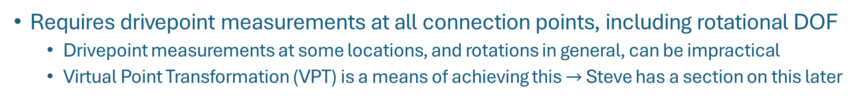
Frequency-based Substructuring Guidelines
Requires drivepoint measurements at all connection points, including rotational DOF
Drivepoint measurements at some locations, and rotations in general, can be impractical
Virtual Point Transformation (VPT) is a means of achieving this $→$ Steve has a section on this later
Physical Measurements
VPT Interface Model
Substructured VPT Model

Slide 17
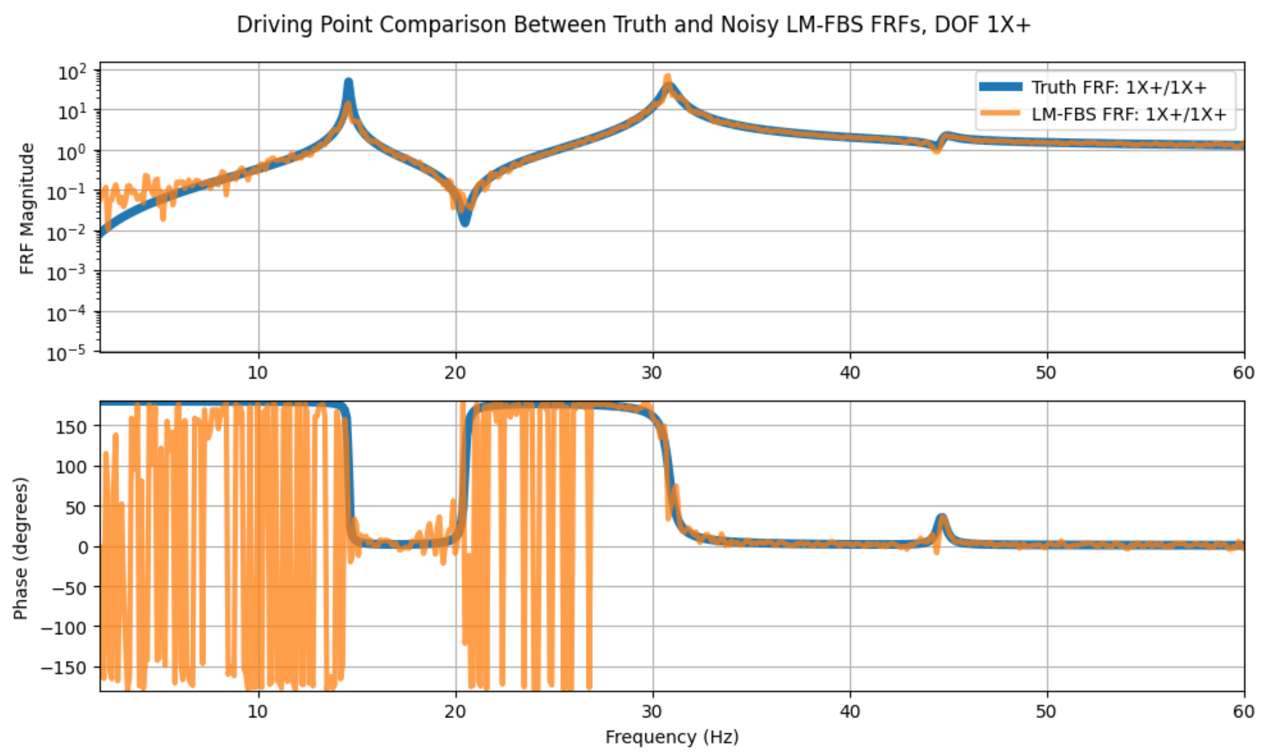
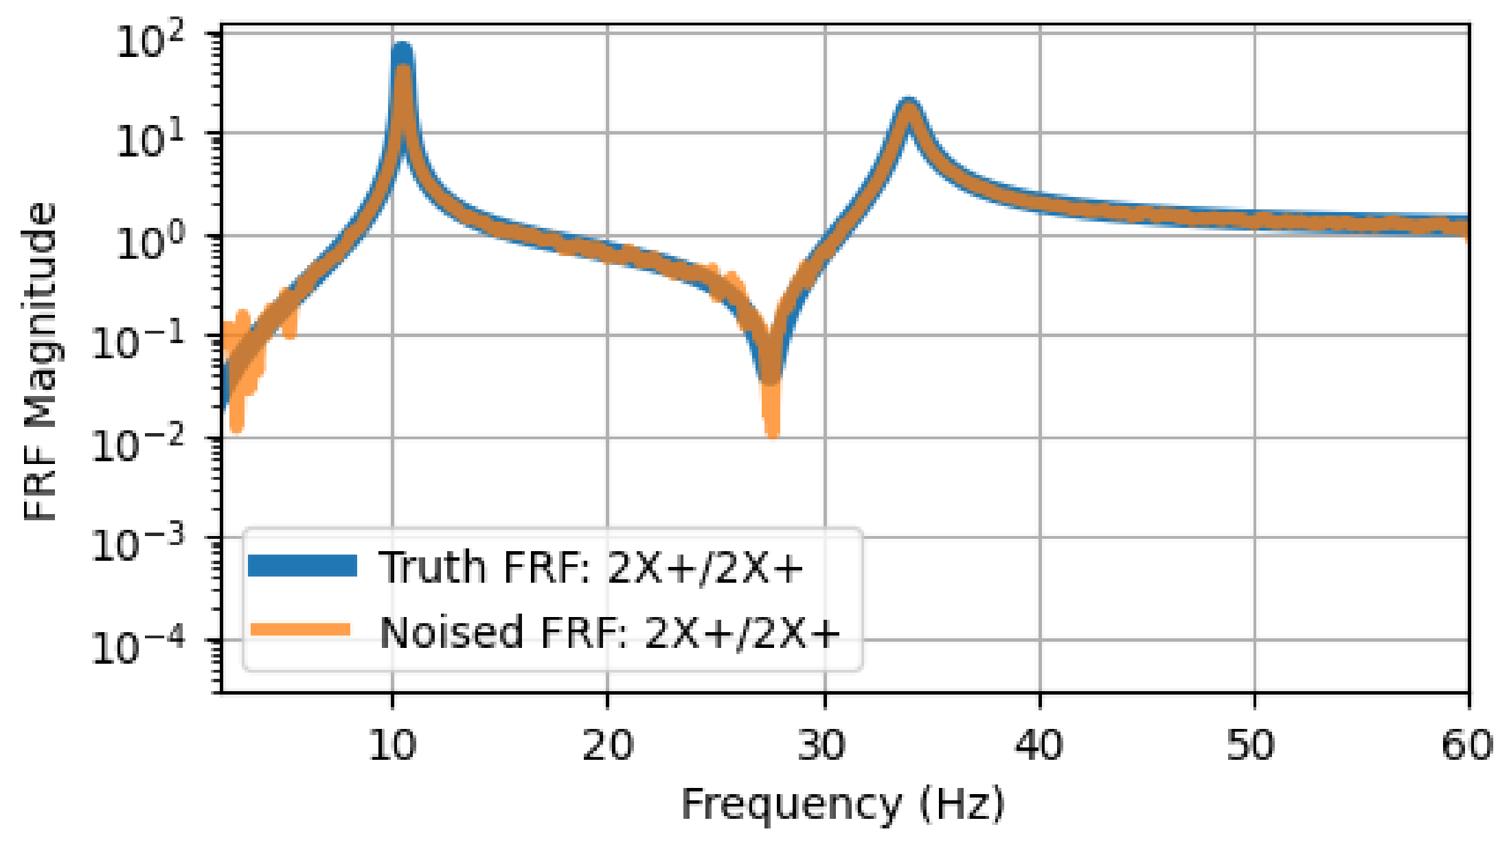
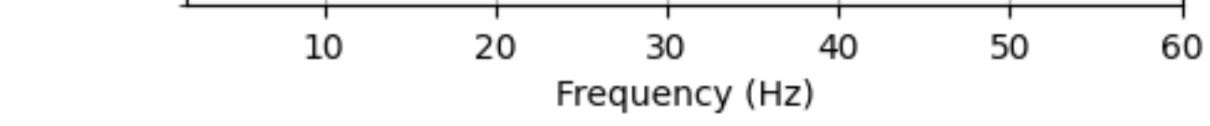
Frequency-based Substructuring Guidelines
Noise in connection point FRF anti-resonances become peaks via the LM-FBS kernel inversion $→$ we saw this in the numerical beam example
$$\left[{\overline{H}}^{ab}\right]−\left[{\overline{H}}^{ab}\right]{\left[B_{ref}\right]}^{T} {\left(\left[B_{res}\right]\left[{\overline{H}}^{ab}\right]{\left[B_{ref}\right]}^{T}\right)}^{+} \left[B_{res}\right]\left[{\overline{H}}^{ab}\right]$$
Subcomponent FRF
Assembled FRF
Notes:
noise vs clean FRFs, Steve examples page 50-60

Slide 18
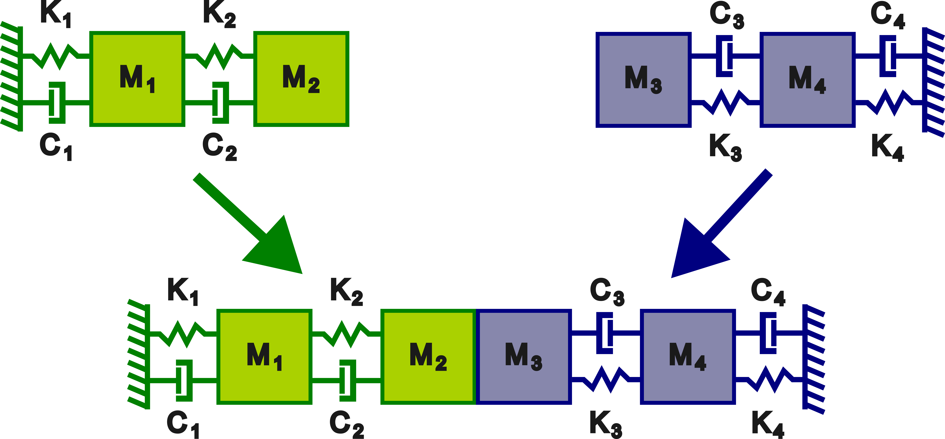
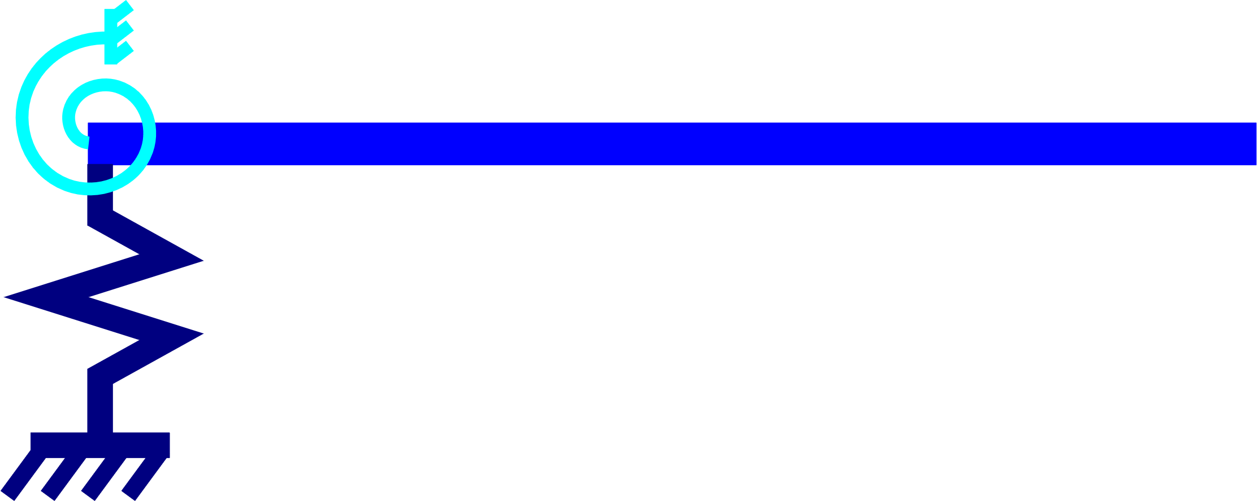
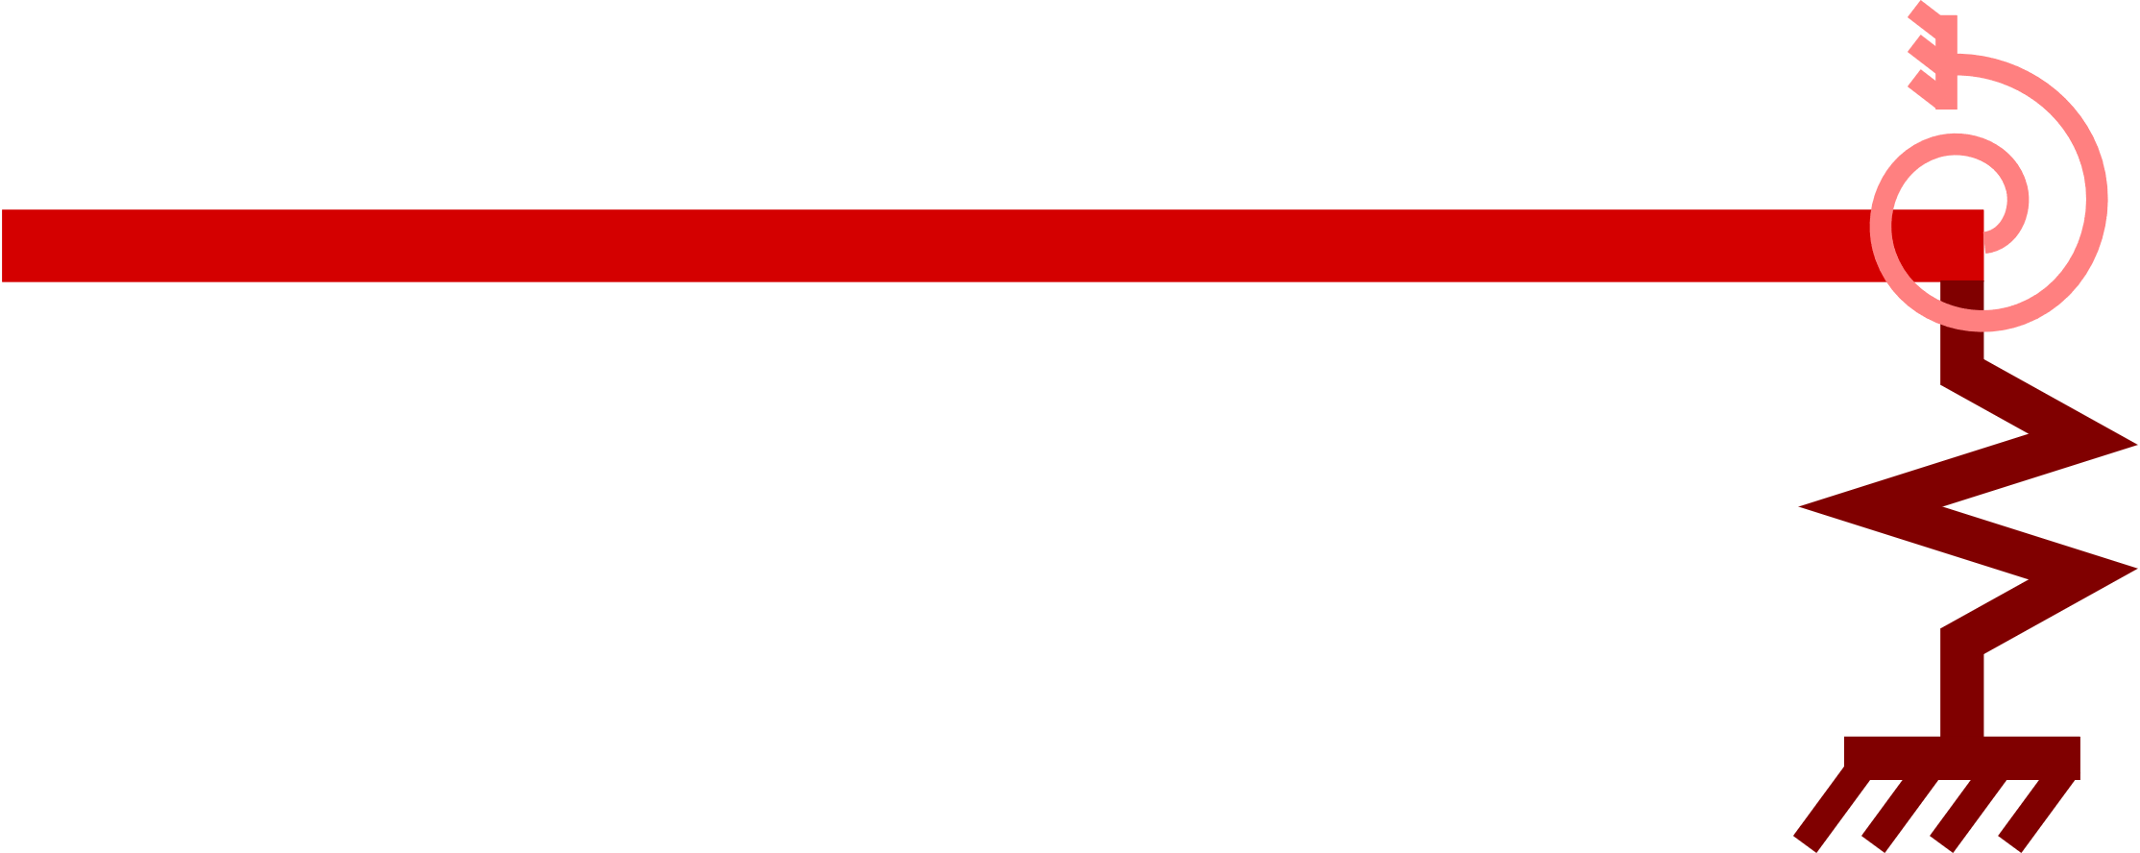
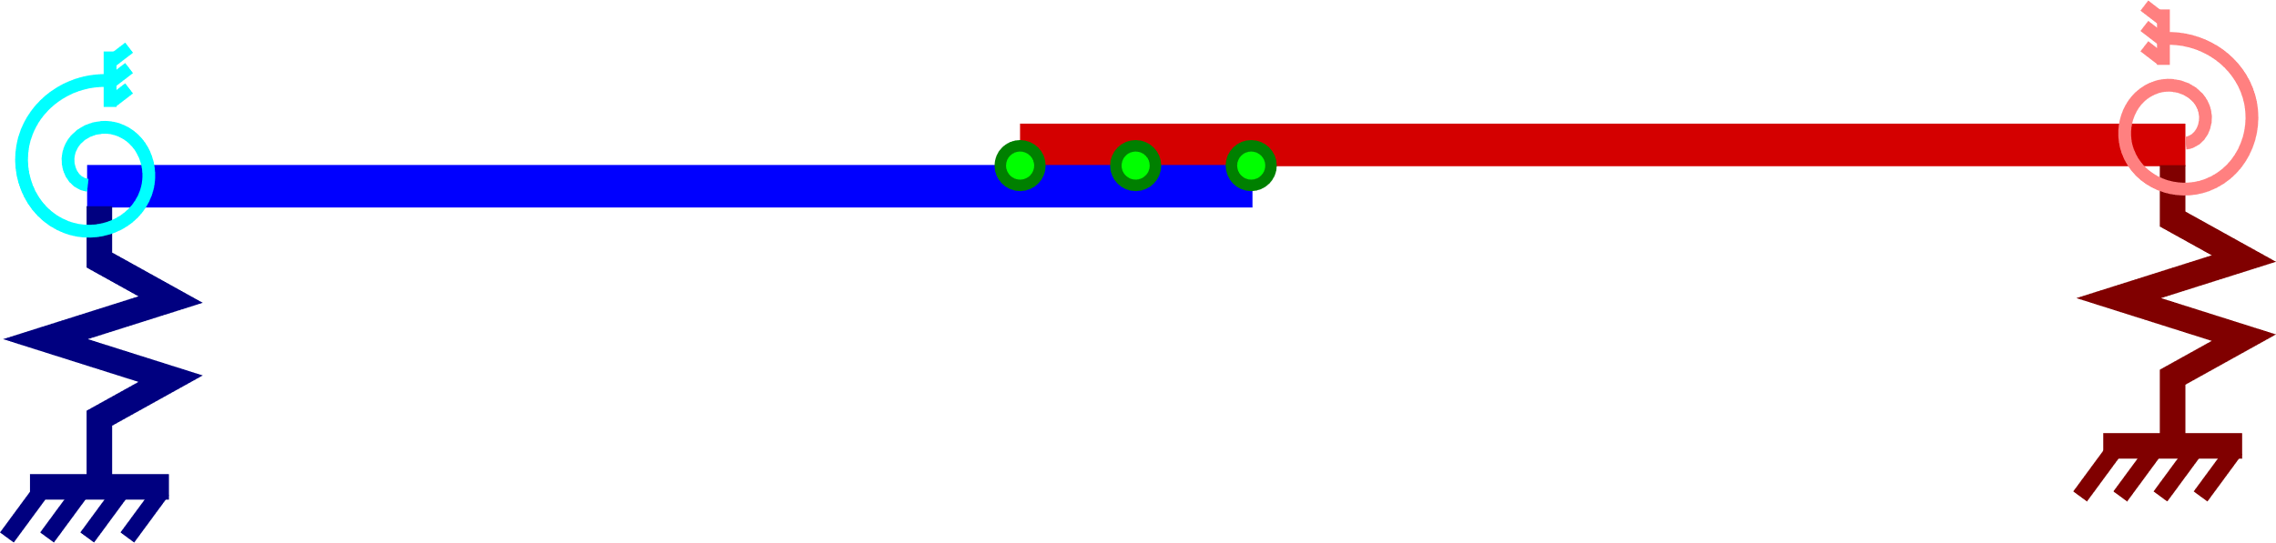
Frequency-based Substructuring Guidelines
Steve has created an excellent document compiling a series of FBS examples with associated Python code utilizing the SDynPy Python package
He has examples exploring the effect on FBS results due to:
Noise in the substructure FRF anti-resonances (the previous example)
Variability in FRF peaks between measurements due to shifting natural frequencies
Small positional errors in the coupling DOFs between substructures
Excluding torsional DOFs in the coupling FRFs

Slide 19
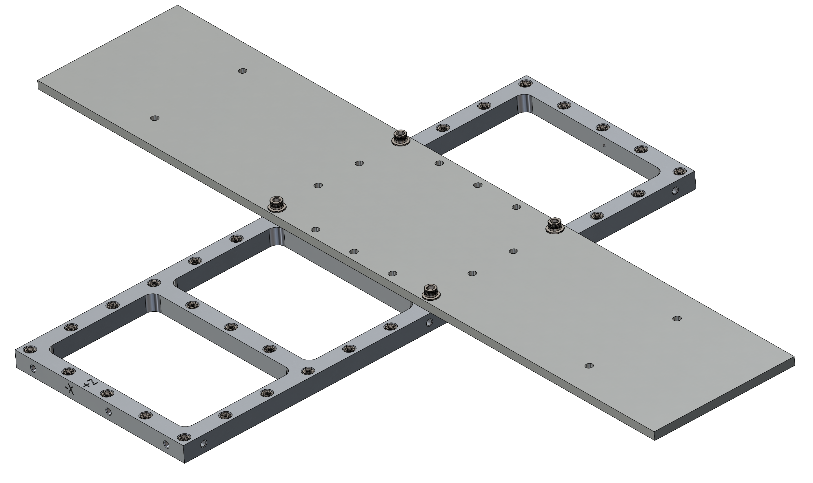
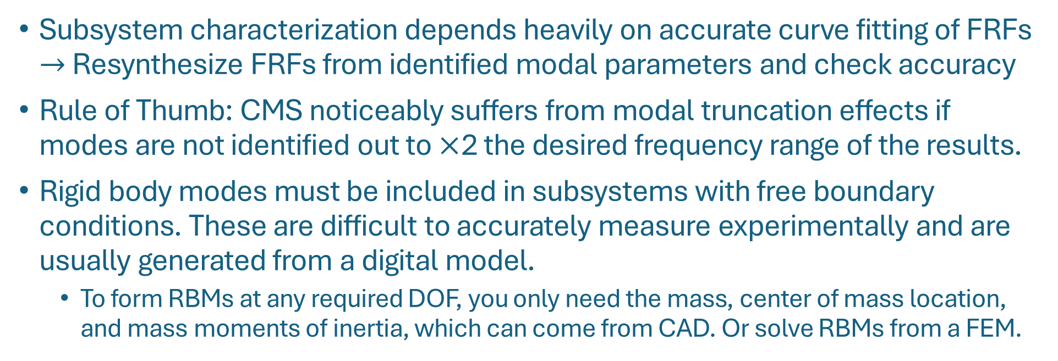
Component Mode Synthesis Guidelines
Subsystem characterization depends heavily on accurate curve fitting of FRFs $→$ Resynthesize FRFs from identified modal parameters and check accuracy
Rule of Thumb: CMS noticeably suffers from modal truncation effects if modes are not identified out to $×$2 the desired frequency range of the results.
Rigid body modes must be included in subsystems with free boundary conditions. These are difficult to accurately measure experimentally and are usually generated from a digital model.
To form RBMs at any required DOF, you only need the mass, center of mass location, and mass moments of inertia, which can come from CAD. Or solve RBMs from a FEM.
Notes:
Some approaches include calculating a pseudoinverse of mode shapes at the connection points, so constraint shapes must be independent at those DOF.

Slide 20
Component Mode Synthesis Guidelines
CMS is a variation of physical substructuring that incorporates Reduced Order Modeling (ROM) by transforming M, C & K to a reduced basis space.
The most straightforward reduction would be to a modal basis via eigenvectors
There are many techniques that augment the modal basis with additional information
While we can experimentally get a subsystem in the reduced modal basis by extracting modal parameters from FRFs, we still encounter several problems when attempting to implement CMS substructuring directly:
How do we handle the rotations at the connection points?
What can we do to improve the experimental modal basis and limit modal truncation error?
Can we model continuous interfaces that would require many constraints?
The Transmission Simulator Method (TSM) was made to address these issues
Notes:
fixed interface modes (Hurty/Craig-Bampton) and free interface modes (McNeal-Rubin) ? Craig-Chang, Craig-Mayes,
Can we mass-load the interfaces to improve the modal basis?

Slide 21
Transmission Simulator Method

Slide 22
Recall the CMS Numerical Beam Example
Beam A & B connected through translation and rotation DOFs at the tips
Modal truncation effects leave the connection too stiff - the free beam tips require many modes to properly exhibit the curvature in the truth assembly
A
+
B
=
C
20%

Slide 23
Create an Interface Better Suited for Assembly
A
TS
A
B
TS
B
Objective: Enrich the dynamic information present at the beam tip
Increase flexibility by adding or altering modes in the subsystem modal bases
Solution: Append a small beam to the ends of both A & B subsystems
Additional mass lowers natural frequencies, adding modes to the bandwidth of interest
Loading the free beam tips alters the mode shapes to span a greater range of motion
This small beam is what we’ll call a Transmission Simulator

Slide 24

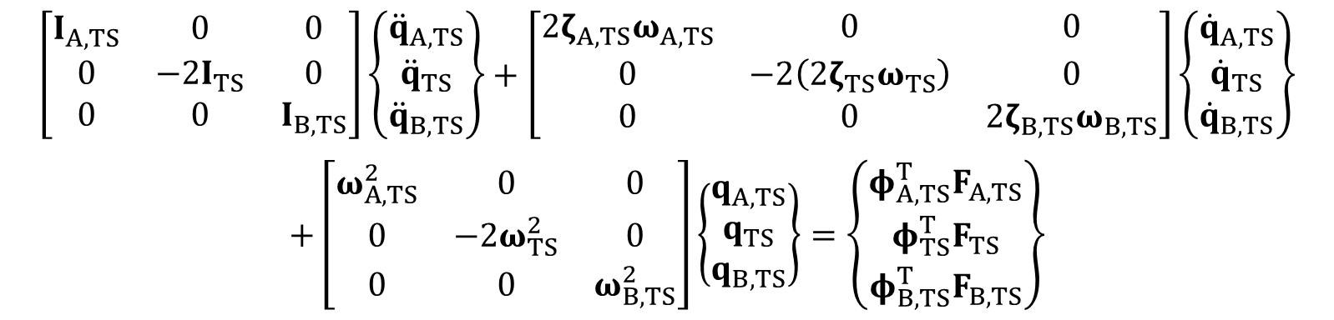
Create an Interface Better Suited for Assembly
TS
TS
TS
B
C
A
-2$×$
+
=
The TS is superimposed over Beam A and appended off the end of Beam B
To generate a model of Beam C, we connect the altered A Beam & B Beam where the integrated TS’s overlap and decouple 2 copies of a standalone TS
The modal equation of motion for this set of subsystems is:
$$\left[\begin{matrix}I_{A,TS} & 0 & 0 \\ 0 & −2I_{TS} & 0 \\ 0 & 0 & I_{B,TS}\end{matrix}\right]\left\{\begin{matrix}{\ddot{q}}_{A,TS} \\ {\ddot{q}}_{TS} \\ {\ddot{q}}_{B,TS}\end{matrix}\right\}+\left[\begin{matrix}2ζ_{A,TS}ω_{A,TS} & 0 & 0 \\ 0 & −2\left(2ζ_{TS}ω_{TS}\right) & 0 \\ 0 & 0 & 2ζ_{B,TS}ω_{B,TS}\end{matrix}\right]\left\{\begin{matrix}{\dot{q}}_{A,TS} \\ {\dot{q}}_{TS} \\ {\dot{q}}_{B,TS}\end{matrix}\right\}$$
$$+\left[\begin{matrix}ω_{A,TS}^{2} & 0 & 0 \\ 0 & −2ω_{TS}^{2} & 0 \\ 0 & 0 & ω_{B,TS}^{2}\end{matrix}\right]\left\{\begin{matrix}q_{A,TS} \\ q_{TS} \\ q_{B,TS}\end{matrix}\right\}=\left\{\begin{matrix}φ_{A,TS}^{T}F_{A,TS} \\ φ_{TS}^{T}F_{TS} \\ φ_{B,TS}^{T}F_{B,TS}\end{matrix}\right\}$$

Slide 25
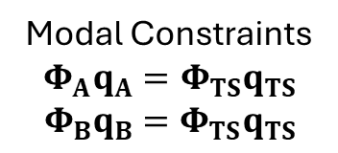
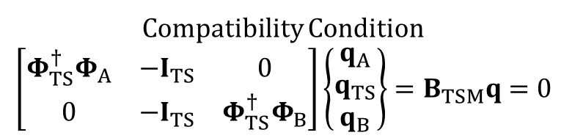

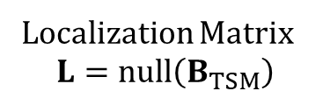

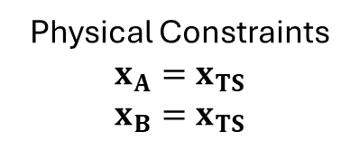

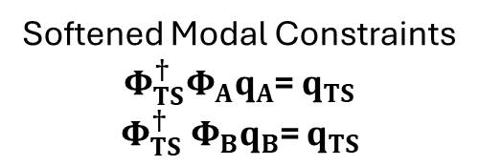

Create an Interface Better Suited for Assembly
$$x_{TS}$$
$$x_{B}$$
A
-2$×$
+
B
=
C
TS
TS
TS
$$x_{A}$$
$$x_{TS}$$
Constrain both altered beams to the standalone TS model via translation DOFs
Key Step: Soften the constraints by projecting them onto the TS modal basis
Pre-multiply by the pseudo-inverse of the TS modes* to cast the constraints to the TS modal DOF
The dynamics of each subsystem at the interface are reduced to what is spanned by the TS modes
Avoid explicitly needing rotational DOF by enforcing the constraints on modal DOF instead
Physical Constraints
$$x_{A}=x_{TS}$$
$$x_{B}=x_{TS}$$
Modal Constraints
$$Φ_{A}q_{A}=Φ_{TS}q_{TS}$$
$$Φ_{B}q_{B}=Φ_{TS}q_{TS}$$
Softened Modal Constraints
${{Φ_{TS}^{†}Φ}_{A}q}_{A}$= $q_{TS}$
$$Φ_{TS}^{†} Φ_{B}q_{B}\text{=} q_{TS}$$
Compatibility Condition
$$\left[\begin{matrix}{Φ_{TS}^{†}Φ}_{A} & −I_{TS} & 0 \\ 0 & −I_{TS} & {Φ_{TS}^{†}Φ}_{B}\end{matrix}\right]\left\{\begin{matrix}q_{A} \\ q_{TS} \\ q_{B}\end{matrix}\right\}=B_{TSM}q=0$$
Localization Matrix
$$L=null\left(B_{TSM}\right)$$
* Note: Singular Vectors can also be used to soften the constraints: https://doi.org/10.1016/j.ymssp.2021.108109

Slide 26
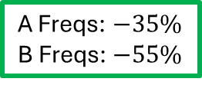
How does the TS Change the A Beam and B Beam?
A lot more going on here now!
A Freqs: $−35\%$
B Freqs: $−55\%$
Added modes to A & B
Notes:
Beams are aluminum with 2cm width and height and are 1m long in full. Here the split is at 65%, so A is 65cm and B is 35cm. The TS is steel and is 3 elements long and is x15 in both dimensions, so 30cm width and height while being 3cm long. So the dimensions are a bit silly, but at least its with physically reasonable material properties.

Slide 27

The TSM Significantly Improves the C Beam Model
TS
TS
TS
B
C
A
-2$×$
+
=
Natural Frequency (Hz)
Truth | CMS | % Error | TSM | % Error
18.0 | 18.1 | 1.0 | 18.0 | 0.2
103.3 | 118.5 | 14.7 | 106.0 | 2.6
288.8 | 364.5 | 26.2 | 296.8 | 2.8
565.7 | 580.1 | 2.5 | 567.8 | 0.4
935.1 | - | - | 976.9 | 4.5
1396.9 | - | - | 1820.6 | 30.3
TSM errors are under 5% in the 1000Hz band
Damping Ratios (%)
Truth | CMS | % Error | TSM | % Error
0.57 | 0.56 | -0.9 | 0.57 | -0.1
0.20 | 0.20 | 1.4 | 0.20 | 0.1
0.32 | 0.39 | 21.2 | 0.33 | 2.2
0.58 | 0.59 | 2.4 | 0.58 | 0.4
0.94 | - | - | 0.98 | 4.4
1.39 | - | - | 1.81 | 30.1

Slide 28
The TSM Significantly Improves the C Beam Model
TS
TS
TS
B
C
A
-2$×$
+
=

Slide 29
The TSM Significantly Improves the C Beam Model
TS
TS
TS
B
C
A
-2$×$
+
=

Slide 30
The TSM Significantly Improves the C Beam Model
TS
TS
TS
B
C
A
-2$×$
+
=

Slide 31
The TSM Significantly Improves the C Beam Model
TS
TS
TS
B
C
A
-2$×$
+
=

Slide 32
The TSM Significantly Improves the C Beam Model
TS
TS
TS
B
C
A
-2$×$
+
=

Slide 33
The TSM Significantly Improves the C Beam Model
TS
TS
TS
B
C
A
-2$×$
+
=

Slide 34
The TSM Significantly Improved the C Beam Model
TS
TS
TS
B
C
A
-2$×$
+
=
What if we have a large, distributed interface with many constraint DOF?

Slide 35
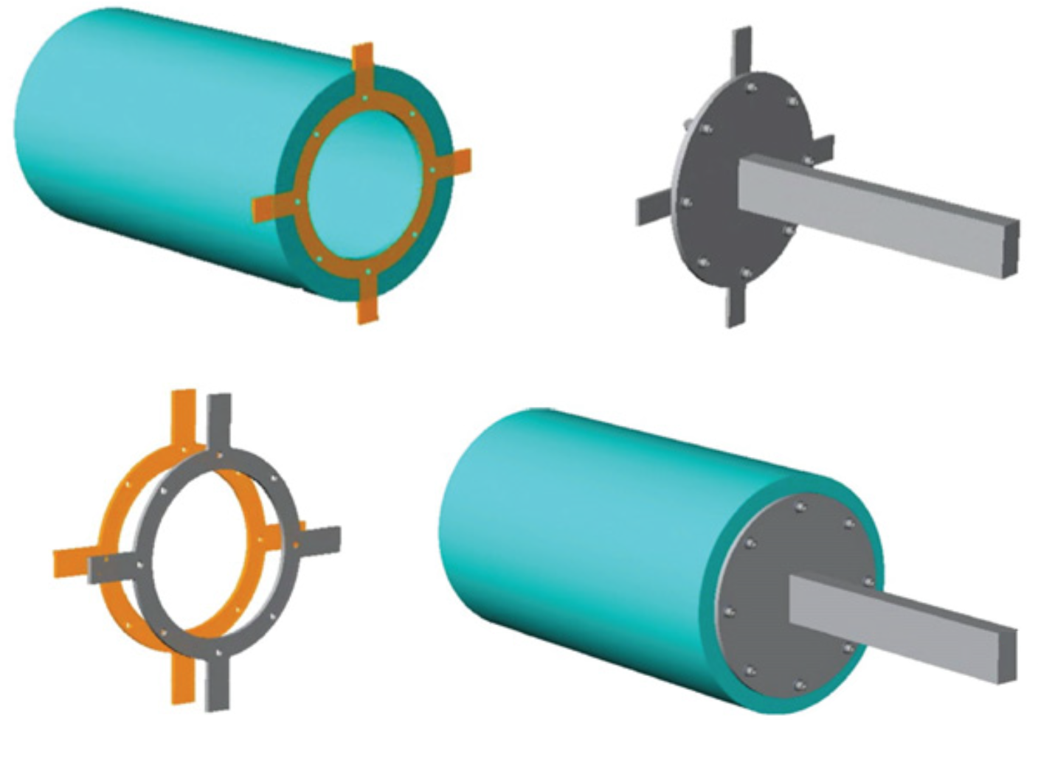



Model the CPB’s Continuous Interface with the TSM
Using an FEM of the Cylinder & TS and experimental data from the Plate-Beam & TS, estimate a modal model of the complete CPB Assembly
A: Cylinder & TS FEM
B: Plate-Beam & TS Test
Experimental Subsystem
$$+$$
$$−$$
$$=$$
Transmission Simulator FEM
C: Cylinder-Plate-Beam Substructured Model

Slide 36
CPB Substructuring Setup for Using TSM
A: Cylinder & TS FEM
Transmission Simulator FEM
B: Plate-Beam & TS Test
6DOF connections at all 8 bolts would be 48 constraints. The experiment only has 36 measurement DOF, which are used to define ~20 modes
Joint dynamics in the experiment are carried through into the final assembly

Slide 37
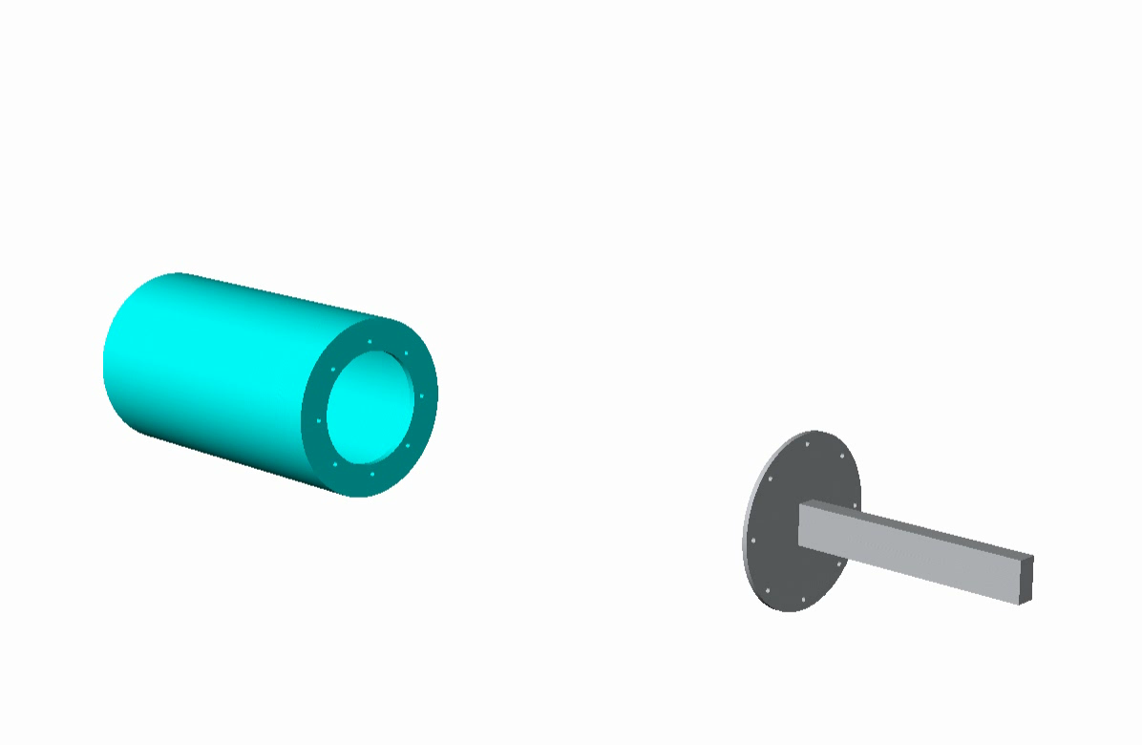
CPB Substructuring Setup for Using TSM

Slide 38
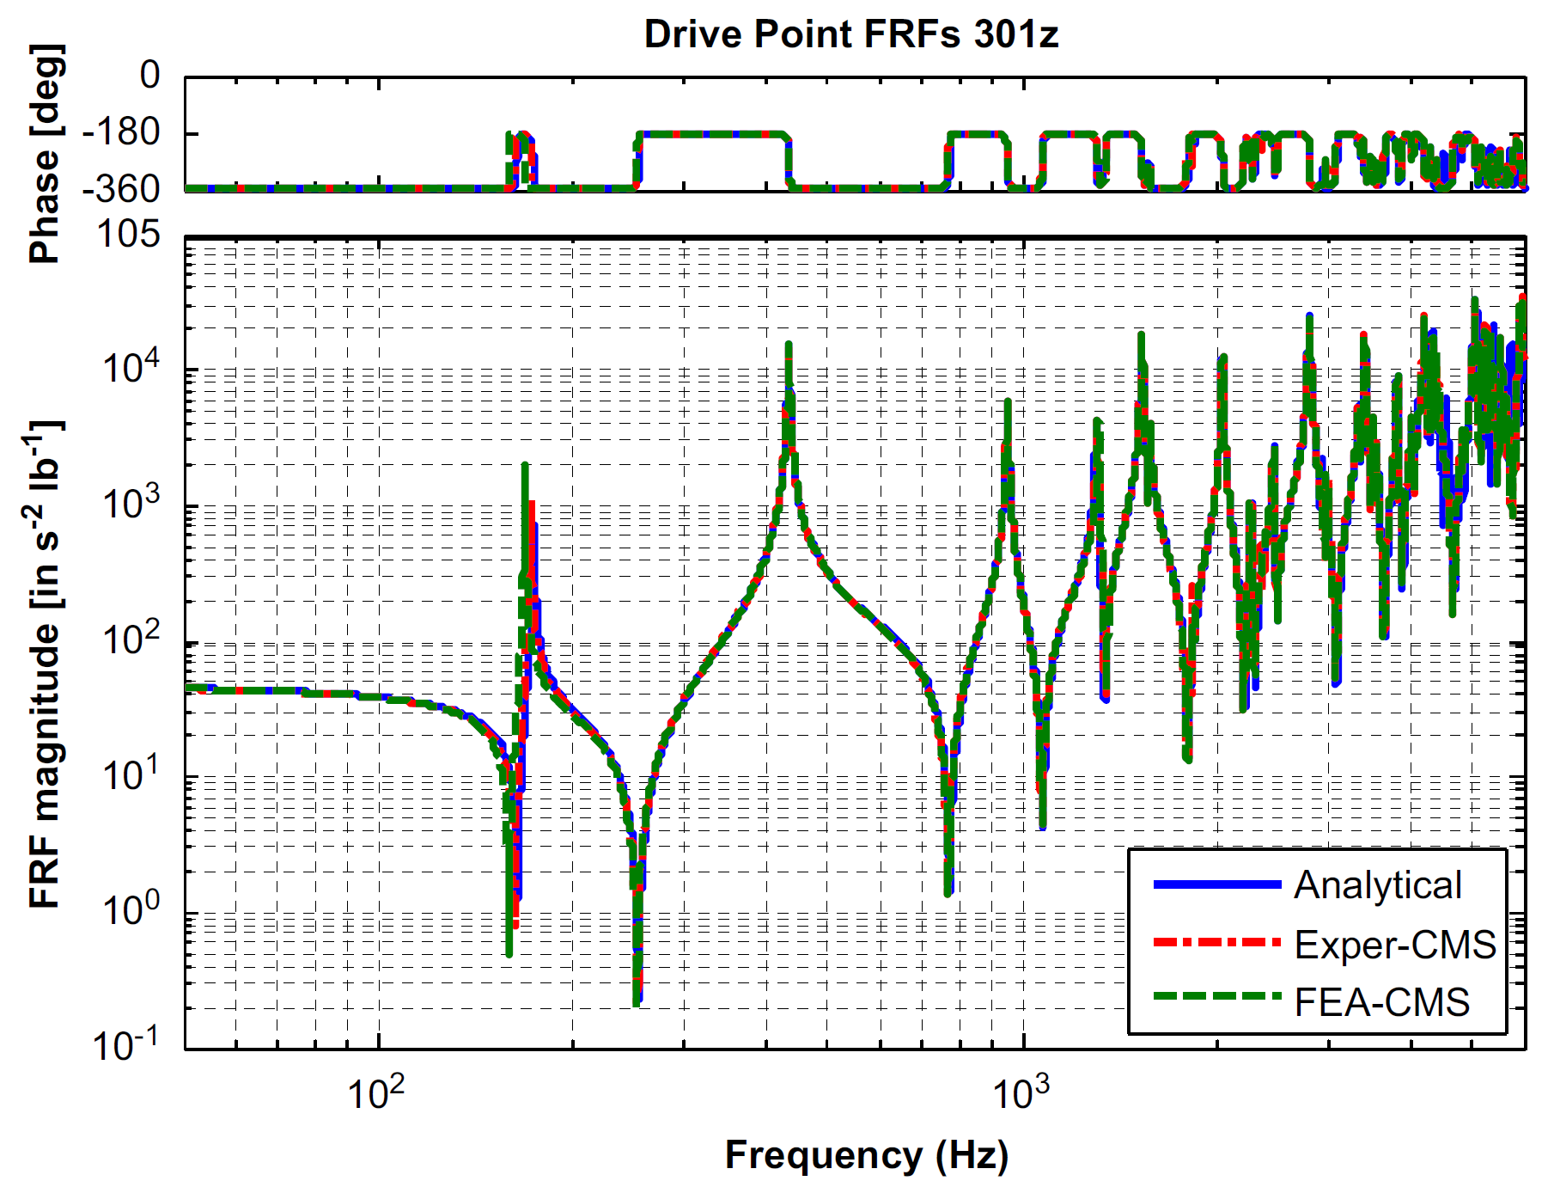
TSM Results for Cylinder-Plate-Beam
Drive Point FRFs: 301Z
301Z
FEA-CMS shows the result of coupling FE models of both substructures using the same approach.

Slide 39
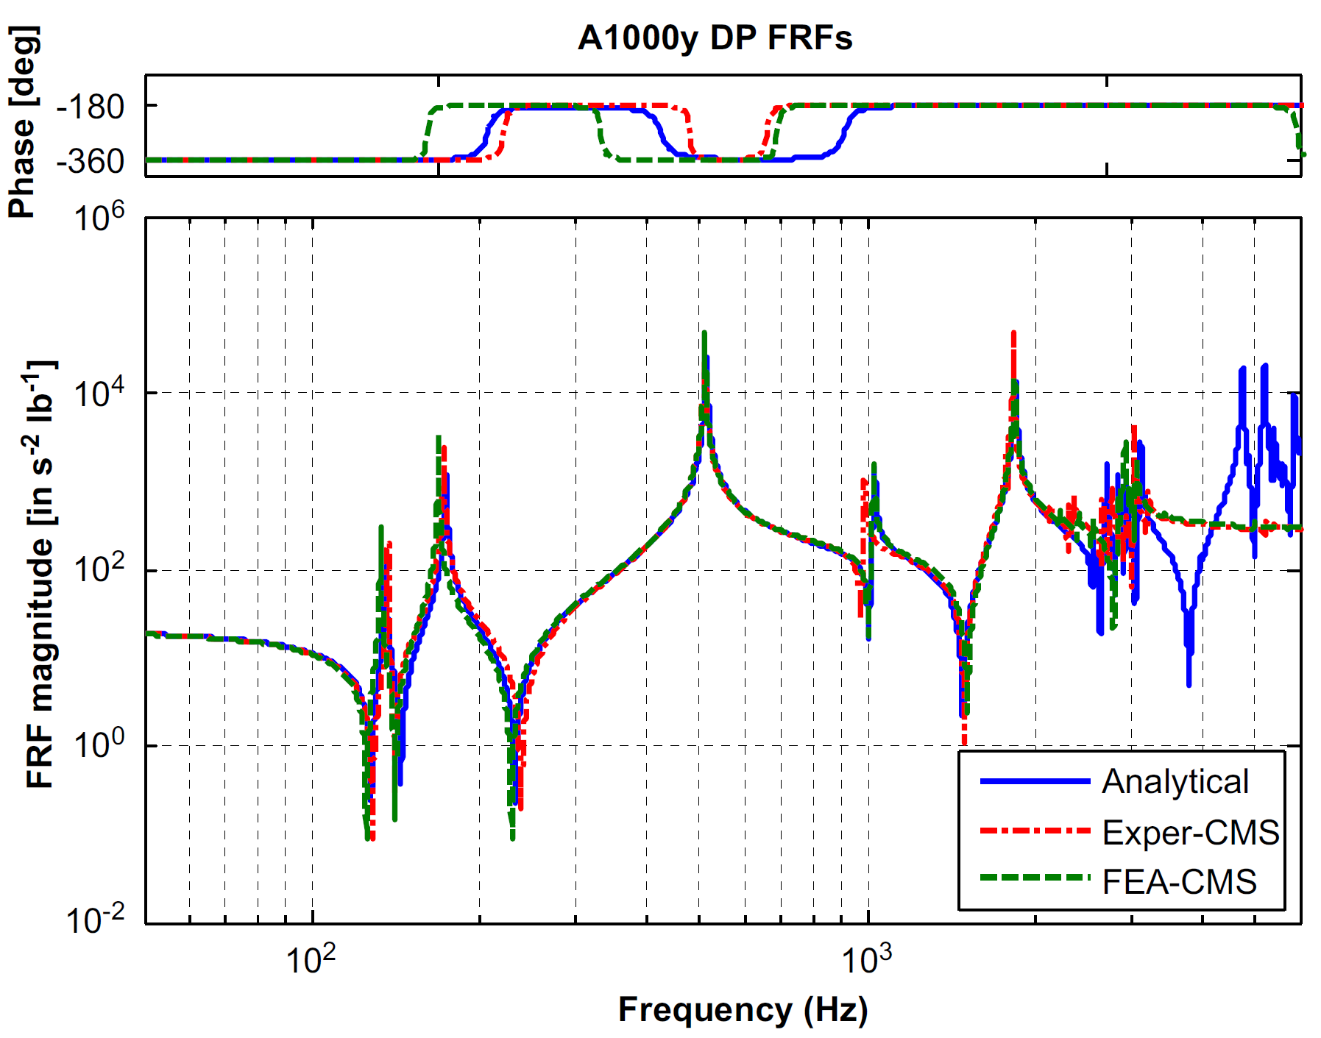
TSM Results for Cylinder-Plate-Beam
Drive Point FRFs: 1000Y
1000Y

Slide 40
Transmission Simulator Design Guidelines
The TS should be as simple as possible
Easily instrumented and excited to accurately characterize its relevant dynamics and produce a well conditioned mode shape matrix
Simple geometry and no joints so it is not a significant effort to produce and correlate a FEM
The TS should replicate the interface dynamics between the subsystems
When connected to the subsystem, the mass loading and stiffness boundary condition provided by the TS should mimic its connection to the other substructure in the assembly.
The joint between the TS and test article should replicate the actual interface in the system of interest as closely as possible to experimentally capture the joint stiffness and damping
A well designed TS balances these two objectives. It should be easy to test and simple to model while still resembling the subsystem interface to mimic the joint behavior and stiffness and mass of the other substructure.
* Note: Singular Vectors can also be used to soften the constraints: https://doi.org/10.1016/j.ymssp.2021.108109
Notes:
The fixture might just be a chopped off version of the other substructure which precisely mimics the mass and stiffness near the connection interface.

Slide 41
Closing Remarks for the Experimental Considerations

Slide 42
Experimental Considerations Takeaways
Experimental Substructuring requires very high quality modal test data
All standard modal testing guidelines must be followed meticulously
Substructuring has additional requirements:
The location and orientation of constraint DOF must coincide and align across subsystems
Rotational DOF are usually necessary for enforcing accurate constraints, but are difficult to determine experimentally. VPT and TSM are typical workarounds.
FBS requires drivepoint FRFs at all connection DOFs and is sensitive to noise
CMS depends on accurate modal parameter estimation from FRFs
Modal truncation errors can impact CMS results in unpredictable ways
The Transmission Simulator Method addresses multiple substructuring issues
The TS loads the interface, enriching the modal basis by adding modes to the bandwidth and altering mode shapes to behave similar to the desired assembled interface
Constraints are projected onto generalized modal DOF, allowing for easy modelling of continuous interfaces while also circumventing the need for rotational constraint DOF

Slide 43
Next Up: The Frame & Wing Structure

