Slide 1
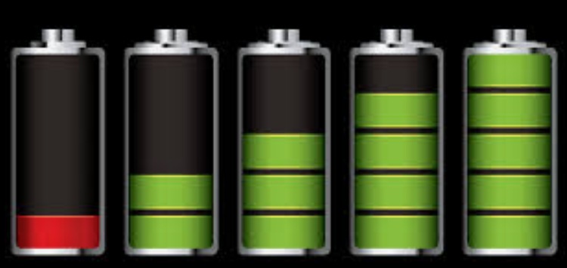

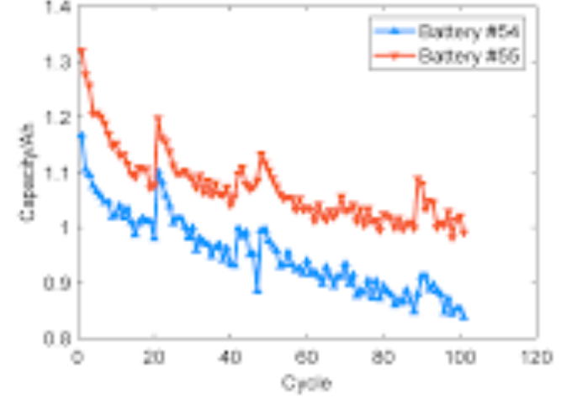
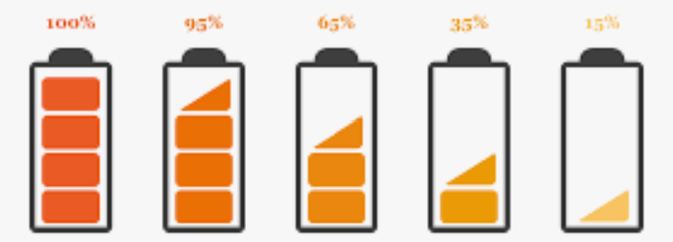
EV Car Battery Management System
Battery Management System
Energy Flow
Battery
Controller
Motor
Battery Pack
State of Charge Algorithms
Real Time Health Map
Electrical to Mechanical (Acceleration)
SenSor Data
State Estimate
Decision Logic
Mechanical to Electrical (Regeneration)
Control Signals
Control Module
Thermal Management Module
Safety Module
Charging & Equalization
Power in
External Charger

