Slide 1
The battle of neighbourhoods

Slide 2
Introduction
New York City review
Optimum location for new restaurant business
Business problem:
Choice of first neighbourhood to start restaurant business
Easy to replicate
Low competition
High demand
Choice menu
Success criteria:
Best neighbourhood which meets above criteria

Slide 3
New York City - Facts
Nost popular city in the USA
Diverse and the financial capital of USA
Multicultural
Provides business opportunities
Business friendly environment
Global hub

Slide 4
New York City – Business Environment
Competitive market
High cost for doing business
New business venture or expansion needs to be analysed carefully

Slide 5
New York City - Cuisine
It’s a multicultural city and as well the cuisine. It’s food culture includes an array of international cuisines influenced by inmigrants:
Central and Eastern European inmigrants: bagels, cheesecake, hot dogs, knishes and delicatessens
Italian: pizza and pasta
Jewish and Irish Inmigrants: pastrami and corned beef
Chinese and oher asian cuisine.

Slide 6
Factors to study for deciding on location
NYC population
NYC demographics
Are there any farmers markets, wholesale markets, etc nearby so that he ingredients can be fresh purchased
Segmentation
Competition

Slide 7
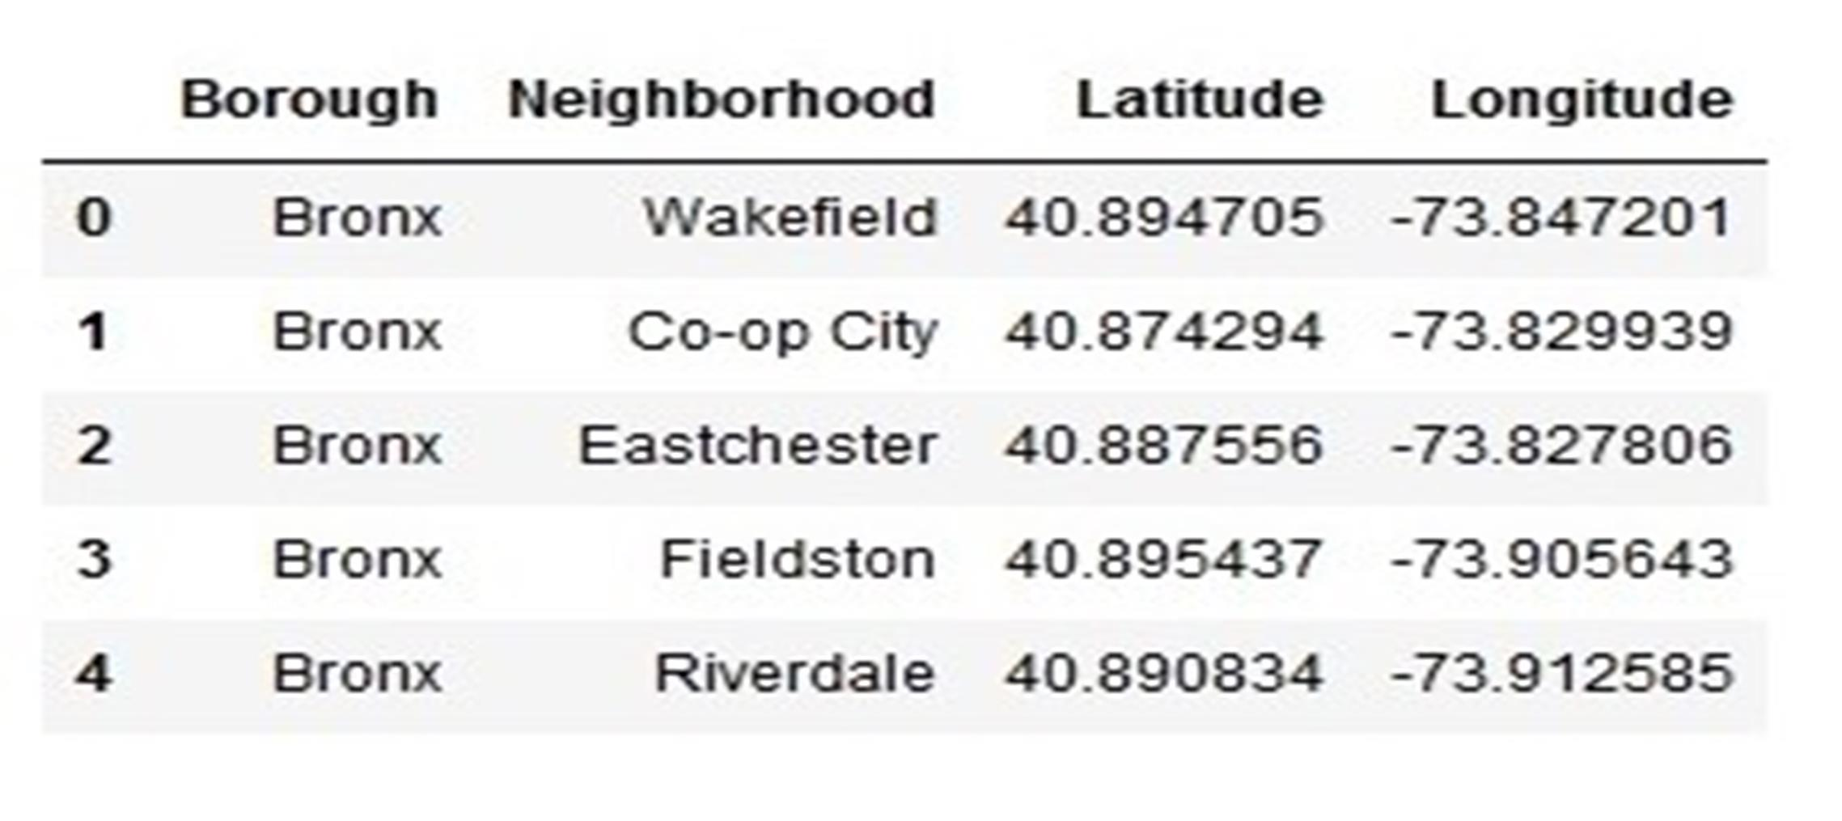
Data description - 1
Neighbourhood has a total of 5 boroughs and 306 neighborhoods. In order to segement the neighborhoods and explore them, we will essentially need a dataset that contains the 5 boroughs and the neighborhoods that exist in each borough as well as the the latitude and logitude coordinates of each neighborhood.

Slide 8
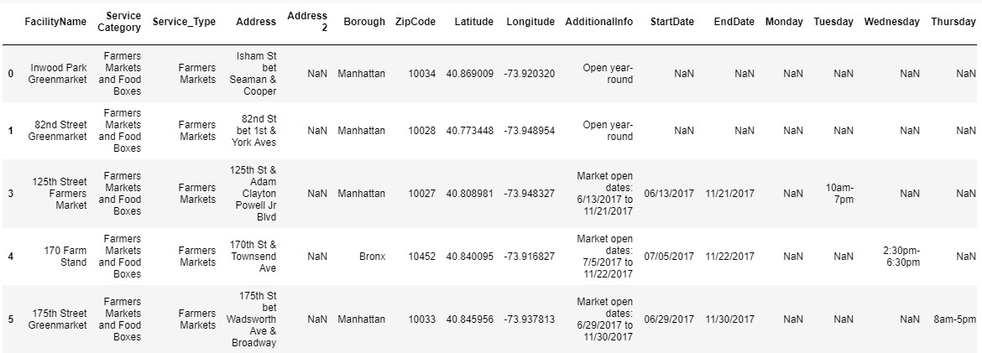
Data description - 2
Second data which will be used is the DOHMH Farmers Markets and Food Boxes dataset. In this we will be using the data of Farmers Markets.
A farmers' market is often defined as a public site used by two or more local or regional producers for the direct sale of farm products to consumers. In addition to fresh fruits and vegetables, markets may sell dairy products, fish, meat, baked goods, and other minimally processed foods.

Slide 9
Data description - 3
New York Population
New York City Demographics
Cuisine of New York city
https://en.wikipedia.org/wiki/New_York_City https://en.wikipedia.org/wiki/Economy_of_New_York_City https://en.wikipedia.org/wiki/Portal:New_York_City https://en.wikipedia.org/wiki/Cuisine_of_New_York_City

Slide 10
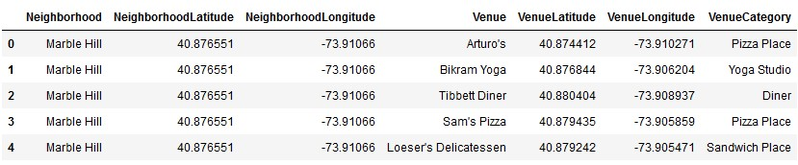
Data description - 4
Newyork city geographical coordinates data will be utilized as input for the Foursquare API, that will be leveraged to provision venues information for each neighborhood.We will use the Foursquare API to explore neighborhoods in New York City. The below is image of the Foursquare API data.

Slide 11
Analytics approach
New York city neighbourhood has a total of 5 boroughs and 306 neighborhoods. In this project first part is clustering of Manhattan and Brooklyn . And second part is clustering of Bronx, Queens and Staten Island. This is done because of the following Exploratory data analysis.

Slide 12
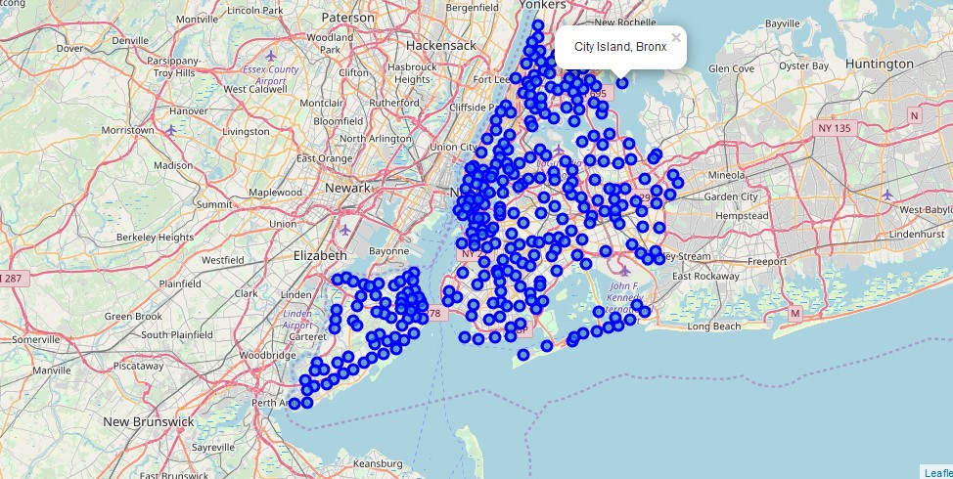
Methodology 1
In this we load the data and explore data from newyork_data.json file.
Transform the data of nested python dictionaries into a pandas dataframe.
This dataframe contains the geographical coordinates of New York city neighborhoods.
This data will used to get Venues data from Fouresquare.
We used geopy and folium libraries to create a map of New York city with neighborhoods
superimposed on top.
New York neighbourhood visualization

Slide 13
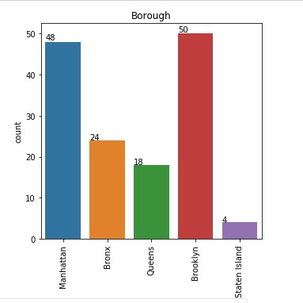
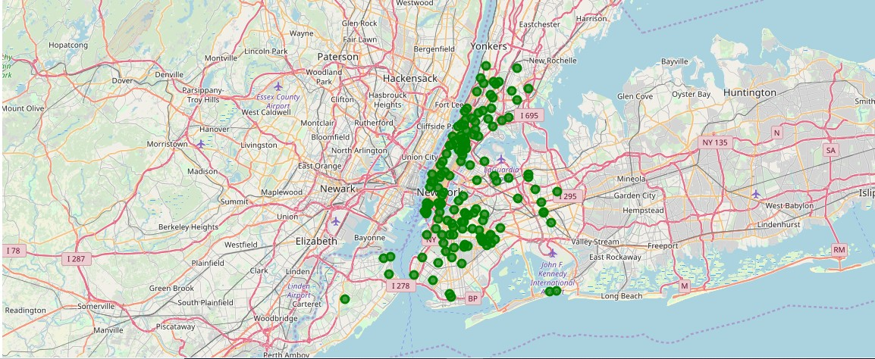
Methodology 2
Second data which is used is the DOHMH Farmers Markets and Food Boxes dataset. In this we will be using the data of Farmers Markets data.
There are totally 144 Farmers Markets in New York city. Highest number are in Manhattan and Brooklyn. And lowest in Queens, Bronx and Staten Island.
The proof of this is as given below.

Slide 14
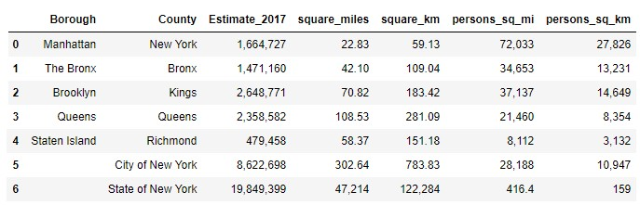
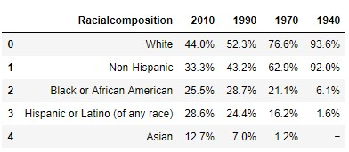
Methodology 3
To analyize New York city Population, Demographics and Cuisine , scrapped the data from Wikipedia pages given above in the data section. We used BeautifulSoup python library. Beautiful Soup is a Python package for parsing HTML and XML documents (including having malformed markup, i.e. non-closed tags, so named after tag soup). It creates a parse tree for parsed pages that can be used to extract data from HTML, which is useful for web scraping

Slide 15
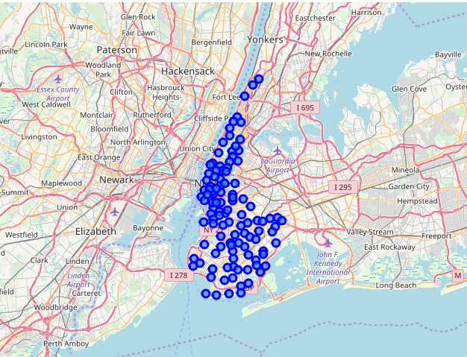
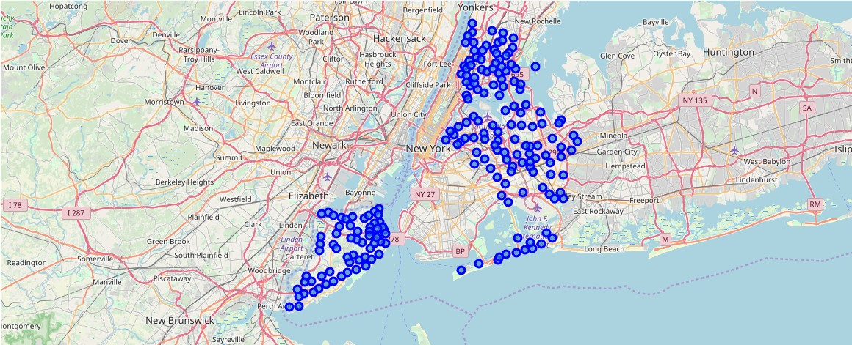
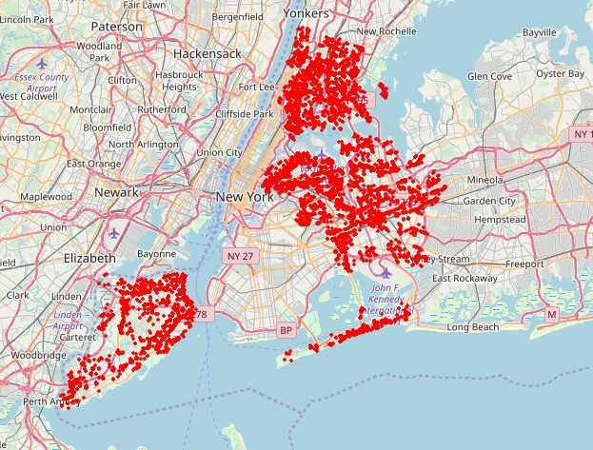
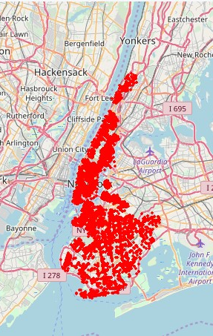
Methodology 4
NewYork city geographical coordinates data has be utilized as input for the Foursquare API, that has been leveraged to provision venues information for each neighborhood. We used the Foursquare API data to explore neighborhoods in New York City.

Slide 16
Results
From this venues data we filtered and used only the restaurant data for Brooklyn & Manhattan clustering and Bronx, Queens and Staten Island clustering. As we focussed only on restaurants business.
Neighborhood K-Means clustering based on mean occurrence of venue category : To cluster the neighborhoods into two clusters we used the K-Means clustering Algorithm. k-means clustering aims to partition n observations into k clusters in which each observation belongs to the cluster with the nearest mean. It uses iterative refinement approach.
Brooklyn & Manhattan : In the below Map Visualization, we can see the different types of clusters created by using K-Means for Brooklyn & Manhattan.
Cluster0 : The Total and Total Sum of cluster0 has smallest value. It shows that the market is not saturated.
Cluster1 : The Total and Total Sum of cluster1 has highest value. It shows that the markets are saturated. Number of restaurants are very high.
There are no untapped neighborhoods in Brooklyn and Manhattan.
Bronx, Queens and Staten Island : In the below Map Visualization, we can see the different types of clusters created by using K-Means for Bronx, Queens and Staten Island.
Cluster0 : The Total and Total Sum of cluster0 has smallest value. It shows that the market is not saturated. There are untapped neighborhoods. List is as given below.
Cluster1 : The Total and Total Sum of cluster1 has highest value. It shows that the markets are saturated. Number of restaurants are very high.

Slide 17
Discussion
There is scope to increase Farmers markets in Bronx, Queens and Staten Island.
There is scope to explore cuisines of various countries in Bronx, Queens and Staten Island.
In Manhattan and Brooklyn restaurants of cuisines of many countries are available. So if risk can be taken with great menu on board. It also shows people love eating cuisines of various countries.

Slide 18
Conclusions
This analysis is performed on limited data. This may be right or may be wrong. But if good amount of data is available there is scope to come up with better results. If there are lot of restaurants probably there is lot of demand. Brooklyn and Manhattan has high concentration of restaurant business. Very competitive market. Bronx, Queens and Staten Island also has good number of restaurants but not as many as required. So this can be explored.
As per the neighbourhood or restaurant type mentioned like Indian Restaurant analysis can be checked. A venue with lowest risk and competition can be identified.

