Slide 1
Secure data hiding images using steganography
CAPSTONE PROJECT
Presented By:saipreethi
Student Name : saipreethi
College Name & Department : PULLAIAH COLLEGE OF ENGINEERING & TECHNOLOGY- -ECE

Slide 2
OUTLINE
Problem Statement
Technology used
Wow factor
End users
Result
Conclusion
Git-hub Link
Future scope

Slide 3
Problem Statement
Explanation of the process:
Encryption (Step-by-Step):
The message is embedded pixel by pixel into the image using the RGB values.
Each character in the message is converted to its corresponding integer value and stored in the image.
The image is saved and can be opened with a default image viewer.
Decryption (Step-by-Step):
The encrypted image is read.
The function checks if the entered password matches the original passcode.
If it matches, it extracts the hidden message from the image by reversing the pixel-to-character mapping.

Slide 4
Technology used
In the project you mentioned (image encryption and decryption), the primary library used is OpenCV. Here’s a list of the libraries used in the code:
1. OpenCV (cv2):
Purpose: OpenCV is used to read, manipulate, and save the image.
Functions used:
cv2.imread() — Reads an image from a file.
cv2.imwrite() — Saves an image to a file.
cv2.imread() — Loads an image.
os.system() — This is used to open the encrypted image using the default viewer (on Windows).
Installation: You can install OpenCV using
pip install opencv-python
2. os:
Purpose: This library is used to interact with the operating system. In your code, it’s used to open the encrypted image on Windows by running the command os.system("start encryptedImage.jpg").
Functions used:
os.system() — Executes system commands like opening files or programs.
Installation: os is part of the Python Standard Library, so you don’t need to install it separately.
3. string (implicitly used in the original code but not directly referenced in the encryption-decryption logic):
Purpose: In your original encryption script, string was used to potentially handle a character set. However, it’s not directly referenced in the final encryption and decryption logic.
It could be useful if you were to map characters to indices or process the message further.
Installation: string is also part of the Python Standard Library, so no installation is needed.
Summary of Libraries:
OpenCV (cv2): For image processing (reading, saving, manipulating the image).
os: For system-level operations (opening images in the default viewer).

Slide 5
Wow factors
Key Unique Features:
Steganography with RGB Channels:
The message is embedded directly into the image pixels by converting each character of the message into its corresponding RGB value using a dictionary (d and c).
The message is hidden by modifying the RGB values of the image in a way that does not noticeably distort the image visually, making it a form of steganography.
Encryption with Password:
Before embedding the message, a password is required for encryption. The message can only be decrypted with the correct password, which adds a layer of security.
The use of a password ensures that only those who know the passcode can retrieve the hidden message, enhancing the privacy of the embedded data.
Image-based Encryption:
This project uses the actual image as a medium for encryption. Rather than creating an entirely new encrypted file, the image itself becomes the carrier of the hidden message.
The message is embedded pixel by pixel (in RGB channels), making the encrypted message part of the image's data.
Cross-platform Displaying:
The code includes a command to automatically open the encrypted image (os.system("start encryptedImage.jpg")), which works on Windows.
This makes it easier for the user to visualize the encrypted image and see how the message is hidden without needing any additional viewer.
Manual Decryption:
The decryption process requires input from the user, specifically the correct password to decode the hidden message.
This manual intervention allows for added security, as it prevents unauthorized access to the original message without the correct password.

Slide 6
End users
Corporate and Business Teams (for Internal Use):
Businesses that need to exchange sensitive information internally might use this tool for added protection, ensuring that internal communications remain confidential.
They could encrypt documents or messages into images and send them securely over less secure channels.
Government or Law Enforcement Agencies:
Agencies needing to communicate sensitive or classified information may find this method of encryption useful for secure internal communication.
They could use the tool to hide critical data in innocuous-looking images.

Slide 7
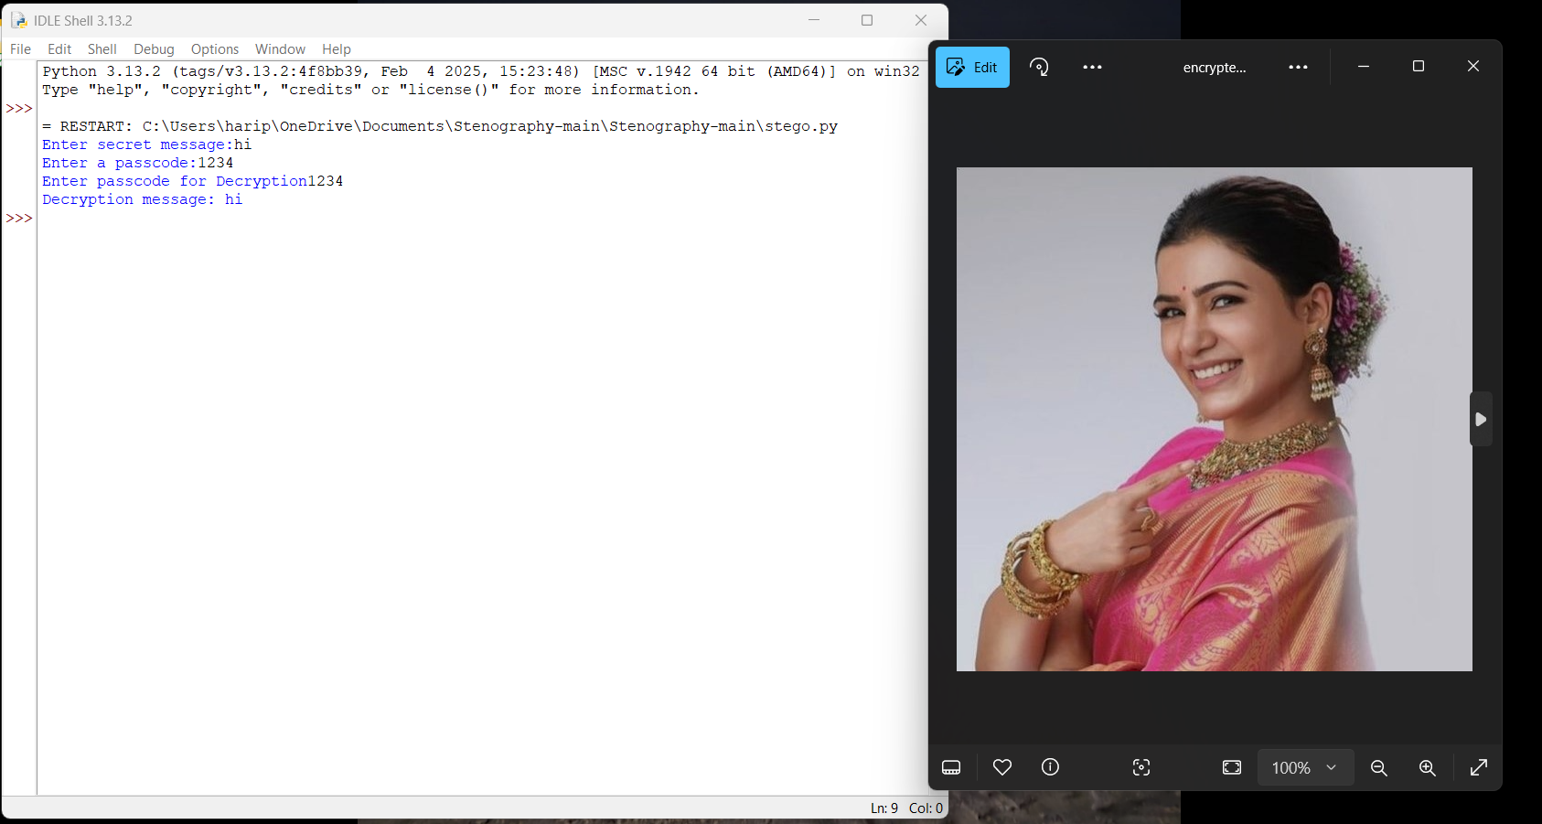
Results

Slide 8
Conclusion
This project demonstrates a basic yet effective approach to image-based encryption and steganography, where a secret message is embedded into the pixel values of an image using RGB channels. The inclusion of a password-based decryption system adds an extra layer of security, ensuring that only those with the correct password can access the hidden message.
Key takeaways:
Steganography is a powerful technique for hiding sensitive information in digital files, and this project provides a simple, user-friendly implementation.
The use of images as a medium for embedding messages allows for visually undetectable encryption, making it ideal for privacy-conscious users.
The password-based protection ensures that the message remains secure even if the encrypted image is intercepted.

Slide 9
GitHub Link
https://github.com/spcode-cyber/aicet-project-cybersecurity.git

Slide 10
Future scope(optional)
While the current project demonstrates basic image encryption and decryption with a password, there is significant potential to extend and enhance it. Here are several areas where the project could evolve:
1. Advanced Encryption Algorithms:
Implementation of Stronger Encryption: Currently, the project relies on modifying pixel values, which is a form of basic encoding rather than robust encryption. Implementing advanced encryption algorithms like AES (Advanced Encryption Standard) or RSA would strengthen the security of the system, ensuring that even if an attacker intercepts the image, it would be nearly impossible to extract the message without the correct password or encryption key.
Hybrid Encryption: Combining image-based encryption with classical encryption methods could provide a layered security model, making the system more resistant to attacks.
2. Error Handling and Validation:
Image Size Limitation: Implement validation to ensure that the image has enough space to accommodate the entire secret message. This would prevent errors when the image is smaller than the message to be embedded.
User-friendly Error Handling: Improve the user experience by adding proper error handling for cases where the image file is corrupted, the password is incorrect, or the message cannot be fully embedded.

Slide 11
THANK YOU

