Slide 1
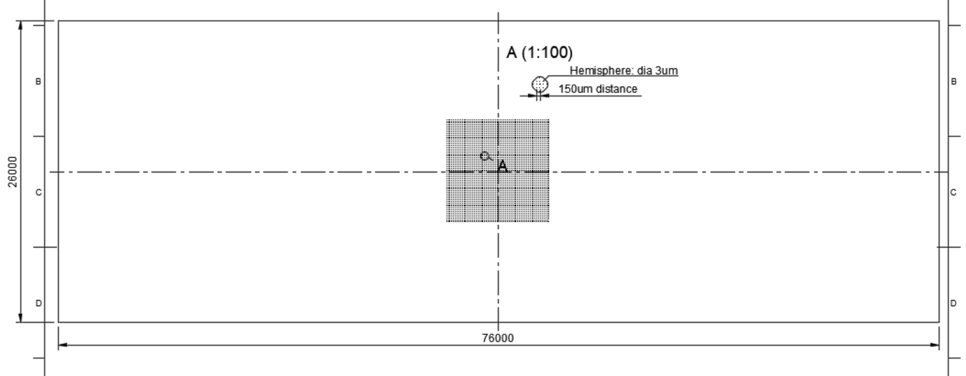
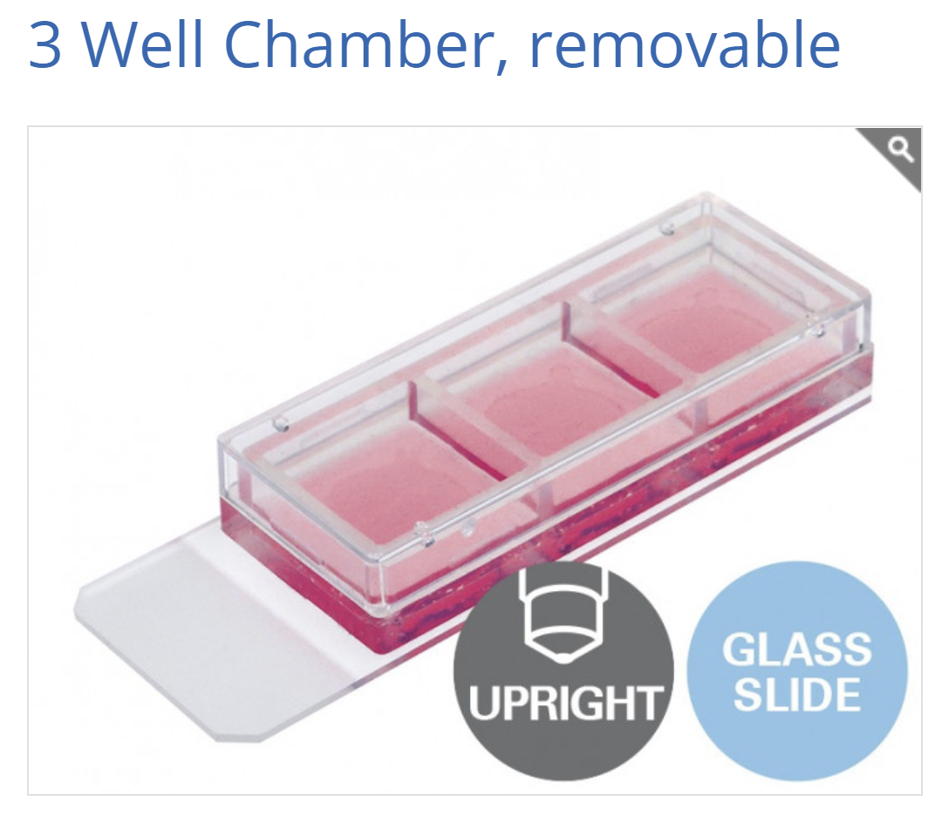
60 hemispheres
60 hemispheres
Φ3 µm hemisphere in 60 x 60 square pattern (interval: 150 µm)
Pattern on the center of Cover glass
Cover glass size: 26 x 76 x 0.17 mm (or comparable like Cat. No. 0107242 from Marienfeld)
Usage : 3 well chamber combinable on the center

