Slide 1
Generative AI: Transformer

Slide 2
Transformer Short note
A Transformer is a deep learning architecture that relies on the attention mechanism.
____________________________________________________________________________________
Note:
Deep learning: It is part of a broader family of machine learning methods, which is based on artificial neural networks with representation learning. Learning can be supervised, semi-supervised or unsupervised.
Attention: It is the concentration of awareness on some phenomenon to the exclusion of other stimuli. It is a process of selectively concentrating on a discrete aspect of information, whether considered subjective objective.
_______________________________________________________________________________________________________________
It is notable for requiring less training time compared to previous recurrent neural architecture and has been prevalently adopted for training LLM on large (language) datasets, such as the Wikipedia Corpus and Common Crawl, by virtue of the parallelized processing of input sequence.
More specifically, the model takes in tokenized(byte pair encoding) input tokens, and at each layer, contextualizes each token with other (unmasked) input tokens in parallel via attention mechanism. Though the Transformer model came out in 2017, the core attention mechanism was proposed earlier in 2014 by bahdanau, Cho, and Bengio for machine translation. This architecture is now used not only in natural language processing, computer vision, but also in audio and multi-modal processing. It has also led to the development of pre-trained systems, such as the GPT(generative pre-trained transformer) and BERT(Bidirectional Encoder Representations from Transformers).

Slide 3
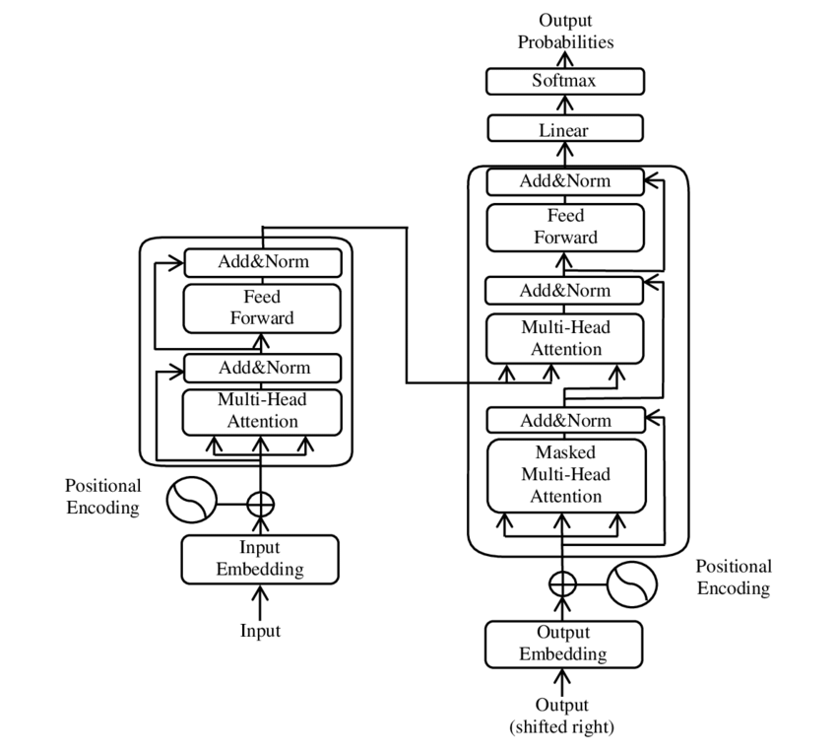
Transformer Model Architecture

Slide 4
Generative AI: Token

Slide 5
Token Short Note
Token is nothing but Byte pair encoding.
____________________________________________________________________________________
Note:
aaabdaaabac
ZabdZabac Z=aa
ZYdZYac Y=ab
XdXac X=ZY
This data cannot be compressed further by byte pair encoding because there are no pairs of bytes that occur more than once.
_______________________________________________________________________________________________________________
Byte pair encoding is an algorithm, first described in 1994 by Philip Gage.
It is use as a tokenizer for transformer models, such as GPT-3.5 model, which first encodes the most frequent words as single tokens, while the less frequent words that contain more frequent words as its subwords are represented by multiple tokens, each of them representing a word part.
For example, the frequent word 'transform' is found in 'transformer' as its first subword/token, and 'ers' as another one. Thus, it can be represented by two tokens. All the unique tokens found in a corpus are listed in a token vocabulary, the size of which, in the case of GPT-3, is 50257. Before the tokenization process can start, the frequency of each word in the training corpus has to be calculated. This calculation is performed by pre-tokenizers such as Spacy and ftfy, which are used by GPT.
The original algorithm uses a simple and robust form of data compression in which the most common pair of contiguous bytes of data in a sequence are replaced with a byte that does not occur within the sequence. A lookup table of the replacements is required to rebuild the original data. The algorithm is effective for the tokenization because it does not require large computational overheads and remains consistent and reliable.

