Slide 1



Presentation
On
Swachh Bharat Abhiyan
Bachelor of Technology
In
Computer Science and Engineering
Dr. A.P.J. Abdul Kalam Technical University , Lucknow (Uttar Pradesh)
Group Member’s
Under the Supervision
Name of Supervisor
(Mr. Rajat Sir)
Roll Number | Student Name | Role & Responsibilities
2101330108001 | Aditya Raj | Developer
2101330109002 | Adarsh Shrivastava | Developer
2101330109012 | Satvik Rai | Developer
2101330109015 | Shivam Pandey | Developer

Slide 2
Introduction
Overview of Swachh Bharat Abhiyan: Swachh Bharat Abhiyan (SBA) is a national cleanliness campaign initiated by the Government of India with the aim of achieving a clean and open defecation-free (ODF) India by October 2, 2019, coinciding with the 150th birth anniversary of Mahatma Gandhi.
Importance of improving public health and sanitation in India: Cleanliness and sanitation are essential for the well-being of individuals and communities. Poor sanitation leads to various health issues and environmental degradation.
Introduction to the software project: The Swachh Bharat Abhiyan Software aims to support the objectives of the SBA by providing a digital platform for efficient monitoring, management, and implementation of cleanliness and sanitation initiatives.

Slide 3
Problem Definition
Current challenges in maintaining cleanliness and sanitation in India:
  Lack of awareness and education about proper sanitation practices
  Inadequate infrastructure for waste management and sewage treatment
  Open defecation practices in rural areas
Issues faced by authorities and citizens:
  Difficulty in monitoring and tracking progress of cleanliness initiatives
  Inefficient allocation of resources and manpower
  Limited community participation and engagement
How the software aims to address these problems:
  Centralized database for data collection and analysis
  Real-time monitoring of cleanliness activities
  Citizen engagement features for feedback and participation

Slide 4
Objectives
Clear objectives of the software project:
  To streamline the implementation of Swachh Bharat Abhiyan initiatives
  To improve transparency and accountability in cleanliness projects
  To facilitate data-driven decision-making for policymakers and administrators
Goals to be achieved through the implementation of the software:
  Increase the number of ODF villages and cities
  Reduce open defecation and littering
  Improve overall public health and environmental hygiene
Long-term benefits for public health and sanitation:
  Reduced incidence of waterborne diseases
  Cleaner environment leading to improved quality of life
  Sustainable development and economic growth

Slide 5
Feasibility Study, Need, and Significance
Feasibility analysis of the software project:
  Technical feasibility: Assessment of available technologies and resources
  Economic feasibility: Cost-benefit analysis of implementing the software
  Operational feasibility: Evaluation of the software's usability and scalability
Why there is a need for such a software solution:
  To address the shortcomings of manual monitoring and reporting systems
  To leverage technology for better governance and service delivery
Significance of improving public health and sanitation:
  Fulfillment of basic human rights to clean water and sanitation
  Contribution to achieving Sustainable Development Goals (SDGs)
  Enhanced reputation and image of the nation on the global stage

Slide 6
Literature Survey
Review of existing literature related to public health and sanitation initiatives:
  Studies on the impact of cleanliness on health outcomes
  Research on community-based sanitation programs
Studies and research supporting the need for Swachh Bharat Abhiyan:
  Evidence of the economic and social benefits of sanitation improvements
  Case studies highlighting successful sanitation interventions in other countries
Insights gained from previous projects and initiatives:
  Lessons learned from past experiences in implementing cleanliness campaigns
  Best practices and strategies for effective behavior change communication

Slide 7
Existing Theoretical and Methodological Contributions
Overview of theoretical frameworks relevant to the project:
  Behavioral theories informing the design of community engagement strategies
  Systems theory applied to the development of monitoring and evaluation systems
Methodologies adopted in similar projects:
  Agile development methodologies for iterative software development
  Participatory approaches for involving stakeholders in project planning and execution
Lessons learned from existing implementations:
  Importance of user-centered design in software development
  Need for continuous monitoring and evaluation to ensure project success

Slide 8
Proposed Methodology in Brief
Outline of the methodology to be followed in the development of the software:
  Requirements gathering and analysis
  System design and architecture
  Implementation and testing
  Deployment and maintenance
Key steps involved in the implementation process:
  Database design for storing cleanliness data
  Integration with existing government systems and databases
Technologies and languages used in software development:
  HTML,CSS, JavaScript for Front-End Development
  JAVA, PHP for Back-End Development
  For Server we use Apache with Xampp
  For Database we use MariaDB from Xampp with SQL.

Slide 9
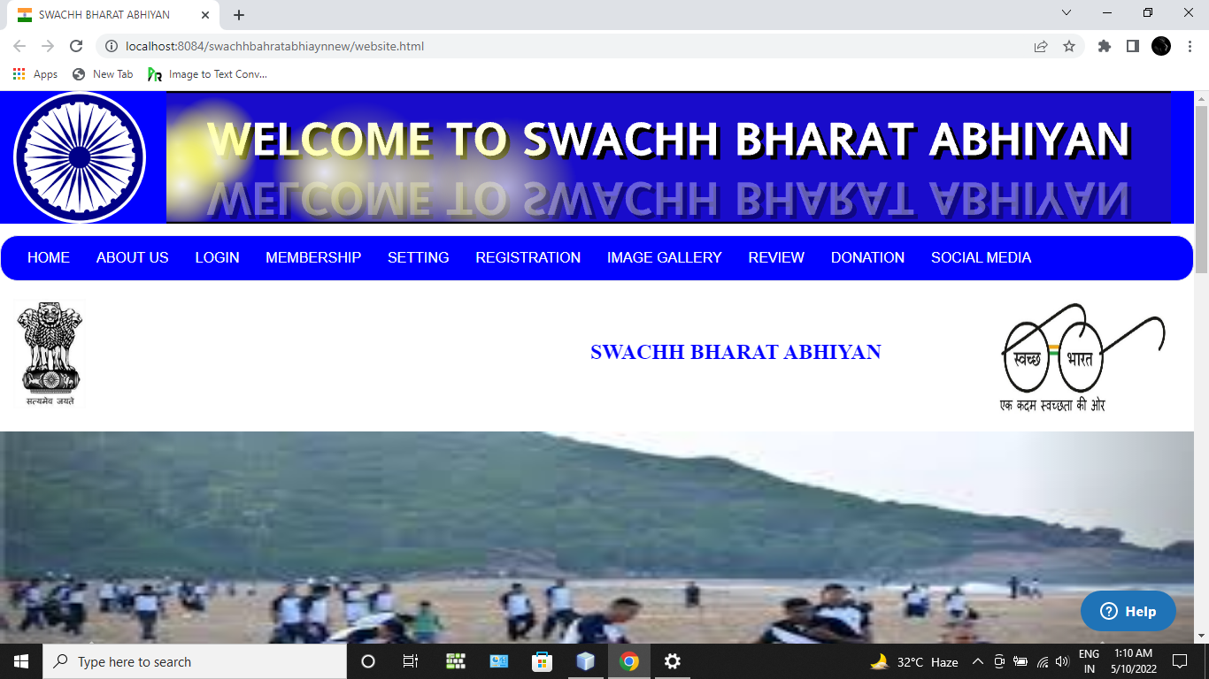
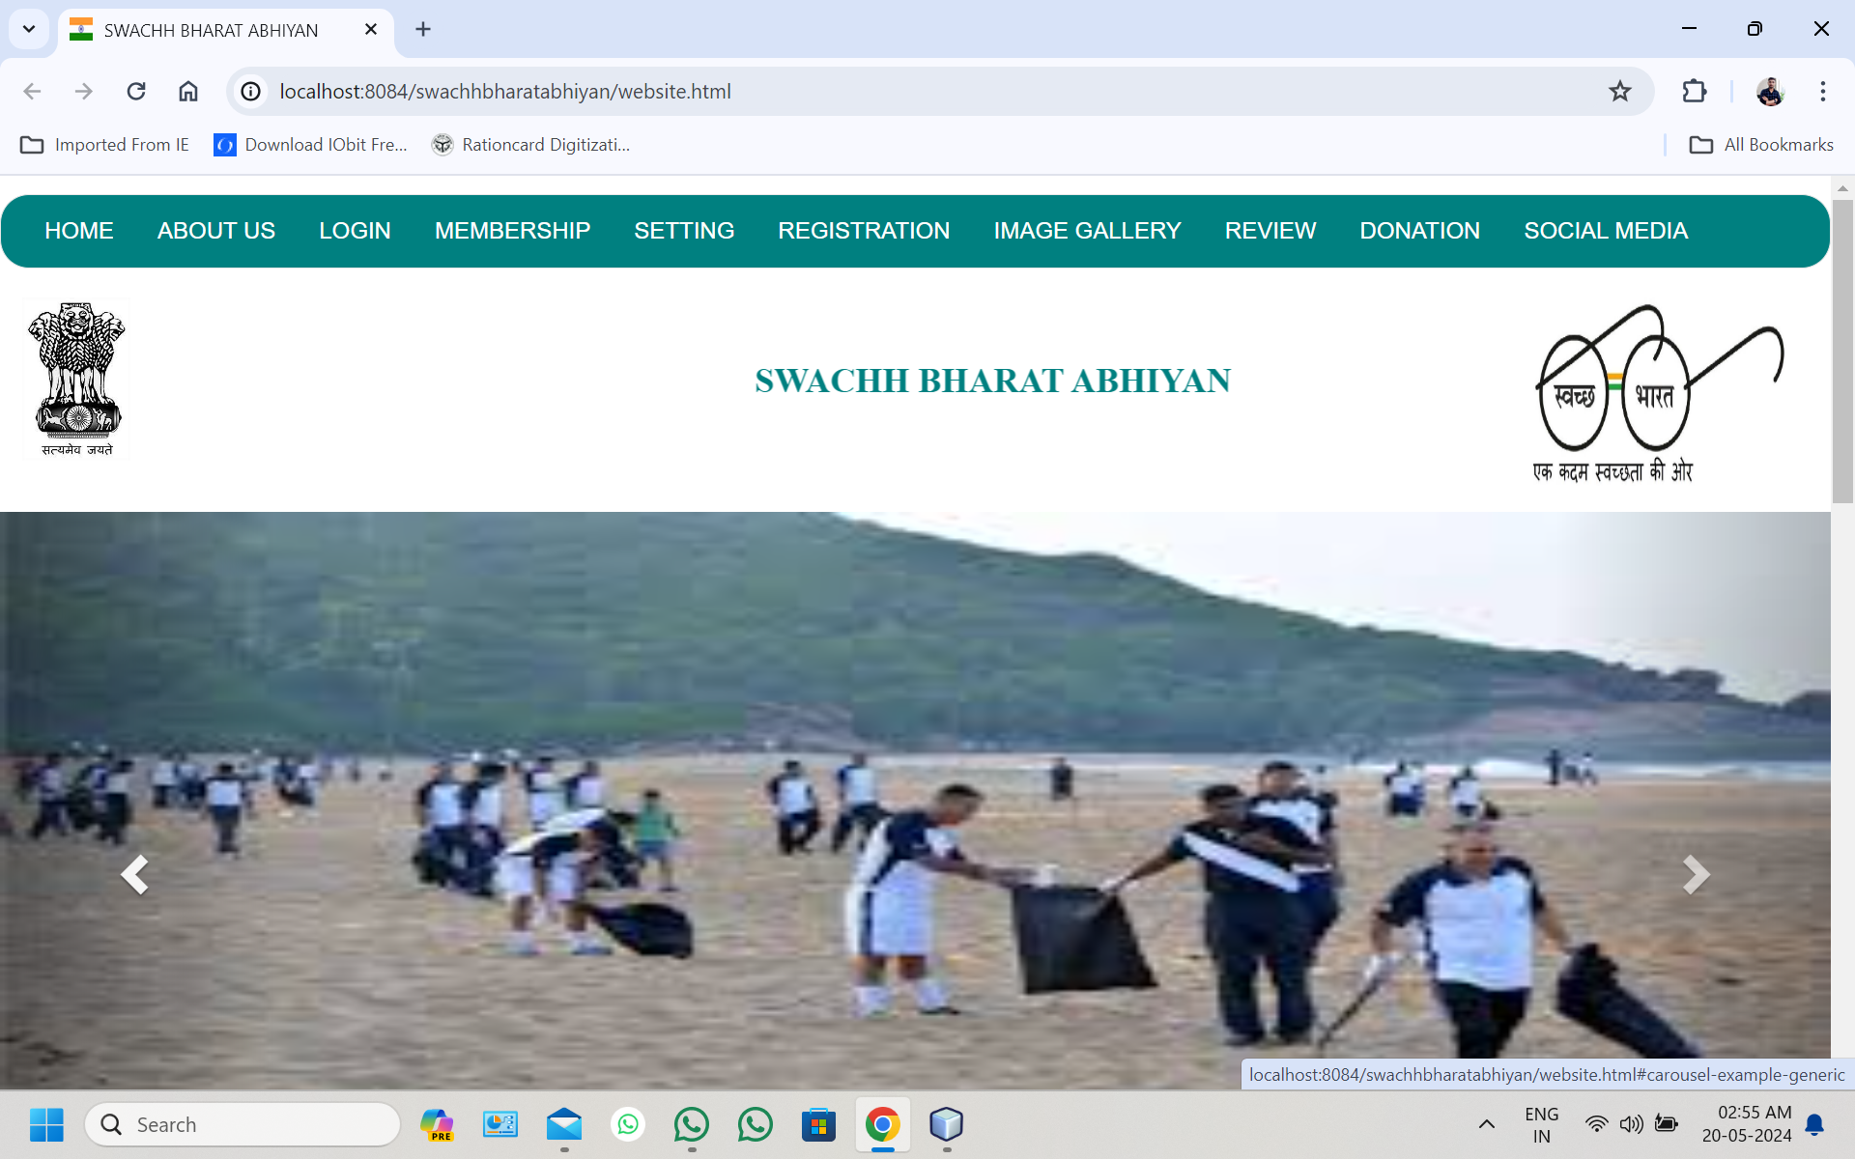
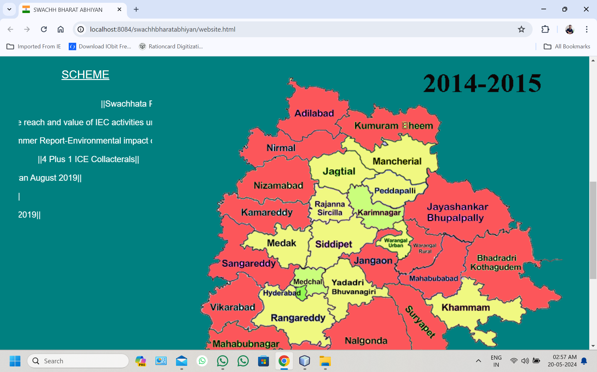
Visual aids

Slide 10
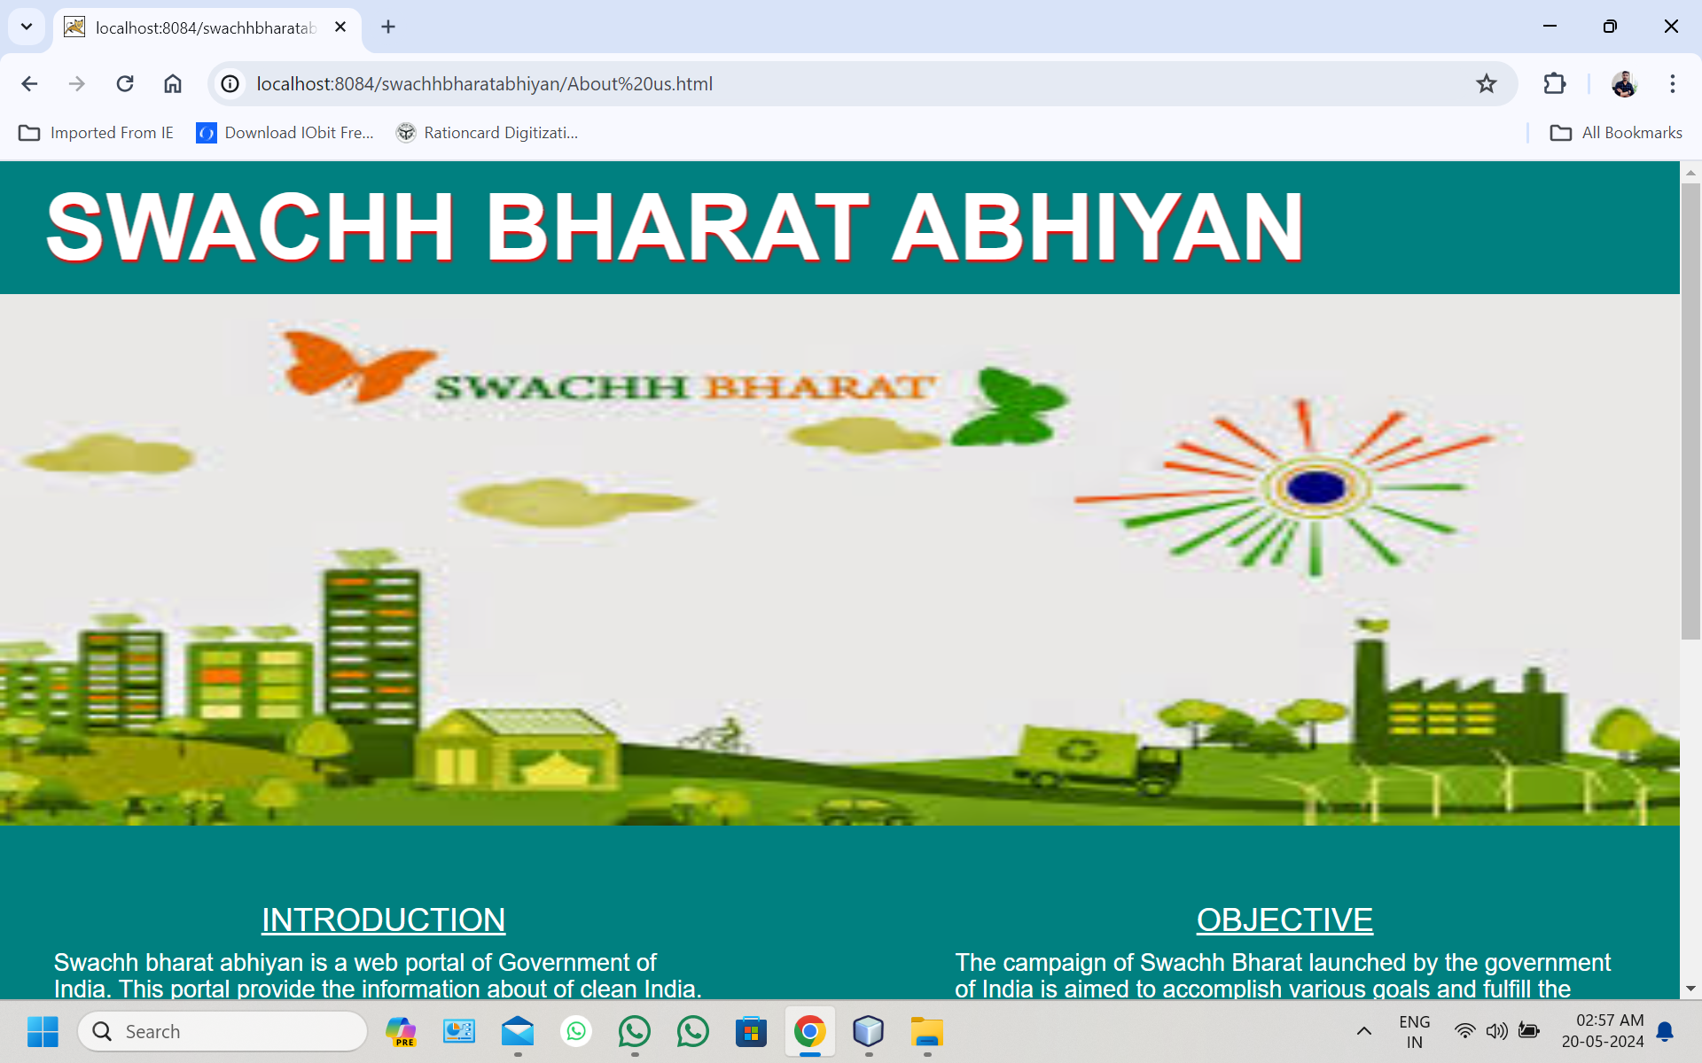
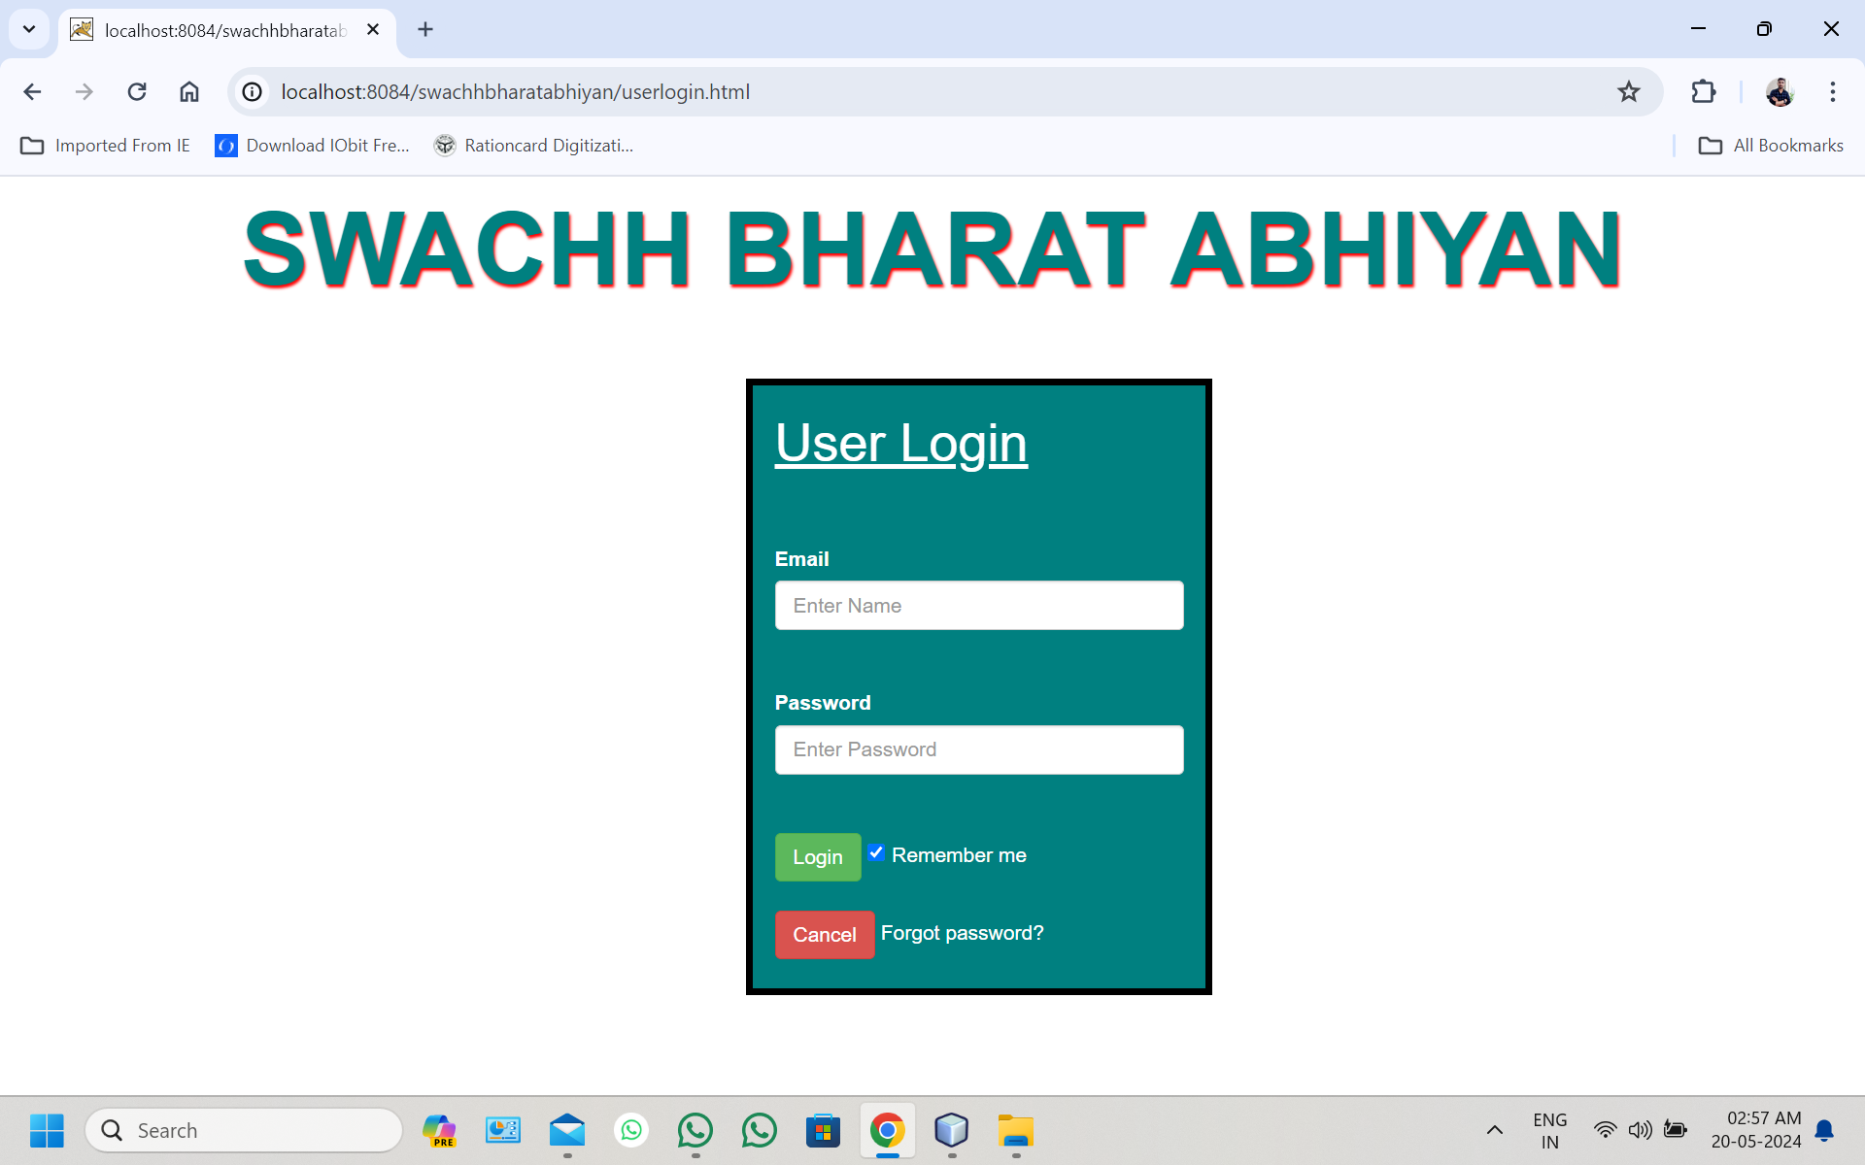
Visual aids

Slide 11
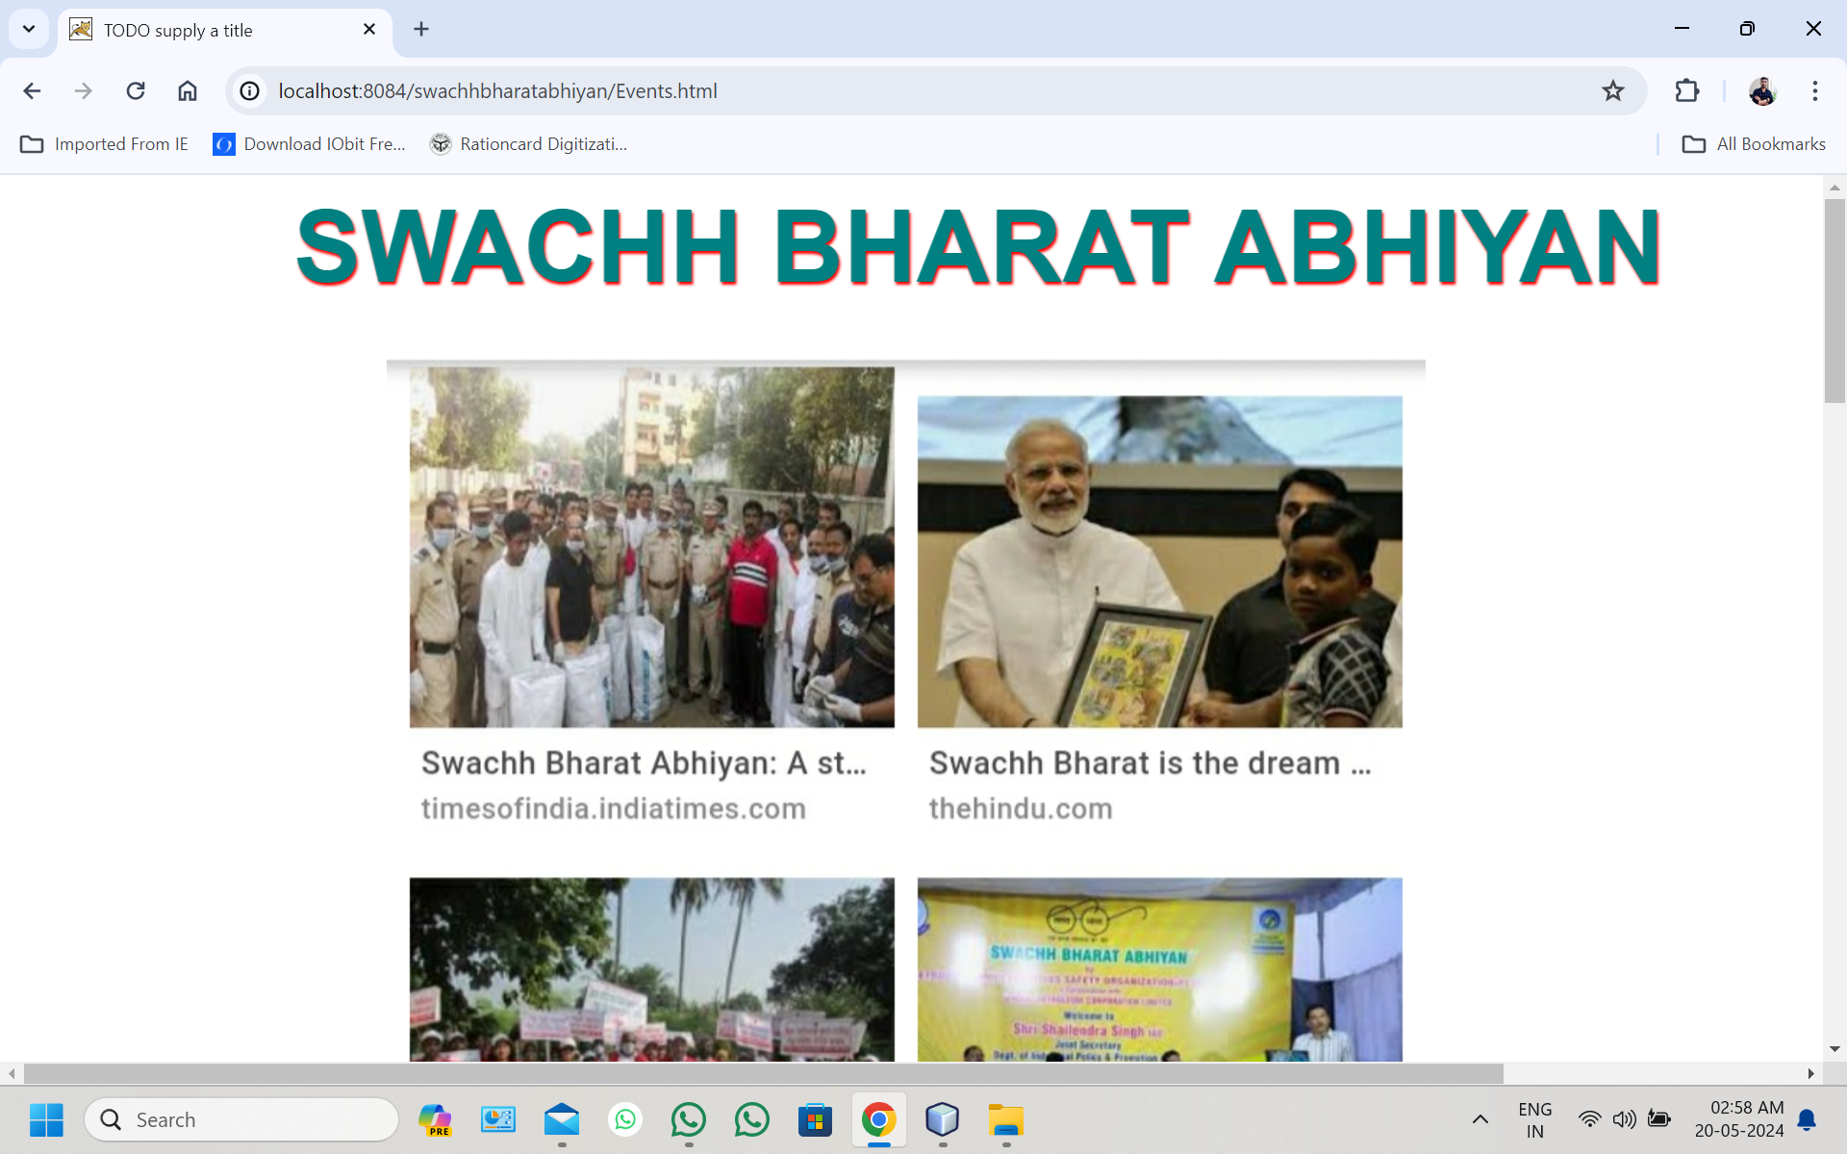
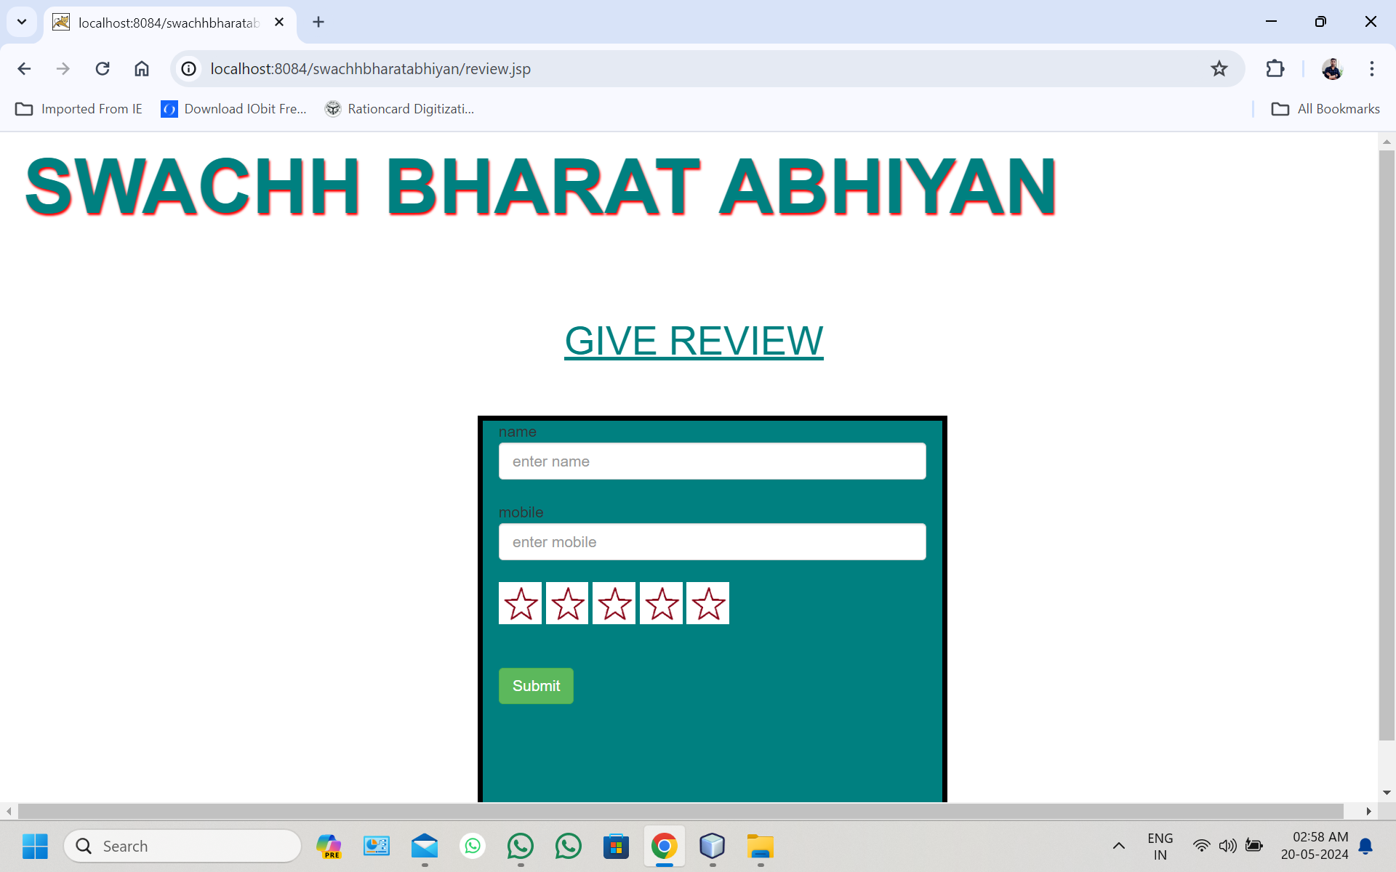
Visual aids

Slide 12
Thank You

