Slide 1
TOLERANCE-MAPS APPLIED TO ANGLED FACES AND TWO CLUSTERS OF FEATURES
Gaurav Ameta
Mechanical and Aerospace Engineering
Arizona State University, Tempe, AZ
Advisor: Dr. Joseph K. Davidson
Professor, Mechanical and Aerospace Engineering
Committee Members
Dr. Jami J. Shah
Professor, Mechanical and Aerospace Engineering
Dr. Thomas Sugar
Professor, Mechanical and Aerospace Engineering
May 4, 2004
This work is supported by NSF Grants DMI # 9821008 and 0245422
Notes:
My name is Gaurav Ameta and I would like to welcome everybody to my defense presentation on the topic “TOLERANCE-MAPS APPLIED TO ANGLED FACES AND TWO CLUSTERS OF FEATURES”. My thesis advisor is Dr. Davidson and my committee members are Dr. Shah and Dr. Sugar. I would like to acknowledge the NSF grants that supported this research work.

Slide 2
Outline
  Introduction
  ASU bi-Level Model
  Scope of this work
  Tolerance on Angled surfaces
  Stackup of Picture Frame (2-D Point-Plane Clusters).
  Stackup of Picture Frame (3-D Point-Line-Plane Clusters).
  Future work
Notes:
Introduction
ASU bi-Level Model
Scope of this work
Tolerance on Angular surfaces
Stackup of Picture Frame (2-D Point-Plane Clusters).
Stackup of Picture Frame (3-D Point-Line-Plane Clusters).
Future work

Slide 3





Introduction
  Designers
  Inspector
  Performance
  Variations
Assemblies and Parts
  Businessmen/Managers
tolerances
  Manufacturer
  Money
  Machine
  Capability
Notes:
Designers like perfect dimensions which are impossible to obtain. No company has enough resources to do that. So some variations in manufacturing related precesses are allowed and considered at design level which are called tolerances. in design area they influence resultant dimensions, function of parts, sensitivity to variations etc and in manufacturing they influence cost, process selection, tooling and fixtures etc. so all in all very imp issue.

Slide 4
Introduction-contd.
Tolerance Representation
Conventional
Tolerancing
GD&T
Geometric
Tolerancing
usually specified with upper and lower limits and are associated with dimensions.
variations are classified as size, form, orientation, position, runout, and profile.
Form, Orientation, Profile??
Tolerances are represented as three-dimensional zones
This three-dimensional representation can be used for tolerance analysis in truly three-dimensional way.
Notes:
There are two techniques for tolerances - conventional and geometric. In conventional tolerancing the variation of a specific dimension is controlled only in the direction of that dimension. Conventional tolerances are usually specified with upper and lower limits and are associated with dimensions. Since perfect parts cannot be manufactured, additional tolerances are needed to control functional aspects of parts or assemblies, viz. form, size, orientation, profile etc. This combination of different tolerances was not possible with conventional tolerancing; thus geometric tolerancing was introduced.
Geometric tolerances are used to control all the variations for size, shape and geometric quality, which are enlisted in the ASME Y14.5-1994 standard. These variations are classified as size, form, orientation, position, runout, and profile. Form tolerances are further classified as straightness, flatness, circularity and cylindricity. An orientation tolerance can be for parallelism, perpendicularity or angularity. Location and concentricity are the types of position tolerances. Runout includes circular and total runout while a profile tolerance can be for a line or a surface.

Slide 5
Motivation
Tolerance Analysis
Manual Tolerance
Analysis
Math
Model
Automated Tolerance
Analysis
Tedious and error prone because the standard is based on rule and the interpretation is ambiguous.
Parametric model
Offset zone model
Variational Surface model
Kinematic model
Degrees of Freedom model
ASU Bi-Level model
Notes:
Manual tolerance analysis is tedious and error prone because the standard is based on rule and their interpretation can be ambiguous. Therefore tolerance analysis needs to be automated. This can be done by two methods, simulation or math models. In this thesis we are interested in Math models. There are six major types of math models viz. parametric, offset zone, variational surface, kinematic, degree of freedom and ASU Bi-level model.

Slide 6

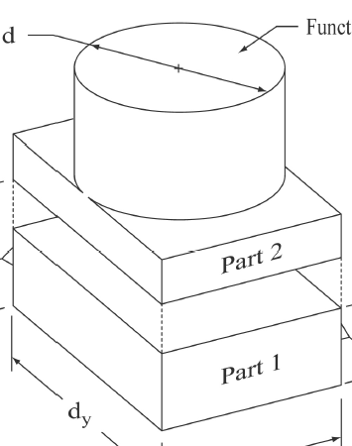
ASU Bi-Level Model
Composite effect of all tolerances on a feature
Tolerance Analysis
Local Level
Parts
Relation of all feature control frames
Complete model of an Assembly
Global Level
Assemblies
Notes:
LOCAL MODEL (T-Maps®)
Models the composite effect of all tolerances on a given feature
Interaction of size, form, orientation and position is clearly identified
Rule # 1 is embedded in the formulation (ASME Y14.5)
Relative volumes of regions can be used to study the trade-off in tolerance allocation
GLOBAL MODEL
Relates all feature control frames in a model with each other
Models datum reference frames (DRF) and their precedence
Provides basis for geometric validation of D&T scheme and downstream tolerance analysis

Slide 7
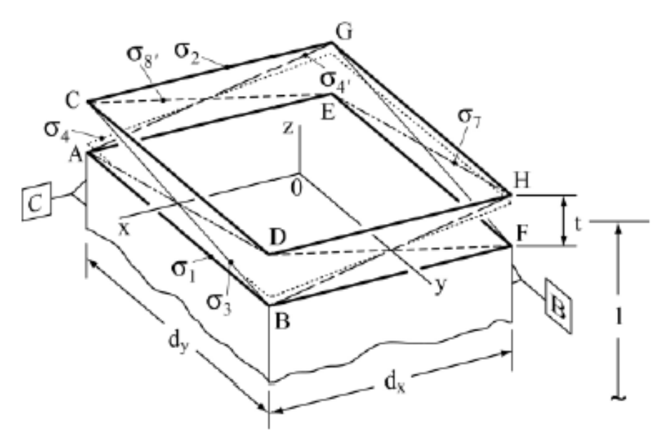
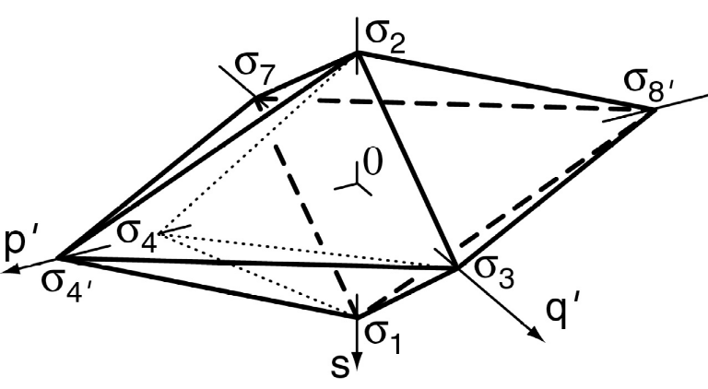
Local Level – Tolerance-Map®
A T-Map® is the range of points resulting from a one-to-one mapping from all the variational possibilities of a feature, within its tolerance-zone, to a hypothetical Euclidean point-space.
σ₂
‘
σ₄
p
σ₃
‘
σ₁
q
s
Hypothetical
Euclidean point space
Notes:
A T-Map® is the range of points resulting from a one-to-one mapping from all the variational possibilities of a feature, within its tolerance-zone, to a hypothetical Euclidean point-space.
Central concept of the new math model
Established in hypothetical Euclidean point-space
One-to-one correspondence between points in the T-Map and features in the tolerance zone
Uses areal coordinates to describe the points, Cartesian coordinate system can be overlain
Features having extreme variation in each of the DoF are selected as basis features for the linear combination. (n + 1 basis features required)
This volume of points is really the “range” of the mapping function

Slide 8
Local Level - Previous Work
Development of math model for tolerances applied to planar features(Mujezinović et. al. (2001))
Planar features
Development of math model for Geometric tolerance specified on an axis and cylindrical features
(Davidson and Shah (2001), Bhide et.al. (2002))
Axis and
cylindrical surface
Development of math model for tab and slot with Material modifiers on features and datums
(Davidson and Shah (2003))
Tab and Slot
Notes:
LOCAL MODEL
Development of math model for tolerances applied to planar features (Davidson et al (2000), Mujezinović et al (2001))
Development of math model for Geometric tolerance specified on cylindrical features (Davidson, Bhide (2002)).
Development of math model for tab and slot with Material modifiers on features and datums (Davidson and Shah (2003)).
GLOBAL MODEL
Tolerance advisory system ( Ramaswamy et al (2001))
Integrated tolerance specification and analysis GD&T system (Wu and Shah (2002))

Slide 9
Problem Statement
This work focuses on development of the new math model for geometric tolerances for angled faces and two feature clusters. In particular it focuses on:
  Mathematical representation of tolerance zones for different tolerances on an angled surface.
  Study the accumulation of tolerances in an assembly and develop stackup equations.
  Mathematical representation of tolerance zones for feature clusters of plane-point and point-line-plane.
Notes:
The scope of this thesis is to extend the local model so that it can represent the permissible variation of (a) angled faces and (b) two feature-clusters. It also deals with the angled faces and feature clusters in an assembly and develops stackup equations from the representation of angled faces and feature clusters as functional features.

Slide 10
Problem Statement-contd.
Planar
ASU Bi-Level Model
Axis and cylindrical surface
Local
Level
Tab and Slot
Angled Planes
Global
Level
Plane-Point
(2-dimension)
Feature
Clusters
Plane-line-Point
Notes:
The scope of this thesis is to extend the local model so that it can represent the permissible variation of (a) angled faces and (b) two feature-clusters. It also deals with the angled faces and feature clusters in an assembly and develops stackup equations from the representation of angled faces and feature clusters as functional features.

Slide 11
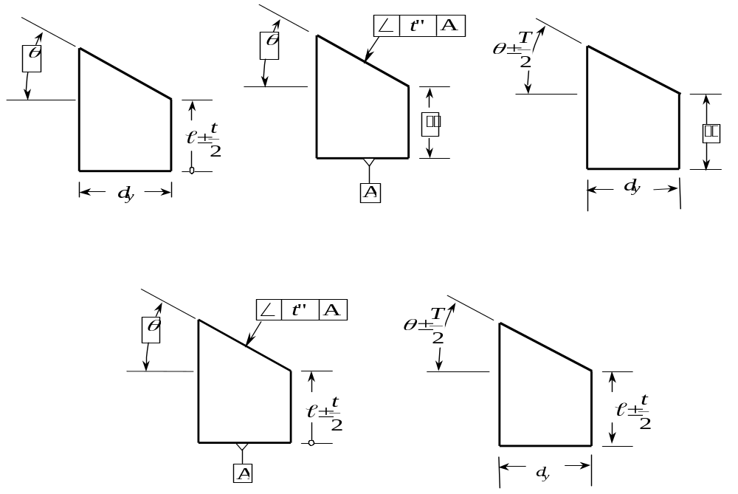
Tolerances on Angled Surface
Size tolerance
Angularity tolerance
Angular size tolerance
Angular Size and Linear Size
tolerance combined
Angularity and Linear Size
tolerance combined
Notes:
Allocation of Tolerance

Slide 12
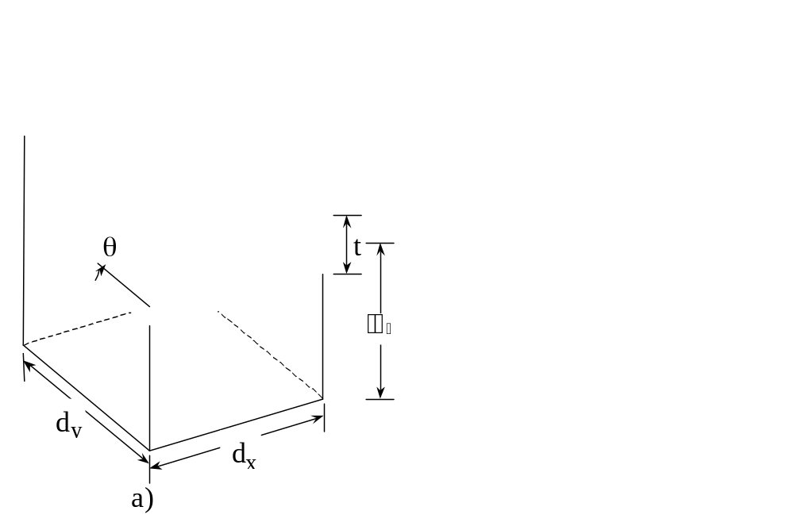

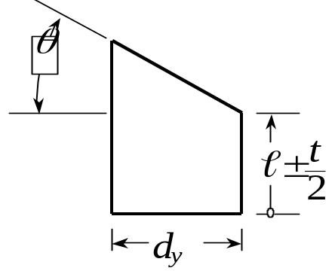
Tolerances on Angled Surface-contd.
σ
2
G
σ
8'
t
cos
θ
σ
4'
2
C
E
σ
z
σ
7
A
7
σ₂
σ
8'
x
H
σ
4'
σ
1
D
p'
σ₁
σ₃
F
t
cos
θ
s
σ
y
3
q'
B
b)
Notes:
Basis points areal coordinates and construction of T-Map from there

Slide 13
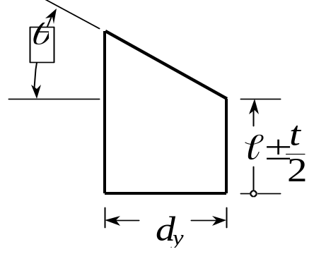
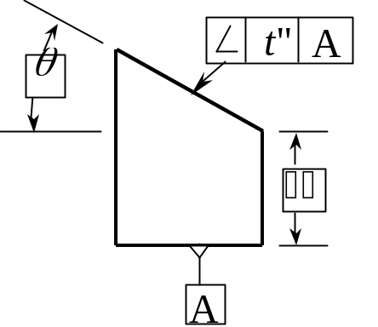
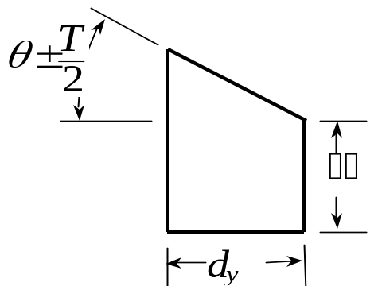

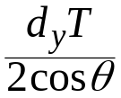


Tolerances on Angled Surface-contd.
Specification:
Tolerance zone:
θ
t
θ
θ
t”
Tolerance Map:
q’
s
q’
s
q’
s
Notes:
Angularity tolerance and specification with tolerance zone and T-Map.

Slide 14
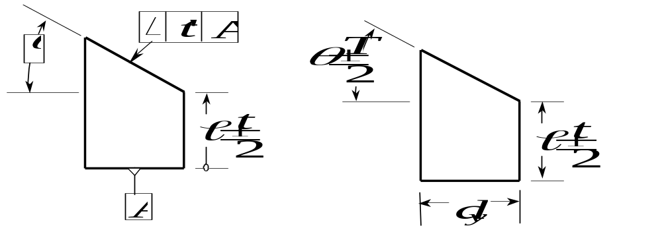


Combination of the specification of Angled Surfaces
Specification:
t”
Tolerance zone:
θ
??
Tolerance-Map:
q’
q’
s
s
Notes:
Combination of specification for angular surfaces and their tolerance zone and T-Map

Slide 15
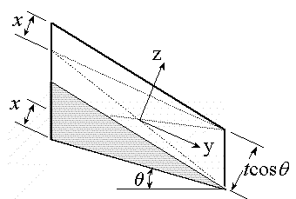

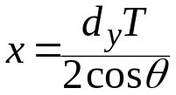

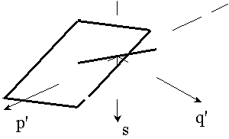
Combined Linear Size and Angular Size tolerance
x
z
x
y
d_{y}
θ
tcosθ
Floating zone for Orientation Control
q'
p'
s
q'
p'
s
p'
q'
a)
b)
s
c)
Notes:
Combination of specification for angular surfaces and their tolerance zone and T-Map

Slide 16



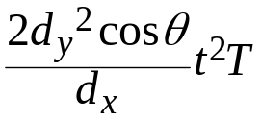
Comparison of specifications
 | Specification | Shape | Content (Volume)
1 | Linear Size | Di-pyramid | d_{y}/(3d_{x})
2 | Angularity | Di-pyramid | d_{y}/(3d_{x})
3 | Angular Size | Line | ----------
4 | Linear Size and Angularity | Truncated di-pyramid | d_{y} /(3d_{x})
5 | Linear and Angular Size | Oblique rhombic prism
Notes:
Combination of specification for angular surfaces and their tolerance zone and T-Map

Slide 17


Comparison of specifications
t= 0.001 inch, t"= 0.0005 inch, d_{y} : d_{x} = 2, T = 0.00021 radians, θ = 30 degrees, d_{y} = 2 inch
 | Content (Volume) | Example | Tolerance relations
 | d_{y}/(3d_{x}) | 17.32X10⁻¹⁰ | t₁ (linear size tolerance)
 | d_{y}/(3d_{x}) | 3.32X10⁻¹⁰ | t" = t₁cosθ
 | ---------- | 0 | ------
 | d_{y} /(3d_{x}) | 3.98X10⁻¹⁰
 |  | 14.5X10⁻¹⁰
Tolerance Map:
Ameta et. al. (2004) "The effects of Different Specifications on the Tolerance-Maps for an Angled Face",ASME-DETC 2004
Notes:
Combination of specification for angular surfaces and their tolerance zone and T-Map

Slide 18
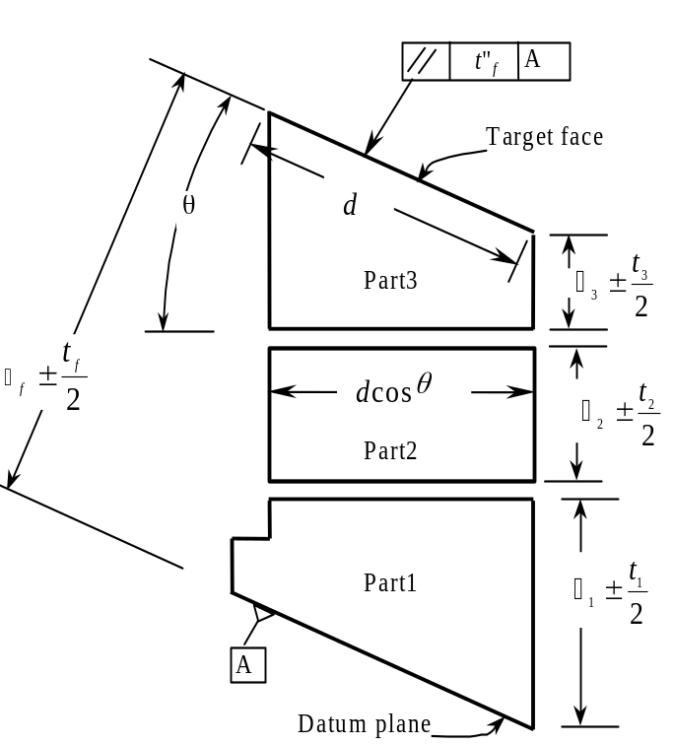
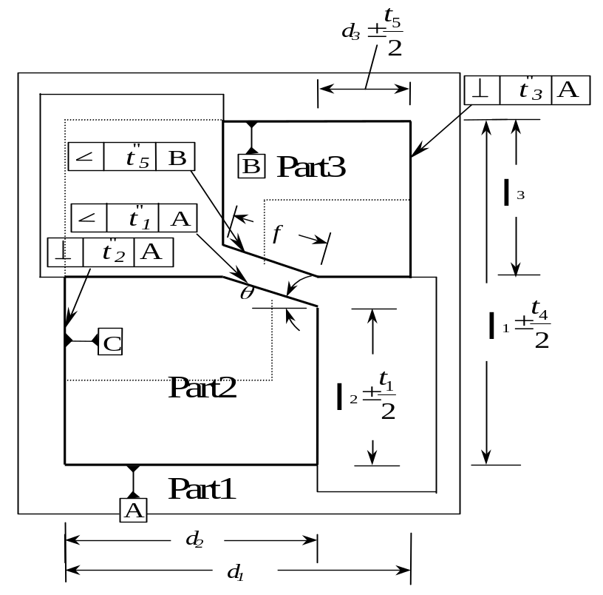
Assembly of Simple Parts
Notes:
Assembly of simple parts

Slide 19
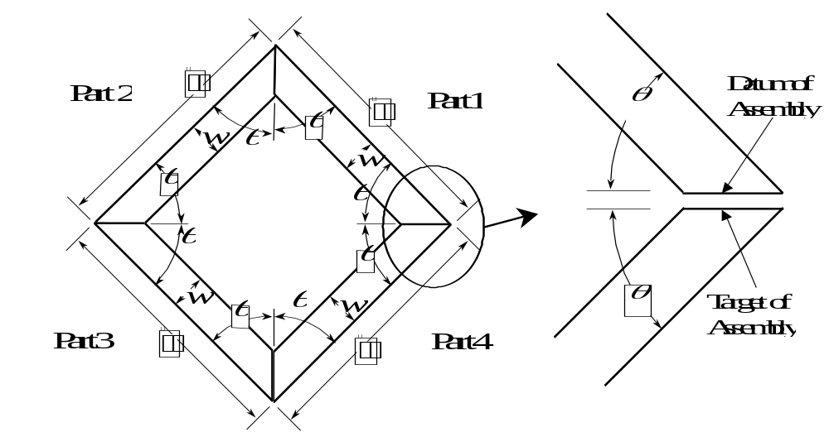
Picture Frame Problem
Notes:
Picture Frame Problem and assembling process

Slide 20

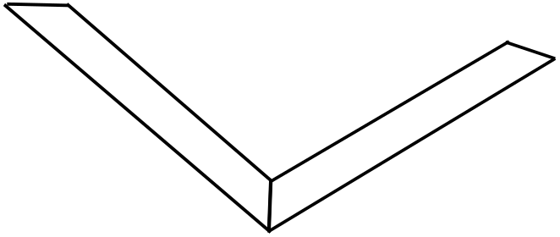
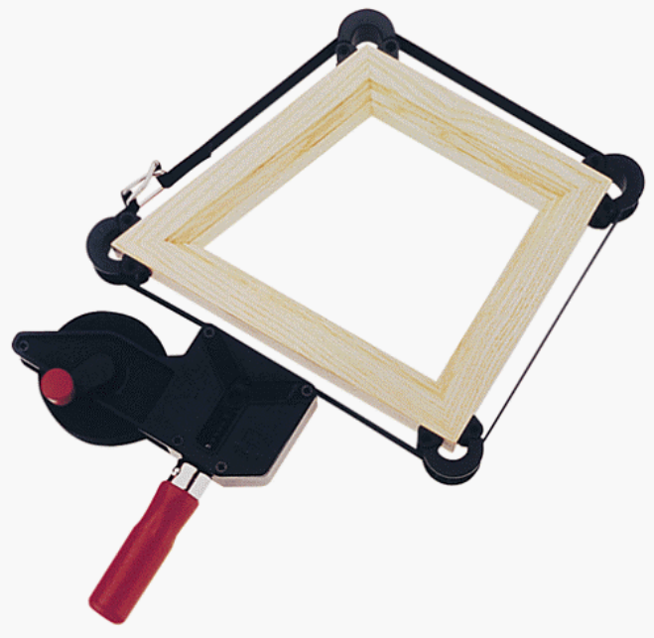
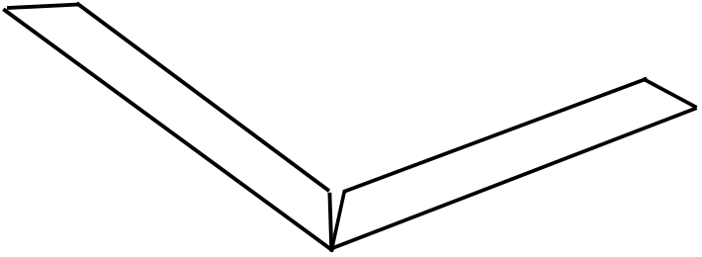
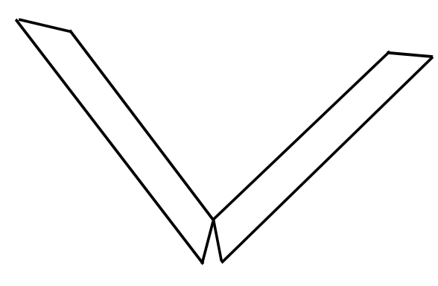

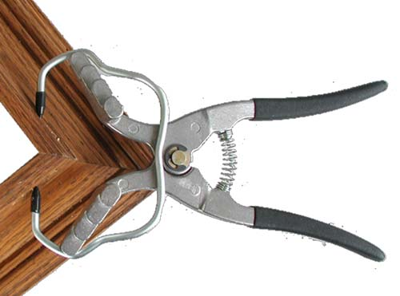
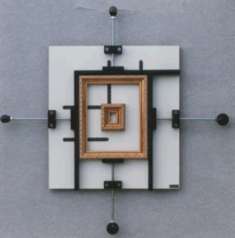
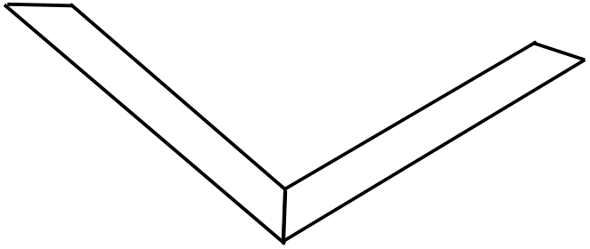
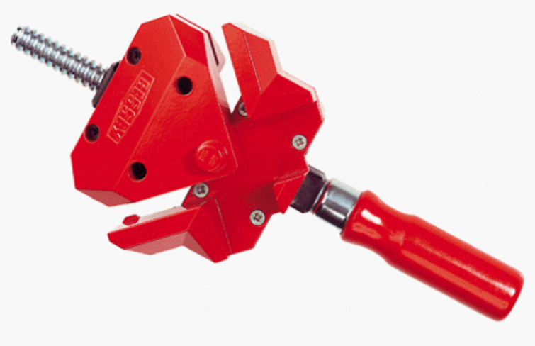






Picture Frame Problem-Assembly Procedures
External Control Point
Internal Control Point
Angle Clamp (ICP)
Angle Strap Clamp (ECP)
Clamp it Assembly Square (ECP)
Four Corner Framing Clamp (ECP)
Miter Clamp System
Miter Vise (ECP)
Spring Clamp (ECP)
Web Clamp
Notes:
Basis points and Composite T-Map for a single part

Slide 21

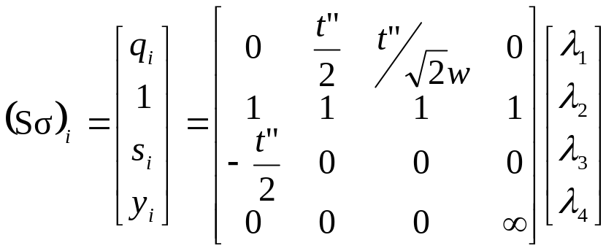
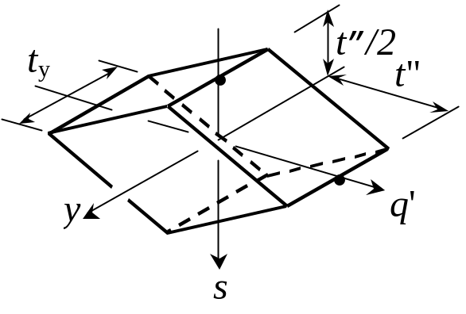
Picture Frame Problem- Basis points
z
(Sσ)₂
(Sσ)₃
(Sσ)₂
(Sσ)₃
(Sσ)₄
(Sσ)₄
q’
y
(Sσ)₁
t”
(Sσ)₁
y
s
Basis Points for
Point-Plane Cluster
Point-Plane Cluster
Functional T-Map
Notes:
Conformance of the second part

Slide 22
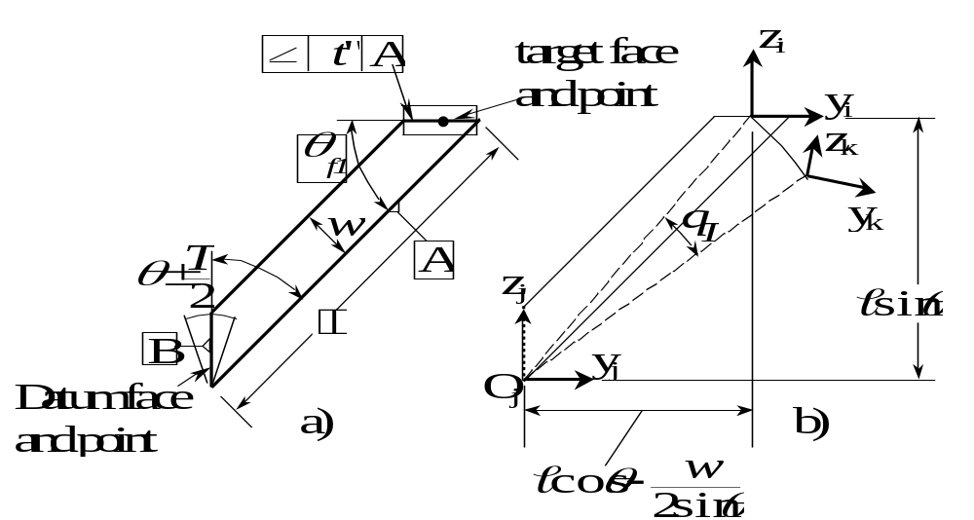
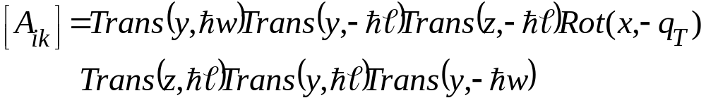
Picture Frame Problem-Single Part
Notes:
Conformance and Accumulation T-Map

Slide 23
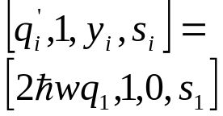
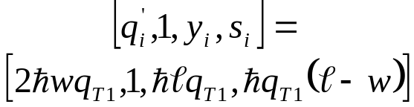
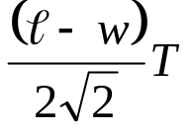
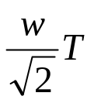
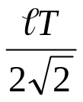
Picture Frame Problem-Single Part
σ_{B}
q'
q'
q'
y
y
s
s
y
σ_{A}
s
Notes:
Conformance and Accumulation T-Map

Slide 24
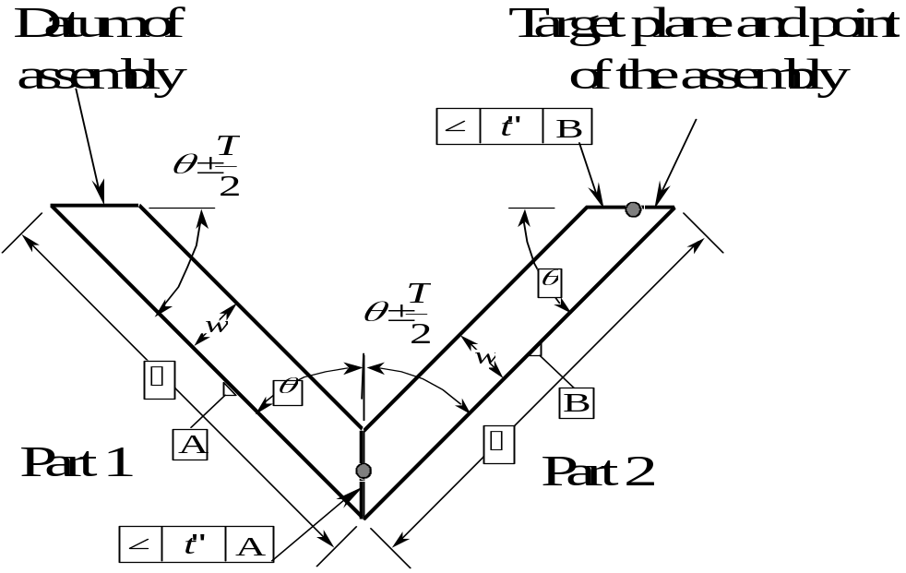
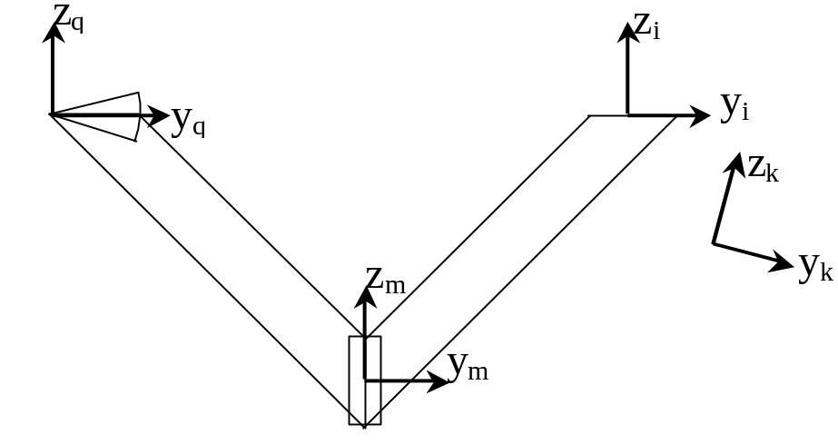
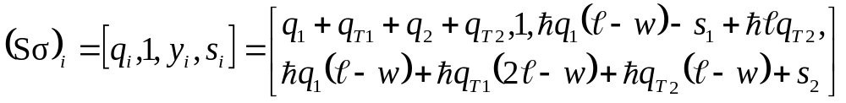
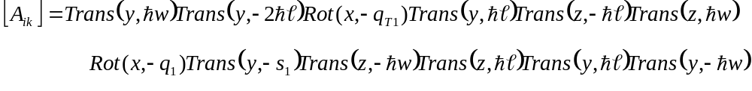
Picture Frame Problem- Two Parts
Notes:
Conformance and Accumulation T-Map

Slide 25
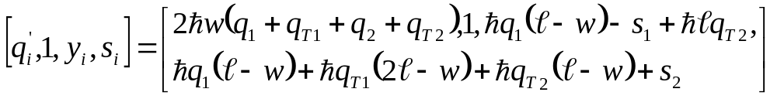
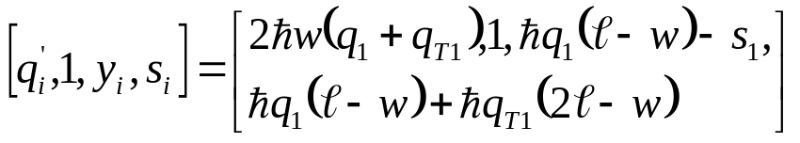
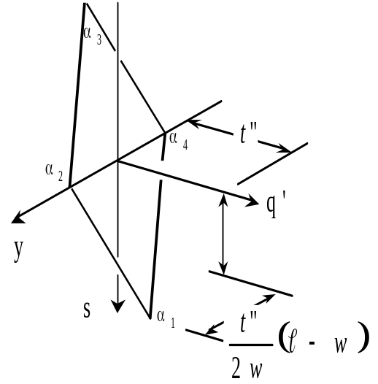
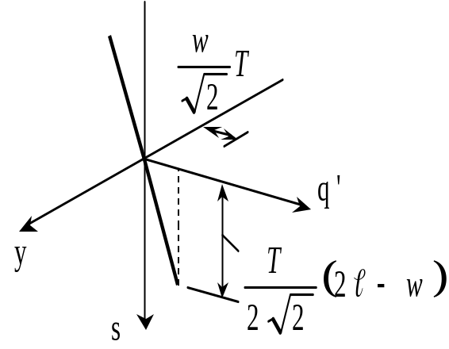
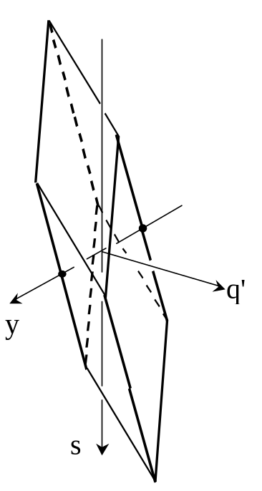
Picture Frame Problem-Two Parts
Notes:
Conformance and Accumulation T-Map

Slide 26
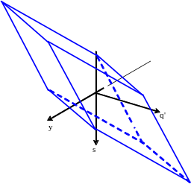
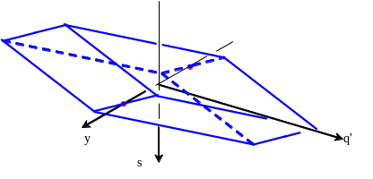
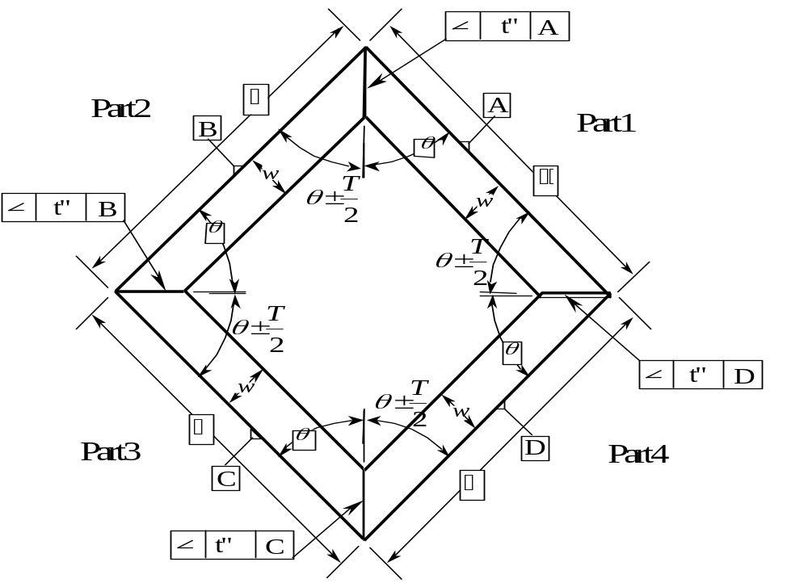
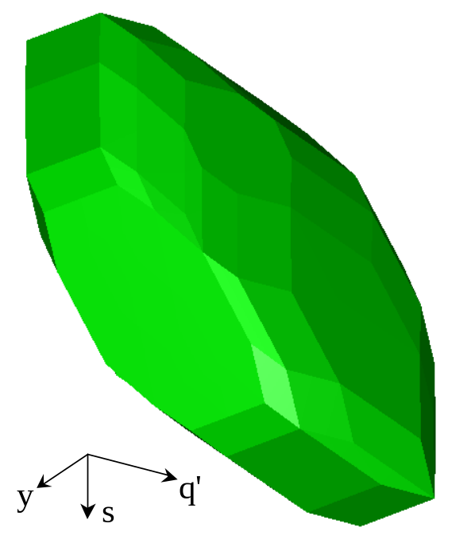
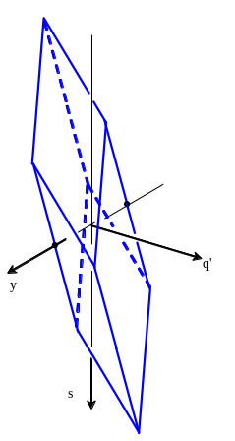
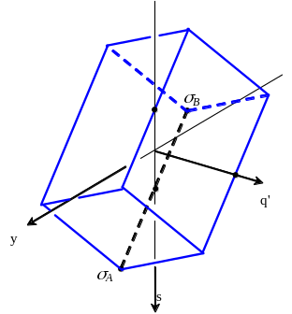
Picture Frame Problem-Four Parts
Notes:
Conformance and Accumulation T-Map

Slide 27



Picture Frame Problem-Functional T-Map
Functional T-Map
Functional T-Map
Accumulation T-Map
Notes:
Conformance and Accumulation T-Map

Slide 28


Picture Frame Problem-Stack Up Equations
Notes:
Conformance and Accumulation T-Map

Slide 29


Picture Frame Problem-Three Dimensional View
Assembly
Cluster
Assembly
Structure
Notes:
Conformance and Accumulation T-Map

Slide 30

Picture Frame Problem-Three Dimensional View
L'
z
(S$σ)₁
(S$σ)₁
(S$σ)₇
(S$σ)₅
y
x
(S$σ)₃
t”
(S$σ)₄
q'
(S$σ)₆
y
(S$σ)₂
(S$σ)₂
x
s
p'
Notes:
Conformance and Accumulation T-Map

Slide 31

Picture Frame Problem-Three Dimensional View
Notes:
Conformance and Accumulation Map

Slide 32


Picture Frame Problem-Three Dimensional View
Notes:
Conformance and Accumulation Map

Slide 33


Picture Frame Problem-Three Dimensional View
Notes:
Conformance and Accumulation Map

Slide 34






Picture Frame Problem-Three Dimensional View
L'
α₃
α₅
x
α₂
α₄
q'
y
α₆
s
p'
α₁
Notes:
Conformance and Accumulation Map

Slide 35


Picture Frame Problem-Three Dimensional View
Notes:
Conformance and Accumulation Map

Slide 36
Conclusion
  Mathematical representation of tolerance zones for
    angled plane with five different tolerance specifications.
    feature clusters of Plane-Point and Point-Line-Plane.
  Accumulation of tolerances in assemblies involving angled plane and Plane-Point Cluster as functional features.
Angled Planes
Plane-Point
(2-dimension)
Feature
Clusters
Plane-line-Point
Notes:
Internal Assembly and assembling procedure

Slide 37
Future Work
Extension of Statistics into T-Maps.
Developing T-Maps for other feature clusters (Cluster of axes, Axis and Point, Axis and Plane etc).
Developing a method for obtaining stack up for parts having higher dimensional T-Map®.
Automation of the Process.
Notes:
Internal Assembly and assembling procedure

Slide 38
Dedication
To my paternal and maternal grandparents, father Rajvallabh Ameta, mother Kusum Ameta and brother Prateek Ameta.
I am very thankful to my committee chair Dr. Joseph K. Davidson, and committee members, Dr. Jami J. Shah and Dr. Thomas Sugar, for their time and guidance.
I am also very thankful to all my DAL-mates and friends who were always forthcoming in providing help and support.
I would also like to acknowledge the financial support for this work from National Science Foundation Grants # DMI-9821008 and DMI-0245422.
Acknowledgements
Notes:
Internal Assembly and assembling procedure

Slide 39
Questions ??
Notes:
Internal Assembly and assembling procedure

Slide 40


Internal Assembly-2
Notes:
Conformance and Accumulation T-Map

Slide 41
Internal Assembly-3
Notes:
Allocation of tolerances

Slide 42
Internal Assembly-3
Future Work
Computation of content of higher dimensional T-Maps.
Developing the maps for tolerances like runout, circularity and straightness of lines elements.
Developing T-Maps for feature patterns and composite tolerance specifications
Developing T-Maps for composite features, where planar feature controls orientation and cylindrical feature controls location.
Incorporation of Statistical Analysis with T-Maps.
Notes:
Allocation of tolerances

Slide 43




Tolerance on Angular Surfaces
Size tolerance
Angularity tolerance
Angular size tolerance
t”
A
θ
θ
A
Angular Size and Linear Size
tolerance combined
Angularity and Linear Size
tolerance combined
t”
A
A
Notes:
Allocation of Tolerance

Slide 44




Picture Frame Problem-Two Parts
Notes:
Conformance and Accumulation T-Map

Slide 45
Minkowski Sum
Notes:
Conformance and Accumulation T-Map

Slide 46
Previous Work
LOCAL MODEL
  Development of math model for tolerances applied to planar features (Davidson et al (2000), Mujezinović et al (2001))
  Development of math model for Geometric tolerance specified on cylindrical features (Davidson, Bhide (2002)).
  Development of math model for tab and slot with Material modifiers on features and datums (Davidson and Shah (2003)).
GLOBAL MODEL
  Tolerance advisory system ( Ramaswamy et al (2001))
  Integrated tolerance specification and analysis GD&T system (Wu and Shah (2002))

Slide 47

Assembly of Simple Parts
Notes:
Assembly of simple parts

Slide 48



Assembly of Simple Parts
for θ =30 and ₂+₃+0.5dSθ=2
Notes:
Conformance and Accumulation Map

Slide 49


Assembly of Simple Parts
Accumulation T-Map for the assembly
T-Map for Part 1
T-Map for Part 2
T-Map for Part 3
Notes:
Conformance and Accumulation Map

Slide 50


Assembly of Simple Parts
Notes:
Conformance and Accumulation Map

Slide 51




Assembly of Simple Parts-2
Notes:
Conformance and Accumulation Map

Slide 52




Assembly of Simple Parts-2
Notes:
Conformance and Accumulation Map

Slide 53



Assembly of Simple Parts-2
Notes:
Conformance and Accumulation Map

Slide 54
Assembly of Simple Parts-2
Notes:
Conformance and Accumulation Map

Slide 55
Tolerance-Map®
A T-Map® is the range of points resulting from a one-to-one mapping from all the variational possibilities of a feature, within its tolerance-zone, to a hypothetical Euclidean point-space.
  Central concept of the new math model
  Established in hypothetical Euclidean point-space
  One-to-one correspondence between points in the T-Map and features in the tolerance zone
  Uses areal coordinates to describe the points, Cartesian coordinate system can be overlain
  Features having extreme variation in each of the DoF are selected as basis features for the linear combination. (n + 1 basis features required)
  This volume of points is really the “range” of the mapping function

Slide 56
Notes:
Combination of specification for angular surfaces and their tolerance zone and T-Map

Slide 57
Picture Frame Problem- Functional T-Map
Notes:
Conformance of the second part

