Slide 1
ME469: Advection Operators: Monotonicity Through “Upwinding” and “Limiters”
Stefan P. Domino^{1,2}
¹ Computational Thermal and Fluid Mechanics, Sandia National Laboratories
² Institute for Computational and Mathematical Engineering, Stanford
SAND2018-4536 PE

Slide 2
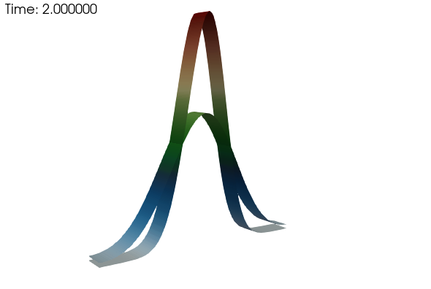
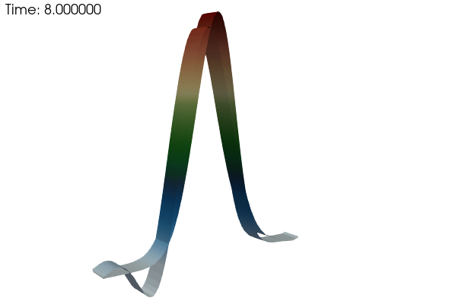
Dissipation and Dispersion Error: Review
Recall, in our modified one-dimensional advection of a passive scalar, we had two types of errors that manifested depending on the underlying numerical approach:
Dissipative-like error:
Dispersion-like error:

Slide 3
Hybrid-Based Blending
For our general temporal advection/diffusion/source equation, can we define an improved, automatic blended approach between central and upwind?
Recall, the advection operator was:
With (for central, or Galerkin):
And (for first-order upwind):
We can define a blended operator as well:

Slide 4
Functional form for η – Linked to Peclet number, Pe Many ad-hoc choices, however, a common physical approach is tanh
- peclet_function_form:
velocity: tanh
mixture_fraction: tanh
- peclet_function_tanh_transition:
velocity: 5000.0
mixture_fraction: 2.0
- peclet_function_tanh_width:
velocity: 200.0
mixture_fraction: 4.0

Slide 5
Hybrid-Blending Sanity Check
Consider a simple fluids case where we have air (298.15K) flowing 1 m/s in a 1 m³ domain
For Pe = 2 at each element, we would require ~0.03 m resolution, or a mesh of size: ~35,000
Consider a simple fluids case where we have air (298.15K) flowing 10 m/s in a 1 m³ domain
For Pe = 2 at each element, we would require ~0.003 m resolution, or a mesh of size: ~35,000,000
In general, this constraint results in extremely high mesh counts for most all practical flow configurations; for turbulent regimes, we would quickly revert to η = unity
Moreover, as presented, we are blending with upwind – an operator that we have already shown to be overly diffuse and non-energy conserving

Slide 6
Monotonic Issues at High Pe: Simple Matrix Analysis
Consider our passive scalar concentration whose natural range (as a mass fraction) is bounded between zero and unity, here, shown as a stationary transport equation:
Using our CDS and standard diffusion operator yields the following matrix system:
With coefficients, and:
Substituting: and defining:
Yields:
u_{x}
i-1
i
i+1
Positive for Pe < 2
For Pe < 2, the value of the scalar at node i is a linear combination of the neighboring values

Slide 7
Monotonic Issues at high Pe: Alternative View (Diagonal Dominance)
Define Diagonal Dominance as:
For a monotonic operator and ease of solving the linear system, diagonal dominance is desired
In our advection/diffusion case, this is expressed as:
Which, again, is only ensured when the Peclet number is less than two

Slide 8
Monotonic Issues Resolved When Using First-order Upwind
u_{x}
i-1
i
i+1
However, at what price?
Positive for all Pe
Fully bounded with
diagonal dominance
First-order, upwind (FOUPW)
Volume-of-fluid example (Domino and Horne, Renew. Ener. 2022)

Slide 9

Alternatives to First-order Upwind: Higher-order Upwind
The remaining set of slides are algebra-intensive!
We do not intend for you to memorize these upcoming formulas, only the philosophy by which they are derived

Slide 10
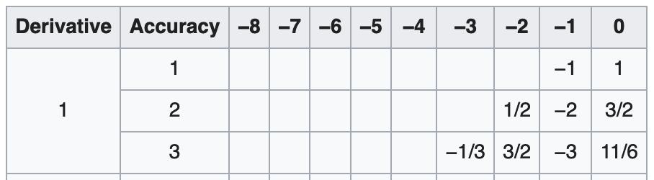
Alternatives to First-order Upwind: Higher-order Upwind
Recall, that in the finite difference context, we could increase the upwind stencil to increase accuracy, e.g.,
For fluids: Varying reconstruction approaches:
Essentially Non-oscillatory (ENO)
A. Harten, B. Engquist, S. Osher and S. Chakravarthy, Uniformly high order essentially non-oscillatory schemes, III, Journal of Computational Physics, 71:231-303, 1987.
Weighted-ENO (WENO)
3rd-order, Liu, X., Osher, S. and Chan, T. (1994) Weighted Essentially Non-Oscillatory Schemes. Journal of Computational Physics, 115, 200-212. https://doi.org/10.1006/jcph.1994.1187
Arbitrary-order, G. Jiang and C.-W. Shu, Efficient implementation of weighted ENO schemes, Journal of Computational Physics, 126:202-228, 1996.
u_{x}
i-2
i-1
_{φι-1/2}
i
_{φι+1/2}
i+1
i+2

Slide 11
ENO and WENO Concept
i-2
_{φι-1 1/2}
i-1
_{φι-1/2}
i
_{φι+1/2}
i+1
_{φι+1 1/2}
i+2
Define a suite of re-constructions that each provide 3rd-order accuracy:
The above are simply defined by each of the three-point stencils, e.g.,
(i-2, i-1, i), (i-1, i, i+1) and (i, i+1, i+2)
We can also define a fifth-order scheme:
This stencil can be reconstructed based on linear weights, γ:
Or a convex-combination of weights: (sum to unity):
The weights, w_{1,2,3}, are a function of a “smoothness” factor (β_{1,2,3}) that are dynamically selected

Slide 12
Alternatives to First-order Upwind: Higher-order Upwind – But how on an unstructured mesh?
For an unstructured setting, the former approach is not easily achieved due to the reduced stencil connectivity
Recall, we are looping edges (as shown), or elements
How to proceed with reconstructing data that is outside the immediate connectivity?
Ideas?

Slide 13
Alternatives to First-order Upwind: Higher-order Upwind – But how on an unstructured mesh?
For an unstructured setting, the former approach is not easily achieved due to the reduced stencil connectivity
Recall, we are looping edges (as shown), or elements
How to proceed with reconstructing data that is outside the immediate connectivity?
Ideas?
Hint… Can we look towards the projected nodal gradient to effectively increase the stencil?

Slide 14
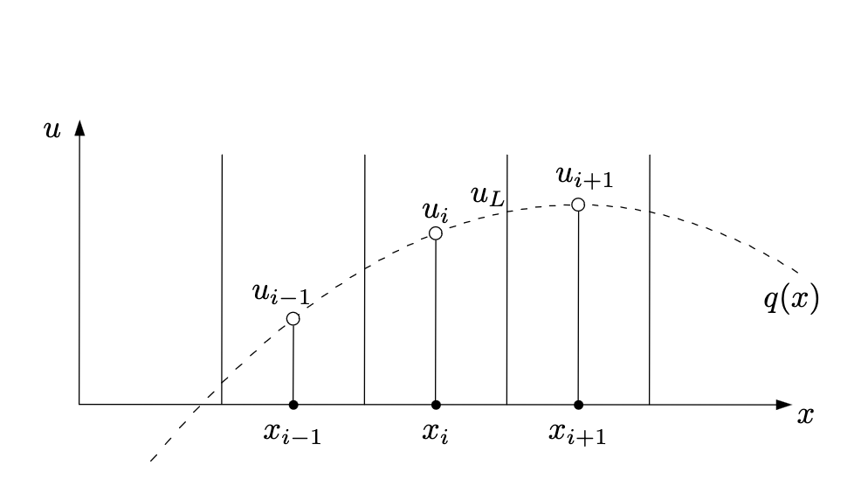
General Kappa-Method of Hirsh Numerical Computation of Internal and External Flows, vol. 2, John Wiley & Sons, 1990
For the edge defined by the i and i+1 node, define a Left and Right state:
For κ = +1, we simply revert to CDS
For κ = -1, Second-order upwind
For κ = 2/3, QUICK (Leonard, “A stable and accurate convective modelling procedure based on quadratic up-stream interpolation”, Comput. Methods Appl. Mech. Eng. 19 (1979) 59–98.)
Quadratic basis (three-points required)

Slide 15
Kappa = 0 Method of Hirsh Numerical Computation of Internal and External Flows, vol. 2, John Wiley & Sons, 1990.
For κ = 0, recast as: (Algebra…..)
Where,
Above, define a “limiter” function that “senses” when the solution is smooth (tends towards unity) and when the solution is oscillatory (tends towards zero)
G_{j} is the projected nodal gradient at each node (or cell-center) that is treated in a deferred-correction context, i.e., this quantity is lagged from the previous iteration
So-called “gradient reconstruction” schemes
Reconstruct a higher-order stencil through extrapolation
Derived by substituting κ = 0, and
using the projected nodal gradient
definition – or – just by noting an
extrapolation using a gradient

Slide 16
Classic Flux Limiters Van Leer, B. (1974), "Towards the ultimate conservative difference scheme II. Monotonicity and conservation combined in a second order scheme", J. Comput. Phys., 14 (4): 361–370
Consider our standard three-point stencil obtained by iterating edge 1 and 2
In the above stencil, we are stressing that when iterating edge 2, we do not have information easily obtain for edge 1 (shown above as a dashed line); (speaking from an unstructured perspective)
Above, the “LOW” and ”HIGH” are any operators that you select, e.g.,
u_{x}
i-1
_{φι-1/2}
i
_{φι+1/2}
i+1
Edge 1
Edge 2
Monotonic upstream-centered
scheme for conservation laws (MUSCL)

Slide 17
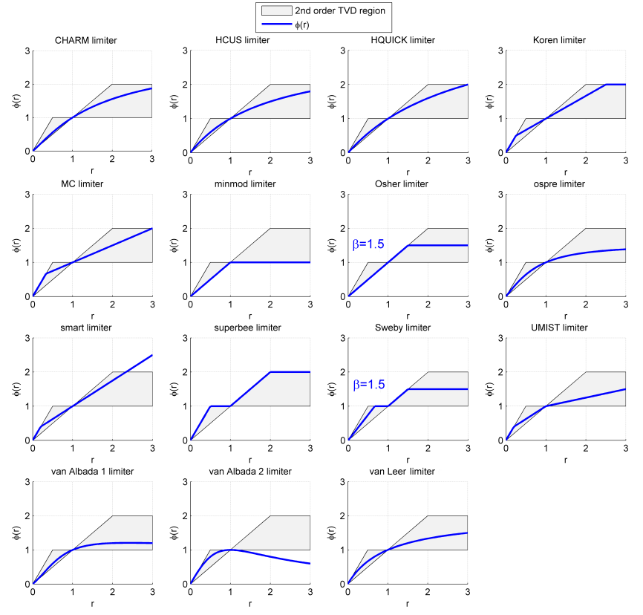
Flux Limiter Definition
Sweby (1984) defined set of permissible limiter regions for the desired second-order accurate methods: A sampling of the Sweby Diagram
For a monotonically increasing function, TV(φ) = |φ₁ −φ_{N} |. Note that if φ₁ and φ_{N} are taken constant, then, as long as the function remains monotonic the total variation is constant
However, if TV(φ) increases, then this suggest oscillations in the solution have occurred
Superbee:
Van Leer:
Symmetry property:
Total Variation:
Sweby's 2nd order TVD region. Created in Matlab. Griffgruff 18:37, 11 October 2006 (UTC)

Slide 18
Blending Approaches to Arrive at Pseudo Higher-order Methods: Upwind and Central
Define an upwind operator now at an arbitrary integration point:
And for a generalized CDS scheme:
Two new blending parameters: α_{upw} and α

Slide 19
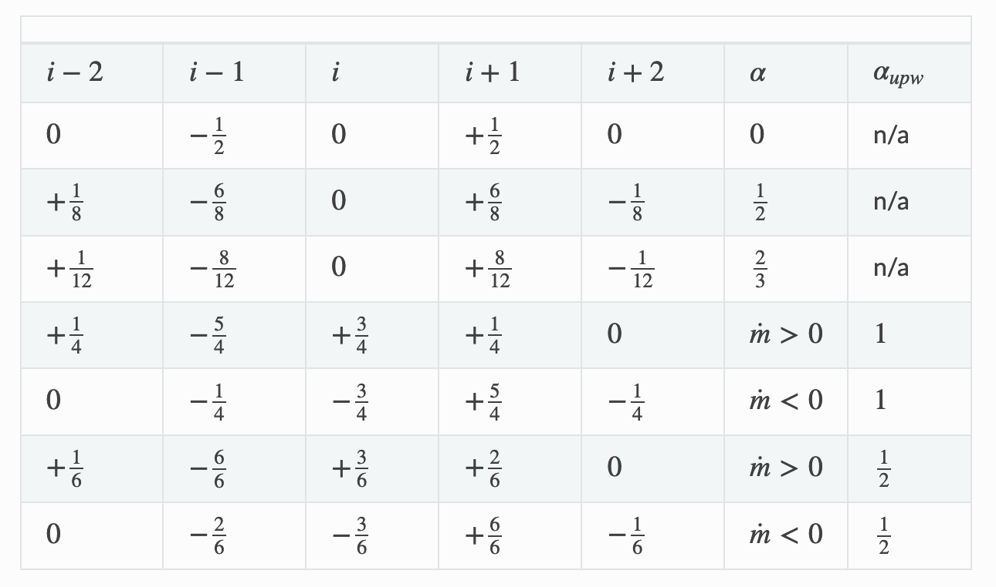
The Idealized Stencil Set
With Nalu input file specifications
- alpha_upw:
velocity: 1.0
- alpha:
velocity: 1.0
- upw_factor:
velocity: 1.0
- limiter:
velocity: [yes/no]
(zero reverts
to first-order)

Slide 20
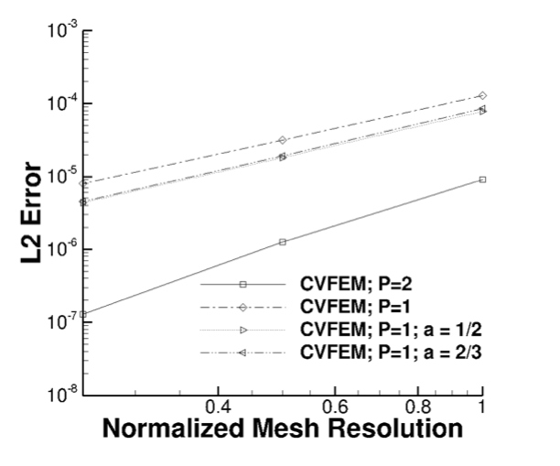
Pseudo 4th order Verification Results
Verification using Central (linear and quadratic) compared to pseudo 4th order
Lower error, however, formally second-order accurate

Slide 21
Conclusions
Central, or Galerkin-based advection operators are accurate, however, at high cell Peclet numbers, admit non-physical oscillations
Upwinding circumvents the oscillatory behavior at the cost of accuracy and conservation of energy-like variables
On unstructured meshes, extracting a full stencil can be difficult for higher-order upwind, hence, gradient reconstruction is used
The usage of limiters sense oscillatory behaviors and, therefore, shifts to upwind-based methods
Several limiter choices are available and can be ad-hoc in nature

