Slide 1
ME469: Boundary Conditions
Stefan P. Domino^{1,2}
¹ Computational Thermal and Fluid Mechanics, Sandia National Laboratories
² Institute for Computational and Mathematical Engineering, Stanford
SAND2018-4536 PE

Slide 2
Review of Discretization Options: New, emphasis on boundaries…
Degree-of-freedom (DOF) for:
Cell-centered: Stencil is based on a element:face:element
DOFs at vertices of elements, or “nodes”, element:node (CVFEM, FEM), edge:node (EBVC)
Definition of an interpolation function:
is the Lagrange function associated with node n
is the value of the DOF at node n
The nodal basis functions obey equipartition of unity and satisfy,

Slide 3
Review of Discretization Options: New, emphasis on boundaries…
Degree-of-freedom (DOF) for:
Cell-centered: Stencil is based on a element:face:element
DOFs at vertices of elements, or “nodes”, element:node (CVFEM, FEM), edge:node (EBVC)
Definition of an interpolation function:
is the Lagrange function associated with node n
is the value of the DOF at node n
The nodal basis functions obey equipartition of unity and satisfy,

Slide 4
Integration Over the Domain: The ”Finite” in Finite-Volume and Finite Element
Consider a simple model equation with the heart domain in mind:
Integrating over the entire domain, Ω:
Without loss of generality, let us define a set of subdomains, Ω_{k}:
As present, only volumetric integrals appear
Where F_{j} is a flux and S is a source term
Note:
The formality of Σ_{k} and Ω_{k} is implied to exist over the full domain and is often times dropped – integral type implied by dV (volume) and dS (domain boundary)

Slide 5
Integration Over the Domain: The ”Finite” in Finite-Volume and Finite Element
Consider a simple model equation with the heart domain in mind:
Integrating over the entire domain, Ω:
Without loss of generality, let us define a set of subdomains, Ω_{k}:
As present, only volumetric integrals appear
Where F_{j} is a flux and S is a source term
Note:
The formality of Σ_{k} and Ω_{k} is implied to exist over the full domain and is often times dropped – integral type implied by dV (volume) and dS (domain boundary)

Slide 6
Towards Boundary Contributions
Given a partial differential equation (PDE) and associated volumetric form:
Applying Gauss Divergence provides the standard finite volume form for fluxes in surface integral form (no distinction between internal control volume faces and boundary faces):
We can also multiple PDE by an arbitrary test function, w, and integrate over a volume,
Next, integrate by parts and apply
Gauss-Divergence. Note, that test function must be differentiable – shown here, at least once..
Interior
Boundary

Slide 7
Towards Boundary Contributions
Given a partial differential equation (PDE) and associated volumetric form:
Applying Gauss Divergence provides the standard finite volume form for fluxes in surface integral form (no distinction between internal control volume faces and boundary faces):
We can also multiple PDE by an arbitrary test function, w, and integrate over a volume,
Next, integrate by parts and apply
Gauss-Divergence. Note, that test function must be differentiable – shown here, at least once..
Interior
Boundary

Slide 8
Cell-Centered vs Vertex-Centered Differences
For a CC scheme, boundary condition is flux-based, while for VC and FEM, there is an option of flux-based, i.e., “weak”, or Dirichlet, i.e., “strong”
CC
VC
FEM

Slide 9
For Example, a Cell-Centered Inflow Boundary
Consider an inflow boundary condition where the advection term is of interest
You may have a pipe flow with a given inflow velocity to match a Reynolds number:
A well-posed condition provides the inlet density, velocity and scalar values
Inflow

Slide 10
For Example, a Vertex-Centered (EBVC/CVFEM) Inflow Boundary Flux-based (Weak treatment)
Consider an inflow boundary condition where the advection term is of interest
You may have a pipe flow with a given inflow velocity to match a Reynolds number:
A well-posed condition provides the inlet density, velocity and scalar values
Inflow

Slide 11
For Example, a Vertex-Centered (EBVC/CVFEM) Inflow Boundary Dirichlet-based (Strong treatment)
Consider an inflow boundary condition where the advection term is of interest
You may have a pipe flow with a given inflow velocity to match a Reynolds number:
A well-posed condition provides the inlet density, velocity and scalar values
Inflow
Dirichelt conditions are applied when you
know the precise value at the boundary,
i.e., an inflow, or a wall
Often times, boundary conditions are
naturally flux-based, e.g., at an adiabatic
wall you know the heat flux, open-bc
(zero flux), etc.

Slide 12
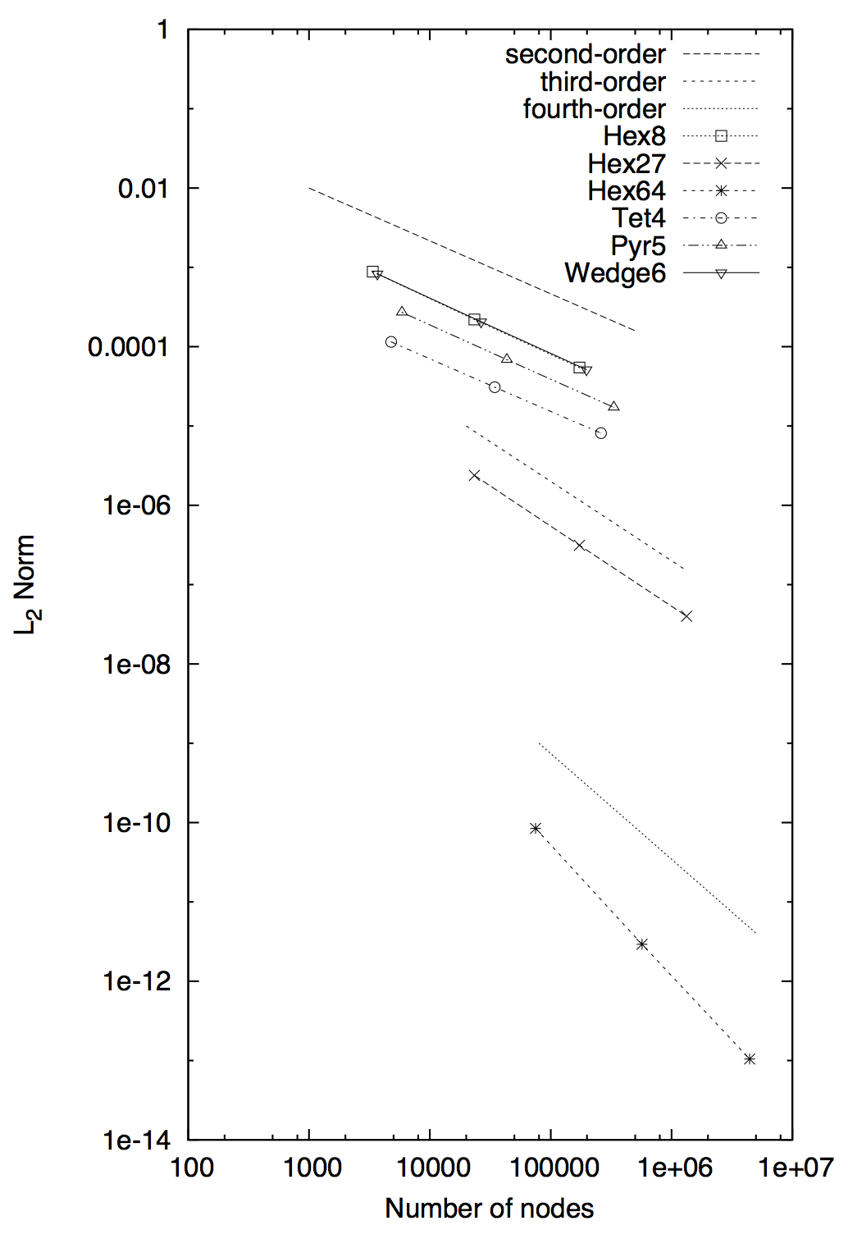
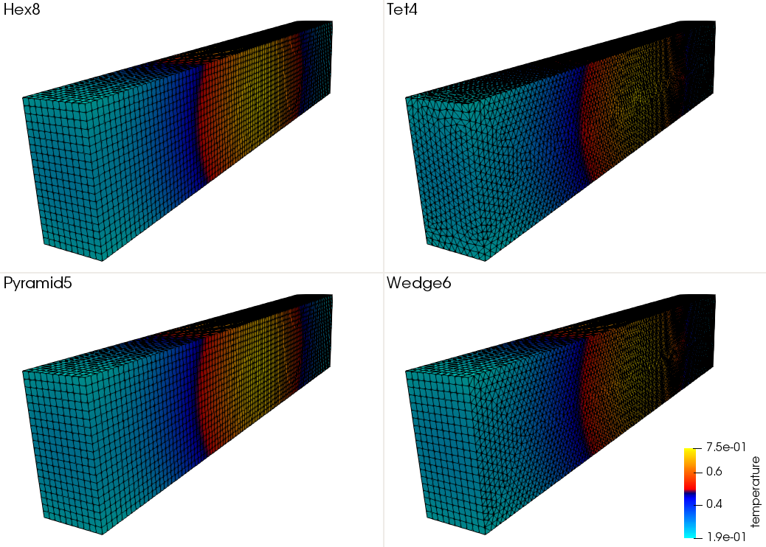
Weak vs Strong: A Practical Heat Conduction Example
Consider a simple heat conduction solution in which temperature is known at the boundaries, T = T^{spec}
Governing Equation:
It can be shown (see Svard and Nordstrom, JCP, 2008) that a stable and accurate weak BC implementation is provided by:
Consider the MMS temperature solution (and convergence to the right):

Slide 13
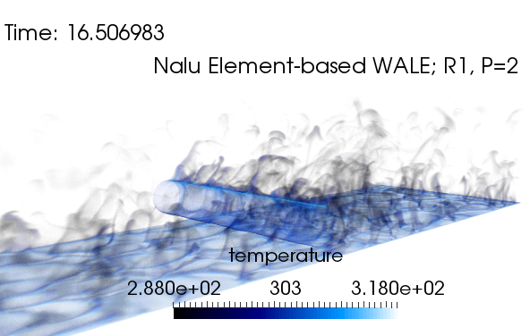
Types of Boundary Conditions in Practical CFD
Flow-past a heated cylinder
Symmetry, “flow slips along” (normal stress pn_{i}dS applied with tangential stress = 0)
Open
(known P and far field temperature, zero normal gradient assumption)
Inflow
(known T and u_{i})
Span-wise periodic
Wall (known T and u_{i})

Slide 14
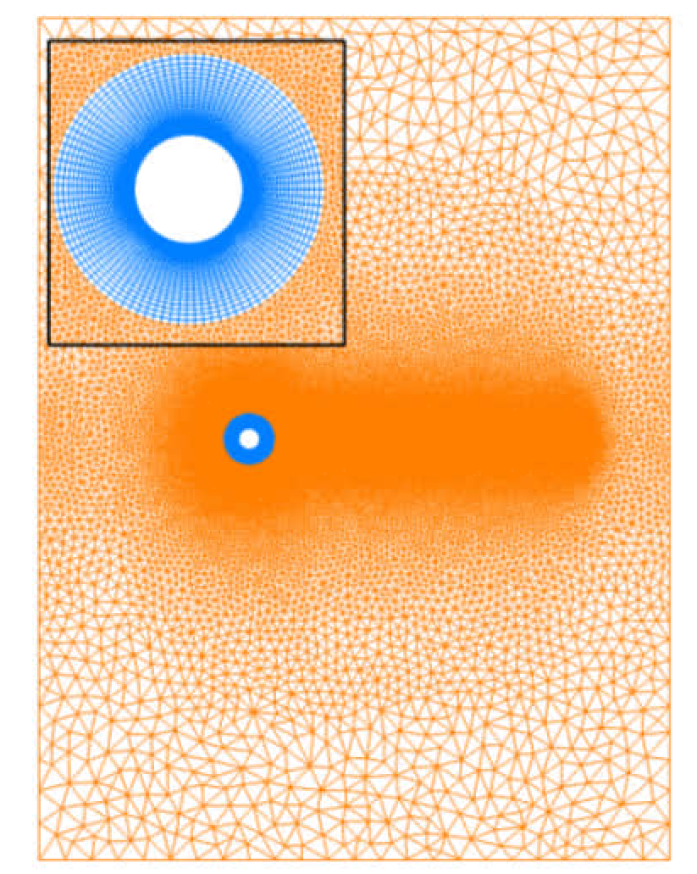
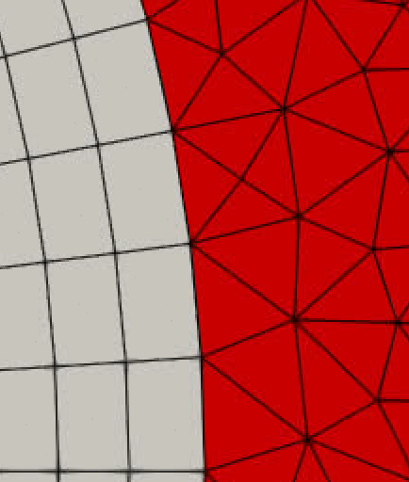
Types of Boundary Conditions in Practical CFD
Flow past a 2-dimensional cylinder (the midterm assignment)
Symmetry, “flow slips along” (normal stress pn_{i}dS applied with tangential stress = 0)
Open
(known P and far field mixture fraction, zero normal gradient assumption)
Inflow
(known u_{i})
Conformal boundary at the Quad4/Tri3 interface, hence, no boundary procedure is required
Wall (known Z and u_{i} )

Slide 15
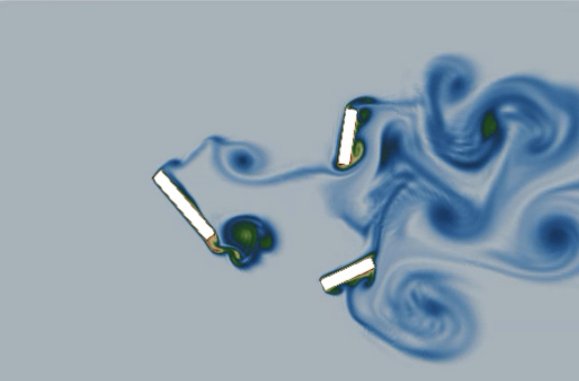
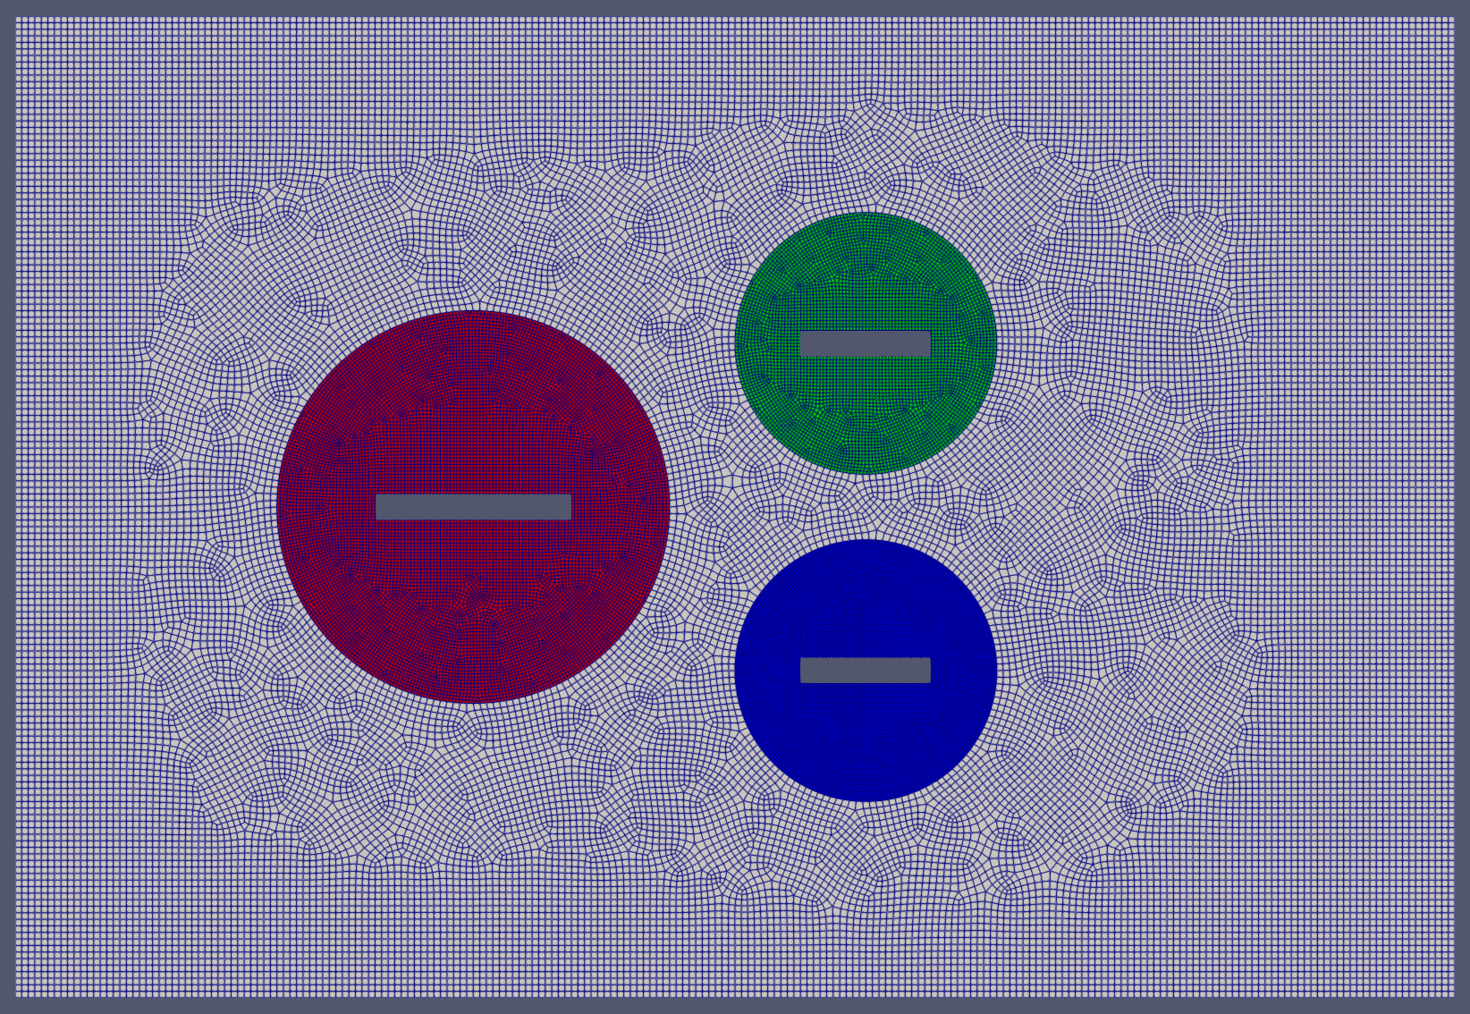
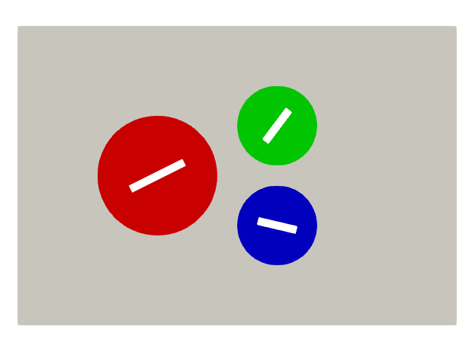
Types of Boundary Conditions in Practical CFD
Flow past a series of rotating blades: Zero normal gradient at open bc?
Symmetry
Non-conformal
Inflow
Open
Wall (spinning)

Slide 16
Mathematical Description
See: https://nalu.readthedocs.io/en/latest/source/theory/boundaryConditions.html

