Slide 1
ME469: Common Discretization Approaches
Stefan P. Domino^{1,2}
¹ Computational Thermal and Fluid Mechanics, Sandia National Laboratories
² Institute for Computational and Mathematical Engineering, Stanford
SAND2018-4536 PE

Slide 2
Lecture Objectives
The Concept of Meshing and Solving a Simple Model Equation
Why Unstructured?
Unstructured Element Types
Cell-centered Finite Volume (FV)
Edge-based Vertex-Centered (EBVC)
Control-Volume Finite Element Method (CVFEM)
Finite Element Method (FEM)
Staggered arrangement

Slide 3
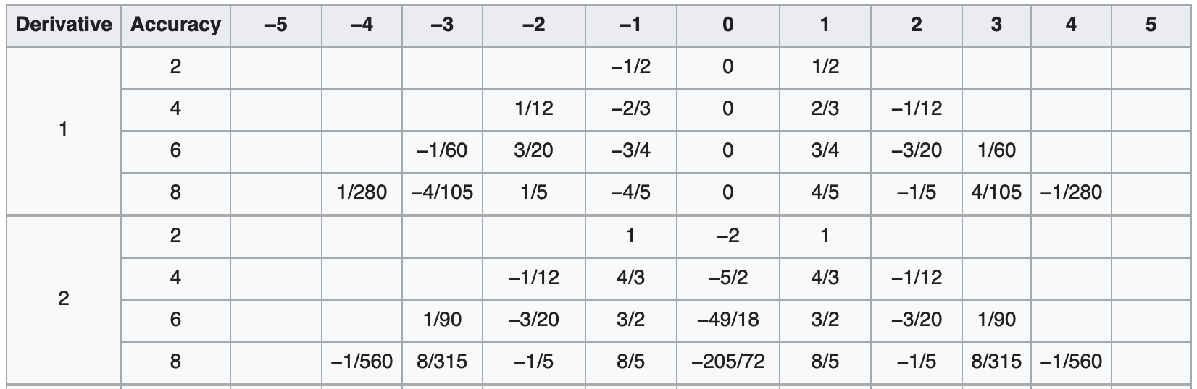
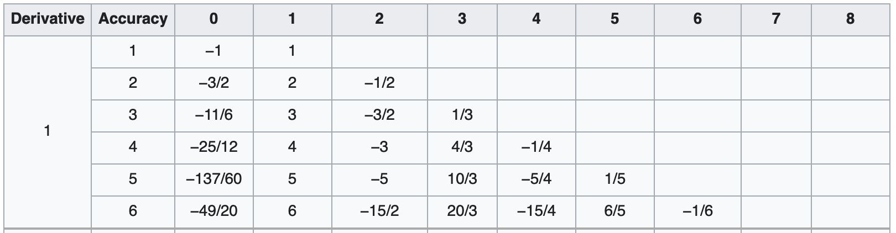
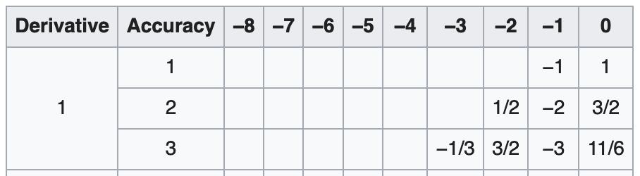
Recall, our Simple Model Equation
With terms: time, advection and diffusion
For a finite difference, centered (2nd order stencil), the continuous PDE can be discretized as:
Noting, above the n+1 fully implicit approach that is solved over the finite difference “mesh”
What is an alternative? Finite-volume/element…..
Central finite difference
Forward finite difference
J-2
J-1
j
J+1
J+2
Backward finite difference

Slide 4
Introducing a Mesh over Heart Domain, Ω
Geometry is:
Complex
Curved
Sharp

Slide 5
Re-introducing a [Finite Difference] Mesh over Heart Domain, Ω
Geometry is:
Complex
Curved
Sharp

Slide 6
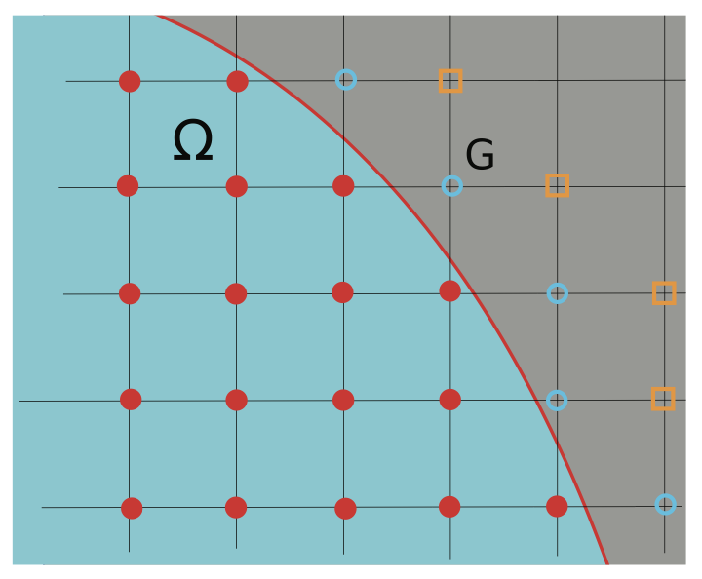
Re-introducing a [Finite Difference] Mesh over Heart Domain, Ω
Geometry is:
Complex
Curved
Sharp
Not impossible: Chertock, et al., “A Second-Order Finite-Difference Method for Compressible Fluids in Domains with Moving Boundaries”, Commun. Comput. Phys., 2018

Slide 7
Introducing a [Structured Mesh] over Heart Domain, Ω;
Geometry is:
Complex
Curved
Sharp

Slide 8
Introducing a [Structured Mesh] over Heart Domain, Ω;
Geometry is:
Complex
Curved
Sharp

Slide 9
Introducing a [Structured Mesh] over Heart Domain, Ω;
Geometry is:
Complex
Curved
Sharp

Slide 10
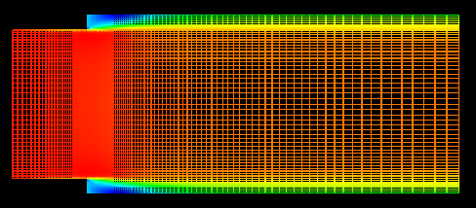
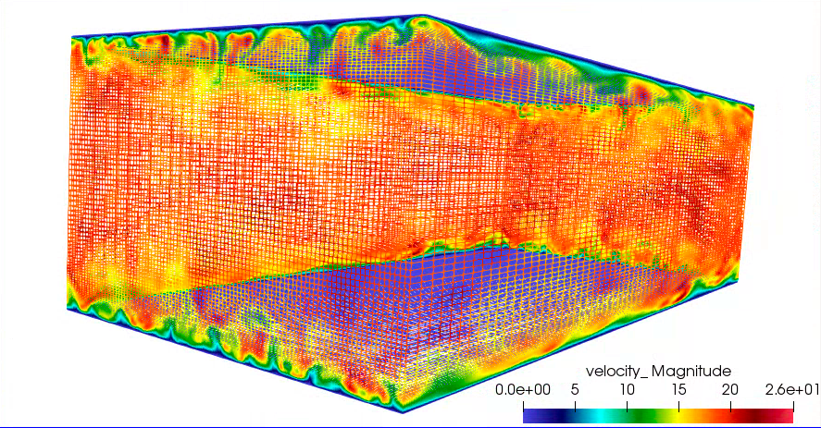
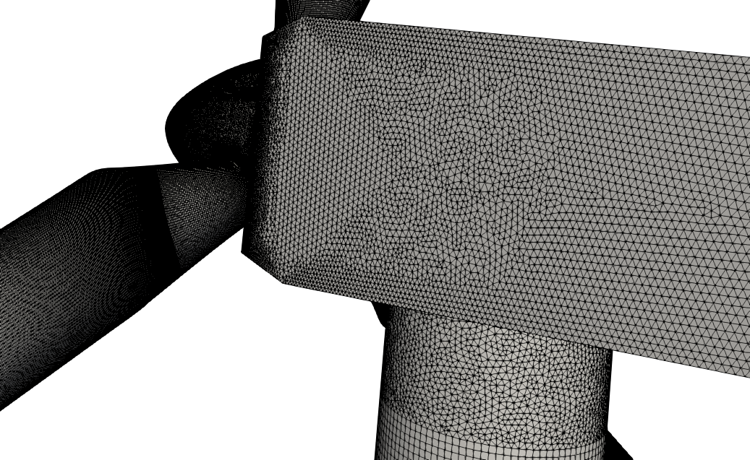
Structured vs Unstructured
Many times, canonical flows of interest are represented by simplified geometries that allow for cartesian meshes – with “stair-stepping”
RANS-based backward facing step (Domino, 2012)
Re^{τ} 395 plane-channel (Jofre, Domino, Iaccarino, 2018)
Often times, not!
https://www.itascainternational.com/software/introduction-to-meshing

Slide 11
Example: The Carbon-Capture Multidisciplinary Simulation Center
15MW coal-fired boiler volume rendered image of large (90 μm) particles
Staggered schemes have been demonstrated to support complex applications
Cut-cells and embedded approaches help
http://ccmsc.utah.edu/about.html

Slide 12
Attributes of an Element
An element consists of nodes, edges, and faces
face
centroid
edge
Hex8, i.e., eight-node hexahedron
8 nodes
6 faces
12 edges
node (or vertex)

Slide 13
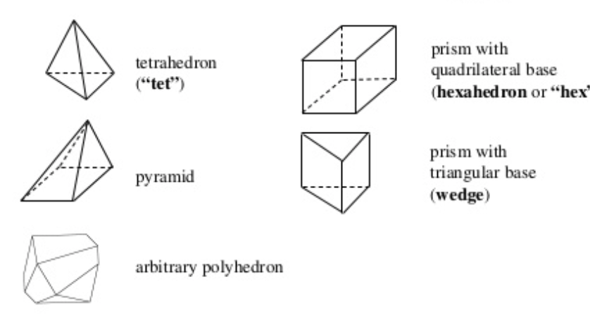
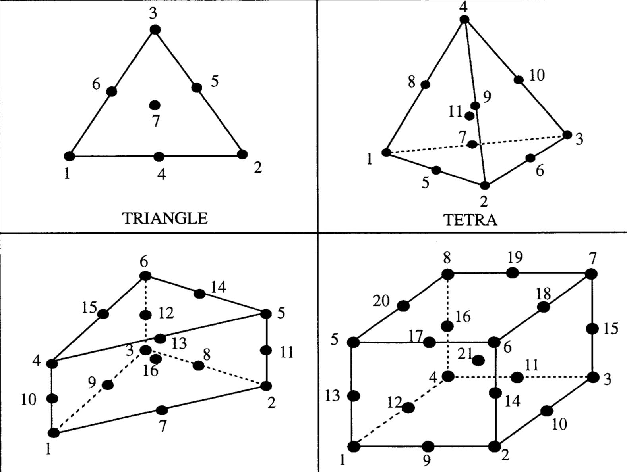
Examples of Various Topologies
Hex8
Tet4
Pyramid5
Wedge6
Arbitrary
Higher-order promoted elements (Hex27, Tet10, Wedge16, Hex64, etc.)

Slide 14
Introducing a Mesh over Heart Domain, Ω
Elements of size 4 (Quad4) or 3 (Tri3) have been introduced
Exterior domain is faceted
Non-conformal interface between the Tri3 and Quad4 block
Two types of connectivity have been presented: node:element and element:face:element
Two types of integration: Ω^{e} vs Ω^{cv}

Slide 15
Integration Over the Domain: The ”Finite” in Finite-Volume and Finite Element
Consider a simple model equation with the heart domain in mind:
Integrating over the entire domain, Ω:
Without loss of generality, let us define a set of subdomains, Ω_{k}:
As present, only volumetric integrals appear
Where F_{j} is a flux and S is a source term
Note:
The formality of Σ_{k} and Ω_{k} is implied to exist over the full domain and is often times dropped – integral type implied by dV (volume) and dS (domain boundary)

Slide 16
Data Structure Ramifications: A bit more complex…
temperature(i,j)
Element and associated data structures are indexed directly via i^{th} and j^{th} location, e.g., temperature (i,j), over the range: temperature(0:nX-1,0:nY-1)
Neighbors are directly indexed, e.g,, “north” neighbor of (i,j) is (i,j+1)
Element and associated data structures are indexed indirectly via a data structure, e.g., temperature(k), over the range: temperature(0:nElem-1)
Nodes of element(k) are obtained via connectivity relationship mappings
std::vector<mesh_type> nodes = elem_nodes (k)
Nodal fields, for element k via:
pressure = field_data(nodes[0,..,numElem)

Slide 17
Fundamentals of Discretization: Surface vs Volume Integrations
Given a partial differential equation (PDE) and associated volumetric form:
Applying Gauss Divergence provides the standard finite volume form for fluxes in surface integral form (no distinction between internal control volume faces and boundary faces):
We can also multiple PDE by an arbitrary test function, w, and integrate over a volume,
Next, integrate by parts and apply
Gauss-Divergence. Note, that test function must be differentiable – shown here, at least once..
Interior
Boundary

Slide 18
Define a Stencil: Element:Face:Element
Cell-centered, finite volume (shaded region)
Degree of freedom (DOF), i.e., solution, resides at the centroid of the element

Slide 19
Define a Stencil: Element:Face:Element
Cell-centered, finite volume (shaded region)
Degree of freedom (DOF), i.e., solution, resides at the centroid of the element
face
(in 2D, also an edge)
centroid
(DOF)
element

Slide 20
Define a Stencil: Element:Face:Element
Cell-centered, finite volume (shaded region)
Degree of freedom (DOF), i.e., solution, resides at the centroid of the element
Connected
DOFs

Slide 21
Define a Stencil: Element:Face:Element
Cell-centered, finite volume (shaded region)
Degree of freedom (DOF), i.e., solution, resides at the centroid of the element
Surface integration
points

Slide 22
Define a Stencil: Element:Face:Element
Cell-centered, finite volume (shaded region)
Degree of freedom (DOF), i.e., solution, resides at the centroid of the element
Volume integration
point

Slide 23
Define a Stencil: Node:Edge:Node
Edge-based, vertex (or node)-centered finite volume (shaded region)
Degree of freedom, i.e., solution, resides at the node, or vertex

Slide 24
Define a Stencil: Node:Edge:Node
Edge-based, vertex (or node)-centered finite volume (shaded region)
Degree of freedom, i.e., solution, resides at the node, or vertex
node
(vertex of an element)
edge
(of an element

Slide 25
Define a Stencil: Node:Edge:Node
Edge-based, vertex (or node)-centered finite volume (shaded region)
Degree of freedom, i.e., solution, resides at the node, or vertex
Connected
DOFs

Slide 26
Define a Stencil: Node:Edge:Node
Edge-based, vertex (or node)-centered finite volume (shaded region)
Degree of freedom, i.e., solution, resides at the node, or vertex
Surface integration
points

Slide 27
Define a Stencil: Node:Edge:Node
Edge-based, vertex (or node)-centered finite volume (shaded region)
Degree of freedom, i.e., solution, resides at the node, or vertex
Volume integration
point

Slide 28
Define a Stencil: Node:Element:Node
Choice #1, Element-based, vertex (or node)-centered finite volume (shaded region)
Degree of freedom, i.e., solution, resides at the node, or vertex

Slide 29
Define a Stencil: Node:Element:Node
Choice #1, Element-based, vertex (or node)-centered finite volume (shaded region)
Degree of freedom, i.e., solution, resides at the node, or vertex
Surface integration
points

Slide 30
Define a Stencil: Node:Element:Node
Choice #1, Element-based, vertex (or node)-centered finite volume (shaded region)
Degree of freedom, i.e., solution, resides at the node, or vertex
Volume integration
points

Slide 31
Define a Stencil: Node:Element:Node
Choice #2, Element-based, finite element
Degree of freedom, i.e., solution, resides at the node, or vertex

Slide 32
Define a Stencil: Node:Element:Node
Choice #2, Element-based, finite element
Degree of freedom, i.e., solution, resides at the node, or vertex
Volume integration
points

Slide 33
VOF Transport Discretization Nuance: Volume- or Surface-based?
Simple enough, define the volume (fraction) of fluid (absent evaporation):
Option 1: volumetric-form:
Option 2: divergence-form:
CVFEM/FEM (really, any element-based approach)
Evaluated as a volumetric-contribution (diamonds)
Gauss-Divergence
Traditional finite volume (element, edge, cell-centered)
Evaluated as a surface integral (triangle)
Allows for a consistent advecting velocity (mass conserving)
that is obtained from the continuity equation

Slide 34
Linking to 1d_quad4_adv_diff
Recall, the transport equation for the 1d_quad4_adv_diff laboratory exercise is as follows:
where
For now, let’s focus on the advection term. We know that we can integrate over the volume and simply compute this term at the volume integration points,
Option: scv_advection_np
As with the volume of fluid equation on the previous slide, we can also write this term as:
that can be simplified (for constant velocity)
Option: scs_advection_np (or scs_upw_advection_np)

Slide 35
Linking to 1d_quad4_adv_diff
Recall, the transport equation for the 1d_quad4_adv_diff laboratory exercise is as follows:
where
For now, let’s focus on the advection term. We know that we can integrate over the volume and simply compute this term at the volume integration points,
Option: scv_advection_np
As with the volume of fluid equation on the previous slide, we can also write this term as:
that can be simplified (for constant velocity)
Option: scs_advection_np (or scs_upw_advection_np)
Q: Is this really simple for all
of the schemes we have discussed?

Slide 36
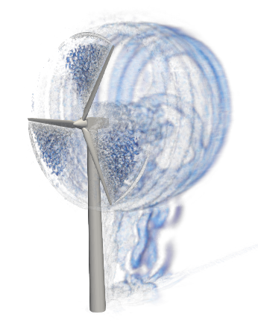
Reality: Meshing time for complex applications remains a significant bottleneck!
Many applications of interest contain complex geometries low-Mach fluids users interested in high-quality simulation results tend towards hexahedral-based topologies (if possible)
However, if a scheme is “design-order” accurate, any topology may suffice as it is simply a matter of mesh size and efficiency – not unlike the active discussion on low- vs higher-order
Sometimes, the penetration of a low-Mach fluids physics addition in common analysis is high as the meshing can be prohibitively complex
Example: Vestas V27 225 kw hybrid low-order Hex8/Tet4/Pyr5/Wedge6
Very complex world – stair-stepped!

Slide 37
Classic Staggered Finite Volume
Stencil for CC-quantities
Stencil for x-velocity
Velocity degree-of-freedom is staggered relative to pressure and other primitives, e.g., enthalpy, mixture fraction, etc.
Stencil for y-velocity
P_{N}
P_{S}

Slide 38
Attributes of a Staggered Scheme
By design, non-orthogonality is absent, however, complex geometry will be stair-stepped
From a fluids perspective, the operators are ideal, i.e., pressure gradient for momentum is compact, e.g., (P_{E} – P_{W})Δx⁻¹
As will be seen in future lecture topics, the skew-adjoint nature of the Divergence operator, D, and Gradient operator, G, allows for a Laplace operator, L = DG
Can be extended to higher-order
Frequently, meshing complex geometries can be extremely difficult (consider our V27 example)

Slide 39
An Informal Survey….
Cell-Centered: (Sometimes generalized Polyhedra)
Ansys Fluent, OpenFOAM (FireFOAM, NavyFOAM), CD-Adapco (Star-CCM), Soleil-X (Stanford)
EBVC: (Most typical in the acoustically compressible space)
SU2, FUN3D, CHAD, Nalu-Wind (production), Nalu (option to explore discretizations)
CVFEM
Fluent (originally!), CFX-TASC-FLOW, Sierra Fuego (SNL), Nalu
FEM
FIDAP, COMSOL, EDDY (NASA), AcuSim, PHASTA
Staggered
Arches (Utah)

Slide 40
An Informal Survey….
Cell-Centered: (Sometimes generalized Polyhedra)
Ansys Fluent, OpenFOAM (FireFOAM, NavyFOAM), CD-Adapco (Star-CCM), Soleil-X (Stanford)
EBVC: (Most typical in the acoustically compressible space)
SU2, FUN3D, CHAD, Nalu-Wind (production), Nalu (option to explore discretizations)
CVFEM
Fluent (originally!), CFX-TASC-FLOW, Sierra Fuego (SNL), Nalu
FEM
FIDAP, COMSOL, EDDY (NASA), AcuSim, PHASTA
Staggered
Arches (Utah)
Common Water-Cooler CFD Arguments:
Structured vs. Un-structured
FEM vs. Finite Volume
Node-centered vs. Cell-centered
Monolithic vs. Operator Split
Compressible vs. (acoustically) Incompressible
Explicit vs. Implicit

Slide 41

An Informal Survey….
Cell-Centered: (Sometimes generalized Polyhedra)
Ansys Fluent, OpenFOAM (FireFOAM, NavyFOAM), CD-Adapco (Star-CCM), Soleil-X (Stanford)
EBVC: (Most typical in the acoustically compressible space)
SU2, FUN3D, CHAD, Nalu-Wind (production), Nalu (option to explore discretizations)
CVFEM
Fluent (originally!), CFX-TASC-FLOW, Sierra Fuego (SNL), Nalu
FEM
FIDAP, COMSOL, EDDY (NASA), AcuSim, PHASTA
Staggered
Arches (Utah)
Common Water-Cooler CFD Arguments:
Structured vs. Un-structured
FEM vs. Finite Volume
Node-centered vs. Cell-centered
Monolithic vs. Operator Split
Compressible vs. (acoustically) Incompressible
Explicit vs. Implicit

Slide 42
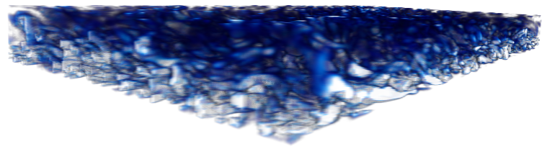
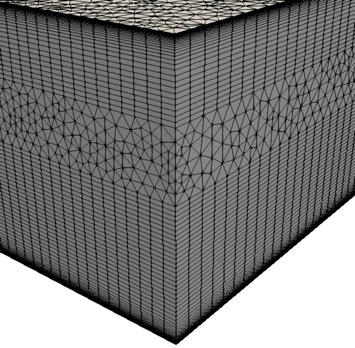
Hybrid Meshes, Even for LES!
Hybrid mesh study based on Ham and Iaccarino, CTR Annual Brief, 2006, found that simulations were extremely sensitive to mesh topology
Non-symmetric time mean flow found for cell-centered; better for the CTR node-centered formulation
Native CVFEM and EBVC are both symmetric in mean quantities
Domino, et. al, “The suitability of hybrid meshes for low-Mach large-eddy simulation” Stanford CTR Summer Program, 2018

Slide 43
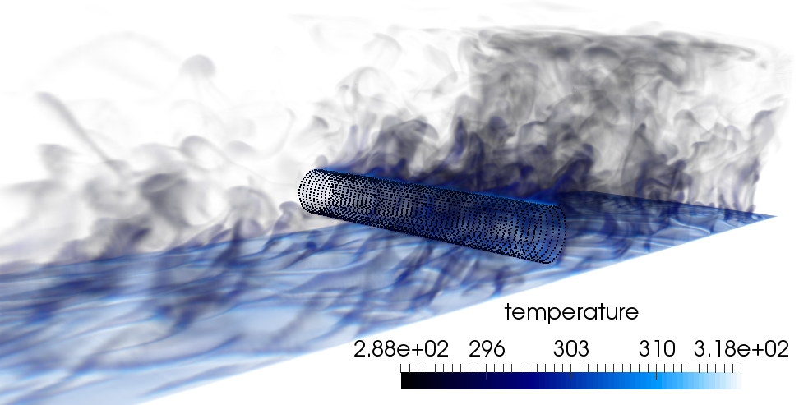
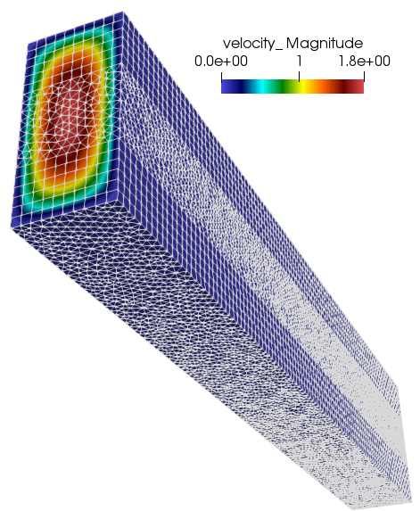
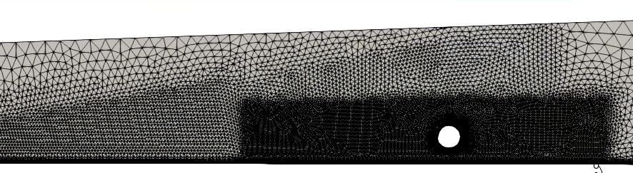
Recent Generalized Unstructured Findings
Domino, et. al, “An assessment of atypical mesh topologies for low-Mach large-eddy simulation”, Comput. Fluids (2019)

