Slide 1
ME469: Common Discretization Approaches: Edge-based,Vertex-Centered (EBVC), and Cell-Centered (CC)
Stefan P. Domino^{1,2}
¹ Computational Thermal and Fluid Mechanics, Sandia National Laboratories
² Institute for Computational and Mathematical Engineering, Stanford
SAND2018-4536 PE

Slide 2
Review of Discretization Options
Degree-of-freedom (DOF) for:
Cell-centered: Stencil is based on a element:face:element
DOFs at vertices of elements, or “nodes”, element:node (CVFEM, FEM), edge:node (EBVC)

Slide 3
Review of Discretization Options: New, a nodal-basis…
Degree-of-freedom (DOF) for:
Cell-centered: Stencil is based on a element:face:element
DOFs at vertices of elements, or “nodes”, element:node (CVFEM, FEM), edge:node (EBVC)
Definition of an interpolation function:
is the Lagrange function associated with node n
is the value of the DOF at node n
The nodal basis functions obey equipartition of unity and satisfy,

Slide 4
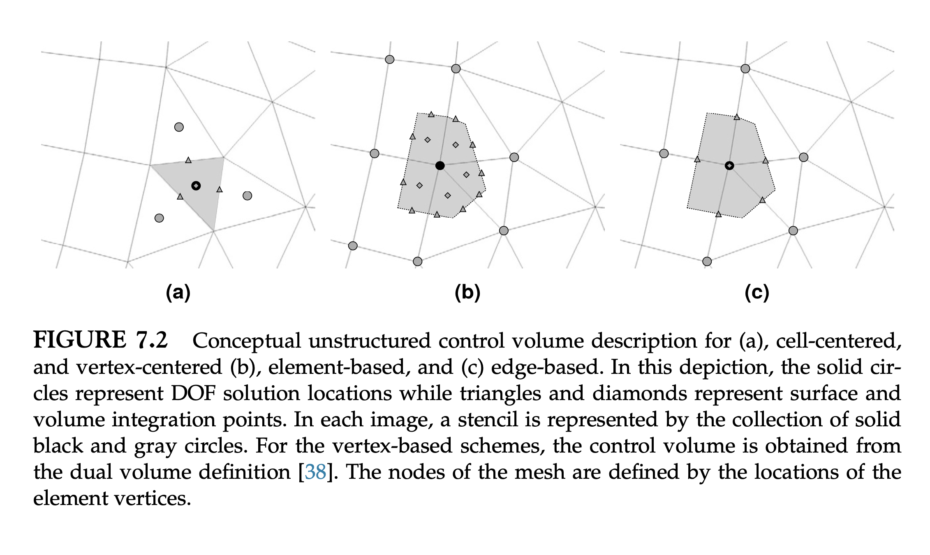
Three Finite Volume Stencils

Slide 5
Fundamentals of Discretization: Surface vs Volume Integrations
Given a partial differential equation (PDE) and associated volumetric form:
Applying Gauss Divergence provides the standard finite volume form for fluxes in surface integral form (no distinction between internal control volume faces and boundary faces):
We can also multiple PDE by an arbitrary test function, w, and integrate over a volume,
Next, integrate by parts and apply
Gauss-Divergence. Note, that test function must be differentiable – shown here, at least once..
Interior
Boundary

Slide 6
Cell-Centered (CC) and Edge-Based Vertex-Centered (EBVC): Each are generally a two-state scheme, Left (L) and Right(R)
CC (A) and EBVC (B) – As shown below, each have a set of common features
Class Discussion: What are the common features?
(A)
(B)

Slide 7
Cell-Centered (CC) and Edge-Based Vertex-Centered (EBVC): Each are generally a two-state scheme, Left (L) and Right(R)
CC (A) and EBVC (B) – As shown below, each have a set of common features
Class Discussion: What are the common features?
Volume integration
point (single)
(A)
(B)

Slide 8
Cell-Centered (CC) and Edge-Based Vertex-Centered (EBVC): Each are generally a two-state scheme, Left (L) and Right(R)
CC (A) and EBVC (B) – As shown below, each have a set of common features
Class Discussion: What are the common features?
Surface integration
point (single)
(A)
(B)

Slide 9
Cell-Centered (CC) and Edge-Based Vertex-Centered (EBVC): Each are generally a two-state scheme, Left (L) and Right(R)
CC (A) and EBVC (B) – As shown below, each have a set of common features
Class Discussion: What are the common features?
Surface integration
point (single)
Virtual edge
Connected by a left and right DOF-
Each at the control volume face
(A)
(B)

Slide 10
The Control Volume for CC is Defined by the Element Volume
All primitives are collocated at the cell-center of the element with equal-order interpolation
Classic two-state, “L” and “R” approach provides spatially second-order accuracy
Iterate Elements for volume-based contributions
Iterate Virtual-Edges or Control Volume Faces for surface-based contributions
T_{L}
T_{R}
n_{j}

Slide 11
The Control Volume for EBVC is Defined by the Dual-Volume
All primitives are collocated at the vertices of the elements with equal-order interpolation
A dual mesh is constructed to obtain flux and volume quadrature locations
Classic two-state, “L” and “R” approach provides spatially second-order accuracy
Iterate Nodes for volume-based contributions
Iterate Edges for surface-based contributions
Dual nodal volume
Area vector
T_{L}
n_{j}
T_{R}
Dual-volume definition
Edge-based stencil

Slide 12
One-Dimensional Example of a Non-Uniform Mesh
The nodes of the mesh need-not be equally spaced
node = 0
1
2
3

Slide 13
Control Volumes for CC and EBVC
Note: Switched depiction of node (or vertex) to the cell-centered location
node = 0
1
2
3
x
x
x
CC = 1
2
3
x
x
x
x

Slide 14
Control Volumes for CC and EBVC
Note: Switched depiction of node (or vertex) to the cell-centered location
node = 0
1
2
3
x
x
x
CC = 1
2
3
x
x
x
x

Slide 15
Control Volumes for CC and EBVC
Face-centered vs Cell-Centered
Face-centered
node = 0
1
2
3
x
x
x
CC = 1
2
3
x
x
x
x
Cell-centered

Slide 16
Basis Function Re-Visited
Define an isoparimetric base element that varies from -1:+1, with integration point at the location ξ:
Face-centered
node = 0
1
2
3
x
x
x
CC = 1
2
3
x
x
x
x
Cell-centered

Slide 17
Basis Function Re-Visited
Define an isoparimetric base element that varies from -1:+1, with integration point at the location ξ:
Face-centered
node = 0
1
2
3
x
x
x
1 2
x
2→3
ξ = 0
CC = 1
2
3
x
x
x
x
Cell-centered

Slide 18
Basis Function Re-Visited
Define an isoparimetric base element that varies from -1:+1, with integration point at the location ξ:
Face-centered
node = 0
1
2
3
x
x
x
1 2
x
2→3
ξ = 0
CC = 1
2
3
x
x
x
x
1 2
x
Cell-centered
2→3
ξ = 1/2

Slide 19
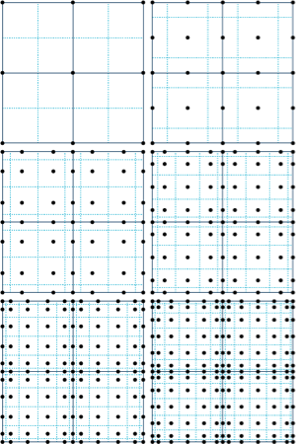
Other Examples of a Basis (This will become important for the element-based schemes)
Linear (Quad4)
1 3 2
Quadratic (Bar3)
Two-dimensional promotion

Slide 20
Model Passive Scalar Transport: Introducing the Test Function, w
Time/Src/Advection/Diffusion equation for scalar φ
Under the assumption, yields:
We can also integrate this PDE over the volume, while introducing a test function, w
The above is the so-called weak-form of the original (strong form) partial differential equation
The elegant concept of a weighted residual statement is to seek a weak solution such that the residual is orthogonal to a selected space of weight functions

Slide 21
Model Passive Scalar Transport: Integration-by-Parts
Recall, integration-by-parts, for example,
Note, that w must be differentiable at least once
Under the special designation of w to be a piecewise constant, or Heaviside function, the gradient of this is a (negative) Diract-delta function
A key property of this function is that the gradient of the piece-wise constant test function is a distribution of delta functions on the sub-control volume surface yielding,
Recall, we could have arrived at this form by simply usage of Gauss-Divergence, however, this formality allows us to view a finite volume scheme as a Petrov-Galerkin scheme, i.e., the underlying basis differs from the test function

Slide 22
Deep Dive on EBVC: Node and Edge-loops
EBVC is a discretization scheme that:
Uses a piecewise-constant test function
Is a two-state flux approach, with a face-centered arrangement
Iterates over locally-owned nodes for Time/Source/etc. (volumetric-based terms)
Iterates over locally-owned edges for Advection/Diffusion terms (surface-based terms)
n5
e3
n1 (L)
n2 (R)
n2 (L)
n3 (R)
n2
n1
n2
n3
e1
e2
e1
e2
Notes For Assembly Procedures:
Surface normal points from L to R nodes
Contributions added to the L, subtracted from the R
e4
n4

Slide 23
EBVC: Implicit Time Discretization
Let us define a general implicit time integrator that is A-stable
For y’ = k y ; y(0) = 1; y(t) = e^{kt} solution approaches zero as time increases for k < 0
Backward Euler (two state) and is first-order accurate (A-stable)
BDF2 (three state) is second-order accurate (A-stable)
This term is assembled over a nodal iteration and uses a single integration point (known as mass-lumping)
For uniform time stepping, the coefficients are give by, γ₁ = 3/2 γ₂ = -2 γ₃ = 1/2
n2

Slide 24
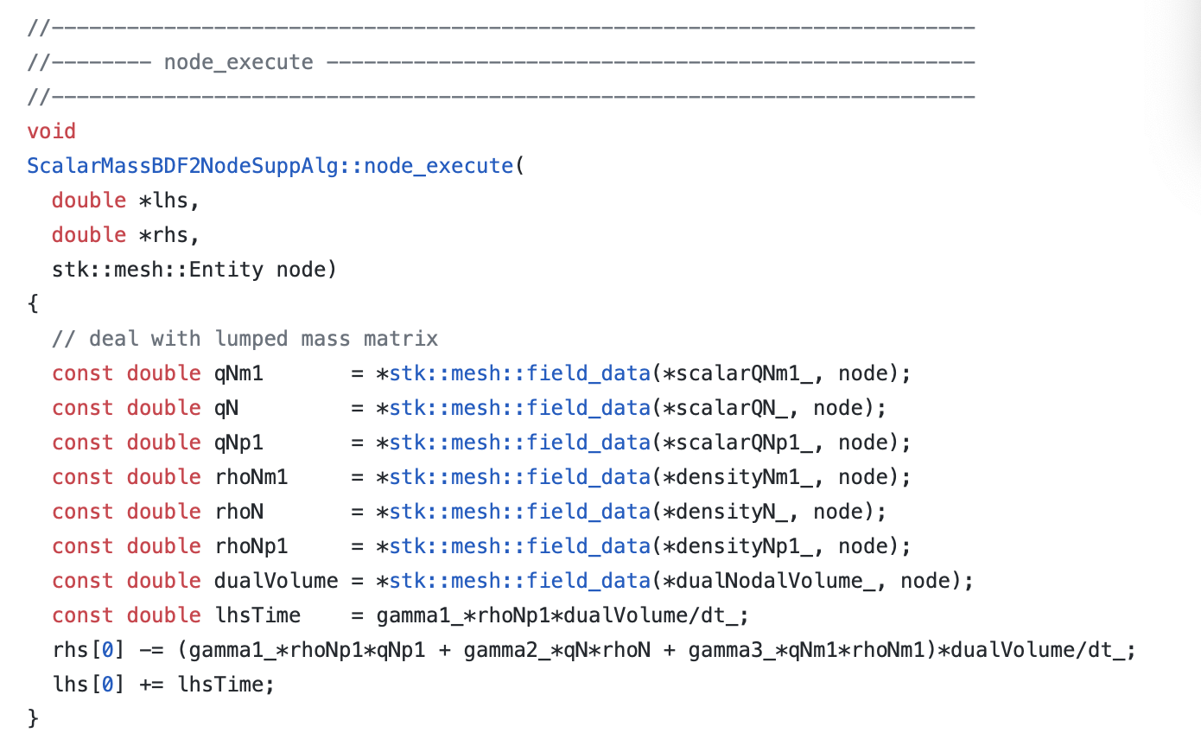
EBVC: Implicit Time Discretization; Code
https://github.com/NaluCFD/Nalu/blob/master/src/ScalarMassBDF2NodeSuppAlg.C

Slide 25
EBVC: Source Term Discretization
Source terms for the edge-based scheme are also assembled over a nodal loop
Note that in this scheme, we are using single point quadrature, i.e., the function is evaluated at a single point
The single point integration point leverages the fac that: p = 2N -1
Where N is the number of integration points and p is the polynomial order
For a linear basis, using one-point quadrature is design-order, or second-order in space
n2

Slide 26
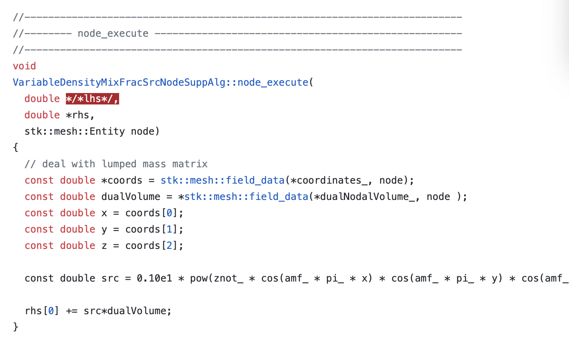
EBVC: Source Term Discretization; Code
https://github.com/NaluCFD/Nalu/blob/master/src/user_functions/VariableDensityMixFracSrcNodeSuppAlg.C

Slide 27
EBVC: Advection Term Discretization
For advection, we have transformed the volume integral to a surface integration
Therefore, a patch of edges are required for the full assembly at node 2
Recall, that the mass flow rate at an integration point is prescribed
Moreover, since the integration point is at the edge mid-point, φ_{ip} = (φ^{R} + φ^{L})/2
This is a central- or Galerkin-based advection operator; shown in conservative form, i.e, is in divergence form and has been integrated-by-parts
n5
e3
n1
n2
n3
n1 (L)
n2 (R)
n2 (L)
n3 (R)
e1
e2
e1
e2
e4
n4

Slide 28
EBVC: Advection Term Discretization
For advection, we have transformed the volume integral to a surface integration
Therefore, a patch of edges are required for the full assembly at node 2
Recall, that the mass flow rate at an integration point is prescribed
Moreover, since the integration point is at the edge mid-point, φ_{ip} = (φ^{R} + φ^{L})/2
This is a central- or Galerkin-based advection operator; shown in conservative form, i.e, is in divergence form and has been integrated-by-parts
n5
e3
n1
n2
n3
n1 (L)
n2 (R)
n2 (L)
n3 (R)
e1
e2
e1
e2
e4
n4
For kinetic energy
conservation, a CC
scheme also
uses ½ weights!
Mahesh et al., JCP (2004)

Slide 29
EBVC: Advection Term Discretization; Code
https://github.com/NaluCFD/Nalu/blob/master/src/AssembleScalarEdgeSolverAlgorithm.C

Slide 30
Upwind Advection Operators
Recall from our finite difference class that in absence of a stabilizing diffusion term, or when the velocity is very high, i.e., the Peclet number > 2, non-physical oscillations can be noted
An upwind approach was devised to mitigate this at the expense of numerical accuracy
For a finite volume approach, upwinding is very easy to construct
However, upwind operators, even if higher-order, are numerically dissipative due to loss of symmetry of the operator
Higher-order upwind (second-order in space) can be obtained on an unstructured mesh by use of projected nodal gradients and extrapolation (will cover this in the advection operator section)
j-1
_{φj-1/2}
j
_{φj+1/2}
j+1
“as the wind blows”

Slide 31
EBVC: Diffusion
For diffusion, we have transformed the volume integral to a surface integration
Therefore, a patch of edges are required for the full assembly at node 2
n5
n1 (L)
n2 (R)
n2 (L)
n3 (R)
e3
e1
e2
n1
n2
n3
e1
e2
e4
n4

Slide 32
EBVC: Diffusion, Non-Orthogonality
The edge-based diffusion operator is a bit more complex in that we are computing a gradient at the integration point while using two nodes, the left and right
In many practical meshes, the distance vector between the edges (dx_{j}) and the edge area vector will not be perfectly orthogonal
This non-orthogonality causes inaccuracy when using a simplified approach
The non-orthogonality approach of Jasek (Ph.D. Imperial College) is a standard cell-centered approach that has been adopted for edge-based schemes
CC and EBVC are each two-state schemes and share non-orthogonality issues
n2 (L)
n3 (R)
e2
Where G_{j}φ is a “projected nodal gradient”
and,

Slide 33
(Projected) Nodal Gradient Operator
Recall, that the edge-based diffusion operator, and as we will see in future lectures for some choices for the advection operator, a nodal gradient is required
First, the gradient of a function (other than linear) is discontinuous, i.e., the value at a shared element face depends on which element is used to compute the gradient
Therefore, we can view the nodal gradient a continuous at the nodes and discontinuous within the elements
Let’s minimize this difference:
by solving:

Slide 34
EBVC: Diffusion, Non-Orthogonality; Code
https://github.com/NaluCFD/Nalu/blob/master/src/AssembleScalarEdgeDiffSolverAlgorithm.C

Slide 35
Typical Difficulties for a Two-State Scheme
With two points, only a linear basis can be used, therefore, unstructured CC and EBVC are limited to second-order spatial accuracy
Non-orthogonality, or the mis-alignment of the distance vector between the two ”L” and “R” states and the surface normal, is present
Both edge- and cell centered-based schemes show degraded accuracy of the diffusion operator on generalized unstructured meshes
Several non-orthogonality approaches are available, for the best source, see Jasak
Jasak, “Error analysis and error estimation for the finite volume method with applications to fluid flow”, Imperial College Dissertation, 1996
Projected nodal gradient:
Expands stencil
Is generally used in a deferred correction context, i.e., any matrix contribution is lagged and only appears in the residual
Δx_{j}
n_{j}
T_{L}
n_{j}
T_{R}

Slide 36
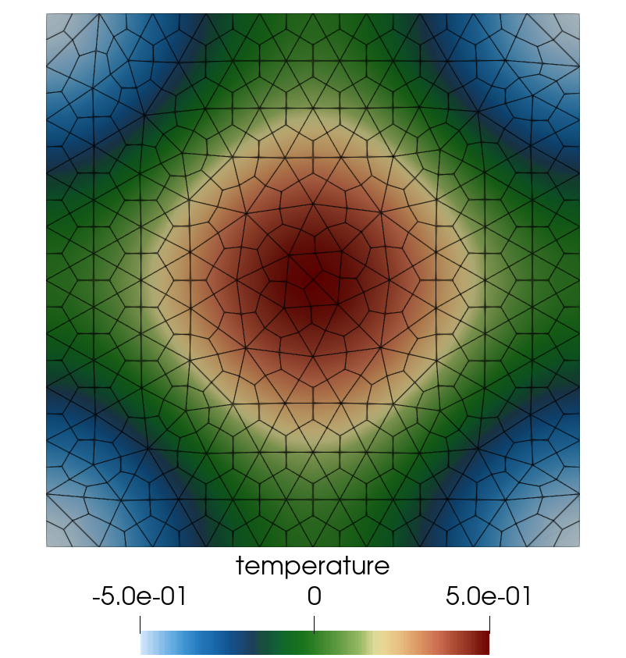
For Instance, Verification of The Diffusion Operator

Slide 37
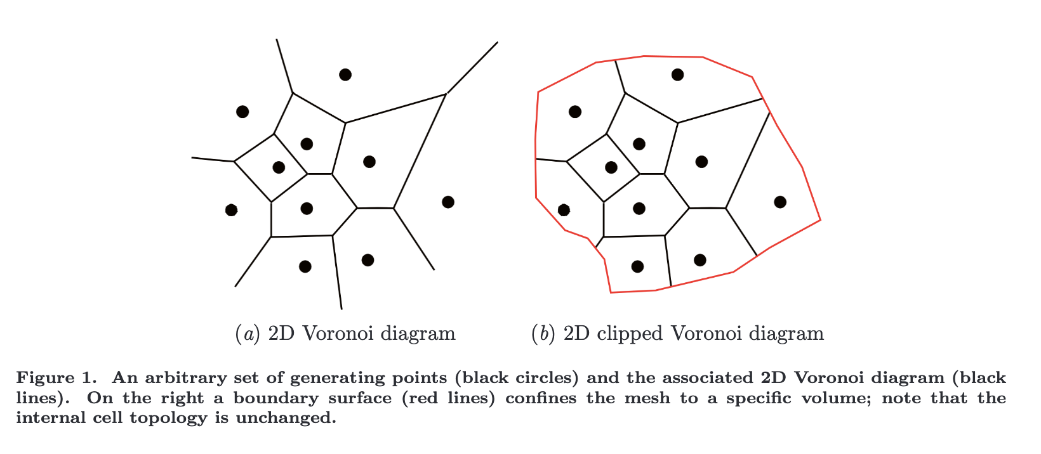
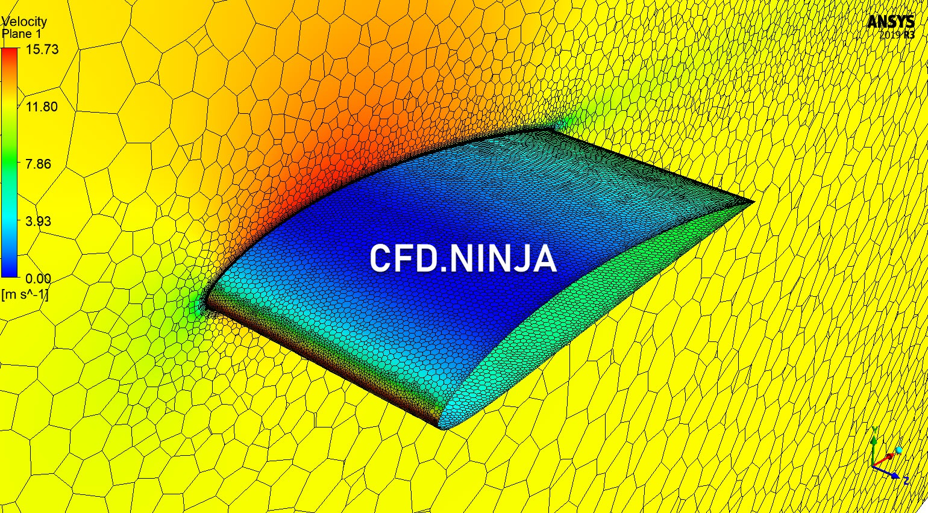
Arbitrary Polyhedra
Thus far, we have described the element types as rather simple, e.g., Hex, Tet, Pyramid, and Wedge (or Prism)
What if the element type was arbitrary and designed to minimize non-orthogonality?
Bres et al., “Large-eddy simulations of co-annular turbulent jet using a Voronoi-based mesh generation framework”, 2018 AIAA/CEAS Aeroacoustics Conference
Two-state limited to second-order-in-space (extensions exist)
Ansys-based arbitrary polyhedra
Exercised by https://cfd.ninja

Slide 38
Simple One-D Diffusion Example
Let us introduce (briefly) the Method of Manufactured Solutions (MMS)
Consider a simple diffusion equation:
with a presumed, or manufactured solution:
Gauss-Divergence
Discrete flux-based form at the sub-control volume surface (scs) and sub-control volume IP:
With error:

Slide 39
Simple One-D MMS Example; Edge-based Assemble of Diffusion
We will use a linear basis and solve this system over a small patch of linear bar elements
Recall, simplified equation with RHS from source term already provided
Iterate elements with a simple left-hand side rule: += L and -=R
(note implicit conservation statement)
node = 0
1
Δx = 1
2
3
x
x
x
Edge 1

Slide 40
Simple One-D MMS Example; Edge-based Assemble of Diffusion
We will use a linear basis and solve this system over a small patch of linear bar elements
Recall, simplified equation with RHS from source term already provided
Iterate elements with a simple left-hand side rule: += L and -=R
(note implicit conservation statement)
node = 0
1
Δx = 1
2
3
x
x
x
Edge 2

Slide 41
Simple One-D MMS Example; Edge-based Assemble of Diffusion
We will use a linear basis and solve this system over a small patch of linear bar elements
Recall, simplified equation with RHS from source term already provided
Iterate elements with a simple left-hand side rule: += L and -=R
(note implicit conservation statement)
node = 0
1
Δx = 1
2
3
x
x
x
Edge 3

Slide 42
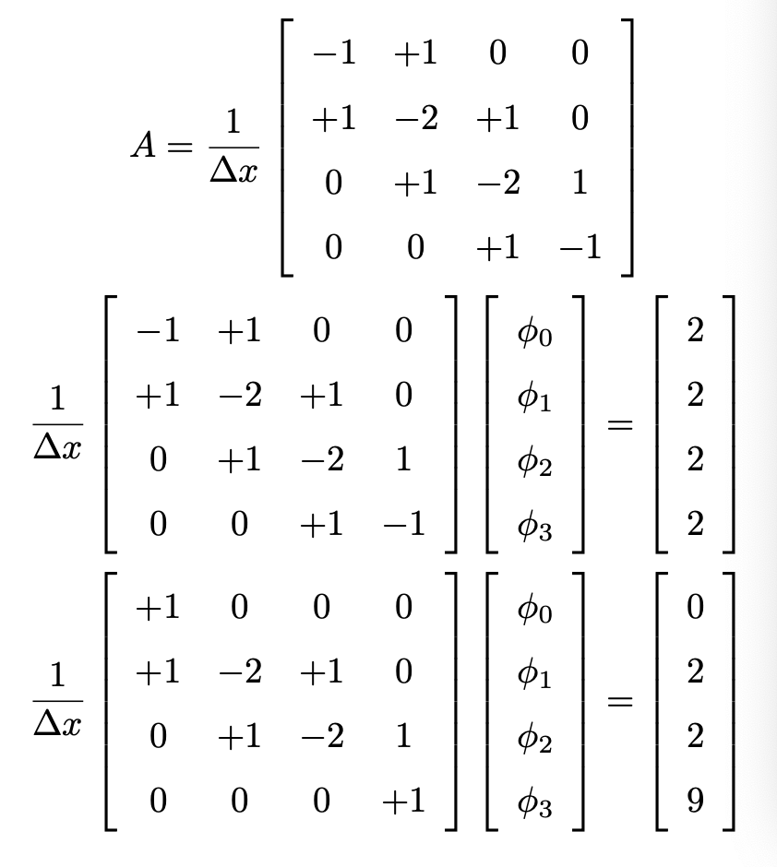
Simple One-D MMS Example; Collect all of the terms
Fully assembled
matrix
Fully assembled
system
Correct for BCs
Solution is exact….. Linear basis exactly captures a quadratic solution

Slide 43
EBVC and CC Review
Each are two-state (left and right schemes)
Nominally, second-order in space due to limited stencil and connectivity
Fast, efficient
Diffusion operator may suffer on non-orthogonal meshes
CC is common in many commercial and open-source codes, e.g., Ansys Fluent, OpenFOAM
Edge-based more often seen in compressible codes
For more information, see: B. Diskin, J.L. Thomas, “Comparison of node-centered and cell-centered unstructured finite-volume discretizations: inviscid fluxes”, AIAA J. 49 (4) (2011) 836–854.

Slide 44
Linking to 1d_quad4_adv_diff
Recall, the transport equation for the 1d_quad4_adv_diff laboratory exercise is as follows:
where
For now, let’s focus on the advection term. We know that we can integrate over the volume and simply compute this term at the volume integration points,
Option: scv_advection_np
As with the volume of fluid equation on the previous slide, we can also write this term as:
that can be simplified (for constant velocity)
Option: scs_advection_np (or scs_upw_advection_np)

