Slide 1
ME469: Introduction to the low-Mach Number Approximation
Stefan P. Domino^{1,2}
¹ Computational Thermal and Fluid Mechanics, Sandia National Laboratories
² Institute for Computational and Mathematical Engineering, Stanford
SAND2018-4536 PE

Slide 2
Consider a Variable Density, non-Isothermal Fluid Flow System
Consider the variable density (non-isothermal) equations of motion (momentum and continuity) with energy transport:
Equation of State (EOS) provides the P and ρ relationship
See Paolucci (1982) or Baum (1978) for the low-Mach pedigree
Number of Equations = (3+nDim) = Number of unknowns
Constitutive Relationships
(2+nDim)

Slide 3
Consider a Variable Density, non-Isothermal Fluid Flow System
Consider the variable density (non-isothermal) equations of motion (momentum and continuity) with energy transport:
Equation of State (EOS) provides the P and ρ relationship
See Paolucci (1982) or Baum (1978) for the low-Mach pedigree
Number of Equations = (3+nDim) = Number of unknowns
Constitutive Relationships
(2+nDim)
(3+nDim)

Slide 4
Degree of Freedom, Properties, and Constitutive Count
DOF: (3+nDim)
Density, ρ (Continuity Eq)
Pressure, P (EOS)
Velocity, u_{i} (Momentum Eq)
Total energy, E (Energy Eq)
Properties:
Viscosity, μ
Specific heat, C_{p}
Thermal conductivity, λ
Constitutive Relationships:
Ideal gas law
Again, provides density/pressure relationship (a key concept)
Newtonian stress, τ_{ij}
Heat flux vector, q_{j}
Total enthalpy, H
Static enthalpy, h
dh/dT = C_{p}

Slide 5
Dimensionless Form
Non-dimensionalization is via a characteristic velocity and length scale:

Slide 6
Dimensionless Form
Non-dimensionalization is via a characteristic velocity and length scale:

Slide 7
Dimensionless Form
Non-dimensionalization is via a characteristic velocity and length scale:
Note, as the Mach number approaches zero, the viscous work and kinetic energy terms become negligible; Fr-based terms also are removed

Slide 8
Dimensionless Form
Non-dimensionalization is via a characteristic velocity and length scale:
However, the momentum equation notes a singularity in the scaled pressure gradient term

Slide 9
Dimensionless Form
Non-dimensionalization is via a characteristic velocity and length scale:
Conclusions: In the limit of zero Mach number, the energy equation is simplified, while the momentum equation is not well defined and, in fact, singular

Slide 10
Exploration of the Pressure Singularity
To explore the singularity, write each DOF as an asymptotic series:
The resulting zeroth-order equations are as follows:

Slide 11
Exploration of the Pressure Singularity
To explore the singularity, write each DOF as an asymptotic series:
The resulting zeroth-order equations are as follows:

Slide 12
Exploration of the Pressure Singularity: Ramifications
In order for the zeroth-order momentum equation to be well conditioned in the limit of zero Mach number, must be spatially zero with
p₀ is a constant-in-space, possibly variable-in-time thermodynamic pressure
p₁ is the variable in space pressure, which is also known as the “motion pressure”, p^{m}
Recall, this is simply a perturbation about the full thermodynamic pressure:

Slide 13
Final low-Mach Equation Set
The resulting Equation set is as follows:
Equation of state given by the thermodynamic pressure:
Energy transport is only required when the system modeled has a temperature difference
EOS does not provide an equation for closure: An alternative approach is required for motion pressure!
2+nDim

Slide 14
The Final low-Mach Number Equation Set: Ramifications
We have effectively filtered out the acoustics, i.e., the wave speed is infinitely fast
DOF/Equation system is: ρ, p^{m}, u_{i}, h; p^{t} is a constant for an open domain
In practice, a functional form for the motion pressure is derived and known as a Pressure Poisson Equation (PPE):
With the continuity equation serving as a mass balance constraint
Note that we have introduced an Elliptic nature to the equation set
Momentum and other equations can be implicit of explicitly solved, however, the Pressure Poisson Equation requires an implicit solve with dedicated solvers, e.g., multi-grid methods
Later lectures will discuss solution approach in depth, in the meantime, an efficient solver approach for the low-Mach system is a “pressure projection” method

Slide 15
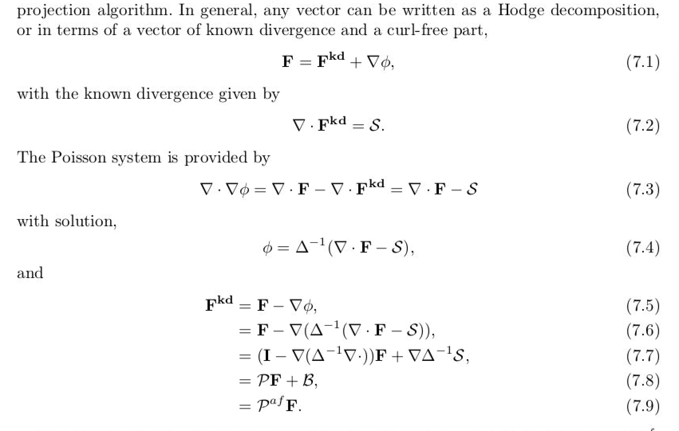
Why ”pressure projection”?
From Domino, 2006 “﻿Toward verification of formal time accuracy for a family of approximate projection methods using the method of manufactured solutions”
For a solenoidal vector, div(u) is zero and P is an “idempotent” projection, i.e., P=P²
Otherwise, P is an affine-projection operator

Slide 16
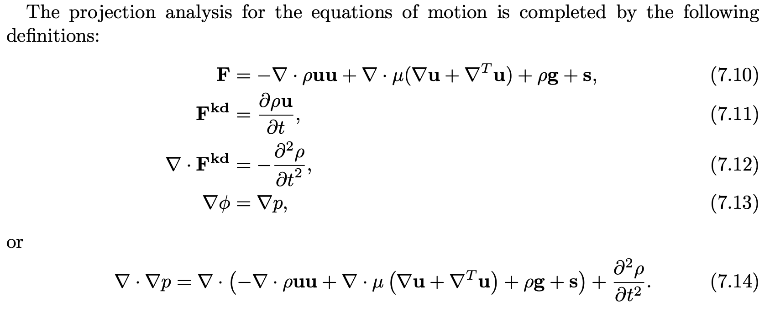
Why ”pressure projection”?
From Domino, 2006 “﻿Toward verification of formal time accuracy for a family of approximate projection methods using the method of manufactured solutions”

Slide 17
Classic Pressure Poisson System
Hodge Decomposition:
Taking the divergence:
While enforcing continuity:
Finally, the projection step:

Slide 18
Classic Pressure Poisson System
Hodge Decomposition:
Taking the divergence:
While enforcing continuity:
Finally, the projection step:
Here is our equation for the motion pressure:
This pressure (or change in pressure) acts to
enforce the continuity constraint

Slide 19
Sneak Peak: Classic Pressure Projection Algorithm
Solve Momentum Equation (with a provisional motion pressure):
Solve Continuity, given the computed velocity:
Update velocity:
In future tutorials, we will be more formal in nomenclature, however, for now, the concept of this “incremental pressure projection scheme” is to solve momentum with a provisional pressure, and then use the continuity constraint to update (or project) the velocity into the space of known divergence. Monolithic approaches are also viable

Slide 20

Thought Experiment…
Large domain, one door, one “exit”
Maples Pavilion

Slide 21
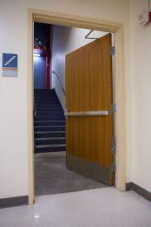
Thought Experiment…
Large domain, one door, one “exit”
Maples Pavilion

Slide 22

Thought Experiment…
Large domain, one door, one “exit”
Maples Pavilion

Slide 23
Thought Experiment…
Large domain, one door, one “exit”
Walls
Inflow
Outflow
Walls

Slide 24
Thought Experiment…
Large domain, one door, one “exit”
Walls
Inflow
Outflow
Walls

Slide 25
Thought Experiment…
Large domain, one door, one “exit”
Walls
Inflow
Out – In = 0 (at t = to+0.0000000001)
Outflow
Walls

Slide 26
Thought Experiment… Solver Ramifications
Fixed point solvers iterate over the domain sequentially and are effective when this sweeping of the mesh corresponds to a particular physical direction
Walls
Sweeping direction
Inflow
Outflow
Walls

Slide 27
Thought Experiment… Solver Ramifications
For Elliptic systems, fixed point iterative solvers fail since the sequential propagation of information is not adequate for a system with infinite wave speeds
Walls
Inflow
All locations are strongly coupled
Outflow
Walls

Slide 28
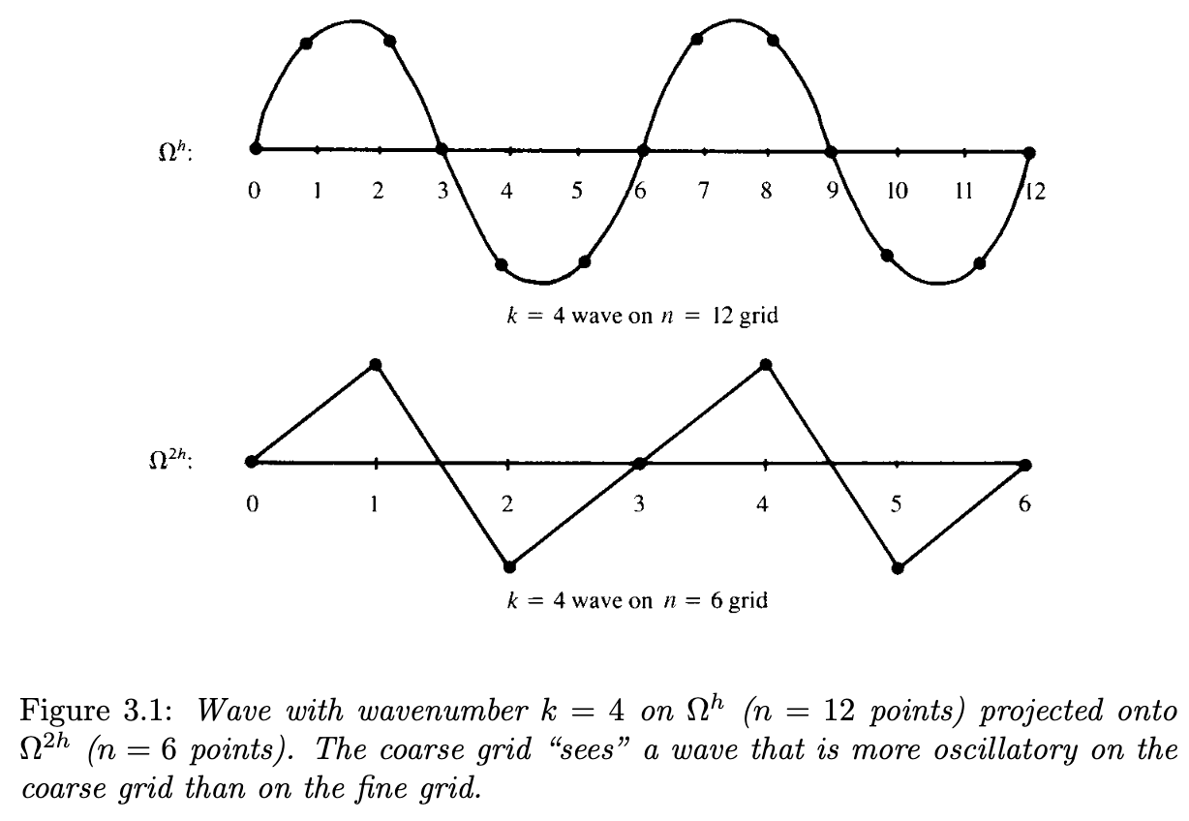
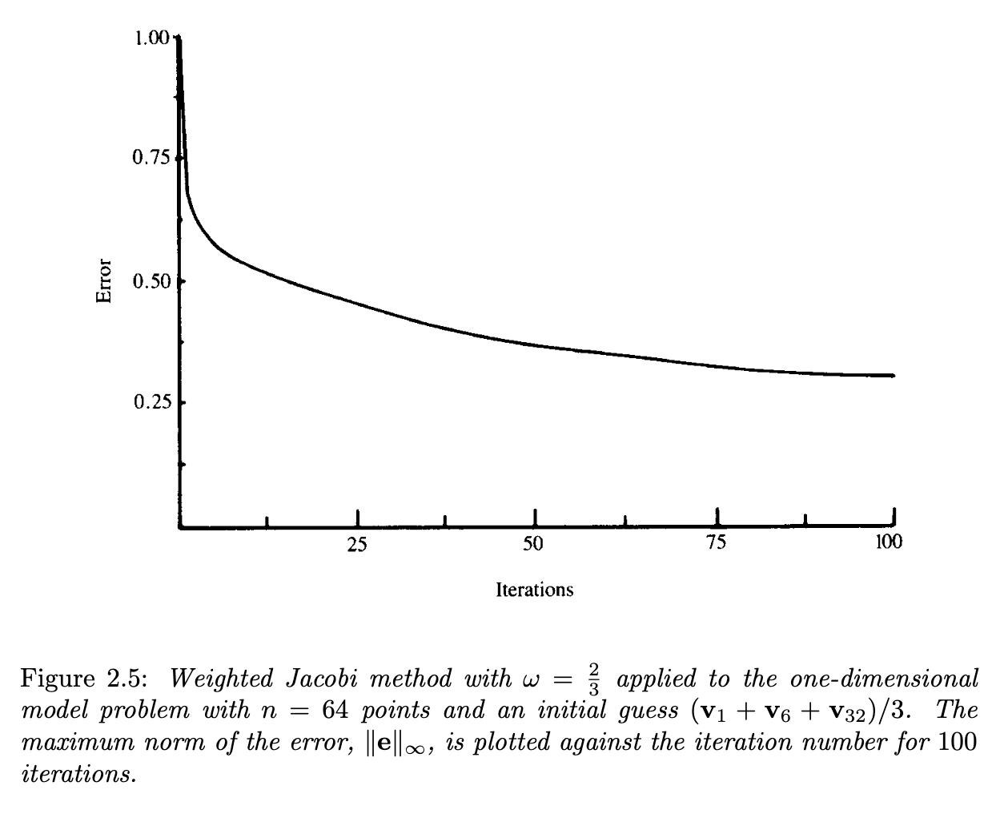
Multigrid Methods: The Concept
Briggs, "A Multigrid Tutorial, 2nd Edition” (2000)
Fixed-point iterations schemes effectively remove high-frequency errors
Can we take a solution, coarsen, and then solve the new system?

Slide 29
Multigrid Methods: The Approach
Multigrid methods (MG) are essential for efficient solver performance in fluids-based Elliptic systems
In simple, structured domains, this can be geometric (GMG), while in unstructured, algebraic (AMG)
Restriction (from fine to coarse mesh)
Prolongation (from coarse to fine mesh)

Slide 30
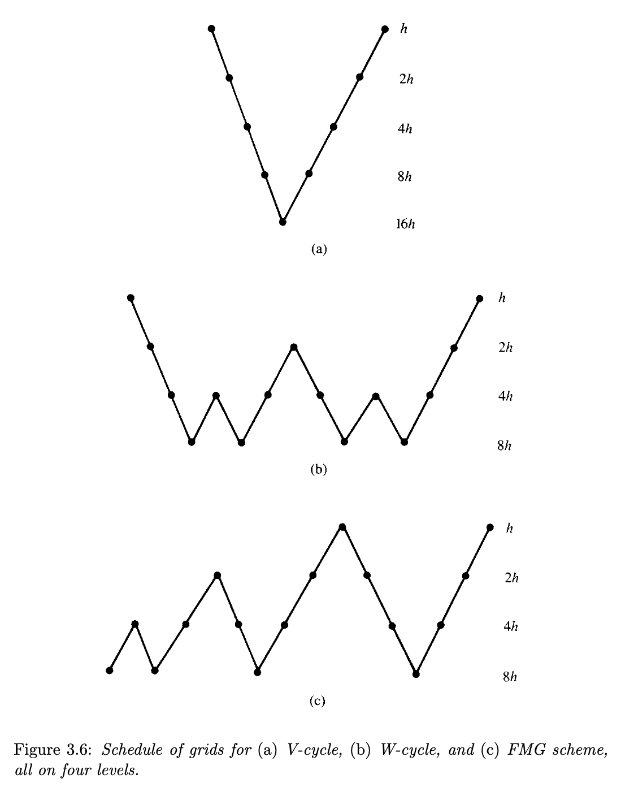
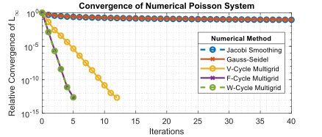
Multigrid Methods: V- and W-Cycles
Briggs (2000)
https://en.wikipedia.org/wiki/Multigrid_method

Slide 31
Low-Mach Final Review Points
For some classes of flow regimes, the acoustics are of secondary interest
The low-Mach approach is an acoustically incompressible approach that allows for variable-density, i.e., div(u) != 0
Filtering gives rise to an Elliptic pressure system that requires special solver/preconditioner techniques for optimal performance

