Slide 1
ME469: Numerical Abstractions
Stefan P. Domino^{1,2}
¹ Computational Thermal and Fluid Mechanics, Sandia National Laboratories
² Institute for Computational and Mathematical Engineering, Stanford
SAND2018-4536 PE

Slide 2
Useful Abstractions
Real World
The intended application
Physical laws, hypothesis and models (e.g. a set of PDEs) and initial and boundary conditions
A set of computational algorithms that allow to build a numerical, or approximated solution to the conceptual model
Conceptual
Model
Computer Model

Slide 3
Mappings:
Real World
Conceptual
Model
?
Computer Model

Slide 4
Qualification: Adequacy of the conceptual model to provide an acceptable level of agreement for the intended application
Real World
Conceptual
Model
Examples:
Is the fluid Newtonian?
Are compressibility effects important?
Uniform or variable-density?
Isothermal or non-isothermal?
Computer Model

Slide 5
Verification: Process of determining that (1) the model implementation faithfully represents the conceptual model (without mistakes) and (2) the solution to the model is accurate
Real World
Conceptual
Model
Examples:
Is it RHS += A, RHS -=A? Which is correct?
Should the contribution be scaled by a volume?
How does the Quantity of Interest (QoI) behave as a function of mesh or time step resolution?
Verification
Computer Model

Slide 6
Validation: Process of determining the degree to which the numerical solutions (hence the model) is an accurate representation of reality from the perspective of the intended application
Real World
Conceptual
Model
Validation
Examples:
Midterm project: compare drag coefficient prediction to an experiment
Final project: compare drag coefficient for flow past rotating shapes; chaotic flow prediction at a given configuration
Computer Model

Slide 7
Verification vs Validation (V&V)? The Formal Lexicon
Verification: Are we solving the equations correctly?
Represents an exercise in computational mathematics
Given an equation, is the solution converging at known rates?
Validation: Are we solving the correct equations?
Represents an exercise in understanding the physics associated with the real world use case
In this course, we will strongly focus on verification
Establishing the correctness of the numerical implementation is key
Comparisons of the numerical results to reality is not the primary objective
Verification challenges?
Knowledge of the true solution, i.e., exact analytical solutions
How many exact solutions exist for our class of physics? Not many!
Hint: Method of Manufactured Solutions (MMS)

Slide 8
The Construction of a Numerical Method: Discretization and Solution
Mathematical Formulation
Partial differential equations (PDE)
Initial Conditions (IC)
Boundary Conditions (BC)
Conceptual
Model
Computer Model
Real World

Slide 9
The Construction of a Numerical Method: Discretization and Solution
Mathematical Formulation
Partial differential equations (PDE)
Initial Conditions (IC)
Boundary Conditions (BC)
Numerical Formulation
Discretize in space and time
Algebraic Differential Equations (ADE)
Conceptual
Model
Computer Model
Real World
Discretization step

Slide 10
The Construction of a Numerical Method: Discretization and Solution
Mathematical Formulation
Partial differential equations (PDE)
Initial Conditions (IC)
Boundary Conditions (BC)
Numerical Formulation
Discretize in space and time
Algebraic Differential Equations (ADE)
Numerical Solution
Algebraic Differential Equations (ADE)
Linear solvers
Convergence, mesh adequacy, ….?
Conceptual
Model
Computer Model
!Real World
Discretization step
Solution step

Slide 11
Numerical Simulation Conundrum
PDE
Exact
Solution
What we would like to have…

Slide 12
Numerical Simulation Conundrum
PDE
ADE
Exact
Solution
Numerical
Solution
What we would like to have…
What we have….

Slide 13
Numerical Simulation Conundrum
PDE
ADE
Need to relate the numerical solution of the discretized problem to the exact solution of the original continuous problem!
Exact
Solution
Numerical
Solution
?
What we would like to have…
What we have….

Slide 14
Numerical Simulation Conundrum
PDE
ADE
Consistency
Stability
Exact
Solution
Numerical
Solution
Convergence
For a well-posed, linear PDE, Lax-Richtmyer Equivalence Theorem, AKA the Fundamental Theorem of Numerical Analysis: Consistency + Stability = Convergence

Slide 15
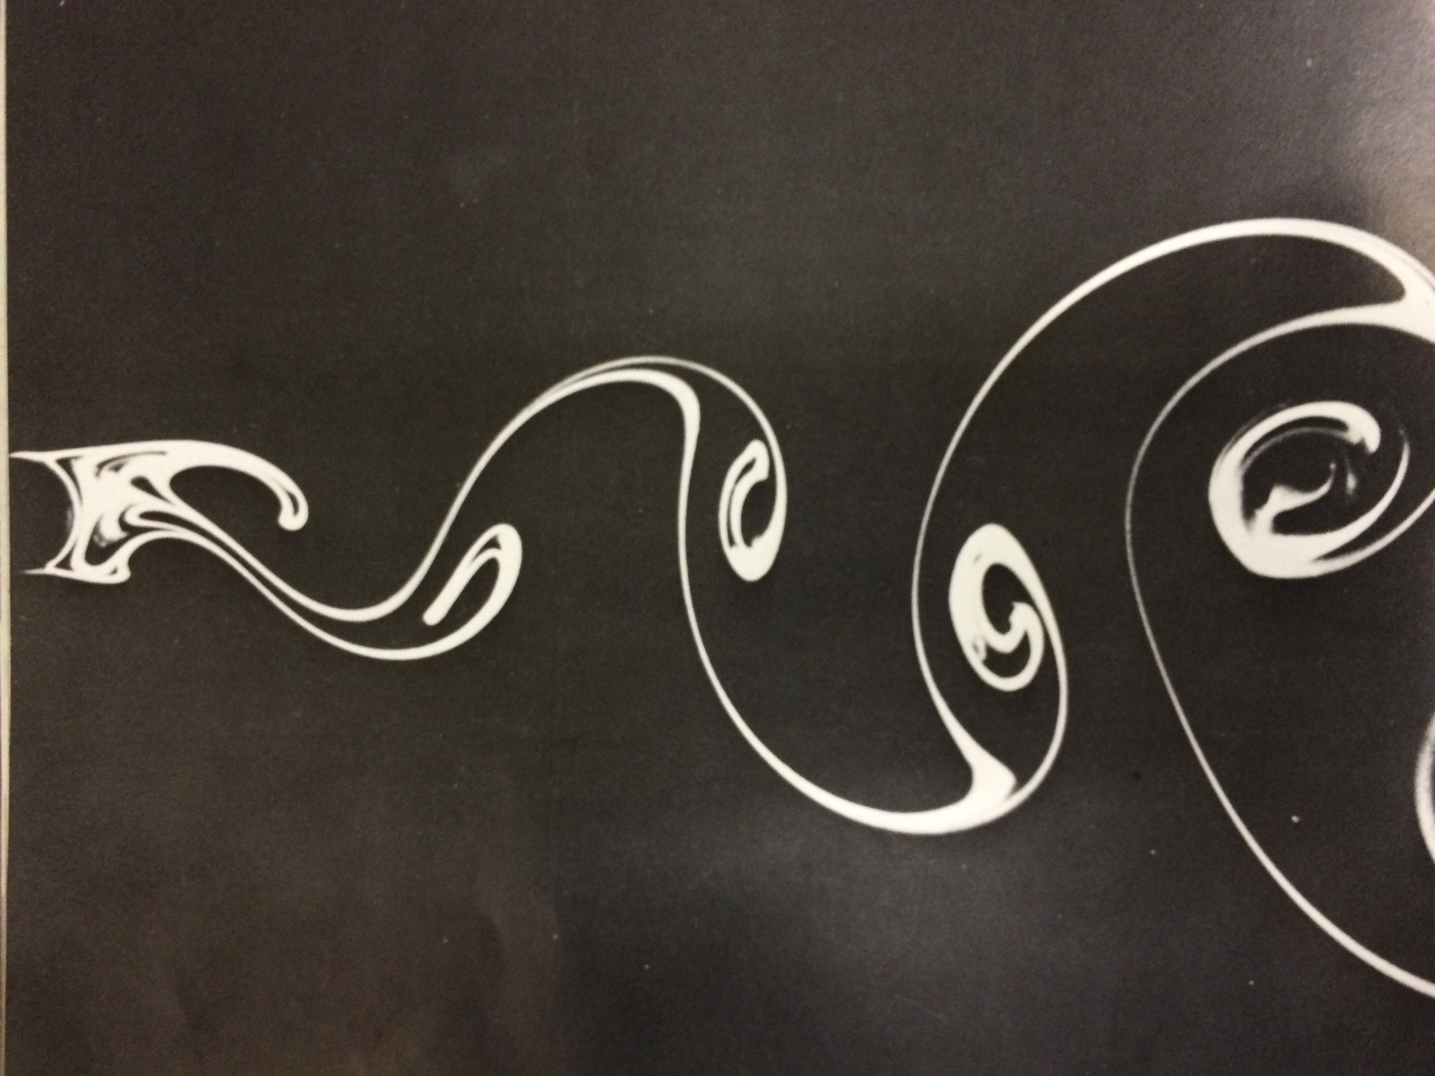
Example 1: Vortex Street
Conceptual
Model
Computer Model
Real World?

Slide 16

Example 2: Modeling a Luminaria – In the Snow!
Conceptual
Model
Computer Model
Real World?

