Slide 1
Stanford ME469: Splitting and Stabilization Errors
Stefan P. Domino
Computational Thermal and Fluid Mechanics
Sandia National Laboratories SAND2018-4536 PE

Slide 2
Splitting and Stabilization Errors: Outline
Block Matrix and Operator Form
Approximate Factorization
Splitting Errors
Stabilization Errors
Detailed Code Verification
Conclusions

Slide 3


Standard Incompressible Equation Set
Consider the uniform density, low-Mach equation system:
$\frac{∂u_{j}}{∂x_{j}}$ $=0$
$\frac{∂ρu_{i}}{∂t}+\frac{∂ρu_{j}u_{i}}{∂x_{j}}$ - $\frac{∂τ_{ij}}{∂x_{j}}=−\frac{∂p_{i}}{∂x_{i}}+S_{i}$

Slide 4
Standard Incompressible Equation Set
Consider the uniform density, low-Mach equation system:
$\frac{∂u_{j}}{∂x_{j}}$ $=0$
$\frac{∂ρu_{i}}{∂t}+\frac{∂ρu_{j}u_{i}}{∂x_{j}}$ - $\frac{∂τ_{ij}}{∂x_{j}}=−\frac{∂p_{i}}{∂x_{i}}+S_{i}$
In our simulation studies, we have been solving this system sequentially and within a nonlinear loop:
For ( non-linear iteration ) {
Momentum
Continuity
If ( converged ) break;
}
Today, we learn more about the consequence of this strategy
Time Step Count: 8 Current Time: 0.32
dtN: 0.04 dtNm1: 0.04 gammas: 1.5 -2 0.5
Max Courant: 0.22364 Max Reynolds: 1294.89 (realm_1)
Realm Nonlinear Iteration: 1/1
realm_1::advance_time_step()
NLI Name Linear Iter Linear Res NLinear Res Scaled NLR
--- ---- ----------- ---------- ----------- ----------
1/2 Equation System Iteration
1/1 myLowMach
MomentumEQS 3 2.62985e-06 0.00890841 1
ContinuityEQS 4 1.06209e-06 0.0021837 1
2/2 Equation System Iteration
1/1 myLowMach
MomentumEQS 3 2.28651e-08 4.62336e-05 0.00518989
ContinuityEQS 5 5.2886e-09 5.42362e-05 0.0248369

Slide 5
Exploration of the Pressure Singularity: Ramifications
REVIEW
In order for the zeroth-order momentum equation to be well conditioned in the limit of zero Mach number, must be spatially zero with
p₀ is a constant-in-space, possibly variable-in-time thermodynamic pressure
p₁ is the variable in space pressure, which is also known as the “motion pressure”, p^{m}
Recall, this is simply a perturbation about the full thermodynamic pressure:

Slide 6







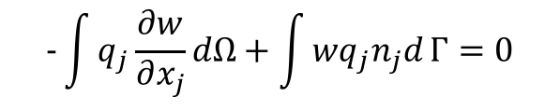
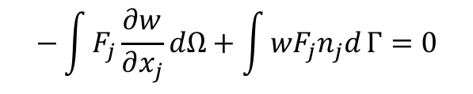
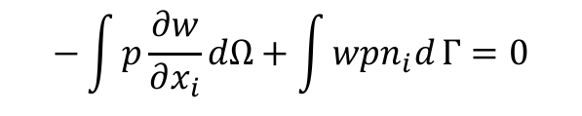

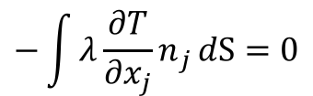




Introduction to Block Matrix Form
Consider the divergence of a vector, DF (a scalar)
Gradient of a scalar, Gp (a vector)
Laplace operator, L_{λ}T
$$\int{\frac{∂F_{j}}{∂x_{j}}}dV=0$$
$$\int{F_{j}n_{j}}dS=0$$
(piecewise-const w)
(Gauss-Divergence)
$\frac{∂F_{j}}{∂x_{j}}$ $=0$
$$\int{w\frac{∂F_{j}}{∂x_{j}}}dΩ=0$$
$$−\int{F_{j}\frac{∂w}{∂x_{j}}}dΩ+\int{{wF}_{j}n_{j}d}Γ=0$$
(Integration-by-parts)
$$\int{\frac{∂p}{∂x_{i}}}dV=0$$
$$\int{pn_{i}}dS=0$$
(piecewise-const w)
(Green-Gauss)
$\frac{∂p}{∂x_{i}}$ $=0$
$$\int{w\frac{∂p}{∂x_{i}}}dΩ=0$$
$$−\int{p\frac{∂w}{∂x_{i}}}dΩ+\int{wpn_{i}d}Γ=0$$
(Integration-by-parts)
(piecewise-const w)
$\frac{∂q_{j}}{∂x_{j}}$ $=0$
$$\int{\frac{∂q_{j}}{∂x_{j}}}dV=0$$
$$−\int{{λ\frac{∂T}{∂x_{j}}n}_{j}}dS=0$$
(Gauss-Divergence)
$$q_{j}=−λ\frac{∂T}{∂x_{j}}$$
$$\int{w\frac{∂q_{j}}{∂x_{j}}}dΩ=0$$
$$−\int{q_{j}\frac{∂w}{∂x_{j}}}dΩ+\int{{wq}_{j}n_{j}d}Γ=0$$
(Integration-by-parts)

Slide 7
Equally Valid Pressure Projection Derivations
Semi-discrete approach (uniform density) Fully discrete approach
Chorin (1968)
Time scale is the time step:
Fully discrete approach
Factored matrix: is an approximation to
SIMPLE family of methods
Time scale is the characteristic scale of :
For convection-dominated flows, this looks like Δx/U

Slide 8

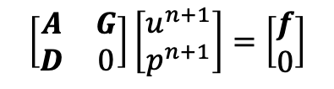



Introduction to Block Matrix Form for Fluids
Consider the monolithic, uniform density, low-Mach equation system:
that can be written in block form as:
We seek to factorize this system via:
B₂ determines the projection time scale, ideally chosen to approximate A⁻¹
B₁ controls the projection error, ideally chosen to cancel BD₂G
$\frac{∂u_{j}}{∂x_{j}}$ $=0$
$\frac{∂ρu_{i}}{∂t}+\frac{∂ρu_{j}u_{i}}{∂x_{j}}$ - $\frac{∂τ_{ij}}{∂x_{j}}=−\frac{∂p}{∂x_{i}}+S_{i}$
$$\left[\begin{matrix}A & G \\ D & 0\end{matrix}\right]\left[\begin{matrix}u^{n+1} \\ p^{n+1}\end{matrix}\right]=\left[\begin{matrix}f \\ 0\end{matrix}\right]$$
$$\left[\begin{matrix}A & G \\ D & 0\end{matrix}\right]≈\left[\begin{matrix}A & 0 \\ D & B_{1}\end{matrix}\right]\left[\begin{matrix}I & B_{2}G \\ 0 & I\end{matrix}\right]≈\left[\begin{matrix}A & AB_{2}G \\ D & (B_{1}+DB_{2}G)\end{matrix}\right]\left[\begin{matrix}u^{n+1} \\ p^{n+1}\end{matrix}\right]=\left[\begin{matrix}f \\ 0\end{matrix}\right]$$
the exact factorization can be recovered by defining:
$$B_{2}=A^{−1}$$
$$B_{1}=−DB_{2}G$$

Slide 9
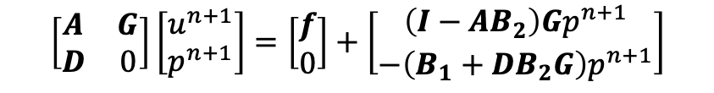
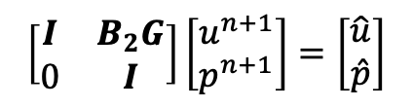

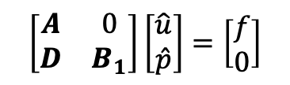





Introduction to Block Matrix Form
The approximate factorization
can be written now as two segregated steps:
This approach seems to be straight forward, however, what errors have we introduced by this procedure of splitting the monolithic (fully coupled) system?
In most cases, B₂ is approximately A⁻¹ and a first-order temporal splitting error is noted
$$\left[\begin{matrix}A & G \\ D & 0\end{matrix}\right]≈\left[\begin{matrix}A & 0 \\ D & B_{1}\end{matrix}\right]\left[\begin{matrix}I & B_{2}G \\ 0 & I\end{matrix}\right]≈\left[\begin{matrix}A & AB_{2}G \\ D & (B_{1}+DB_{2}G)\end{matrix}\right]\left[\begin{matrix}u^{n+1} \\ p^{n+1}\end{matrix}\right]=\left[\begin{matrix}f \\ 0\end{matrix}\right]$$
Momentum and Continuity:
$$\left[\begin{matrix}A & 0 \\ D & B_{1}\end{matrix}\right]\left[\begin{matrix}\hat{u} \\ \hat{p}\end{matrix}\right]=\left[\begin{matrix}f \\ 0\end{matrix}\right]$$
$$A\hat{u}=f$$
$$D\hat{u}+B_{1}\hat{p}=0$$
Nodal Projection:
$$\left[\begin{matrix}I & B_{2}G \\ 0 & I\end{matrix}\right]\left[\begin{matrix}u^{n+1} \\ p^{n+1}\end{matrix}\right]=\left[\begin{matrix}\hat{u} \\ \hat{p}\end{matrix}\right]$$
$$u^{n+1}=\hat{u}−B_{2}Gp^{n+1}=0$$
$$p^{n+1}=\hat{p}$$
$$\left[\begin{matrix}A & G \\ D & 0\end{matrix}\right]\left[\begin{matrix}u^{n+1} \\ p^{n+1}\end{matrix}\right]=\left[\begin{matrix}f \\ 0\end{matrix}\right]+\left[\begin{matrix}\left(I−AB_{2}\right)Gp^{n+1} \\ {−\left(B_{1}+DB_{2}G\right)p}^{n+1}\end{matrix}\right]$$
$$B_{2}=A^{−1}$$
Exact iff:
$$B_{1}=−DB_{2}G$$

Slide 10
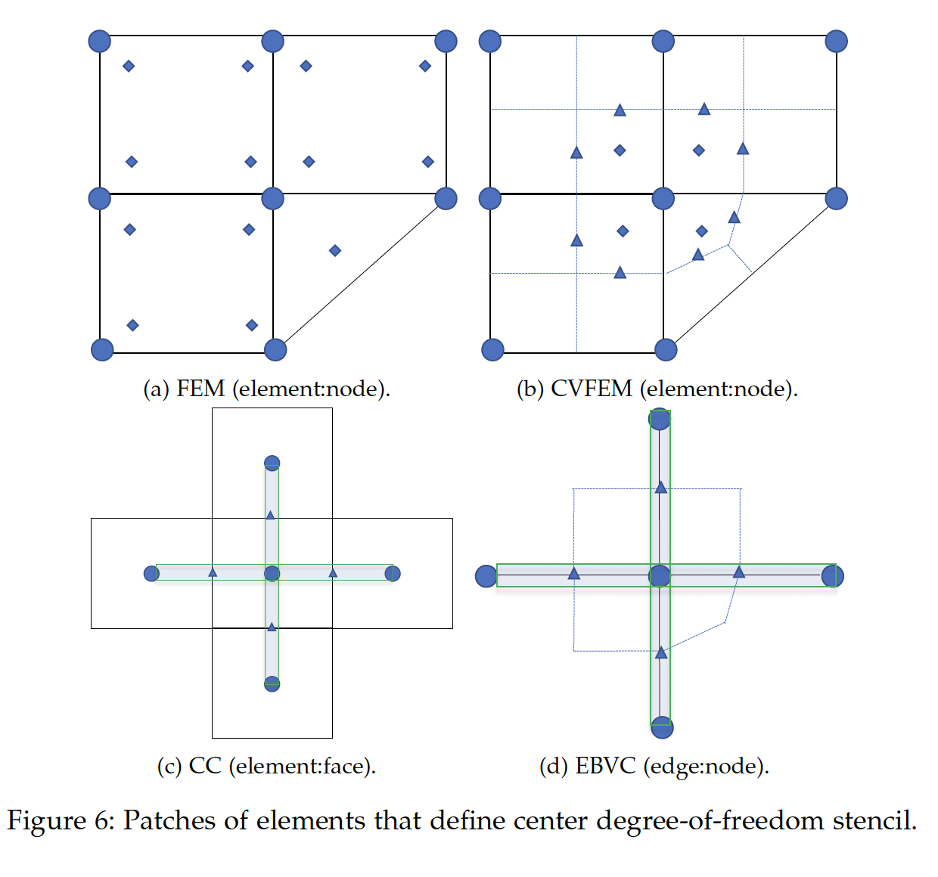
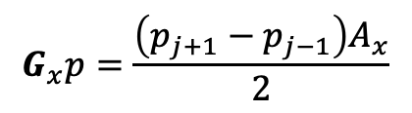
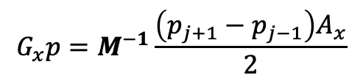
Recall Mesh Structure… ”co-located”, or “equal-order”
We have the choice of where the DOFs are solved… Our choice?
Here, all variables are solved at the same location (nodes/vertices or cell-centers)
Underlying basis for each DOF is the same, i.e., “equal-order” interpolation
We already have noted the gradient operator in 1-D that might pose some problems…
$$G_{x}p=\frac{\left(p_{j+1}−p_{j−1}\right)A_{x}}{2}$$
$$G_{x}p=M^{−1}\frac{\left(p_{j+1}−p_{j−1}\right)A_{x}}{2}$$
j-1
j
j+1

Slide 11
Staggered…..
Stencil for CC-quantities
Stencil for x-velocity
Stencil for y-velocity
Velocity degree-of-freedom is staggered relative to pressure and other primitives, e.g., enthalpy, mixture fraction, etc.

Slide 12

Staggered…..
Stencil for CC-quantities
Stencil for x-velocity
Operators are now very compact and local…
P₁
P₂
$$G_{x}p=M^{−1}\left(p_{2}−p_{1}\right)A_{x}$$

Slide 13
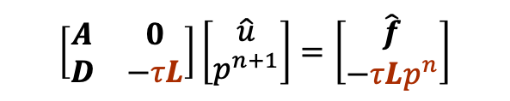

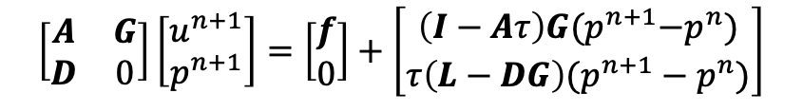
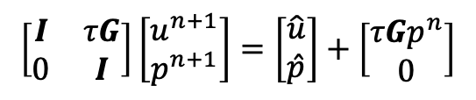



Incremental Pressure-Projection without Pressure Stabilization
Let the inverse of A, A⁻¹ be approximated by B₂ as a scalar, τ
Let B₁ be equal to the scaled Laplace operator, - τL
The new splitting and stabilization error is given by:
The above can be shown to demonstrate second-order temporal error (coming)
A scheme can be designed such that L = DG (staggered)
A scheme in which L != DG (collocated or equal-order) can show that L-DG ~ 4th-order pressure stabilization, however, in this case acting on p^{n+1}-p^{n}
Momentum and Continuity:
$$\left[\begin{matrix}A & 0 \\ D & −τL\end{matrix}\right]\left[\begin{matrix}\hat{u} \\ p^{n+1}\end{matrix}\right]=\left[\begin{matrix}\hat{f} \\ −τLp^{n}\end{matrix}\right]$$
$$A\hat{u}=\hat{f}=f−Gp^{n}$$
$$D\hat{u}−τL{(p}^{n+1}−p^{n})=0$$
Nodal Projection:
$$\left[\begin{matrix}I & τG \\ 0 & I\end{matrix}\right]\left[\begin{matrix}u^{n+1} \\ p^{n+1}\end{matrix}\right]=\left[\begin{matrix}\hat{u} \\ \hat{p}\end{matrix}\right]+\left[\begin{matrix}τGp^{n} \\ 0\end{matrix}\right]$$
$$u^{n+1}=\hat{u}−{τG(p}^{n+1}−p^{n})$$
$$p^{n+1}=\hat{p}$$
Examples:
Dwyer (1990)
Almgren (2000)
$$\left[\begin{matrix}A & G \\ D & 0\end{matrix}\right]\left[\begin{matrix}u^{n+1} \\ p^{n+1}\end{matrix}\right]=\left[\begin{matrix}f \\ 0\end{matrix}\right]+\left[\begin{matrix}\left(I−Aτ\right)G{(p}^{n+1}−p^{n}) \\ {τ\left(L−DG\right)(p}^{n+1}−p^{n})\end{matrix}\right]$$

Slide 14
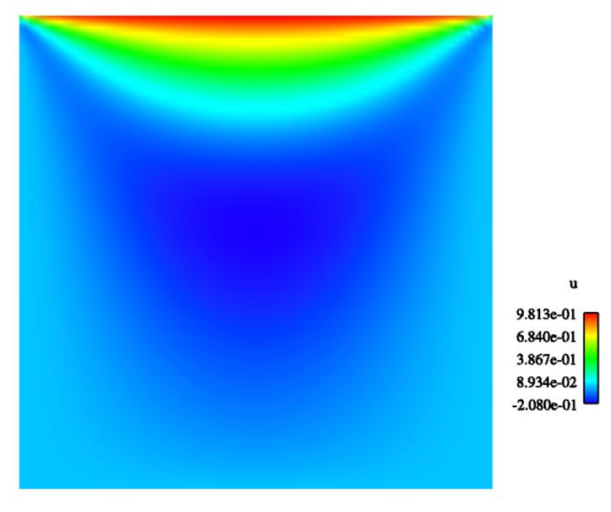
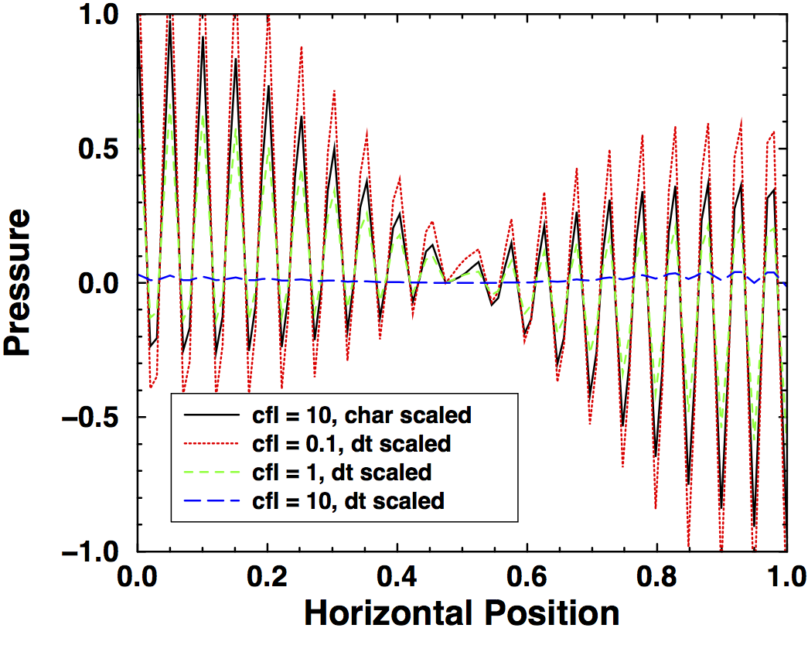
The Role of Pressure Stabilization (L!=DG) in an Equal-Order Approach
Consider the classic lid-driven cavity flow with top wall velocity of Uo
Uo
Unsmoothed pressure field at
various Courant numbers
lid-driven cavity velocity
(u-component)
Equal-Order: same basis and interpolation operators for continuity and momentum Also known as: “collocated”

Slide 15
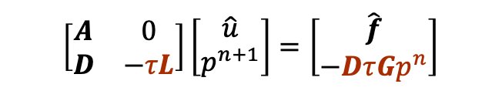


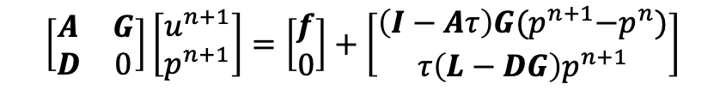


Incremental Approximate Pressure-Projection with Pressure Stabilization Errors
Let the inverse of A, A⁻¹ be approximated by B₂ as a scalar, τ (which is ~ time scale)
Let B₁ be equal to the scaled Laplace operator, - τL
The new splitting and stabilization error is given by:
The above can be shown to hold a second-order temporal error (coming)
Here, due to equal-order interpolation, i.e., collocation of primitives, L != DG
Therefore, L-DG ~ 4th-order pressure stabilization (pressure oscillations damped)
However, pressure-stabilization error remains
Momentum and Continuity:
$$\left[\begin{matrix}A & 0 \\ D & −τL\end{matrix}\right]\left[\begin{matrix}\hat{u} \\ p^{n+1}\end{matrix}\right]=\left[\begin{matrix}\hat{f} \\ −DτGp^{n}\end{matrix}\right]$$
$$A\hat{u}=f−Gp^{n}$$
$$D\hat{u}=τ(Lp^{n+1}−DGp^{n})$$
Nodal Projection:
$$\left[\begin{matrix}I & τG \\ 0 & I\end{matrix}\right]\left[\begin{matrix}u^{n+1} \\ p^{n+1}\end{matrix}\right]=\left[\begin{matrix}\hat{u} \\ \hat{p}\end{matrix}\right]+\left[\begin{matrix}τGp^{n} \\ 0\end{matrix}\right]$$
$$u^{n+1}=\hat{u}−{τG(p}^{n+1}−p^{n})$$
$$p^{n+1}=\hat{p}$$
Examples:
Rhie-Chow (1983)
Peric (1985)
Domino (2006)
$$\left[\begin{matrix}A & G \\ D & 0\end{matrix}\right]\left[\begin{matrix}u^{n+1} \\ p^{n+1}\end{matrix}\right]=\left[\begin{matrix}f \\ 0\end{matrix}\right]+\left[\begin{matrix}\left(I−Aτ\right)G{(p}^{n+1}−p^{n}) \\ τ\left(L−DG\right)p^{n+1}\end{matrix}\right]$$

Slide 16


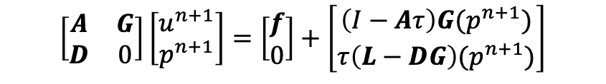



Non-Incremental Pressure-Projection: “Pressure-Free” with or without Pressure Stabilization
Let the inverse of A, A⁻¹ be approximated by B₂ as a scalar, τ
Let B₁ be equal to the scaled Laplace operator, - τL
The new splitting and stabilization error is given by:
A fully-implicit scheme can be shown to demonstrate first-order temporal error (coming)
A scheme can be designed such that L = DG (staggered) to remove stabilization error
A scheme in which L != DG (collocated or equal-order) can show that L-DG ~ 4th-order pressure stabilization (however, in this case acting on p^{n+1}-p^{n}
Momentum and Continuity:
$$\left[\begin{matrix}A & 0 \\ D & −τL\end{matrix}\right]\left[\begin{matrix}\hat{u} \\ p^{n+1}\end{matrix}\right]=\left[\begin{matrix}f \\ 0\end{matrix}\right]$$
$$A\hat{u}=f$$
$$D\hat{u}−τL{(p}^{n+1})=0$$
Nodal Projection:
$$\left[\begin{matrix}I & τG \\ 0 & I\end{matrix}\right]\left[\begin{matrix}u^{n+1} \\ p^{n+1}\end{matrix}\right]=\left[\begin{matrix}\hat{u} \\ \hat{p}\end{matrix}\right]+\left[\begin{matrix}τGp^{n} \\ 0\end{matrix}\right]$$
$$u^{n+1}=\hat{u}−{τG(p}^{n+1})$$
$$p^{n+1}=\hat{p}$$
Examples:
Kim and Moin (1985)
$$\left[\begin{matrix}A & G \\ D & 0\end{matrix}\right]\left[\begin{matrix}u^{n+1} \\ p^{n+1}\end{matrix}\right]=\left[\begin{matrix}f \\ 0\end{matrix}\right]+\left[\begin{matrix}\left(I−Aτ\right)G{(p}^{n+1}) \\ {τ\left(L−DG\right)(p}^{n+1})\end{matrix}\right]$$

Slide 17
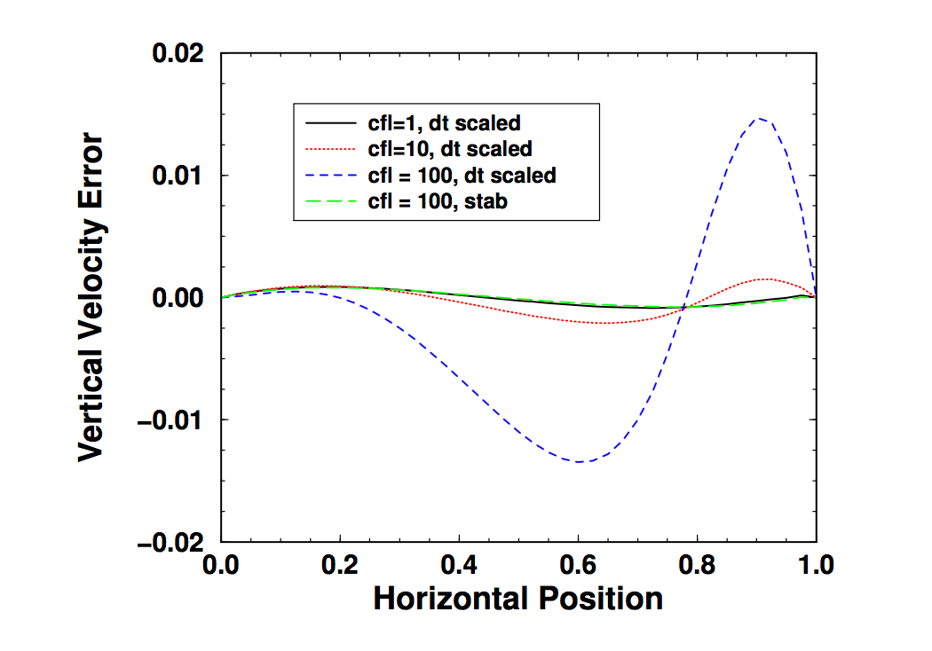
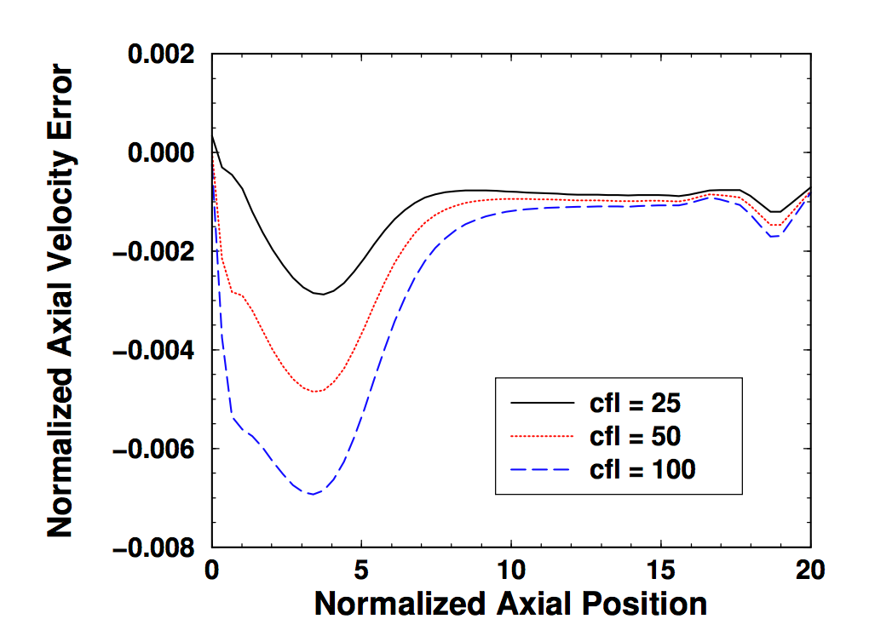
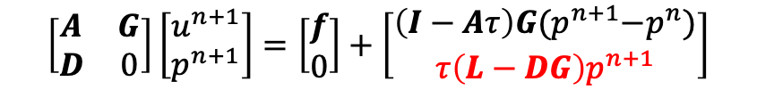

Sensitivity to chosen τ
Recall that the equal-order pressure stabilization error is given by,
Practical examples of error as a function of:
τ $∝$ Δt (the simulation timestep)
$τC∝$ (u/Δx)⁻¹ (characteristic advection time scale)
${τC\left(L−DG\right)p}^{n+1}{+\text{D}tL(p}^{n+1}−p^{n})$ (Soto and Lohner, “stabilized”)
$$\left[\begin{matrix}A & G \\ D & 0\end{matrix}\right]\left[\begin{matrix}u^{n+1} \\ p^{n+1}\end{matrix}\right]=\left[\begin{matrix}f \\ 0\end{matrix}\right]+\left[\begin{matrix}\left(I−Aτ\right)G{(p}^{n+1}−p^{n}) \\ {τ\left(L−DG\right)p}^{n+1}\end{matrix}\right]$$
Stabilizing effect
Driven Cavity
Open Jet

Slide 18
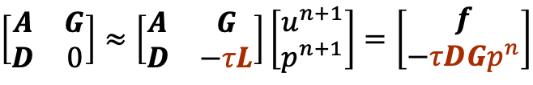
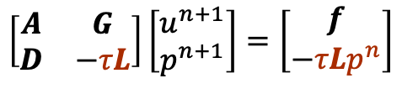
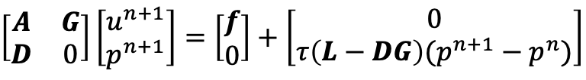
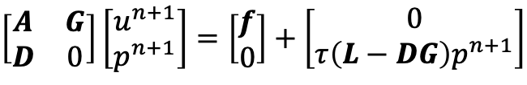
Monolithic Staggered or Equal-order Interpolation (Collocated)
Note that we need not split the system for a staggered scheme:
or collocated:
Conclusion: Monolithic schemes control splitting error, however, dealing with pressure stabilization is an additional complexity for equal-order methods regardless of the chosen approach to solve the coupled system
$$\left[\begin{matrix}A & G \\ D & −τL\end{matrix}\right]\left[\begin{matrix}u^{n+1} \\ p^{n+1}\end{matrix}\right]=\left[\begin{matrix}f \\ −τLp^{n}\end{matrix}\right]$$
$$\left[\begin{matrix}A & G \\ D & 0\end{matrix}\right]\left[\begin{matrix}u^{n+1} \\ p^{n+1}\end{matrix}\right]=\left[\begin{matrix}f \\ 0\end{matrix}\right]+\left[\begin{matrix}0 \\ {τ\left(L−DG\right)(p}^{n+1}−p^{n})\end{matrix}\right]$$
$$\left[\begin{matrix}A & G \\ D & 0\end{matrix}\right]≈\left[\begin{matrix}A & G \\ D & −τL\end{matrix}\right]\left[\begin{matrix}u^{n+1} \\ p^{n+1}\end{matrix}\right]=\left[\begin{matrix}f \\ −τDGp^{n}\end{matrix}\right]$$
$$\left[\begin{matrix}A & G \\ D & 0\end{matrix}\right]\left[\begin{matrix}u^{n+1} \\ p^{n+1}\end{matrix}\right]=\left[\begin{matrix}f \\ 0\end{matrix}\right]+\left[\begin{matrix}0 \\ τ\left(L−DG\right)p^{n+1}\end{matrix}\right]$$

Slide 19

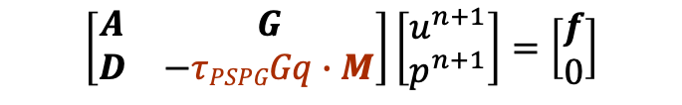
The Choice of the B₁ can Vary by The Method..
In Pressure-Stabilized Petrov-Galerkin (PSPG) methods (Hughes et al, 1985):
Here, M is a fine scale momentum residual and q is the test function for the Finite Element Method (continuity equation)
Note that M contains a local pressure gradient which, thereby, provides the pressure stabilization
The fine-scale momentum residual is evaluated locally at the quadrature point and with mesh refinement reduces at a design-order rate
With some algebra, one can show that L-DG ~ M
For more references, see Majumdar, Numerical Heat Transfer, 1988; Tezduyar and Sathe, J. Comput. Appl. Mech., 2003
Ηere, τ can be:
Simulation time step, i.e., Δt
Local advection/diffusion time scale, - or a more accurate flow-aligned approach
Diagonal of A
Full inverse of A (Ozawa)
$$\left[\begin{matrix}A & G \\ D & −τPSPGGq∙M\end{matrix}\right]\left[\begin{matrix}u^{n+1} \\ p^{n+1}\end{matrix}\right]=\left[\begin{matrix}f \\ 0\end{matrix}\right]$$
$${\left(\frac{u}{Δx}+\frac{υ}{{Δx}^{2}}\right)}^{−1}$$

Slide 20
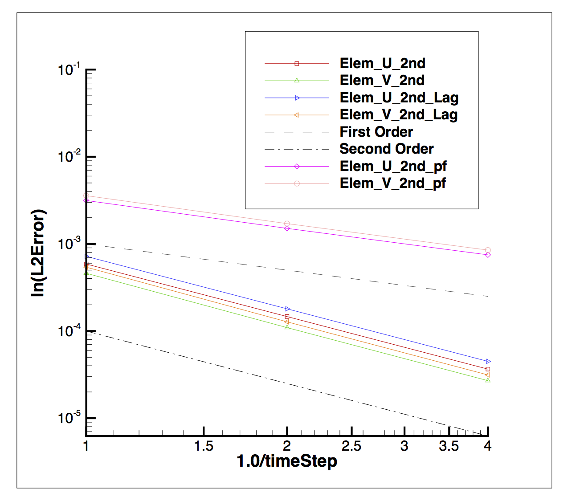
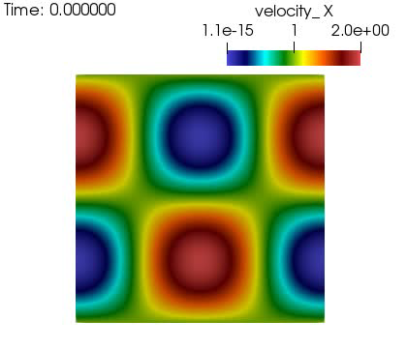
Code Verification To Establish Accuracy
Consider a two-dimensional transient solution to the incompressible equations of motion:
This solution is known as the convecting, decaying, Taylor vortex
$$u=u^{o}−\cos\left(π\left(x−u^{o}t\right)\right)\sin\left(π\left(y−v^{o}t\right)\right)e^{−2ωt}$$
$$v=v^{o}+\sin\left(π\left(x−u^{o}t\right)\right)\cos\left(π\left(y−v^{o}t\right)\right)e^{−2ωt}$$
$$p=−\frac{p^{o}}{4}\left[(cos\left(2π\left(x−u^{o}t\right)\right)+cos⁡(π\left(y−v^{o}t\right))\right]e^{−4ωt}$$
Approximate
factorization
Flavors of
incremental

Slide 21
Splitting and Stabilization Errors: Conclusion
Block matrix and operator form represents a useful construct to analyze coupling and stabilization
Approximate Factorization is generally O(Δt)
With very simple modifications, splitting error is mitigated
Detailed code verification is a critical tool to both test theoretical understandings in addition to establishing a proper code implementation

Slide 22
Stanford ME469: Splitting and Stabilization Errors Review
Stefan P. Domino
Computational Thermal and Fluid Mechanics
Sandia National Laboratories SAND2018-4536 PE

Slide 23
Introduction to Block Matrix Form for Fluids
Consider the monolithic, uniform density, low-Mach equation system:
that can be written in block form as:
We seek to factorize this system via:
B₂ determines the projection time scale, ideally chosen to approximate A⁻¹
B₁ controls the projection error, ideally chosen to cancel BD₂G
$\frac{∂u_{j}}{∂x_{j}}$ $=0$
$\frac{∂ρu_{i}}{∂t}+\frac{∂ρu_{j}u_{i}}{∂x_{j}}$ - $\frac{∂τ_{ij}}{∂x_{j}}=−\frac{∂p}{∂x_{i}}+S_{i}$
$$\left[\begin{matrix}A & G \\ D & 0\end{matrix}\right]\left[\begin{matrix}u^{n+1} \\ p^{n+1}\end{matrix}\right]=\left[\begin{matrix}f \\ 0\end{matrix}\right]$$
$$\left[\begin{matrix}A & G \\ D & 0\end{matrix}\right]≈\left[\begin{matrix}A & 0 \\ D & B_{1}\end{matrix}\right]\left[\begin{matrix}I & B_{2}G \\ 0 & I\end{matrix}\right]≈\left[\begin{matrix}A & AB_{2}G \\ D & (B_{1}+DB_{2}G)\end{matrix}\right]\left[\begin{matrix}u^{n+1} \\ p^{n+1}\end{matrix}\right]=\left[\begin{matrix}f \\ 0\end{matrix}\right]$$
the exact factorization can be recovered by defining:
$$B_{2}=A^{−1}$$
$$B_{1}=−DB_{2}G$$

Slide 24
Coupling Definitions: Monolithic
Fully Coupled, or Monolithic
One equation system, one solve
{
do while (!converged) {
}
For a given
time step:
Reduced radius of convergence
Second order convergence

Slide 25
Coupling Definitions: Segregated
Loosely Coupled, or Segregated
Multiple matrix systems solved within a Picard linearization, i.e., Jacobi or Gauss-Seidel iteration. Coupling is two-way (or multiple way if the physics becomes really complex)
{
do while (!converged) {
}
For a given
time step:
Every equation is segregated..
Larger radius of convergence
Often, stagnates to first-order convergence

Slide 26


Incremental Approximate Pressure-Projection with Pressure Stabilization Errors
Let the inverse of A, A⁻¹ be approximated by B₂ as a scalar, τ (which is ~ time scale)
Let B₁ be equal to the scaled Laplace operator, - τL
The new splitting and stabilization error is given by:
The above can be shown to hold a second-order temporal error (coming)
Here, due to equal-order interpolation, i.e., collocation of primitives, L != DG
Therefore, L-DG ~ 4th-order pressure stabilization (pressure oscillations damped)
However, pressure-stabilization error remains
Momentum and Continuity:
$$\left[\begin{matrix}A & 0 \\ D & −τL\end{matrix}\right]\left[\begin{matrix}\hat{u} \\ p^{n+1}\end{matrix}\right]=\left[\begin{matrix}\hat{f} \\ −DτGp^{n}\end{matrix}\right]$$
$$A\hat{u}=f−Gp^{n}$$
$$D\hat{u}=τ(Lp^{n+1}−DGp^{n})$$
Nodal Projection:
$$\left[\begin{matrix}I & τG \\ 0 & I\end{matrix}\right]\left[\begin{matrix}u^{n+1} \\ p^{n+1}\end{matrix}\right]=\left[\begin{matrix}\hat{u} \\ \hat{p}\end{matrix}\right]+\left[\begin{matrix}τGp^{n} \\ 0\end{matrix}\right]$$
$$u^{n+1}=\hat{u}−{τG(p}^{n+1}−p^{n})$$
$$p^{n+1}=\hat{p}$$
Examples:
Rhie-Chow (1983)
Peric (1985)
Domino (2006)
$$\left[\begin{matrix}A & G \\ D & 0\end{matrix}\right]\left[\begin{matrix}u^{n+1} \\ p^{n+1}\end{matrix}\right]=\left[\begin{matrix}f \\ 0\end{matrix}\right]+\left[\begin{matrix}\left(I−Aτ\right)G{(p}^{n+1}−p^{n}) \\ τ\left(L−DG\right)p^{n+1}\end{matrix}\right]$$

Slide 27
The Role of Pressure Stabilization (L!=DG) in an Equal-Order Approach
Consider the classic lid-driven cavity flow with top wall velocity of Uo
Uo
Unsmoothed pressure field at
various Courant numbers
lid-driven cavity velocity
(u-component)
Equal-Order: same basis and interpolation operators for continuity and momentum Also known as: “collocated”

Slide 28
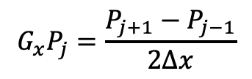
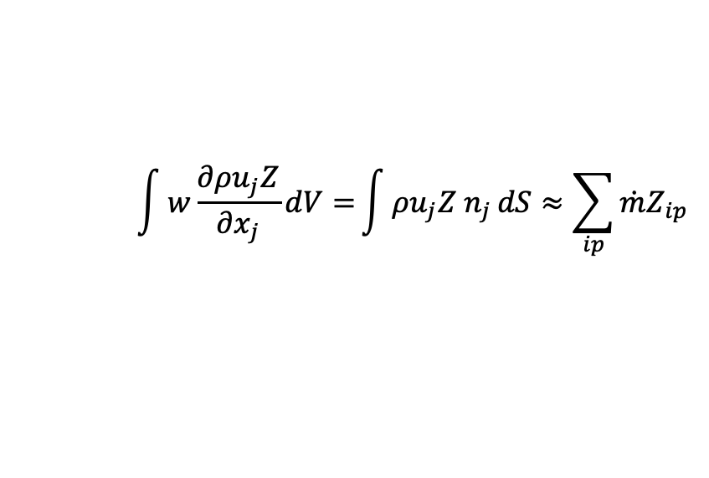
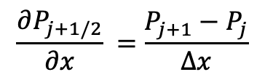

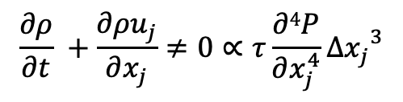
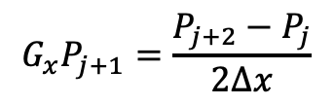
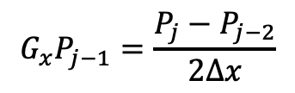
First, The Role of $\dot{m }$
For an equal-order, low-Mach approximate projection scheme, explicit pressure stabilization was added. How does this manifest itself in the advection operator?
Using the above equations, we can derive the actual continuity equation that we are solving:
Recall discrete continuity solve
$$\int{w\frac{∂ρu_{j}Z}{∂x_{j}}dV=}\int{ρu_{j}Z n_{j}}dS≈\sum_{ip}{\dot{m}Z_{ip}}$$
$$D\hat{u}=τ(Lp^{n+1}−DGp^{n})$$
$$\frac{∂P_{j−1/2}}{∂x} =\frac{P_{j}−P_{j−1}}{∆x}$$
$$\frac{∂P_{j+1/2}}{∂x} =\frac{P_{j+1}−P_{j}}{∆x}$$
j-2
j-1
_{j-1/2}
j
_{j+1/2}
j+1
j+2
$$G_{x}P_{j−1}=\frac{P_{j}−P_{j−2}}{2∆x}$$
$$G_{x}P_{j}=\frac{P_{j+1}−P_{j−1}}{2∆x}$$
$$G_{x}P_{j+1}=\frac{P_{j+2}−P_{j}}{2∆x}$$
$$\frac{∂ρ}{∂t} +\frac{∂ρu_{j}}{∂x_{j}}≠0∝τ\frac{∂4P}{∂x_{j}^{4}}{∆x_{j}}^{3}$$

Slide 29
Wait, What is an alternative view of what L-DG forms?
Let’s define an assembled system for velocity component as:
Tu_{i} + Vu_{i} – Du_{i} – S = -Gp_{i}
Where T, V, D, S, and G are the time, advection, diffusion, source and gradient operators (matrix form)
We can do the same for a local integration point fine-scale momentum equation:
Tu_{i} + Vu_{i} – Du_{i} – S = -dp/dx_{i}|ip
Algebraically, we can reconstruct the fine scale residual to be an interpolation of the nodal-assembled momentum equation that we solved:
(dp/dx_{i} – M⁻¹Gp_{i}|ip) = Res_u_{i}
…. And uses this scaled residual as a correction to the interpolated velocity
The finite volume community calls this “Rhie-Chow”, or “Momentum interpolation”, while the finite element community terms this “residual-based stabilization”

