Slide 1
ME469: Geometric Fidelity
Stefan P. Domino^{1,2}
¹ Computational Thermal and Fluid Mechanics, Sandia National Laboratories
² Institute for Computational and Mathematical Engineering, Stanford
SAND2018-4536 PE

Slide 2
Review of Discretization Options
Degree-of-freedom (DOF) for:
Cell-centered: Stencil is based on an element:face:element
DOFs at vertices of elements, or “nodes”, element:node (CVFEM, FEM), edge:node (EBVC)

Slide 3
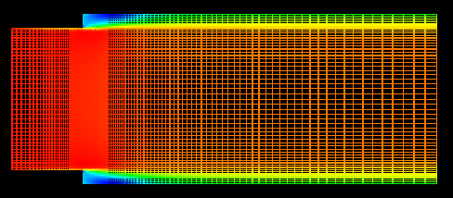
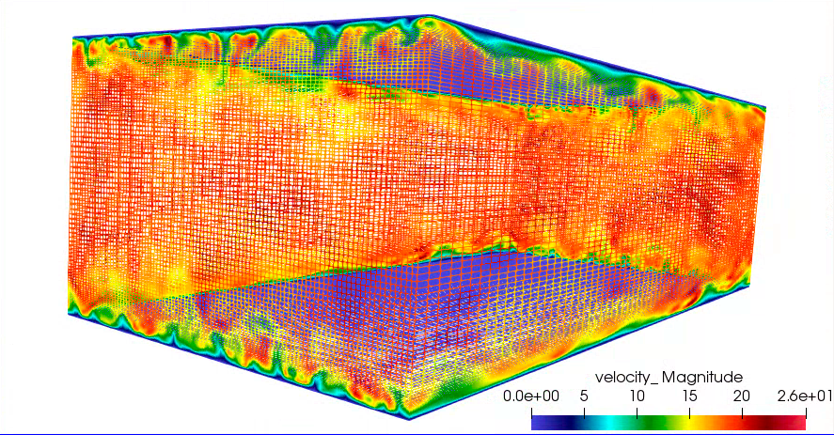
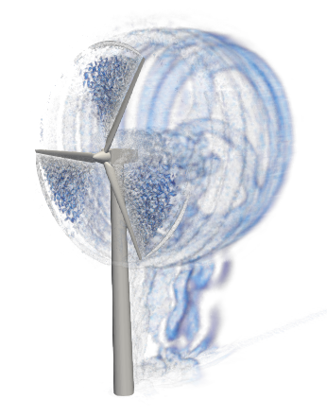
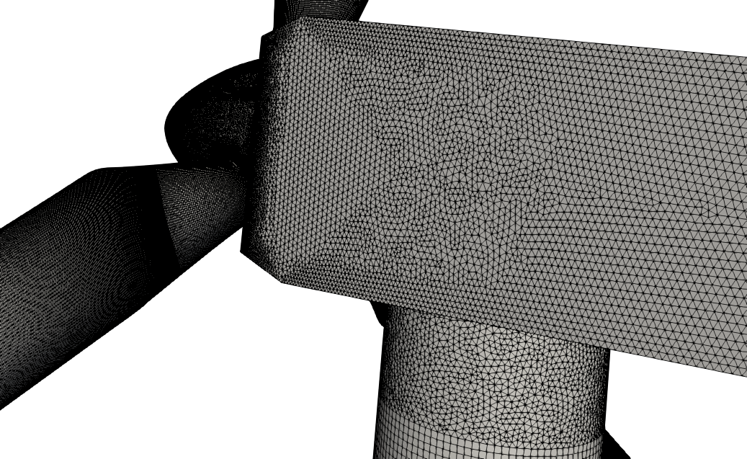
Simple vs Complex Domains
Some Geometries are simple, while others are complex

Slide 4
Review: Simple One-Dimensional Diffusion MMS Example
Let us introduce (briefly) the Method of Manufactured Solutions (MMS)
Consider a simple diffusion equation:
with a presumed, or manufactured solution:
Gauss-Divergence
Discrete flux-based form at the sub-control volume surface (scs) and sub-control volume IP:
With error:

Slide 5
First….
Let’s review matrix assembly from a previous lecture, with a focus on a verification “patch test”
Recall, a linear basis was able to reconstruct a quadratic solution perfectly when the norm was computed at the degree of freedom locations

Slide 6
Simple One-D MMS Example; Edge-based Assemble of Diffusion
We will use a linear basis and solve this system over a small patch of linear bar elements
Recall, simplified equation with RHS from source term already provided
Iterate elements with a simple left-hand side rule: += L and -=R
(note implicit conservation statement)
node = 0
1
Δx = 1
2
3
x
x
x
Edge 1

Slide 7
Simple One-D MMS Example; Edge-based Assemble of Diffusion
We will use a linear basis and solve this system over a small patch of linear bar elements
Recall, simplified equation with RHS from source term already provided
Iterate elements with a simple left-hand side rule: += L and -=R
(note implicit conservation statement)
node = 0
1
Δx = 1
2
3
x
x
x
Edge 2

Slide 8
Simple One-D MMS Example; Edge-based Assemble of Diffusion
We will use a linear basis and solve this system over a small patch of linear bar elements
Recall, simplified equation with RHS from source term already provided
Iterate elements with a simple left-hand side rule: += L and -=R
(note implicit conservation statement)
node = 0
1
Δx = 1
2
3
x
x
x
Edge 3

Slide 9
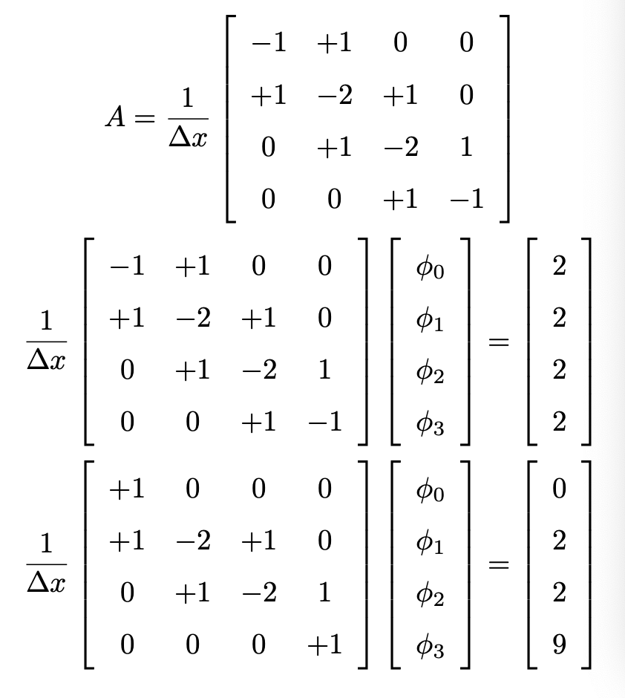
Simple One-D MMS Example; Collect all of the terms
Fully assembled
matrix
Fully assembled
system
Correct for BCs
Solution is exact….. Linear basis exactly captures a quadratic solution

Slide 10
Simple One-D Advection; Edge-based Assembly
Similar approach: Iteration of edges, definition of Left and Right node, etc.
node = 0
1
Δx = 1
2
3
x
x
x
We may also create a local matrix data structure, A[4]: With:
A[0] += lhsFac (row node 1, column node 1, “central-coeff”)
A[1] += lhsFac (row node 1, column node 2, ”east-coeff”)
A[2] -= lhsFac (row node 2, column node 1, “west-coeff”)
A[3] -= lhsFac (row node 2, column node 2, “central-coeff”)
With:
Edge 2

Slide 11
Focus on Three Nalu/reg_tests/test_files/laboratory
2d_quad9_couette
2d_quad4_channel
3d_tet4_pipe

Slide 12
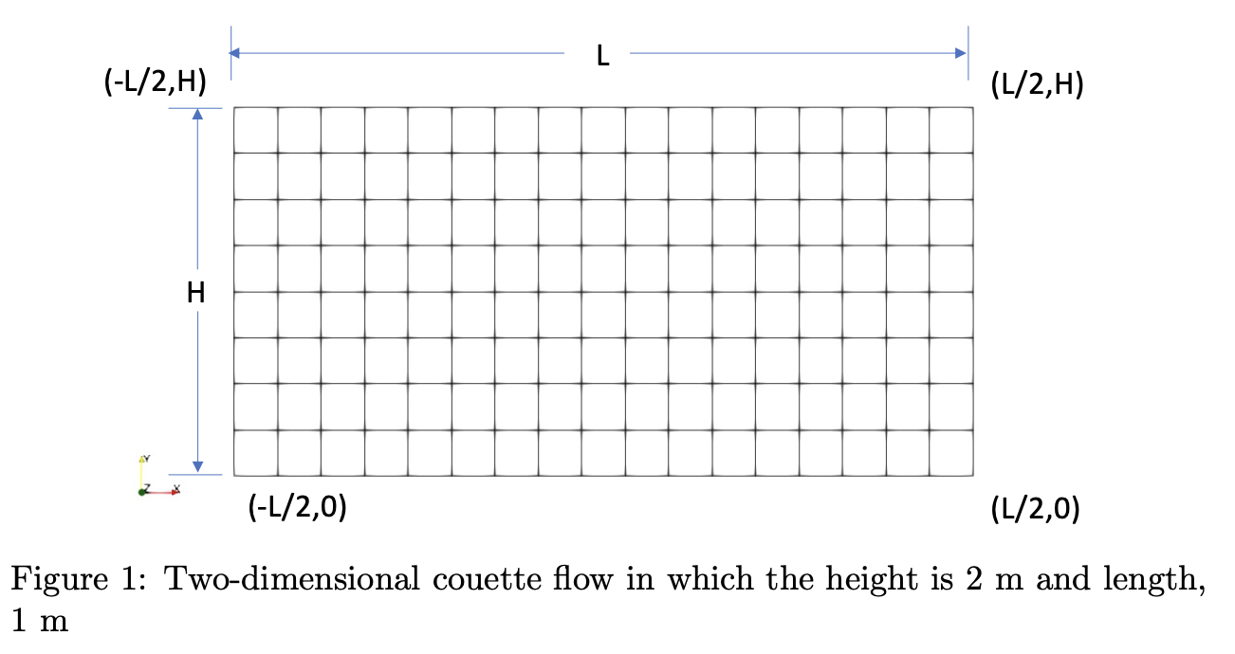
Nalu/reg_tests/test_files/laboratory/2d_quad9_couette: Geometry/Boundary Conditions
Top, imposed velocity
Bottom, no-slip wall
Left and right sides, periodic

Slide 13
Nalu/reg_tests/test_files/laboratory/2d_quad9_couette: Equations
Subject to the imposed conditions, the momentum equation reduces to:
With analytical solutions (at a given Reynolds number):
Simple, and a linear profile

Slide 14
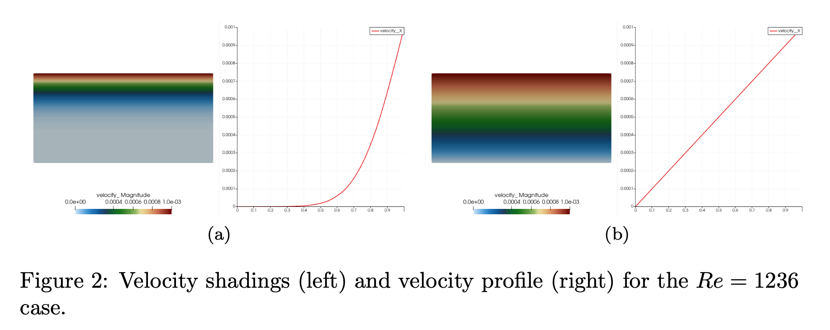
Nalu/reg_tests/test_files/laboratory/2d_quad9_couette: Simulation Results
Start-up adds additional complexity to the solution, however, at steady state, our profile is predicted to be linear

Slide 15
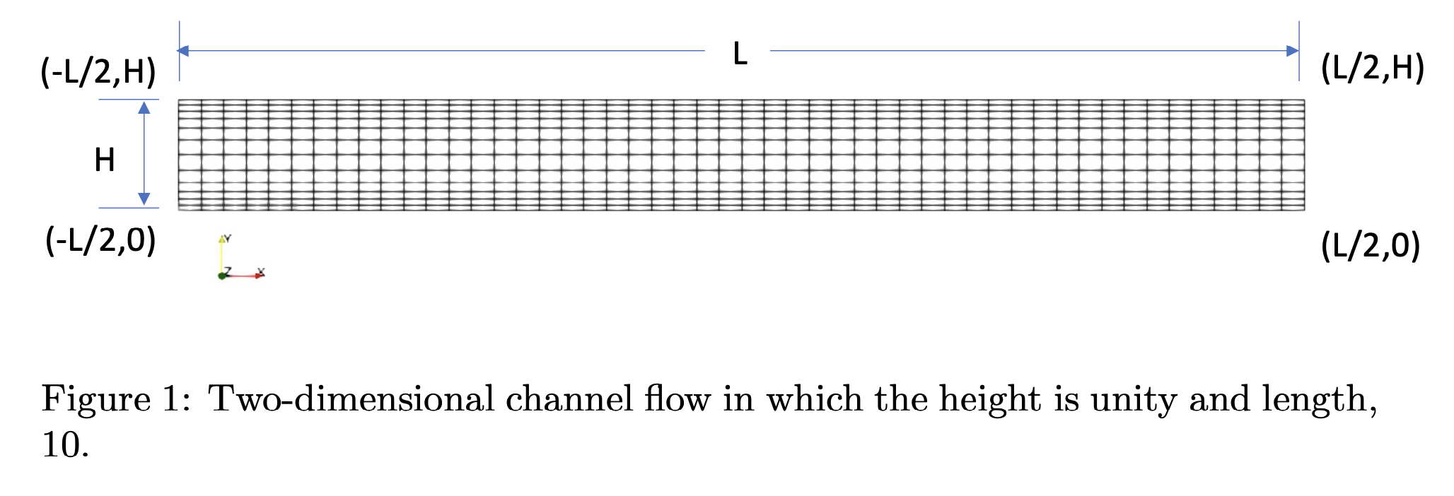
Nalu/reg_tests/test_files/laboratory/2d_quad4_channel: Geometry/Boundary Conditions
Top and bottom, no-slip wall
Left and right sides, either open (specified pressure drop) or with a body force, periodic

Slide 16
Nalu/reg_tests/test_files/laboratory/2d_quad4_channel: Equations
Subject to the imposed conditions, the momentum equation reduces to:
With analytical solutions (at a given Reynolds number):
Quadratic profile
Wall shear stress and pressure gradient balance:

Slide 17
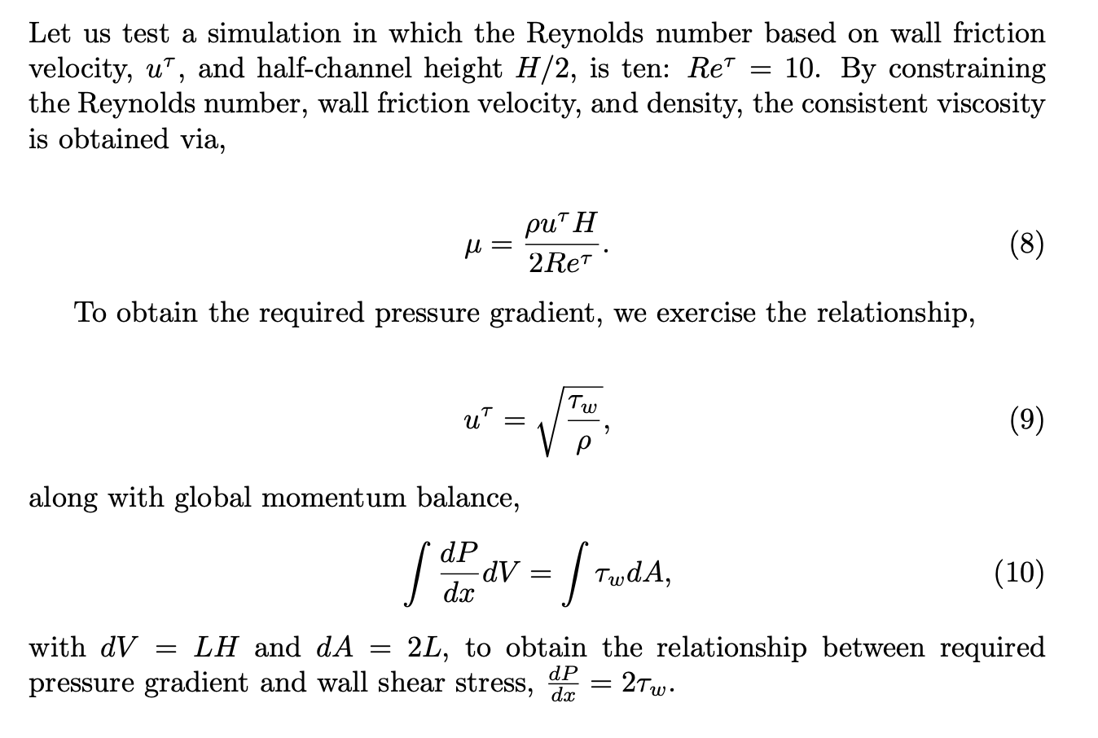
Nalu/reg_tests/test_files/laboratory/2d_quad4_channel: Sizing
Let’s run at Re_{τ}=10
Reynolds number:
Ratio of inertial to viscous forces
In this channel, define Reynolds number based on the wall friction velocity, u_{τ} (at H/2 length scale)

Slide 18
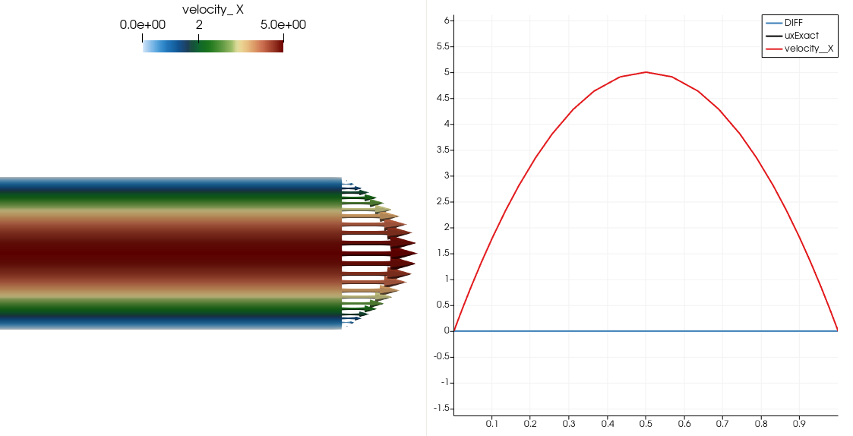
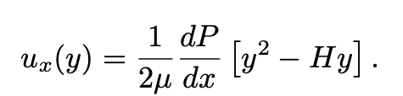
Nalu/reg_tests/test_files/laboratory/2d_quad4_channel: Simulation Results
Analytical Expression:
Zero Error when evaluating the norm at the nodes (in general, we may integrate over a domain and choose integration points that are not nodally-lumped
However, the post-processed wall shear stress showcases error…

Slide 19
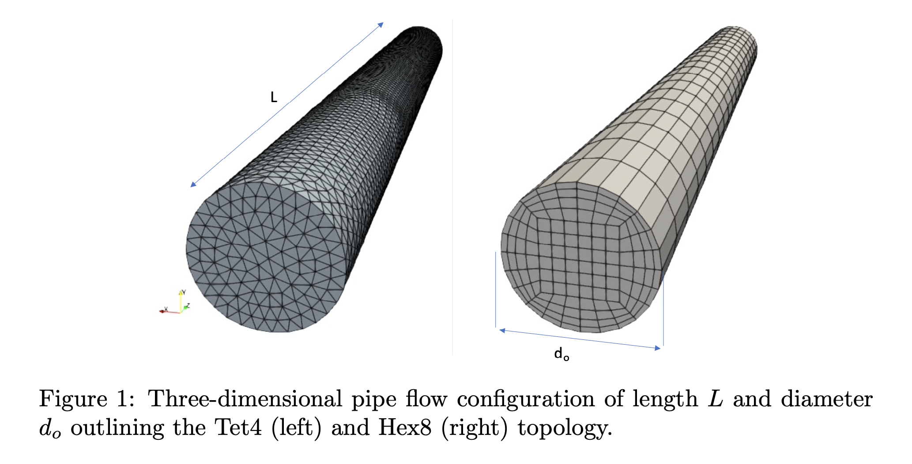
Nalu/reg_tests/test_files/laboratory/3d_tet4_pipe: Geometry/Boundary Conditions
No-slip (walls) outer pipe
Periodic (left and right) with a constant body force …or… Open (left and right pressure drop)

Slide 20
Nalu/reg_tests/test_files/laboratory/ 3d_tet4_pipe: Equations
Subject to the imposed conditions, the axial momentum equation (cylindrical coordinates) reduces to:
With analytical solutions (at a given Reynolds number):
Quadratic profile
Wall shear stress, and pressure gradient balance

Slide 21
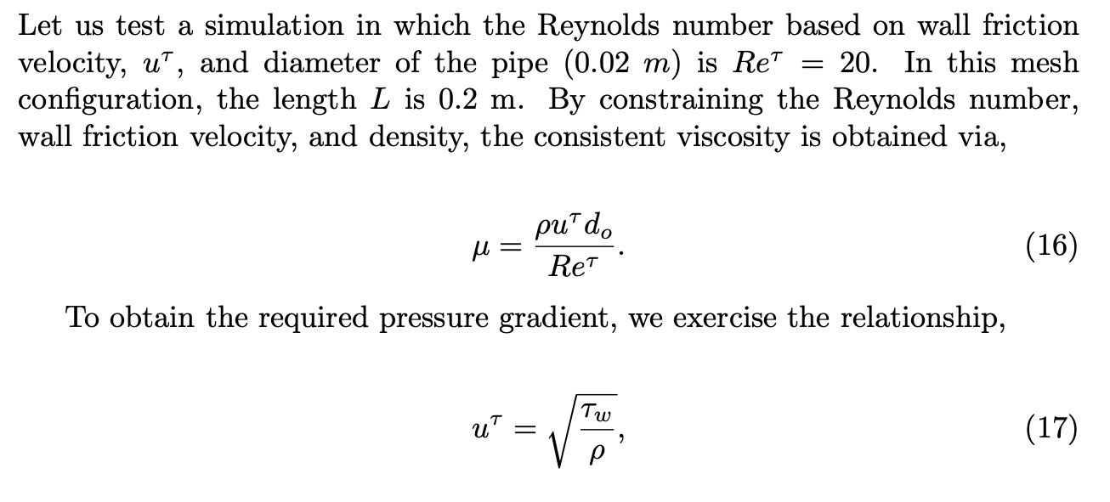
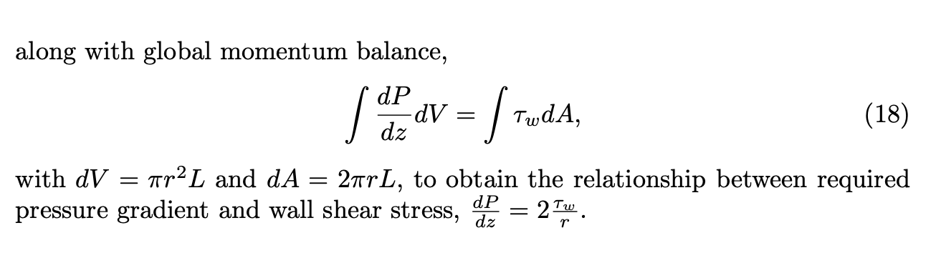
Nalu/reg_tests/test_files/laboratory/ 3d_tet4_pipe: Sizing
Let’s run at Re_{τ}=20
Reynolds number:
Ratio of inertial to viscous forces
In this channel, define Reynolds number based on the wall friction velocity, u_{τ} (at d_{o} length scale)

Slide 22
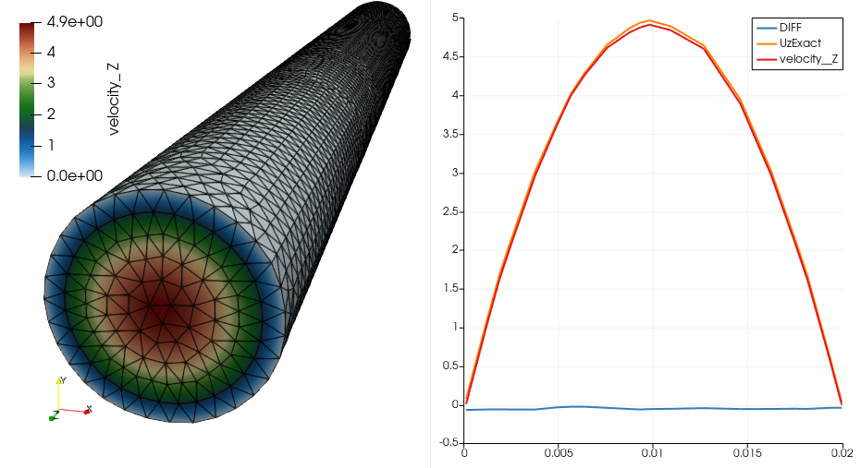
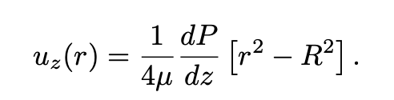
Nalu/reg_tests/test_files/laboratory/2d_quad9_channel: Simulation Results
Analytical Expression:
Non-zero error when evaluating the norm at the nodes…

Slide 23
Nalu/reg_tests/test_files/laboratory/2d_quad9_channel: Simulation Results
Analytical Expression:
Non-zero error when evaluating the norm at the nodes…
What happened?

Slide 24
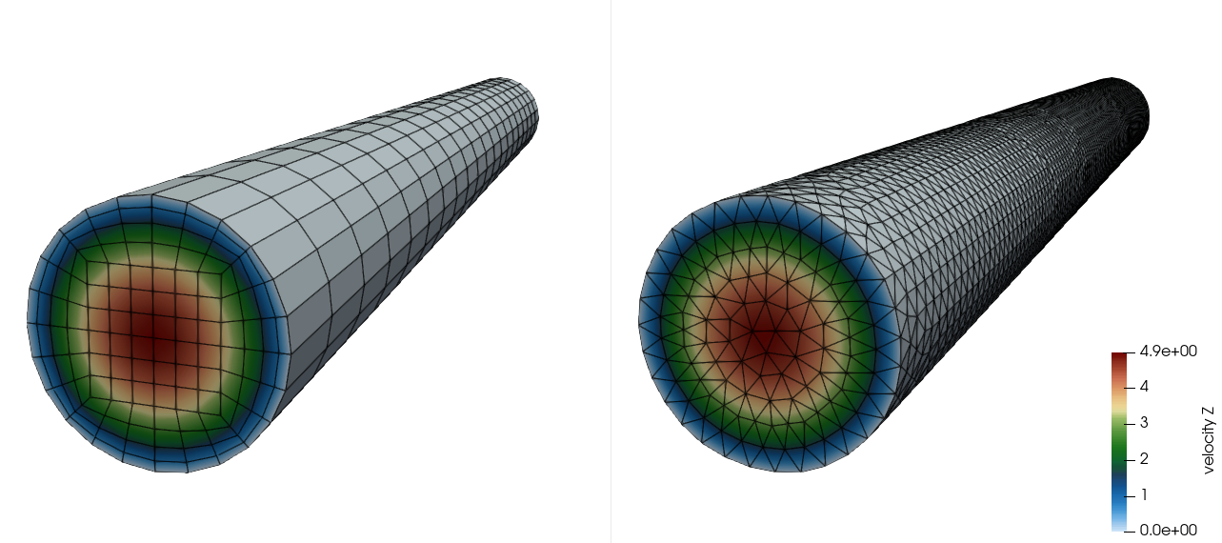
Nalu/reg_tests/test_files/laboratory/2d_quad9_channel: What About Tet4 vs Hex8?

Slide 25
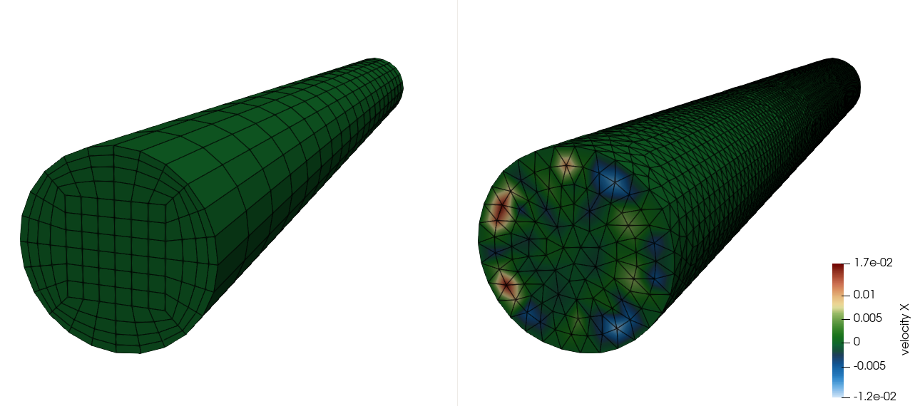
Nalu/reg_tests/test_files/laboratory/2d_quad9_channel: What About Tet4 vs Hex8?
~0.3% error in non-streamwise velocity components in the tet-based result, ~0% for Hex8!!!

Slide 26
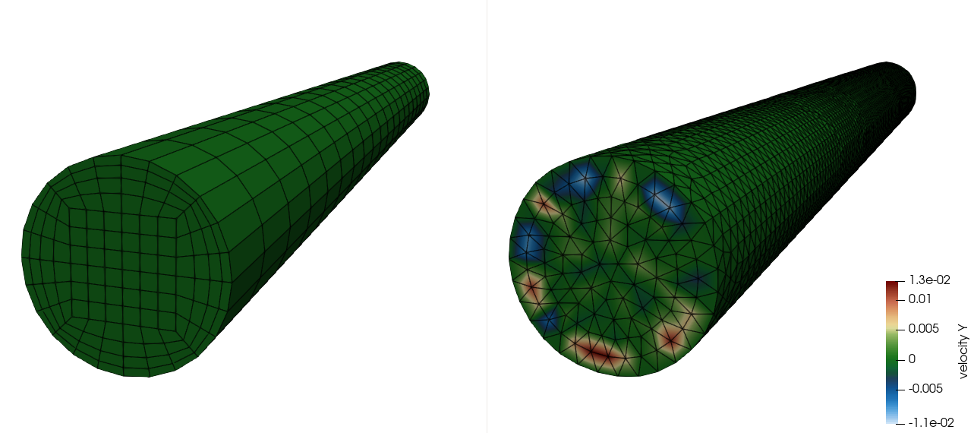
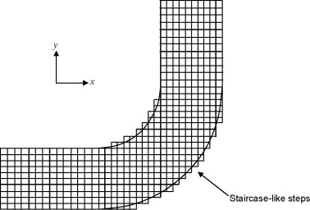
Nalu/reg_tests/test_files/laboratory/2d_quad9_channel: What About Tet4 vs Hex8?
Jiyuan Tu, Guan-Heng Yeoh, Chaoqun Liu,
Chapter 4 - CFD Mesh Generation: A Practical Guideline,
Editor(s): Jiyuan Tu, Guan-Heng Yeoh, Chaoqun Liu,
Computational Fluid Dynamics (Third Edition),
Butterworth-Heinemann, 2018, Pages 125-154,
~0.3% error in non-streamwise velocity components in the tet-based result, ~0% for Hex8!!!

Slide 27
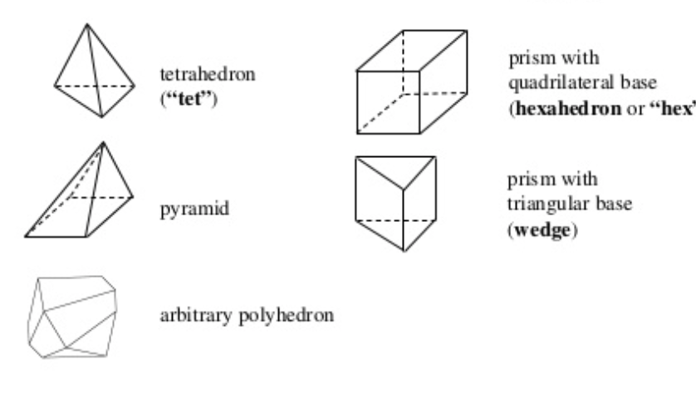
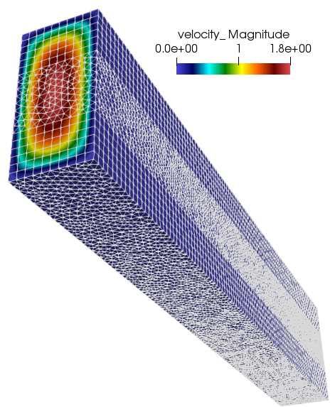
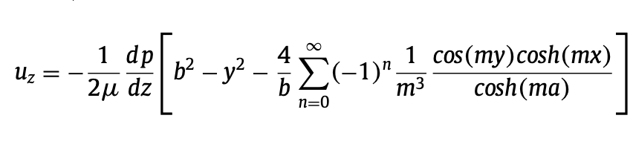
Unstructured Mesh Types (Review) and Results
Hex8
Tet4
Pyramid5
Wedge6
Domino et al., “An assessment of atypical mesh topologies for low-Mach large-eddy simulation”, Computers & Fluids, 2019
Design order…..

Slide 28
Unstructured Mesh Types (Review) and Results
Tet4
Pyramid5
Wedge6
Hex8
Domino et al., “An assessment of atypical mesh topologies for low-Mach large-eddy simulation”, Computers & Fluids, 2019

Slide 29
Conclusions
Geometric fidelity for curved surfaces can be very important
Unstructured meshing generally affords easier meshing, with increase throughput (especially when simulating complex geometries)
Hex-based errors may be lower than Tet-based simulation results, however, balanced with ease of meshing
The key is that all methods are “design-order”, i.e., demonstrate expected reduction of errors as a function of mesh size

