Slide 1
ME469: Review of Partial Differential Equations
Stefan P. Domino^{1,2}
¹ Computational Thermal and Fluid Mechanics, Sandia National Laboratories
² Institute for Computational and Mathematical Engineering, Stanford
SAND2018-4536 PE

Slide 2
Equation Review
Real World
The intended application
Physical laws, hypothesis and models (e.g. a set of PDEs) and initial and boundary conditions
A set of computational algorithms that allow to build a numerical, or approximated solution to the conceptual model
Conceptual
Model
Computer Model

Slide 3
Partial Differential Equation: Transient Evolution of a Scalar with Advection, Diffusion, and Source
General Transport Equation using Einstein notation, i.e., repeated index, for scalar φ
Density, ρ [kg/m³]
Velocity, u_{j} [m/s]
Mass diffusivity, D [m²/s²]
Dynamic viscosity, μ [kg/(m-s)]
Schmidt number, Sc
Time term, or “accumulation”
advection
diffusion
source/sink term
Repeated Index Example

Slide 4
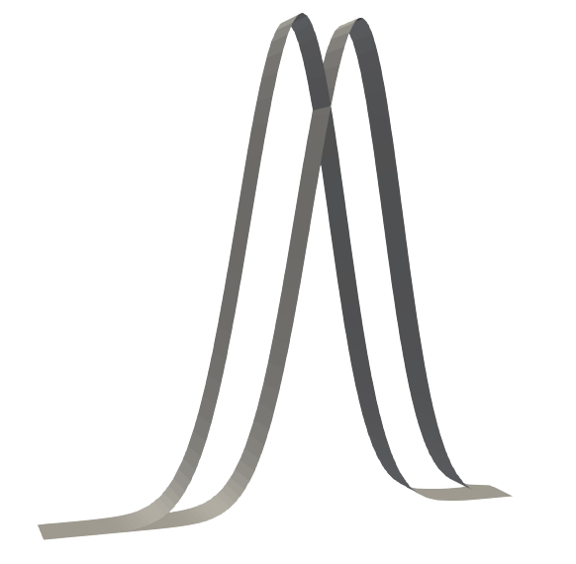
Partial Differential Equation: Transient Evolution of a Scalar with Advection
General Transport Equation using Einstein notation, i.e., repeated index, for scalar φ
Density, ρ [kg/m³]
Velocity, u_{j} [m/s]
Mass diffusivity, D [m²/s²]
Dynamic viscosity, μ [kg/(m-s)]
Schmidt number, Sc
Δt
u_{x}
0.0
0.0

Slide 5
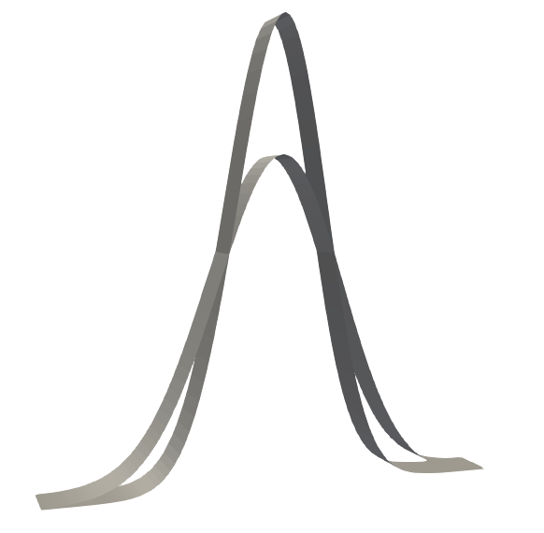
Partial Differential Equation: Transient Evolution of a Scalar with Diffusion
General Transport Equation using Einstein notation, i.e., repeated index, for scalar φ
Density, ρ [kg/m³]
Velocity, u_{j} [m/s]
Mass diffusivity, D [m²/s²]
Dynamic viscosity, μ [kg/(m-s)]
Schmidt number, Sc
Δt
0.0
0.0

Slide 6
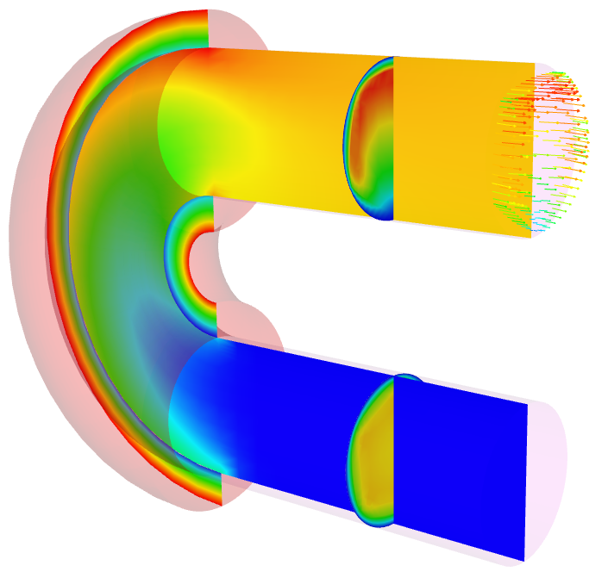
Partial Differential Equation: Transient Heat Conduction
Thermal Heat Conduction
Density, ρ [kg/m³]
Specific Heat, C_{p} [J/(kg-K)]
Thermal conductivity, λ [W/(m-K)], 1W = 1 J/s
Heat flux vector, q_{j}
Thermal heat conduction (outer shell heated)

Slide 7
Variable Density, non-Isothermal Fluid Flow System
Consider the variable density (non-isothermal) equations of motion (momentum and continuity) with energy transport:
Equation of State (EOS) provides the P and ρ relationship
Constitutive Relationships
(2+nDim)

Slide 8
Conserved vs Non-conserved Form
For the so-called non-conserved form, chain-rule the advection term, while enforcing continuity:
0.0

Slide 9
Incompressible Navier Stokes
For a constant density and viscosity (in absence of a source term), we revert to the classic form:
0.0
0.0
0.0
(trick)

