Slide 1
ME469: Numerical Methods and Errors
Stefan P. Domino^{1,2}
¹ Computational Thermal and Fluid Mechanics, Sandia National Laboratories
² Institute for Computational and Mathematical Engineering, Stanford
SAND2018-4536 PE

Slide 2
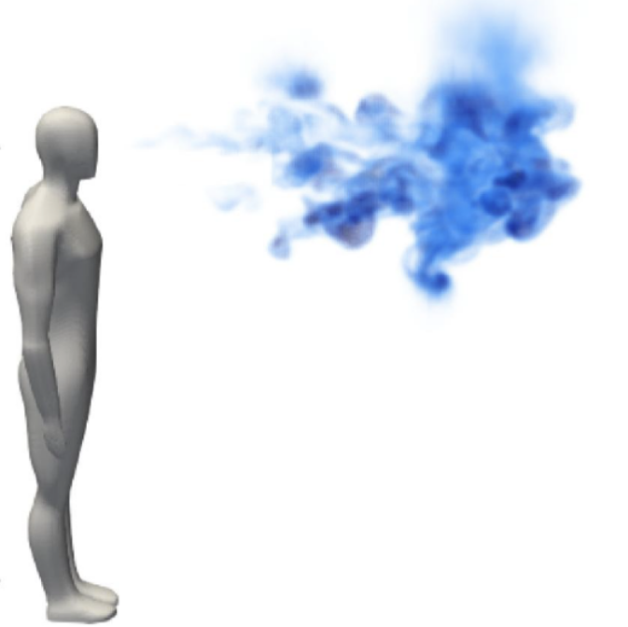
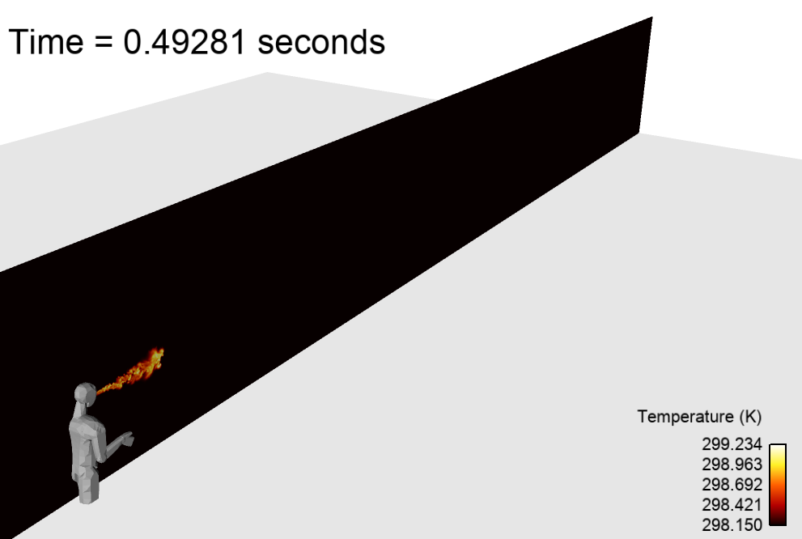
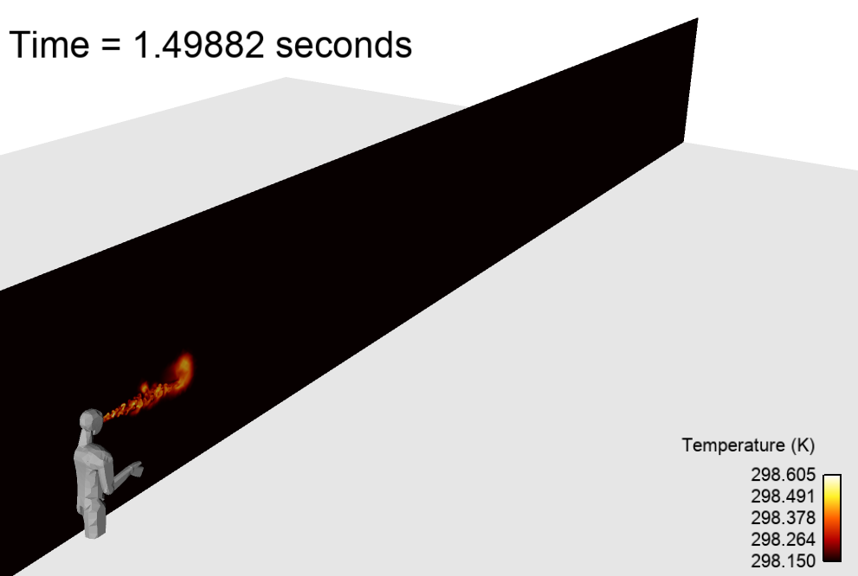
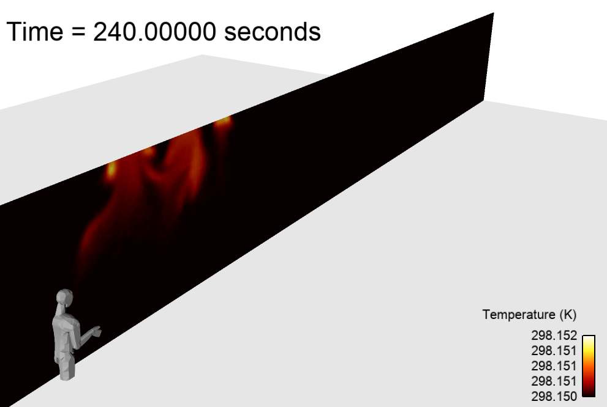
Simple Passive Scalar Transport
The study of passive transport of nutrients or pollutants is important in biological and environmental applications (smoke, pathogens, etc.)
Left, depicts a passive scalar representing a synthetic cough, Vuorinen et al. “Modelling aerosol transport and virus exposure with numerical simulations in relation to SARS-CoV-2 transmission by inhalation indoors”, Safety Science (2020)
Recall that the conceptual model may require buoyancy effects, right, Domino, “A case study on pathogen transport, deposition, evaporation and transmission: Linking high-fidelity computational fluid dynamics simulations to probability of infection”, Int J. CFD (2021)

Slide 3
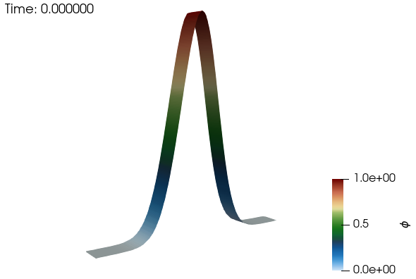
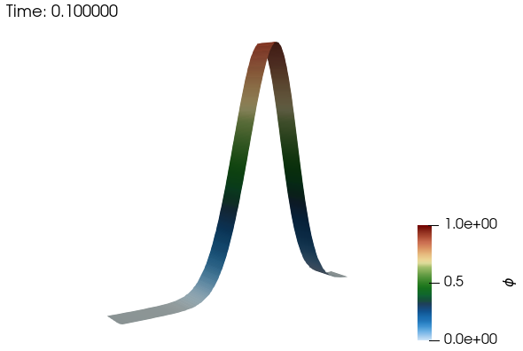
One Dimensional Temporal, Advection-Diffusion Equation Passive Scalar Transport
Let us assume that the problem is defined in a one-dimensional configuration, and that the pollutant concentration is given by, φ(x,t)
Given an initial distribution of the pollutant φ(x,t = T_{o}), we can evaluate the concentration at any later time T₁ through solving a partial differential equation of the form:
Above, the air velocity v is constant
Diffusion is characterized by a constant diffusivity ν, (m²/2)
Initial Condition:
Gaussian
Boundary Condition:
Domain is periodic

Slide 4
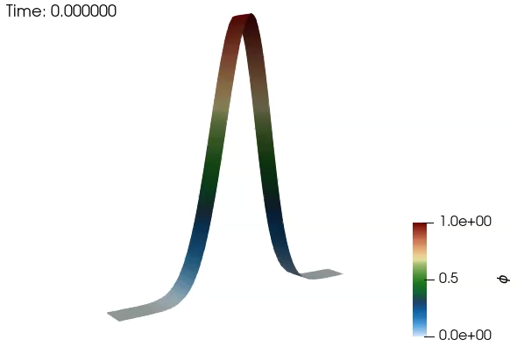
One Dimensional Temporal, Advection-Diffusion Equation Passive Scalar Transport
Let us assume that the problem is defined in a one-dimensional configuration, and that the pollutant concentration is given by, φ(x,t)
Given an initial distribution of the pollutant φ(x,t = T_{o}), we can evaluate the concentration at any later time T₁ through solving a partial differential equation of the form:
Above, the air velocity v is constant
Diffusion is characterized by a constant diffusivity ν, (m²/2)
Initial Condition:
Gaussian
Boundary Condition:
Domain is periodic

Slide 5
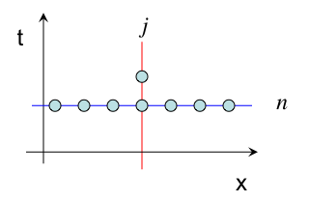
The Discretization Step
The region of interest ( x_{L} ≤ x ≤ x_{R} ) is transformed into a discrete tessellation, i.e. the grid defined by the nodes x_{j} or the intervals between two nodes (volume) x_{j+1} − x_{j} = Δx
A similar tessellation is also used to represent time discretely in terms of level t_{n} or intervals t_{n+1} − t_{n} = Δτ
The solution of the original advection-diffusion equation is only sought at the specific locations (x_{j}) and time (t_{n})
Nodes j-1, j, j+1, …

Slide 6
Approximations to the Continuous Derivative
The governing equation must also be transformed into an equivalent discrete representation
The simplest approach involves replacing each (continuous) derivative into a discrete relationship between the function φ represented at the grid nodes
Recall the formal definition of derivative:
Evaluated for a finite value of Δx
Note: The approximate sign represent the effect of the discretization error consequence of a non-zero Δx

Slide 7
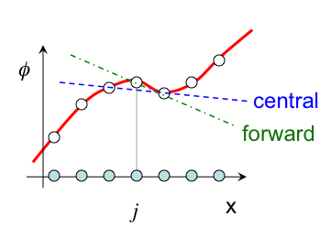
Geometric Interpretation
The formula introduced before,
is only one of the possible representations of the derivative
It can be interpreted geometrically as the approximate slope of a smooth interpolant of the discrete values φ_{j}
forward scheme
central scheme

Slide 8
Algebraic System of Equations: Explicit
Starting from the (continuous) mathematical model:
The discretization step results in (discrete) computational model, for example using forward-in-time and central-in-space derivatives: FT-CS
In this case the solution step is straightforward:
The scheme is explicit and represents an example of a finite difference technique: Note: this scheme, for ν = 0, is NOT STABLE (more later)

Slide 9
Algebraic System of Equations: Implicit
Different choices of discretization techniques lead to more complex solution steps
For example, backward-in-time and central-in-space derivatives: BT-CS
Here, the solution step is formally:
Or, better written as a Matrix system:
This scheme is implicit, i.e., requires a matrix inversion, and represents an example of a finite difference technique

Slide 10
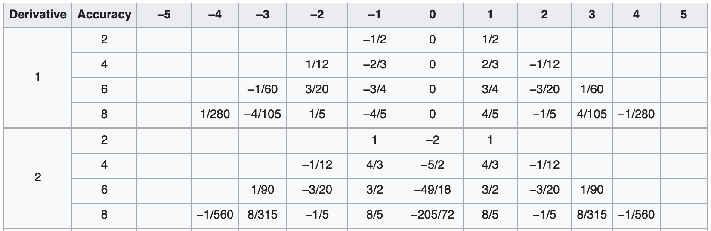
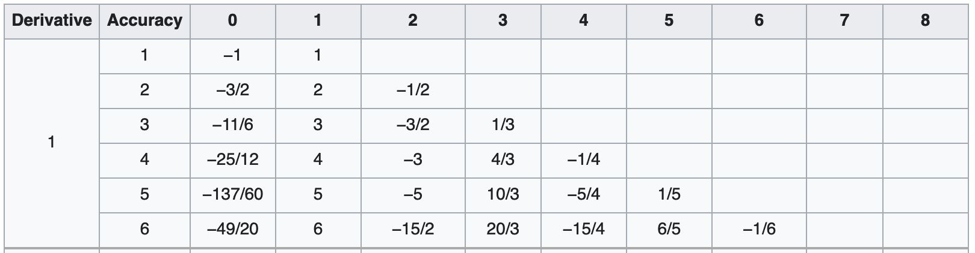
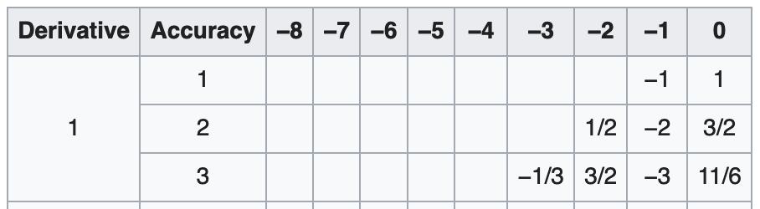
Many Choices on Finite Difference Operators
Central finite difference
Forward finite difference
https://en.wikipedia.org/wiki/Finite_difference_coefficient
Backward finite difference

Slide 11
Properties of Numerical Methods
Outline:
Consistency
Stability, Von Neumann Analysis
Convergence - Lax Equivalence Theorem
Understanding Errors

Slide 12
High Level Concepts
A discretized mathematical model – a numerical model – is an approximation to the original, postulated, continuous model
The properties of such numerical model have a strong effect on the computed solution
As a first step we will study three critical properties
Consistency
Accuracy
Stability

Slide 13
Consistency
Definition: A discretization scheme for a mathematical model is consistent if it asymptotes to the original continuous form as the grid and timestep size tend to zero
Consistency is a property of the discretization, not of the numerical solution to the given problem
Q: How to assess if a discretization technique is consistent?
A: Study the truncation error and verify that is vanishes as the grid and timestep size tend to zero.

Slide 14
Stability
Definition: A discretization scheme for a mathematical model is stable if numerical errors (e.g. round-off due to the precision in the computer representation) are not allowed to grow unbounded
Stability is a property of the discretization, not of the numerical solution to the given problem
Q: How to assess if a discretization technique is stable?
A: This is fairly easy for linear PDEs with constant coefficients and no boundary conditions (periodic domains)

Slide 15
Stability Analysis
The simple discretization scheme (FT-CS) for the pure-advection problem is consistent but NOT stable
Recall its explicit form:
Can we understand why and, perhaps, design a different scheme that is stable?
0

Slide 16
Consistency + Stability Analysis
We can consider the effect of the truncation error as continuous terms in a modified differential equation
Applying again a Taylor series expansion and plugging in the expression for the truncation error just found we obtain:
For a given Δx and Δt, note that we are not solving the pure advection equation, although the scheme is consistent (asymptotically)
Physical viscosity (positive) has the effect of smoothing the solution; but here, the value is negative, and, therefore, destabilizing

Slide 17
Convergence
Definition: The numerical solution of a computational model approaches is convergent the exact if it asymptotes to the exact solution of the original continuous problem as the grid and timestep tend to zero
Convergence is a property of the solution
Q: How to assess if the solution is converging?
A: This is formally possible only if the exact solution to the original problem is known!

Slide 18
Numerical Simulation Conundrum
PDE
ADE
Consistency
Stability
Exact
Solution
Numerical
Solution
Convergence
Convergence is required for a consistent and stable numerical method to recover the exact solution!

Slide 19
Lax Equivalence Theorem
Definition: For a well-posed linear problem discretized using a consistent method, stability is the necessary and sufficient condition for convergence
In the case of a linear PDE, studying the properties of the computational method is sufficient to know that the exact solution can be computed; even before obtaining any numerical solution!
For non-linear problems, the analysis is much harder and only weaker statements can be made
Convergence is studied than directly and in addition to consistency and stability.

Slide 20
Origin of Numerical Errors
Consider again, the pure advection problem:
Recall, the forward-in-time and central-in-space scheme is consistent but unstable!
This PDE problem supports an exact solution with a simple physical interpretation
Let’s use this finding to gain insight into the behavior of the numerical scheme
0

Slide 21
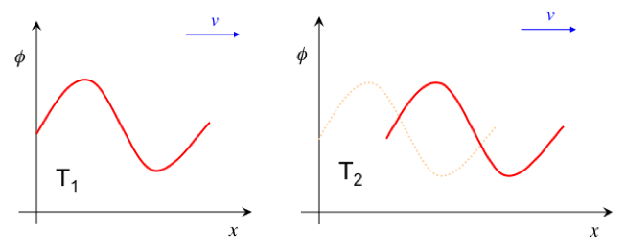
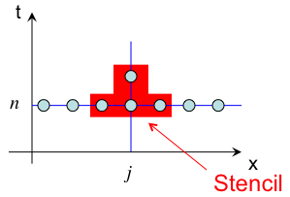
Evaluating the Exact Advection Equation Solution
Physical Interpretation: Information travels in the v-direction (positive)
Numerical Method: However, information is gathered from both j-1 and j+1 states

Slide 22
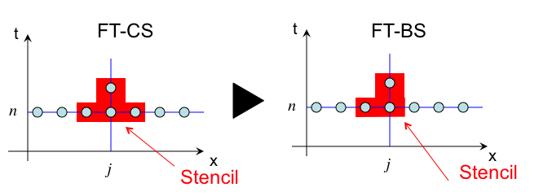
Exploiting the Directionality of the Flow
An alternative choice of spatial discretization provides a more physically-consistent discrete model: for example, if flow is moving from left to right, let’s remove the j+1 contribution
Consider a forward-in-time and backward-in-space differentiation (FT-BS)
This scheme is consistent and conditionally stable (see course reader) using Von Neumann stability analysis that shows |amplification factor| is less than unity when
Recall backward finite difference stencil

Slide 23
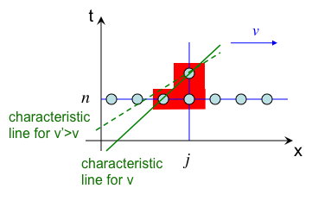
Properties of the FT-BS
The scheme is consistent and conditionally stable. Why?
The characteristics lines (for fixed ∆x and ∆t) provide the physical picture:
Deriving the modified equation leads to a clear understanding of an underlying stabilization mechanism….

Slide 24
Modified Equation for the Forward-in-time, Backward-in-space
The FT-BS scheme is equivalent to:
and results in the modified equation:
The backward-in-space discretization leads to a positive dissipation, e.g. a stabilization of the scheme
However, what happens if velocity < 0?

Slide 25
Introducing: An Upwind-based Scheme
Is it possible to simply switch between FT-BS (v > 0) and FT-FS (v < 0), while ensuring that the scheme is consistent and conditionally stable?
First, let’s define an upwind and downwind operators:
Furthermore, let’s provide a general upwind scheme system as:
That can be reorganized as:

Slide 26
Modified Equation for the Upwind-based Scheme
Recall,
and results in the modified equation:
The above form provides stabilization that is positive for all real values of velocity
Stability can also be studied using Von Neumann analysis and results in the constraint that:

Slide 27
General Comments
The consistency analysis and the derivation of the modified equation clearly illustrate the impact of numerical errors on the problem being solved
The derivation of the upwind scheme shows that dissipation-like errors lead to stabilization
What other errors can we expect to see using different discretization schemes?
Let’s re-visit the FT-CS advection system:
The truncation error for the FT-CS scheme is:
Let’s examine each separately
0

Slide 28
Model 1 and Model 2 Modified Equations
Model 1:
Model 2:
Objective: Find the exact solution to these model equations in a simple periodic domain

Slide 29
Model 1
Postulate an expression for the solution:
Plug in the PDE:
to obtain
This is satisfied if , leading to the solution:

Slide 30
Model 1
Postulate an expression for the solution:
Plug in the PDE:
to obtain
This is satisfied if , leading to the solution:

Slide 31
Model 2
Postulate an expression for the solution:
Plug in the PDE:
to obtain
This is satisfied if , leading to the solution:

Slide 32
Model 2
Postulate an expression for the solution:
Plug in the PDE:
to obtain
This is satisfied if , leading to the solution:

Slide 33
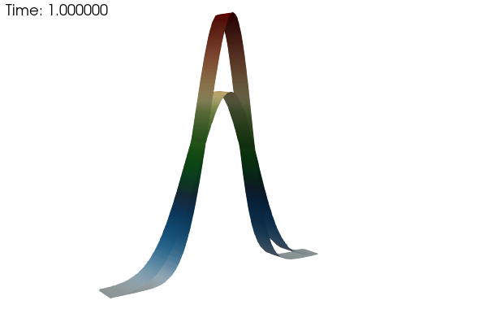
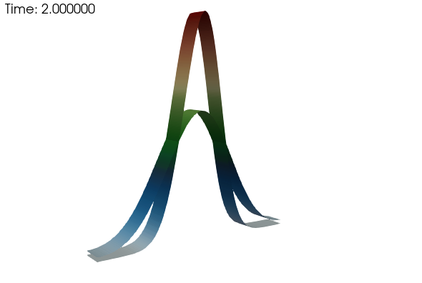
Model 1: Dissipative-like Error
Review:

Slide 34
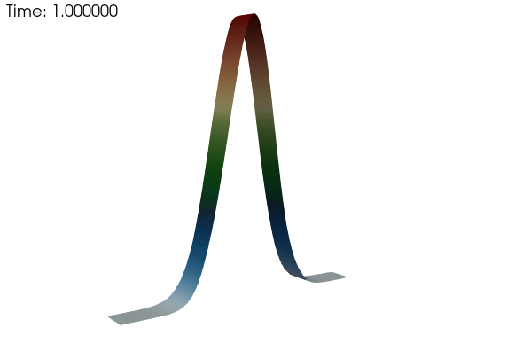
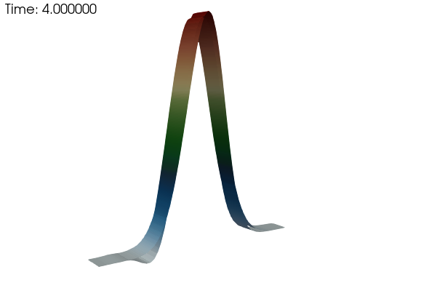
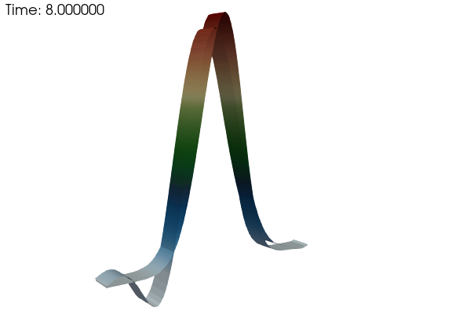
Model 2: Dispersion-like Error
Review:

Slide 35
A Note on Conservation: φ
For our fully implicit backward-in-time and central-in-space Nalu finite volume approach:
Integration φ over the full domain, for any advection operator choice, results in:
Perfect conservation

Slide 36
Derivation of a Energy Quantity
Starting with out model equation:
And scale by φ:
Results in the modified equation,
that mimics an energy,
Let’s see how this quantity is conserved….
0

Slide 37
A Note on Conservation: φ²/2
For our fully implicit backward-in-time and central-in-space Nalu finite volume approach:
Integration φ²/2 over the full domain, for any advection operator choice, results in:
Lack of conservation for the upwinded approaches
Ideal conservation for the central operator
Energy-method where the PDE is derived for the energy-variable, see course reader

Slide 38
Final Notes
Studying the numerical properties of the discretization technique is critical to set the proper expectations on the solutions
Classical tools such as Von Neumann stability analysis are easy to use but not generalizable
Other properties (beyond consistency, stability, etc.) can be critical.
We will introduce conservation, boundedness and symmetry.
Good understanding of the physics of the problem leads to better choices for the numerical schemes

