Slide 1

SPDX™ Beta Program
Kim Weins
SVP Products & Marketing

Slide 2
Beta Program
The SPDX Beta Program is designed to ensure the SPDX specification meets your needs

Slide 3
Timeline
Jan
2010
Jun
2010
Mar
2011
Apr
2011
Jun
2011
Aug
2011
Spec started
Spec v1 Beta
Spec v1 RC
Start
Beta
Beta
Feedback
Spec v1
Final
Beta Testing between Apr and Jun 2011

Slide 4


Beta Process
Company 1
Company 2
Create your SW BOM
Convert to an SPDX file
Convert from SPDX
Review SW BOM
Tools will be provided to convert to/from SPDX

Slide 5
Feedback We Need
How well did the SPDX format cover information you need to exchange?
What was effort involved in converting to/from SPDX format?
Did the SPDX format help you understand what was in the software?
How did the standard license information work for you?
Can you see how using SPDX could save your organization time/money?
Are any changes needed to make SPDX meet your needs?
What other tooling is needed for SPDX?

Slide 6
The SPDX™ File
Identification Info
Source of this SPDX™ file
Package Info
Associates an SPDX™ file with a software package (tarball, zip, archive)
Non-Standard Licenses
Text of licenses that are not in the SPDX™ standard list
Per File Info
License associated with each file

Slide 7
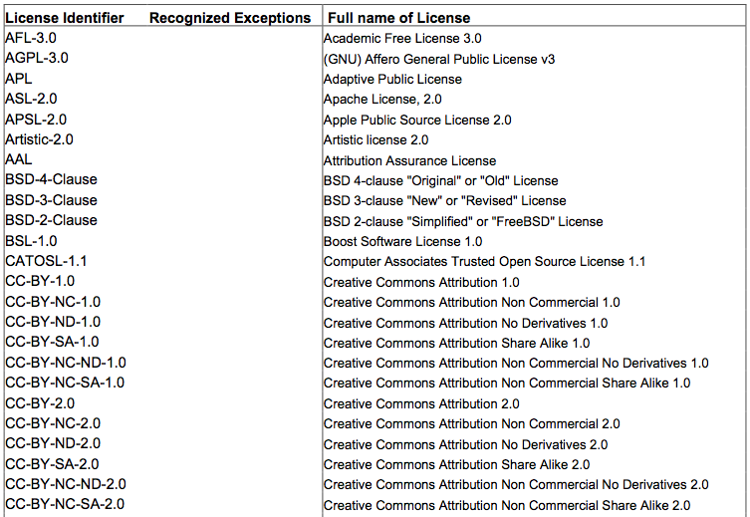
SPDX™ Standard Licenses
SPDX™ license repo
List of most common licenses (100+)
Include common exceptions
Standardized license names
Exact text of licenses
available on SPDX™ website – URLs won’t change

Slide 8
How We Will Help
  Beta Coordinator
    Designated SPDX community member to work with you to define and manage the beta plan
    Regular calls with your team throughout Beta process to address your issues and provide feedback
  Beta Support Team
    Technical, business and legal group ready to respond quickly to questions and issues
  Training
    Web meeting based training to familiarize you with SPDX spec and tools
  Documentation
    How-to guide for creating and reading SPDX and using tools

Slide 9
Sample Beta Project Plan
  Week 1
    Beta Kickoff & Training (2 hrs)
      Meeting with your team and trading partner team to identify project and define plan, schedule, tasks etc
      Training via web conference
  Weeks 2-3
    Supplier to create SPDX from BOM
    Resolve any issues
  Weeks 4-5
    Receiver to review SPDX
    Resolve any issues
  Week 6
    Debrief with entire team

Slide 10
Marketing Requests
Ability to name company as a SPDX Beta site
Include quotes on SPDX web site or in press releases
Possible reference for press or analysts

Slide 11
Protecting your data
Licensing info?
  Data?
  Tools?
Privacy
  Do we need to have Beta coordinator and support team under NDAs? Or have some Beta agreement
What else???

Slide 12
Wrap Up
Next Steps
  Confirm participation
  Identify a trading partner
  Identify a project
  Review SPDX specification
Questions?

