Slide 1
SPDX™ Beta Orientation
Kim Weins, SPDX Business Team
Gary O’Neall, SPDX Technical Team

Slide 2
Agenda
Overview of SPDX
About the Beta Program
Tools to Help

Slide 3
Open Source Compliance:
The Challenge
New code
OSS Package
OSS Package
OSS Package
License A
License B
License C
One OSS Package = Many Licenses
License D
License E
OSS Package
License A
License B
License C
License D
License E
License info for OSS is not provided in a consistent, easy-to-use format

Slide 4

Open Source Compliance:
The Challenge
Your code
Software
Bill of Materials
(BOM)
OSS Package
?
OSS Package
Companies combine OSS with other software
Outsourced
SW
Creating an accurate bill of materials requires
effort & research
3rd party
SW

Slide 5

Open Source Compliance:
The Challenge
Customers
Supplier 1
The effort is repeated at
each step in the supply chain
Supplier 2

Slide 6


Software Package Data Exchange™ (SPDX™)
SPDX™ - A standard format for communicating the components, licenses and copyrights associated with a software package.
Key pillar in Linux Foundation’s Open Compliance Program

Slide 7
Benefits
Reduce burden of providing information in different formats for different consumers
Avoids redundancy where packages are re-analyzed
Enable better compliance with open source licenses

Slide 8
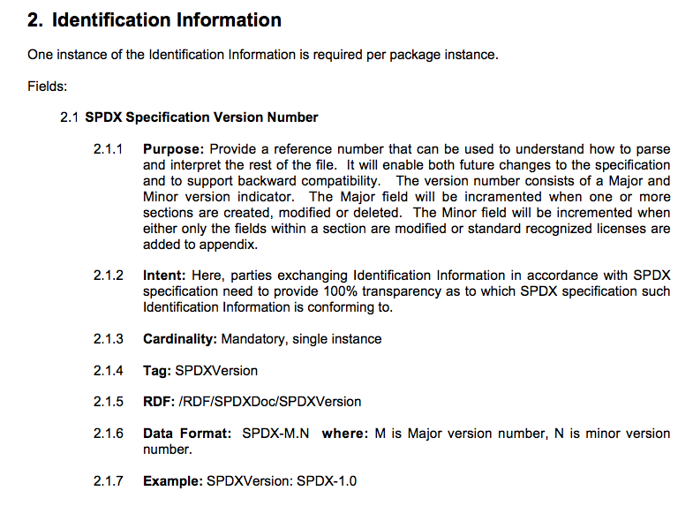
The SPDX™ Specification
Describes the format for the file and the data to be included

Slide 9
The SPDX™ File
Identification Info
Source of this SPDX™ file
Package Info
Associates an SPDX™ file with a software package (tarball, zip, archive)
Non-Standard Licenses
Text of licenses that are not in the SPDX™ standard list
Per File Info
License and copyright info associated with each file
Reviewer Info
Optional reviewer signoff

Slide 10
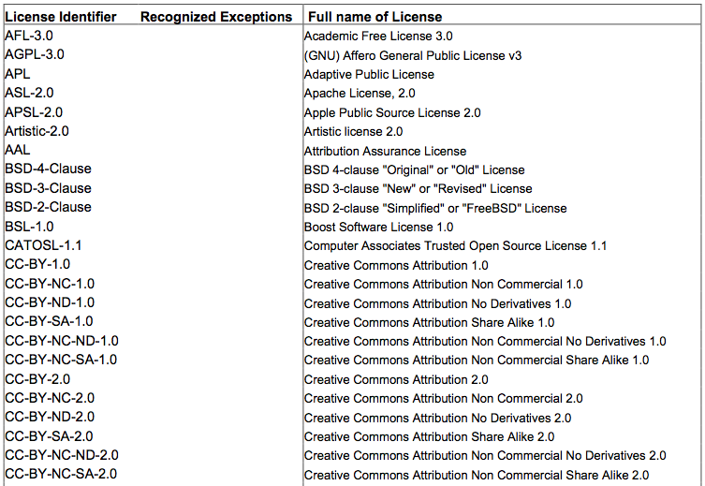
The SPDX™ List of
“Standard Licenses”
SPDX™ license repo
List of most common licenses
Include common exceptions
Standardized license names
Exact text of licenses
Available on SPDX™ website – URLs won’t change

Slide 11
SPDX™ BETA PROGRAM

Slide 12
Beta Program
The SPDX Beta Program is designed to ensure the SPDX specification meets your needs

Slide 13
Timeline
Jan
2010
Jun
2010
Mar
2011
Apr
2011
Jun
2011
Aug
2011
Spec started
Spec v1 Beta
Spec v1 RC
Start
Beta
Beta
Feedback
Spec v1
Final
Beta Testing between Apr and Jun 2011

Slide 14
Beta Process
Company 1
Company 2
Create your SW BOM
Convert to an SPDX file
Convert from SPDX
Review SW BOM
Tools will be provided to convert to/from SPDX

Slide 15
Feedback We Need
How well did the SPDX format cover information you need to exchange?
What was effort involved in converting to/from SPDX format?
Did the SPDX format help you understand what was in the software?
How did the standard license information work for you?
Can you see how using SPDX could save your organization time/money?
Are any changes needed to make SPDX meet your needs?
What other tooling is needed for SPDX?

Slide 16
How We Will Help
  Beta Coordinator
    Designated SPDX community member to work with you to define and manage the beta plan
    Regular calls with your team throughout Beta process to address your issues and provide feedback
  Beta Support Team
    Technical, business and legal group ready to respond quickly to questions and issues
  Training
    Web meeting based training to familiarize you with SPDX spec and tools
  Documentation
    How-to guide for creating and reading SPDX and using tools

Slide 17
Sample Beta Project Plan
  Week 1
    Beta Kickoff & Training (2 hrs)
      Meeting with your team and trading partner team to identify project and define plan, schedule, tasks etc
      Training via web conference
  Weeks 2-3
    Supplier to create SPDX from BOM
    Resolve any issues
    Weekly check-ins with Beta coordinator
  Weeks 4-5
    Receiver to review SPDX
    Resolve any issues
    Weekly check-ins with Beta coordinator
  Week 6
    Debrief with entire team

Slide 18
Beta Roles
  Project Leader
    Person responsible for coordinating Beta program
  BOM creator
    Person using your normal processes to create BOM
  SPDX translator
    Person that will use tools to turn spreadsheet BOM into SPDX file and vice versa. Should be technical.
  Legal (Supplier & Recipient)
    To review SPDX info

Slide 19
Suggested Project Roles
Project Leader
Supplier
BOM creator
SPDX
translator
Legal
reviewer
Project Leader
Recipient
SPDX
translator
BOM
reviewer
Legal
reviewer

Slide 20
Marketing Requests
Ability to name company as a SPDX Beta site
Include quotes on SPDX web site or in press releases
Possible reference for press or analysts

Slide 21
Licensing
Spec
  Creative Commons Attribution License 3.0
Data
  TBD
Tools
  Primary License – MIT
  Libraries – BSD 3 Clause and Apache 2.0

Slide 22
Wrap Up
Next Steps
  Confirm participation
  Identify a trading partner
  Identify a project
  Review SPDX specification
Questions?

Slide 23
SPDX™ Tools
Objectives:
  Reduce the effort of creating, consuming and validating SPDX Documents
  Provide a translation from the technical document (e.g. RDF/XML or tag-value format) and a more readable format
  Provide a mechanism for validating SPDX documents
  Enable contributions and review of the tool implementation by the broader technical community through open source licensing

Slide 24
SPDX Viewer
Command line driven Java application which formats a valid SPDX document into a text file
Validates the SPDX document and provides somewhat detailed error messages when there are parsing errors
Status: Currently being updated to the latest specifications. Will be available for Beta.

Slide 25
SPDX Translator
Converts a spreadsheet containing SPDX information into a valid SPDX/RDF file
Converts a valid SPDX/RDF file into a spreadsheet
Java based command line tool
Requires the spreadsheet be in a very specific format
A spreadsheet template with the specific column names and order will be provided as part of the tool
Status: In development. Will be available for Beta.

Slide 26
Technical Info in the SPDX Spec
OWL Document
  Specifies the RDF for the SPDX document
  Can be used to generate your own RDF parsers and tools
Tag-Value Grammar
  Specifies the grammar for the SPDX tag value format
  Can be used to generate your own tag-value parsers and tools

Slide 27
Contributing to SPDX Tools
A GIT repository for SPDX tools can be found at: http://git.linuxfoundation.org/pretty-printer.git/
Contributions and suggestions are welcome.
  Report any defects or suggest any improvements to bugs.linux-foundation.org product:spdx (you can sign up for a bugzilla account at bugs.linux-foundation.org)
  Email spdx-tech@fossbazaar.com

