Slide 1
SPDX™ Technicalities

Slide 2
What's in an SPDX file
Analysis meta-data
Package information
Files information
Licensing information

Slide 3
Analysis meta-data
Who performed the analysis
What tools where used
When was it created
Who has reviewed it

Slide 4
Package information
Name
Download location
Description
Licenses explicitly referenced
Actual licensing of package
Verification codes

Slide 5
File information
Name
Licenses explicitly referenced
Actual licensing
Verification codes

Slide 6
Licensing information
Text of license notices
Text of embedded licenses
Compound licensing

Slide 7
What's on SPDX.org
License registry
Normalization dictionary

Slide 8
License registry
Trusted, curated, shared source of license data
Web accessible
Machine readable (HTML+RDFa)

Slide 9
Normalization dictionary
Rules for how tools normalize license text
Web accessible
Machine readable (HTML+RDFa)

Slide 10
Formats
HTML+RDFa
Spreadsheet
RDF/XML
Tag

Slide 11
HTML+RDFa
Readable with any browser
Libraries widely available
Standards based

Slide 12
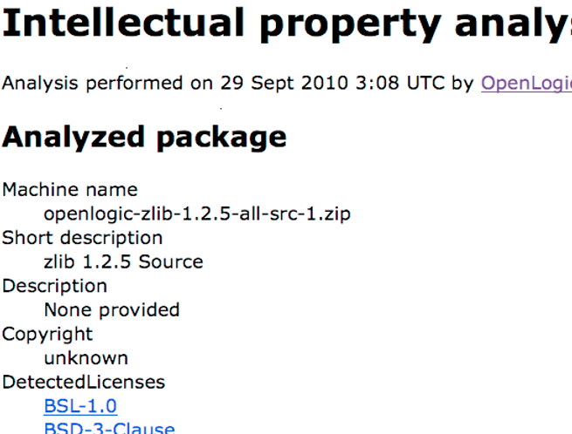
HTML+RDFa example

Slide 13
HTML+RDFa example
...
<div about="http://zlib.net/zlib-1.2.5.tar.gz"
typeof="spdx:Package">
<dl>
<dt>Package file name</dt>
<dd property="spdx:packageFileName">
openlogic-zlib-1.2.5-all-src-1.zip</dd>
<dt>Short description</dt>
<dd property="spdx:ShortDesc">
zlib 1.2.5 Source</dd>
<dt>DetectedLicenses</dt>
<dd><a href="http://spdx.org/licenses/bsl-1.0"
rel="spdx:LicensesInAllFiles">
BSL-1.0</a></dd>
…

Slide 14
Spreadsheet
Readable with Excel (et al)
Libraries widely available

Slide 15
Spreadsheet example
[screen shot here]

Slide 16
RDF/XML
XML
Library widely available
Standards based

Slide 17
RDF/XML example
<?xml version="1.0" encoding="UTF-8"?>
<rdf:RDF xmlns="..." xmlns:spdx="...">
<spdx:SPDXDoc rdf:about="http://example.com/an-ip-analysis">
<spdx:analysedPackage>
<spdx:Package rdf:about="http://zlib.net/zlib-1.2.5.tar.gz">
<spdx:packageFileName>
openlogic-zlib-1.2.5-all-src-1.zip</spdx:packageFileName>
<spdx:shortDesc>
zlib 1.2.5 Source</spdx:shortDesc>
<spdx:DetectedLicense
rdf:resource="http://spdx.org/licenses/bsl-1.0"/>
...

Slide 18
SPDX Tag
Text based
Compact
SPDX specific format
Limited tool support (so far)

Slide 19
SPDX Tag example
...
URI: http://zlib.net/zlib-1.2.5.tar.gz
packageFileName: openlogic-zlib-1.2.5-all-src-1.zip
shortDesc: zlib 1.2.5 Source
licensesInAllFiles: BSL-1.0
...

Slide 20
Ground rules
One package per analysis
Fields contain easily deducible facts
Except concluded licenses and comment fields

Slide 21
Compound licensing
License A or B
Licenses A and B
Licenses A and B
- or -
A and C
Notes:
Abstract model allows more complex arrangements but they are not by the tag-value format. More complex arrangements will be translated in to an equivalent one or two level form when generating tag-value and, probably, spreadsheet files.

Slide 22
Compound licensing
Composed from
Standard licenses
Unrecognized license text
Unrecognized licensing notices

Slide 23
License recognition
Normalized unicode string comparison
Notices count
Must be exact
Notes:
Recognizing a licenses standard notice is equivalent to recognizing the full text.

Slide 24
Text normalization
Convert to plain (unicode) text
Coalesce whitespace
Normalize bullets
Replace all sequences in the normalization dictionary

Slide 25
Individual fields
In which we take a quick jaunt through the spec.

Slide 26
Questions
?

