Slide 1
SPDX® Slides
1 Slide Version
High Level Presentation
Extra Slides with detail on group, problem, and spec that can be added into body for more detailed presentation
Revision
1.1 6/20/10 Added ™ (trademark) to SPDX and full name.
1.2 7/16/10 Added logo to template. Minor tweaks.
1.3 7/30/10 Minor formatting tweaks. Schedule/status updates. Added copyright. Added some logos. Replaced diagram on 17.
1.4 8/10/10 Added references to Open Compliance Program. Clarified SPDX is standard. SPDX Group works on it. Changed “Membership” to “Participation”
2.0 9/7/10 Tweaked format. Updated to reflect Kate’s updates for LinuxCon. Added slide 9 (why me?). Moved more slides to back up sections, shortening standard version to about 10 slides.
2.2 3/9/11 Updated status. Incorporated some of Kim W’s slides detailing the problem and the spc. Oher minor tweaks.
2.3 3/22/11 Updated Details of Spec section to reflect updated field names
2.3.2/ 3/22/11 A few more changes to the spec details. Tweaked slide with participant logos.
2.4 8/2/11 Lots of cleanup throughout. Registered Trademark added. Updated spec details to V1.0.
2.5 8/15/11 and 3/27/12 Added OSI logo and other small changes
2.6 4/2/12 ® for SPDX
2.7/2.8/2.9 8/12 Clean up. Changed status with new dates. Added screenshot of new website. Working Group > Workgroup
2.10 4/13 Clean up. Added Linaro/UNO to contributors. Added FOSSology UNO reference.

Slide 2
Software Package Data Exchange® (SPDX®)
Standard:
A standard format for communicating the components, licenses and copyrights associated with a software package.
Key pillar in Linux Foundation’s Open Compliance Program
SPDX Group:
Workgroup of Linux Foundation
Participation from over 20 organizations including software, systems and tool vendors, consultants and foundations
Charter is to create a defined format for a file of license factual information describing a software package
Status: V1.1 of spec released August, 2012

Slide 3
SPDX® SOFTWARE PACKAGE DATA EXCHANGE®
Executive Overview
<<INSERT NAME, Company>>
<<INSERT DATE>>

Slide 4

Software Package Data Exchange® (SPDX®)
A standard format for communicating the components, licenses and copyrights associated with a software package.
Key pillar in Linux Foundation’s Open Compliance Program which comprises:
Tools, Self-Assessment, SPDX, Rapid Alert System, Training, Community

Slide 5

The Need
I don’t mind vetting our code, but I’m sure this imported package has been analyzed a dozen times before.
Our suppliers aren’t giving us complete licensing information for open source packages.
Every customer wants a bill of materials in a different form.
software in
software out
We need a standardized, adopted format for a software Bill of Materials

Slide 6
Solution
A file format for license information to accompany open source packages
Guiding Principle: Focus on capturing facts; avoid interpretations.
Benefits
Allows easy exchange of license information between companies reducing burden on both suppliers and consumers
Avoids due diligence redundancy where the same source code package is analyzed multiple times by different receivers
Ultimately yields better compliance with less effort

Slide 7
SPDX® Group
A working group of Linux Foundation
Goal
To create a defined format for a file of license fact information describing a software package
History
A grass roots effort started by corporate counsels, business leads, and release managers responsible for ensuring release compliance with applicable licenses of FOSS included in the release
Operation
Open participation through www.spdx.org

Slide 8
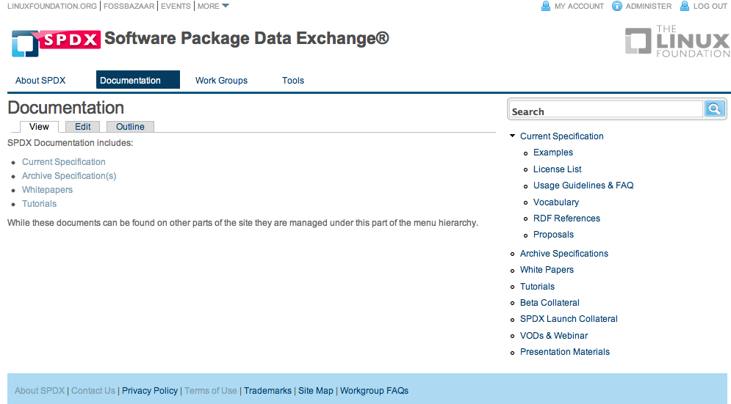
Status
Version 1.0 – Released August 2011
Version 1.1– Q3 2012
Version 2.0– 2013
http://www.spdx.org

Slide 9

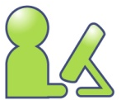

What it Means to You
Embedded & SW
Supply Chains
Save Time/Money
Better Compliance
Open Source
Developers
Help Users Comply
With Your Licenses
Consumers of
SW & OSS
Understand Licensing
of the Code You Use

Slide 10
Getting involved…
See:
http://www.spdx.org
Mailing lists, meetings
Contact:
Phil Odence (Chair) - podence@blackducksoftware.com
Kate Stewart (Tech Team Chair) - stewart@linux.com
Jilayne Lovejoy (Legal Team Co-Chair) - jilayne.lovejoy@openlogic.com
Jack Manbeck (Business Team Co-Chair)- j-manbeck2@ti.com
Scott Lamons (Business Team Co-Chair)- scott.lamons@hp.com

Slide 11
QUESTIONS?
Thank you!

Slide 12
BACKUP MODULES- DETAILED
Use these slide for a more detailed presentation.

Slide 13
DETAILS ABOUT THE GROUP
Notes:
Meta data about the analysis

Slide 14
SPDX®
A workgroup of Linux Foundation
Charter:
Create a set of data exchange standards to enable companies and organizations to share license and component information (metadata) for software packages and related content with the aim of facilitating license and other policy compliance
History
A grass roots effort started by corporate counsels, business leads, and release managers responsible for ensuring release compliance with applicable licenses of FOSS included in the release

Slide 15



























Participants
Open Source Organizations
End-Users
Integration & Services
Device OEMs
Applications
OS Distributions
Systems
Semiconductor Vendors
…and others
Participation is from a range of organizations and across various roles

Slide 16
Contribution
Runs like an open source project without centralized constitution or bylaws
Intellectual property contributed by participants members is covered under the Creative Commons license (CC-BY-3.0)
http://spdx.org

Slide 17
Workgroup Operation
Structure
General Meeting and mailing list
Teams with separate meetings and lists
Technical
Business
Legal
Very inclusive process
Self-subscription for interested participants
Those willing to “do” can influence direction
Mail-list, WIKI, phone calls, BOFs…
Face to face meetings at Linux Foundation and other events

Slide 18
DETAILS OF THE PROBLEM
Notes:
Meta data about the analysis

Slide 19
Scope of the Problem:
Prior to distributing a collection of software the contents of each package to be included needs to be reviewed, to ensure compliance with all the licenses in the code being redistributed.
Supply chain for products now requires software copyright and licensing information for lawsuit avoidance and risk mitigation.
A package’s declared license may not always match the licenses of individual files inside the package itself.
A package may consist of thousands of files with different licenses in the files.
Need a standard way of referring to the legal compliance “bill-of-materials” of a software package and be able exchange information with others efficiently and accurately.

Slide 20

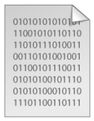




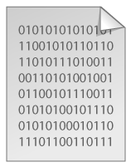




Products have mixed code from many different sources…
Outsourced Code Development
Internally Developed Code
Commercial 3rd-Party Code
Code
Open Source Software
Your Application
Obligations
YOUR COMPANY – TOOLS, PROCESSES
Diagram Source: Black Duck Software
Notes:
20
Developed code… sometime OSS introduced on purpose, sometime accidently

Slide 21
Open Source Compliance: The Challenge
New code
OSS Package
OSS Package
OSS Package
License A
License B
License C
One OSS Package = Many Licenses
License D
License E
OSS Package
License A
License B
License C
License D
License E
License info for OSS is not provided in a consistent, easy-to-use format

Slide 22
Open Source Compliance: The Challenge
Your code
Software
Bill of Materials
(BOM)
OSS Package
?
OSS Package
Companies combine OSS with other software
Outsourced
SW
Creating an accurate bill of materials requires
effort & research
3rd party
SW

Slide 23
Open Source Compliance: The Challenge
Customers
Supplier 1
The effort is repeated at
each step in the supply chain
Supplier 2

Slide 24
1000s of packages and complex dependencies between them…
Package contents evolve over time
Different versions can have different licenses
Declared license of a package is not always accurate
Package with different license has “useful” routines (that potentially get included)
Different versions can have different licenses at the file levels
Package dependency/requisite hierarchy can have incompatibilities
Hidden/enveloped package in dependency chain
Incidental packages get included by accident
All OSS licenses not compatible with each other

Slide 25
DETAILS OF THE STANDARD
NOTE: Any information in these slides describing the spec is superseded by the actual spec
Notes:
Meta data about the analysis

Slide 26
Specification Goals
A file format for license and copyright information to accompany packages
Guiding Principle: Focus on capturing facts; avoid interpretations.
A standardized short form to refer to the official version of common licenses
Benefits
Allows easy exchange of license information between companies reducing burden on both suppliers and consumers
Avoids due diligence redundancy where the same source code package is analyzed multiple times by different receivers
Provides a unified method for exchanging license information

Slide 27
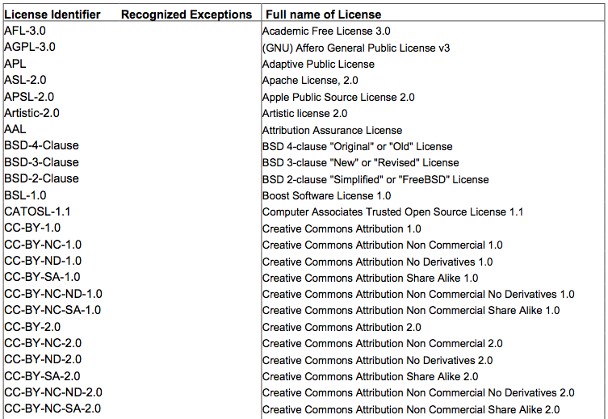
The SPDX® List of “Standard Licenses”
SPDX® license repo
List of most common licenses (150+)
Include common exceptions
Standardized license names
Exact text of licenses
Available on SPDX® website – URLs won’t change
Short names adopted by OSI

Slide 28
The SPDX File
Document Information
Creation Information
Package Information
File Information
Licensing Information
Review Information
SPDX Version and Licensing
How and when created
Package identification, copyright and licensing
File by file identification, copyright and licensing
Text of licenses that are not in SPDX standard list
Log of 3rd party reviews
File is in RDF/XML or tag value form and can be converted to/from spreadsheets.

Slide 29
Document and Creation Information
SPDX Version (used in creation of SPDX file)
Licensing of meta data
How the info in the file was generated
Manual review (who, when)
Tool (id, version, when)
Creator (who created the SPDX file)
Creator License (license of data in file)
Notes:
Meta data about the analysis

Slide 30
Package Information
Identification
Formal Name of Package (Full name given by originator and version information)
Package File Name (Name package obtained under (.tar, .rpm, etc.))
Unique ID (to unambiguously map file to a package)
Package Download Location (download URL)
Package Supplier and Originator
Licensing for Package
Declared License- License that has been asserted for the package
Concluded License- License that Creator has concluded
List of file licenses
Copyright Text
Description of Package (optional)

Slide 31
File Information
File Name
File Type (source, binary, archive)
File CheckSum
Concluded License (license determined by SPDX file creator)
License Text in File
Copyright Text
Artifact of Project Name (from which project it came)
Notes:
31

Slide 32
Other Licensing Information
NOTES:
This section is for licenses not on the standard list.
Aim for ~90% coverage with standard short forms NOT exhaustive
Background:
Black Duck identifies >2000 licenses in use
~20 licenses responsible for nearly all licensed open source projects
http://www.blackducksoftware.com/oss/licenses#top20
OSI currently recognizes 69 licenses as “open source”
http://www.opensource.org/licenses
Identifier Assigned (short form)
Extracted Text

Slide 33
Review
Reviewer
Review Date
Review Comment

Slide 34
Tools for SPDX®
Open Source Tools (hosted on SPDX Git Repo)
Viewer
Spreadsheet to RDF/Tag Value xlator
RDF/Tag Value to Spreadsheet xlator
License file generator (from Spreadsheet)
Spreadsheet template
FOSSology via University of Nebraska Omaha
Commercial Tools
Scanning tools to provide SPDX® support

Slide 35
Status
Version 1.0 – Released August 2011
Version 1.1– Q3 2012
Version 1.2– Targeted Q3 2013
Version 2.0- Targeted 2014
http://www.spdx.org

