Slide 1
CS 5573/EE 5423/IS 6973: Cloud Computing Spark Installation and Setup
Palden Lama, PhD
Department of Computer Science
University of Texas at San Antonio

Slide 2
Installing Spark (standalone)
Pre-requisites
Java installation and JAVA_HOME environment variable set
Password less authentication between Spark Master and Worker nodes
Hadoop installation
Download the spark package pre-built for Hadoop 1.x from http://spark.apache.org/downloads.html
Unpack Spark and Change ownership to cc
Repeat on all VMs.
cd /usr/local
sudo wget http://cs.utsa.edu/~plama/CS4843/spark-1.6.1-bin-hadoop1.tgz
sudo tar -xvf spark-1.6.1-bin-hadoop1.tgz
sudo chown -R cc:sudo spark-1.6.1-bin-hadoop1

Slide 3
Spark Cluster Configuration
a) Login to the master VM and ..
b) Edit spark-env.sh file as follows
c) Edit slaves file inside the conf folder to include the hostnames or ip addresses of worker VMs.
d) Copy spark-env.sh to all other VMs (using scp command) as follows.
cd /usr/local/spark-1.6.1-bin-hadoop1
cp ./conf/spark-env.sh.template ./conf/spark-env.sh
cp ./conf/slaves.template ./conf/slaves
HADOOP_CONF_DIR=/usr/local/hadoop-1.2.1/conf
SPARK_MASTER_IP=<private ipaddress of your master VM>
SPARK_MASTER_PORT=7077
cd /usr/local/spark-1.6.1-bin-hadoop1/conf
scp spark-env.sh workerip:/usr/local/spark-1.6.1-bin-hadoop1/conf

Slide 4
Spark Cluster Configuration
Spark-env.sh must be copied to all nodes if modified
# spark-env.sh
Environment Variable | Meaning
SPARK_WORKER_CORES | Total number of cores to allow Spark applications to use on the machine (default: all available cores).
SPARK_WORKER_MEMORY | Total amount of memory to allow Spark applications to use on the machine, e.g. 1000m, 2g (default: total memory minus 1 GB); note that each application's individual memory is configured using its spark.executor.memory property.

Slide 5
Spark Cluster Configuration (cont’d)
Environment Variable | Meaning
SPARK_WORKER_INSTANCES | Number of worker instances to run on each machine (default: 1). You can make this more than 1 if you have very large machines and would like multiple Spark worker processes. If you do set this, make sure to also set SPARK_WORKER_CORES explicitly to limit the cores per worker, or else each worker will try to use all the cores.
SPARK_WORKER_DIR | Directory to run applications in, which will include both logs and scratch space (default: SPARK_HOME/work).
SPARK_DAEMON_MEMORY | Memory to allocate to the Spark master and worker daemons themselves (default: 512m).

Slide 6
Starting the Spark Cluster
Start master server
Start workers
Check if master on master VM and workers on worker VMs have started.
cd /usr/local/spark-1.6.1-bin-hadoop1
sbin/start-master.sh
sbin/start-slaves.sh
jps
Assuming that HDFS daemons are already running in the cluster…
On Master VM: Master, NameNode
On Worker VMs: Worker, DataNode

Slide 7
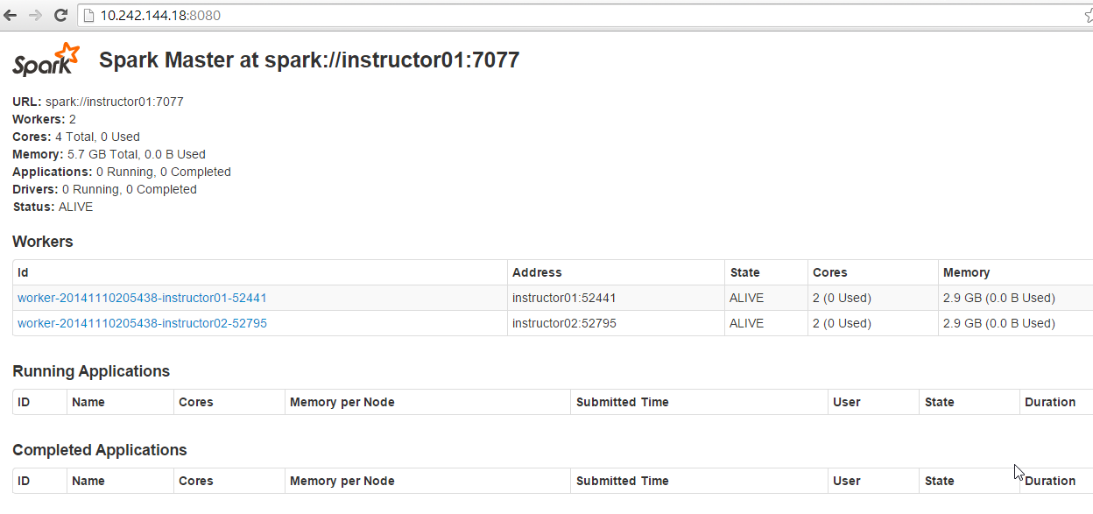
Spark Master Web Portal

Slide 8
Spark Shell
https://spark.apache.org/docs/1.6.1/quick-start.html
cd /usr/local/spark-1.6.1-bin-hadoop1
./bin/pyspark -–master local[4]
Or,
./bin/pyspark
Modify /etc/hosts
file on the master node to include localhost.
Spark shell provides a simple way to learn the Spark APIs, as well as a powerful tool to analyze data interactively.
A special interpreter-aware SparkContext is automatically created, in the variable called sc.
sc.setLogLevel(“ERROR”)
Hides INFO, and WARN messages.

Slide 9
Spark Shell Demo
textFile = sc.textFile("file:///usr/local/spark-1.6.1-bin-hadoop1/README.md")
textFile.count()
textFile.first()
linesWithSpark = textFile.filter(lambda line: "Spark" in line)
# How many lines contain "Spark"?
textFile.filter(lambda line: "Spark" in line).count()

Slide 10
Launching Applications
Run a python application on a standalone Spark cluster
./bin/spark-submit --master spark://ipaddress:7077 examples/src/main/python/pi.py
Use private IP address of master VM.

Slide 11
References
http://spark.apache.org
http://spark.apache.org/docs/1.6.1/quick-start.html
http://spark.apache.org/docs/1.6.1/programming-guide.html

