Slide 1


Recommender System
in a nutshell
Machine Learning & Data Science
TechHub
Semi-supervised hybrid approach for content boosted

Slide 2



Recommender Systems – Who are we?
Mauro Di Liddo
Role: Senior Software Engineer – Consultant
Mail: mauro.diliddo@finconsgroup.com
Linkedin profile:
Armando Andreula
Role: Software Engineer - Analyst
Mail: armando.andreula@finconsgroup.com
Linkedin profile: https://www.linkedin.com/in/armando-andreula

Slide 3
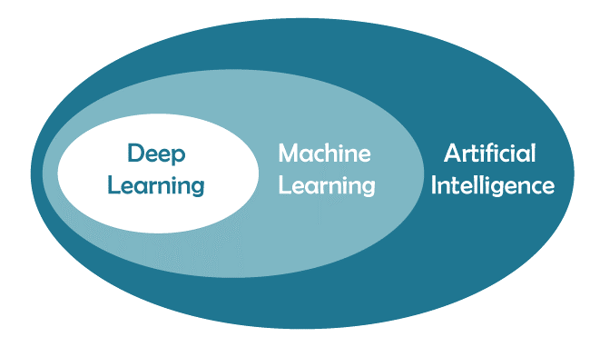
Machine Learning – Where is it?

Slide 4
Machine Learning – Definition
Machine Learning (ML) is the part of Artificial Intelligence (AI) studying.
How computer agents can improve their perception, knowledge, thinking, or actions based on experience or data.
For this, ML draws from computer science, statistics, psychology, neuroscience, economics and control theory.

Slide 5
Machine Learning – Types of learning
Supervised
Supervised Learning is akin to a scenario where a student learns under the guidance of a teacher.
Unsupervised
Unsupervised Learning, on the other hand, is like a student learning without direct supervision.
The 'teacher' here is the labeled dataset, which provides the machine with both the input and the
correct output.
The goal of supervised learning algorithms is to create a mathematical model that can make
predictions or decisions by learning the relationships between the given input and output.
The algorithm is given data without explicit instructions on what to do with it. It must find structure
and patterns within the dataset on its own. This form of learning is ideal for exploratory data analysis,
pattern discovery, and finding hidden structures in data.

Slide 6
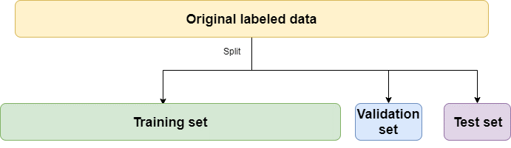
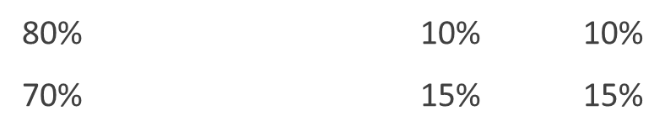
Machine Learning – Train/Validation/Test
Training
it’s used for model training
Test
It’s used once the training phase is finished and it’s required to check the model final performances
Validation
It’s used for training control operations:
Is the training going well?
Is the model still able to make good predictions on unseen data?
“early stopping”
Preprocessing
Data cleaning and normalization
Alternatively, K-Fold Validation can be used for higher reliability

Slide 7
Machine Learning – Characteristics
Regression
Classification
For each training row you have a true value and a predicted one
Root Mean Squared Error – RMSE
You can easily calculate the error made for each prediction
Possible metrics:
Mean Absolute Error – MAE
For each training row you have a true label and a predicted one
You can easily calculate if the prediction is correct for each row
Possible metrics:
Accuracy
Precision
Recall

Slide 8
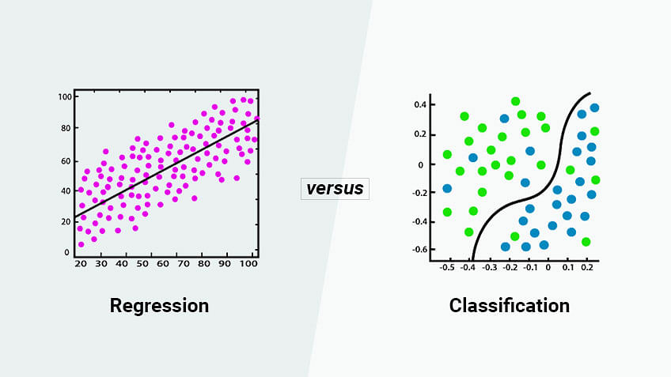
Machine Learning – Supervised learning tasks
Classification
Email spam detection
Regression
Churn prediction
Fraud detection
Sentiment analysis
Demand Forecasting
Predictive Maintenance
Sales and Revenue predictions
Stock Market Prediction

Slide 9
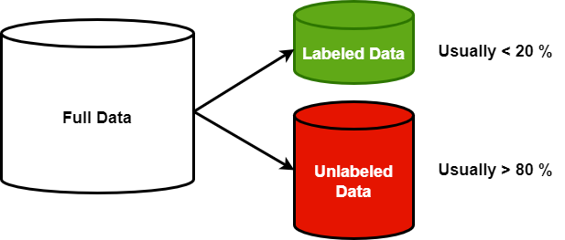
Recommender Systems – Semi-supervised learning
Partially labeled data
Data distribution high unbalanced or not uniform
Need for resources with specific and high skills
Combine two or more supervised learning alghoritm

Slide 10
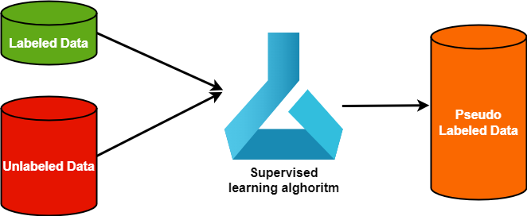
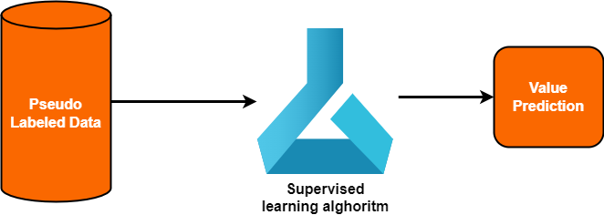
Recommender Systems – Semi-supervised learning
Train first model on labeled data
Combine labeled data and pseudo-labeled data into new dataset
Calculate label prediction value for unlabeled data
Train second model on new dataset created

Slide 11
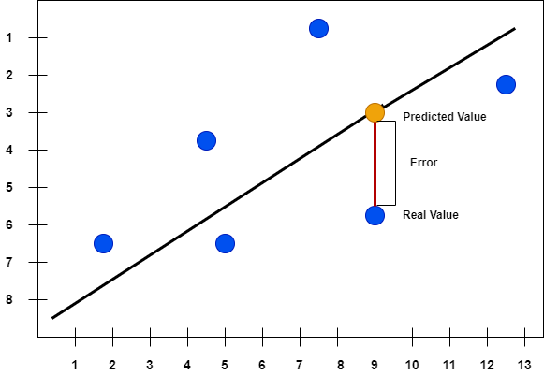
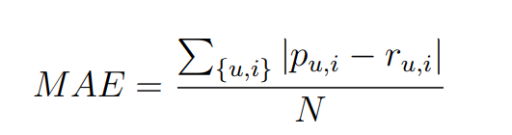
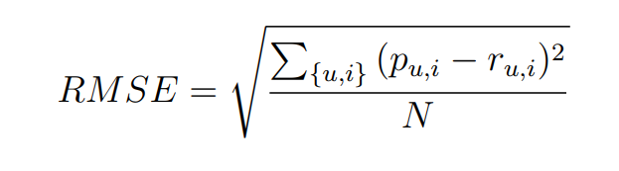
Machine Learning – Evaluation MAE & RMSE

Slide 12
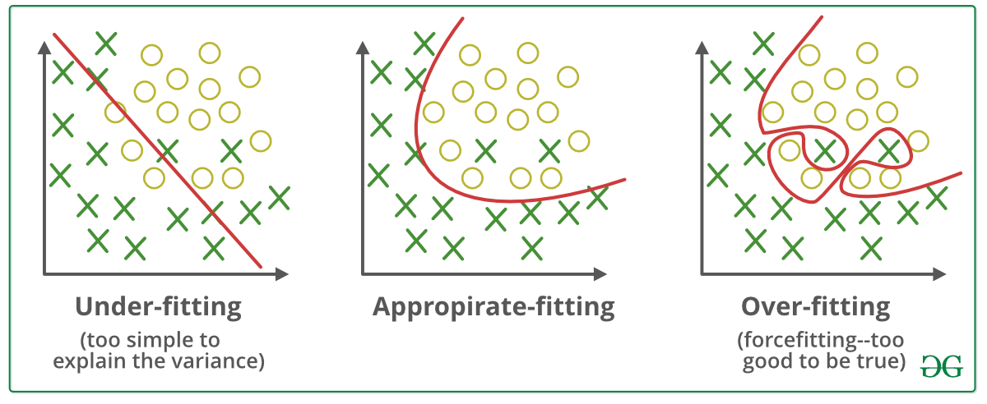
Machine Learning – Evaluation Underfitting/Overfitting

Slide 13
Recommender Systems - Characteristics
Supervised learning problem
Specialized prediction task
Suggests interest items to the user

Slide 14

Recommender Systems - Example

Slide 15
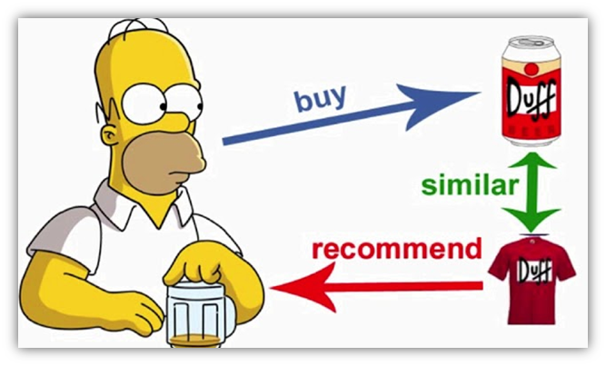
Recommender Systems - Example

Slide 16
Recommender Systems - Typology
Content based
Collaborative filtering
Hybrid
Memory based system (neighborhood based system)
Model based system

Slide 17
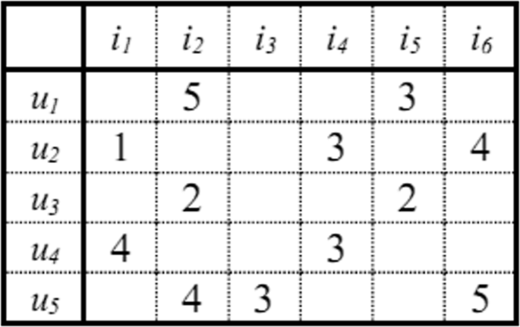
Recommender Systems – Matrix users-items
«R» is a matrix of rank (m x n)
«m» indicates the users of systems
«n» indicates the items of systems
«R[i, j]», 1<=i<=m, 1<=j<=n indicates the preference value of user i for item j

Slide 18
Recommender Systems – Content Based
Knowledge base
Numeric rappresentation
The items of the application domain are stored as unit vectors
Rappresentation of the application domain
Representation using graph database (Neo4J, RDF, OWL)
The system calculates the similarity cosine between items' prefered of user and all items
TF-IDF
Term Frequency - Inverse Document Frequency
It measures how important a term is within a document relative to a collection of documents

Slide 19
Recommender Systems – TF-IDF
TF-IDF
IDF
Inverse Document Frequency
Term Frequency
Ratio between the number of occurrences of a term within a document and the total number of terms present in the document
Logarithm of the ratio between the number of documents and the number of documents within which the analyzed term appears
Stop Words
It allows you to avoid the management or removal of stop words
Product between the TF (term frequency) and the IDF (inversion document frequency)
TF

Slide 20
Recommender Systems – Remove stop words example
A huge doping row is overshadowing the start of the Olympic Games
British athletes have turned their backs on restaurants in the Paris
When Elon Musk spoke about the
In case you have missed it, the Olympic Games are coming.
“Falling in Love (Is Hard on the Knees)”
“The Curious Case of Benjamin Button”
«Marley & Me»
«About a girl»

Slide 21
Recommender Systems – Collaborative filtering – memory based
Assign a weight to all users respecting the similarity with the active user (Pearson correlation coefficient)
Select a subset of users that have more high similar preferences of active user (neighborhood)
Calculate the prediction value using a weighted average across neighborhood ratings

Slide 22
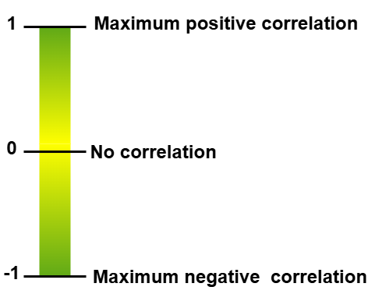
Recommender Systems – Pearson correlation coefficient
Is used to understand the strength of the relationship between two variables.
In addition, your variables should have a similar spread across their individual ranges.
Should be continuous
Your variables of interest are:
Be normally distributed
Be linearly related
Be outlier free.
https://www.statstest.com/pearson-correlation/

Slide 23
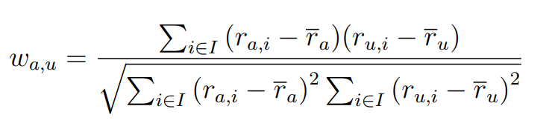
Recommender Systems – Pearson correlation coefficient
Measures the similarity beetwen user active "a" and generic user "u”

Slide 24
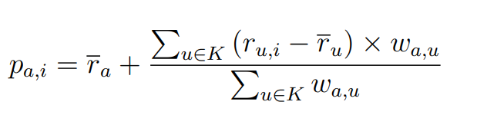
Recommender Systems – Prediction
Weighted average of the difference between the neighborhood rating and their average rating

Slide 25
Recommender Systems – Collaborative filtering Model Based
Matrix factorization
SVD – Singular value decomposition matrix
Latent factor

Slide 26
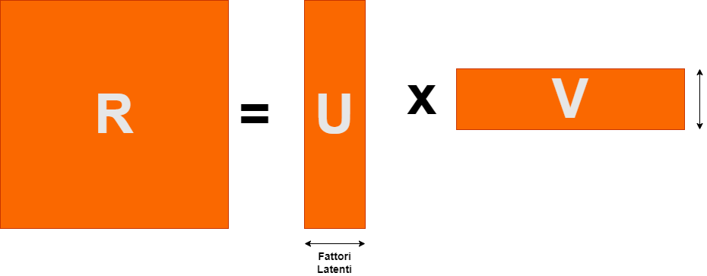
Recommender Systems – Matrix factorization
Decomposes a large sparse matrix into the product of smaller dense matrices
R = U x V^{T}

Slide 27
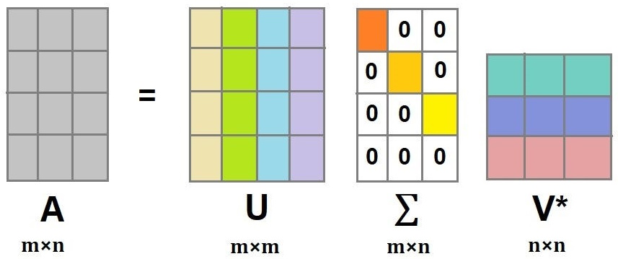
Recommender Systems – SVD Singular value decomposition matrix
U
∑
Diagonal matrix with increasing values σ₁ <= σ₂ <=…<= σ_{p} (i = 1..p) p = min (m, n)
V*
Matrix with the first H vectors relating to items
A
Initial users-items matrix
Rank is m x n
Matrix with the first K vectors relating to users
Rank is m x n
U-is left singular matrix (columns are left singular vectors). U columns contain eigenvectors of matrix MMᵗ
V*- is right singular matrix (columns are right singular vectors). V columns contain eigenvectors of matrix MᵗM

Slide 28
Recommender Systems – Semi-supervised Hybrid approach
A is a high sparse matrix
A is very unbalanced matrix
Missing exiplicit rating value

Slide 29
Recommender Systems – Distribution items
Nome Polizza | Numero Clienti | Percentuale
R.C.A. | 573.876 | 89,4675
INFORTUNI | 64.266 | 10,0191
MULTIGARANZIA ABITAZIONE | 2.413 | 0,3762
MALATTIA | 766 | 0,1194
R.C. DIVERSI | 78 | 0,0122
A.R.D. | 22 | 0,0034
GLOBALE FABBRICATI | 8 | 0,0012
INCENDIO/FURTO | 4 | 0,0006
TUTELA GIUDIZIARIA | 2 | 0,0003

Slide 30
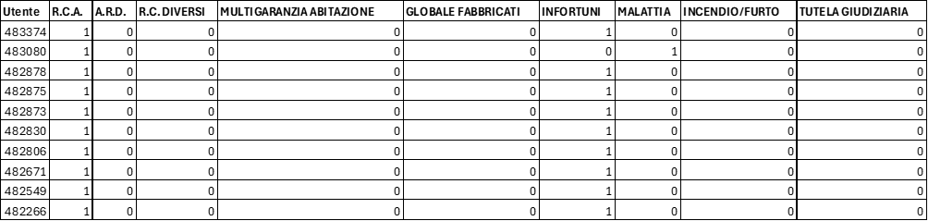
Recommender Systems – Matrix users-items example

Slide 31
Recommender Systems – Considerations
The matrix users-items is very sparse >= 85 %
The current value of RMSE is <= 0,5
The matrix users-items is very unbalanced
The model is unusable

Slide 32
Recommender Systems – Content boosted
Content boosted
Improve recommendations
The model is unusable
Reduce the sparsity and unbalanced of matrix users-items

Slide 33
Recommender Systems – Content boosted
Content boosted
Improve recommendations
Current value of RMSE is <= 0,5
Determines the rating value for all items for all users
Define knowledge base
Generic features of the articles
Generic features of the users
Combine them into one dataset
Define a classifier

Slide 34
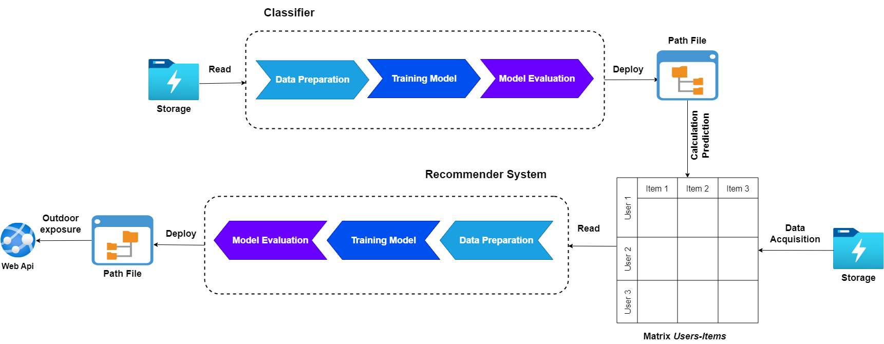
Recommender Systems – Architecture

Slide 35

Recommender Systems – Knowledge base
Extract generic features from users
Calculate userId for every user-feature
Combine them in one dataset
Training classifier
Extract generic features from items

Slide 36
Recommender Systems - Content enhancement algorithm
For every user u and for every item i
If exists ratings for (u, i) set value as 1
Else Calculate "p_ui" prediction value for pair (u, i)
If p_ui equals i set value as prediction_score
Else set value as 0

Slide 37
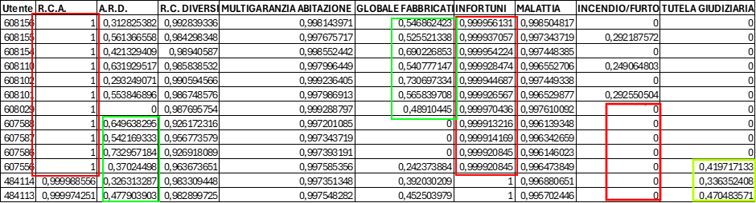
Recommender Systems – Matrix users-items

Slide 38
Recommender Systems – Pro-Cons
The scattered of matrix users-items is reduced
Current value of RMSE is <= 0,85
A high number of items for (Incendio/Furto and Tutela Giuridica) is null (0)
The calculated rating value for high number of items is same
The value of RMSE decreases if increases the numbers of users
The model goes in overfitting

Slide 39
Recommender Systems – Upgrade content boosted
Change rappresentation scale for rating value from [0..1] to [0..100]
Add to all rating value a bias random

Slide 40
Recommender Systems - Content enhancement algorithm
For every user u and for every item i
If exists ratings for (u, i) set value as (100 + bias_random)
Else Calculate p_ui prediction value for pair (u, i)
If p_ui equals i set value as (prediction_score * 100 + bias random)
Else set value as bias_random

Slide 41
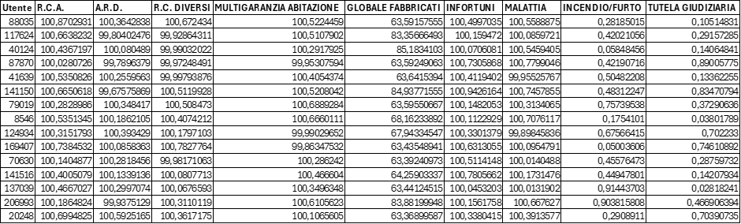
Recommender Systems – Matrix users-items

Slide 42
Recommender Systems – Matrix users-items
The all items of matrix users-items have a value not null (different 0)
The value of all items matrix users-items is different from each other
Current value of RMSE is >= 0,94

Slide 43
Recommender Systems – Experimental results compared

Slide 44
Recommender Systems – Experimental results valutation
Step | Number of Customers | Model Evaluation
1 | 62.693 | 0,9551
2 | 125.386 | 0,9902
3 | 188.079 | 0,9922
4 | 250.772 | 0,9951
5 | 313.465 | 0,9808
6 | 376.158 | 0,9864
7 | 438.851 | 0,9671
8 | 501.544 | 0,9843
9 | 564.237 | 0,9956
10 | 626.929 | 0,9797

Slide 45
Recommender System – Future developments
Adding features to the classifier
Enhancing the complexity of a knowledge base can lead to improved performance of a classifier.
Creation of customized insurance packages for the customer

Slide 46

Recommender Systems – Q & A
Do
you
have
questions
?

Slide 47
Recommender System – Bibliography
Recommender Systems, Prem Melville and Vikas Sindhwani
Content-Boosted Collaborative Filtering for Improved Recommendations, Prem Melville and Raymond J. Mooney and Ramadass Nagarajan.
MAE – Mean Absolute Error
RMSE – Root Mean Squared Error
TF-IDF — Term Frequency-Inverse Document Frequency – LearnDataSci, Fatih Karabiber
Stop word - Wikipedia, Wikipedia
Machine Learning at Microsoft with ML.NET, Zeeshan Ahmed et al.
DEVELOPMENT OF RECOMMENDER SYSTEMS USING ML.NET IZGRADNJA SISTEMA PREPORUKE POMOĆU ML.NET, Bahrudin Hrnjica, Denis Mušić, Softić Selver
A Recommendation System For Car Insurance, Laurent Lesage, Madalina Deaconu, Antoine Lejay, Jorge Augusto Meira, Geoffrey Nichil, Radu State
RDF – Resource Description Framework
OWL – Web Ontology Language
Neo4j

Slide 48
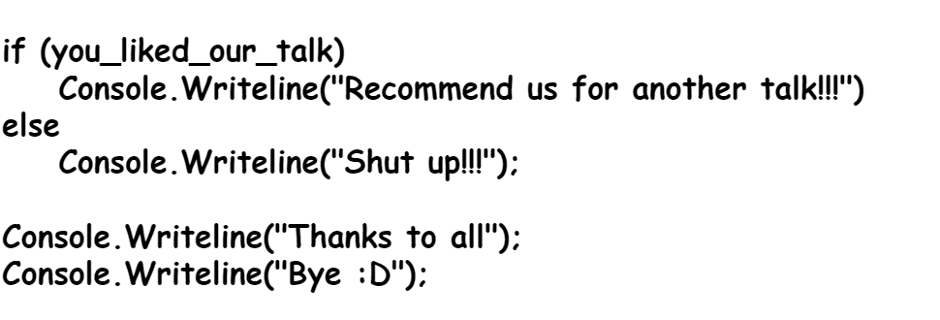

Recommender Systems – Greetings and thanks

