Slide 1
A custom dashboard for insurance agents

Slide 2
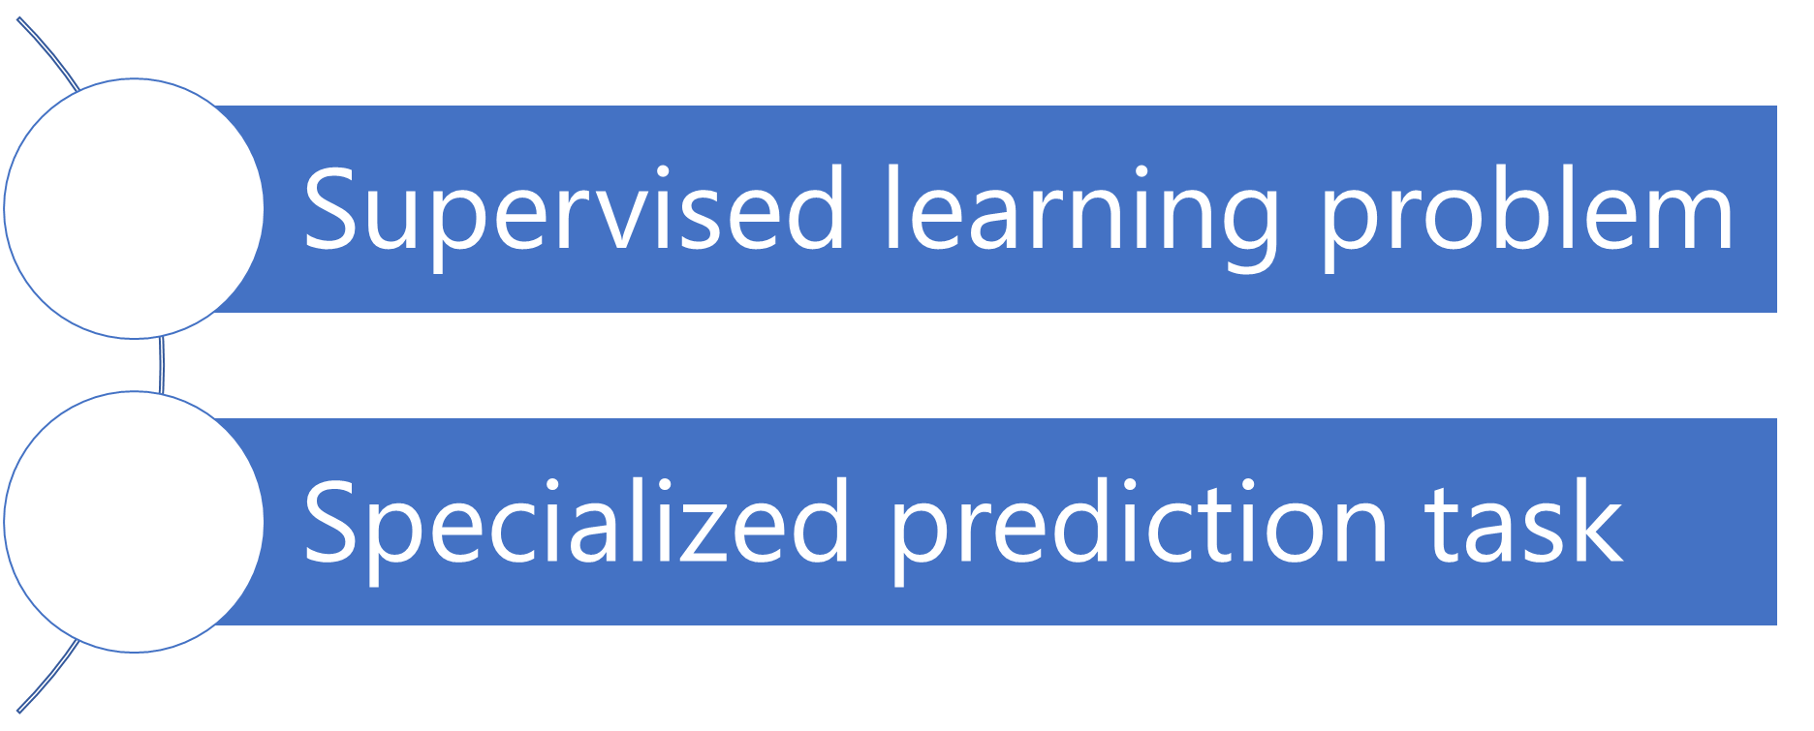
Recommender Systems - Characteristics

Slide 3
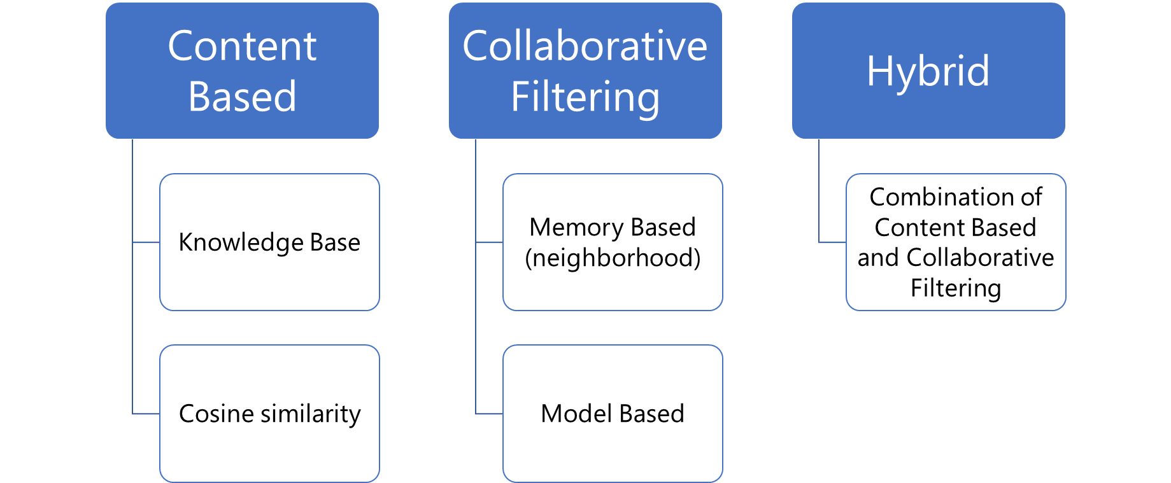
Recommender Systems - Typology

Slide 4
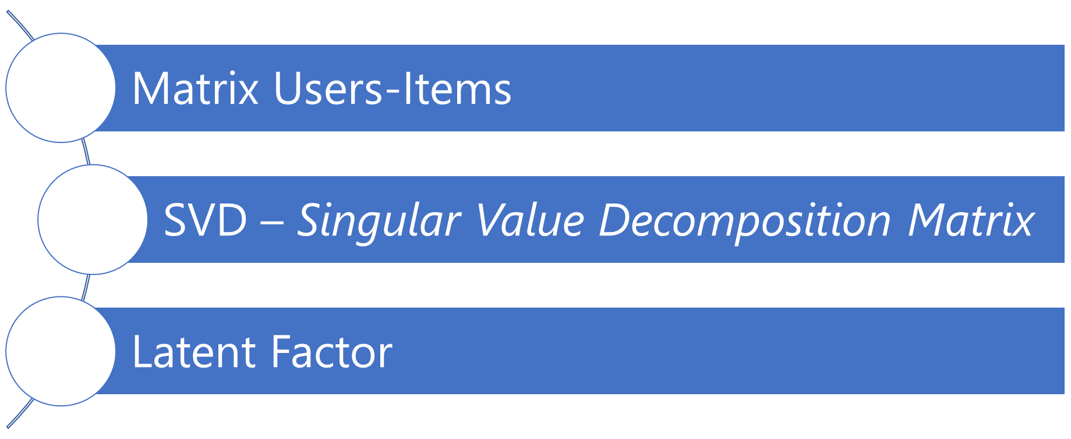
Recommender System – Collaborative filtering Model Based

Slide 5
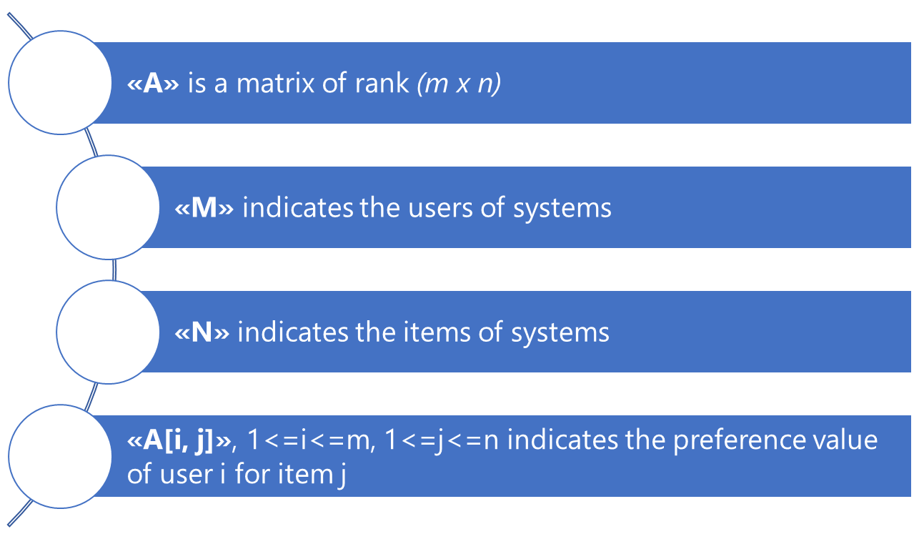
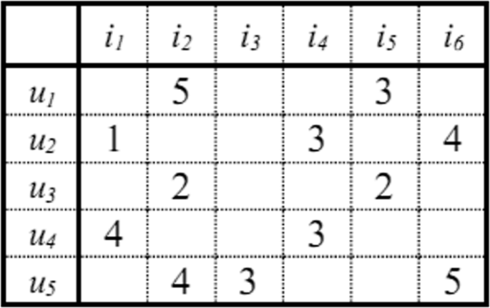
Recommender System – Matrix Users-items

Slide 6
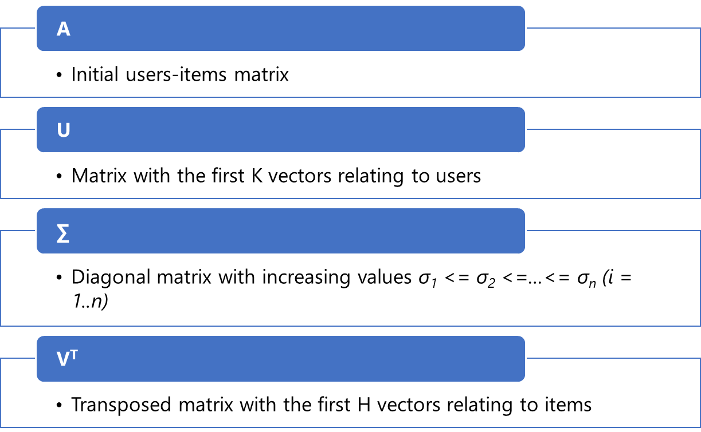

Recommender System – SVD Singular Value Decomposition

Slide 7
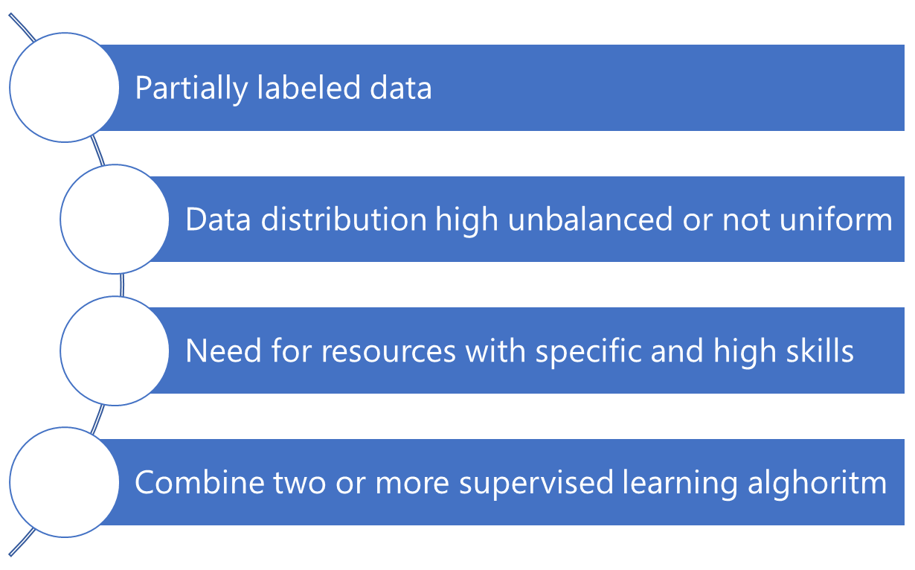
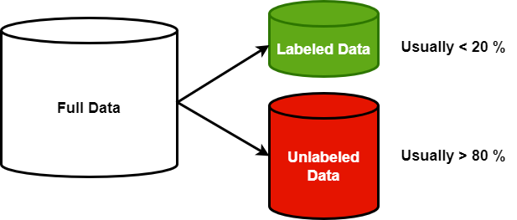
Recommender System – Semi-supervised learning

Slide 8
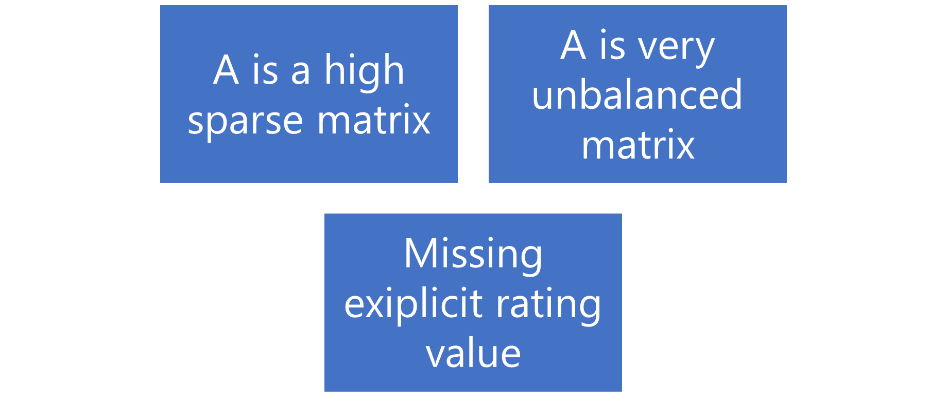
Recommender System – Semi-supervised Hybrid approach

Slide 9
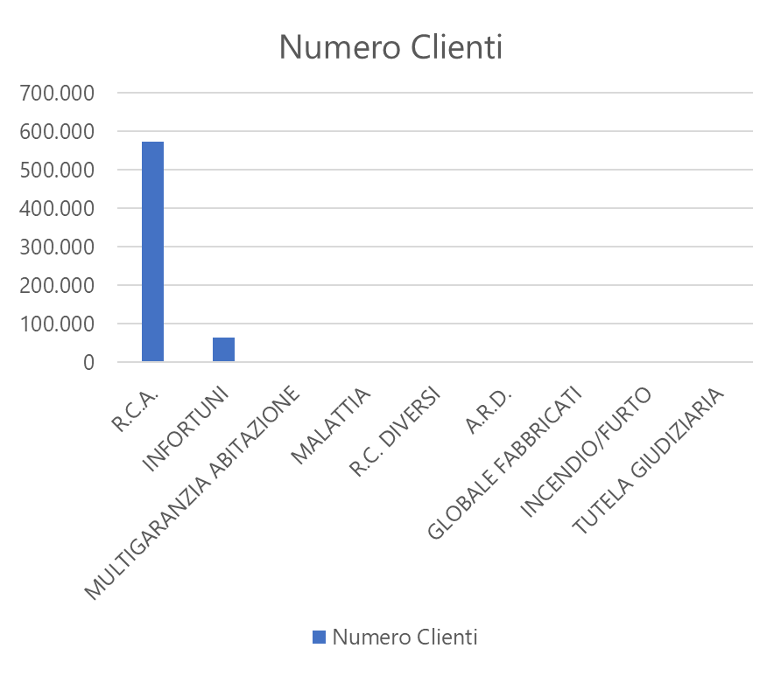
Recommender System – Distribution Items
Nome Polizza | Numero Clienti | Percentuale
R.C.A. | 573.876 | 89,4675
INFORTUNI | 64.266 | 10,0191
MULTIGARANZIA ABITAZIONE | 2.413 | 0,3762
MALATTIA | 766 | 0,1194
R.C. DIVERSI | 78 | 0,0122
A.R.D. | 22 | 0,0034
GLOBALE FABBRICATI | 8 | 0,0012
INCENDIO/FURTO | 4 | 0,0006
TUTELA GIUDIZIARIA | 2 | 0,0003

Slide 10
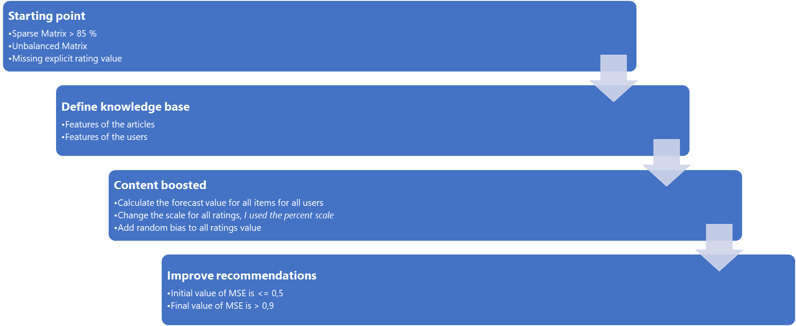
Recommender System – Semi-supervised Hybrid approach

Slide 11
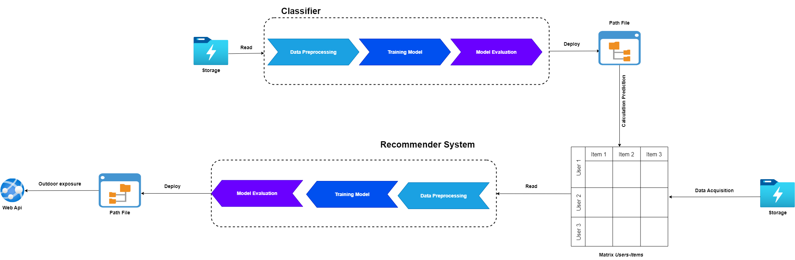
Recommender System – Architecture

Slide 12
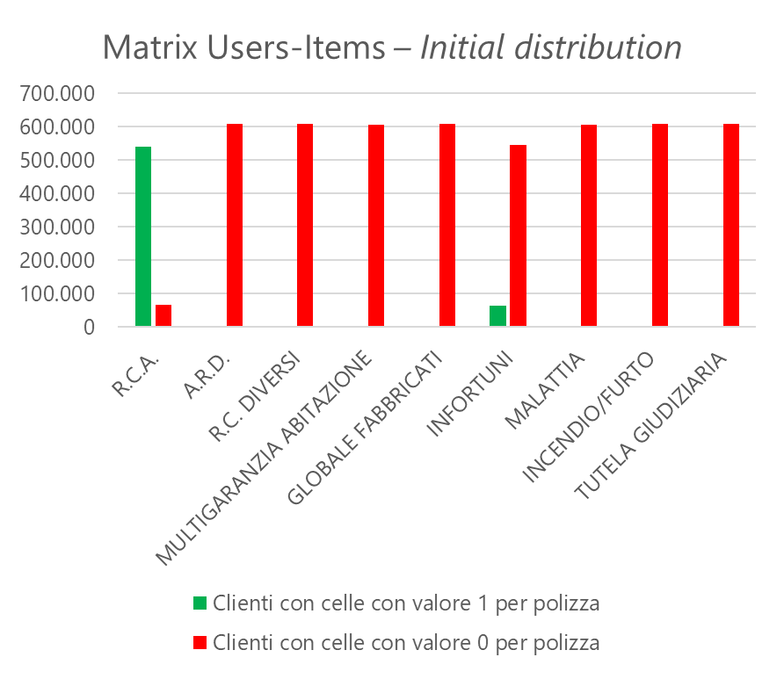
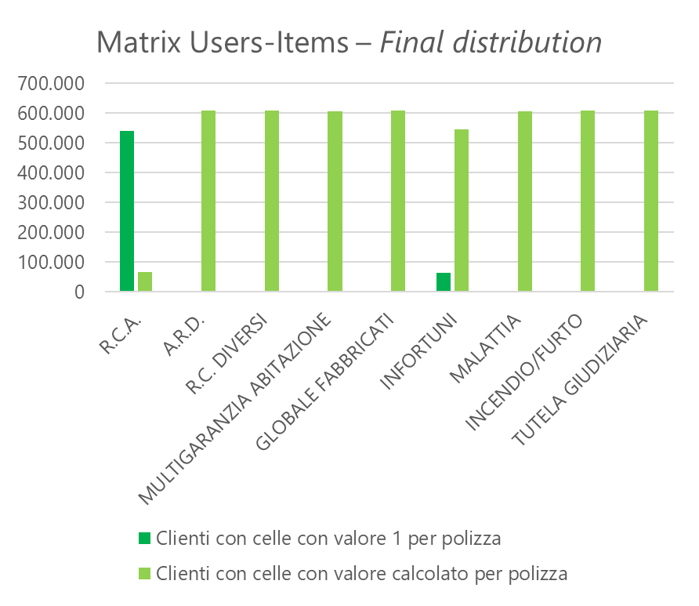
Recommender System – Experimental results compared

Slide 13
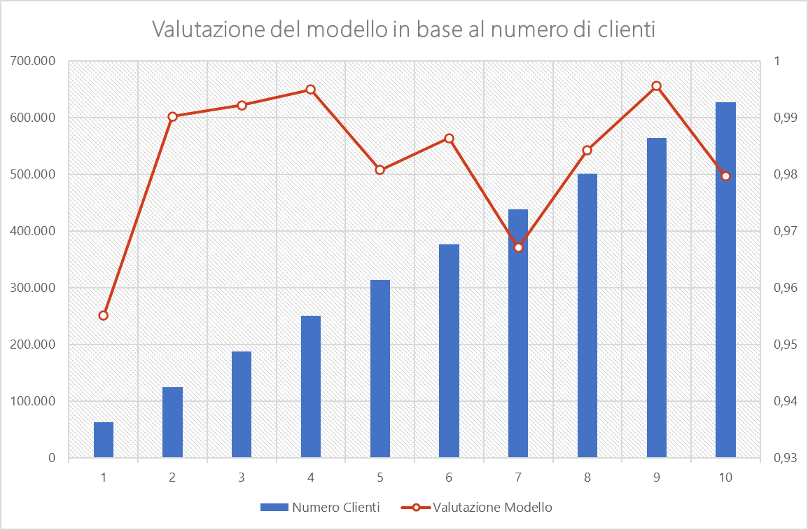
Recommender System – Experimental results valutation
Numero Clienti | Valutazione Modello
62.693 | 0,9551
125.386 | 0,9902
188.079 | 0,9922
250.772 | 0,9951
313.465 | 0,9808
376.158 | 0,9864
438.851 | 0,9671
501.544 | 0,9843
564.237 | 0,9956
626.929 | 0,9797

