Slide 1
A custom dashboard for insurance agents

Slide 2
Recommender Systems - Characteristics
Supervised learning problem
Specialized prediction task

Slide 3
Recommender Systems - Typology
Content Based
Cosine similarity
Collaborative Filtering
Memory Based (neighborhood)
Model Based
Hybrid
Knowledge Base
Combination of Content Based and Collaborative Filtering

Slide 4
Recommender System – Collaborative filtering Model Based
Matrix Users-Items
SVD – Singular Value Decomposition Matrix
Latent Factor

Slide 5
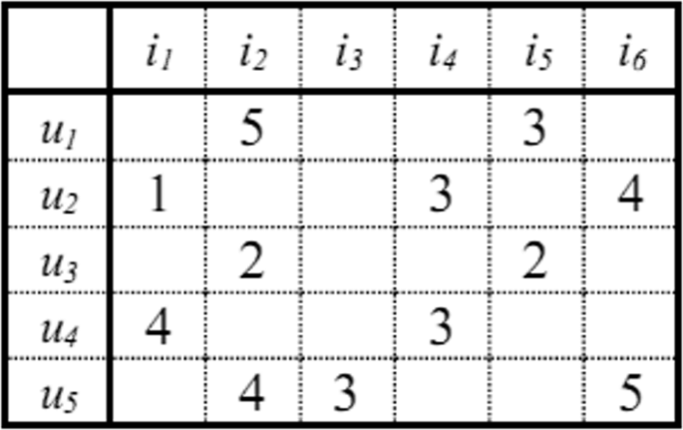
Recommender System – Matrix Users-items
«A» is a matrix of rank (m x n)
«M» indicates the users of systems
«N» indicates the items of systems
«A[i, j]», 1<=i<=m, 1<=j<=n indicates the preference value of user i for item j

Slide 6
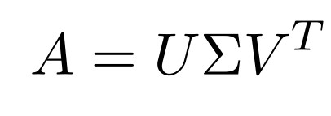
Recommender System – SVD Singular Value Decomposition
U
Matrix with the first K vectors relating to users
∑
Diagonal matrix with increasing values σ₁ <= σ₂ <=…<= σ_{n} (i = 1..n)
V^{T}
Transposed matrix with the first H vectors relating to items
A
Initial users-items matrix

Slide 7
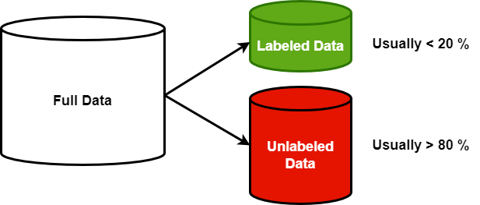
Recommender System – Semi-supervised learning
Partially labeled data
Data distribution high unbalanced or not uniform
Need for resources with specific and high skills
Combine two or more supervised learning alghoritm

Slide 8
Recommender System – Semi-supervised Hybrid approach
A is a high sparse matrix
A is very unbalanced matrix
Missing exiplicit rating value

Slide 9
Recommender System – Distribution Items
Nome Polizza | Numero Clienti | Percentuale
R.C.A. | 573.876 | 89,4675
INFORTUNI | 64.266 | 10,0191
MULTIGARANZIA ABITAZIONE | 2.413 | 0,3762
MALATTIA | 766 | 0,1194
R.C. DIVERSI | 78 | 0,0122
A.R.D. | 22 | 0,0034
GLOBALE FABBRICATI | 8 | 0,0012
INCENDIO/FURTO | 4 | 0,0006
TUTELA GIUDIZIARIA | 2 | 0,0003

Slide 10
Recommender System – Semi-supervised Hybrid approach
Content boosted
Change the scale for all ratings, I used the percent scale
Add random bias to all ratings value
Improve recommendations
Initial value of MSE is <= 0,5
Final value of MSE is > 0,9
Starting point
Sparse Matrix > 85 %
Unbalanced Matrix
Missing explicit rating value
Calculate the forecast value for all items for all users
Define knowledge base
Features of the articles
Features of the users

Slide 11
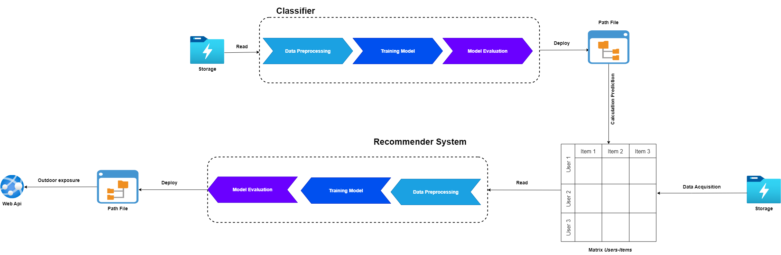
Recommender System – Architecture

Slide 12
Recommender System – Experimental results compared

Slide 13
Recommender System – Experimental results valutation
Numero Clienti | Valutazione Modello
62.693 | 0,9551
125.386 | 0,9902
188.079 | 0,9922
250.772 | 0,9951
313.465 | 0,9808
376.158 | 0,9864
438.851 | 0,9671
501.544 | 0,9843
564.237 | 0,9956
626.929 | 0,9797

