Slide 1


Memphis Ruby User Group

Slide 2
Who Am I?
Daniel Lissner
Software Engineer at Mosaik Solutions
Android development ~3 years
http://speakingcode.com
@speakingcode github.com/speakingcode

Slide 3
Ruboto
Framework and tool chain to develop Android apps, using Ruby
Exposes full Android API
Uses jRuby (http://jruby.org)
http://ruboto.org

Slide 4
Install jdk
# pacman -S jdk7-openjdk (arch)
# apt-get install openjdk-7-jdk (deb/ubuntu)

Slide 5
Install Apache Ant
# pacman -S apache-ant (arch)
# apt-get install ant (deb/ubuntu)

Slide 6
Install jRuby
$ packer -S jruby (arch AUR)
$ rvm install jruby (rvm)
# apt-get install jruby (deb/ubuntu)

Slide 7
Install Android SDK
http://developer.android.com/sdk/index.html
Download ADT Bundle
Extract to path of choice
Includes eclipse/ and sdk/

Slide 8
Environment Variables
Add absolute path to sdk/ to $ANDROID_HOME
Add absolute path to sdk/tools/ and sdk/platform-tools to $PATH
Add ant directory $ANT_HOME

Slide 9
Ex .bashrc
export ANDROID_HOME=/home/speakingcode/android/sdk
export PATH=$PATH:/home/speakingcode/android/sdk/tools
Export PATH=$PATH:/home/unknown/android/sdk/platform-tools
export PATH=$PATH:/usr/share/java/apache-ant/bin/ant
export ANT_HOME=/usr/share/java/apache-ant/bin/ant

Slide 10
Install Rubuto
gem install ruboto

Slide 11
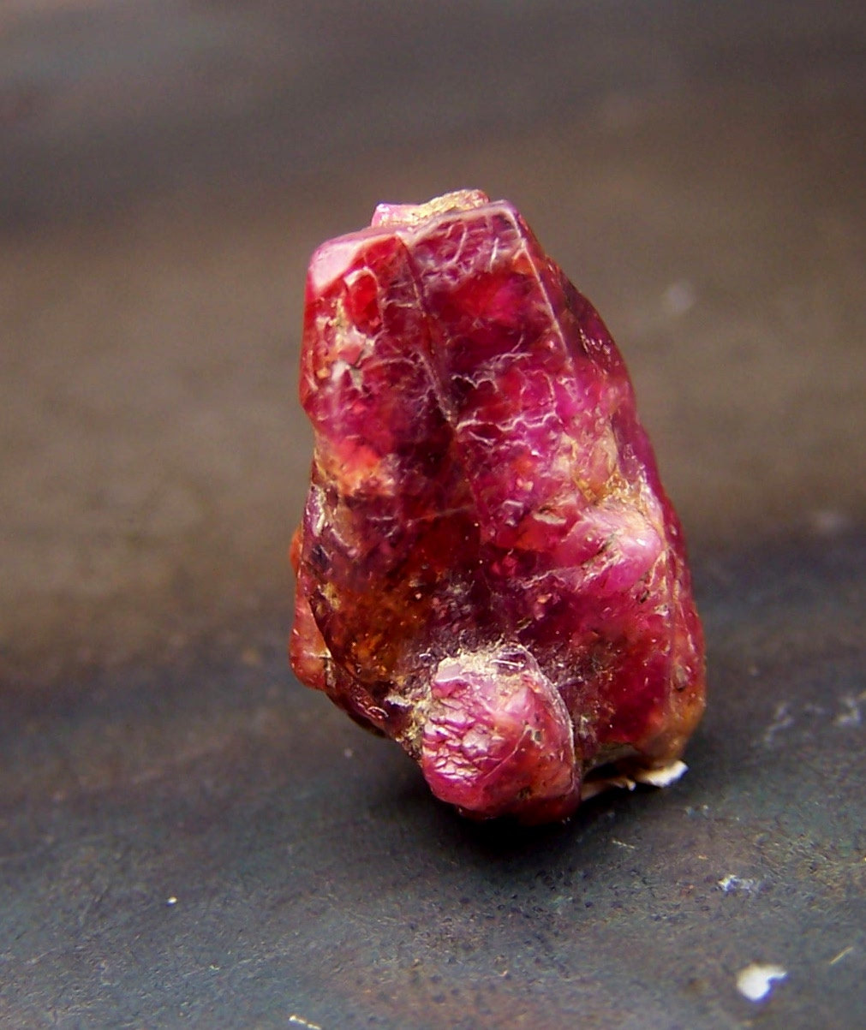
Ready to Rock

Slide 12
ruboto
Command-line tool for managing ruboto projects
Typically run in root of app directory

Slide 13
Generate Application
$ ruboto gen app
--package <package-name>
--path <path-for-app>
--name <app-name>
--target android-<api-level>
--min-sdk android-<api-level>
--activity <main-activity-name>

Slide 14
Generate Classes
Generates Java class for Android component (Activity, Service, BroadcastReceiver) & corresponding ruboto script and test script
$ ruboto gen class <parent-class-name> --name <class-name>
Ex $ ruboto gen class Activity --name MyActivity

Slide 15
Scripts
Placed in src/
Correspond to your Android java classes
Use under_score_names instead of CamelCase
Must have: require 'rubuto/activity'

Slide 16
Ex Script
require 'ruboto/activity'
class FooActivity
  include Ruboto::Activity
  def onCreate(bundle)
    Log.v 'FooActivity', 'onCreate called'
  end
  def onPause
    Log.v 'FooActivity', 'onPause called'
  end
end

Slide 17
Java Equiv
public class FooActivity extends Activity
{
@Override
public void onCreate(Bundle savedInstanceState)
{
super.onCreate(savedInstanceState);
Log.v(“FooActivity”, “onCreate called”);
}
}

Slide 18
UI – Typical XML Layout
<RelativeLayout xmlns:android="http://schemas.android.com/apk/res/android"
xmlns:tools="http://schemas.android.com/tools"
android:layout_width="match_parent"
android:layout_height="match_parent"
android:paddingBottom="@dimen/activity_vertical_margin"
android:paddingLeft="@dimen/activity_horizontal_margin"
android:paddingRight="@dimen/activity_horizontal_margin"
android:paddingTop="@dimen/activity_vertical_margin"
tools:context=".InsightsActivity" >
<ListView
android:id="@+id/insightArticlesListView"
android:layout_width="match_parent"
android:layout_height="match_parent"
/>
</RelativeLayout>

Slide 19
UI - Ruboto
  java_import "android.widget.EditText"
  java_import "android.widget.Button"
  java_import "android.widget.ListView"
  java_import "android.widget.LinearLayout"
  inner_ll = LinearLayout.new(@ruboto_java_instance)
  outer_ll.add_view inner_ll
  params = inner_ll.get_layout_params
  params.width = ViewGroup::LayoutParams::FILL_PARENT
  params.height = ViewGroup::LayoutParams::WRAP_CONTENT
EW! ruboto/widget.rb provides simple DSL to avoid tedious programmatic UI building
widget DSL is similar to XML in typical Android

Slide 20
UI with ruboto/widget
require "ruboto/widget"
ruboto_import_widgets :EditText, :TextView, :Button, :LinearLayout
class RubotoDemoActivity
def on_create(bundle)
super
setContentView(
linear_layout(:orientation => :vertical) do
@et = edit_text
linear_layout do
button :text => "Hello, World", :on_click_listener => handle_click
button :text => "Hello, Ruboto", :on_click_listener => handle_click
end
@tv = text_view :text => "Click buttons or menu items:"
end
)
end
end

Slide 21
Launching Activities - Java
Intent i = new Intent
(
getApplicationContext(),
AnotherActivity.class
);
startActivity(i);

Slide 22
Launch Activty - Ruby
ruboto gen app and ruboto gen class create subclasses of RubotoActivity
Can still use Intent with startActivity
java_import 'android.content.Intent'
intent = Intent.new($package_name, 'FooActivity') startActivity(intent)
Necessary for launching Activities from other apps or Activities not subclassed from RubotoActivity

Slide 23
Launch Activity – Ruboto
start_rubuto_activity
Req'd params:
string – global reference to new activity
block – to be executed on new Activity's creation (self in the block is the new Activity)
Optional params
class – An Activity class to be created (default is RubotoActivity)
theme – Resource id, defaults to nil

Slide 24
Launching Ruboto Activity
start_ruboto_activity("$foo_activity") do
def on_create(bundle)
setTitle 'Foo Foo'
self.content_view =
linear_layout(:orientation => :vertical) do
@text_view = text_view :text => "Welcome"
end
end
end

Slide 25
Deploy
Generate apk:
$ rake
Generate apk + install:
$ rake install
Deploy ruby-only changes (requires root)
$ rake update_scripts

Slide 26
Demo
No fail plz!

Slide 27
QA

