Slide 1


SOA Application with Flask and Backbone.js

Slide 2
If I have seen farther than others, it is because I was standing on the shoulders of giants.
Sir Isaac Newton.

Slide 3
Service Oriented Architecture
Service-oriented architecture (SOA) is a software design methodology based on structured collections of discrete software modules, known as services, that collectively provide the complete functionality of a large or complex software application. - Wikipedia

Slide 4
SOA
Build system as composition of small subsystems
Subsystems communicate via defined, independent messaging protocol
Allows reuse of code across platforms, programming languages, environments, organizations

Slide 5
Services
Implement a tight set of functions
Discrete pieces of code
Have no direct calls to each other
May consume other services
May be composed together in several ways

Slide 6
Web Services
Network accessible
Communicate via standard Internet protocols
May povide new functionality or make exisiting applications network-accessible
SOAP and REST are common protocols

Slide 7
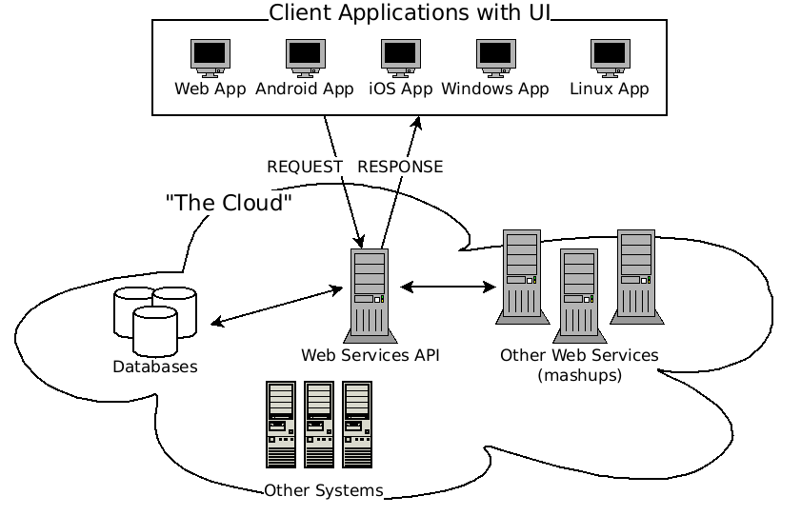
Web Service Architecture

Slide 8
SOAP
Simple Object Access Protocol
XML messaging
Nuetral toward transport protocol (HTTP, SMTP, TCP, etc.)
Big enterprises
Clunky & bulky

Slide 9
POST /InStock HTTP/1.1
Host: www.example.org
Content-Type: application/soap+xml; charset=utf-8
Content-Length: 299
SOAPAction: "http://www.w3.org/2003/05/soap-envelope"
<?xml version="1.0"?>
<soap:Envelope xmlns:soap="http://www.w3.org/2003/05/soap-envelope">
<soap:Header>
</soap:Header>
<soap:Body>
<m:GetStockPrice xmlns:m="http://www.example.org/stock">
<m:StockName>IBM</m:StockName>
</m:GetStockPrice>
</soap:Body>
</soap:Envelope>

Slide 10
REST
Respresentational State Transfer
“Architectural style”
Client-server model
Requests/responses capture the state of 'resources'
HTTP POST, GET, PUT, DELETE (CRUD)
XML, JSON

Slide 11














Slide 12
HTTP GET http://freemusicarchive.org/api/get/albums.json?api_key=60BLHNQCAOUFPIBZ&album_id=10620
Response:
{
"album_id":"10620",
"album_title":"\"...Through The Cracks\" Mix Vol. 1",
"album_handle":"Through_The_Cracks_Mix_Vol_1",
"album_type":"Album",
"artist_name":"The Yes Sirs",
"album_date_released":null,
"album_comments":"0",
"album_favorites":"0",
"album_tracks":"4",
"album_listens":"1071",
"album_date_created":"12\/18\/2011 07:31:38 PM",
"album_image_file":"20111218183001853.png"
}

Slide 13

Python web-application micro-framework
Binds HTTP methods to function calls
Well suited for RESTful webservice development
http://flask.pocoo.org/

Slide 14
Install
$ pip install flask
$ python hello.py
  * Running on http://localhost:5000

Slide 15
Cloud-Based Notes Application
Keep track of notes
Notes have id, title, body, timestamp (created)

Slide 16
RESTful API
POST /notes – create new note
GET /notes/:id – retrieve note with :id
PUT /notes/:id – update note with :id
GET /notes – return all notes

Slide 17
Boilerplate
from flask import Flask, jsonify, json, request, Response
app = Flask(__name__)
allnotes = []
index = 0
if __name__ == '__main__':
app.run()

Slide 18
Create a note
@app.route('/notes', methods=['POST'])
def notes():
if request.method == 'POST':
createNote()
else:
show_the_login_form()

Slide 19
Routing
@app.route('/notes', methods=['GET', 'POST'])
def notes():
if request.method == 'GET':
return get_all_notes()
elif request.method == 'POST':
return create_note(json.loads(request.data))
@app.route('/notes/<int:id>', methods=['GET', 'PUT'])
def notes_id(id):
if request.method == 'GET':
return get_note(id)
elif request.method == 'PUT':
return update_note(id, json.loads(request.data))

Slide 20
Create a Note
def create_note(note):
global allnotes
global index
note['id'] = index
allnotes.append(note)
index = index + 1
return jsonify(allnotes[len(allnotes)-1])

Slide 21
Get a Note
def get_note(id):
global allnotes
return jsonify(allnotes[id])

Slide 22
Update a Note
def update_note(id, note):
global allnotes
allnotes[id] = note
return jsonify(allnotes[id])

Slide 23
Get All Notes
def get_all_notes():
global allnotes
return Response(json.dumps(allnotes), mimetype='application/json')

Slide 24
Whole Thing
from flask import Flask, jsonify, json, request, Response
app = Flask(__name__)
allnotes = []
index = 0
@app.route('/notes', methods=['GET', 'POST'])
def notes():
if request.method == 'GET':
return get_all_notes()
elif request.method == 'POST':
return create_note(json.loads(request.data))
@app.route('/notes/<int:id>', methods=['GET', 'PUT'])
def notes_id(id):
if request.method == 'GET':
return get_note(id)
elif request.method == 'PUT':
return update_note(id, json.loads(request.data))
def get_all_notes():
global allnotes
return Response(json.dumps(allnotes), mimetype='application/json')
def create_note(note):
global allnotes
global index
note['id'] = index
allnotes.append(note)
index = index + 1
return jsonify(allnotes[len(allnotes)-1])
def update_note(id, note):
global allnotes
allnotes[id] = note
return jsonify(allnotes[id])
def get_note(id):
global allnotes
return jsonify(allnotes[id])
if __name__ == '__main__':
app.debug = True
app.run()

Slide 25

Provides structure for web applications
Models, Views, Collections, Routers
Routing binds hash-urls (site.com/#example) with JavaScript functions
Automagic data-modelling with RESTful APIs!!

Slide 26
index.js
var App = {
Views: {},
Routers: {},
Collections: {},
  Models: {},
init: function() {
new App.Routers.Notes();
Backbone.history.start();
}
};

Slide 27
Model
App.Models.Note = Backbone.Model.extend({
url : function() {
var base = 'notes';
if (this.isNew()) return base;
return base + (base.charAt(base.length - 1) == '/' ? '' : '/') + this.id;
}
});

Slide 28
Collection
App.Collections.Notes = Backbone.Collection.extend({
model: Note,
url: '/notes'
});

Slide 29
Routes
App.Routers.Notes = Backbone.Controller.extend({
routes: {
"note/:id": "edit",
"": "index",
"new": "newNote"
},
...

Slide 30
Edit Route
edit: function(id) {
var note = new Note({ id: id });
note.fetch({
success: function(model, resp) {
new App.Views.Edit({ model: note });
}
});
},

Slide 31
Index
index: function() {
var notes = new App.Collections.Notes();
notes.fetch({
success: function() {
new App.Views.Index({ collection: notes });
}
});
},

Slide 32
New
newNote: function() {
new App.Views.Edit({ model: new Note() });
}

Slide 33
Index View
App.Views.Index = Backbone.View.extend({
initialize: function() {
this.notes = this.options.notes;
this.render();
},
render: function() {
if(this.notes.length > 0) {
var out = "<h3><a href='#new'>Create New</a></h3><ul>";
_(this.notes).each(function(item) {
out += "<li><a href='#notes/" + item.id + "'>" + item.escape('title') + "</a></li>";
});
out += "</ul>";
} else {
out = "<h3>No notes! <a href='#new'>Create one</a></h3>";
}
$(this.el).html(out);
$('#app').html(this.el);
}
});

