Slide 1
SPEAK
DAILY
English · Reading Images

Slide 2

SPEAK
DAILY
Hello :)
Welcome to SpeakDaily English!
Chibi - ‘Head of Motivation’
Notes:
Safe classroom culture. No judgment. This is how we learn.

Slide 3
SPEAK
DAILY
What to Expect
Your 30-minute class, in 3 parts
1
2
3
Pronunciation
We start here every class
Vocabulary
Words that sharpen your English
Discussion
What is the image really saying?
Relax. No pressure.

Slide 4

SPEAK
DAILY
Not sure
of an answer?
Don’t hesitate to ask for help.
“Help me out!”
Notes:
Safe classroom culture. No judgment. This is how we learn.

Slide 5
SPEAK
DAILY
Let’s begin!
Notes:
Energy up! Match Bárbara's enthusiasm.

Slide 6
SPEAK
DAILY
🔊
PRONUNCIATION
Sound Workout

Slide 7
SPEAK
DAILY
How it works:
L
Listen
R
Repeat
Don't think, just copy!

Slide 8
PRONUNCIATION
SPEAK
DAILY
Post
Host
Most
The host will post the programme online, and most guests have already seen it.
Listen carefully, then repeat each word aloud.

Slide 9
PRONUNCIATION
SPEAK
DAILY
Bird
Third
Word
The bird returned for the third time that week.
Listen carefully, then repeat each word aloud.

Slide 10
PRONUNCIATION
SPEAK
DAILY
Live
Alive
Lived
We live near the sea, and the concert was broadcast live, so the whole town felt alive.
Listen carefully, then repeat each word aloud.

Slide 11
PRONUNCIATION
SPEAK
DAILY
Book
Look
Could
Could you take a look at this book before the meeting?
Listen carefully, then repeat each word aloud.

Slide 12
PRONUNCIATION
SPEAK
DAILY
Would
Should
Wood
I would help, but I should finish this first.
Listen carefully, then repeat each word aloud.

Slide 13
PRONUNCIATION
SPEAK
DAILY
Thought
Taught
Brought
She taught us to write down what we thought, and she brought her own notes.
Listen carefully, then repeat each word aloud.

Slide 14
PRONUNCIATION
SPEAK
DAILY
Knowledge
Acknowledge
Knowledgeable
He acknowledged that her knowledge of the subject was impressive.
Listen carefully, then repeat each word aloud.

Slide 15
PRONUNCIATION
SPEAK
DAILY
Relevant
Irrelevant
Elephant
The comment was irrelevant, but the next speaker’s point was highly relevant.
Listen carefully, then repeat each word aloud.

Slide 16
PRONUNCIATION
SPEAK
DAILY
Peculiar
Particular
Particularly
It was a peculiar noise, and he was particularly bothered by it.
Listen carefully, then repeat each word aloud.

Slide 17
PRONUNCIATION
SPEAK
DAILY
Mountain
Fountain
Captain
The captain pointed to the fountain at the foot of the mountain.
Listen carefully, then repeat each word aloud.

Slide 18
PRONUNCIATION
SPEAK
DAILY
Beautiful
Duty
Tuesday
It was my duty to open the gallery on Tuesday, and the beautiful old hall was empty.
Listen carefully, then repeat each word aloud.

Slide 19
PRONUNCIATION
SPEAK
DAILY
Awkward
Toward
Reward
There was an awkward silence, but the reward at the end was worth it.
Listen carefully, then repeat each word aloud.

Slide 20
SPEAK
DAILY
🎉
Well done!

Slide 21
SPEAK
DAILY
Advanced Vocabulary

Slide 22
VOCABULARY
SPEAK
DAILY
haunting

Slide 23
VOCABULARY
SPEAK
DAILY
haunting
Beautiful or sad in a way that stays in your mind for a long time.
“The photograph has a haunting quality that I could not forget.”
Used for images, music and memories. Also: unforgettable, lingering.

Slide 24
VOCABULARY
SPEAK
DAILY
ambiguous

Slide 25
VOCABULARY
SPEAK
DAILY
ambiguous
Having more than one possible meaning, so it is not clear which one is intended.
“The ending of the film is deliberately ambiguous.”
The noun is “ambiguity”. Not the same as “vague”. Also: open to interpretation.

Slide 26
VOCABULARY
SPEAK
DAILY
stark

Slide 27
VOCABULARY
SPEAK
DAILY
stark
Very plain and clear, often in a harsh or bare way.
“The stark landscape made the figure look even smaller.”
Common in “a stark contrast” and “a stark reminder”. Also: bleak, bare.

Slide 28
VOCABULARY
SPEAK
DAILY
melancholy

Slide 29
VOCABULARY
SPEAK
DAILY
melancholy
A deep, quiet sadness, often without a clear cause.
“There was a melancholy mood in the room after the news.”
Can be a noun or an adjective. Softer and more reflective than “depressed”. Also: wistful, sombre.

Slide 30
VOCABULARY
SPEAK
DAILY
symbolise

Slide 31
VOCABULARY
SPEAK
DAILY
symbolise
To represent an idea or a quality.
“In the story, the locked door symbolises the family’s secrets.”
British spelling: symbolise. The noun is “a symbol”, or “symbolism”. Also: represent, stand for.

Slide 32
SPEAK
DAILY
Discussion

Slide 33
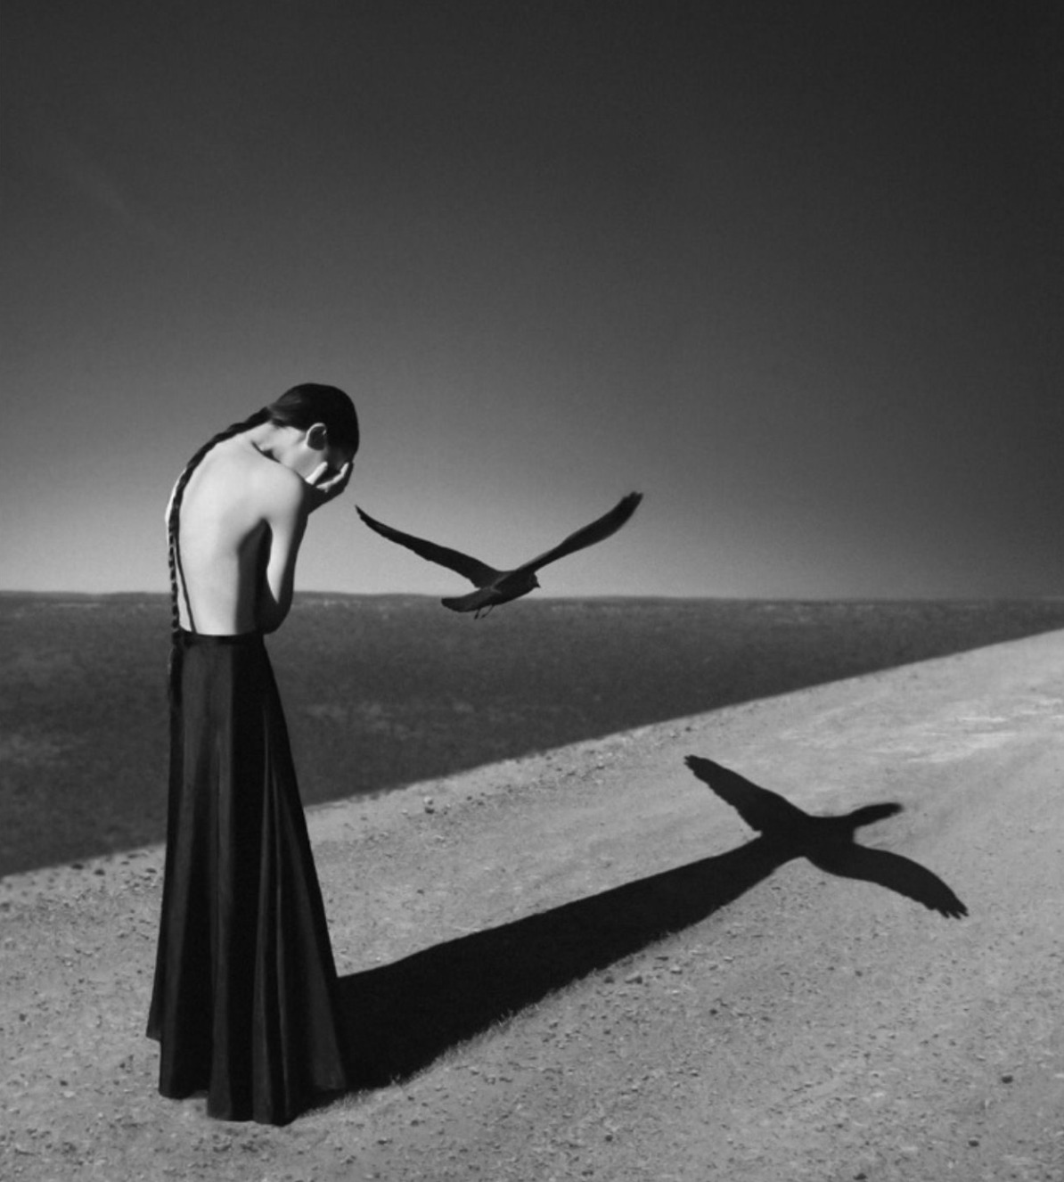
DISCUSSION · IMAGE 2
SPEAK
DAILY
What Is the Deeper Meaning?
Notes:
IMAGE 2 - THE WOMAN AND THE BIRD. Same method: 30 seconds of silence, one-sentence description, then the deeper meaning.
What is in the image: a black and white photograph. A woman with a long braid, bare back and a long black skirt stands bent forward with her face in her hands. A bird flies close above and in front of her. On the ground, a long shadow stretches from her; at its end the bird's shadow appears with its wings spread wide, almost like a cross. The land is flat and empty, with a dark sky.
Possible readings (do not give these first): grief, sorrow or shame; a private moment of pain in an empty world; the bird as hope, a soul, a messenger or a sign of loss; a shadow that shows what the person cannot see; loneliness against vastness; the shape of the shadow, which can be read as a cross, a burden or a release.
Follow-ups: Is the bird real, or is it a thought? Why is the shadow more complete than the person? What does the empty landscape add? Is this a moment of sadness or of letting go?
Words to offer if stuck: haunting, stark, melancholy, ambiguous, symbolise.

Slide 34
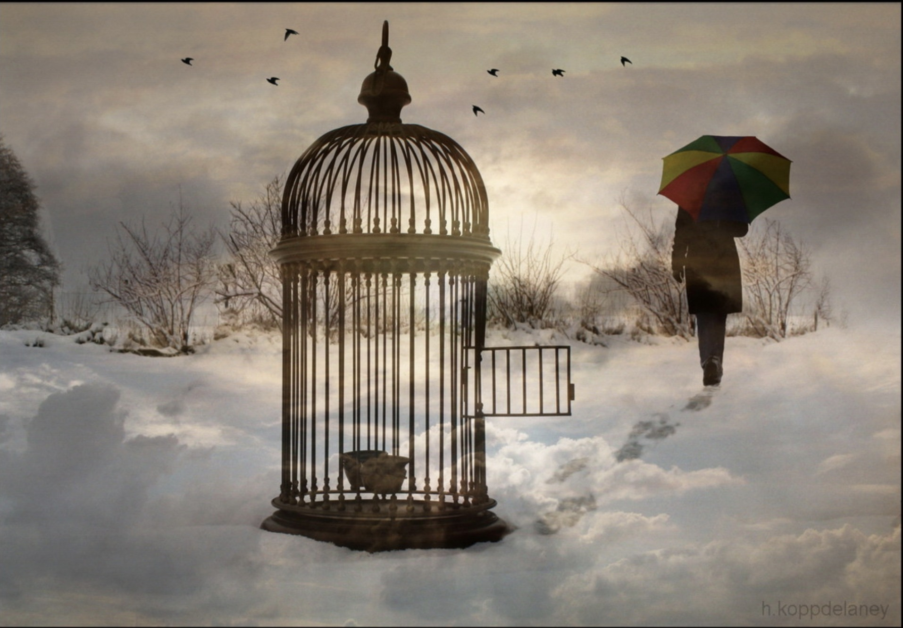
DISCUSSION · IMAGE 1
SPEAK
DAILY
What Is the Deeper Meaning?
Notes:
IMAGE 1 - THE OPEN CAGE. Do ONE image at a time; the others can wait for another lesson. Let them look in silence for 30 seconds. Ask: what do you see (one sentence), and then what is the deeper meaning? Let them type their ideas on the slide, then push them to justify.
What is in the image: an ornate birdcage standing in deep snow, its small door open. Something small sits at the bottom of the cage (it is not clear whether it is a bird, a nest or a bowl). Footprints in the snow lead away from the cage to a person in a dark coat, seen from behind, walking away under a brightly coloured umbrella. Birds fly in a grey, cloudy sky. Cold, muted colours, with the umbrella as the only bright colour.
Possible readings (do not give these first): freedom that is offered but not taken; someone leaving a situation, a relationship or a habit behind; who opened the door, and why; the cage as the past; the choice to stay or go; being released versus being abandoned; colour and hope against a cold, bleak world.
Follow-ups: Who opened the door? Is the person walking away the one who was caged, or the one who freed the bird? Why is the cage so large? What does the winter setting add? Is the mood hopeful or sad?
Words to offer if stuck: ambiguous, stark, symbolise, melancholy.

Slide 35
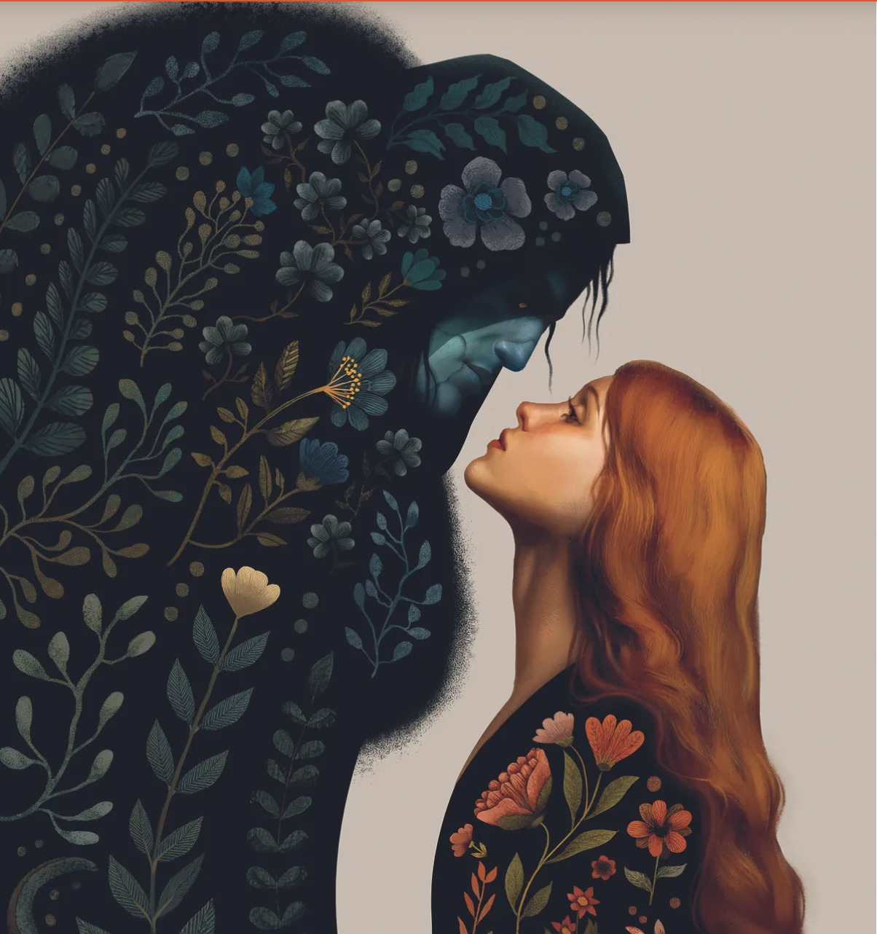
DISCUSSION · IMAGE 3
SPEAK
DAILY
What Is the Deeper Meaning?
Notes:
IMAGE 3 - THE FLOWERED GIANT AND THE WOMAN. Same method: 30 seconds of silence, one-sentence description, then the deeper meaning.
What is in the image: an illustration. A huge dark figure in a hood bends down towards a young woman with long red hair who looks up at it, their faces very close. The dark figure's body is covered in a pattern of leaves, flowers and plants in deep blues and greens. The woman's sleeve carries flowers in warm reds and oranges. The background is a plain pale grey.
Possible readings (do not give these first): fear and tenderness together; appearances versus what is inside; something that looks frightening but is full of life and growth; trust between two very different beings; love across a difference; her calm, upturned face against his huge shape; cool colours against warm colours.
Follow-ups: Who is the more powerful of the two? Why is she not afraid? What do the flowers tell us about the dark figure? Do you read the scene as a meeting, a farewell or a moment before a kiss?
Words to offer if stuck: ambiguous, stark, symbolise, haunting.

Slide 36
SPEAK
DAILY
👋
See you next time!
SPEAK DAILY · English

