Slide 1
SPEAK
DAILY
English · Describing Pictures

Slide 2

SPEAK
DAILY
Hello :)
Welcome to SpeakDaily English!
Chibi - ‘Head of Motivation’
Notes:
Safe classroom culture. No judgment. This is how we learn.

Slide 3
SPEAK
DAILY
What to Expect
Your 30-minute class, in 3 parts
1
2
3
Pronunciation
We start here every class
Vocabulary
Words that sharpen your English
Describe the Picture
One picture, in detail
Relax. No pressure.

Slide 4

SPEAK
DAILY
Not sure
of an answer?
Don’t hesitate to ask for help.
“Help me out!”
Notes:
Safe classroom culture. No judgment. This is how we learn.

Slide 5
SPEAK
DAILY
Let’s begin!
Notes:
Energy up! Match Bárbara's enthusiasm.

Slide 6
SPEAK
DAILY
🔊
PRONUNCIATION
Sound Workout

Slide 7
SPEAK
DAILY
How it works:
L
Listen
R
Repeat
Don't think, just copy!

Slide 8
PRONUNCIATION
SPEAK
DAILY
Bit
Beat
Bet
I was a bit nervous, but we beat the clock and finished on time.
Listen carefully, then repeat each word aloud.

Slide 9
PRONUNCIATION
SPEAK
DAILY
Chip
Cheap
Chop
The chips were cheap, so we ordered two bags.
Listen carefully, then repeat each word aloud.

Slide 10
PRONUNCIATION
SPEAK
DAILY
Ship
Sheep
Shop
We saw a sheep near the shop, and then a ship out at sea.
Listen carefully, then repeat each word aloud.

Slide 11
PRONUNCIATION
SPEAK
DAILY
Earth
Hurt
Heart
It really hurt when she left, and I still think about it with a heavy heart.
Listen carefully, then repeat each word aloud.

Slide 12
PRONUNCIATION
SPEAK
DAILY
Calm
Walk
Talk
We stayed calm and went for a long walk, so we could talk it over properly.
Listen carefully, then repeat each word aloud.

Slide 13
PRONUNCIATION
SPEAK
DAILY
Castle
Whistle
Listen
Please listen for the whistle, because the castle gates close at six.
Listen carefully, then repeat each word aloud.

Slide 14
PRONUNCIATION
SPEAK
DAILY
Heard
Herd
Hard
I heard it was hard to find, so we walked around for almost an hour.
Listen carefully, then repeat each word aloud.

Slide 15
PRONUNCIATION
SPEAK
DAILY
Breath
Breathe
Breadth
Take a deep breath, breathe out slowly, and then try again.
Listen carefully, then repeat each word aloud.

Slide 16
PRONUNCIATION
SPEAK
DAILY
Rough
Tough
Enough
It was a rough week and a tough month, but we had enough support.
Listen carefully, then repeat each word aloud.

Slide 17
PRONUNCIATION
SPEAK
DAILY
Picture
Pleasure
Measure
It was a pleasure to see the picture, and it is hard to measure what it means.
Listen carefully, then repeat each word aloud.

Slide 18
PRONUNCIATION
SPEAK
DAILY
Quiet
Quite
Quit
It was quite quiet in the hall, and nobody wanted to quit before the end.
Listen carefully, then repeat each word aloud.

Slide 19
PRONUNCIATION
SPEAK
DAILY
Height
Width
Weight
The height and the weight are on the form, but the width is missing.
Listen carefully, then repeat each word aloud.

Slide 20
SPEAK
DAILY
🎉
Well done!

Slide 21
SPEAK
DAILY
Advanced Vocabulary

Slide 22
VOCABULARY
SPEAK
DAILY
suspended

Slide 23
VOCABULARY
SPEAK
DAILY
suspended
Hanging or held up in the air, without touching the ground.
“She is suspended upside down from a length of silk.”
More precise than “hanging”. Also: dangling (loose, swinging), hovering.

Slide 24
VOCABULARY
SPEAK
DAILY
poised

Slide 25
VOCABULARY
SPEAK
DAILY
poised
Balanced and still, in a calm, controlled position, ready to move.
“He is poised in mid-air, perfectly still.”
Suggests calm control. Also: “poised to win”, meaning ready to. Also: composed, steady.

Slide 26
VOCABULARY
SPEAK
DAILY
taut

Slide 27
VOCABULARY
SPEAK
DAILY
taut
Pulled tight, with no slack.
“His arms are taut, and every muscle is working.”
Used for ropes, fabric and muscles. Instead of “tight”. Also: stretched, rigid.

Slide 28
VOCABULARY
SPEAK
DAILY
contort

Slide 29
VOCABULARY
SPEAK
DAILY
contort
To twist or bend something, especially a body, into an unusual shape.
“She can contort her body into positions most people could never reach.”
A person who does this for a living is a contortionist. Also: twist, bend.

Slide 30
VOCABULARY
SPEAK
DAILY
defy gravity

Slide 31
VOCABULARY
SPEAK
DAILY
defy gravity
To seem to ignore the normal laws of physics, especially by staying in the air.
“The gymnast seems to defy gravity.”
Often used to praise performers and athletes. A fixed phrase: defy + gravity. Also: seem weightless.

Slide 32
SPEAK
DAILY
Describe the Picture

Slide 33
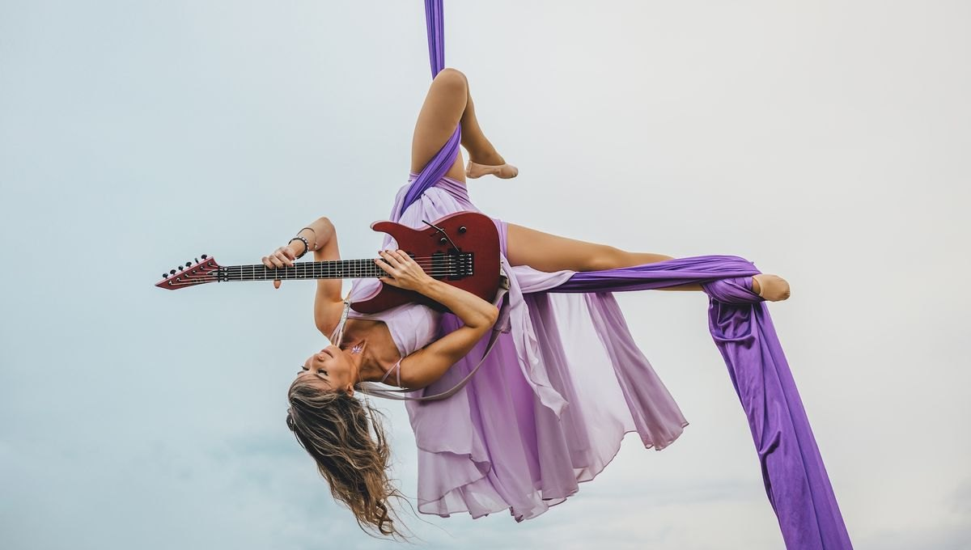
DESCRIBE THE PICTURE · PICTURE 1
SPEAK
DAILY
Describe What She Is Doing
Notes:
PICTURE 1 - AERIALIST WITH GUITAR. Do ONE picture per lesson. Let them look in silence for 30 seconds, then ask them to describe what she is doing. Same task for both students; the difference is how much detail they give. If they get stuck they can say 'Help me out!'.
What is in the picture: a woman in a lilac dress hanging upside down from purple aerial silks against a pale, cloudy sky, playing a red electric guitar. One leg is bent up, the other is stretched out and wrapped in fabric, her hair is hanging down.
Simple answer: 'She is upside down. She has a guitar. One leg is up.'
Fuller answer: 'She is suspended upside down from purple silks, with one leg bent and the other stretched out, while she plays a red electric guitar.'
Words from the lesson to offer if stuck: suspended, poised, taut, contort, defy gravity. Do not force them. Listen for present continuous and prepositions; correct one or two things after they finish.

Slide 34
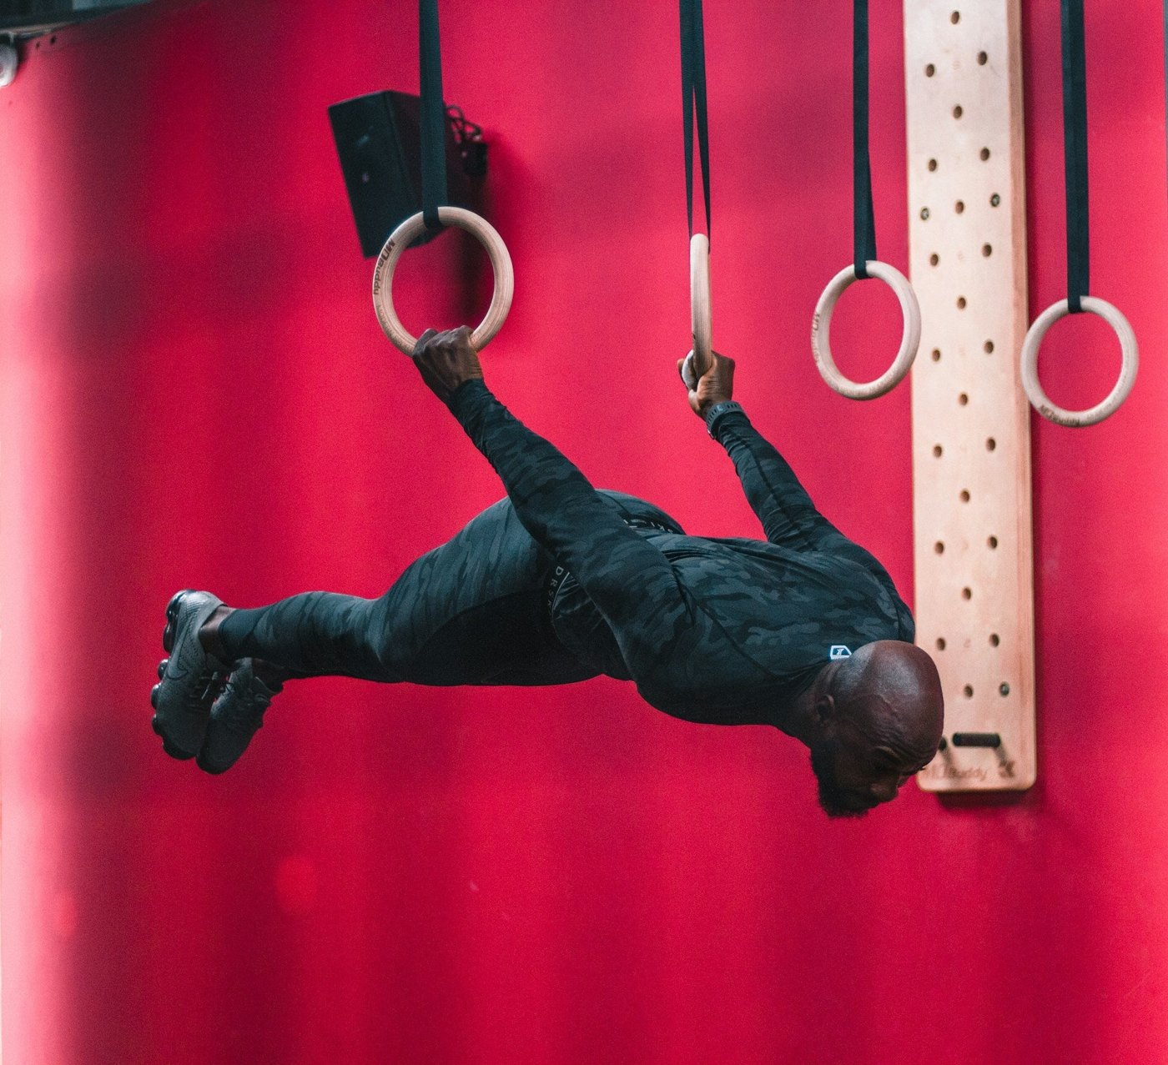
DESCRIBE THE PICTURE · PICTURE 2
SPEAK
DAILY
Describe What He Is Doing
Notes:
PICTURE 2 - MAN ON GYMNASTIC RINGS. Use on a different day from Picture 1. Let them look in silence for 30 seconds, then ask them to describe what he is doing. Same task for both students.
What is in the picture: a bald man with a beard in a dark camouflage-print training suit and grey trainers, wearing a watch, holding two wooden rings hanging from black straps. His arms are straight, his body is horizontal and face down, his legs are together behind him. Behind him: a red wall, a wooden board with holes, a speaker. Do not worry about the name of the exercise; the description is the task.
Simple answer: 'He is holding two rings. His body is flat. He is in a gym.'
Fuller answer: 'He is holding two rings with straight arms while his whole body is horizontal and completely rigid, as if he were lying on air.'
Words to offer if stuck: poised, taut, defy gravity.

Slide 35
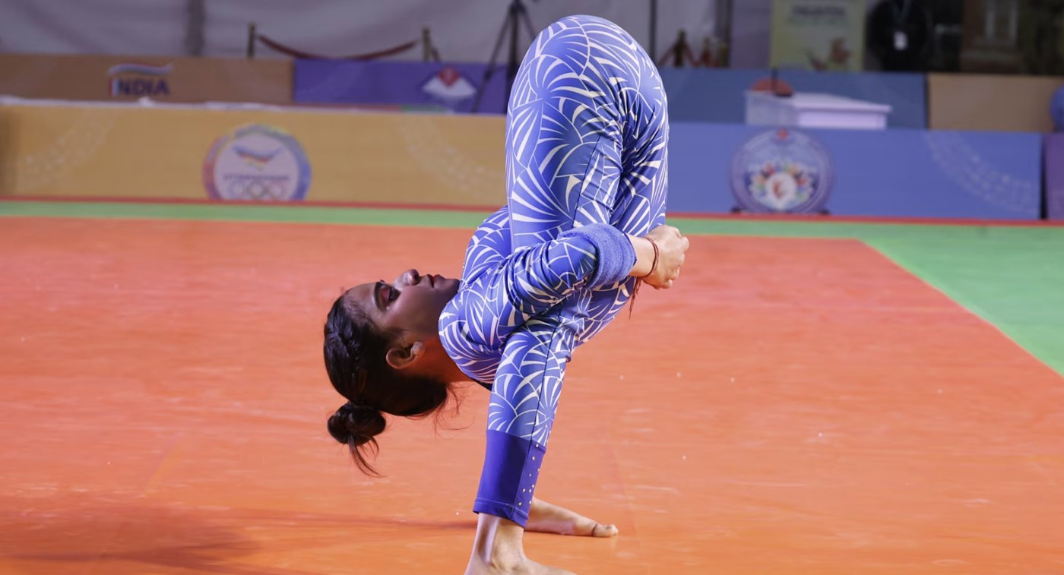
DESCRIBE THE PICTURE · PICTURE 3
SPEAK
DAILY
Describe What She Is Doing
Notes:
PICTURE 3 - WOMAN FOLDED FORWARD. Use on a different day from Pictures 1 and 2. Let them look in silence for 30 seconds, then ask them to describe what she is doing. Same task for both students.
What is in the picture: a woman in a long-sleeved blue and white patterned bodysuit with a wristband, hair in a plait and a bun, standing on both feet on an orange mat with a green border, folded forward at the waist with her arms wrapped around her legs and her head lifted. Banners and logos in the hall behind her; it looks like an organised event, but do not state which sport.
Simple answer: 'She is bending forward. She holds her legs.'
Fuller answer: 'She is folded in half, with her torso pressed against her legs and her arms wrapped around them, while her head is lifted and she looks calm.'
Words to offer if stuck: contort, taut, poised.

Slide 36
SPEAK
DAILY
👋
See you next time!
SPEAK DAILY · English

