Slide 1
SPEAK
DAILY
English · The Meaning Behind the Image

Slide 2

SPEAK
DAILY
Hello :)
Welcome to SpeakDaily English!
Chibi - ‘Head of Motivation’
Notes:
Safe classroom culture. No judgment. This is how we learn.

Slide 3
SPEAK
DAILY
What to Expect
Your 30-minute class, in 3 parts
1
2
3
Pronunciation
We start here every class
Vocabulary
Words that sharpen your English
Discussion
What is the image really saying?
Relax. No pressure.

Slide 4

SPEAK
DAILY
Not sure
of an answer?
Don’t hesitate to ask for help.
“Help me out!”
Notes:
Safe classroom culture. No judgment. This is how we learn.

Slide 5
SPEAK
DAILY
Let’s begin!
Notes:
Energy up! Match Bárbara's enthusiasm.

Slide 6
SPEAK
DAILY
🔊
PRONUNCIATION
Sound Workout

Slide 7
SPEAK
DAILY
How it works:
L
Listen
R
Repeat
Don't think, just copy!

Slide 8
PRONUNCIATION
SPEAK
DAILY
Cot
Caught
Court
He was caught arriving late at court, and the judge was not amused.
Listen carefully, then repeat each word aloud.

Slide 9
PRONUNCIATION
SPEAK
DAILY
Pull
Pool
Pole
She pulled the boat out of the pool and tied it to the pole.
Listen carefully, then repeat each word aloud.

Slide 10
PRONUNCIATION
SPEAK
DAILY
Think
Sink
Thing
I think the whole thing is going to sink if we do not act quickly.
Listen carefully, then repeat each word aloud.

Slide 11
PRONUNCIATION
SPEAK
DAILY
Very
Wary
Berry
He was very wary of the first offer, and he asked for time to think.
Listen carefully, then repeat each word aloud.

Slide 12
PRONUNCIATION
SPEAK
DAILY
Answer
Island
Sword
Nobody could answer how the island had survived such a long winter.
Listen carefully, then repeat each word aloud.

Slide 13
PRONUNCIATION
SPEAK
DAILY
Receipt
Cupboard
Plumber
Keep the receipt in the cupboard, in case the plumber asks for it.
Listen carefully, then repeat each word aloud.

Slide 14
PRONUNCIATION
SPEAK
DAILY
Vegetable
Secretary
Necessary
It is not necessary to ask the secretary, because the report is already on her desk.
Listen carefully, then repeat each word aloud.

Slide 15
PRONUNCIATION
SPEAK
DAILY
Chaos
Choir
Stomach
There was chaos when the choir arrived late, and my stomach was in knots.
Listen carefully, then repeat each word aloud.

Slide 16
PRONUNCIATION
SPEAK
DAILY
Sure
Sugar
Pressure
I am sure the pressure is manageable, as long as we stay organised.
Listen carefully, then repeat each word aloud.

Slide 17
PRONUNCIATION
SPEAK
DAILY
Comparable
Preferable
Reputable
A reputable firm would offer a comparable price, which is preferable to a bargain.
Listen carefully, then repeat each word aloud.

Slide 18
PRONUNCIATION
SPEAK
DAILY
Mortgage
Foreign
Sovereign
He took out a mortgage to buy a flat in a foreign country.
Listen carefully, then repeat each word aloud.

Slide 19
PRONUNCIATION
SPEAK
DAILY
Vehicle
Muscle
Fascinate
The mechanic was fascinated by the vehicle, and he strained a muscle lifting it.
Listen carefully, then repeat each word aloud.

Slide 20
SPEAK
DAILY
🎉
Well done!

Slide 21
SPEAK
DAILY
Advanced Vocabulary

Slide 22
VOCABULARY
SPEAK
DAILY
convey

Slide 23
VOCABULARY
SPEAK
DAILY
convey
To communicate an idea or a feeling, often without stating it directly.
“The image conveys a sense of helplessness without a single word.”
More precise than “show” or “say”. Often used with “a sense of”, “a message” or “an impression”.

Slide 24
VOCABULARY
SPEAK
DAILY
evoke

Slide 25
VOCABULARY
SPEAK
DAILY
evoke
To bring a feeling, a memory or an image into the mind.
“The empty playground evoked memories of her childhood.”
Instead of “remind you of” or “make you feel”. Also: conjure up, call to mind.

Slide 26
VOCABULARY
SPEAK
DAILY
allude to

Slide 27
VOCABULARY
SPEAK
DAILY
allude to
To refer to something indirectly, without naming it.
“He alluded to the rumours without ever mentioning them directly.”
Not the same as “elude” (to escape). The noun is “an allusion”. Also: hint at, refer to.

Slide 28
VOCABULARY
SPEAK
DAILY
juxtaposition

Slide 29
VOCABULARY
SPEAK
DAILY
juxtaposition
Placing two very different things side by side, so that the contrast is obvious.
“The juxtaposition of old and new buildings is what makes the city so interesting.”
Common when talking about art, film and writing. The verb is “juxtapose”. Also: stark contrast.

Slide 30
VOCABULARY
SPEAK
DAILY
ostensibly

Slide 31
VOCABULARY
SPEAK
DAILY
ostensibly
Apparently or officially, but perhaps not in reality.
“He was ostensibly there to help, but he spent the afternoon checking his phone.”
Hints that the real reason is different. Also: supposedly, on the face of it.

Slide 32
SPEAK
DAILY
Discussion

Slide 33
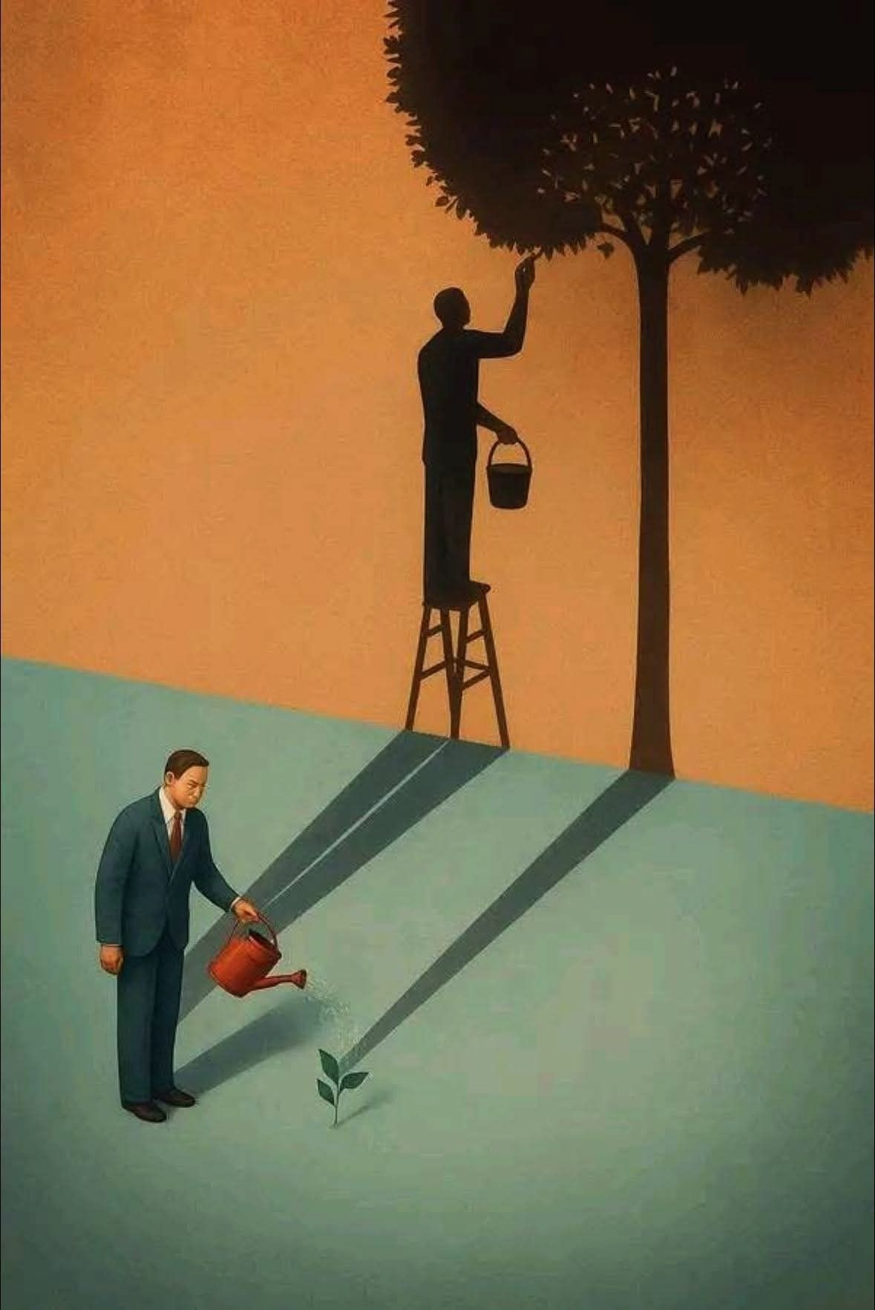
DISCUSSION · IMAGE 3
SPEAK
DAILY
What Is the Deeper Meaning?
Notes:
IMAGE 3 - MAN WATERING A SEEDLING. Same method: 30 seconds of silence, then one-sentence description, then the deeper meaning.
What is in the image: a man in a dark suit and red tie waters a tiny seedling with a red watering can. Long shadows stretch across the ground and up a wall, where the shadow shows a figure on a stool tending a huge, full tree. Warm orange wall, cool green-blue ground.
Possible readings (do not give these first): small efforts today grow into something large; patience and vision; he sees the future in a tiny beginning; what we do now shapes what we become; the gap between what is visible now and what is possible; the shadow as imagination, ambition or a future self.
Follow-ups: What is the shadow telling us that the man cannot see? Why did the artist use a suit? Why the contrast between the orange and the blue? Is the message about work, about ideas, about people, or something else? What have you planted that you are still waiting to see grow?
Words to offer if stuck: convey, evoke, allude to, juxtaposition.

Slide 34
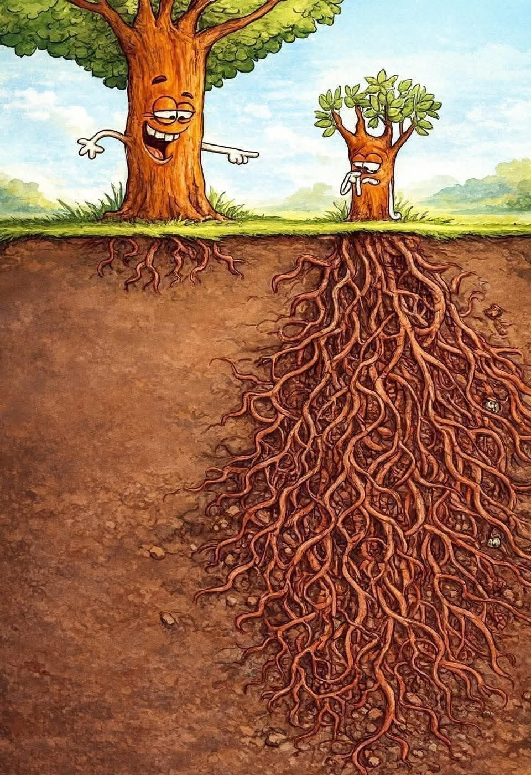
DISCUSSION · IMAGE 2
SPEAK
DAILY
What Is the Deeper Meaning?
Notes:
IMAGE 2 - TWO TREES. Same method: 30 seconds of silence, then one-sentence description, then the deeper meaning.
What is in the image: a big cartoon tree on the left laughs and points at a much smaller tree on the right, which looks embarrassed with a hand to its face. Underground, the big tree has a small, shallow root system, and the small tree has an enormous, deep, spreading one.
Possible readings (do not give these first): what you can see is not the whole story; hidden effort and strong foundations matter more than size or appearance; people who look small or slow may be building something deeper; judging others by what is visible is unfair; appearances versus substance; long-term strength versus short-term show.
Follow-ups: Who is the big tree, and who is the small tree? Which one would you rather be, and why? What does the soil represent? Why did the artist make the big tree laugh? Where do you see this in real life, for example in careers, in business or in social media?
Words to offer if stuck: convey, evoke, juxtaposition, ostensibly.

Slide 35
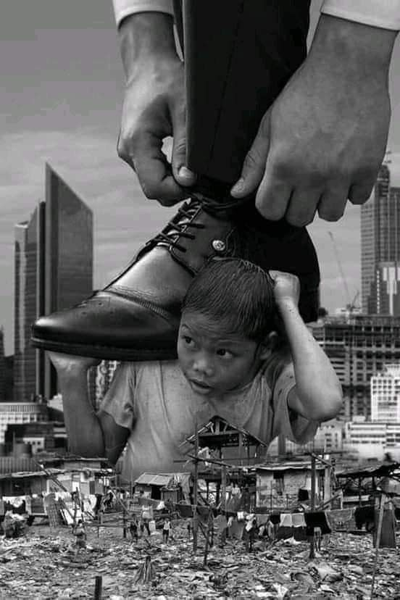
DISCUSSION · IMAGE 4
SPEAK
DAILY
What Is the Deeper Meaning?
Notes:
IMAGE 4 - BOOT OVER A CHILD. Same method: 30 seconds of silence, then one-sentence description, then the deeper meaning. This is the heaviest image of the four, so it works best last.
What is in the image: a black and white photo-style scene. Two huge hands tie the laces of a polished shoe, which rests above a small child who is crouching with his hands raised, as if holding it up. The child is among crowded makeshift houses and rubbish; modern skyscrapers rise in the background.
Possible readings (do not give these first): the cost of success is carried by someone else; the contrast between wealth and poverty in one city; power and scale, with the powerful barely noticing the people beneath them; being overlooked; weight and responsibility placed on those least able to carry them.
Follow-ups: Who do the hands belong to, and why do we not see the face? Why is the shoe so enormous? What is the child's expression telling us? What is the role of the skyscrapers behind? What would you change in the image to make the message softer or stronger?
Keep it on interpretation and the image's message, not on anyone's political position. Words to offer if stuck: convey, evoke, juxtaposition, allude to.

Slide 36
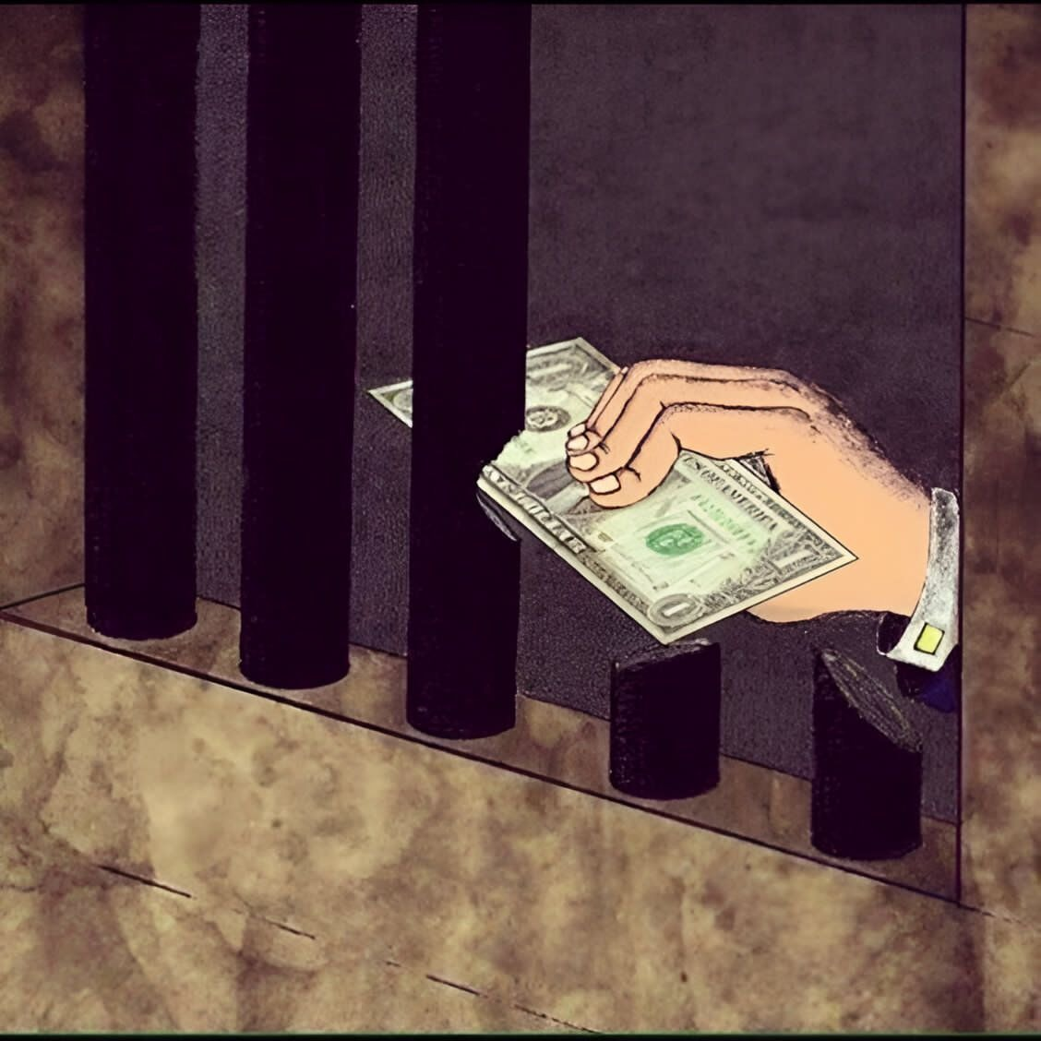
DISCUSSION · IMAGE 1
SPEAK
DAILY
What Is the Deeper Meaning?
Notes:
IMAGE 1 - MONEY THROUGH THE BARS. Do ONE image at a time; the others can wait for another lesson. Let them look in silence for 30 seconds. Ask: what do you see (one sentence), and then what is the deeper meaning? Let them type their ideas on the slide, then push them to justify.
What is in the image: a hand in a white shirt cuff with a gold cufflink holds US dollar notes and reaches through prison bars. Two of the bars have been cut off at the base. Muted brown and grey colours.
Possible readings (do not give these first): money can buy freedom or favours; the law can be bent or bypassed by those who can pay; justice that is for sale; the bars look solid but money cuts straight through them; temptation and corruption on both sides of the bars.
Follow-ups: Who is the hand giving the money to, and why? What do the cut bars represent? Why did the artist show only a hand, not a face? Is the message hopeful or pessimistic? Does it apply beyond prisons?
Keep it to the image and its message, not to any particular country or party. Words to offer if stuck: convey, evoke, allude to, juxtaposition, ostensibly.

Slide 37
SPEAK
DAILY
👋
See you next time!
SPEAK DAILY · English

