Slide 1
SPEAK
DAILY
European Portuguese · Olá!

Slide 2
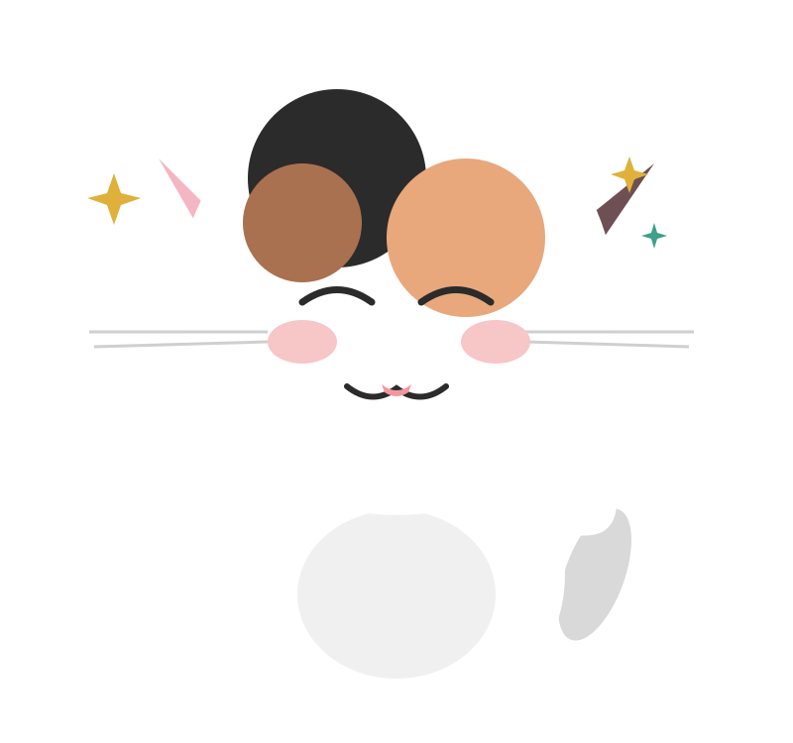
SPEAK
DAILY
Olá :)
Bem-vindos ao SpeakDaily Portuguese!
Chibi - ‘Head of Motivation’
Notes:
Safe classroom culture. No judgment. This is how we learn.

Slide 3
SPEAK
DAILY
What to Expect
Your 30-minute class, in 3 parts
1
2
3
Pronunciation
We start here every class
Verb / Rule / Topic
Today's focus
Conversation
Putting the rule into practice, together
Relax. No pressure.

Slide 4
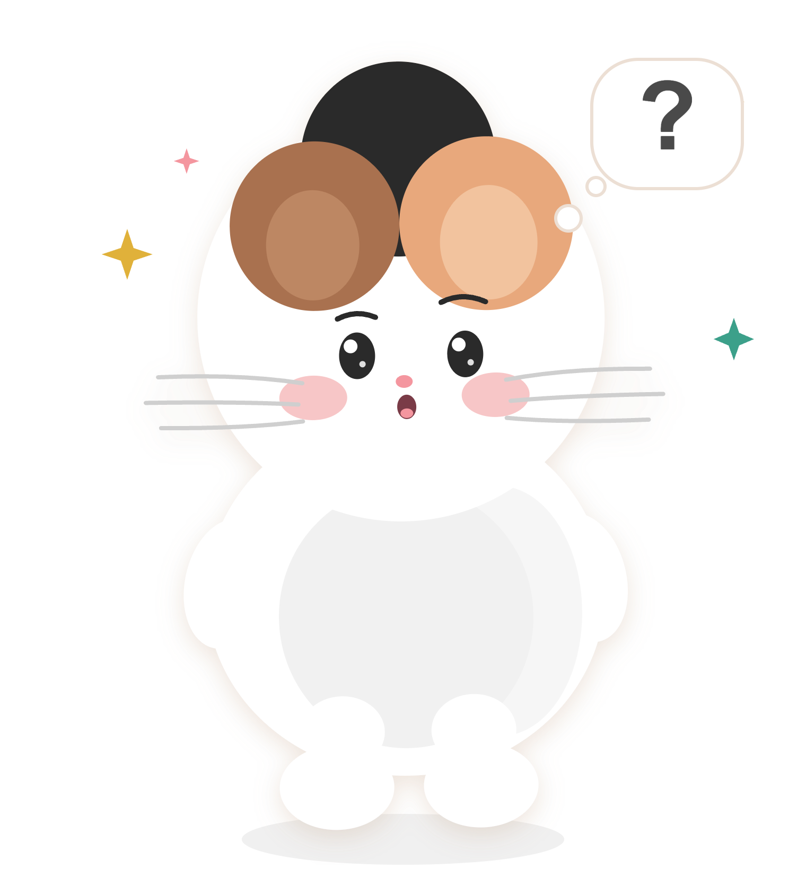
SPEAK
DAILY
Não sabes?
Pede ajuda.
You don't know? Ask for help.
“Ajuda-me!”
Notes:
Safe classroom culture. No judgment. This is how we learn.

Slide 5
SPEAK
DAILY
Vamos começar!
Let's begin!
Notes:
Energy up! TIMING PLAN (30 min): 0-5 pronunciation, 5-10 gostar de in the present plus a few drills, 10-30 Imaginemos, conversation and translation. You MUST reach Imaginemos by minute 10. Slides marked OPTIONAL in these notes can be skipped. The lesson stands alone: do not assume anyone was in the last class.

Slide 6
SPEAK
DAILY
SONS DO PORTUGUÊS
Sounds of Portuguese
SOM DE HOJE: “G”
G
Vamos praticar!
like 'gostar', 'gato', 'guitarra'
Notes:
Transition into the pronunciation workout. Today's sound: the hard G, as in gostar. Move straight into the next slide.

Slide 7
SPEAK
DAILY
Como funciona:
L
Vamos ouvir Listen
R
Vamos repetir Repeat
Don't think, just copy!
Notes:
Tell students: don't overthink the sounds. Copy the teacher like a parrot.

Slide 8
SPEAK
DAILY
gostar
gato
gosto
to like
cat
I like
Gosto muito de gatos, mas o meu gato não gosta de ninguém!
I really like cats, but my cat doesn't like anyone!
Notes:
ESSENTIAL. G before A, O, U or a consonant is a hard G, like English 'go': gato, gosto, grupo. Before E or I it turns soft (gente, girafa), so Portuguese writes GU to keep it hard: guitarra, guerra. In GUE / GUI the U is usually silent. Between vowels the G is a little softer and lighter (lago, amigo): copy the teacher, don't overthink it. Common student errors: saying 'gw' in guitarra, or a soft G in gostar. Only the hard Gs are in red. Today's verb starts with this sound: gostar. DELIVERY: say each word, students repeat together, then one by one. Then the sentence in two halves, then whole. Correct the G straight away here: this is the one place in the class where you interrupt.

Slide 9
SPEAK
DAILY
guitarra
grupo
garagem
guitar
group / band
garage
O meu filho toca guitarra num grupo e ensaiam na nossa garagem.
My son plays guitar in a band and they rehearse in our garage.
Notes:
ESSENTIAL. G before A, O, U or a consonant is a hard G, like English 'go': gato, gosto, grupo. Before E or I it turns soft (gente, girafa), so Portuguese writes GU to keep it hard: guitarra, guerra. In GUE / GUI the U is usually silent. Between vowels the G is a little softer and lighter (lago, amigo): copy the teacher, don't overthink it. Common student errors: saying 'gw' in guitarra, or a soft G in gostar. Only the hard Gs are in red. Today's verb starts with this sound: gostar. DELIVERY: say each word, students repeat together, then one by one. Then the sentence in two halves, then whole. Correct the G straight away here: this is the one place in the class where you interrupt.

Slide 10
SPEAK
DAILY
Algarve
agosto
golfe
the Algarve
August
golf
Em agosto, o Algarve está cheio de turistas, por isso gosto mais de ir em junho.
In August the Algarve is full of tourists, so I prefer going in June.
Notes:
ESSENTIAL. G before A, O, U or a consonant is a hard G, like English 'go': gato, gosto, grupo. Before E or I it turns soft (gente, girafa), so Portuguese writes GU to keep it hard: guitarra, guerra. In GUE / GUI the U is usually silent. Between vowels the G is a little softer and lighter (lago, amigo): copy the teacher, don't overthink it. Common student errors: saying 'gw' in guitarra, or a soft G in gostar. Only the hard Gs are in red. Today's verb starts with this sound: gostar. DELIVERY: say each word, students repeat together, then one by one. Then the sentence in two halves, then whole. Correct the G straight away here: this is the one place in the class where you interrupt.

Slide 11
SPEAK
DAILY
amigo
segredo
guardar
friend
secret
to keep
O meu melhor amigo nunca consegue guardar um segredo, mas gosto muito dele.
My best friend can never keep a secret, but I really like him.
Notes:
ESSENTIAL. G before A, O, U or a consonant is a hard G, like English 'go': gato, gosto, grupo. Before E or I it turns soft (gente, girafa), so Portuguese writes GU to keep it hard: guitarra, guerra. In GUE / GUI the U is usually silent. Between vowels the G is a little softer and lighter (lago, amigo): copy the teacher, don't overthink it. Common student errors: saying 'gw' in guitarra, or a soft G in gostar. Only the hard Gs are in red. Today's verb starts with this sound: gostar. DELIVERY: say each word, students repeat together, then one by one. Then the sentence in two halves, then whole. Correct the G straight away here: this is the one place in the class where you interrupt.

Slide 12
SPEAK
DAILY
galão
logo
agora
milky coffee
later
now
Logo à tarde vamos beber um galão? Agora tenho uma reunião.
Shall we have a galão later this afternoon? Right now I have a meeting.
Notes:
OPTIONAL - skip if short on time. G before A, O, U or a consonant is a hard G, like English 'go': gato, gosto, grupo. Before E or I it turns soft (gente, girafa), so Portuguese writes GU to keep it hard: guitarra, guerra. In GUE / GUI the U is usually silent. Between vowels the G is a little softer and lighter (lago, amigo): copy the teacher, don't overthink it. Common student errors: saying 'gw' in guitarra, or a soft G in gostar. Only the hard Gs are in red. Today's verb starts with this sound: gostar. Note: um galão = a tall milky coffee in a glass (very Portuguese). logo = later (today). DELIVERY: say each word, students repeat together, then one by one. Then the sentence in two halves, then whole. Correct the G straight away here: this is the one place in the class where you interrupt.

Slide 13
SPEAK
DAILY
jogar
jogo
golo
to play
match / game
goal
Gosto de jogar futebol, mas não gosto nada de ver os jogos na televisão.
I like playing football, but I don't like watching the matches on TV at all.
Notes:
OPTIONAL - skip if short on time. G before A, O, U or a consonant is a hard G, like English 'go': gato, gosto, grupo. Before E or I it turns soft (gente, girafa), so Portuguese writes GU to keep it hard: guitarra, guerra. In GUE / GUI the U is usually silent. Between vowels the G is a little softer and lighter (lago, amigo): copy the teacher, don't overthink it. Common student errors: saying 'gw' in guitarra, or a soft G in gostar. Only the hard Gs are in red. Today's verb starts with this sound: gostar. DELIVERY: say each word, students repeat together, then one by one. Then the sentence in two halves, then whole. Correct the G straight away here: this is the one place in the class where you interrupt.

Slide 14
SPEAK
DAILY
frango
grelhado
salgado
chicken
grilled
salty
Gosto de frango grelhado, mas este está muito salgado.
I like grilled chicken, but this one is very salty.
Notes:
OPTIONAL - skip if short on time. G before A, O, U or a consonant is a hard G, like English 'go': gato, gosto, grupo. Before E or I it turns soft (gente, girafa), so Portuguese writes GU to keep it hard: guitarra, guerra. In GUE / GUI the U is usually silent. Between vowels the G is a little softer and lighter (lago, amigo): copy the teacher, don't overthink it. Common student errors: saying 'gw' in guitarra, or a soft G in gostar. Only the hard Gs are in red. Today's verb starts with this sound: gostar. DELIVERY: say each word, students repeat together, then one by one. Then the sentence in two halves, then whole. Correct the G straight away here: this is the one place in the class where you interrupt.

Slide 15
SPEAK
DAILY
igual
seguro
segunda
the same
safe
Monday
Os dois bairros são seguros, mas não são iguais: gosto mais deste.
Both neighbourhoods are safe, but they aren't the same: I like this one more.
Notes:
OPTIONAL - skip if short on time. G before A, O, U or a consonant is a hard G, like English 'go': gato, gosto, grupo. Before E or I it turns soft (gente, girafa), so Portuguese writes GU to keep it hard: guitarra, guerra. In GUE / GUI the U is usually silent. Between vowels the G is a little softer and lighter (lago, amigo): copy the teacher, don't overthink it. Common student errors: saying 'gw' in guitarra, or a soft G in gostar. Only the hard Gs are in red. Today's verb starts with this sound: gostar. DELIVERY: say each word, students repeat together, then one by one. Then the sentence in two halves, then whole. Correct the G straight away here: this is the one place in the class where you interrupt.

Slide 16
SPEAK
DAILY
domingo
largo
longo
Sunday
square
long
Ao domingo gosto de dar um passeio longo e acabar num largo com esplanada.
On Sundays I like going for a long walk and ending up in a square with a café terrace.
Notes:
OPTIONAL - skip if short on time. G before A, O, U or a consonant is a hard G, like English 'go': gato, gosto, grupo. Before E or I it turns soft (gente, girafa), so Portuguese writes GU to keep it hard: guitarra, guerra. In GUE / GUI the U is usually silent. Between vowels the G is a little softer and lighter (lago, amigo): copy the teacher, don't overthink it. Common student errors: saying 'gw' in guitarra, or a soft G in gostar. Only the hard Gs are in red. Today's verb starts with this sound: gostar. Note: um largo = a small square (very common in Lisbon street names). DELIVERY: say each word, students repeat together, then one by one. Then the sentence in two halves, then whole. Correct the G straight away here: this is the one place in the class where you interrupt.

Slide 17
SPEAK
DAILY
pagar
gorjeta
agradecer
to pay
tip
to thank
Gosto de pagar em dinheiro e deixar sempre uma pequena gorjeta.
I like paying in cash and always leaving a small tip.
Notes:
OPTIONAL - skip if short on time. G before A, O, U or a consonant is a hard G, like English 'go': gato, gosto, grupo. Before E or I it turns soft (gente, girafa), so Portuguese writes GU to keep it hard: guitarra, guerra. In GUE / GUI the U is usually silent. Between vowels the G is a little softer and lighter (lago, amigo): copy the teacher, don't overthink it. Common student errors: saying 'gw' in guitarra, or a soft G in gostar. Only the hard Gs are in red. Today's verb starts with this sound: gostar. Note: gorjeta: hard G, soft J. DELIVERY: say each word, students repeat together, then one by one. Then the sentence in two halves, then whole. Correct the G straight away here: this is the one place in the class where you interrupt.

Slide 18
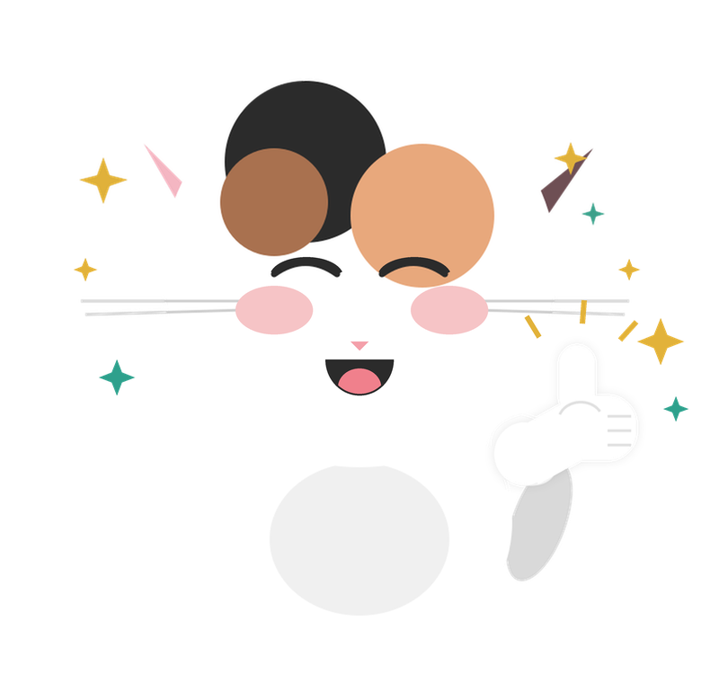
Muito bem!
Notes:
Muito bem! = Very good · Boa! = Nice one! (very common in Portugal)

Slide 19
SPEAK
DAILY
G
Gramática
O verbo “gostar de” no presente
Notes:
Transition to grammar. Keep energy up!

Slide 20
SPEAK
DAILY
gostar de
to like
Gosto de caminhar à beira-rio.
I like walking by the river.
gostar de = to like (present)
Notes:
ESSENTIAL. gostar de = to like. A regular verb: gosto, gostas, gosta, gostamos, gostam.
The DE is part of the verb and never disappears before a thing or an action: Gosto de café. Gosto de ler. It joins with the article: de + o = do, de + a = da, de + os = dos, de + as = das: Gosto do Porto, Gosto da praia, Gosto dos teus amigos.
In a short answer the DE goes: Gostas? - Gosto! / Não gosto.
For Spanish speakers: it's the opposite of me gusta. In Portuguese the person who likes is the subject: Eu gosto de chocolate.
Keep this to 1-2 minutes.

Slide 21
SPEAK
DAILY
gostar de - infinitive vs present vs past
THE ACTION
PRESENT TENSE
THE PAST
gostar de
eu gosto
eu gostei
I liked / enjoyed (a finished experience)
to like
I like (present)
Gostei muito do filme.
I really enjoyed the film.
É bom gostar do que fazemos.
Gosto muito desta cidade.
eu gostava
I liked / I used to like (depends on context)
It’s good to like what we do.
I really like this city.
Gostava de futebol quando era novo.
I liked football when I was young.
HOJE / TODAY
Notes:
Brief aid only. Today's focus is the present, circled in red. The past has two forms: gostei is for a finished experience (Gostei muito do filme); gostava describes a background situation (Gostava de futebol quando era novo). Both can be 'I liked'. Do not teach 'gostei = once, gostava = used to'. Bonus: Gostava de... is also the polite 'I'd like': Gostava de marcar uma mesa. Keep this to 1 minute.

Slide 22

SPEAK
DAILY
gostar de (present) - all forms
Write these down - you’ll need them
Eu gosto
Tu gostas
(Ele, Ela, Você) gosta
“You (informal) like”
“I like”
“He/She likes / you (Formal) like”
Nós gostamos
Vocês gostam
Eles/Elas gostam
“You all (plural) like”
“They like”
“We like”
Notes:
OPTIONAL if short on time, but ask students to copy the forms. gosto, gostas, gosta, gostamos, gostam: all regular. Remind them the de follows every form: gosto de, gostas de... In Portugal vocês uses the same form as eles/elas: gostam.

Slide 23
SPEAK
DAILY
gosto
gostas
gosta
gostamos
gostam
?
“I like walking by the river”
__________ de caminhar à beira-rio.
Notes:
ESSENTIAL. Drill: student supplies the present-tense form of gostar for this person and says the whole sentence out loud. gostar de + verb. à beira-rio = by the river. DELIVERY: read the English, give a few seconds, then reveal. Listen for: a missing de (gosto café), de o instead of do, and me gusta / me gosta from Spanish speakers. Stronger students can add why.

Slide 24
SPEAK
DAILY
gosto
gostas
gosta
gostamos
gostam
?
“I like walking by the river”
Eu gosto de caminhar à beira-rio.
Notes:
ESSENTIAL. Drill: student supplies the present-tense form of gostar for this person and says the whole sentence out loud. gostar de + verb. à beira-rio = by the river. DELIVERY: read the English, give a few seconds, then reveal. Listen for: a missing de (gosto café), de o instead of do, and me gusta / me gosta from Spanish speakers. Stronger students can add why.

Slide 25
SPEAK
DAILY
?
gosto
gostas
gosta
gostamos
gostam
“We like the new neighbourhood”
__________ do bairro novo.
Notes:
ESSENTIAL. Drill: student supplies the present-tense form of gostar for this person and says the whole sentence out loud. de + o bairro = do bairro. DELIVERY: read the English, give a few seconds, then reveal. Listen for: a missing de (gosto café), de o instead of do, and me gusta / me gosta from Spanish speakers. Stronger students can add why.

Slide 26
SPEAK
DAILY
?
gosto
gostas
gosta
gostamos
gostam
“We like the new neighbourhood”
Nós gostamos do bairro novo.
Notes:
ESSENTIAL. Drill: student supplies the present-tense form of gostar for this person and says the whole sentence out loud. de + o bairro = do bairro. DELIVERY: read the English, give a few seconds, then reveal. Listen for: a missing de (gosto café), de o instead of do, and me gusta / me gosta from Spanish speakers. Stronger students can add why.

Slide 27
SPEAK
DAILY
?
gosto
gostas
gosta
gostamos
gostam
“Do you guys like spicy food?”
__________ de comida picante?
Notes:
ESSENTIAL. Drill: student supplies the present-tense form of gostar for this person and says the whole sentence out loud. picante = spicy. Vocês uses the same form as eles: gostam. DELIVERY: read the English, give a few seconds, then reveal. Listen for: a missing de (gosto café), de o instead of do, and me gusta / me gosta from Spanish speakers. Stronger students can add why.

Slide 28
SPEAK
DAILY
?
gosto
gostas
gosta
gostamos
gostam
“Do you guys like spicy food?”
Vocês gostam de comida picante?
Notes:
ESSENTIAL. Drill: student supplies the present-tense form of gostar for this person and says the whole sentence out loud. picante = spicy. Vocês uses the same form as eles: gostam. DELIVERY: read the English, give a few seconds, then reveal. Listen for: a missing de (gosto café), de o instead of do, and me gusta / me gosta from Spanish speakers. Stronger students can add why.

Slide 29
SPEAK
DAILY
?
gosto
gostas
gosta
gostamos
gostam
“You don’t like getting up early”
__________ de acordar cedo.
Notes:
OPTIONAL - skip if you are past minute 9. Drill: student supplies the present-tense form of gostar for this person and says the whole sentence out loud. não goes right before the verb: não gostas. DELIVERY: read the English, give a few seconds, then reveal. Listen for: a missing de (gosto café), de o instead of do, and me gusta / me gosta from Spanish speakers. Stronger students can add why.

Slide 30
SPEAK
DAILY
?
gosto
gostas
gosta
gostamos
gostam
“You don’t like getting up early”
Tu não gostas de acordar cedo.
Notes:
OPTIONAL - skip if you are past minute 9. Drill: student supplies the present-tense form of gostar for this person and says the whole sentence out loud. não goes right before the verb: não gostas. DELIVERY: read the English, give a few seconds, then reveal. Listen for: a missing de (gosto café), de o instead of do, and me gusta / me gosta from Spanish speakers. Stronger students can add why.

Slide 31
SPEAK
DAILY
?
gosto
gostas
gosta
gostamos
gostam
“They really like fado”
__________ muito de fado.
Notes:
OPTIONAL - skip if you are past minute 9. Drill: student supplies the present-tense form of gostar for this person and says the whole sentence out loud. muito goes between gostam and de: gostam muito de. DELIVERY: read the English, give a few seconds, then reveal. Listen for: a missing de (gosto café), de o instead of do, and me gusta / me gosta from Spanish speakers. Stronger students can add why.

Slide 32
SPEAK
DAILY
?
gosto
gostas
gosta
gostamos
gostam
“They really like fado”
Eles gostam muito de fado.
Notes:
OPTIONAL - skip if you are past minute 9. Drill: student supplies the present-tense form of gostar for this person and says the whole sentence out loud. muito goes between gostam and de: gostam muito de. DELIVERY: read the English, give a few seconds, then reveal. Listen for: a missing de (gosto café), de o instead of do, and me gusta / me gosta from Spanish speakers. Stronger students can add why.

Slide 33
SPEAK
DAILY
?
gosto
gostas
gosta
gostamos
gostam
“She likes the beach in winter”
__________ da praia no inverno.
Notes:
OPTIONAL - skip if you are past minute 9. Drill: student supplies the present-tense form of gostar for this person and says the whole sentence out loud. de + a praia = da praia. DELIVERY: read the English, give a few seconds, then reveal. Listen for: a missing de (gosto café), de o instead of do, and me gusta / me gosta from Spanish speakers. Stronger students can add why.

Slide 34
SPEAK
DAILY
?
gosto
gostas
gosta
gostamos
gostam
“She likes the beach in winter”
Ela gosta da praia no inverno.
Notes:
OPTIONAL - skip if you are past minute 9. Drill: student supplies the present-tense form of gostar for this person and says the whole sentence out loud. de + a praia = da praia. DELIVERY: read the English, give a few seconds, then reveal. Listen for: a missing de (gosto café), de o instead of do, and me gusta / me gosta from Spanish speakers. Stronger students can add why.

Slide 35
Muito bem!
Notes:
Muito bem! = Very good · Boa! = Nice one! (very common in Portugal)

Slide 36
SPEAK
DAILY
C
Conversemos
Responde usando o verbo GOSTAR DE
gosto · gostas · gosta · gostamos · gostam
Notes:
Page break for the conversation section. Students choose ONE question each and answer with gostar in the present. Simple or complex answers are both fine.

Slide 37
SPEAK
DAILY
DON’T WORRY IF YOU DON’T KNOW A WORD!
Use the vocab you have
1
Replace with English when you have to
2
We will work on the sentence TOGETHER as a group
3
Notes:
Read this out before the conversation. It is fine not to know every word: use the vocab you have, replace with English when needed, and we build the sentence together.

Slide 38

Vamos conversar!
ESCOLHE UMA PERGUNTA PARA RESPONDER / Choose a question to answer
Sentences can be as simple or as complex as you are comfortable with - no pressure!
1
De que é que gostas mais em Portugal? E de menos?
What do you like most about Portugal? And least?
2
Há alguma coisa de que toda a gente gosta, mas tu não?
Is there something everyone likes, but you don’t?
3
Gostas de surpresas ou preferes saber tudo antes?
Do you like surprises, or do you prefer to know everything in advance?
Podes usar:
gosto · gostas · gosta · gostamos · gostam
Notes:
Each student picks ONE question. Let them finish before correcting; note 1-2 mistakes and go over them at the end.
1. Simple: Gosto do sol. Não gosto da burocracia. / I like the sun. I don't like the bureaucracy. More: Gosto muito de como as pessoas param para conversar na rua; do que gosto menos é de esperar meses por uma marcação nas Finanças! / I love how people stop to chat in the street; what I like least is waiting months for an appointment at the tax office! Follow-up: E no teu país, como é? (And in your country?)
2. Simple: Não gosto de praia. / I don't like the beach. More: Toda a gente gosta de bacalhau, mas eu não gosto nada, e aqui é difícil fugir! / Everyone likes salt cod, but I don't like it at all, and here it's hard to escape! Follow-up: As pessoas ficam surpreendidas? (Are people surprised?)
3. Simple: Gosto de surpresas. / I like surprises. More: Gosto de surpresas pequenas, mas uma festa surpresa para mim é um pesadelo! / I like small surprises, but a surprise party is a nightmare for me! Follow-up: Qual foi a melhor surpresa da tua vida?
SIMPLER PARAPHRASE for Q2: De que é que não gostas? (What don't you like?)

Slide 39
Vamos conversar!
ESCOLHE UMA PERGUNTA PARA RESPONDER / Choose a question to answer
Sentences can be as simple or as complex as you are comfortable with - no pressure!
1
Que música é que gostas de ouvir quando estás sozinho?
What music do you like listening to when you’re alone?
2
Gostas mais de cozinhar ou de lavar a loiça?
Do you prefer cooking or washing up?
3
Que tipo de pessoas é que gostas de ter por perto?
What kind of people do you like having around you?
Podes usar:
gosto · gostas · gosta · gostamos · gostam
Notes:
Each student picks ONE question. Questions get more open from 1 to 3; beginners can answer any of them with one sentence.
1. Simple: Gosto de ouvir jazz. / I like listening to jazz. More: Quando estou sozinho, gosto de ouvir músicas dos anos oitenta e canto muito alto! / When I'm alone, I like listening to eighties songs and I sing really loudly! Follow-up: Qual é a tua música favorita?
2. Simple: Gosto mais de cozinhar. / I prefer cooking. More: Gosto de cozinhar, mas a cozinha fica sempre uma confusão, por isso a regra é: quem cozinha não lava! / I like cooking, but the kitchen is always a mess, so the rule is: whoever cooks doesn't wash up! Follow-up: E em tua casa, quem lava?
3. Simple: Gosto de pessoas calmas. / I like calm people. More: Gosto de pessoas que me fazem rir e que não levam a vida muito a sério. / I like people who make me laugh and don't take life too seriously. Follow-up: E que tipo de pessoas evitas? (And what kind of people do you avoid?)
Watch for the missing de and the contractions do / da.

Slide 40
SPEAK
DAILY
VAMOS TRADUZIR PARA PORTUGUÊS
Traduz frases completas com o que aprendeste
Notes:
Page break for the translation section. Translation is OPTIONAL if the conversation is going well: speaking comes first.

Slide 41
SPEAK
DAILY
DON’T WORRY IF YOU DON’T KNOW A WORD!
Use the vocab you have
1
Replace with English when you have to
2
We will work on the sentence TOGETHER as a group
3
Notes:
Read this out before the translation: use the vocab you have, English is fine when stuck, and we build the sentence together.

Slide 42
VAMOS TRADUZIR PARA PORTUGUÊS
SPEAK
DAILY
EM PORTUGUÊS, POR FAVOR
I joined a book club in my neighbourhood. There are eight of us and we meet once a month in a bookshop. I really like the idea, but I don’t always like the books: last month’s had four hundred pages about a war! Luckily, everyone likes talking more than reading, so the conversations are always fun. And the bookshop owner likes us because we always buy something. And you, do you like reading, or do you prefer podcasts?
Don’t know a word? Say…
“Ajuda-me!”
gosto · gostas · gosta · gostamos · gostam
Notes:
Someone describing their neighbourhood book club. Students translate together, sentence by sentence; accept simple versions and English for missing words. Other verbs appear naturally (entrei, somos, compramos): help with them, the focus is gostar de.
ANSWER: Entrei num clube de leitura no meu bairro. Somos oito e encontramo-nos uma vez por mês numa livraria. Gosto muito da ideia, mas nem sempre gosto dos livros: o do mês passado tinha quatrocentas páginas sobre uma guerra! Felizmente, toda a gente gosta mais de falar do que de ler, por isso as conversas são sempre divertidas. E o dono da livraria gosta de nós porque compramos sempre alguma coisa. E tu, gostas de ler ou preferes podcasts?

Slide 43
VAMOS TRADUZIR PARA PORTUGUÊS
SPEAK
DAILY
Entrei num clube de leitura no meu bairro. Somos oito e encontramo-nos uma vez por mês numa livraria. Gosto muito da ideia, mas nem sempre gosto dos livros: o do mês passado tinha quatrocentas páginas sobre uma guerra! Felizmente, toda a gente gosta mais de falar do que de ler, por isso as conversas são sempre divertidas. E o dono da livraria gosta de nós porque compramos sempre alguma coisa. E tu, gostas de ler ou preferes podcasts?
Don’t know a word? Say…
“Ajuda-me!”
gosto · gostas · gosta · gostamos · gostam
Notes:
Entrei num clube de leitura no meu bairro. Somos oito e encontramo-nos uma vez por mês numa livraria. Gosto muito da ideia, mas nem sempre gosto dos livros: o do mês passado tinha quatrocentas páginas sobre uma guerra! Felizmente, toda a gente gosta mais de falar do que de ler, por isso as conversas são sempre divertidas. E o dono da livraria gosta de nós porque compramos sempre alguma coisa. E tu, gostas de ler ou preferes podcasts?
NOTES: um clube de leitura = a book club. encontramo-nos = we meet. gosto da ideia / dos livros = de + a / de + os. gosta mais de falar do que de ler = likes talking more than reading. gosta de nós = likes us. Follow-up: ask the final question for real.

Slide 44
SPEAK
DAILY
gosto
gostas
gosta
gostamos
gostam
?
Don’t know a word? Say…
“Ajuda-me!”
“I like my job, even when it’s stressful”
___________________
Notes:
OPTIONAL. de + o meu trabalho = do meu trabalho. Follow-up: O que é que é mais stressante no teu trabalho?

Slide 45
SPEAK
DAILY
gosto
gostas
gosta
gostamos
gostam
?
“I like my job, even when it’s stressful”
Gosto do meu trabalho, mesmo quando é stressante.
Notes:
OPTIONAL. de + o meu trabalho = do meu trabalho. Follow-up: O que é que é mais stressante no teu trabalho?

Slide 46
SPEAK
DAILY
gosto
gostas
gosta
gostamos
gostam
?
Don’t know a word? Say…
“Ajuda-me!”
“My partner likes horror films, but I don’t”
___________________
Notes:
OPTIONAL. mas eu não = but I don't (no need to repeat the verb). Follow-up: E tu, gostas de filmes de terror?

Slide 47
SPEAK
DAILY
gosto
gostas
gosta
gostamos
gostam
?
“My partner likes horror films, but I don’t”
O meu companheiro gosta de filmes de terror, mas eu não.
Notes:
OPTIONAL. mas eu não = but I don't (no need to repeat the verb). Follow-up: E tu, gostas de filmes de terror?

Slide 48
SPEAK
DAILY
gosto
gostas
gosta
gostamos
gostam
?
Don’t know a word? Say…
“Ajuda-me!”
“We like going to the market to buy flowers”
___________________
Notes:
OPTIONAL. gostar de + verb. para + verb = to / in order to. Follow-up: Gostas de ter flores em casa?

Slide 49
SPEAK
DAILY
gosto
gostas
gosta
gostamos
gostam
?
“We like going to the market to buy flowers”
Gostamos de ir ao mercado para comprar flores.
Notes:
OPTIONAL. gostar de + verb. para + verb = to / in order to. Follow-up: Gostas de ter flores em casa?

Slide 50
SPEAK
DAILY
gosto
gostas
gosta
gostamos
gostam
?
Don’t know a word? Say…
“Ajuda-me!”
“I don’t like Mondays because I have too many meetings”
___________________
Notes:
OPTIONAL. de + as segundas = das segundas. a mais = too many. Follow-up: Qual é o teu dia preferido da semana?

Slide 51
SPEAK
DAILY
gosto
gostas
gosta
gostamos
gostam
?
“I don’t like Mondays because I have too many meetings”
Não gosto das segundas porque tenho reuniões a mais.
Notes:
OPTIONAL. de + as segundas = das segundas. a mais = too many. Follow-up: Qual é o teu dia preferido da semana?

Slide 52
Muito bem!
Notes:
Muito bem! = Very good · Boa! = Nice one! (very common in Portugal)

Slide 53
SPEAK
DAILY
I
Imaginemos
Responde usando o verbo GOSTAR DE
gosto · gostas · gosta · gostamos · gostam
Notes:
Page break for the scenarios. Everyone gets the same situation; a short sentence is a full answer and stronger students can add more. If time allows, students act it out in pairs.

Slide 54
SPEAK
DAILY
DON’T WORRY IF YOU DON’T KNOW A WORD!
Use the vocab you have
1
Replace with English when you have to
2
We will work on the sentence TOGETHER as a group
3
Notes:
Read this out before the scenarios: use the vocab you have, English is fine when stuck, and we build the sentence together.

Slide 55
Vamos imaginar!
SITUAÇÃO 2 - A ENTREVISTA / What do you say?
You’re in a job interview at a hotel. The manager asks what you like about working with people. You like helping guests and speaking languages, but you don’t like night shifts. Tell her.
Say it in Portuguese using GOSTAR DE in the present.
Keep it simple, or add more detail. Both are correct!
The teacher will help you find the words.
PODES USAR:
gosto · gostas · gosta · gostamos · gostam
Notes:
TASK: presenting yourself honestly.
POSSIBLE ANSWERS (teacher only), simple to more complex:
1. Gosto de ajudar as pessoas. / I like helping people.
2. Gosto de ajudar os hóspedes e gosto de falar línguas. / I like helping guests and I like speaking languages.
3. Gosto muito de trabalhar com pessoas: gosto de ajudar os hóspedes e de falar várias línguas. Sinceramente, não gosto muito do turno da noite, mas posso fazer alguns. / I really like working with people: I like helping guests and speaking several languages. Honestly, I don't really like the night shift, but I can do some.
NOTE: os hóspedes = hotel guests. o turno da noite = the night shift.
ROLE-PLAY (if time): one student is the manager (E do que é que não gosta no seu trabalho atual?).
DELIVERY: read the situation aloud, give 30 seconds to think, then each student answers. The story is given: students only need to say it. A short sentence is a full answer. Help build the sentence (offer a word, let them finish) rather than giving the whole answer. Correct gently at the end, not mid-sentence.

Slide 56
Vamos imaginar!
SITUAÇÃO 3 - O PRIMEIRO ENCONTRO / What do you say?
You’re on a first date. You both like walking, but your date prefers the beach and you prefer the hills. Suggest a plan for next weekend that you will both like.
Say it in Portuguese using GOSTAR DE in the present.
Keep it simple, or add more detail. Both are correct!
The teacher will help you find the words.
PODES USAR:
gosto · gostas · gosta · gostamos · gostam
Notes:
TASK: finding common ground and suggesting a plan.
POSSIBLE ANSWERS (teacher only), simple to more complex:
1. Gostas de caminhar? Eu também! / Do you like walking? Me too!
2. Tu gostas de praia e eu gosto de serra. Vamos a Sintra: tem as duas coisas! / You like the beach and I like the hills. Let's go to Sintra: it has both!
3. Então, tu gostas mais de praia e eu gosto mais de serra... Que tal uma caminhada em Sintra e depois um mergulho na praia da Adraga? / So, you prefer the beach and I prefer the hills... How about a walk in Sintra and then a swim at Adraga beach?
NOTE: a serra = the hills / mountains. Que tal...? = How about...? um mergulho = a swim / a dip.
ROLE-PLAY (if time): one student is the date (Mas eu não gosto nada de subidas!).
DELIVERY: read the situation aloud, give 30 seconds to think, then each student answers. The story is given: students only need to say it. A short sentence is a full answer. Help build the sentence (offer a word, let them finish) rather than giving the whole answer. Correct gently at the end, not mid-sentence.

Slide 57
Muito bem!
Notes:
Muito bem! = Very good · Boa! = Nice one! (very common in Portugal)

Slide 58
SPEAK
DAILY
👋
Até à próxima!
SPEAK DAILY · Português

