Slide 1
SPEAK
DAILY
Spanish · ¡Hola!

Slide 2
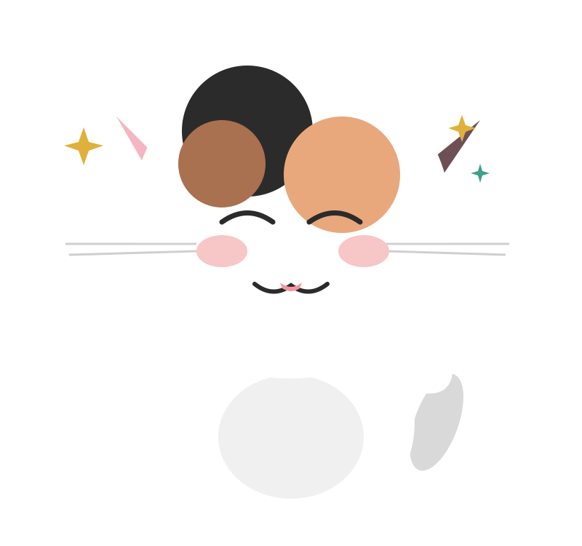
SPEAK
DAILY
Hola :)
Bienvenidos a SpeakDaily Spanish!
Chibi - ‘Head of Motivation’
Notes:
Safe classroom culture. No judgment. This is how we learn.

Slide 3
SPEAK
DAILY
What to Expect
Your 30-minute class, in 3 parts
1
2
3
Pronunciation
We start here every class
Verb / Rule / Topic
Today's focus
Conversation
Putting the rule into practice, together
Relax. No pressure.

Slide 4
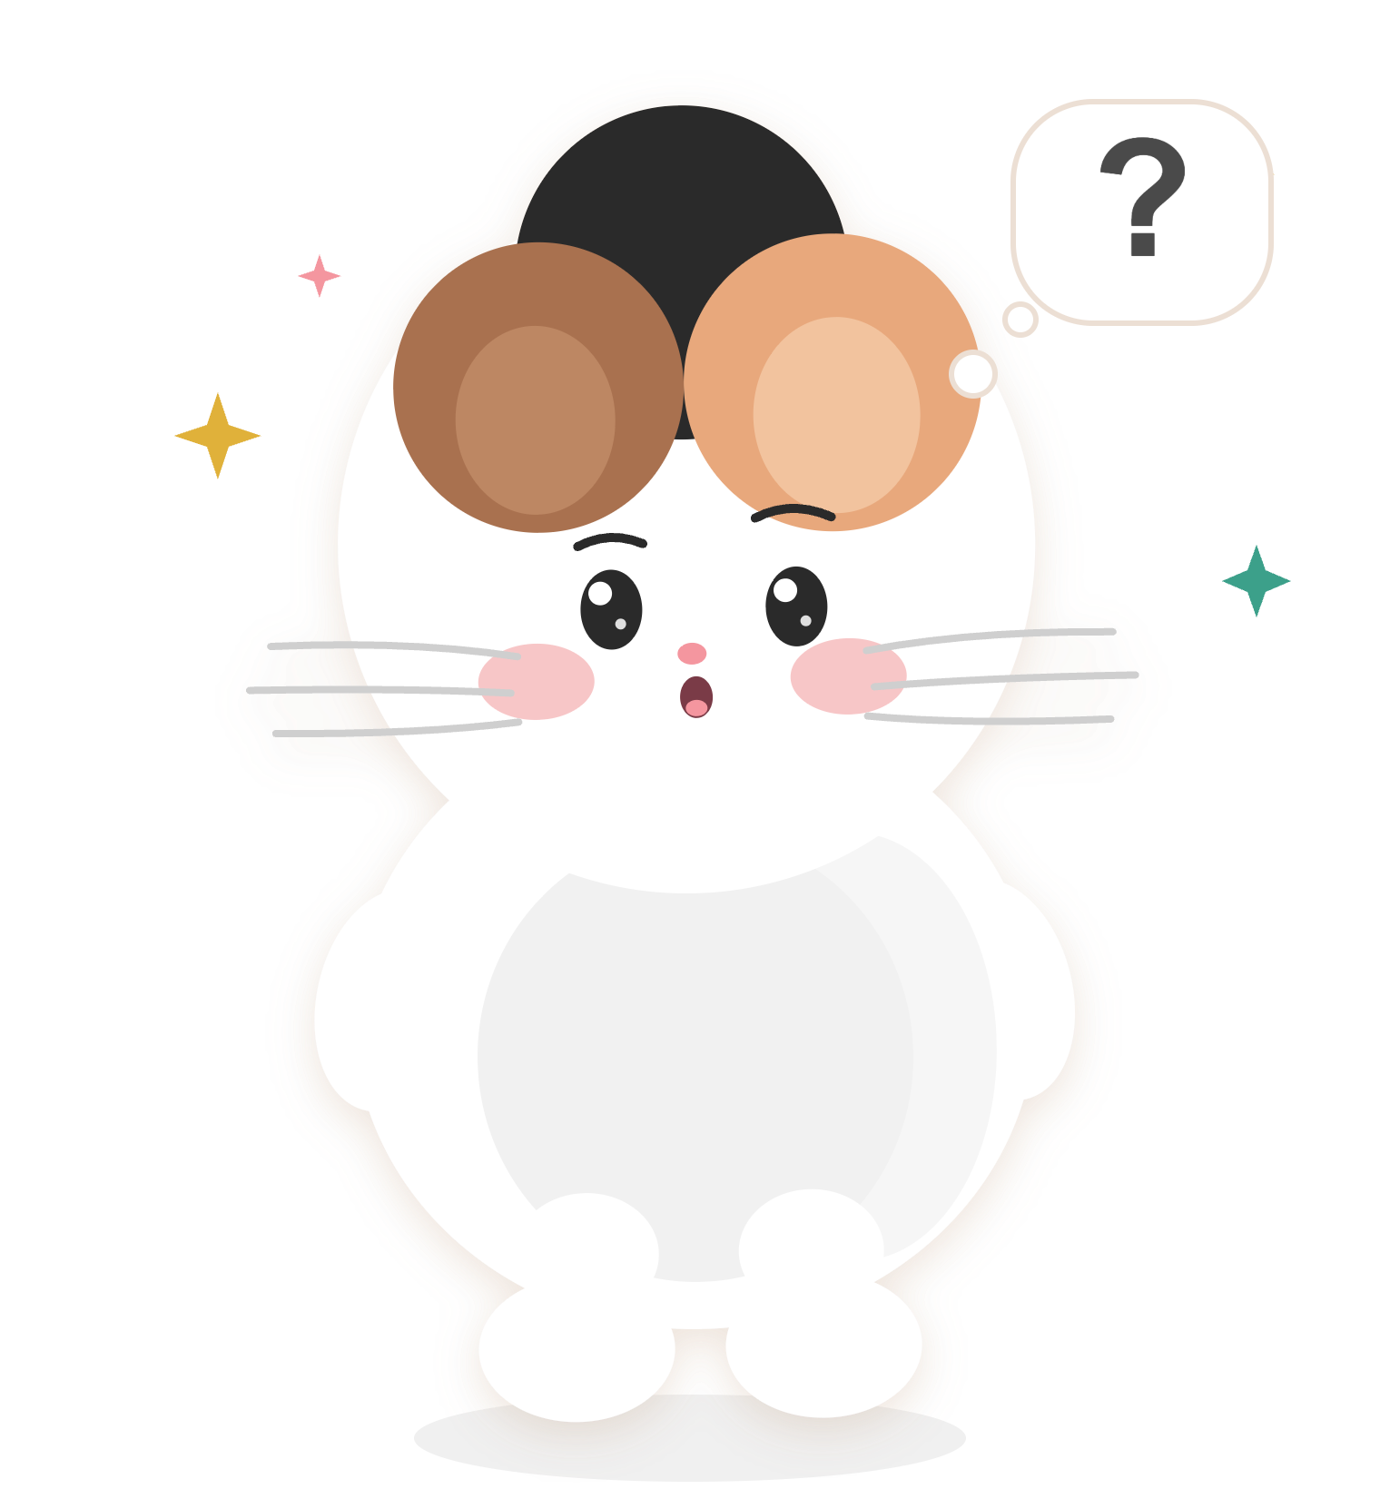
SPEAK
DAILY
¿No sabes?
Pide ayuda.
You don't know? Ask for help.
“¡Ayúdame!”
Notes:
Safe classroom culture. No judgment. This is how we learn.

Slide 5
SPEAK
DAILY
¡Vamos a empezar!
Let's begin!
Notes:
Energy up! Match Bárbara's enthusiasm.

Slide 6

SPEAK
DAILY
SONIDOS DEL ESPAÑOL
Sounds of Spanish
¡Practiquemos!
Notes:
Transition into the pronunciation workout. Move straight into the next slide.

Slide 7
SPEAK
DAILY
SONIDO DE HOY…
“G”
G
like 'gato', 'gol', 'gafas'
Notes:
ESSENTIAL (minutes 0-5, pronunciation). The sound does not need to relate to the verb. Today is the hard G, as in 'gato' (G before a, o, u) and 'gu' before e or i (guitarra, guerra), where the U is silent. Do NOT mix it up with the soft J-sound of 'gente' or 'jota' (practised in another class); the letter G only makes a hard sound before a, o, u today. Between vowels (amigo, lago, algo, agua) the G is softer: the tongue almost touches the roof of the mouth but does not fully block the air. Common errors: pronouncing the U in guitarra and guerra ('gwitarra'), and using the J sound in 'gato'. Activity is active repetition: teacher says, students repeat, 3x. Do slides 9-12 (about 5 minutes); slides 13-18 are OPTIONAL extra repetition if there is time. The red G (or GU before e/i) shows the part to focus on. Keep it brisk and do not lecture.

Slide 8
SPEAK
DAILY
Cómo funciona:
L
Vamos a oír Listen
R
Vamos a repetir Repeat
Don't think, just copy!
Notes:
Tell students: don't overthink the sounds. Mimic like a parrot.

Slide 9
SPEAK
DAILY
gato
gol
gafas
cat
goal
glasses
Dije que mi gato rompió las gafas.
I said my cat broke the glasses.
Notes:
ESSENTIAL pronunciation repetition. Teacher says each word, students repeat 3x, then the sentence. Highlighted in red: the G (or GU before e, i, where the U is silent). Then move on quickly.

Slide 10
SPEAK
DAILY
gracias
grande
grupo
thank you
big
group
Le dije gracias al grupo por el regalo grande.
I said thank you to the group for the big present.
Notes:
ESSENTIAL pronunciation repetition. Teacher says each word, students repeat 3x, then the sentence. Highlighted in red: the G (or GU before e, i, where the U is silent). Then move on quickly.

Slide 11
SPEAK
DAILY
guitarra
guiso
guerrero
guitar
stew
warrior
Dijo que compró una guitarra vieja en un mercadillo.
He said he bought an old guitar at a flea market.
Notes:
ESSENTIAL pronunciation repetition. Teacher says each word, students repeat 3x, then the sentence. Highlighted in red: the G (or GU before e, i, where the U is silent). Then move on quickly.

Slide 12
SPEAK
DAILY
amigo
lago
mago
friend
lake
magician
Un amigo dijo que había un mago cerca del lago.
A friend said there was a magician near the lake.
Notes:
ESSENTIAL pronunciation repetition. Teacher says each word, students repeat 3x, then the sentence. Highlighted in red: the G (or GU before e, i, where the U is silent). Then move on quickly.

Slide 13
SPEAK
DAILY
tengo
agua
algo
I have
water
something
Dijiste que no tenías agua en casa.
You said you had no water at home.
Notes:
OPTIONAL extra pronunciation repetition. Use only if there is time, otherwise go straight to the grammar. Highlighted in red: the G (or GU before e, i). Between vowels the G is softer.

Slide 14
SPEAK
DAILY
ganas
ganar
ganga
desire / feel like
to win
bargain
Dijimos que no tuvimos ganas de ir.
We said we did not feel like going.
Notes:
OPTIONAL extra pronunciation repetition. Use only if there is time, otherwise go straight to the grammar. Highlighted in red: the G (or GU before e, i). Between vowels the G is softer.

Slide 15
SPEAK
DAILY
gorra
goma
golpe
cap
rubber / eraser
blow / knock
Dijo que perdió la gorra en el parque.
He said he lost his cap in the park.
Notes:
OPTIONAL extra pronunciation repetition. Use only if there is time, otherwise go straight to the grammar. Highlighted in red: the G (or GU before e, i). Between vowels the G is softer.

Slide 16
SPEAK
DAILY
garganta
gamba
ganso
throat
prawn
goose
Dijisteis que tenéis dolor de garganta.
You all said you have a sore throat.
Notes:
OPTIONAL extra pronunciation repetition. Use only if there is time, otherwise go straight to the grammar. Highlighted in red: the G (or GU before e, i). Between vowels the G is softer.

Slide 17
SPEAK
DAILY
gracioso
grito
gris
funny
shout
grey
Dijiste algo gracioso y todos gritaron de risa.
You said something funny and everyone shouted with laughter.
Notes:
OPTIONAL extra pronunciation repetition. Use only if there is time, otherwise go straight to the grammar. Highlighted in red: the G (or GU before e, i). Between vowels the G is softer.

Slide 18
SPEAK
DAILY
guante
guapo
guardar
glove
good-looking
to keep / put away
Dijo que guardó los guantes en el coche.
He said he kept the gloves in the car.
Notes:
OPTIONAL extra pronunciation repetition. Use only if there is time, otherwise go straight to the grammar. Highlighted in red: the G (or GU before e, i). Between vowels the G is softer.

Slide 19
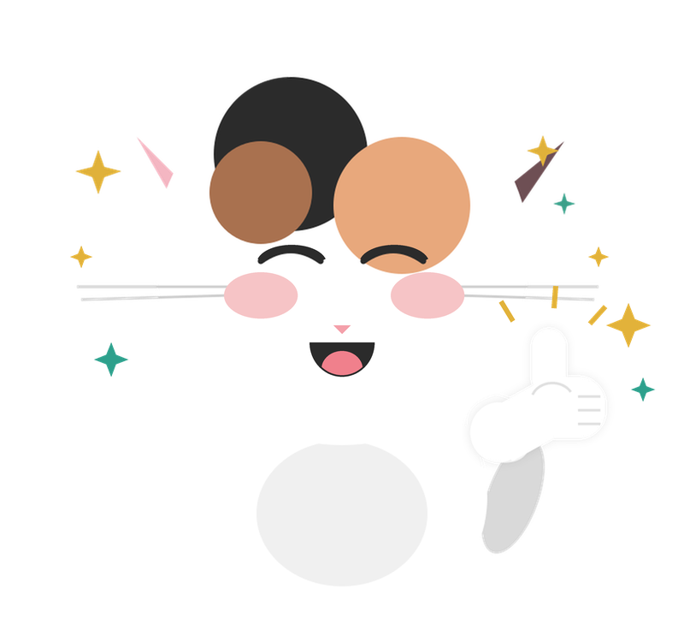
¡Muy bien!
Notes:
¡Muy bien, gracias! = I'm great, thanks!
¡Bien! = Good · ¡Muy bien! = Very good

Slide 20
SPEAK
DAILY
G
Gramática
El verbo “decir” en pretérito
Notes:
Transition to grammar. Keep energy up!

Slide 21
SPEAK
DAILY
decir
to say / to tell
Ayer le dije la verdad.
Yesterday I told him the truth.
decir = to say / to tell (past)
Notes:
ESSENTIAL (minutes 5-10, grammar focus). decir is irregular in the pretérito indefinido: dije, dijiste, dijo, dijimos, dijisteis, dijeron. The stem is dij- for every person and the endings are -e, -iste, -o, -imos, -isteis, -eron, with no written accents. Important: the last form is dijeron, NOT 'dijieron' (when the stem ends in J, the -ieron ending loses its I). Also 'dijo', not 'dijió' or 'dijó'. decir means both 'to say' and 'to tell'. Use 'decir que + sentence' (Dije que sí) and 'le dije' for the person told (Le dije la verdad = I told him/her the truth). It is different from hablar (to speak) and contar (to tell a story). Common mistakes: 'decí', 'dició', 'dijieron', and 'digo' (present) slipping in. dije presents the saying as a completed event (Ayer dije la verdad). Keep the focus on dije and its conjugation; mention decía (the imperfecto) only briefly so students recognise it.

Slide 22
SPEAK
DAILY
decir - infinitive vs present vs past
THE ACTION
PRESENT TENSE
THE PAST
yo dije
decir
yo digo
I said / I told (completed)
Ayer dije la verdad.
to say / to tell
I say / I tell (present)
Yesterday I told the truth.
HOY / TODAY
Me gusta decir lo que pienso.
Hoy digo que no.
yo decía
I was saying / used to say
I like saying what I think.
Today I’m saying no.
Siempre decía que sí.
I always used to say yes.
Notes:
ESSENTIAL (minutes 5-10). Brief comparison only, to help students see how the forms relate. Today's focus is decir in the pretérito indefinido, mainly dije (circled in red).
The action: decir = to say / to tell.
Present tense: digo describes what I say now (irregular yo form: digo).
The past shows two forms. dije (indefinido) presents what was said as completed: Ayer dije la verdad = Yesterday I told the truth. decía (imperfecto) describes a repeated or background action: Siempre decía que sí = I always used to say yes.
Do not teach 'indefinido = once, imperfecto = used to'. decía is only recognised here; it has its own class. Keep this to about a minute.

Slide 23

SPEAK
DAILY
decir (past) — all forms
Write these down - you’ll need them
Yo dije
Tú dijiste
(Él, Ella, Usted) dijo
“You (informal) said”
“I said”
“He/She/It said / you (Formal) said”
Nosotros dijimos
Vosotros dijisteis
Ellos/Ellas dijeron
“You all (plural) said”
“They said”
“We said”
Notes:
OPTIONAL reference slide - show it only if students ask or after the drills. The six forms of decir in the indefinido: dije, dijiste, dijo, dijimos, dijisteis, dijeron. Point out the single stem dij-, that there are no accents, and that the last form is -eron (dijeron), not -ieron. Have students say each form aloud if there is time. Do not let this delay the conversation section.

Slide 24
SPEAK
DAILY
dije
dijiste
dijo
dijimos
dijisteis
dijeron
?
“I said no to the offer”
__________ que no a la oferta.
Notes:
ESSENTIAL (slides 24-29) - do these 3 drill pairs; the conversation section MUST start by minute 10. Drill: the blank slide shows the sentence in English; the student only supplies the correct form of decir for the person (with the pronoun) and then says the whole sentence. The next slide reveals the answer. Listen for: 'dijieron' (it is dijeron), 'dijió/dijó' (it is dijo), 'decí', digo slipping in from the present. Correct by repeating the right form once and moving on. Beginners can say just the verb form. If a student offers decía naturally, accept it and give a one-line comparison only if it helps (see slide 22).

Slide 25
SPEAK
DAILY
dije
dijiste
dijo
dijimos
dijisteis
dijeron
?
“I said no to the offer”
Yo dije que no a la oferta.
Notes:
ESSENTIAL (slides 24-29) - do these 3 drill pairs; the conversation section MUST start by minute 10. Drill: the blank slide shows the sentence in English; the student only supplies the correct form of decir for the person (with the pronoun) and then says the whole sentence. The next slide reveals the answer. Listen for: 'dijieron' (it is dijeron), 'dijió/dijó' (it is dijo), 'decí', digo slipping in from the present. Correct by repeating the right form once and moving on. Beginners can say just the verb form. If a student offers decía naturally, accept it and give a one-line comparison only if it helps (see slide 22).

Slide 26
SPEAK
DAILY
?
dije
dijiste
dijo
dijimos
dijisteis
dijeron
“We said goodbye at the door”
__________ adiós en la puerta.
Notes:
ESSENTIAL (slides 24-29) - do these 3 drill pairs; the conversation section MUST start by minute 10. Drill: the blank slide shows the sentence in English; the student only supplies the correct form of decir for the person (with the pronoun) and then says the whole sentence. The next slide reveals the answer. Listen for: 'dijieron' (it is dijeron), 'dijió/dijó' (it is dijo), 'decí', digo slipping in from the present. Correct by repeating the right form once and moving on. Beginners can say just the verb form. If a student offers decía naturally, accept it and give a one-line comparison only if it helps (see slide 22).

Slide 27
SPEAK
DAILY
?
dije
dijiste
dijo
dijimos
dijisteis
dijeron
“We said goodbye at the door”
Nosotros dijimos adiós en la puerta.
Notes:
ESSENTIAL (slides 24-29) - do these 3 drill pairs; the conversation section MUST start by minute 10. Drill: the blank slide shows the sentence in English; the student only supplies the correct form of decir for the person (with the pronoun) and then says the whole sentence. The next slide reveals the answer. Listen for: 'dijieron' (it is dijeron), 'dijió/dijó' (it is dijo), 'decí', digo slipping in from the present. Correct by repeating the right form once and moving on. Beginners can say just the verb form. If a student offers decía naturally, accept it and give a one-line comparison only if it helps (see slide 22).

Slide 28
SPEAK
DAILY
?
dije
dijiste
dijo
dijimos
dijisteis
dijeron
“You all said the same thing”
__________ lo mismo.
Notes:
ESSENTIAL (slides 24-29) - do these 3 drill pairs; the conversation section MUST start by minute 10. Drill: the blank slide shows the sentence in English; the student only supplies the correct form of decir for the person (with the pronoun) and then says the whole sentence. The next slide reveals the answer. Listen for: 'dijieron' (it is dijeron), 'dijió/dijó' (it is dijo), 'decí', digo slipping in from the present. Correct by repeating the right form once and moving on. Beginners can say just the verb form. If a student offers decía naturally, accept it and give a one-line comparison only if it helps (see slide 22).

Slide 29
SPEAK
DAILY
?
dije
dijiste
dijo
dijimos
dijisteis
dijeron
“You all said the same thing”
Vosotros dijisteis lo mismo.
Notes:
ESSENTIAL (slides 24-29) - do these 3 drill pairs; the conversation section MUST start by minute 10. Drill: the blank slide shows the sentence in English; the student only supplies the correct form of decir for the person (with the pronoun) and then says the whole sentence. The next slide reveals the answer. Listen for: 'dijieron' (it is dijeron), 'dijió/dijó' (it is dijo), 'decí', digo slipping in from the present. Correct by repeating the right form once and moving on. Beginners can say just the verb form. If a student offers decía naturally, accept it and give a one-line comparison only if it helps (see slide 22).

Slide 30
SPEAK
DAILY
?
dije
dijiste
dijo
dijimos
dijisteis
dijeron
“You said it was a secret”
__________ que era un secreto.
Notes:
OPTIONAL (slides 30-35) - skip if time is short; the conversation section MUST start by minute 10. Drill: the blank slide shows the sentence in English; the student only supplies the correct form of decir for the person (with the pronoun) and then says the whole sentence. The next slide reveals the answer. Listen for: 'dijieron' (it is dijeron), 'dijió/dijó' (it is dijo), 'decí', digo slipping in from the present. Correct by repeating the right form once and moving on. Beginners can say just the verb form. If a student offers decía naturally, accept it and give a one-line comparison only if it helps (see slide 22).

Slide 31
SPEAK
DAILY
?
dije
dijiste
dijo
dijimos
dijisteis
dijeron
“You said it was a secret”
Tú dijiste que era un secreto.
Notes:
OPTIONAL (slides 30-35) - skip if time is short; the conversation section MUST start by minute 10. Drill: the blank slide shows the sentence in English; the student only supplies the correct form of decir for the person (with the pronoun) and then says the whole sentence. The next slide reveals the answer. Listen for: 'dijieron' (it is dijeron), 'dijió/dijó' (it is dijo), 'decí', digo slipping in from the present. Correct by repeating the right form once and moving on. Beginners can say just the verb form. If a student offers decía naturally, accept it and give a one-line comparison only if it helps (see slide 22).

Slide 32
SPEAK
DAILY
?
dije
dijiste
dijo
dijimos
dijisteis
dijeron
“They said nothing during the meeting”
__________ nada durante la reunión.
Notes:
OPTIONAL (slides 30-35) - skip if time is short; the conversation section MUST start by minute 10. Drill: the blank slide shows the sentence in English; the student only supplies the correct form of decir for the person (with the pronoun) and then says the whole sentence. The next slide reveals the answer. Listen for: 'dijieron' (it is dijeron), 'dijió/dijó' (it is dijo), 'decí', digo slipping in from the present. Correct by repeating the right form once and moving on. Beginners can say just the verb form. If a student offers decía naturally, accept it and give a one-line comparison only if it helps (see slide 22).

Slide 33
SPEAK
DAILY
?
dije
dijiste
dijo
dijimos
dijisteis
dijeron
“They said nothing during the meeting”
Ellos dijeron nada durante la reunión.
Notes:
OPTIONAL (slides 30-35) - skip if time is short; the conversation section MUST start by minute 10. Drill: the blank slide shows the sentence in English; the student only supplies the correct form of decir for the person (with the pronoun) and then says the whole sentence. The next slide reveals the answer. Listen for: 'dijieron' (it is dijeron), 'dijió/dijó' (it is dijo), 'decí', digo slipping in from the present. Correct by repeating the right form once and moving on. Beginners can say just the verb form. If a student offers decía naturally, accept it and give a one-line comparison only if it helps (see slide 22).

Slide 34
SPEAK
DAILY
?
dije
dijiste
dijo
dijimos
dijisteis
dijeron
“She said yes straight away”
__________ que sí enseguida.
Notes:
OPTIONAL (slides 30-35) - skip if time is short; the conversation section MUST start by minute 10. Drill: the blank slide shows the sentence in English; the student only supplies the correct form of decir for the person (with the pronoun) and then says the whole sentence. The next slide reveals the answer. Listen for: 'dijieron' (it is dijeron), 'dijió/dijó' (it is dijo), 'decí', digo slipping in from the present. Correct by repeating the right form once and moving on. Beginners can say just the verb form. If a student offers decía naturally, accept it and give a one-line comparison only if it helps (see slide 22).

Slide 35
SPEAK
DAILY
?
dije
dijiste
dijo
dijimos
dijisteis
dijeron
“She said yes straight away”
Ella dijo que sí enseguida.
Notes:
OPTIONAL (slides 30-35) - skip if time is short; the conversation section MUST start by minute 10. Drill: the blank slide shows the sentence in English; the student only supplies the correct form of decir for the person (with the pronoun) and then says the whole sentence. The next slide reveals the answer. Listen for: 'dijieron' (it is dijeron), 'dijió/dijó' (it is dijo), 'decí', digo slipping in from the present. Correct by repeating the right form once and moving on. Beginners can say just the verb form. If a student offers decía naturally, accept it and give a one-line comparison only if it helps (see slide 22).

Slide 36
¡Muy bien!
Notes:
¡Muy bien, gracias! = I'm great, thanks!
¡Bien! = Good · ¡Muy bien! = Very good

Slide 37
SPEAK
DAILY
I
Imaginemos
Responde usando el verbo DECIR
dije · dijiste · dijo · dijimos · dijisteis · dijeron
Notes:
Page break for the scenario section (essential, minutes 10-30 part of the class). Principle: one situation, different levels of response. Everyone gets the same situation; a short, simple sentence is a complete answer, and students who are comfortable can add detail, reasons, questions or what other people did. No pressure, no levels shown to students. The teacher helps with vocabulary and sentence building. Students use decir in the past (dije, dijiste, dijo...). English words are fine when they get stuck.

Slide 38
SPEAK
DAILY
DON’T WORRY IF YOU DON’T KNOW A WORD!
Use the vocab you have
1
Replace with English when you have to
2
We will work on the sentence TOGETHER as a group
3
Notes:
Read this out before the translation. Reassure students: it is fine not to know every word. They use the vocabulary they have, say the English word where they are stuck, and the group builds the sentence together. The teacher writes the sentence as it is built.

Slide 39

¡Vamos a imaginar!
SITUACIÓN 2 - UN MALENTENDIDO / What do you say?
Your friend is angry because they think you said their new boyfriend is boring. But you actually said that the film you watched together was boring. Explain the misunderstanding to your friend. What do you say?
Say it in Spanish using DECIR in the past.
Keep it simple, or add more detail. Both are correct!
The teacher will help you find the words.
PUEDES USAR:
dije · dijiste · dijo · dijimos · dijisteis · dijeron
Notes:
POSSIBLE ANSWERS (teacher only, increasing complexity):
1. No dije eso. Dije que la película fue aburrida. / I did not say that. I said the film was boring.
2. No dije que tu novio es aburrido. Dije que la película fue aburrida. / I did not say your boyfriend is boring. I said the film was boring.
3. Escucha, creo que hay un malentendido. Yo no dije que tu novio es aburrido. Dije que la película que vimos juntos fue aburrida. Alguien entendió mal lo que dije. Lo siento mucho. / Listen, I think there is a misunderstanding. I did not say your boyfriend is boring. I said the film we watched together was boring. Someone misunderstood what I said. I am very sorry.
FRIEND'S QUESTIONS (for the second student if you role-play): ¿Qué dijiste exactamente? ¿Cuándo lo dijiste? ¿Quién estaba allí? ¿Por qué lo dijiste?
NOTE: the key language is denying politely (no dije eso) and clarifying. Students will not know 'aburrido' / 'novio' automatically: give the words or let them use English.
HOW TO RUN IT (same situation for everyone, answers at each student's own level):
- PURPOSE: students clear up a misunderstanding by saying what they did and did not say.
- Read the situation aloud and give students a moment to think. Ask for a response in Spanish BEFORE showing any example. The examples above are for the teacher only.
- OPTIONAL ROLE-PLAY: one student is the upset friend and the other explains what they really said. If time is short, one student answering and the other reacting is enough.
- Beginners may use English words and give one short sentence; the teacher helps build the Spanish. Comfortable students should explain, elaborate, ask a question back or bring in another person.
- LISTEN FOR: 'dijieron', 'dijió', digo slipping in from the present, and 'le dije' for the person told. Do not force decir where another verb is more natural (pregunté, contesté). Let the student finish, then recast.
- KEEP IT MOVING: about 4-5 minutes per scenario.

Slide 40
¡Vamos a imaginar!
SITUACIÓN 3 - ALGO GRACIOSO / What do you say?
In the lift this morning, a little boy said very loudly to his mum: “That man smells of pizza.” The man said nothing and everyone laughed. Tell a colleague what the boy said and what happened. What do you say?
Say it in Spanish using DECIR in the past.
Keep it simple, or add more detail. Both are correct!
The teacher will help you find the words.
PUEDES USAR:
dije · dijiste · dijo · dijimos · dijisteis · dijeron
Notes:
POSSIBLE ANSWERS (teacher only, increasing complexity):
1. Un niño dijo: «Ese señor huele a pizza». / A boy said: 'That man smells of pizza.'
2. Un niño dijo: «Mamá, ese señor huele a pizza». El señor no dijo nada. / A boy said: 'Mum, that man smells of pizza.' The man said nothing.
3. Estaba en el ascensor y un niño dijo en voz muy alta: «Mamá, ese señor huele a pizza». El señor no dijo nada, pero todos nos reímos. Al salir, el señor dijo: «Adiós, amigo». / I was in the lift and a boy said very loudly: 'Mum, that man smells of pizza.' The man did not say anything, but we all laughed. On the way out, the man said: 'Bye, friend.'
COLLEAGUE'S QUESTIONS (for the second student if you role-play): ¿Qué dijo el niño? ¿Qué dijo el señor? ¿Qué hicisteis todos? ¿Qué dijo la madre?
NOTE: the quote is given on the slide, so students can use direct speech (dijo: «...») instead of reported speech; this is easier and perfectly natural.
HOW TO RUN IT (same situation for everyone, answers at each student's own level):
- PURPOSE: students tell a short funny story using what someone said.
- Read the situation aloud and give students a moment to think. Ask for a response in Spanish BEFORE showing any example. The examples above are for the teacher only.
- OPTIONAL ROLE-PLAY: one student is the curious colleague asking what happened and the other tells the story. If time is short, one student answering and the other reacting is enough.
- Beginners may use English words and give one short sentence; the teacher helps build the Spanish. Comfortable students should explain, elaborate, ask a question back or bring in another person.
- LISTEN FOR: 'dijieron', 'dijió', digo slipping in from the present, and 'le dije' for the person told. Do not force decir where another verb is more natural (pregunté, contesté). Let the student finish, then recast.
- KEEP IT MOVING: about 4-5 minutes per scenario.

Slide 41
SPEAK
DAILY
VAMOS A TRADUCIR AL ESPAÑOL
Traduce frases completas usando lo que has aprendido

Slide 42
SPEAK
DAILY
DON’T WORRY IF YOU DON’T KNOW A WORD!
Use the vocab you have
1
Replace with English when you have to
2
We will work on the sentence TOGETHER as a group
3
Notes:
Read this out before the translation. Reassure students: it is fine not to know every word. They use the vocabulary they have, say the English word where they are stuck, and the group builds the sentence together. The teacher writes the sentence as it is built.

Slide 43
VAMOS A TRADUCIR AL ESPAÑOL
SPEAK
DAILY
EN ESPAÑOL, POR FAVOR
Last Tuesday my flatmate told me she was moving to Valencia for a new job. I was surprised, but I said I was very happy for her. She said she was nervous, and I told her she would be great. Later we called our friends, and they all said we had to celebrate. Then my flatmate asked, “What will you do about the flat?” I didn’t know what to say! What did you say the last time someone surprised you?
Don’t know a word? Say…
“¡Ayúdame!”
dije · dijiste · dijo · dijimos · dijisteis · dijeron
Notes:
SPANISH VERSION (teacher only; this is also on the answer slide):
El martes pasado mi compañera de piso me dijo que se mudaba a Valencia por un trabajo nuevo. Me sorprendí, pero le dije que me alegraba mucho por ella. Ella dijo que estaba nerviosa y yo le dije que lo iba a hacer genial. Más tarde llamamos a nuestros amigos y todos dijeron que teníamos que celebrarlo. Entonces mi compañera me preguntó: «¿Qué vas a hacer con el piso?». ¡No supe qué decir! ¿Qué dijiste tú la última vez que alguien te sorprendió?
This paragraph describes one believable situation (a flatmate's news and everyone's reaction) and the grammar appears naturally. Students do not need to hit every form.
KEY EXPRESSIONS:
- Mi compañera de piso: my flatmate.
- Me dijo que se mudaba: she told me she was moving (the imperfect is normal after 'dijo que'; give it as a chunk, do not explain).
- Le dije que me alegraba mucho por ella: I told her I was very happy for her.
- Lo iba a hacer genial: she was going to do great.
- Todos dijeron que teníamos que celebrarlo: they all said we had to celebrate.
- ¡No supe qué decir!: I did not know what to say!
- ¿Qué dijiste tú la última vez...?: What did you say the last time...?
Some structures go beyond the lesson focus (reported speech with the imperfect, iba a, me alegraba). Do not turn them into mini-lessons: give the phrase, move on, and allow English or simple direct speech when needed (Ella dijo: «Estoy nerviosa»).
HOW TO RUN IT: students translate together, one sentence at a time; the teacher writes the Spanish as the group builds it. Finish by asking the last question in your own words: ¿Y tú? ¿Qué dijiste?

Slide 44
VAMOS A TRADUCIR AL ESPAÑOL
SPEAK
DAILY
El martes pasado mi compañera de piso me dijo que se mudaba a Valencia por un trabajo nuevo. Me sorprendí, pero le dije que me alegraba mucho por ella. Ella dijo que estaba nerviosa y yo le dije que lo iba a hacer genial. Más tarde llamamos a nuestros amigos y todos dijeron que teníamos que celebrarlo. Entonces mi compañera me preguntó: «¿Qué vas a hacer con el piso?». ¡No supe qué decir! ¿Qué dijiste tú la última vez que alguien te sorprendió?
Don’t know a word? Say…
“¡Ayúdame!”
dije · dijiste · dijo · dijimos · dijisteis · dijeron
Notes:
SPANISH VERSION (teacher only; this is also on the answer slide):
El martes pasado mi compañera de piso me dijo que se mudaba a Valencia por un trabajo nuevo. Me sorprendí, pero le dije que me alegraba mucho por ella. Ella dijo que estaba nerviosa y yo le dije que lo iba a hacer genial. Más tarde llamamos a nuestros amigos y todos dijeron que teníamos que celebrarlo. Entonces mi compañera me preguntó: «¿Qué vas a hacer con el piso?». ¡No supe qué decir! ¿Qué dijiste tú la última vez que alguien te sorprendió?
This paragraph describes one believable situation (a flatmate's news and everyone's reaction) and the grammar appears naturally. Students do not need to hit every form.
KEY EXPRESSIONS:
- Mi compañera de piso: my flatmate.
- Me dijo que se mudaba: she told me she was moving (the imperfect is normal after 'dijo que'; give it as a chunk, do not explain).
- Le dije que me alegraba mucho por ella: I told her I was very happy for her.
- Lo iba a hacer genial: she was going to do great.
- Todos dijeron que teníamos que celebrarlo: they all said we had to celebrate.
- ¡No supe qué decir!: I did not know what to say!
- ¿Qué dijiste tú la última vez...?: What did you say the last time...?
Some structures go beyond the lesson focus (reported speech with the imperfect, iba a, me alegraba). Do not turn them into mini-lessons: give the phrase, move on, and allow English or simple direct speech when needed (Ella dijo: «Estoy nerviosa»).
HOW TO RUN IT: students translate together, one sentence at a time; the teacher writes the Spanish as the group builds it. Finish by asking the last question in your own words: ¿Y tú? ¿Qué dijiste?

Slide 45
SPEAK
DAILY
dije
dijiste
dijo
dijimos
dijisteis
dijeron
?
Don’t know a word? Say…
“¡Ayúdame!”
“I said yes, although I did not really want to go”
___________________
Notes:
OPTIONAL translation practice (use if time remains after conversation and scenarios). Practise the sentence conversationally, not as translate-and-forget. Students translate using decir in the past (mainly dije) plus the connector. Check the stem dij- and the ending for the person (dijeron, not dijieron). Imperfect forms (tenía, daba) in the second half of some sentences are background that students only need to recognise. Students can use English words where stuck; teacher builds the sentence with them. FOLLOW-UP (only if time allows): After the sentence: ¿Cuándo dices que sí cuando quieres decir que no? / When do you say yes when you want to say no?
Natural Spanish: Dije que sí, aunque no tenía muchas ganas de ir.

Slide 46
SPEAK
DAILY
dije
dijiste
dijo
dijimos
dijisteis
dijeron
?
“I said yes, although I did not really want to go”
Dije que sí, aunque no tenía muchas ganas de ir.
Notes:
OPTIONAL translation practice (use if time remains after conversation and scenarios). Practise the sentence conversationally, not as translate-and-forget. Students translate using decir in the past (mainly dije) plus the connector. Check the stem dij- and the ending for the person (dijeron, not dijieron). Imperfect forms (tenía, daba) in the second half of some sentences are background that students only need to recognise. Students can use English words where stuck; teacher builds the sentence with them. FOLLOW-UP (only if time allows): After the sentence: ¿Cuándo dices que sí cuando quieres decir que no? / When do you say yes when you want to say no?
Natural Spanish: Dije que sí, aunque no tenía muchas ganas de ir.

Slide 47
SPEAK
DAILY
dije
dijiste
dijo
dijimos
dijisteis
dijeron
?
Don’t know a word? Say…
“¡Ayúdame!”
“We said hello, but he did not answer”
___________________
Notes:
OPTIONAL translation practice (use if time remains after conversation and scenarios). Practise the sentence conversationally, not as translate-and-forget. Students translate using decir in the past (mainly dije) plus the connector. Check the stem dij- and the ending for the person (dijeron, not dijieron). Imperfect forms (tenía, daba) in the second half of some sentences are background that students only need to recognise. Students can use English words where stuck; teacher builds the sentence with them. FOLLOW-UP (only if time allows): After the sentence: ¿Te ignoró alguien alguna vez? / Did anyone ever ignore you?
Natural Spanish: Dijimos hola, pero no contestó.

Slide 48
SPEAK
DAILY
dije
dijiste
dijo
dijimos
dijisteis
dijeron
?
“We said hello, but he did not answer”
Dijimos hola, pero no contestó.
Notes:
OPTIONAL translation practice (use if time remains after conversation and scenarios). Practise the sentence conversationally, not as translate-and-forget. Students translate using decir in the past (mainly dije) plus the connector. Check the stem dij- and the ending for the person (dijeron, not dijieron). Imperfect forms (tenía, daba) in the second half of some sentences are background that students only need to recognise. Students can use English words where stuck; teacher builds the sentence with them. FOLLOW-UP (only if time allows): After the sentence: ¿Te ignoró alguien alguna vez? / Did anyone ever ignore you?
Natural Spanish: Dijimos hola, pero no contestó.

Slide 49
SPEAK
DAILY
dije
dijiste
dijo
dijimos
dijisteis
dijeron
?
Don’t know a word? Say…
“¡Ayúdame!”
“I wrote down what he said so I would not forget it”
___________________
Notes:
OPTIONAL translation practice (use if time remains after conversation and scenarios). Practise the sentence conversationally, not as translate-and-forget. Students translate using decir in the past (mainly dije) plus the connector. Check the stem dij- and the ending for the person (dijeron, not dijieron). Imperfect forms (tenía, daba) in the second half of some sentences are background that students only need to recognise. Students can use English words where stuck; teacher builds the sentence with them. FOLLOW-UP (only if time allows): After the sentence: ¿Qué apuntas tú para no olvidar? / What do you write down so you do not forget?
Natural Spanish: Apunté lo que dijo para no olvidarlo.

Slide 50
SPEAK
DAILY
dije
dijiste
dijo
dijimos
dijisteis
dijeron
?
“I wrote down what he said so I would not forget it”
Apunté lo que dijo para no olvidarlo.
Notes:
OPTIONAL translation practice (use if time remains after conversation and scenarios). Practise the sentence conversationally, not as translate-and-forget. Students translate using decir in the past (mainly dije) plus the connector. Check the stem dij- and the ending for the person (dijeron, not dijieron). Imperfect forms (tenía, daba) in the second half of some sentences are background that students only need to recognise. Students can use English words where stuck; teacher builds the sentence with them. FOLLOW-UP (only if time allows): After the sentence: ¿Qué apuntas tú para no olvidar? / What do you write down so you do not forget?
Natural Spanish: Apunté lo que dijo para no olvidarlo.

Slide 51
SPEAK
DAILY
dije
dijiste
dijo
dijimos
dijisteis
dijeron
?
Don’t know a word? Say…
“¡Ayúdame!”
“They said nothing because they were embarrassed”
___________________
Notes:
OPTIONAL translation practice (use if time remains after conversation and scenarios). Practise the sentence conversationally, not as translate-and-forget. Students translate using decir in the past (mainly dije) plus the connector. Check the stem dij- and the ending for the person (dijeron, not dijieron). Imperfect forms (tenía, daba) in the second half of some sentences are background that students only need to recognise. Students can use English words where stuck; teacher builds the sentence with them. FOLLOW-UP (only if time allows): After the sentence: ¿Cuándo te da vergüenza hablar? / When do you feel too shy to speak?
Natural Spanish: No dijeron nada porque les daba vergüenza.

Slide 52
SPEAK
DAILY
dije
dijiste
dijo
dijimos
dijisteis
dijeron
?
“They said nothing because they were embarrassed”
No dijeron nada porque les daba vergüenza.
Notes:
OPTIONAL translation practice (use if time remains after conversation and scenarios). Practise the sentence conversationally, not as translate-and-forget. Students translate using decir in the past (mainly dije) plus the connector. Check the stem dij- and the ending for the person (dijeron, not dijieron). Imperfect forms (tenía, daba) in the second half of some sentences are background that students only need to recognise. Students can use English words where stuck; teacher builds the sentence with them. FOLLOW-UP (only if time allows): After the sentence: ¿Cuándo te da vergüenza hablar? / When do you feel too shy to speak?
Natural Spanish: No dijeron nada porque les daba vergüenza.

Slide 53
SPEAK
DAILY
C
Conversemos
Responde usando el verbo DECIR
dije · dijiste · dijo · dijimos · dijisteis · dijeron
Notes:
Page break for the conversation section. The teacher must reach this point by minute 10. Students pick a question and answer it in Spanish using decir in the past. Simple or detailed answers are both fine, and English words are allowed when students get stuck.

Slide 54
SPEAK
DAILY
DON’T WORRY IF YOU DON’T KNOW A WORD!
Use the vocab you have
1
Replace with English when you have to
2
We will work on the sentence TOGETHER as a group
3
Notes:
Read this out before the translation. Reassure students: it is fine not to know every word. They use the vocabulary they have, say the English word where they are stuck, and the group builds the sentence together. The teacher writes the sentence as it is built.

Slide 55
¡Vamos a conversar!
ELIGE UNA PREGUNTA PARA RESPONDER / Choose a question to answer
Sentences can be as simple or as complex as you are comfortable with - no pressure!
1
¿Dijiste alguna vez algo que no querías decir? ¿Qué pasó?
Did you ever say something you did not mean to say? What happened?
2
¿Qué te dijo alguien esta semana que te hizo sonreír?
What did someone say to you this week that made you smile?
3
¿Cuál fue el mejor consejo que te dijeron? ¿Quién te lo dijo?
What is the best advice anyone gave you? Who said it?
Puedes usar:
dije · dijiste · dijo · dijimos · dijisteis · dijeron
Notes:
ESSENTIAL (conversation, minutes 10-30). TEACHER GUIDANCE: these three questions open different conversations (an embarrassing slip, a kind comment and good advice). Students choose ONE; read all three aloud and let them pick. Encourage reactions and follow-up questions between students (¿En serio? ¿Y qué pasó? ¿A ti también?).
SIMPLE PARAPHRASES: ¿Dijiste algo sin querer? ¿Qué te dijo alguien que te gustó? ¿Qué consejo te dijeron? (Did you say something by accident? What did someone say to you that you liked? What advice did you get?)
BEGINNER ANSWERS (all successful): Dije un nombre equivocado. / I said the wrong name.
Mi amigo dijo: «Estás muy guapo». / My friend said: 'You look great.'
Mi profesor dijo: «Practica cada día». / My teacher said: 'Practise every day.'
MORE ELABORATE: Dije «buenos días» a una persona por la tarde y se rio de mí, pero fue gracioso. / I said 'good morning' to someone in the afternoon and they laughed at me, but it was funny.
Un compañero me dijo que mi presentación le inspiró mucho y estuve contento todo el día. / A colleague told me my presentation inspired him and I was happy all day.
Un amigo me dijo que no tuviera miedo a equivocarme y desde entonces me atrevo a hablar más. / A friend told me not to be afraid of making mistakes and since then I dare to speak more.
FOLLOW-UPS: ¿Quién estaba contigo? ¿Qué dijiste después? ¿Cómo te sentiste? ¿Qué pasó al final? ¿Sigues el consejo?
LISTEN FOR: 'dijieron' (it is dijeron), 'dijió/dijó', 'decí', digo slipping in from the present, and 'le/me/te dijo' for the person told. Reported speech after 'dijo que' often needs the imperfect (dijo que estaba cansado): accept whatever tense the student uses and do not turn it into a grammar lesson. Let the student finish the thought, then recast the sentence correctly and invite one repeat. If a student uses another past verb (hablé, contesté, pregunté), accept it: the goal is communication, not forcing decir into every sentence.
KEEP IT MOVING: about 3-4 minutes per student turn; use English words for gaps and build the sentence together.

Slide 56
¡Vamos a conversar!
ELIGE UNA PREGUNTA PARA RESPONDER / Choose a question to answer
Sentences can be as simple or as complex as you are comfortable with - no pressure!
1
¿Dijiste alguna vez una mentirijilla para no ofender a alguien?
Did you ever tell a white lie so as not to offend someone?
2
¿Qué le dijiste a un amigo la última vez que estaba triste?
What did you say to a friend the last time they were sad?
3
¿Qué dijeron tus amigos la última vez que les diste una noticia importante?
What did your friends say the last time you gave them important news?
Puedes usar:
dije · dijiste · dijo · dijimos · dijisteis · dijeron
Notes:
ESSENTIAL (conversation, minutes 10-30). TEACHER GUIDANCE: these three questions open different conversations (a white lie, supporting a friend and sharing news). Students choose ONE; read all three aloud and let them pick. Encourage reactions and follow-up questions between students (¿En serio? ¿Y qué pasó? ¿A ti también?).
SIMPLE PARAPHRASES: ¿Dijiste una mentira pequeña? ¿Qué dijiste a un amigo triste? ¿Qué dijeron tus amigos con tu noticia? (Did you tell a small lie? What did you say to a sad friend? What did your friends say about your news?)
BEGINNER ANSWERS (all successful): Dije: «Me gusta tu regalo». / I said: 'I like your present.'
Dije: «Estoy aquí para ti». / I said: 'I am here for you.'
Mis amigos dijeron: «¡Felicidades!». / My friends said: 'Congratulations!'
MORE ELABORATE: Dije que me encantó la comida de mi vecina, pero estaba un poco salada. Fue una mentirijilla para no ofenderla. / I said I loved my neighbour's food, but it was a bit salty. It was a small lie not to offend her.
Le dije a mi amiga que todo iba a salir bien y la invité a pasear. / I told my friend that everything would be fine and invited her for a walk.
Cuando les dije que me mudaba de ciudad, todos dijeron que me iban a echar de menos. / When I told them I was moving city, they all said they would miss me.
FOLLOW-UPS: ¿Qué dijo la otra persona? ¿Se dio cuenta? ¿Lo repetirías? ¿Cómo reaccionaron? ¿Qué dijiste tú después?
LISTEN FOR: 'dijieron' (it is dijeron), 'dijió/dijó', 'decí', digo slipping in from the present, and 'le/me/te dijo' for the person told. Reported speech after 'dijo que' often needs the imperfect (dijo que estaba cansado): accept whatever tense the student uses and do not turn it into a grammar lesson. Let the student finish the thought, then recast the sentence correctly and invite one repeat. If a student uses another past verb (hablé, contesté, pregunté), accept it: the goal is communication, not forcing decir into every sentence.
KEEP IT MOVING: about 3-4 minutes per student turn; use English words for gaps and build the sentence together.

Slide 57
¡Muy bien!
Notes:
¡Muy bien, gracias! = I'm great, thanks!
¡Bien! = Good · ¡Muy bien! = Very good

Slide 58
SPEAK
DAILY
👋
¡Hasta la próxima!
SPEAK DAILY · Español

