Slide 1
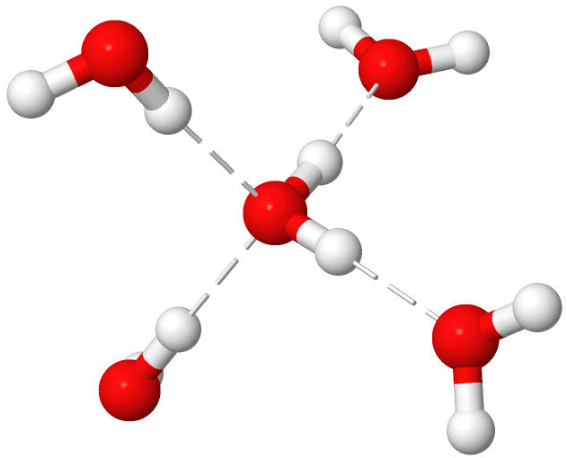

$$E_{CBS}^{IP}=E_{cc−pVXZ}^{IP}+27.15×e^{−0.16X} (X=D,T,Q)$$

