Slide 1
A Game Theoretic Model for WSN with Hidden-Action Attacks
CS 535 Term Project
Furkan Reha Tutaş 21036
furkanreha@sabanciuniv.edu

Slide 2
PAPER INTRODUCTION
Explore game theory
Model the situation for WSN
With malicious nodes
To Secure WSN with a game-based approach
Evaluates/simulates the provided approach

Slide 3
PROJECT AIMS
Understand
Replicate the provided method
Replicate the provided simulations
Compare replicated-provided simulations’ results

Slide 4
NETWORK MODEL
Simple-undirected-unweighted graph
Static locations
With at least one edge.
Two types of nodes;
- Normal/Malicious
Four types of actions:
- Forward/Receive/Detect (Jam)/Sleep
Normal nodes much larger
Hidden information of identities

Slide 5
GAME THEORETIC FORMULATION-1
Main Idea:
- Pairwise simultaneous games → Update by the rules of spatial structured game
First letter of the actions [F,R,D/J,S]

Slide 6
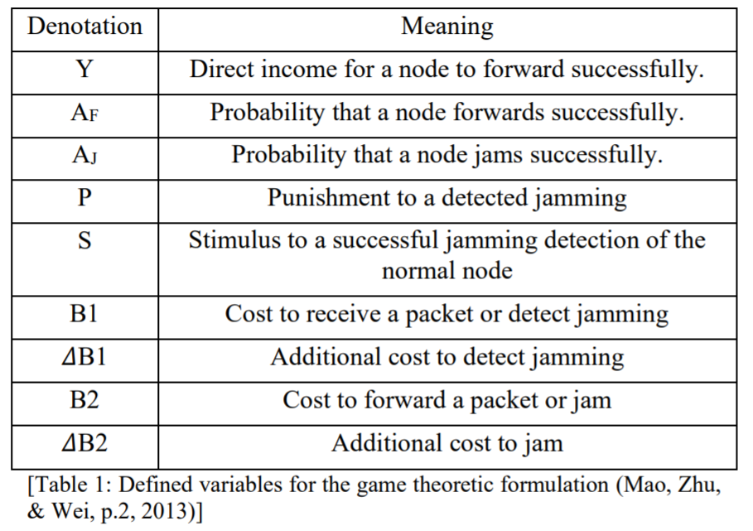
GAME THEORETIC FORMULATION-2

Slide 7
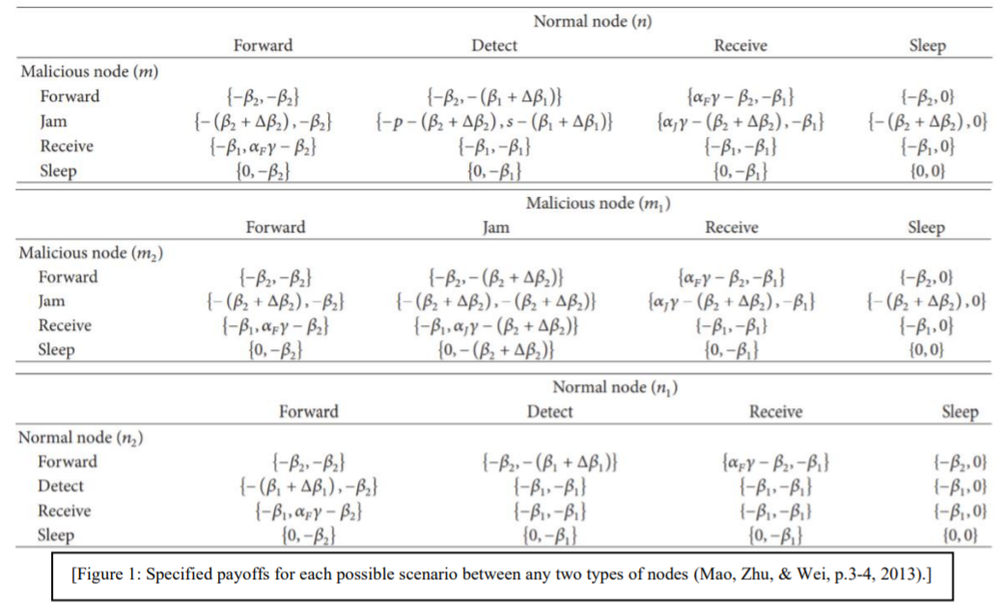
PAIRWISE SIMULTANEOUS GAME
There are three different scenarios: (N-N, N-M, M-M)

Slide 8
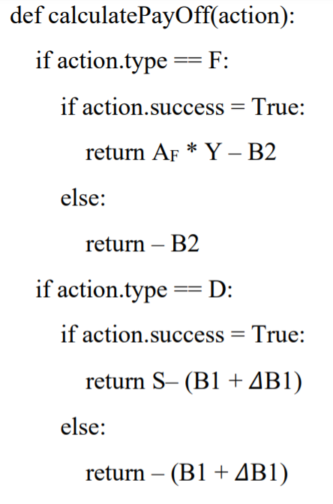
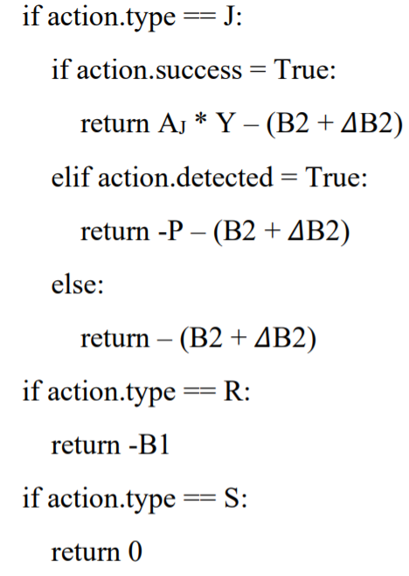
SIMPLIFIED VERSION

Slide 9
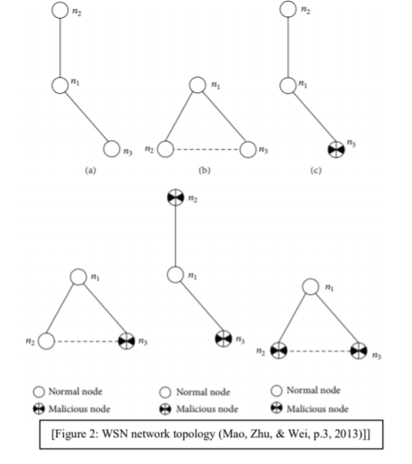
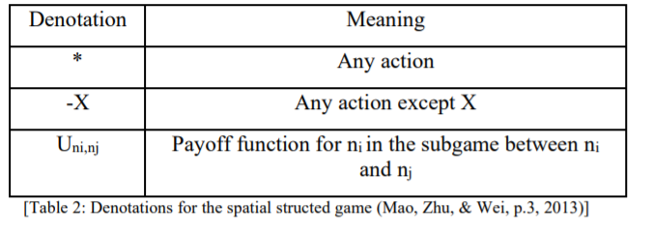
SPATIAL STRUCTURED GAME-1
Let’s define nodes n1,n2 and n3
n2 and n3 → neighbours of n1
Assume that n1 is normal
Simultaneous actions
Should not overpay

Slide 10
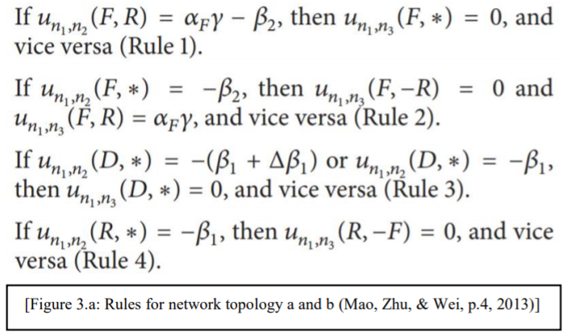
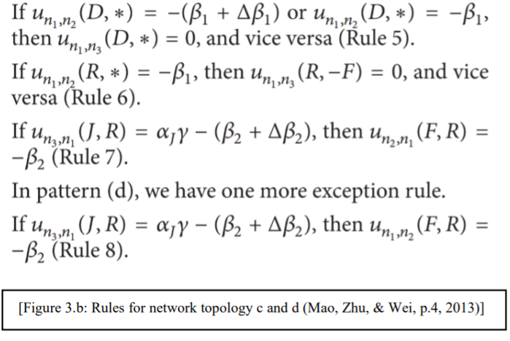
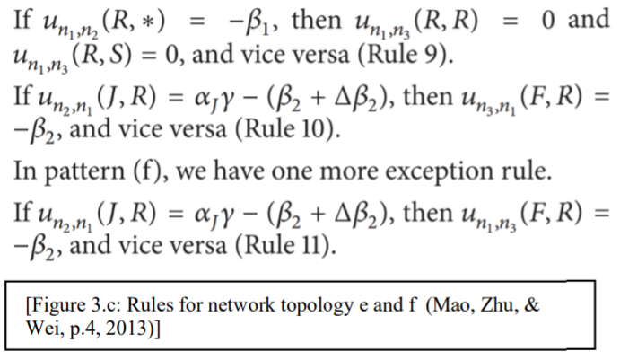
SPATIAL STRUCTURED GAME-2
Rule 1 and Rule 2 applied to all cases
When n1 is malicious → no rules needed;
- Since rules for c-d-e-f covers.
Rule 1-2: Forward cost already paid
Rule 3-5: Additional cost for detection already paid
Rule 4-6-9: Receive cost already paid
Rule 7-8-10-11: Forward unsuccessful because of jamming

Slide 11
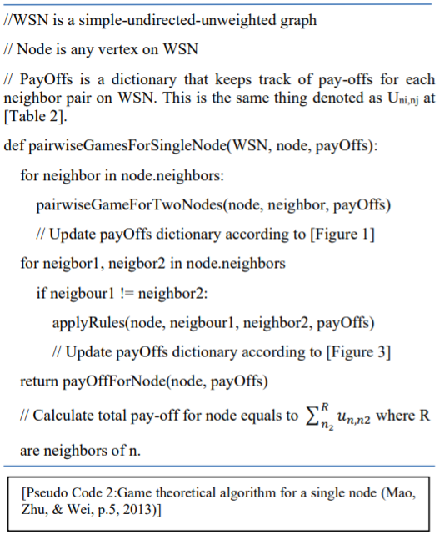
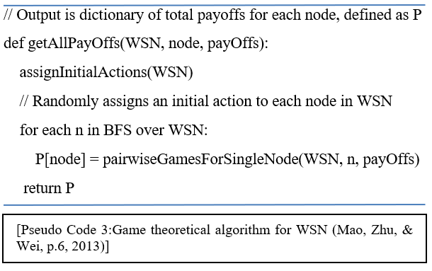
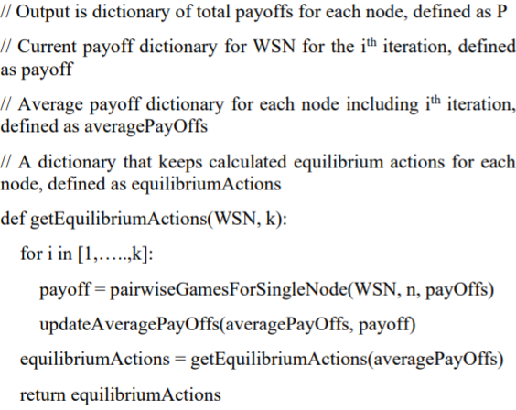
IMPLEMENTATION
Sleep action is not included in the equilibrium calculation due to S >= R
With %25 chance, each node (independent of the equilibrium) takes Sleep action.
With %75 chance each node takes the calculated equilibrium action.

Slide 12
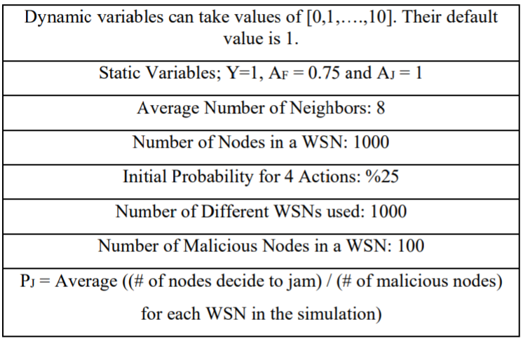
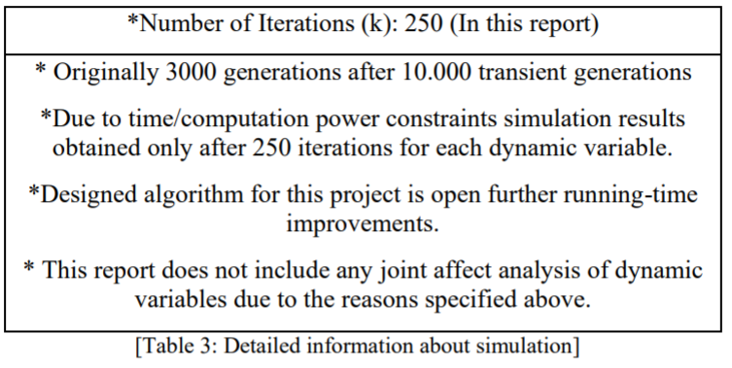
SIMULATION

Slide 13
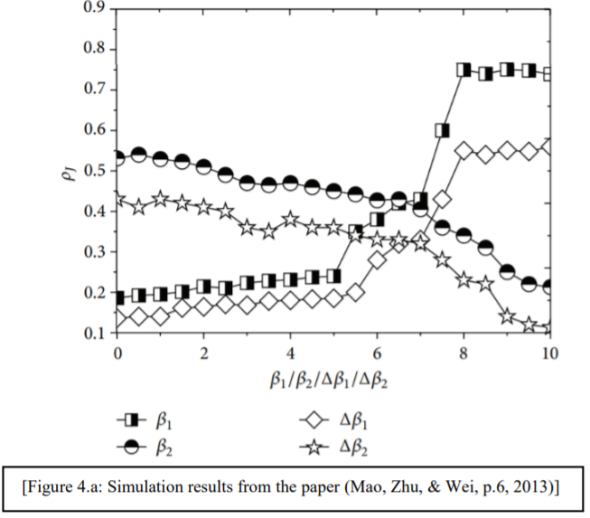
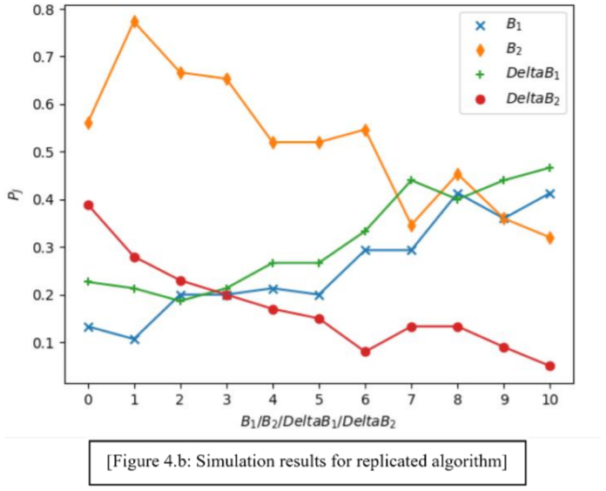
SIMULATION RESULTS-1

Slide 14
SIMULATION CONCLUSIONS-1
Detection Cost = (B1 + DeltaB1)
Jamming Cost = (B2 + DeltaB2)
Detection Cost Increases → Pj increases
Jamming Cost Increases → Pj decreases
Same conclusions but more fluctuations (less reliable)

Slide 15
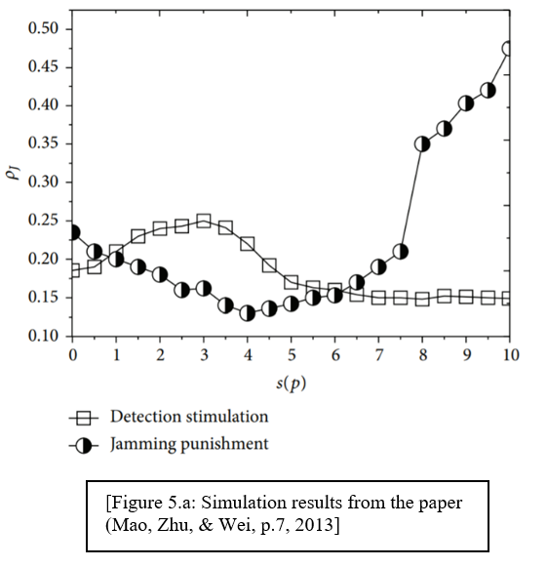
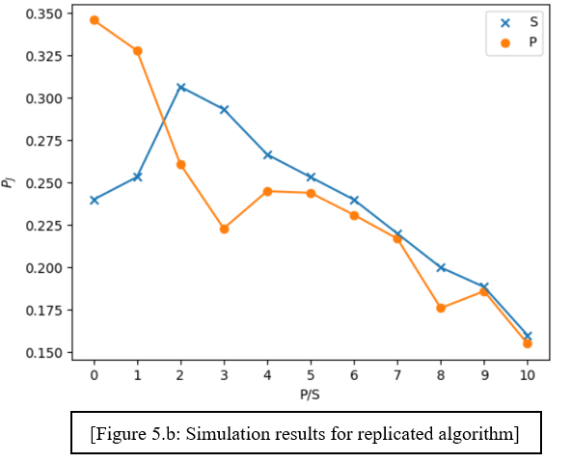
SIMULATION RESULTS-2

Slide 16
SIMULATION CONCLUSIONS-2
S increases → Pj firstly increases to local maxima, then decreases to a stable value.
P increases → Pj firstly decreases to local minima, then increases.
Before threshold for S → Not enough to encourage to detect jamming → Increase in Pj
After threshold for S → # of jamming nodes are limited → Limited income for detectors → Decrease in Pj to a stable value
For small P → Pj is constrained
After threshold for P → Income for malicious nodes exceeds income for detectors.
Successfully simulates S, fails to simulate P.

