Slide 1
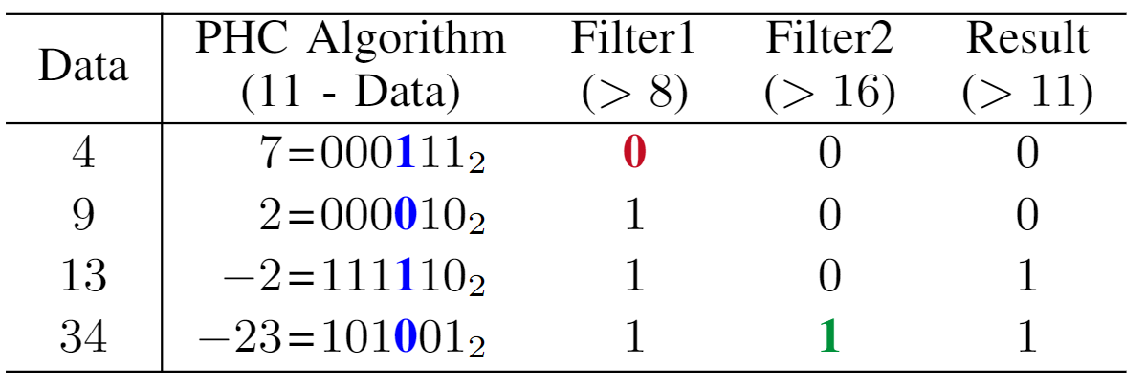

Overflow!
AND Filter 1
OR Filter 2

