Slide 1
The Doors of Perceptron
UWC 5009 - Applied Text Analysis from Close Reading to Machine Learning
Ian Goodrich

Slide 2


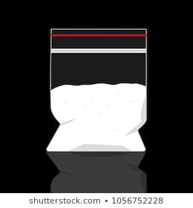
Drugs and Drug Policy
Policy failure
Public health
Security and crime
Changing policy environment
Legalisation
New substances
Difficult to acquire reliable information

Slide 3
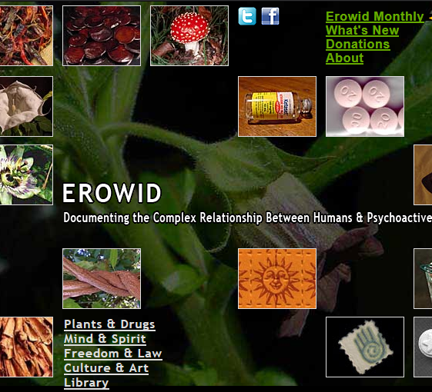
Erowid
“Documenting the complex relationship between humans and psychoactives”
Established in 1995, contains “reliable, non-judgmental information about psychoactive plants, chemicals, and related issues”
Over 30,000 “trip reports”

Slide 4
A gentle surge of energy flowed through my chest and I felt lighter. Something had changed. […] I saw other ravers without shirts and that seemed like a terrific idea. For an unknown amount of time I bobbed back and forth in place, without a shirt on, rubbing my hair over and over underneath the June night sky. My inhibitions dropped to almost nil and I was completely liberated.
Big Bright Lights (MDMA) by “Lightshowoff”
THE GOOD

Slide 5
With my eyes closed, I see what I can only describe as a slot machine, infinitely long and tall, that adjusts in perspective according to my heads actual position. On the face of each is a picture of myself in a different emotion or physical state. […] Finally, the slot machine rests on a single face: Madness. It is a picture of myself in green, clawing at my eyes. I realize what is going to happen: When the machine adds the sum total of all I’ve been, I will be defined, and I will die.
Juxtaposition of All Selves into Singularity (Mushrooms) by “FantomeCiel”
THE BAD

Slide 6
I have ADD so I get bored easily, I had 10 hits left from the last rave I went too. So I figured I'd eat the whole strip and chill at home and have a good time. And let me tell ya, it was a fucking blast! I was tripping so hard to the point where time meant nothing and I just curled up in a ball. It was valentines day at the time and at around 6 in the morning, I dropped the 10 at around 1230 am, my mom came in my room and gave me some chocolate, she though I was sleeping but I was just tripping balls haha.
It Was a Fucking Blast (LSD) by “TRIPGOD”
THE (GRAMMATICALLY) UGLY

Slide 7
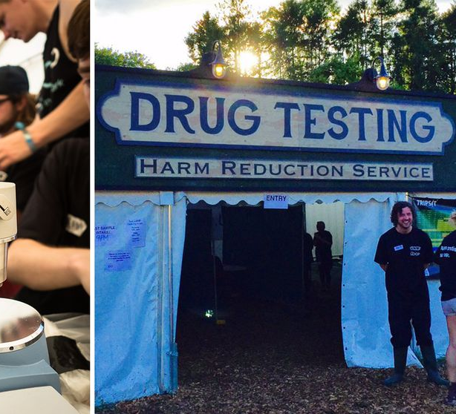
Hypothesis
User experiences are valuable information from a harm-reduction perspective:
If users report negative experiences with a particular, novel substance, this may suggest the need for research/policy interventions, education
We can use sentiment analysis tools to identify positive or negative drug experiences from text

Slide 8
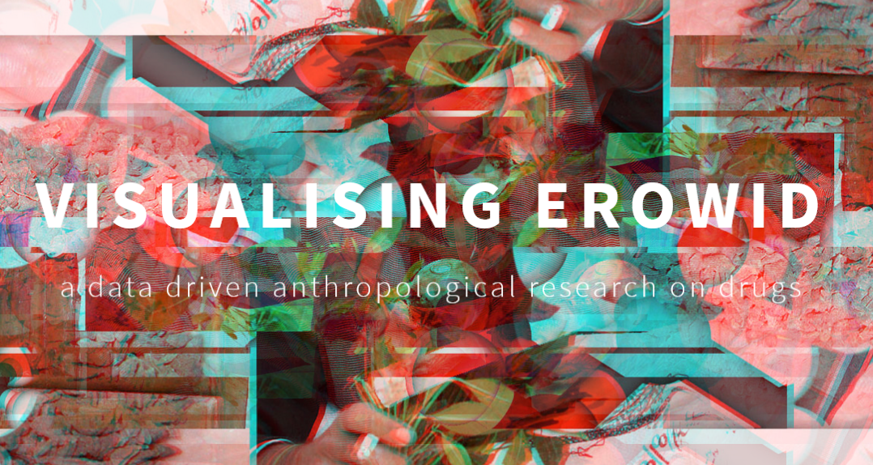
Methodology
Data acquisition
Pre-scraped data from GitHub
Supplemented by categories and substances scraped directly from the site
Data processing
Merging scraped data
Text processing with NLTK
Positive/Negative categorisation

Slide 9
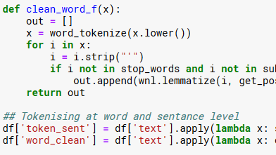
Methodology
Meta-data analysis
Positive/negative experiences by substance
Sentiment analysis
NLTK using VADER algorithm
Naïve Bayes Classifier
Data:
19,057 records after dropping poly-substance
568 “substances”

Slide 10
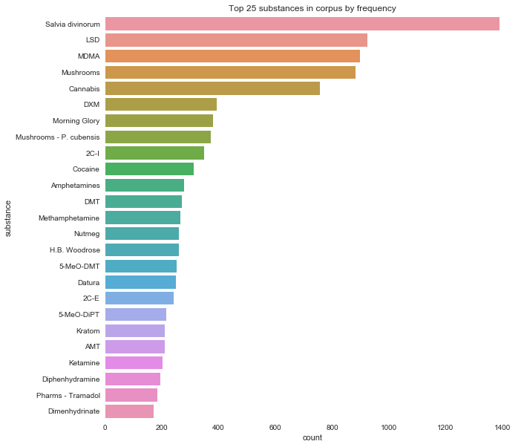
Meta-Data: Counts
Very diverse
No clear relationship with broader use patterns
Psychedelics and novel psychoactive substances feature highly

Slide 11
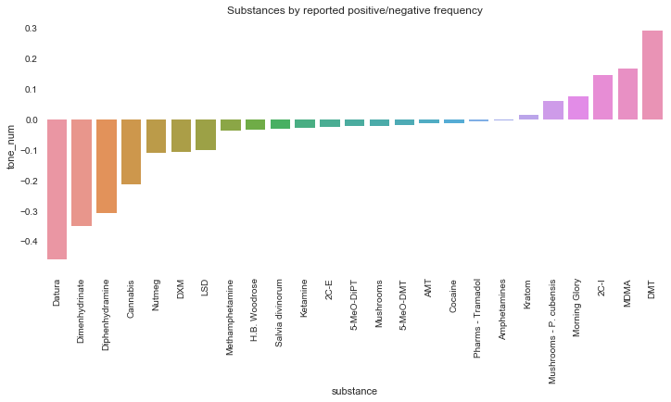
Meta Data: Positive and Negative Experiences
Interesting in itself
Top five negative (mostly) legal
Don’t take this as a recommendation!
This distribution is what we’ll seek to replicate with text analysis

Slide 12
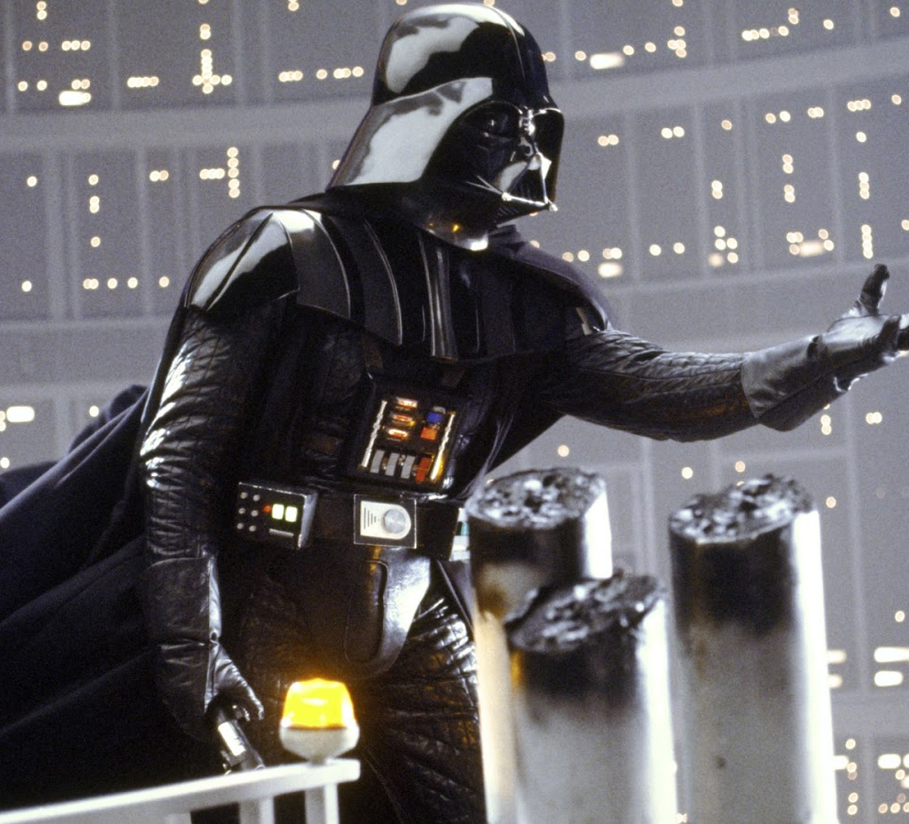
Sentiment Analysis: VADER
Rule-based sentiment analysis designed to analyse social media
Built in to the Python NLTK module
Returns four scores:
pos
Neg
Neu
compound
Hutto, C.J. & Gilbert, E.E. (2014). VADER: A Parsimonious Rule-based Model for Sentiment Analysis of Social Media Text. Eighth International Conference on Weblogs and Social Media (ICWSM-14). Ann Arbor, MI, June 2014.

Slide 13
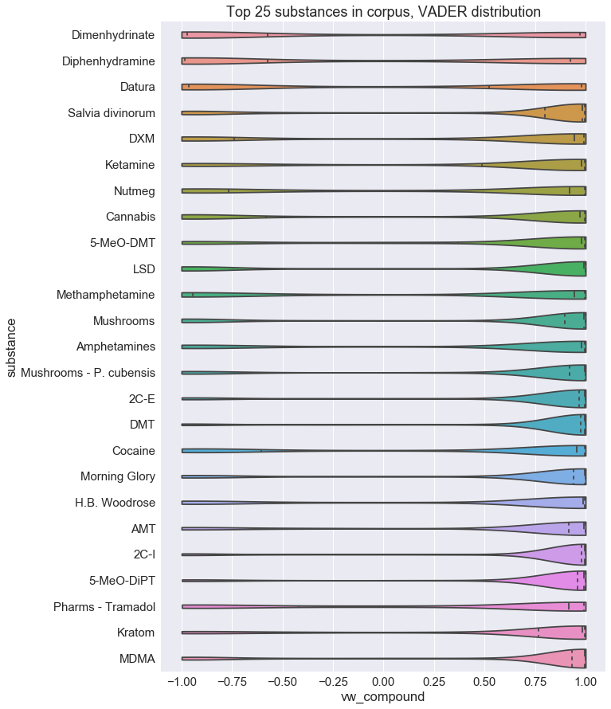
Vader: Results
Nice overview of distribution
Plot on left is ordered by median, reasonable replication of categories provided by users
Seems to be something of a positive bias

Slide 14
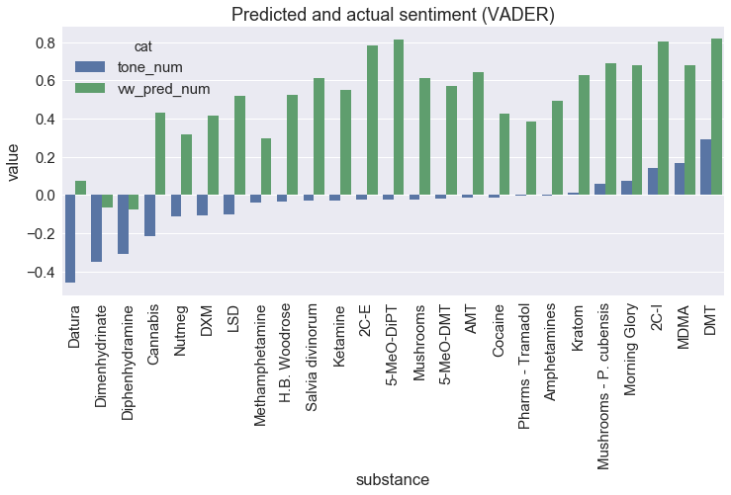
Vader Bias
I use VADER to classify as positive, negative or neutral based on compound score and plot against user reports
Performance is pretty poor, overwhelming positive bias
Although, note our “top 3”

Slide 15
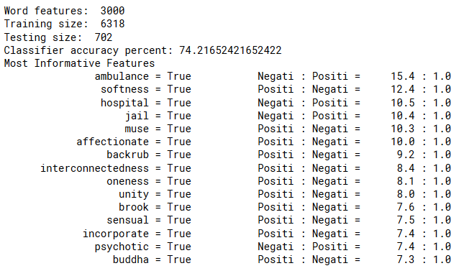
Naïve Bayes Classifier with NLTK
Trained against positive and negative user reports only
Great identifying features
Please don’t ask me to explain the math

Slide 16
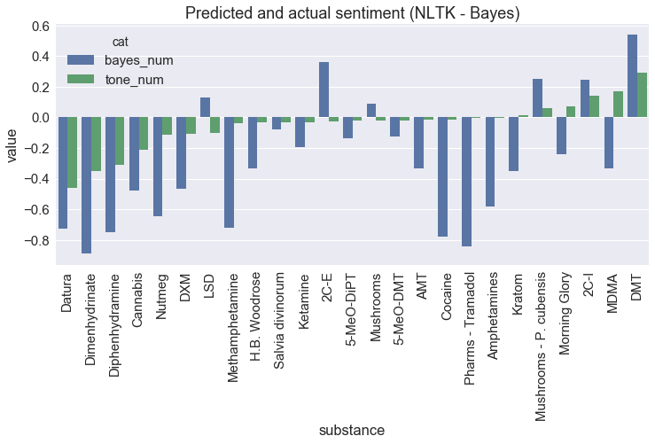
Bayes Bias
NB: I’m not graphing my training/testing data for the Bayes classifier, only “Neutral Reports”
Assumptions:
Characteristics of substances constant
Reports not categorized as positive/negative will contain indications either way
Still not great, more pessimistic this time.
Best performance again at extremes

Slide 17
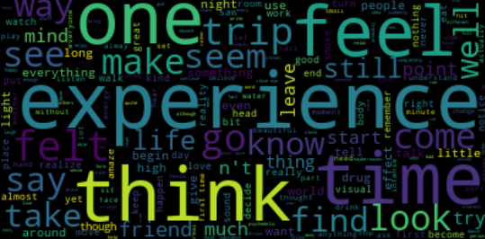
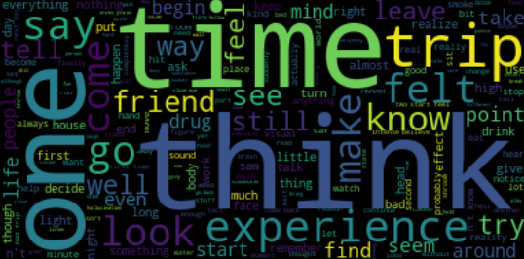
Word Influence (Frequency)
Positive
Negative

Slide 18
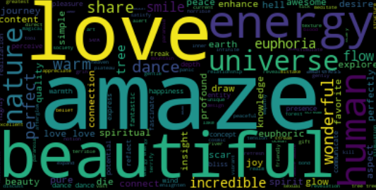
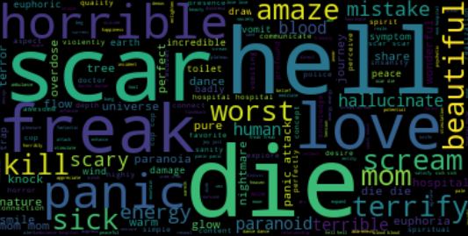
Word Influence (BAYES CLASSIFIER)
Positive
Negative

