Slide 1

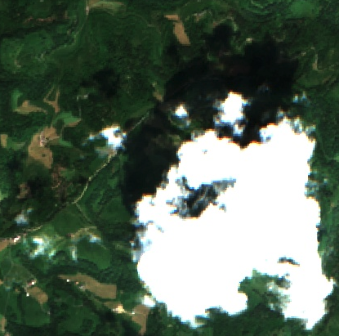
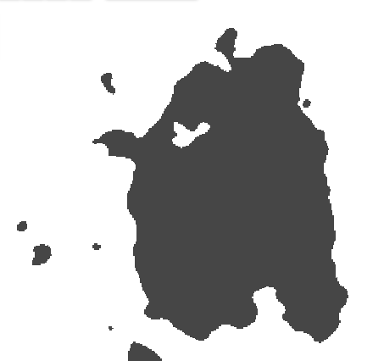

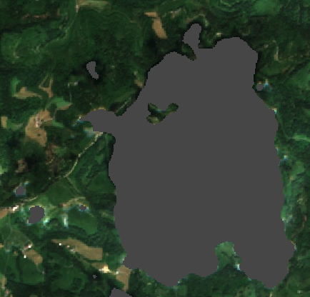
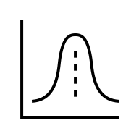

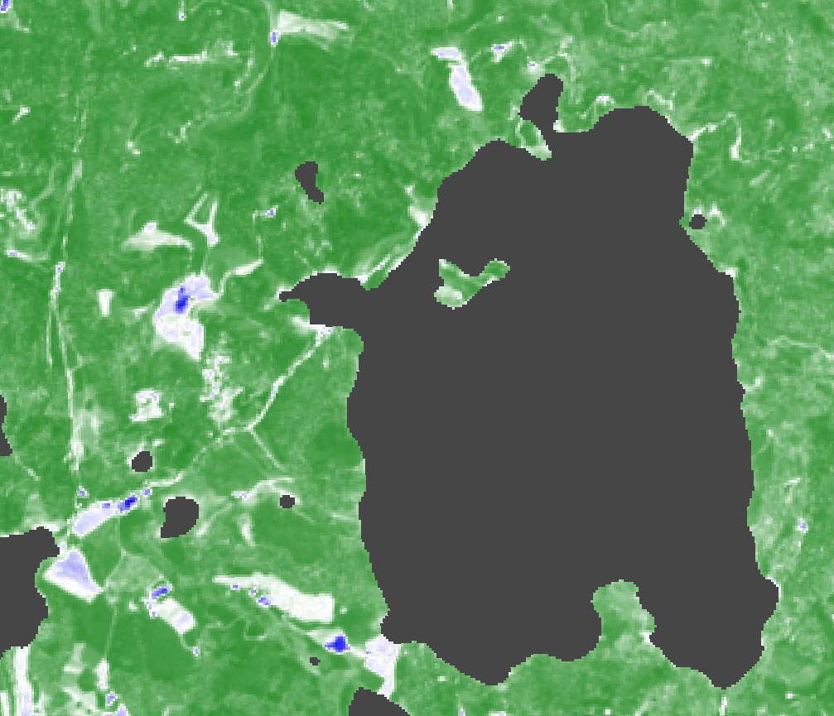
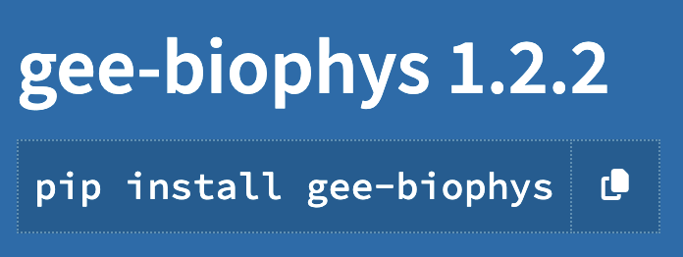
Figure 1: Overview of Model Training and Prediction Workflow
A The core of the model training workflow revolves around the iterative optimisation of the parameters involved in a PROSAIL RTM hybrid inversion procedure. First, we defined input trait ranges and distributions (A1) and then simulated reflectances using PROSAIL for each trait combination (A2). The simulated reflectances (A3) served as training training data for fitting (A4) a multi-layer perceptron regression model (A5). We evaluated the model fit using the calibration split of the in-situ data (A6) and repeated this procedure for 1000 iterations. We used the Optuna hyperparameter optimisation framework with the search space defined in Table 2.
B We obtained in-situ reference measurements from GBOV (B1) for LAI, FAPAR, and FCOVER and overlaid them with the closest available cloud-free Sentinel-2 reflectances (B2). For each biophysical property, we performed a 5-fold stratified CV split based on ecoregions, ensuring observations from the same ecoregion appeared only in either calibration or validation splits (B3). For each CV split, we repeated the optimisation of the PROSAIL RTM hybrid inversion procedure and stacked (A8) the best models into a model ensemble (A9). We evaluated the model performance on held-out ecoregions using the validation split (B4).
C For global predictions, we used the Sentinel-2 L2A data catalog (C1) and joined it with the precomputed CloudScore+ collection (C2) to mask clouds at the pixel level (C3). To represent the vegetative period throughout the year, we calculated mean scene-level NDVI and retained scenes that balanced lower cloud coverage and higher NDVI (C4). We randomly assigned each Sentinel-2 scene to a model ensemble member (A9), predicted the scene (C5) and aggregated the predictions to compute mean, standard deviation, and acquisition count at the pixel level (C6). The resulting global biophysical maps (C8) are available for LAI, FAPAR, and FCOVER at 1000m, 100m, and 20m resolutions from 2019 to 2024.
(A) Model Training
(B) Model Calibration / Validation
(C) Model Prediction
Version
One-Earth
Revision 1
A3 Simulated Training Data
A5 MLP-Regressor
B1 In-situ RMs
C1 Sentinel-2 L2A
C2 CloudScore+
A4 Model fitting
C3 Pixel-based cloud masking
Hybrid RTM retrieval
----------------
Bayesian hyperparameter
optimisation
A2 Simulate reflectance with PROSAIL RTM
B2 Space-time overlay
A6 Evaluate on
calibration split
B3 5-fold stratified CV
(by ecoregion)
A7 Repeat
for 8000 iterations
C4 NDVI-based image
selection
C8 Python package gee-biophys
-----
Export custom spatial extents and flexible temporal frequencies
(e.g. monthly)
A1 Define input ranges
A8 Combine best models
from CV splits
B4 Assess performance on validation split
C5 Model prediction
A9 Model ensemble
S2BIOPHYS
C6 Aggregate predictions
C7 Global maps LAIe, FAPAR, FCOVER
(mean, std, count)

