Slide 1
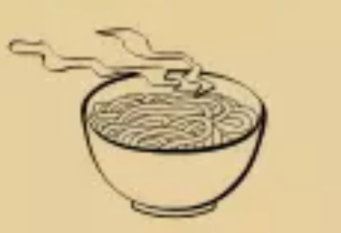



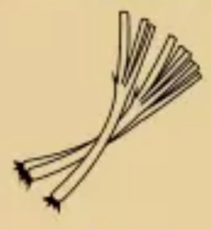


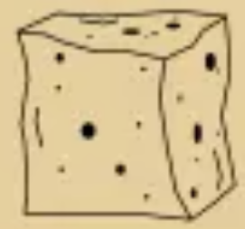

Noodle
Soy Sauce
Ginger
Mushrooms
Green Onion
1 Point
(Must have noodle to cook)
1 Points
2 pts if cooked w/ Gr. Onion
3pts if cooked w/ Ginger
2 Points
4 pts if cooked w/ Pork
2 Points
3 points if cooked w/ Chicken
3 Points
5 pts if cooked w/ Shrimp
Chicken
Pork
Shrimp
Tofu
3 Points
5 pts if cooked w/ Gr. Onion
7 pts if cooked w/ Gr. Onion & Ginger
May discard this to draw 2
5 Points
8 pts if cooked w/ Mushrooms
May discard this to draw 3
6 Points
9 pts if cooked w/ Ginger
11 pts if cooked w/ Soy Source & Ginger
May discard this to draw 4
7 Points
8 pts if cooked w/ Soy Source
10 pts if cooked w/ Ginger & Soy Source
May discard w/ vegetables as a pair
Lose 5 points if cooked w/ any protein
May discard this to draw 1

