Slide 1



TITLE
SUBTITLE
AUTHORS
DATE

Slide 2
Outline

Slide 3
Why another AOP language?
Several AOP languages
No reusability between AOP languages
Flexibility on the join point capture
Include the support of code transformations
Concerns related to code transformations and compiler optimizations:
Performance, Power, Energy
Parallelism, Concurrency
Monitoring, Test, Debug
Safety, Security
Targeting hardware accelerators, multicore and manycore architectures
Different tool flows
Fully explore compiler optimizations
Existence of many crosscutting concerns!
Notes:
Several AOP languages
No reusability between AOP languages
Important when dealing with different tool flows
Flexibility on the join point capture
Easily add/remove new join point types
Include the support of code transformations beside code instrumentation and introduction
type definitions
compiler optimizations

Slide 4
The LARA Language
aspectdef myAspect
end
Secondary concerns detached from application logic code
Not tied to a specific target language
Current languages: Java, C, C++ and MATLAB
Static weaving: changes in the code are resolved at weaving time
input
in0, in1=3;
end
output
out0, out1;
end
function h() { }
var z = 2;
select … end apply … end condition … end
J. M.P. Cardoso, T. Carvalho, J. G. de F. Coutinho, W. Luk, R. Nobre, P. C. Diniz, Z. Petrov, “LARA: An Aspect-Oriented Programming Language for Embedded Systems,” in Int’l Conf. on Aspect-Oriented Software Development (AOSD’12), Potsdam, Germany, March 25-30, 2012.
Notes:
Weaving engine responsible to target a specific language

Slide 5
Main LARA Features
Declarative select-apply clauses
Select points of interest in the code
Apply code transformations over them
Modularity and reuse based on calling aspects and using parameters
Composition of strategies based on other strategies
select method end
apply
…
end
apply
call LoopTiling(64);
call Timer("ns");
end

Slide 6
LARA Select
Access join points on the source code
Uses an hierarchical join point chain
Defined in the language specification
Join points not present in the chain are inferred
Filtering based on attributes
select file.class.method.body.call end
select method.call end
select method{name=="draw"}.call end
Notes:
Can combine different selects into a single chain
Similar to an SQL “natural join”
Useful when multiple join points are necessary to process during a join point iteration

Slide 7
LARA Apply
Iterates over the selected join points (prefixed with $)
Any join point in the select statement can be accessed
Can access join point attributes
Can change the application
select method{name=="draw"}.call end
apply
$call.insert before 'code to inject';
insert before 'more code';
end
$loop.exec Unroll();
$var.def type='float';
insert before|after|replace
For injecting code in input application source code
exec
For executing a compiler action
def
For defining the value of an attribute

Slide 8
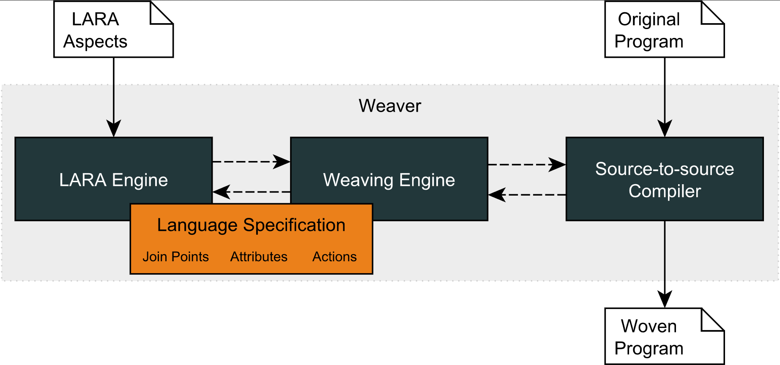
LARA Compilation Flow
WeaverGenerator
Notes:
8

Slide 9
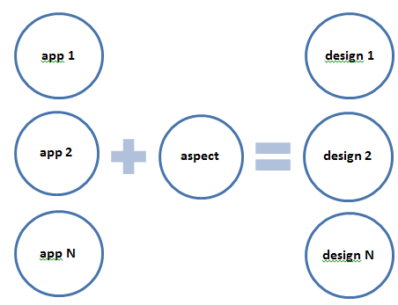
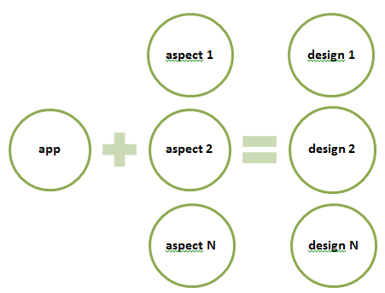
LARA Reusability and Targetability
Design benefits that are similar to AspectJ
Reusable Strategies
Custom Targetability

Slide 10
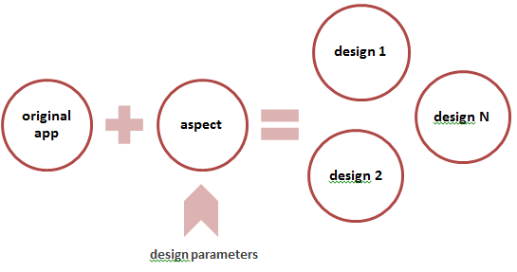
LARA Reusability and DSE
More design benefits
Reusable Between Different Languages
Java
Java
Design Exploration
C
C
MATLAB
MATLAB

Slide 11
Examples
Download Clava and examples:
LINK

Slide 12
Call Graph
Build a static call graph from the application source
“Supergraph” of the dynamic call graph
Edges indicate how many times a call appears in the code
Strategy
Select all methods (caller) and the calls inside (callee)
Make <caller, callee> tuples
Generate a graph with the tuples in dot format
Notes:
TODO: add dot image

Slide 13
Static Report
Generate a report about the application
Number of files, functions and calls
Number and types of loops
Call information
Strategy
Select files, functions and calls to count
Select loops and query their type
Get <caller, callee> tuples
Print reports
Notes:
NOTE: printing the report uses JS, mention how JS can help in aspects
NOTE: explain how this could be extended with other points and attributes and segue into the specs docs

Slide 14
Logging with Insertions
Log certain execution events, e.g.:
Start of loops
Entering functions
Strategy
Select loops and their parent file
Insert logging code before loop
Add header include at the start of the file
Do the same for functions but log at the start of the body
Notes:
NOTE: present the first use of actions, insert and addInclude
NOTE: present and explain codedef and it’s advantages: robustness, reuse, efficiency

Slide 15
Code Insertion with LARA
insert injects literal code into the application
Upsides:
extremely versatile, can insert any code you want
Downsides:
cumbersome (\n), error prone (code might have errors)
Mitigating the downsides:
codedef
Clava option to verify syntax
Notes:
NOTE: segue into APIs at the end

Slide 16
Logging with APIs
Log certain execution events (a more complex example)
Make use of Clava APIs
Strategy
Same as before for functions
Look for writes to variables inside a specific function
Filter variables based on type
Log when the writing happens using the Logger API
Notes:
NOTE: explain that the first part of the example is the same
NOTE: explain imports (user and Clava)
NOTE: introduce Clava APIs (explain the idea is to declare your intentions, not to specify how to do them: multi-lang and multi-implementation)
NOTE: introduce and show Clava Docs

Slide 17
Measurements
Collect metrics on certain events or around pieces of code
Measure execution time and energy consumption
Strategy
Capture loops inside a specific function
Call APIs to measure around the selected loops
Notes:
NOTE: API allows us to abstract from target language, show C and C++ generated code
NOTE: show that rapl header was included automatically and explain the API that performs this
NOTE: mention the extreme multi-lang case where this exact aspect can be used in Java (got to Kadabra)

Slide 18
AutoPar
Improve execution performance with OpenMP
Free the user from analysis
Strategy
Select target loop based on pragma
Call AutoPar API to parallelize the target loop
Notes:
NOTE: stress that analysis is performed automatically and the library decides what and how to parallelize

Slide 19
Conclusions
LARA is a source-to-source AOP language
Aspect reusability between programs and languages
Fine-grained, structural/syntactic join points with semantic information
Code injection, elements introduction and code transformations
Kadabra weaver includes runtime adaptation mechanisms such as Autotuning

Slide 20


Thank you! Questions?

Slide 21
Backup Slides

Slide 22
The LARA Language
Attribute Model
Join Point Model
attributes
|\_var
| |\_name
| |\_type
| |\_is_array
| |\_is_pointer
| |\_is_write
| |\_is_read
| |\_is_in
| \_is_out
|\_function
| |\_name
| |\_num_lines
| \_return_type
|\_call
| |\_name
| |\_return_type
| |\_num_argin
| \_num_argout
\_loop
|\_type
|\_is_innermost
|\_num_iterations
|\_increment_value
|\_rank
\_nested_level
file
|\_var
|\_declaration
\_function
|\_prototype
\_body
|\_first
|\_last
|\_var
|\_call
|\_if
| |\_condition
| |\_then
| \_else
\_loop
|\_init
|\_condition
|\_counter
|\_body
\_control
Join Point Model
Allows the front-end to adapt to other target programming languages
Attribute Model
Allows LARA to access join point values and to associate values to join points
Action Model
Allows LARA to express actions

Slide 23
Instrumentation Example: Static Call Graph
Select all pairs of <caller, callee> function tuples
Increments a counter every time the same tuple is observed
Uses this counter to print the static call graph in dot format
Useful to check the structure of the code
Takes into account all possible function calls
aspectdef StaticCallGraph
var cg = new LaraObject();
select function.call end
apply
cg.increment($function.name, $call.name);
end
println('digraph static_cg {\n');
for (f in cg) {
for (c in cg[f]) {
print(f + '->' + c);
println(' [label="' + cg[f][c] + '"];');
}
}
println('}');
end

