Slide 1




LARA Tutorial
Introduction to the LARA AOP Language
Tiago Carvalho, Pedro Pinto, João Bispo and João M.P. Cardoso
University of Porto, FEUP, Porto, Portugal
May 16th, 2018

Slide 2
Outline
Motivation
The LARA Approach
Examples
Static Profiling
Non-functional Requirements
Functional Requirements
Code Optimization
Conclusions

Slide 3
Why another AOP language?
Several AOP languages
No reusability between AOP languages
Flexibility on the join point capture
Include the support of code transformations
Concerns related to code transformations and compiler optimizations:
Performance, Power, Energy
Parallelism, Concurrency
Monitoring, Test, Debug
Safety, Security
Targeting hardware accelerators, multicore and manycore architectures
Different tool flows
Fully explore compiler optimizations
Existence of many crosscutting concerns!
Notes:
Several AOP languages
No reusability between AOP languages
Important when dealing with different tool flows
Flexibility on the join point capture
Easily add/remove new join point types
Include the support of code transformations beside code instrumentation and introduction
type definitions
compiler optimizations

Slide 4
The LARA Language
aspectdef myAspect
end
Secondary concerns detached from application logic code
Not tied to a specific target language
Current languages: Java, C, C++ and MATLAB
Static weaving: changes in the code are resolved at weaving time
input
in0, in1=3;
end
output
out0, out1;
end
function h() { }
var z = 2;
select … end apply … end condition … end
J. M.P. Cardoso, T. Carvalho, J. G. de F. Coutinho, W. Luk, R. Nobre, P. C. Diniz, Z. Petrov, “LARA: An Aspect-Oriented Programming Language for Embedded Systems,” in Int’l Conf. on Aspect-Oriented Software Development (AOSD’12), Potsdam, Germany, March 25-30, 2012.
Notes:
Weaving engine responsible to target a specific language

Slide 5
Main LARA Features
Declarative select-apply clauses
Select points of interest in the code
Apply code transformations over them
Modularity and reuse based on calling aspects and using parameters
Composition of strategies based on other strategies
select method end
apply
…
end
apply
call LoopTiling(64);
call Timer("ns");
end

Slide 6
LARA Select
Access join points on the source code
Uses an hierarchical join point chain
Defined in the language specification
Join points not present in the chain are inferred
Filtering based on attributes
select file.class.method.body.call end
select method.call end
select method{name=="draw"}.call end
Notes:
Can combine different selects into a single chain
Similar to an SQL “natural join”
Useful when multiple join points are necessary to process during a join point iteration

Slide 7
LARA Apply
Iterates over the selected join points (prefixed with $)
Any join point in the select statement can be accessed
Can access join point attributes
Can change the application
select method{name=="draw"}.call end
apply
$call.insert before 'code to inject';
insert before 'more code';
end
$loop.exec Unroll();
$var.def type='float';
insert before|after|replace
For injecting code in input application source code
exec
For executing a compiler action
def
For defining the value of an attribute

Slide 8
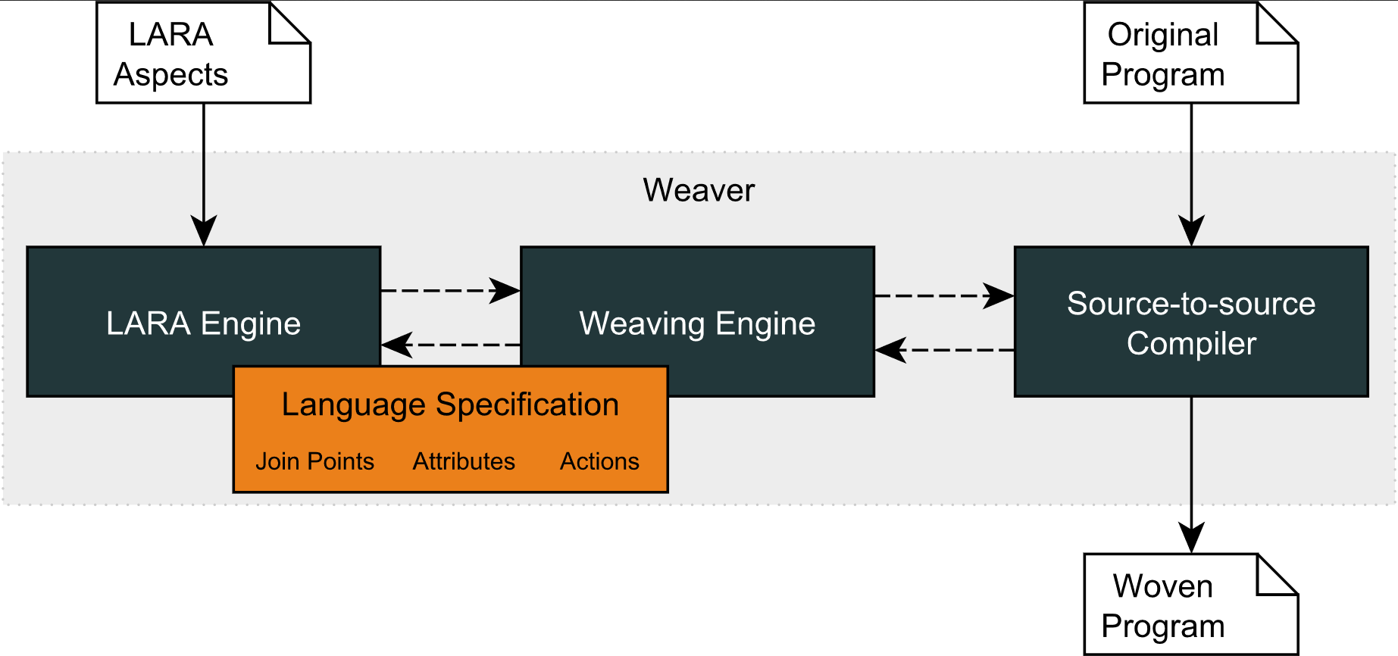
LARA Compilation Flow
WeaverGenerator
Notes:
8

Slide 9
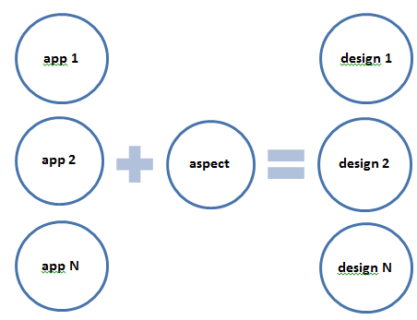
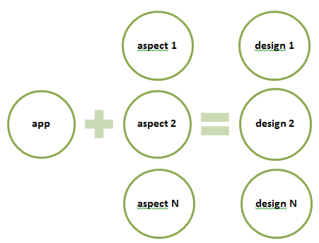
LARA Reusability and Targetability
Design benefits that are similar to AspectJ
Reusable Strategies
Custom Targetability

Slide 10
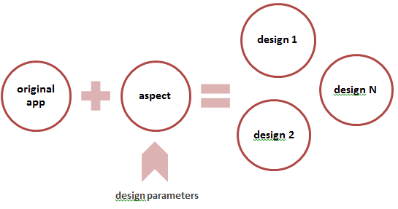
LARA Reusability and DSE
More design benefits
Reusable Between Different Languages
Java
Java
Design Exploration
C
C
MATLAB
MATLAB

Slide 11
Examples
Static Profiling
Caller and Callee
Call Graph
Static Profiling
Non-functional Requirements
Logging
Measurements
Functional Requirements
Permissions
Observer Pattern
Code Optimization
Loop Interchange
Autotuning
Download Kadabra (Java-to-Java Weaver) and Examples:
specs.fe.up.pt/tutorials/2018maylara/laratutorial.zip

Slide 12
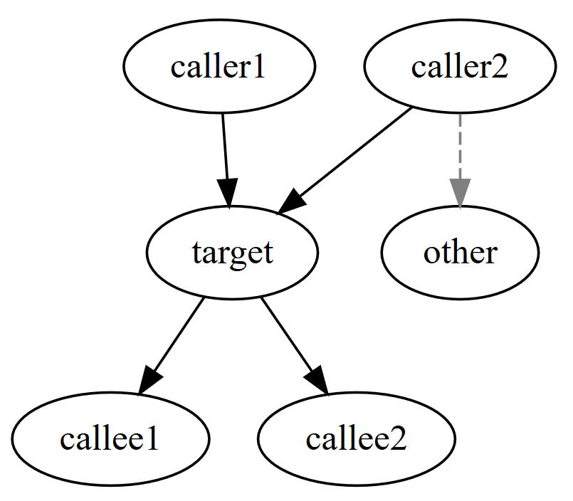
Caller And Callee
>lara CallerAndCallee.lara –p QuicksortApp
Functions that call quicksort
quicksort
quicksort
sort
Functions that are called by quicksort
exchange
quicksort
quicksort
Statically verify
Which methods (caller) call a target method
Which methods are called by that target method (callee)
Strategy
Select all methods that contain function calls
Filter by the name of the method called
Print the name of the caller
Select the calls inside the target method
Print the name of the called methods

Slide 13
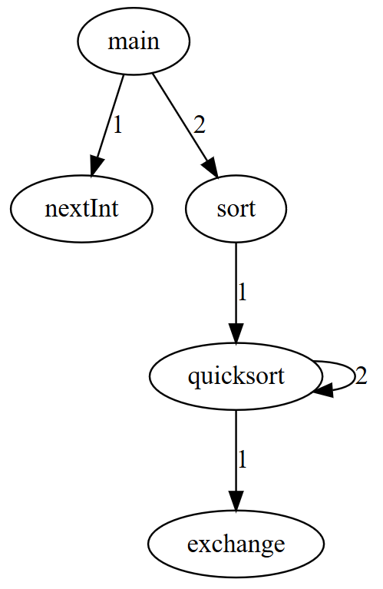
Call Graph
Develop a diagram of the method calls that shows the methods relationship
Strategy
Select all methods (caller) and the calls (callee) inside
Create caller->callee tuples
Create a graph, in dot format, with the tuples

Slide 14
Static Profiling
LARA
source-to-source approach
structural/syntactic join points
“behavioral” join points can be emulated
semantic information
fine-grained join point selection (e.g. loops, variables and operations)
AspectJ can
select structural and behavioral join points
access both compile- and runtime information
limited join point selection (usually limited to assignments and method calls)
-== [ General Information ] ==-
No. of Files: 2
No. of Classes: 2
No. of Methods: 4
No. of Calls: 7
-== [ Loop Information ] ==-
==============================
Type Total Innermost
------------------------------
For 1 1
While 3 2
Do-While 0 0
Foreach 0 0
------------------------------
Total 4 3
==============================
Create a report about the application
Number of files, classes, methods and calls
Caller->callee information
Type of loops
Strategy
Select files, classes,…, to count
Get caller->callee tuples
Select loops and verify their type
Print report

Slide 15
Logging
LARA
Static weaving
Apply is executed at weaving time
Inject code “around” the join point
AspectJ
Static, Load-time and runtime weaving
Advice code will be executed when pointcut is reached
Log access to setters of objects of type “Shape”
Strategy
Select calls to methods starting with "set"
Filter selection by classes that are subtype of "Shape"
Insert code after that prints the access to that method
| I | 2017/10/19 19:17:23 | Update: Rectangle(20.0, 10.0, 20.0, 20.0) |
| I | 2017/10/19 19:17:23 | Update: Circle(15.0, 15.0, 20.0) |

Slide 16
Measurements
Both AspectJ and LARA can introduce:
New classes
New elements inside a class
New methods
Measure execution time of calls to method “sort”
Count the exchanges in Quicksort method
Strategy
Add fields to measure the time and the exchanges
Increment exchanges when “exchange” method is called
Start timer before calls to sort method
Stop timer after the calls and print the time and exchanges

Slide 17
Permissions
Add access permissions to setter methods only to people that are admins
Strategy
Extend class Person with username, password and admin status
Add Auth class to control the list of persons, the login method, and the current user
Add code to verify user permissions before calls to setters

Slide 18
Observer Pattern
Although functional requirements can be specified in LARA, they are not regular cases of LARA usage
Observe setter invocations over Shape instances to redraw the shape in the Screen
Strategy
Add Subject and Observer interfaces
Extend target classes with these interfaces and methods implementations
Add code to notify observers when shape changes
Notes:
importing other lara files allows the

Slide 19
Loop Interchange
Nested loops of matrix multiplication: which is the best performing loop order?
First Strategy
Select nested loops to interchange
Apply “interchange” code transformation
Add execution time monitor
Execute application and verify execution time

Slide 20
Loop Interchange
LARA
Code transformations
Loop tiling, interchange, unroll,...
Different weaving tools may have different code transformations
Capability of defining and using aspects and JavaScript APIs
AspectJ
Limited to code injection and new members introduction
Nested loops of matrix multiplication: which is the best performing loop order?
Second Strategy
Generate clone for each possible loop permutation
Apply a different loop “interchange” in each clone
Add execution of these clones after the original method
Add execution time monitors for all invocations
Execute application and verify execution time

Slide 21


Autotuning
A way of exploring and managing:
Different algorithms with the same goal
Parameter configurations
Provides new versions to the application
Application feedbacks measurements
Configured with:
Signature of the algorithms
List of candidate algorithms
Type of monitor to use
Exploration key – adaptation for different inputs
Alg. 1
Alg. 2
Alg. 3
…
Alg. N
Which one?
Notes:
Our approach also features an autotuning mechanism that uses all the techniques I have specified.
The autotuner allows the management of a list of candidate algorithms/versions that we specify. And the autotuner will provide, at runtime, new versions to the application to execute while the application will feedback measurements. We also have to specify the type of monitor to use and the locations where adaptation, measurement and update should occur.
Here we can use selection of algorithms, mixed with algorithms that require knob configurations and generative algorithms.
The application requests a version from the Autotuner via the update method (1).
The Version Manager keeps a channel with the generated versions and the best performing algorithm, and is responsible to update the adaptation point based on the mode in which is executing (2).
The application feedbacks measurements to the Autotuner via its measurements channel (3).
The measurements are analyzed (4) to decide if the explored version is better than the current best version (5).
Finally, the Autotuner requests the Configurer for new versions (6), which are dispatched to the versions channel (7).
Modes
Exploration: provides new versions to explore while waiting for new measurements for those versions
Best: selects the best performing version based on the measurements.
manage multiple explorations

Slide 22
Sort Autotuning
Which sorting algorithm is the best according to the number of elements to sort?
BubbleSort, CountingSort, InsertionSort, MergerSort, Quicksort and SortingNetwork
Strategy
Extract call to sort of Quicksort into a field
Generate an autotuner based on:
Signature of sort method
List of sort algorithms available
Average execution time as measurer
Number of elements to sort as exploration key
Inject code to update the new field and measure the sort execution
Notes:
Our approach also features an autotuning mechanism that uses all the techniques I have specified.
The autotuner allows the management of a list of candidate algorithms/versions that we specify. And the autotuner will provide, at runtime, new versions to the application to execute while the application will feedback measurements. We also have to specify the type of monitor to use and the locations where adaptation, measurement and update should occur.
Here we can use selection of algorithms, mixed with algorithms that require knob configurations and generative algorithms.
The application requests a version from the Autotuner via the update method (1).
The Version Manager keeps a channel with the generated versions and the best performing algorithm, and is responsible to update the adaptation point based on the mode in which is executing (2).
The application feedbacks measurements to the Autotuner via its measurements channel (3).
The measurements are analyzed (4) to decide if the explored version is better than the current best version (5).
Finally, the Autotuner requests the Configurer for new versions (6), which are dispatched to the versions channel (7).
Modes
Exploration: provides new versions to explore while waiting for new measurements for those versions
Best: selects the best performing version based on the measurements.

Slide 23
Autotuning Report
Exploration key: array size
After exploring all available algorithms it will always execute the most fitting algorithm
-= SORT EXPLORATION REPORT =-
...
100={
BEST: Quicksort @ 9043ns(w: 5, t:120)
Explored(Top 5): [Quicksort @ 9043ns (w: 5, t:120) | CountingSort @ 16915ns (w: 5, t:10) |...]
}
200={
BEST: InsertionSort @ 12727ns (w: 5, t:120)
Explored(Top 5): [InsertionSort @ 12727ns (w: 5, t:120) | Quicksort @ 17180ns (w: 5, t:10) |...]
}
500={
BEST: CountingSort @ 17784ns (w: 5, t:120)
Explored(Top 5): [CountingSort @ 17784ns (w: 5, t:120) | Quicksort @ 53578ns (w: 5, t:10) |...]
}

Slide 24
Conclusions
LARA is a source-to-source AOP language
Aspect reusability between programs and languages
Fine-grained, structural/syntactic join points with semantic information
Code injection, elements introduction and code transformations
Kadabra weaver includes runtime adaptation mechanisms such as Autotuning

Slide 25


Thank you! Questions?

Slide 26
Backup Slides

Slide 27
The LARA Language
Attribute Model
Join Point Model
attributes
|\_var
| |\_name
| |\_type
| |\_is_array
| |\_is_pointer
| |\_is_write
| |\_is_read
| |\_is_in
| \_is_out
|\_function
| |\_name
| |\_num_lines
| \_return_type
|\_call
| |\_name
| |\_return_type
| |\_num_argin
| \_num_argout
\_loop
|\_type
|\_is_innermost
|\_num_iterations
|\_increment_value
|\_rank
\_nested_level
file
|\_var
|\_declaration
\_function
|\_prototype
\_body
|\_first
|\_last
|\_var
|\_call
|\_if
| |\_condition
| |\_then
| \_else
\_loop
|\_init
|\_condition
|\_counter
|\_body
\_control
Join Point Model
Allows the front-end to adapt to other target programming languages
Attribute Model
Allows LARA to access join point values and to associate values to join points
Action Model
Allows LARA to express actions

Slide 28
Instrumentation Example: Static Call Graph
Select all pairs of <caller, callee> function tuples
Increments a counter every time the same tuple is observed
Uses this counter to print the static call graph in dot format
Useful to check the structure of the code
Takes into account all possible function calls
aspectdef StaticCallGraph
var cg = new LaraObject();
select function.call end
apply
cg.increment($function.name, $call.name);
end
println('digraph static_cg {\n');
for (f in cg) {
for (c in cg[f]) {
print(f + '->' + c);
println(' [label="' + cg[f][c] + '"];');
}
}
println('}');
end

