Slide 1


DSL and Source to Source Compilation
Hands-on-approach and the Clava+LARA approach
João Bispo, Pedro Pinto, João Cardoso
2018-10-23 – PRACE School 2018

Slide 2
Outline
Overview
Clava
LARA
Hands-on approach
First LARA Strategy (Call Graph)
Code Instrumentation (Logging)
Clava APIs (Time and Energy Measurement)
CMake Plugin (Auto-Parallelization)
Third-party Libraries (DSE)

Slide 3
Clava Installation
All platforms: download JAR
http://specs.fe.up.pt/tools/clava.jar
Linux: script clava-update
http://specs.fe.up.pt/tools/clava/clava-update
CMake Plugin:
https://github.com/specs-feup/clava/tree/master/CMake

Slide 4


Clava
Source-to-source C/C++ compiler (weaver)
User-defined strategies written in LARA
Several kinds of strategies possible
Analysis, Generation, Insertion, Modification
Open-source
github.com/specs-feup/clava
Notes:
- Developed during the H2020 project ANTAREX
- During this tutorial we will show how to write several kinds of strategies

Slide 5
Clava - Toolflow
LARAI
C/C++ Weaver
Client
CLAVA
(C/C++ AST)
ClangDump Parser
JAVA
Clang-based parser
Custom Clava AST
AST-based transformations
LARA framework
C++
ClangDump.exe
Notes:
Clang supports text-based transformations.
Changing the AST does not reflect on the output code (does not support generating code from the AST)
Generic LARA interpreter, used as library
LARAI executes LARA code, Weaver Client answer requests from interpreter
Maps code points specified in LARA (e.g., function, loop) to the corresponding nodes in the AST
When running a LARA strategy, we provide input source code, that will be parsed to an AST
This AST is implicit during the execution of the strategy

Slide 6
The LARA Language
aspectdef myAspect
end
JavaScript-based language
Strategies written separately from application logic code
Not tied to a specific target language
Weavers binds LARA code to a target language
Current languages: Java, C, C++ and MATLAB
input
in0, in1=3;
end
output
out0, out1;
end
function h() { }
var z = 2;
select … end apply … end condition … end
J. M.P. Cardoso, T. Carvalho, J. G. de F. Coutinho, W. Luk, R. Nobre, P. C. Diniz, Z. Petrov, “LARA: An Aspect-Oriented Programming Language for Embedded Systems,” in Int’l Conf. on Aspect-Oriented Software Development (AOSD’12), Potsdam, Germany, March 25-30, 2012.
Notes:
- Weaving engine responsible to target a specific language

Slide 7
Main LARA Features
Declarative select-apply clauses
Select points of interest in the code
Apply code transformations over them
Modularity and reuse based on calling aspects and using parameters
Composition of strategies based on other strategies
select method end
apply
…
end
apply
call LoopTiling(64);
call Timer("ns");
end

Slide 8
LARA Select
Access points on the source code
Uses an hierarchical point chain
Defined in the language specification
Points not present in the chain are inferred
Filtering based on attributes
select file.function.body.call end
select function.call end
select function{name==="draw"}.call end
Notes:
Can combine different selects into a single chain
Similar to an SQL “natural join”
Useful when multiple join points are necessary to process during a join point iteration

Slide 9
LARA Apply
Iterates over the selected points (prefixed with $)
Any point in the select statement can be accessed
Can access point attributes
Can change the application
select function{name=="draw"}.call end
apply
$call.insert before 'code to inject';
insert before 'more code';
end
$loop.exec interchange($innerLoop);
$var.def type='float';
insert before|after|replace
For injecting code in input application source code
exec
For executing a compiler action
def
For defining the value of an attribute
Notes:
- Apply can be seen as a for loop, that will iterate over the points obtained with the select

Slide 10
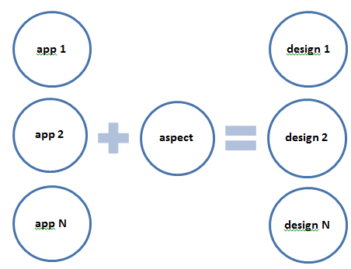
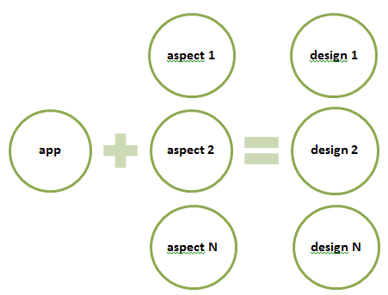
LARA Reusability and Targetability
Reusable Strategies
Custom Targetability

Slide 11
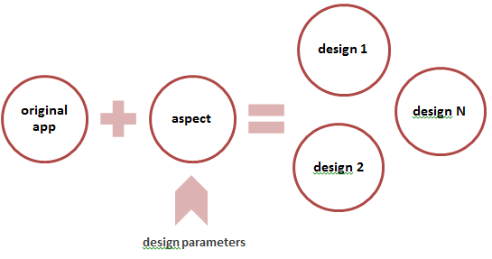
LARA Reusability and DSE
Reusable Between Different Languages
Java
Java
Design Exploration
C
C
MATLAB
MATLAB

Slide 12
Hands-on
Getting Started
Objectives
Open the Virtual Machine
Find the tutorial folder
Run Clava GUI
Tutorial can be downloaded from:
http://specs.fe.up.pt/tutorials/PRACE2018.zip

Slide 13
Hands-on
1. CallGraph
Objectives
Read some LARA code
Load and run a LARA strategy

Slide 14
Hands-on
2. Logging
Objectives
Write some LARA code (exercise)
Introduction to LARA APIs

Slide 15
Hands-on
3. Measurements
Objectives
Use LARA APIs (exercise)
Introduction to Clava documentation

Slide 16
Hands-on
4. AutoPar
Objectives
Auto-parallelize code
Introduction to CMake plugin

Slide 17
Hands-on
5. Exploration
Objectives
Use the CMake plugin
Perform Design-Space Exploration

Slide 18
Backup Slides

Slide 19
The LARA Language
Attribute Model
Join Point Model
attributes
|\_var
| |\_name
| |\_type
| |\_is_array
| |\_is_pointer
| |\_is_write
| |\_is_read
| |\_is_in
| \_is_out
|\_function
| |\_name
| |\_num_lines
| \_return_type
|\_call
| |\_name
| |\_return_type
| |\_num_argin
| \_num_argout
\_loop
|\_type
|\_is_innermost
|\_num_iterations
|\_increment_value
|\_rank
\_nested_level
file
|\_var
|\_declaration
\_function
|\_prototype
\_body
|\_first
|\_last
|\_var
|\_call
|\_if
| |\_condition
| |\_then
| \_else
\_loop
|\_init
|\_condition
|\_counter
|\_body
\_control
Join Point Model
Allows the front-end to adapt to other target programming languages
Attribute Model
Allows LARA to access join point values and to associate values to join points
Action Model
Allows LARA to express actions

Slide 20
AOP Approach
Several AOP languages
No reusability between AOP languages
Flexibility on the join point capture
Include the support of code transformations
Concerns related to code transformations and compiler optimizations:
Performance, Power, Energy
Parallelism, Concurrency
Monitoring, Test, Debug
Safety, Security
Targeting hardware accelerators, multicore and manycore architectures
Different tool flows
Fully explore compiler optimizations
Existence of many crosscutting concerns!
Notes:
Several AOP languages
No reusability between AOP languages
Important when dealing with different tool flows
Flexibility on the join point capture
Easily add/remove new join point types
Include the support of code transformations beside code instrumentation and introduction
type definitions
compiler optimizations

Slide 21
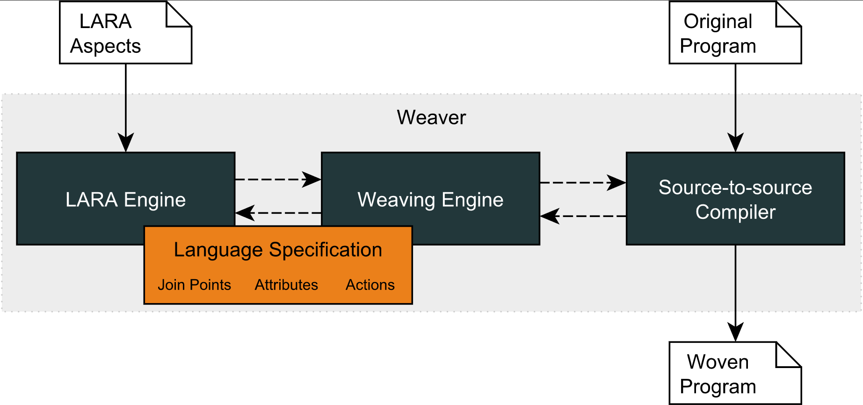
LARA Compilation Flow
WeaverGenerator
Notes:
21

