Slide 1




Source-to-source Compilation for Instrumentation and Code Transformations
João Bispo, Pedro Pinto
2019-05-08 – 3rd Workshop of the Green Software Lab 2019

Slide 2
Outline
DSL-based Source-to-Source
Motivation
Use Cases
LARA
Framework
Language
Compilers
Clava
Tool-flow
Example

Slide 3
Motivation
Source-to-source compilation
Output code in the same language as input code (e.g., C-to-C)
Useful for code analysis, generation and transformation
Not tied to a particular compiler toolchain
DSL-based
Domain-specific constructs
Encode strategies separately from the application
Enables features not present in target language, and multi-language support

Slide 4
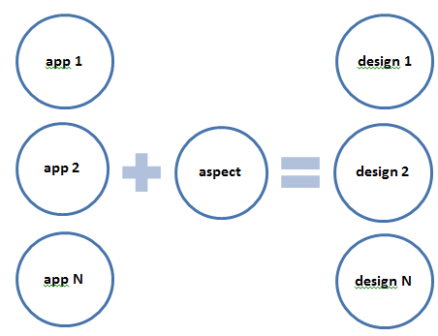
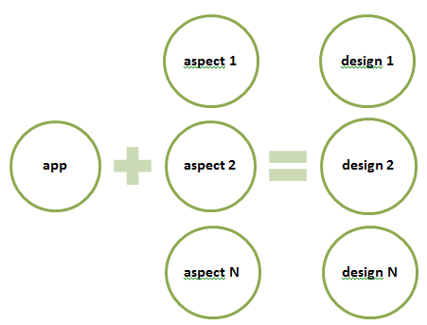
Use Cases
Reusable Strategies
Custom Targetability
Notes:
- Encode common patterns in a an aspect/strategy

Slide 5
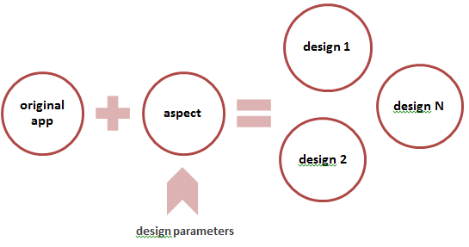
Use Cases
Reusable Between Different Languages
Java
Java
Design Exploration
C
C
MATLAB
MATLAB

Slide 6
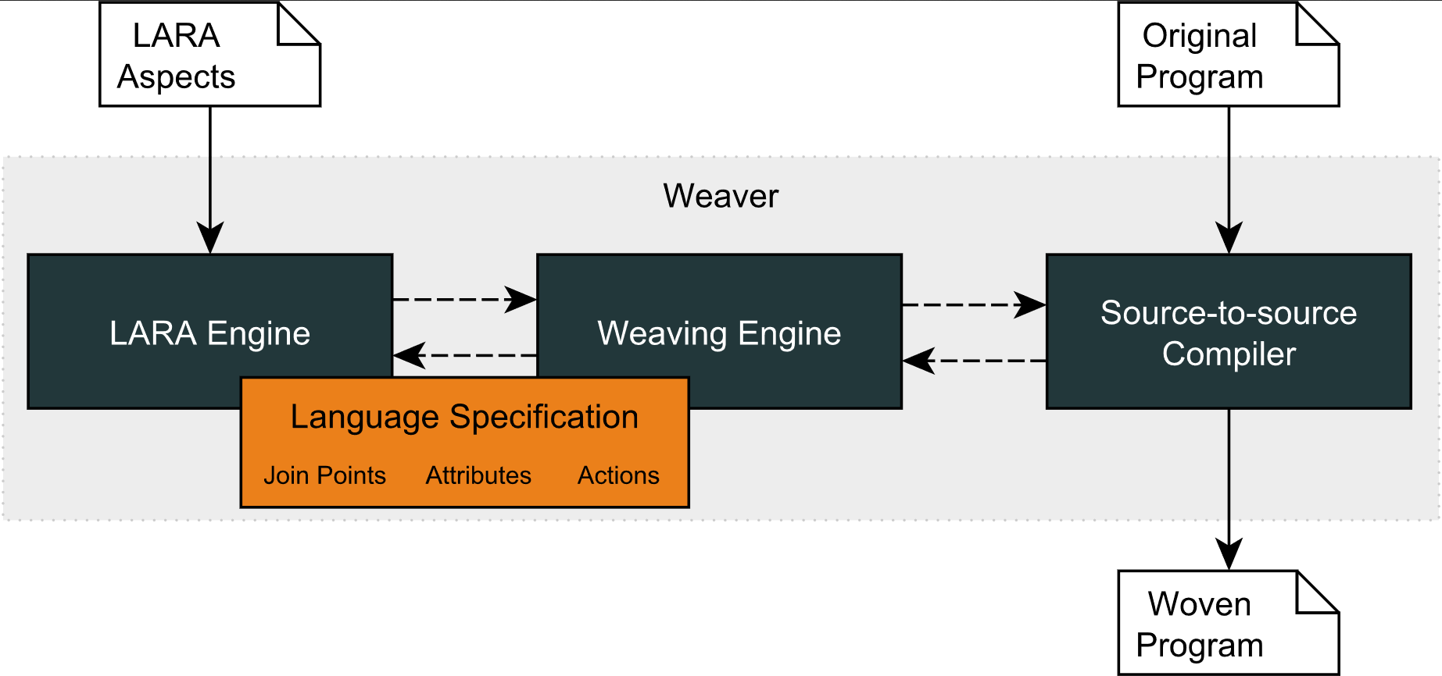
LARA Framework
WeaverGenerator
Notes:
6

Slide 7
The LARA Language
aspectdef myAspect
end
JavaScript-based language
Strategies written separately from application logic code
Not tied to a specific target language
Weavers binds LARA code to a target language
Current languages: Java, C, C++ and MATLAB
input
in0, in1=3;
end
output
out0, out1;
end
function h() { }
var z = 2;
select … end apply … end condition … end
J. M.P. Cardoso, T. Carvalho, J. G. de F. Coutinho, W. Luk, R. Nobre, P. C. Diniz, Z. Petrov, “LARA: An Aspect-Oriented Programming Language for Embedded Systems,” in Int’l Conf. on Aspect-Oriented Software Development (AOSD’12), Potsdam, Germany, March 25-30, 2012.
Notes:
- Weaving engine responsible to target a specific language

Slide 8
Main LARA Features
Select-apply clauses
Select points of interest in the code
Apply analysis and transformations over them
Modularity and reuse based on calling aspects and using parameters
Composition of strategies based on other strategies
select method end
apply
…
end
apply
call LoopTiling(64);
call Timer("ns");
end

Slide 9
LARA Select
Access points on the source code
Uses an hierarchical point chain
Defined in the language specification
Points not present in the chain are inferred
Filtering based on attributes
select file.function.body.call end
select function.call end
select function{name=="draw"}.call end
Notes:
Can combine different selects into a single chain
Similar to an SQL “natural join”
Useful when multiple join points are necessary to process during a join point iteration

Slide 10
LARA Apply
Iterates over the selected points (prefixed with $)
Any point in the select statement can be accessed
Can access point attributes
Can change the application
select function{name=="draw"}.call end
apply
$call.insert before 'code to inject';
insert before 'more code';
end
$loop.exec interchange($innerLoop);
$var.def type='float';
insert before|after|replace
For injecting code in input application source code
exec
For executing a compiler action
def
For defining the value of an attribute
Notes:
- Apply can be seen as a for loop, that will iterate over the points obtained with the select

Slide 11



LARA Source-to-Source Compilers
MATISSE: MATLAB-to-C/OpenCL compiler
specs.fe.up.pt/tools/matisse
CLAVA: C/C++ source-to-source compiler
specs.fe.up.pt/tools/clava
KADABRA: JAVA source-to-source compiler
specs.fe.up.pt/tools/kadabra
All tools have online demos

Slide 12


Clava
Source-to-source C/C++/OpenCL compiler
User-defined strategies written in LARA
Several kinds of strategies possible
Analysis, Generation, Insertion, Modification
Open-source
github.com/specs-feup/clava
Notes:
- Developed during the H2020 project ANTAREX
- During this tutorial we will show how to write several kinds of strategies

Slide 13
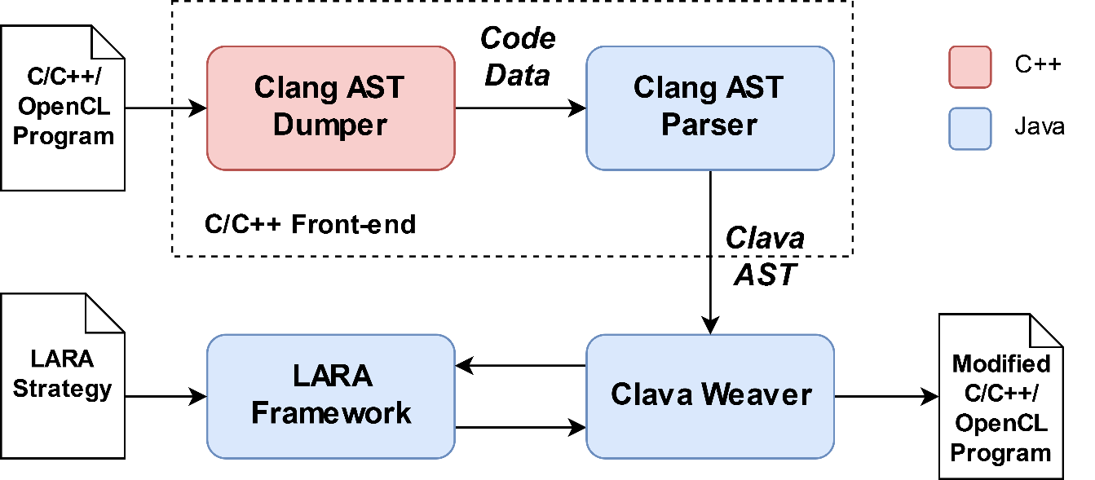
Clava - Toolflow
Clang-based parser
Custom Clava AST
AST-based transformations
Notes:
Clang supports text-based transformations.
Changing the AST does not reflect on the output code (does not support generating code from the AST)
Generic LARA interpreter, used as library
LARAI executes LARA code, Weaver Client answer requests from interpreter
Maps code points specified in LARA (e.g., function, loop) to the corresponding nodes in the AST
When running a LARA strategy, we provide input source code, that will be parsed to an AST
This AST is implicit during the execution of the strategy

Slide 14
Examples
Download Clava and examples:
specs.fe.up.pt/tutorials/INDIN2018.zip
Static profiling
Call Graph
Static Report
Code Insertion
Logging with Insertions
Logging with APIs
Measurements
Code Optimization
Gprofer
AutoPar
Exploration
Loop Tiling Exploration
Notes:
- Mini-tutorial of Clava GUI/IDE

Slide 15
Call Graph
Build a static call graph from the application source
“Supergraph” of the dynamic call graph
Edges indicate how many times a call appears in the code
Strategy
Select all methods (caller) and the calls inside (callee)
Make <caller, callee> tuples
Generate a graph with the tuples in dot format
Notes:
LaraObject: utility object that can count tuples
Show that signature takes into account C++ elements, such as classes and namespaces
Refer that you can use arbitrary Javascript in the strategies

Slide 16
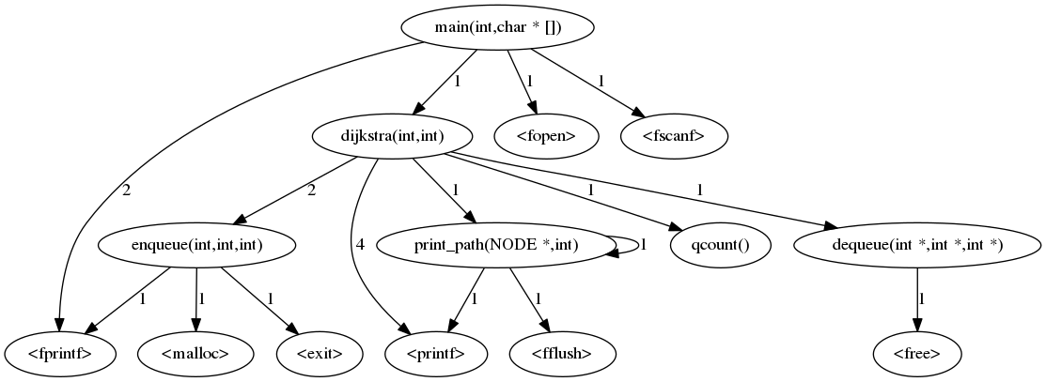
Call Graph
Test in webgraphviz.com
Notes:
TODO: add dot image

Slide 17
Static Report
Generate a report about the application
Number of files, functions and calls
Number and types of loops
Call information
Strategy
Select files, functions and calls to count
Select loops and query their type
Get <caller, callee> tuples
Print reports
Notes:
- Most of this strategy is JS, we are selecting nodes and querying the attributes and storing the information to print later
NOTE: printing the report uses JS, mention how JS can help in aspects
NOTE: explain how this could be extended with other points and attributes and segue into the language specs docs

Slide 18
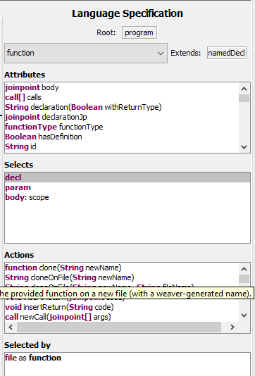
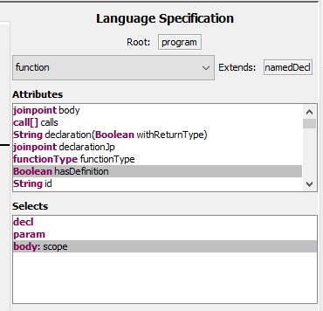
Language Specification
Online: specs.fe.up.pt/tools/clava/language_specification.html
IDE:

Slide 19
Logging with Insertions
Log certain execution events, e.g.:
Start of loops
Entering functions
Strategy
Select loops and their parent file
Insert logging code before loop
Add header include at the start of the file
Do the same for functions but log at the start of the body
Notes:
NOTE: present the first use of actions, insert and addInclude
NOTE: present and explain codedef and it’s advantages: robustness, reuse, efficiency
NOTE: Show that code for C and C++ are the same

Slide 20
Code Insertion with LARA
insert injects literal code into the application
Upsides:
extremely versatile, can insert any code you want
Downsides:
cumbersome (\n), error prone, opaque
Mitigating the downsides:
codedef
Clava option to verify syntax
Clava.rebuild()
Notes:
NOTE: segue into APIs at the end

Slide 21
Logging with APIs
Log certain execution events (a more complex example)
Make use of Clava APIs
Strategy
Same as before for functions
Look for writes to variables inside a specific function
Filter variables based on type
Log when the writing happens using the Logger API
Notes:
NOTE: explain imports (user and Clava)
NOTE: introduce Clava APIs (explain the idea is to declare your intentions, not to specify how to do them: multi-lang and multi-implementation)
NOTE: introduce and show Clava Docs
NOTE: C and C++ code is different

Slide 22
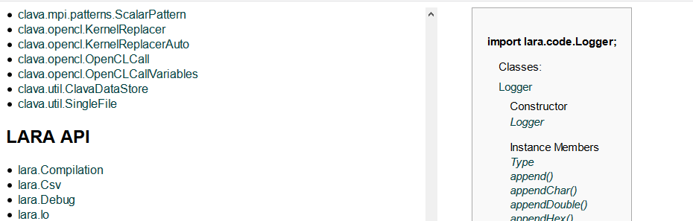
Clava Documentation
specs.fe.up.pt/tools/clava/doc/

Slide 23
Measurements
Collect metrics on certain events or around pieces of code
Measure execution time and energy consumption
Strategy
Capture loops inside a specific function
Call APIs to measure around the selected loops
Notes:
NOTE: API allows us to abstract from target language, show C and C++ generated code, also changes with Platform (e.g., C in Windows vs Linux)
NOTE: mention the extreme multi-lang case where this exact aspect can be used in Java (go to Kadabra, Matisse, remove printing of code program)
(Bispo) NOTE: show that rapl header was included automatically and explain the API that performs this

Slide 24
Gprofer
Profile an application using gprof
This can be the start of your analysis and optimization cycle
Strategy
Import and configure Gprofer
Profile the application
Get hotspot and its gprof information
Notes:
NOTE: stress this returns a function join point, which can be used with all aspects we've seen so far
NOTE: it can be used to start a more refined search inside the hotspot or it can passed to other aspects that automatically transform the code

Slide 25
AutoPar
Improve execution performance with OpenMP
Free the user from analysis
Strategy
Select target loop based on pragma
Call AutoPar API to parallelize the target loop
Notes:
NOTE: stress that analysis is performed automatically and the library decides what and how to parallelize
NOTE: pragma, to avoid other more brittle selection strategies
NOTE: If no arguments are given to Parallelize.forLoops(), tries to parallelize all loops
NOTE: Internally, autopar uses the Omega library for constraint manipulation. This library which is written in C, and currently Clava only provides binaries for Linux, so this example will not work in Windows

Slide 26
Exploration
Perform a design space exploration on an OpenMP application
This can be the output of AutoPar
Automatically explore the number of threads
Strategy
Use LAT to define a variable range for the thread exploration
Configure compilation options (in this case, activate OpenMP)
Define the scope where LAT will perform changes
Define the scope where LAT will collect metrics
Start the exploration
Notes:
NOTE: LAT is an external library, available in github. In the config it was added as an external dependency. Before execution, it will clone/pull the repository and add it as LARA dependency
NOTE: segue into a more complex exploration that cannot be performed with LAT
NOTE: LAT can be used to explore values of variables already in the code (e.g., numOmpThreads, parameters of algorithms)

Slide 27
Loop Interchange Exploration
Apply loop interchange to a matrix multiplication kernel
Automatically explore what the best permutation is
Use some more Clava APIs
Strategy
Generate all possible interchange permutations and for each:
Apply interchange
Add code to measure execution time
Compile and execute the application
Save the results
Print the results
Notes:
NOTE: Example where we explore transformations in the code
NOTE: API ‘metrics’, instrument() e report()
NOTE: Introduce Clava.pushAst() and .popAst()
NOTE: take some time to explain the cmaker library

Slide 28
Conclusions
Clava is a source-to-source C/C++ compiler
Strategy reusability between programs and languages
Fine-grained, structural/syntactic points with semantic information
Code analysis, generation, insertion, and modification

Slide 29
Backup Slides

Slide 30
The LARA Language
Attribute Model
Join Point Model
attributes
|\_var
| |\_name
| |\_type
| |\_is_array
| |\_is_pointer
| |\_is_write
| |\_is_read
| |\_is_in
| \_is_out
|\_function
| |\_name
| |\_num_lines
| \_return_type
|\_call
| |\_name
| |\_return_type
| |\_num_argin
| \_num_argout
\_loop
|\_type
|\_is_innermost
|\_num_iterations
|\_increment_value
|\_rank
\_nested_level
file
|\_var
|\_declaration
\_function
|\_prototype
\_body
|\_first
|\_last
|\_var
|\_call
|\_if
| |\_condition
| |\_then
| \_else
\_loop
|\_init
|\_condition
|\_counter
|\_body
\_control
Join Point Model
Allows the front-end to adapt to other target programming languages
Attribute Model
Allows LARA to access join point values and to associate values to join points
Action Model
Allows LARA to express actions

Slide 31
Instrumentation Example: Static Call Graph
Select all pairs of <caller, callee> function tuples
Increments a counter every time the same tuple is observed
Uses this counter to print the static call graph in dot format
Useful to check the structure of the code
Takes into account all possible function calls
aspectdef StaticCallGraph
var cg = new LaraObject();
select function.call end
apply
cg.increment($function.name, $call.name);
end
println('digraph static_cg {\n');
for (f in cg) {
for (c in cg[f]) {
print(f + '->' + c);
println(' [label="' + cg[f][c] + '"];');
}
}
println('}');
end

Slide 32
AOP Approach
Several AOP languages
No reusability between AOP languages
Flexibility on the join point capture
Include the support of code transformations
Concerns related to code transformations and compiler optimizations:
Performance, Power, Energy
Parallelism, Concurrency
Monitoring, Test, Debug
Safety, Security
Targeting hardware accelerators, multicore and manycore architectures
Different tool flows
Fully explore compiler optimizations
Existence of many crosscutting concerns!
Notes:
Several AOP languages
No reusability between AOP languages
Important when dealing with different tool flows
Flexibility on the join point capture
Easily add/remove new join point types
Include the support of code transformations beside code instrumentation and introduction
type definitions
compiler optimizations

