Slide 1


DSL and Source to Source Compilation
Hands-on-approach
with
Clava+LARA
Pedro Pinto, João Cardoso
2018-11-03 – PACT 2018
Notes:
21

Slide 2
Outline
Overview
Clava
LARA
Hands-on approach
First LARA Strategy (Call Graph)
Code Instrumentation (Logging)
Clava APIs (Time and Energy Measurement)
CMake Plugin (Auto-Parallelization)
Third-party Libraries (DSE)
ANTAREX component Integration (mARGOt)
1
Notes:
21

Slide 3
Clava Installation
All platforms: download JAR
http://specs.fe.up.pt/tools/clava.jar
Linux: script clava-update
http://specs.fe.up.pt/tools/clava/clava-update
CMake Plugin:
https://github.com/specs-feup/clava/tree/master/CMake
1

Slide 4


Clava
Source-to-source C/C++ compiler (weaver)
User-defined strategies written in LARA
Several kinds of strategies possible
Analysis, Generation, Insertion, Modification
Open-source
github.com/specs-feup/clava
4
Notes:
- Developed during the H2020 project ANTAREX
- During this tutorial we will show how to write several kinds of strategies
21

Slide 5
Clava - Toolflow
LARAI
C/C++ Weaver
Client
CLAVA
(C/C++ AST)
ClangDump Parser
JAVA
Clang-based parser
Custom Clava AST
AST-based transformations
LARA framework
C++
ClangDump.exe
4
Notes:
Clang supports text-based transformations.
Changing the AST does not reflect on the output code (does not support generating code from the AST)
Generic LARA interpreter, used as library
LARAI executes LARA code, Weaver Client answer requests from interpreter
Maps code points specified in LARA (e.g., function, loop) to the corresponding nodes in the AST
When running a LARA strategy, we provide input source code, that will be parsed to an AST
This AST is implicit during the execution of the strategy
21

Slide 6
The LARA Language
aspectdef myAspect
end
JavaScript-based language
Strategies written separately from application logic code
Not tied to a specific target language
Weavers binds LARA code to a target language
Current languages: Java, C, C++ and MATLAB
input
in0, in1=3;
end
output
out0, out1;
end
function h() { }
var z = 2;
select … end apply … end condition … end
J. M.P. Cardoso, T. Carvalho, J. G. de F. Coutinho, W. Luk, R. Nobre, P. C. Diniz, Z. Petrov, “LARA: An Aspect-Oriented Programming Language for Embedded Systems,” in Int’l Conf. on Aspect-Oriented Software Development (AOSD’12), Potsdam, Germany, March 25-30, 2012.
6
Notes:
- Weaving engine responsible to target a specific language
21

Slide 7
Main LARA Features
Declarative select-apply clauses
Select points of interest in the code
Apply code transformations over them
Modularity and reuse based on calling aspects and using parameters
Composition of strategies based on other strategies
select method end
apply
…
end
apply
call LoopTiling(64);
call Timer("ns");
end
7
Notes:
21

Slide 8
LARA Select
Access points on the source code
Uses an hierarchical point chain
Defined in the language specification
Points not present in the chain are inferred
Filtering based on attributes
select file.function.body.call end
select function.call end
select function{name==="draw"}.call end
8
Notes:
Can combine different selects into a single chain
Similar to an SQL “natural join”
Useful when multiple join points are necessary to process during a join point iteration
21

Slide 9
LARA Apply
Iterates over the selected points (prefixed with $)
Any point in the select statement can be accessed
Can access point attributes
Can change the application
select function{name=="draw"}.call end
apply
$call.insert before 'code to inject';
insert before 'more code';
end
$loop.exec interchange($innerLoop);
$var.def type='float';
insert before|after|replace
For injecting code in input application source code
exec
For executing a compiler action
def
For defining the value of an attribute
8
Notes:
- Apply can be seen as a for loop, that will iterate over the points obtained with the select
21

Slide 10
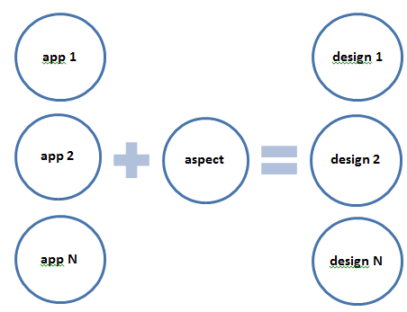
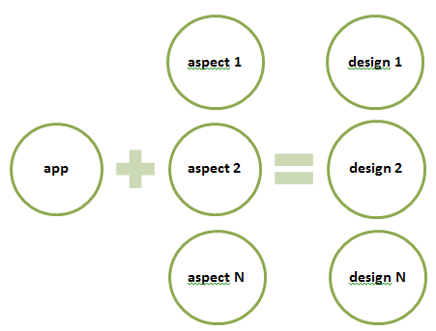
LARA Reusability and Targetability
Reusable Strategies
Custom Targetability
10
Notes:
21

Slide 11
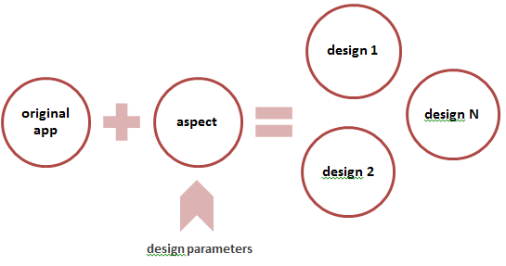
LARA Reusability and DSE
Reusable Between Different Languages
Java
Java
Design Exploration
C
C
MATLAB
MATLAB
11
Notes:
21

Slide 12
Hands-on – Getting Started
Linux
Get script: specs.fe.up.pt/tools/clava/clava-update
Put in path and run (may require sudo)
Windows
Get jar: specs.fe.up.pt/tools/clava.jar
Get Cmake files: https://bit.ly/2EVVnF7
Tutorial files
specs.fe.up.pt/tutorials/PACT2018.zip
11

Slide 13
Hands-on
1. CallGraph
Objectives
Read some LARA code
Load and run a LARA strategy
11

Slide 14
Hands-on
2. Logging
Objectives
Write some LARA code (exercise)
Introduction to LARA APIs
11

Slide 15
Hands-on
3. Measurements
Objectives
Use LARA APIs (exercise)
Introduction to Clava documentation
11

Slide 16
Hands-on
4. AutoPar
Objectives
Auto-parallelize code
Introduction to CMake plugin
11

Slide 17
Hands-on
5. Exploration
Objectives
Use the CMake plugin
Perform Design-Space Exploration
11

Slide 18
Hands-on
6. mARGOt Integration
Objectives
Use mARGOt Clava API to:
Generate configuration
Perform exploration
Instrument the code
Run the enhanced application
11

Slide 19
Backup Slides
11
Notes:
<number>

Slide 20
The LARA Language
Attribute Model
Join Point Model
attributes
|\_var
| |\_name
| |\_type
| |\_is_array
| |\_is_pointer
| |\_is_write
| |\_is_read
| |\_is_in
| \_is_out
|\_function
| |\_name
| |\_num_lines
| \_return_type
|\_call
| |\_name
| |\_return_type
| |\_num_argin
| \_num_argout
\_loop
|\_type
|\_is_innermost
|\_num_iterations
|\_increment_value
|\_rank
\_nested_level
file
|\_var
|\_declaration
\_function
|\_prototype
\_body
|\_first
|\_last
|\_var
|\_call
|\_if
| |\_condition
| |\_then
| \_else
\_loop
|\_init
|\_condition
|\_counter
|\_body
\_control
Join Point Model
Allows the front-end to adapt to other target programming languages
Attribute Model
Allows LARA to access join point values and to associate values to join points
Action Model
Allows LARA to express actions
20
Notes:
<number>

Slide 21
AOP Approach
Several AOP languages
No reusability between AOP languages
Flexibility on the join point capture
Include the support of code transformations
Concerns related to code transformations and compiler optimizations:
Performance, Power, Energy
Parallelism, Concurrency
Monitoring, Test, Debug
Safety, Security
Targeting hardware accelerators, multicore and manycore architectures
Different tool flows
Fully explore compiler optimizations
Existence of many crosscutting concerns!
21
Notes:
Several AOP languages
No reusability between AOP languages
Important when dealing with different tool flows
Flexibility on the join point capture
Easily add/remove new join point types
Include the support of code transformations beside code instrumentation and introduction
type definitions
compiler optimizations
<number>

Slide 22
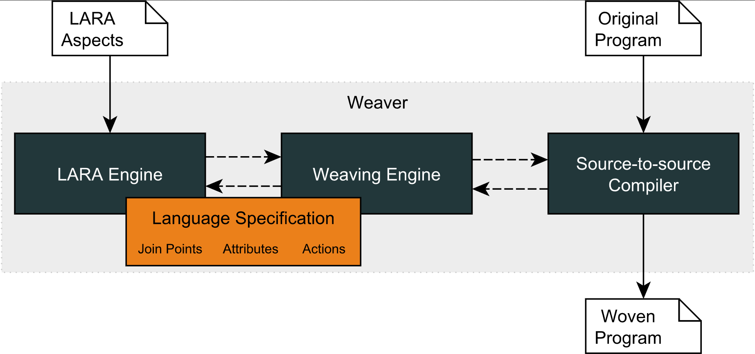
LARA Compilation Flow
WeaverGenerator
21
Notes:
<number>

