Slide 1
Angular NGRX
NGRX
Lecture 1
By James(Jin) Wang
05/08/2021

Slide 2
Outline
Introduction
The Redux Pattern
NgRx case study

Slide 3
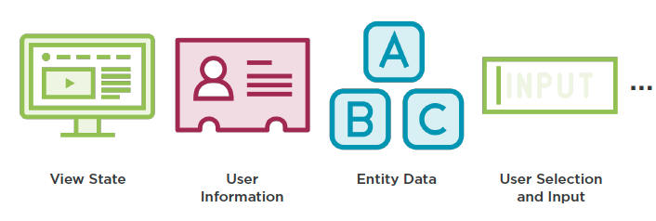
Introduction
  What is State?

Slide 4
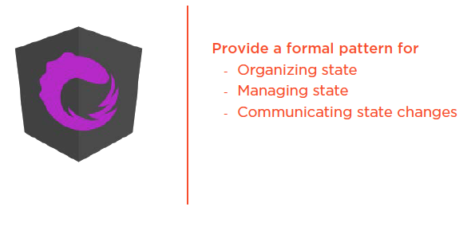
Introduction
  Purpose of NgRx

Slide 5
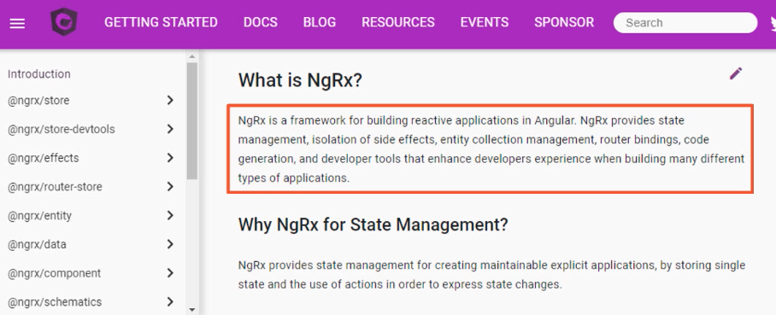
Introduction
  What is NgRx?

Slide 6
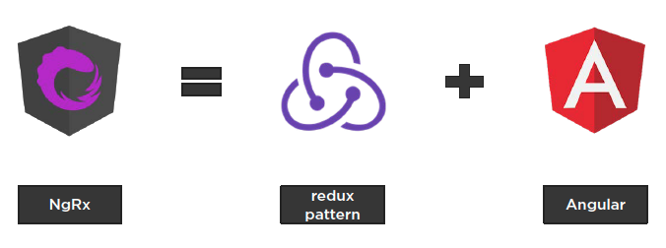
Introduction
  What is NgRx?

Slide 7
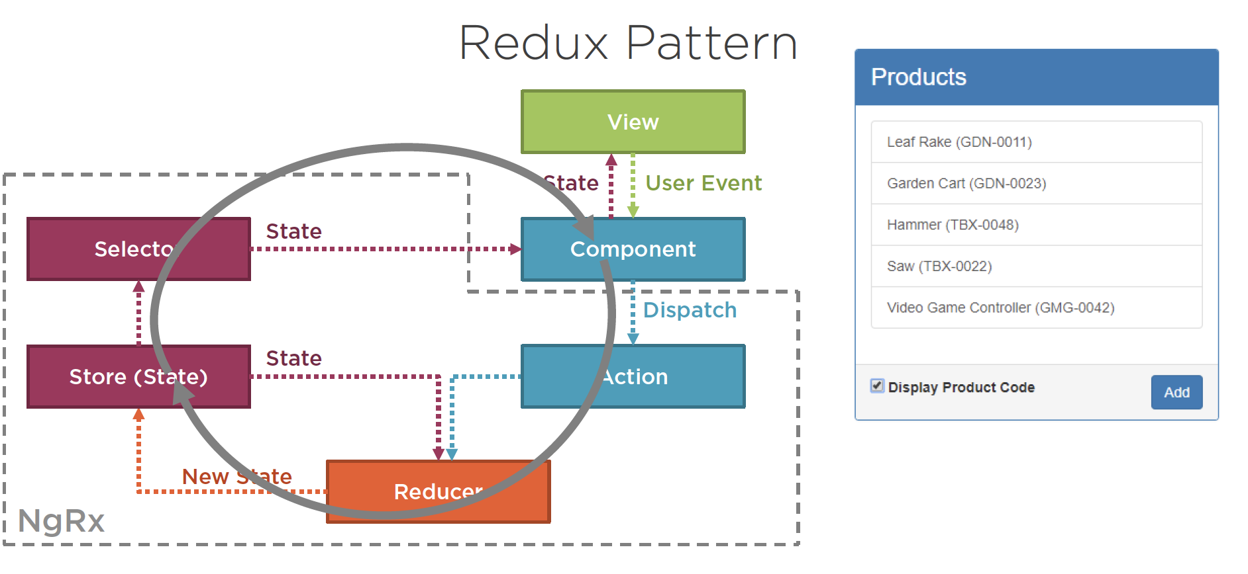
Introduction
  Redux Pattern

Slide 8
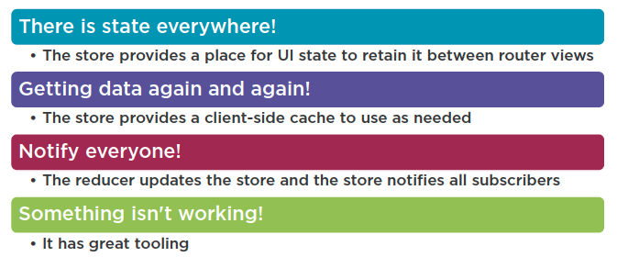
Introduction
  Use NgRx When…

Slide 9
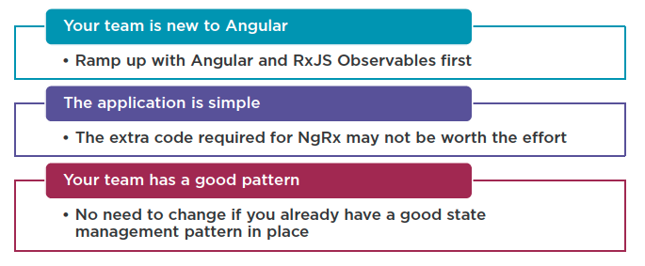
Introduction
  Don’t use NgRx When…

Slide 10
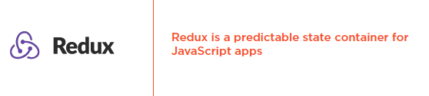
The Redux Pattern

Slide 11
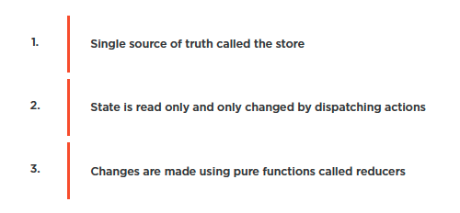
The Redux Pattern
  Redux Principles

Slide 12
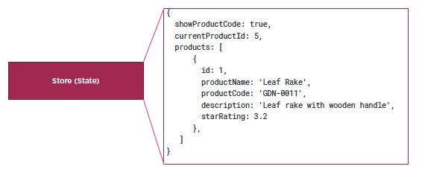
The Redux Pattern
  Store is the Single Source of Truth

Slide 13
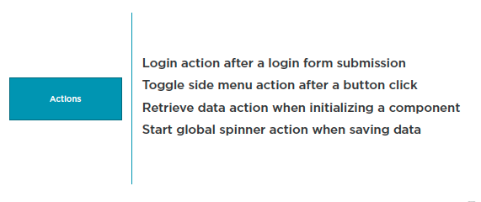
The Redux Pattern
  Dispatch an Action to Change State

Slide 14
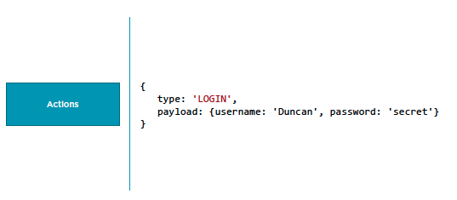
The Redux Pattern
  Dispatch an Action to Change State

Slide 15
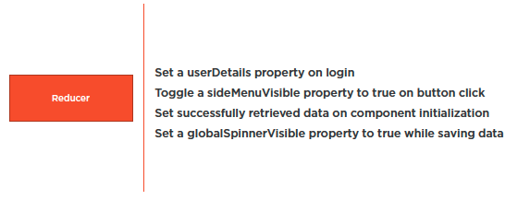
The Redux Pattern
  Use Reducers to Change State

Slide 16
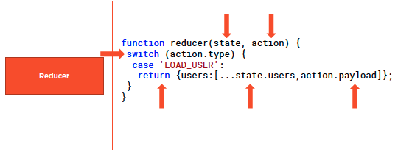
The Redux Pattern
  Reducers are Pure Functions

Slide 17
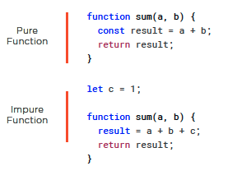
The Redux Pattern
  Pure and Impure Functions

Slide 18
NgRx Case Study
  Module Overview
Set up the sample application
Install @ngrx/store
Initialize the store
Define the state and actions
Build a reducer to process actions and set store state
Dispatch an action to change state
Subscribe to state change notifications

Slide 19
NgRx Case Study
  Install @ngrx/store
  ng add @ngrx/store

Slide 20
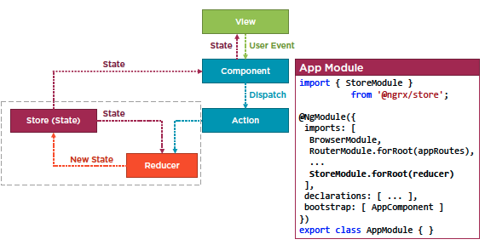
NgRx Case Study
  Initialize store

Slide 21
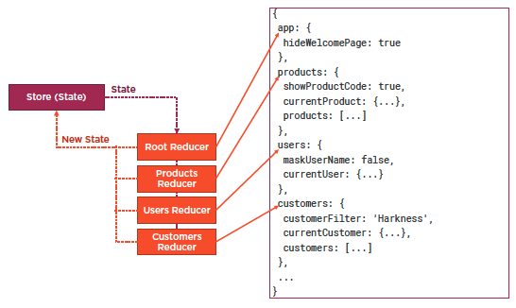
NgRx Case Study
  Initialize store

Slide 22
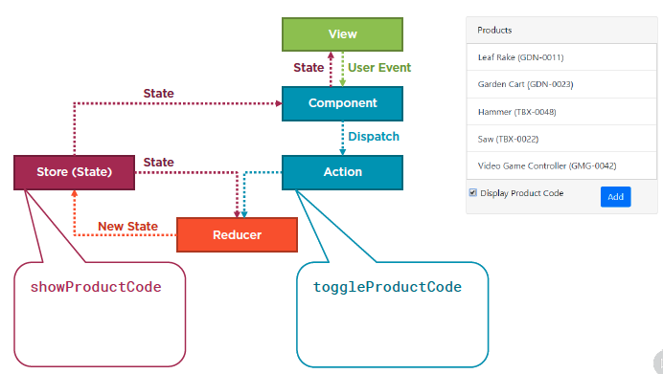
NgRx Case Study
  Define the state and actions

Slide 23
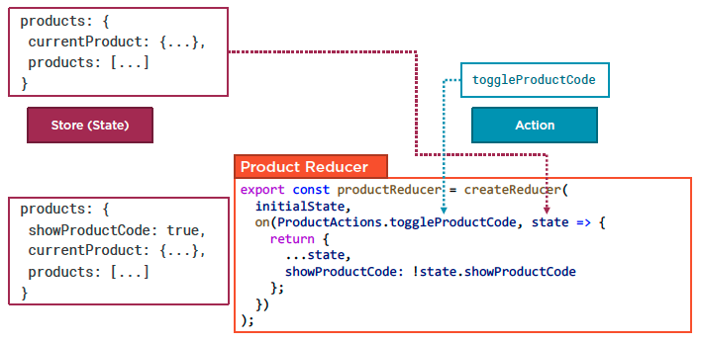
NgRx Case Study
  Build reducer

Slide 24
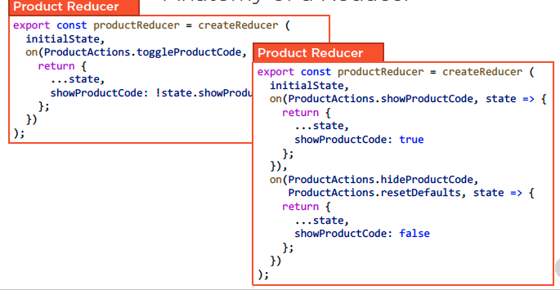
NgRx Case Study
  Anatomy of a Reducer

Slide 25
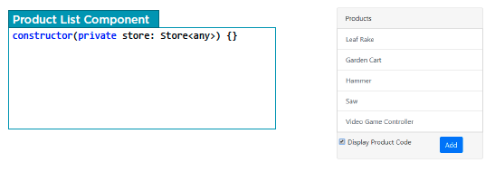
NgRx Case Study
  Dispatch an Action

Slide 26
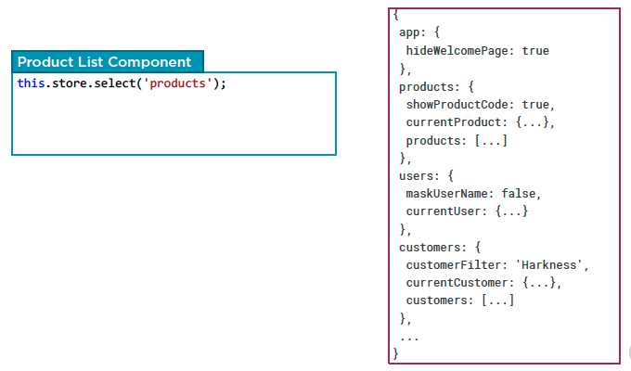
NgRx Case Study
  Subscribe to state changes

Slide 27
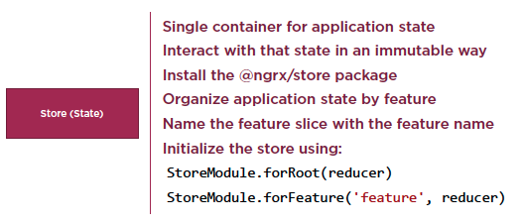
NgRx Case Study
  Checklist: Store

Slide 28
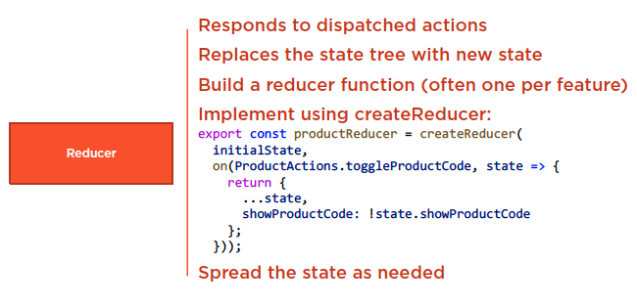
NgRx Case Study
  Checklist: Reducer

Slide 29
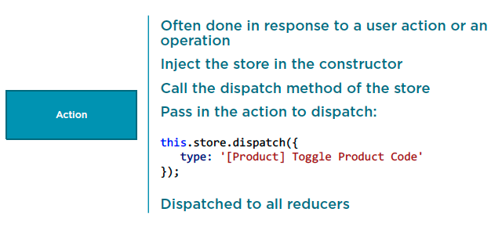
NgRx Case Study
  Checklist: Dispatching an Action

Slide 30
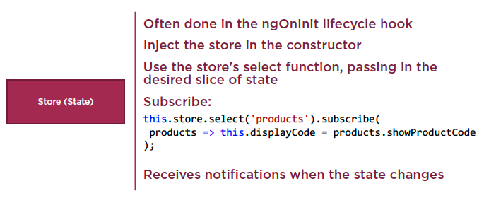
NgRx Case Study
  Checklist: Subscribing to the Store

Slide 31
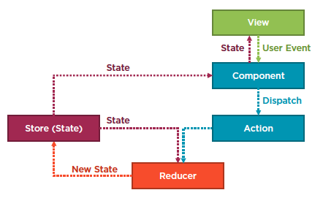
NgRx Case Study

Slide 32
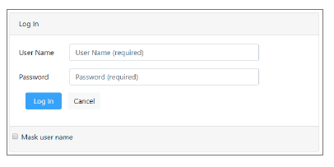
Homework
Login page
Initialize the store in the user module
Define the state and action
Create the reducer function
Dispatach an action
Subscribe to the user slice of state

Slide 33
Reference
Angular NgRx: Getting Started
https://app.pluralsight.com/library/courses/angular-ngrx-getting-started/table-of-contents
Play by Play: Angular and ngrx
https://app.pluralsight.com/library/courses/play-by-play-angular-ngrx/table-of-contents

Slide 34
Summary

