Slide 1

Aravindan Vijayaraghavan CMU $⇒$ Northwestern University
Smoothed Analysis of Tensor Decompositions and Learning
based on joint works with
Aditya Bhaskara
Google Research
Moses Charikar
Princeton
Ankur Moitra
MIT

Slide 2
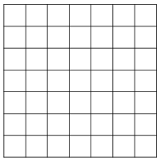
Factor analysis
Explain using few unobserved variables
M
Assumption: matrix has a “simple explanation”
d
d
Sum of “few” rank one matrices (k < d )
$$M=a_{1}⊗b_{1}+a_{2}⊗b_{2}+…+a_{k}⊗b_{k}$$
Qn [Spearman]. Can we find the ``desired’’ explanation ?
Notes:
In factor analysis, the goal is to take many variables.. And explain them away using few unobserved variables.

Slide 3
The rotation problem
Any suitable “rotation” of the vectors gives a different decomposition
$$M=a_{1}⊗b_{1}+a_{2}⊗b_{2}+…+a_{k}⊗b_{k}$$
A
A
B^{T}
=
Q
Q^{T}
B^{T}
Often difficult to find “desired” decomposition..
Notes:
(a_1 + a_2) \otimes (b_1 + b_2) + (a_1 - a_2) \otimes (b_1-b_2) = 2 (a_1 \otimes b_1 + a_2 \otimes b_2)

Slide 4
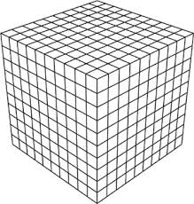
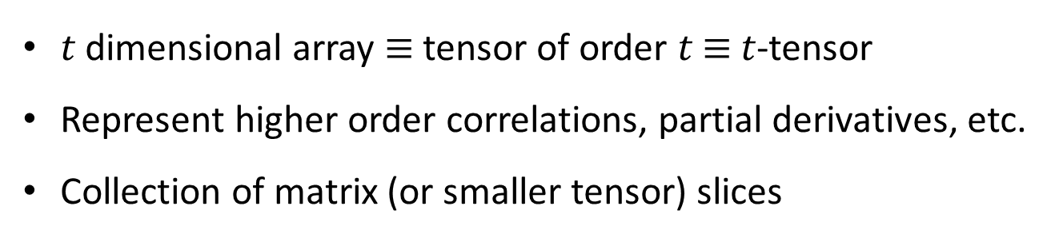
Tensors
Multi-dimensional arrays
d
d
d
d
d
$t$ dimensional array $≡$ tensor of order $t$ $≡$ $t$-tensor
Represent higher order correlations, partial derivatives, etc.
Collection of matrix (or smaller tensor) slices

Slide 5



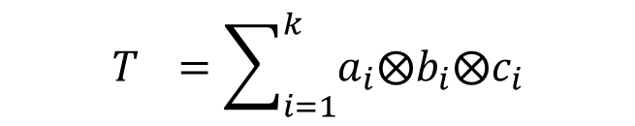





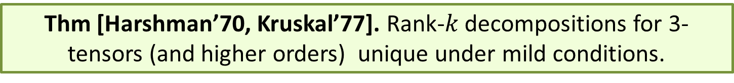


3-way factor analysis
Tensor can be written as a sum of few rank-one tensors
3-Tensors:
$$b_{1}$$
$$b_{2}$$
$$b_{k}$$
$$T_{}=\sum_{i=1}^{k}{a_{i}⨂b_{i}⨂c_{i}}$$
T
$$a_{1}$$
$$a_{2}$$
$$a_{k}$$
$$c_{1}$$
$$c_{2}$$
$$c_{k}$$
Rank(T) = smallest k s.t. T written as sum of k rank-1 tensors
Rank of 3-tensor $T_{d×d×d}$ $≤ d^{2}$ . Rank of t-tensor $T_{d×…×d}$ $≤ d^{t−1}$
Thm [Harshman’70, Kruskal’77]. Rank-$k$ decompositions for 3-tensors (and higher orders) unique under mild conditions.
3-way decompositions overcome rotation problem !
Notes:
T = a_1 \otimes b_1 \otimes c_1 + \dots + a_R \otimes b_R \otimes c_R
(15 min)

Slide 6
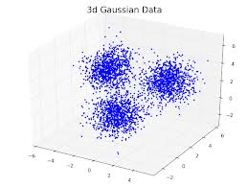
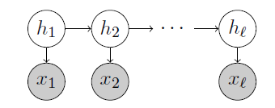
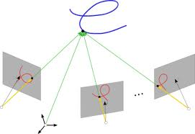

Learning Probabilistic Models:
Parameter Estimation
Question: Can given data be “explained” by a simple probabilistic model?
Mixture of Gaussians
for clustering points
HMMs
for speech recognition
Multiview models
Learning goal: Can the parameters of the model be learned from polynomial samples generated by the model ?
Algorithms have exponential time & sample complexity
EM algorithm – used in practice, but converges to local optima
Notes:
1. A very common approach in Machine Learning, UL to be particular, is to assume that the data that is given to us comes from a probabilistic model that is appropriate for the task at hand. For instance, mixtures of gaussians are commonly used while clustering, HMMs for speech recognition etc. etc. Now suppose we are given data generated from the probabilistic model, the question is can we learn the parameters of the model? Known algorithms for the problem take exponential time.
2. EM is the method-of-choice in practice -- but it has no provable guarantees.

Slide 7
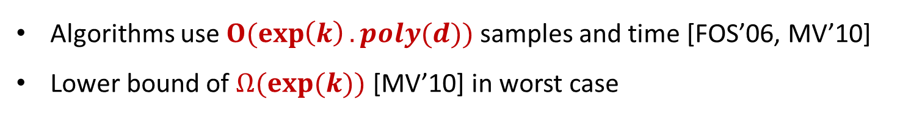

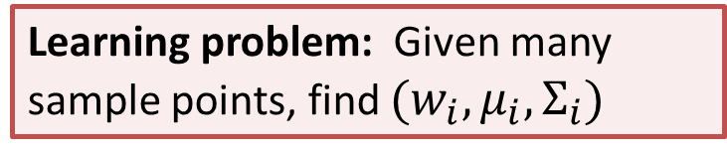

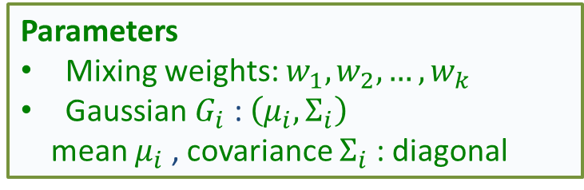

Mixtures of (axis-aligned) Gaussians
Probabilistic model for Clustering in $d$-dims
$$ℝ^{d}$$
Parameters
Mixing weights: $w_{1}, w_{2}, …, w_{k}$
Gaussian $G_{i}$ : $\left(μ_{i},Σ_{i}\right)$
mean $μ_{i}$ , covariance $Σ_{i}$ : diagonal
$$μ_{i}$$
$$x$$
Learning problem: Given many sample points, find $(w_{i},μ_{i},Σ_{i})$
Algorithms use $O(exp\left(k\right).poly(d))$ samples and time [FOS’06, MV’10]
Lower bound of $Ω(exp(k))$ [MV’10] in worst case
Aim: $poly(k,d)$ guarantees in realistic settings
Notes:
2 points.
Let us focus on 1 case study of mixture of gaussians.This is a very useful probabilistic model for clustering into k pieces.
The data comes from k-gaussians in d-dims. The parameters of the model corresponds to mixing weights w_1… w_k, and the parameters of the k-gaussians, the k-means in d-dims, and the covariances.
The sample generated by first picking the gaussian with prob. W_i, and the picking the point according to the gaussian.
We don’t know which sample comes from which gaussian. Given many samples, can we learn the parameters.
The best known algorithms take time exp(k). In fact there are unconditional sample complexity lower bounds that match this dependence on k – hence we can’t hope for any better.
The aim is whether we can design better algorithms in an average-case sense.

Slide 8


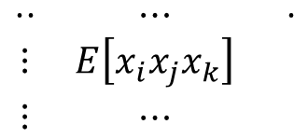


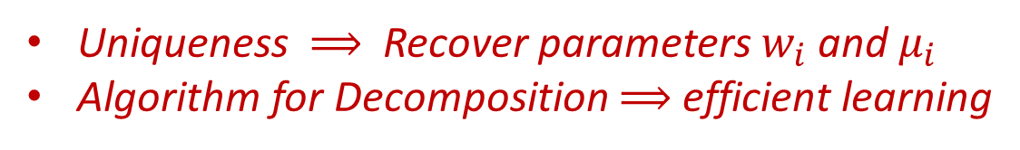

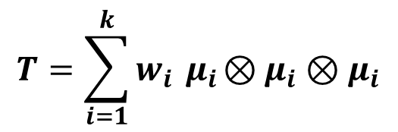
Method of Moments and Tensor decompositions
step 1. compute a tensor whose decomposition encodes model parameters
step 2. find decomposition (and hence parameters)
$d$
$$⋱$$
$$T=\sum_{i=1}^{k}{w_{i}{ μ}_{i}⊗μ_{i}⊗μ_{i}}$$
$$\begin{matrix}⋅⋅ & ⋯ & ⋅ \\ ⋮ & E\left[x_{i}x_{j}x_{k}\right] & \\ ⋮ & ⋯ & \end{matrix}$$
$$d$$
Uniqueness $⟹$ Recover parameters $w_{i}$ and $μ_{i}$
Algorithm for Decomposition $⟹$ efficient learning
$d$
[Chang] [Allman, Matias, Rhodes]
[Anandkumar,Ge,Hsu, Kakade, Telgarsky]

Slide 9



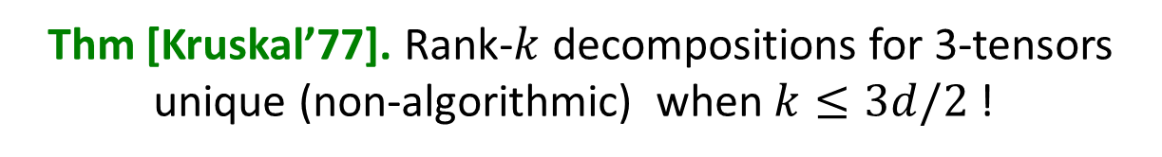
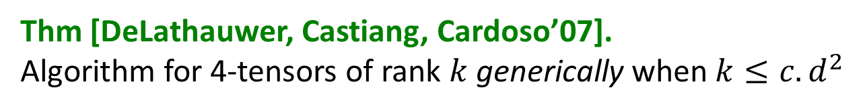
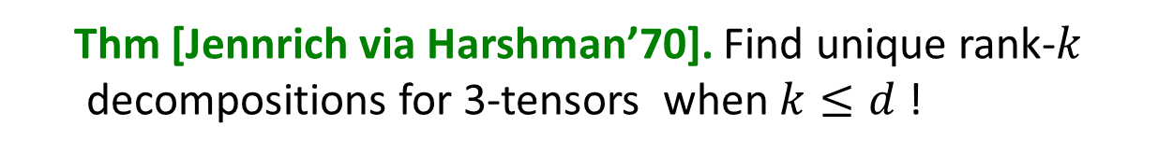
What is known about Tensor Decompositions ?
Thm [Jennrich via Harshman’70]. Find unique rank-$k$ decompositions for 3-tensors when $k≤d$ !
Uniqueness proof is algorithmic !
Called Full-rank case. No symmetry or orthogonality needed.
Rediscovered in [Leurgans et al 1993] [Chang 1996]
Thm [Kruskal’77]. Rank-$k$ decompositions for 3-tensors unique (non-algorithmic) when $k≤3d/2$ !
Thm [Chiantini Ottaviani‘12].
Uniqueness (non-algorithmic) of 3-tensors of rank $k≤c.d^{2}$ generically
Thm [DeLathauwer, Castiang, Cardoso’07].
Algorithm for 4-tensors of rank $k$ generically when $k≤{c.d}^{2}$

Slide 10


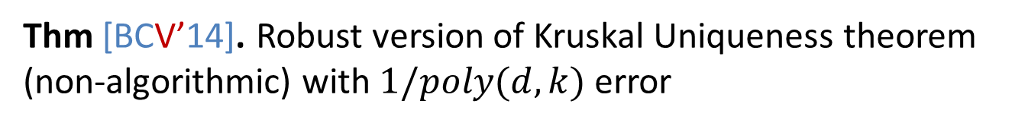
Robustness to Errors
Beware : Sampling error
Empirical estimate $T=_{ε}\sum_{i=1}^{k}{w_{i } μ_{i}^{}⨂{ μ}_{i}^{}⨂{ μ}_{i}^{}}$
With $poly(d,k)$ samples, error $ϵ≈1/poly(d,k)$
Uniqueness and Algorithms resilient to noise of 1/poly(d,k) ?
Thm. Jennrich’s polynomial time algorithm for Tensor Decompositions robust up to $1/poly(d,k)$ error
Thm [BCV’14]. Robust version of Kruskal Uniqueness theorem (non-algorithmic) with $1/poly(d,k)$ error
Open Problem: Robust version of generic results[De Lauthewer et al]?
Notes:
4 points.
1. However, these covariances and third-moment were estimated from the samples. Hence, there is always sampling error.
2. In particular, since we only have access to polynomially many samples, we only get inverse polynomial accuracy. We need uniqueness and algorithms resilient to 1/poly errors.
3. Unfortunately Kruskal theorem is only for exact decomposition – adapting the proof corresponds to an error tolerance of only inverse-exponential error.
4. We first give a robust uniquenss theorem for tensor decompositions resilient to 1/poly error.

Slide 11
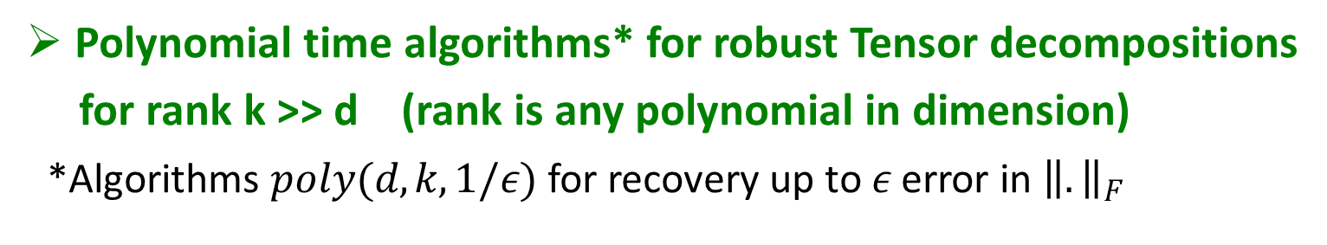
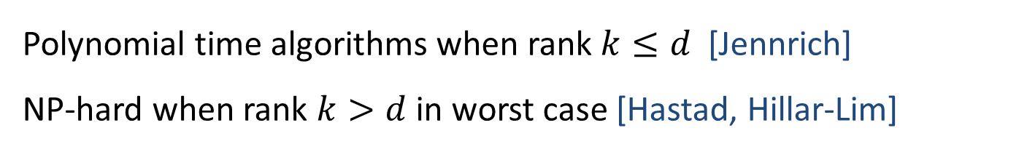
Algorithms for Tensor Decompositions
Polynomial time algorithms when rank $k≤d$ [Jennrich]
NP-hard when rank $k>d$in worst case [Hastad, Hillar-Lim]
This talk
Overcome worst-case intractability using Smoothed Analysis
Polynomial time algorithms* for robust Tensor decompositions
for rank k >> d (rank is any polynomial in dimension)
*Algorithms $poly(d,k,1/ε)$ for recovery up to $ε$ error in ${\left\|.\right\|}_{F}$

Slide 12
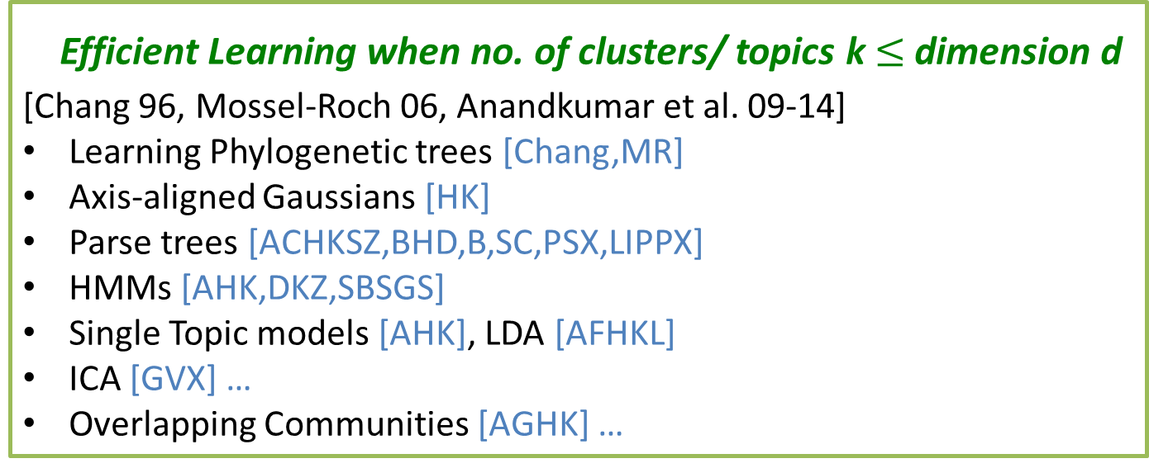
Implications for Learning
Known only in restricted cases:
No. of clusters $k≤$ No. of dims$d$
``Full rank’’ or ``Non-degenerate’’ setting
Efficient Learning when no. of clusters/ topics k $≤$dimension d
[Chang 96, Mossel-Roch 06, Anandkumar et al. 09-14]
Learning Phylogenetic trees [Chang,MR]
Axis-aligned Gaussians [HK]
Parse trees [ACHKSZ,BHD,B,SC,PSX,LIPPX]
HMMs [AHK,DKZ,SBSGS]
Single Topic models [AHK], LDA [AFHKL]
ICA [GVX] …
Overlapping Communities [AGHK] …
Notes:
3 points.
1. But of course, we saw some guarantees. Problem is NP-hard in worst-case for rank k>= 6d.
Kolda and more recently others, gave polytime algorithms under very special cases – when the rank k \le d.
2. This has led to a large series of works in the field called spectral learning. They give efficient learning for various problem in this special case when k<d (i.e. no of cluster s< d).
3. Does not even work when k=d+1. More generally, what about k>>d? This is called the overcomplete setting – useful in speech and vision.

Slide 13
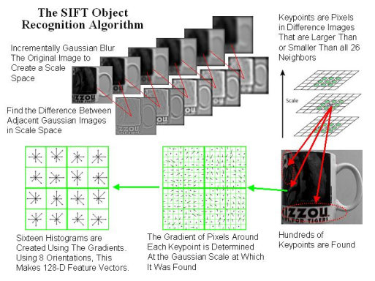
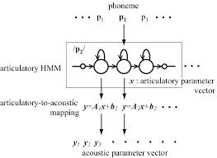

Overcomplete Learning Setting
Number of clusters/topics/states $k≫$ dimension$d$
Computer Vision
Speech
Previous algorithms do not work when $k>d$!
Need polytime decomposition of Tensors of rank $k≫d?$
Notes:
While this non-degenerate or full-rank assumption is useful in certain settings like Topic models, in many areas like speech and computer vision, the number of states or clusters is much larger than the dimension.
1. For example in computer vision, researchers commonly use SIFT features which reduce the space to 128 dimensions.
e.g. 256 classes in the Caltech-256 dataset [GHP07] and several thousands in the case of ImageNet [DDS+09].
2. Speech: MFCC features – 39 dimensional, PLP encoding. HTK toolkit.
the features of an audio signal are typically based on mel-frequency cepstral coecients (MFCCs) or an encoding called perceptual linear prediction (PLP) that incorporates psychoacoustic constraints [GY08], e.g. these are used to obtain a 39 dimensional feature vector in the popular HTK toolkit for building HMMs for speech recognition [YEG+02, WGPY97].

Slide 14
Overcomplete Tensor decompositions
Overcomplete Learning setting: clusters $k≫d$
Polytime decomposition of Tensors of rank $k≫d?$ $($rank $k≤d^{t−1})$
NP-hard in worst-case (for rank $k≥6d$)
Notes:
3 points.
1. But of course, we saw some guarantees. Problem is NP-hard in worst-case for rank k>= 6d.
Kolda and more recently others, gave polytime algorithms under very special cases – when the rank k \le d.
2. This has led to a large series of works in the field called spectral learning. They give efficient learning for various problem in this special case when k<d (i.e. no of cluster s< d).
3. Does not even work when k=d+1. More generally, what about k>>d? This is called the overcomplete setting – useful in speech and vision.

Slide 15
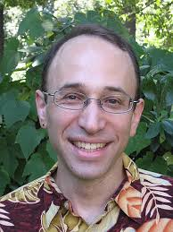
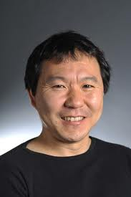
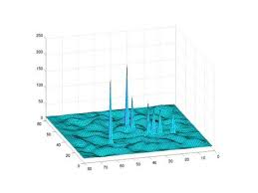
Smoothed Analysis
Simplex algorithm solves LPs efficiently (explains practice).
[Spielman & Teng 2000]
Smoothed analysis guarantees:
Worst instances are isolated
Small random perturbation of input
makes instances easy
Best polytime guarantees in the absence of any worst-case guarantees
Notes:
One problem with Average-case analysis… is that the choice of the distribution is critical.
Consider a problem which has a large chunk of hard instances in its problem space; the average-case distribution can put all its mass on the easy instances. While this may be appropriate for the task at hand, this does not give any indication about the easiness/ hardness of the problem.
3. Smoothed analysis is this really beautiful concept introduced by Spielman-Teng in their Godel prize winning work to explain the practical success of the simplex algorithm in solving instances in practice.
4. Good SA guarantees captures the fact that worst instances are isolated – so, if we just randomly perturb the instance slightly it becomes easy. So really, if you look at the whole problem space.. and plot the run time of the algorithm w.r.t the instance, the graph looks like this with isolated peaks !
5. These are the best possible guarantees one can hope for in the absence of good worst-case guarantees.. and hence good SA guarantees are also very hard to come by.

Slide 16
Today’s talk: Smoothed Analysis for Learning [BCMV STOC’14]
First Smoothed Analysis treatment for Unsupervised Learning
Mixture of Gaussians
Multiview models
Thm. Polynomial time algorithms for learning axis-aligned Gaussians, Multview models etc. even in ``overcomplete settings’’.
based on
Thm. Polynomial time algorithms for tensor decompositions in smoothed analysis setting.
Notes:
In my work with Bhaskara, Charikar and Moitra that is to appear at STOC’2014, we give the first polynomial time algorithm using smoothed analysis which learns a bunch of popular probabilistic models even in overcomplete settings – this is an important setting of the problem which were previously intractable. I will define the overcomplete setting formally later in the talk. They are based on polytime algos for tensor decompositions in a smoothed analysis setting

Slide 17


Smoothed Analysis for Learning
Learning setting (e.g. Mixtures of Gaussians)
Worst-case instances: Means $\left\{μ_{i}\right\}$ in pathological configurations
Means not in adversarial configurations
in real-world!
$$μ_{i}$$
$${\tilde{μ}}_{i}$$
What if means $\left\{μ_{i}\right\}$ perturbed slightly ?
Generally, parameters of the model are perturbed slightly.
Notes:
This is where we go to smoothed analysis. Let us consider the learning mixtures of gaussians setting.
The worst-case instances come from means being in some adversarial configs. However, unless adversarially chosen, in real world very unliekly that means are in this bad configuration.
Hence, in smoothed analysis we ask: what if the means are perturbed slightyl using a random perturbation?
We show that this works!!! In fact we show that a simple algorithm based on spectral techniques from the 70s actually works!

Slide 18


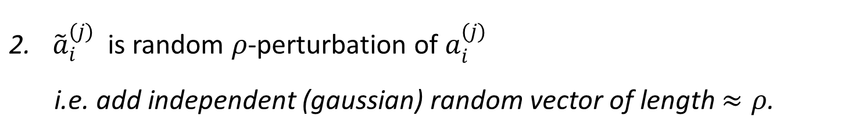




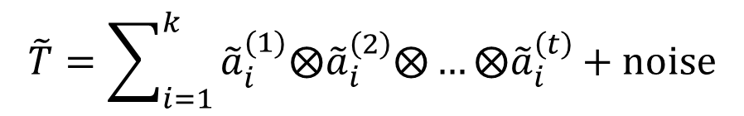



Smoothed Analysis for Tensor Decompositions
Factors of the Decomposition are perturbed
$$a_{1}^{(2)}$$
$$a_{2}^{(2)}$$
$$a_{k}^{(2)}$$
Adversary chooses tensor
$$a_{1}^{(1)}$$
$$a_{2}^{(1)}$$
$$a_{k}^{(1)}$$
T
$$a_{1}^{(3)}$$
$$a_{2}^{(3)}$$
$$a_{k}^{(3)}$$
$$T_{d×d×…×d}=\sum_{i=1}^{k}{a_{i}^{(1)}⨂a_{i}^{\left(2\right)}⨂{…⨂a}_{i}^{\left(t\right)}}$$
${\tilde{a}}_{i}^{(j)}$ is random $ρ$-perturbation of $a_{i}^{(j)}$
i.e. add independent (gaussian) random vector of length $≈ρ$.
Input: $\tilde{T}$. Analyse algorithm on $\tilde{T}$.
$$\tilde{T}=\sum_{i=1}^{k}{{\tilde{a}}_{i}^{(1)}⨂{\tilde{a}}_{i}^{\left(2\right)}⨂{…⨂\tilde{a}}_{i}^{\left(t\right)}+noise}$$

Slide 19

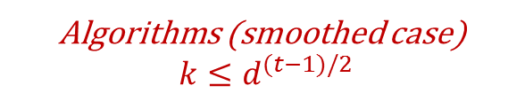

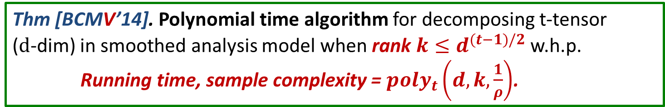
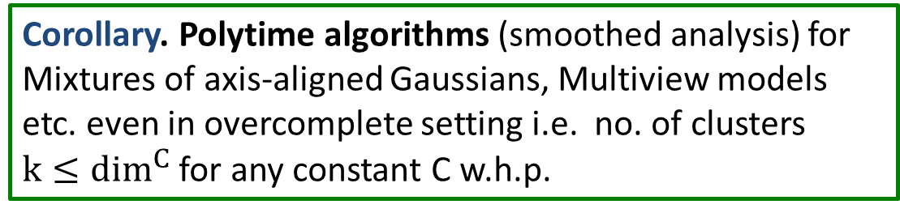
Algorithmic Guarantees
Thm [BCMV’14]. Polynomial time algorithm for decomposing t-tensor
($d$-dim) in smoothed analysis model when rank $k≤d^{(t−1)/2}$ w.h.p.
Running time, sample complexity = $poly_{t}\left(d,k,\frac{1}{ρ}\right)$.
Guarantees for order-$t$ tensors in d-dims (each)
Previous Algorithms
$$k≤d$$
Algorithms (smoothed case)
$$k≤d^{(t−1)/2}$$
Rank of the t-tensor=k (number of clusters)
Corollary. Polytime algorithms (smoothed analysis) for Mixtures of axis-aligned Gaussians, Multiview models etc. even in overcomplete setting i.e. no. of clusters $k≤\dim^{C}$ for any constant C w.h.p.
Notes:
4 points.
This allows us to give polytime algorithms for tensors even when k~ d^{t/2}, in smoothed setting.
Hence we get a dramatic improvement over previous results which only worked for k~n, by resorting to smoothed analysis
This can be used as a very big hammer in learning applications. Gives first polytime algorithms for leanrning……
Also gives new algorithms for other unsupervised learning problem like Ranking models.

Slide 20
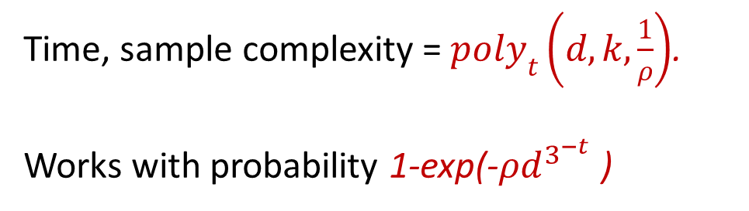
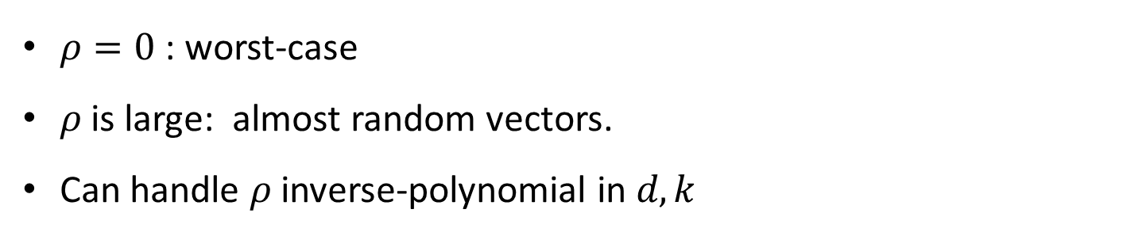
Interpreting Smoothed Analysis Guarantees
Time, sample complexity = $poly_{t}\left(d,k,\frac{1}{ρ}\right)$.
Works with probability 1-exp(-$ρd^{3^{−t}}$ )
Exponential small failure probability (for constant order t)
Smooth Interpolation between Worst-case and Average-case
$ρ=0$ : worst-case
$ρ$ is large: almost random vectors.
Can handle $ρ$ inverse-polynomial in $d,k$

Slide 21

Algorithm Details

Slide 22
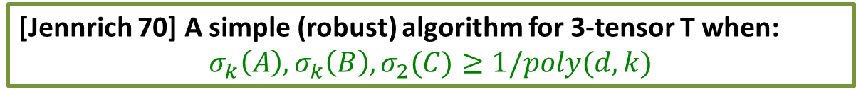


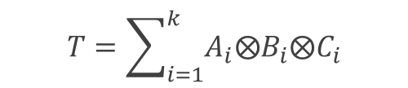




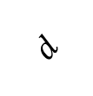
Algorithm Outline
An algorithm for 3-tensors in the ``full rank setting’’ ($k≤d$).
$$T=\sum_{i=1}^{k}{A_{i}⨂B_{i}⨂C_{i}}$$
$$⋱$$
Recall:
$$A_{i}$$
$$d$$
$$T$$
Aim: Recover A, B, C
$A (d_{}×k)$
$d$
$d_{}$
[Jennrich 70] A simple (robust) algorithm for 3-tensor T when:
$$σ_{k}\left(A\right),σ_{k}\left(B\right), σ_{2}(C)≥1/poly(d,k)$$
Any algorithm for full-rank (non-orthogonal) tensors suffices
For higher order tensors using ``tensoring / flattening’’.
Helps handle the over-complete setting $(k ≫d)$

Slide 23

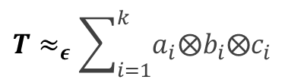
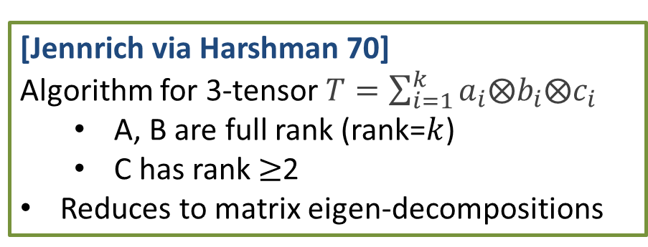
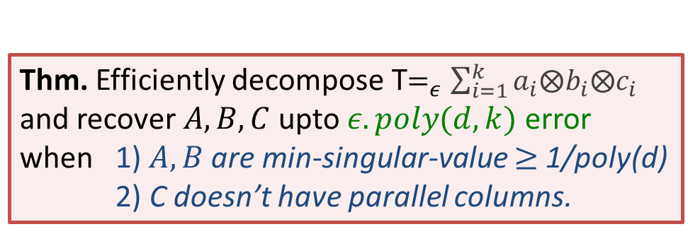

Blast from the Past
$$⋱$$
[Jennrich via Harshman 70]
Algorithm for 3-tensor $T=\sum_{i=1}^{k}{a_{i}⨂b_{i}⨂c_{i}}$
A, B are full rank (rank=$k$)
C has rank $≥$2
Reduces to matrix eigen-decompositions
$$T$$
Recall
Qn. Is this algorithm robust to errors ?
$${T≈}_{ε}\sum_{i=1}^{k}{a_{i}⨂b_{i}⨂c_{i}}$$
Yes ! Needs perturbation bounds for eigenvectors.
[Stewart-Sun]
Thm. Efficiently decompose T$=_{ε}\sum_{i=1}^{k}{a_{i}⨂b_{i}⨂c_{i}}$
and recover $A, B, C$ upto $ε.poly(d,k)$ error
when 1) $A, B$are min-singular-value $≥$ 1/poly(d)
2) C doesn’t have parallel columns.
$$a_{i}$$
$A (d×k)$
Aim: Recover A, B, C

Slide 24
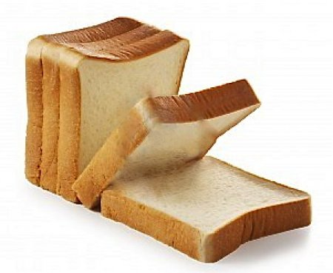
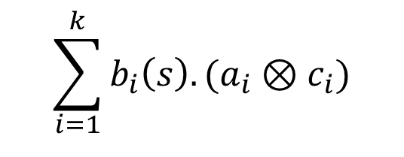
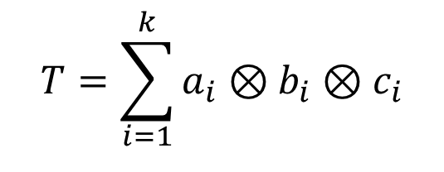
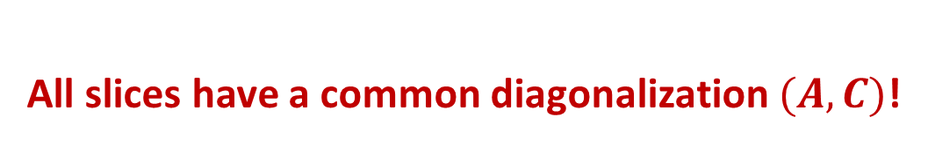
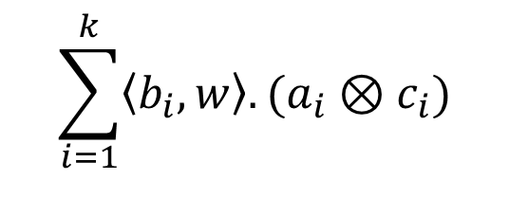

Slices of tensors
Consider rank 1 tensor
s’th slice:
$$T=\sum_{i=1}^{k}{a_{i}⊗b_{i}⊗c_{i}}$$
$$\sum_{i=1}^{k}{b_{i}\left(s\right).(a_{i}⊗c_{i})}$$
s’th slice:
All slices have a common diagonalization $(A, C)$!
$$\sum_{i=1}^{k}{\left\langle b_{i},w\right\rangle .(a_{i}⊗c_{i})}$$
Random combination $w$of slices:
Notes:
T(w) = \sum_{i=1}^R \langle b_i, w \rangle (a_i \otimes c_i)
= A ~\text{diag}(w^T B) ~C

Slide 25
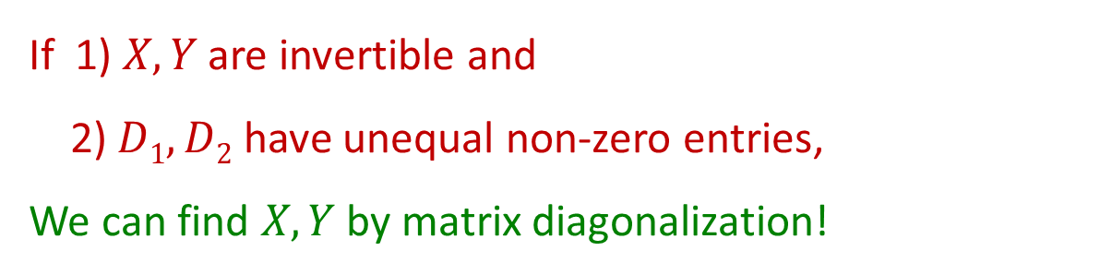
Simultaneous diagonalization
Two matrices with common diagonalization $(X , Y)$
If 1) $X,Y$ are invertible and
2) $D1, D2$ have unequal non-zero entries,
We can find $X,Y$ by matrix diagonalization!
Notes:
T(w_2) = A ~\text{diag}(w_2^T B) ~C

Slide 26
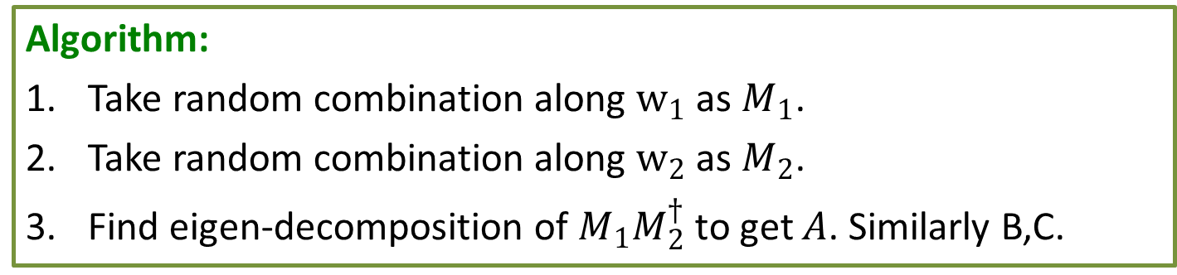
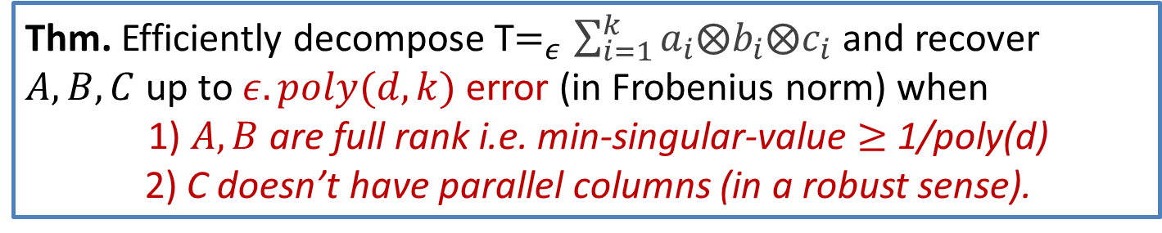
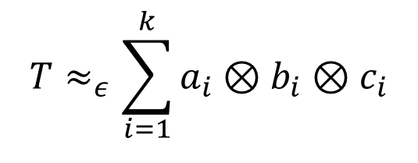
Decomposition algorithm [Jennrich]
$$T≈_{ε}\sum_{i=1}^{k}{a_{i}⊗b_{i}⊗c_{i}}$$
Algorithm:
Take random combination along $w_{1}$as $M_{1}$.
Take random combination along $w_{2}$as $M_{2}$.
Find eigen-decomposition of $M_{1}M_{2}^{†}$ to get $A$. Similarly B,C.
Thm. Efficiently decompose T$=_{ε}\sum_{i=1}^{k}{a_{i}⨂b_{i}⨂c_{i}}$ and recover $A, B, C$ up to $ε.poly(d,k)$ error (in Frobenius norm) when
1) $A, B$are full rank i.e. min-singular-value $≥$ 1/poly(d)
2) C doesn’t have parallel columns (in a robust sense).
Notes:
T(w) = \sum_{i=1}^R \langle b_i, w \rangle (a_i \otimes c_i)
= A ~\text{diag}(w^T B) ~C

Slide 27

Overcomplete Case into Techniques

Slide 28


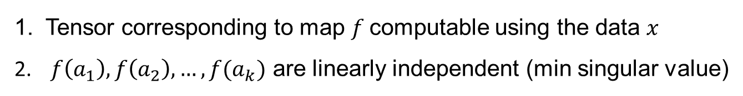


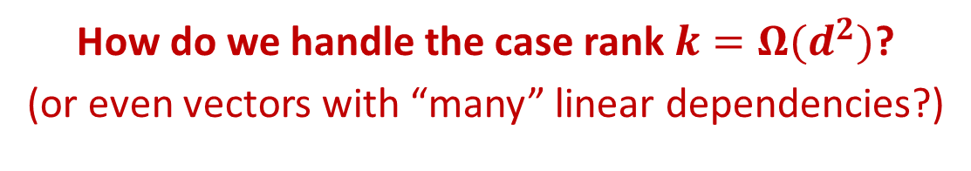







Mapping to Higher Dimensions
How do we handle the case rank $k=Ω(d^{2})$?
(or even vectors with “many” linear dependencies?)
$$ℝ^{d}$$
$$ℝ^{d^{2}}$$
$$f(a_{i})$$
Factor matrix A
$$a_{i}$$
$$a_{2}$$
$${f(a}_{2})$$
$$a_{1}$$
$${f(a}_{k})$$
$$a_{k}$$
map $f$
$${f(a}_{1})$$
$f$ maps parameter/factor vectors to higher dimensions s.t.
Tensor corresponding to map $f$computable using the data $x$
$f\left(a_{1}\right), f\left(a_{2}\right),…,f(a_{k})$ are linearly independent (min singular value)
Reminiscent of Kernels in SVMs

Slide 29





A mapping to higher dimensions
Outer product / Tensor products:
Map $f\left(a_{i}\right)=a_{i}⊗a_{i}$
Map $f$
Tensor is $E[x^{⊗2}⊗x^{⊗2}{⊗x}^{⊗2}]$
Basic Intuition:
$a_{i}⊗a_{i}$ has $d^{2}$ dimensions.
For non-parallel unit vectors $a_{i} and a_{j},$distance increases:
$$\left\langle a_{i}⊗a_{i} ,a_{j}⊗a_{j}\right\rangle = {\left\langle a_{i}, a_{j}\right\rangle }^{2}<|\left\langle a_{i}, a_{j}\right\rangle |$$
Qn: are these vectors $a_{i}⊗a_{i}$linearly independent?
Is ``essential dimension’’ ${Ω(d}^{2})$?
Notes:
T(w_2) = A ~\text{diag}(w_2^T B) ~C

Slide 30








Bad cases
U, V have rank=d. Vectors $z_{i}=u_{i}^{}⨂v_{i}^{}{∈ℝ}^{d^{2}}$
$$U(d×k)$$
$$V(d×k)$$
$$u_{i}^{}$$
$$v_{i}^{}$$
Lem. Dimension (K-rank) under tensoring is additive.
Bad example where $k>2d$:
Every $d$ vectors of U and V are linearly independent
But $(2d−1)$ vectors of Z are linearly dependent !
$z_{i}$=
$$u_{i}^{}⨂v_{i}^{}$$
Z$(d^{2}×k)$
Strategy does not work in the worst-case
But, bad examples are pathological and hard to construct!
Beyond Worst-case analysis
Can we hope for “dimension” to multiply “typically”?

Slide 31








Product vectors & linear structure
Map $f(a_{i})=a_{i}^{⊗t}$
Easy to compute tensor with $f\left(a_{i}\right)$ as factors / parameters (``Flattening’’ of 3t-order moment tensor)
New factor matrix is full rank using Smoothed Analysis.
$$a_{i}$$
$${\tilde{a}}_{i}$$
random
$ρ$-perturbation
$A (d×k)$
$\tilde{A} (d×k)$
Theorem. For any matrix $A_{d×k}$, for $k<d^{t}/2$,
$σ_{k}\left(\tilde{A}\right)≥1/poly\left(k,d,\frac{1}{ρ}\right)$ with probability 1- exp(-poly(d)).
Notes:
\sum_{i=1}^R w_i ~(\mu_i \otimes \mu_i \otimes \mu_i \otimes \mu_i \otimes \mu_i \otimes \mu_i )

Slide 32






Proof sketch (t=2)
Prop. For any matrix $A$, matrix $U$ below $(k<d^{2}/2)$ has
$σ_{k}\left(\tilde{A}\right)≥1/poly\left(k,d,\frac{1}{ρ}\right)$ with probability 1- exp(-poly(d)).
Main Issue: perturbation before product..
easy if columns perturbed after tensor product (simple anti-concentration bounds)
$$k$$
only $2d$ bits of randomness in $d^{2}$ dims
Block dependencies
$$d^{2}$$
Technical component
show perturbed product vectors behave like random vectors in $R^{d^{2}}$
$$U$$
Notes:
a_i \rightarrow \widetilde{a_i}
\widetilde{a_i} = a_i + \varepsilon_i

Slide 33



Projections of product vectors
Question. Given any vector $a∈ℝ^{d}$ and gaussian $ρ$-perturbation $\tilde{a}=a+ε$, does $\tilde{a}⊗\tilde{a}$ have projection $poly(ρ,\frac{1}{d})$ onto any given $d^{2}/2$ dimensional subspace $S⊂R^{d^{2}}$ with prob. $1−exp(−\sqrt{d})$ ?
Easy : Take $d^{2}$ dimensional $x$, $ρ$-perturbation to $x$ →
will have projection $>1/poly(ρ)$on to S w.h.p.
anti-concentration for polynomials implies this with probability 1-1/poly
Much tougher for product of perturbations!
(inherent block structure)
….
...
$$\tilde{a}\left(d\right)⊗b$$
Notes:
|\langle \widetilde{p}_r \otimes \widetilde{p}_r, M \rangle|^2 = (\widetilde{p}_r^T M \widetilde{p}_r )^2

Slide 34






Projections of product vectors
Question. Given any vector $a,b∈ℝ^{d}$ and gaussian $ρ$-perturbation $\tilde{a},\tilde{b}$, does $\tilde{a}⊗\tilde{b}$ have projection $poly(ρ,\frac{1}{d})$ onto any given $d^{2}/2$ dimensional subspace $S⊂R^{d^{2}}$ with prob. $1−exp(−\sqrt{d})$ ?
$Π_{S}$ is projection matrix onto $S$
$Π_{S}(x)$ is a $\frac{d^{2}}{2}×d$ matrix
=
$$\frac{d^{2}}{2}$$
$$d^{2}$$
$$\tilde{a}\left(d\right)⊗b$$
dot product of block with
Notes:
|\langle \widetilde{p}_r \otimes \widetilde{p}_r, M \rangle|^2 = (\widetilde{p}_r^T M \widetilde{p}_r )^2

Slide 35



Two steps of Proof..
W.h.p. (over perturbation of b), $Π_{S}(\tilde{b})$has at least
$r$ eigenvalues $>poly(ρ,\frac{1}{d})$
will show with $r=√d$
If$Π_{S}(\tilde{b})$ has $r$ eigenvalues $>poly(ρ,\frac{1}{d})$, then w.p. $1−exp⁡(−r)$ (over perturbation of $\tilde{a}$), $\tilde{a}⊗\tilde{b}$ has large projection onto $S$.
follows easily analyzing projection of a vector to a dim-k space
Notes:
|\langle \widetilde{p}_r \otimes \widetilde{p}_r, M \rangle|^2 = (\widetilde{p}_r^T M \widetilde{p}_r )^2

Slide 36




Structure in any subspace S
Suppose: Choose $Π_{S}$ first $\sqrt{d}×\sqrt{d}$ “blocks” in $Π_{S}$ were orthogonal...
….
$$v_{ij}∈ℝ^{d}$$
….
….
$$\sqrt{d}$$
Entry (i,j) is:
Translated i.i.d. Gaussian matrix!
$Π_{S}\left(\tilde{b}\right){\left.​\right|}_{\sqrt{d}}=$
(restricted to $\sqrt{d}$ cols)
has many big eigenvalues
Notes:
\text{Proj}_S (\widetilde{a_i} \otimes \widetilde{b_i}) \ge 1/\text{poly}(n, \delta)

Slide 37




Finding Structure in any subspace S
Main claim: every $c.d^{2}$ dimensional space $S$ has $\sim √d$ vectors with such a structure..
$$v_{1}$$
….
$$v_{2}$$
….
$$v_{√d}$$
….
Property: picked blocks (d dim vectors) have “reasonable” component orthogonal to span of rest..
Earlier argument goes through even with blocks not fully orthogonal!
Notes:
\text{Proj}_S (\widetilde{a_i} \otimes \widetilde{b_i}) \ge 1/\text{poly}(n, \delta)

Slide 38


Main claim (sketch)..
crucially use the fact that we have a ${Ω(d}^{2})$ dim subspace
Idea: obtain “good” columns one by one..
Show there exists a block with many linearly independent “choices”
Fix some choices and argue the same property holds, …
Generalization: similar result holds for higher order products, implies main result.
Uses a delicate inductive argument
Notes:
\text{Proj}_S (\widetilde{a_i} \otimes \widetilde{b_i}) \ge 1/\text{poly}(n, \delta)

Slide 39


Summary
Smoothed Analysis for Learning Probabilistic models.
Polynomial time Algorithms in Overcomplete settings:
Guarantees for order-$t$ tensors in d-dims (each)
Previous Algorithms
$$k≤d$$
Algorithms (smoothed case)
$$k≤d^{(t−1)/2}$$
Rank of the t-tensor=k (number of clusters)
Flattening gets beyond full-rank conditions:
Plug into results on Spectral Learning of Probabilistic models
Notes:
To summarize this section, we used smoothed analysis to design the first polynomial time algorithms with provable guarantees for learning various probabilitistic models like mixtures of gaussians, HMMs and tensor decompositions, even in highly overcomplete settings.
And earlier in the talk, we saw how we could design algorithms with much better guarantees for realistic average-case models of graph partitioning. These algorithms used new structure insights about convex relaxations on these instances.

Slide 40
Future Directions
Better Robustness to Errors
Modelling errors?
Tensor decomposition algorithms that more robust to errors ?
promise: [Barak-Kelner-Steurer’14] using Lasserre hierarchy
Better dependence on rank k vs dim d (esp. 3 tensors)
Next talk by Anandkumar: Random/ Incoherent decompositions
Better guarantees using Higher-order moments
Better bounds w.r.t. smallest singular value ?
Smoothed Analysis for other Learning problems ?
Notes:
1. In the field of optimization there are many basic problems for which we do not have good worst-case guarantees. It would be really great to obtain much better guarantees on realistic average case instances, just as we did with graph partitioning. For this we first need good average-case models that capture real-world instances, and I hope to engage in an active discussion with other researchers and experts in different applied areas to make progress on this front.
2. In machine learning, there are many important problems like learning complex graphical models that are widely used in practice, or deep-learning networks, or learning in the presence of errors --- both when the model has errors, or when there is classification error, for which we don’t have good algorithms in the worst case. It would be great to obtain efficient algorithms in paradigms beyond worst-case analysis.
3. Finally while our new algorithmic framework and average-case models seem to capture real-world instances, our algorithms require solving semi-definite programs that take time in practice. I really believe that much more lightweight relaxations like eigenvalues will also work instead in the pre-processing, and this would lead to algorhtms which have provable guarantees and are also practically efficient.

Slide 41
Thank You! Questions?

Slide 42








Learning using Decompositions
$d$ columns
$$\begin{matrix}⋅⋅ & ⋯ & ⋅ \\ ⋮ & E\left[x_{i}{ x}_{j}\right] & ⋮ \\ ⋮ & ⋯ & ⋮\end{matrix}$$
$$M=\sum_{i=1}^{k}{w_{i}{ μ}_{i}⊗μ_{i}}$$
$$Cov \left(x\right)=$$
$d$ rows
where $μ_{i}$ is mean of $i^{th}$Gaussian
can be estimated from samples…
Given M, can we find ${\left\{μ_{i}\right\}}_{i∈[k]}$ by matrix decomposition?
Matrix Decompositions not unique! (unless rank=1)
$$M=UV^{T}=(UZ)(Z^{T}V^{T})$$
for a unitary matrix $Z$ of dimension $k$ (eg. SVD)
Notes:
3 points.
Let’s now see how low-rank decompositions come into learning.
Consider the covariance matrix of the distribution from which random point x is sampled. This can be estimated from samples. It turns out that this gives rise to a matrix with a rank-k decomposition: with one term each per decomposition.
Qn: can be learn these parameters by just looking at this matrix M.
Unfortunately this is not the case: matrix decompositions are not unique. Many sets of parameters can give you same M

Slide 43










Tensors to the rescue
$$B_{1}$$
$$B_{2}$$
$$B_{k}$$
Uniqueness of
Tensor Decompositions
T
$$A_{1}$$
$$A_{2}$$
$$A_{k}$$
$$C_{1}$$
$$C_{2}$$
$$C_{k}$$
Thm [Kruskal’77]. Tensor decompositions for 3-tensors and above are unique (under mild conditions)!
$d$
$$T=\sum_{i=1}^{k}{w_{i}{ μ}_{i}⊗μ_{i}⊗μ_{i}}$$
$$⋱$$
$$\begin{matrix}⋅⋅ & ⋯ & ⋅ \\ ⋮ & E\left[x_{i}x_{j}x_{k}\right] & \\ ⋮ & ⋯ & \end{matrix}$$
$$d$$
$d$
Uniqueness $⟹$ Recover parameters $w_{i}$ and $μ_{i}$
Algorithm for Decomposition $⟹$ efficient learning
Notes:
3 points.
However, the nice thing about tensors is that tensor decompositions are unique! This is because of a celebrated result of Kruskal in 1977.
As with matrices, by looking at the third moment – i.e. three-way correlations, we can get access to a tensor with a rank-k decomposition.
Uniqueness of decomposition implies a unique set of parameters that satisfy this tensor.
Algorithms give efficient learning.

Slide 44

Robustness
Beware : Sampling error
Empirical estimate $T=_{ε}\sum_{i=1}^{k}{w_{i } μ_{i}^{}⨂{ μ}_{i}^{}⨂{ μ}_{i}^{}}$
With $poly(n,k)$ samples, error $ϵ≈1/poly(d,k)$
Uniqueness and Algorithms resilient to noise of 1/poly(d,k) ?
Kruskal’s theorem is only for exact decompositions
Thm [BCV’13]. Robust version of Kruskal Uniqueness theorem for Tensor Decompositions with $1/poly(d,k)$ error
Notes:
4 points.
1. However, these covariances and third-moment were estimated from the samples. Hence, there is always sampling error.
2. In particular, since we only have access to polynomially many samples, we only get inverse polynomial accuracy. We need uniqueness and algorithms resilient to 1/poly errors.
3. Unfortunately Kruskal theorem is only for exact decomposition – adapting the proof corresponds to an error tolerance of only inverse-exponential error.
4. We first give a robust uniquenss theorem for tensor decompositions resilient to 1/poly error.

Slide 45



Algorithms ?
Matrix Decompositions:
Σ
V^{T}
M
U
SVD: matrix toolkit
Computable in polynomial time.
Tensor Decompositions ?
Most Tensor problems are NP-hard! [Hastad, HK]
Particularly when rank $k >d$
Notes:
1. Well, sure, decompositions are unique. But what about algorithms?
2. For matrices, decompositions can be done in poly time. This is because of the SVD which forms a really power toolkit in matrix algebra, data mining, PCA etc.
3. Unfortunately for tensors, the corresponding problems are all NP-hard in the wrost-case. Hence, this only forms a stone-age tool kit. Particularly when the rank >d.

Slide 46
Blast from the past
[Harshman 1972] [Jennrich] Decomposition is easy when the vectors involved are (component wise) linearly independent
[Anandkumar, Hsu, Kakade 11]
If A,B,C are full rank, then can recover them, given T
If A,B,C are well conditioned, can recover given T+(noise)
A =
Does not work in when rank k > d

