Slide 1

Android App Programming
Activities, Activity Life Cycle
Fragments, Fragment Life Cycle
Screen Layout with XML
Event Handlers in Java

Slide 2



Android App
Android App: Software application running on Android platform
Java: primary programming language
Android: Linux OS for mobile devices “Multiuser” capable, where each app is a separate user
Android is since 2005 owned by Google
Androids market share:
- worldwide: 87% (iOS 13%) (Q3/2016, units shipped, source: IDC, Nov 2016)
- CH: 44% (iOS 53%) (Q2/2015, http://stats.areppim.com/...)
Android Studio: primary and official IDE for Android, includes the Android SDK

Slide 3
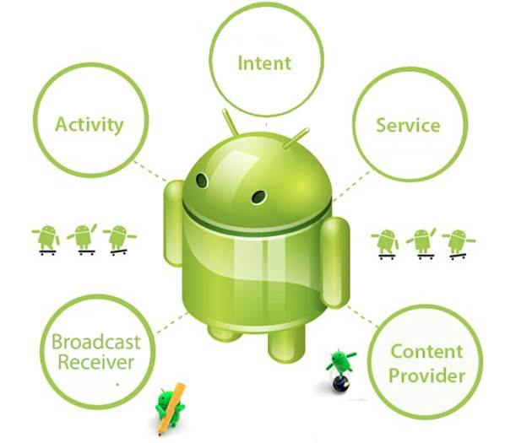
App Components
Visual representation of an app i.e. a screen, an app may have several activities
Moodlight Reference Design is based on one activity
Background process without UI, e.g. play sound
Provides shared data to an app e.g. with a file system or a local DB
Responds to system- wide broadcasted announcements, e.g. «battery low»
http://designthing.net/the-basic-components-in-an-android-app/

Slide 4
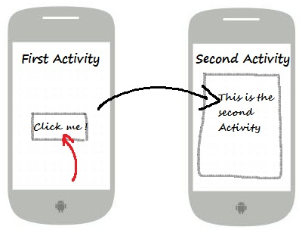
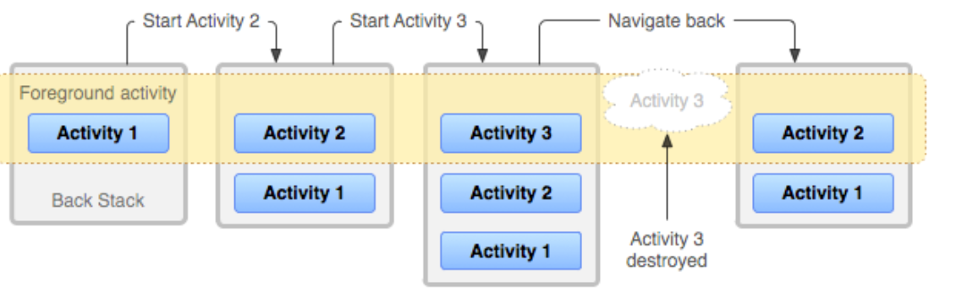
Activities
An app may switch between several activities.
First activity after start is the “main activity”
When a new activity starts, previous activity stops, is hidden but is preserved (pushed on the “back stack”)
The states of an activity are described with the activity lifecycle diagram …
Main activity

Slide 5
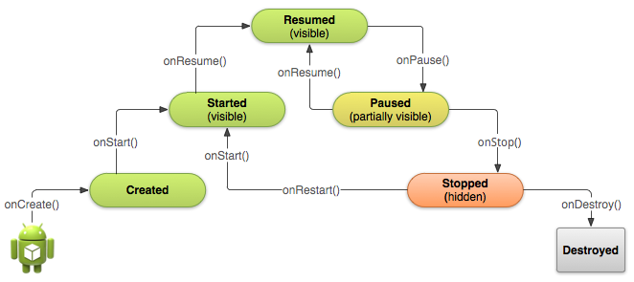
Activity Lifecycle
Activity interacts with user, is on top of the stack
Activity goes into background, no longer receives user input, an other activity is resumed
Activity gets focus
Activity becomes visible
Activity gets hidden
Activity will be removed
Activity is launched
No code is executed
Activity restarts after it has been stopped
Activity is deleted from memory
http://developer.android.com/reference/android/app/Activity.html

Slide 6
Activity Implementation
Activities are implemented as subclasses of the Activity class import android.app.Activity; public class myActivity extends Activity {…
Dedicated callback methods, e.g. onCreate(), onStart(), …, are assigned to each lifecycle transition. They act as event handler.
onCreate() must be implemented. Initializes the activity, in particular the (visual) layout for the user interface by calling setContentView(…).
Implemented callback methods must call their superclass implementation, e.g. super.onCreate(…)
Add other callback methods to handle user interaction events, e.g. onButtonPessed(), onTextEntered()…

Slide 7
Activity Class Skeleton
Inherits from Activity class
public class ExampleActivity extends Activity { @Override public void onCreate(Bundle savedInstanceState) { super.onCreate(savedInstanceState); // The activity is being created. } @Override protected void onStart() { super.onStart(); // The activity is about to become visible. } @Override protected void onResume() { super.onResume(); // The activity has become visible (it is now "resumed"). } @Override protected void onPause() { super.onPause(); // Another activity is taking focus (this activity is about to be "paused"). } @Override protected void onStop() { super.onStop(); // The activity is no longer visible (it is now "stopped") } @Override protected void onDestroy() { super.onDestroy(); // The activity is
about to be destroyed. } }
onCreate() callback method must always be implemented
savedInstanceState restores settings from a previous life of the this activity
Always call superclass implementation from each implemented callback method

Slide 8
Activity Screen Layout
The layout defines the visual structure of the user interface
The Android framework provides two ways for declaring the layout:
Declare the UI elements in XML (eXtensible Markup Language), presentation and application code are separated straightforward, easy to use,
Instantiate everything programmatically at runtime, create objects and manipulate their properties in Java
Either or both of the above concepts may be used interchangeably
The layout for the Moodlight Reference Design is declared with XML
http://developer.android.com/reference/android/app/Activity.html

Slide 9
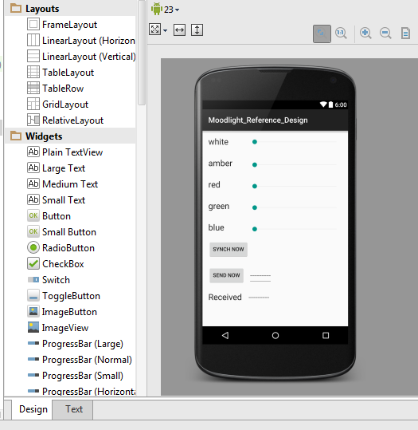
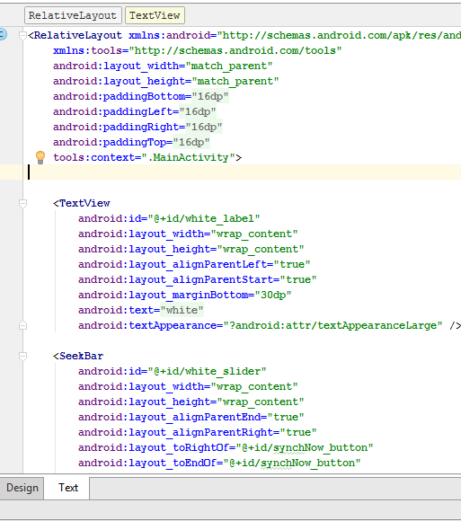
Android Studio Layout Editors
Graphical Editor
XML Text Editor
Mutually updated

Slide 10
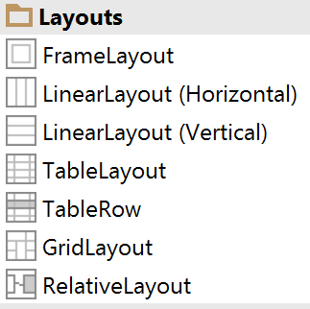
Proposed Layouts
Used for Moodlight Reference Design

Slide 11
eXtensible Markup Language (XML)
XML is widely used in the IT to store or exchange structured sets of data.
Objectives: human – and machine readable, easy to learn, easy to process, formal and concise
XML syntax and terminology:
Element
<message status = ’’sent’’>Hello</message>
<doc>
</doc>
one root element
<list> <message status = ’’sent’’>Hello</message> <message status = ’’received’’>Goobye</message> </list>
Start tag
Attribute: name, value
Content
End tag (with /)
Elements can be nested
empty element (short form)
<rectangle width = ’’2’’ width = ’’4’’ />
http://www.w3schools.com/xml/
https://wiki.selfhtml.org/wiki/XML

Slide 12
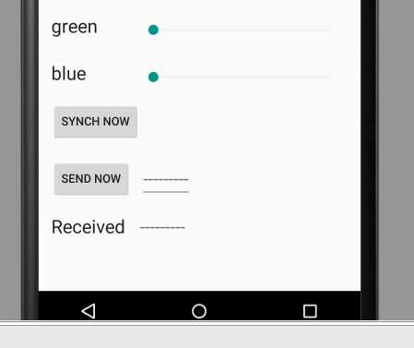
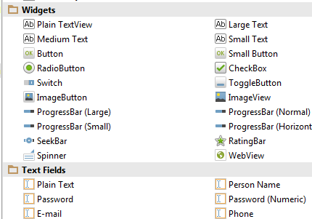
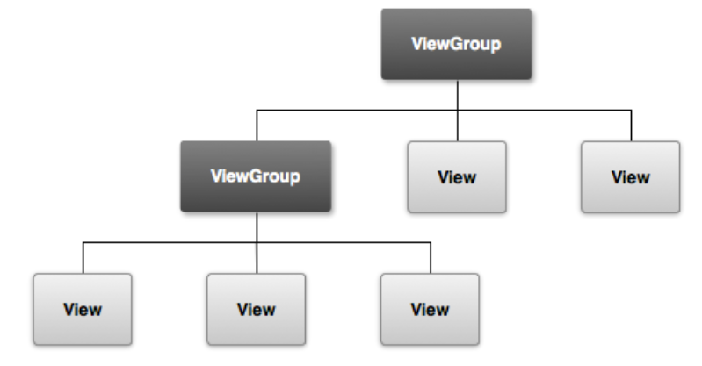
Android Views
Views are visual objects on a UI screen that users can interact with
Views can be grouped using view groups
Both can be declared with XML
User interaction through Java event handlers
Android provides a large collection of views and view groups

Slide 13
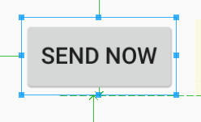
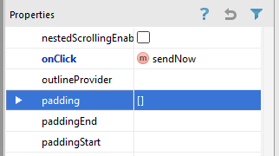
Button Example
Graphical - Layout
XML - Layout
<Button android:id="@+id/sendNow_button" android:layout_width="wrap_content" android:layout_height="wrap_content" android:layout_alignParentLeft="true" android:layout_alignParentStart="true" android:layout_below="@+id/synchNow_button" android:layout_marginTop="20dp" android:onClick="sendNow" android:text="@string/TX_label" />
public void sendNow(View view) { logInfo("Send now"); sendData(); }
Java event handler

Slide 14
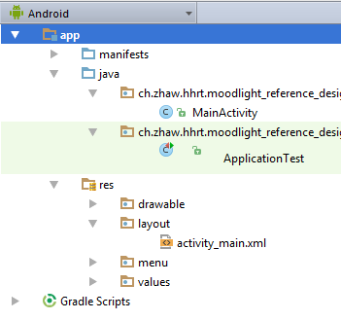
Activate XML Layout in Java
Android project view
Java source code file
XML layout file
Java code called from onCreate()
setContentView(R.layout.activity_main);

Slide 15

XML and Java R Class
Android framework provides the Java “R class” for all resources declared with XML
Allows to access all XML declared resources as Java objects
Moodlight example “white seekbar”:
id = R.id.white_slider;
XML
SeekBar bar = (SeekBar) findViewById(id);
<SeekBar android:id="@+id/white_slider" android:layout_width="wrap_content" android:layout_height="wrap_content" android:layout_alignParentEnd="true" android:layout_alignParentRight="true" android:layout_toRightOf="@+id/synchNow_button" android:layout_toEndOf="@+id/synchNow_button" android:layout_alignBottom="@+id/white_label" android:layout_alignParentTop="true" android:max="255" />
Java code

Slide 16
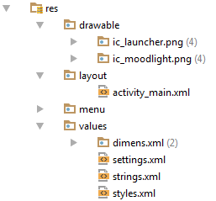
Other XML Resources
The same concept can also be applied to other types of resources:
Pictures …
Java code
String deviceName =
getString(R.string.device_name);
<string name="device_name">RNBT-412F</string>
Constants
<integer name="TXRX_delimiter">13</integer>
<string name="red_label">red</string>
Java code
TXRX_delimiter = (byte) getResources().getInteger(R.integer.TXRX_delimiter);

Slide 17
Moodlight Reference Design
onCreate() event handler
@Override protected void onCreate(Bundle savedInstanceState) { logInfo("onCreate"); super.onCreate(savedInstanceState); setContentView(R.layout.activity_main); // Bond variables to resources TX_message = (EditText) findViewById(R.id.bluetoothTX_message); RX_message = (TextView) findViewById(R.id.bluetoothRX_message); TXRX_delimiter = (byte) getResources().getInteger(R.integer.TXRX_delimiter); // Register the listeners for the SeekBars changeSeekBarListener(R.id.white_slider, getString(R.string.white_label)); changeSeekBarListener(R.id.amber_slider, getString(R.string.amber_label)); changeSeekBarListener(R.id.red_slider, getString(R.string.red_label) ); changeSeekBarListener(R.id.green_slider, getString(R.string.green_label)); changeSeekBarListener(R.id.blue_slider, getString(R.string.blue_label) ); findBTdevice(); }
see more on next slide …

Slide 18
Moodlight Reference Design
Register a handler for seek bars
private void changeSeekBarListener(int id, final String command) { SeekBar bar = (SeekBar) findViewById(id); bar.setOnSeekBarChangeListener( new SeekBar.OnSeekBarChangeListener() { // Uses an inner anonymous class public void onProgressChanged(SeekBar SeekBar, int progress, boolean fromUser) { logInfo("SeekBar " + command + " changed to " + SeekBar.getProgress() + " : from user = " + fromUser); if (fromUser) { TX_message.setText(command + " " + SeekBar.getProgress(), TextView.BufferType.NORMAL); sendData(); } } public void onStartTrackingTouch(SeekBar SeekBar) {} public void onStopTrackingTouch(SeekBar SeekBar) {} } ); }
Method will be called on slider pos. changes
Installs a handler that acts on changes of the slider position
Handler is defined within an inner anonymous class (directly instantiated within the method call)

Slide 19
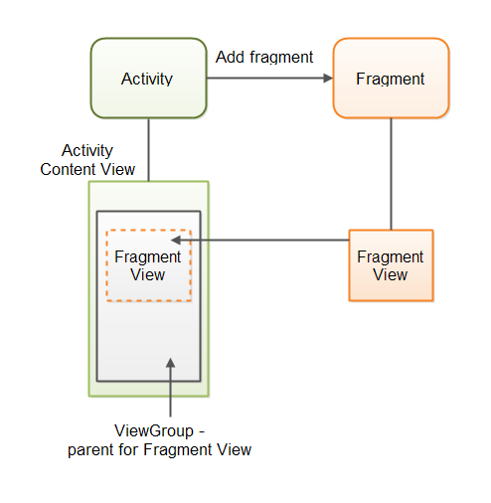
Fragments
Instead of switching between Activities …
it is also possible to stay in ONE Activity and use several Fragments for the different menu items.
Advantages are: - Fragments are lightweight - Data sharing is much simpler - Flexible layout on big screens
Source of diagram: http://tutorials.jenkov.com/android/fragment.html

Slide 20
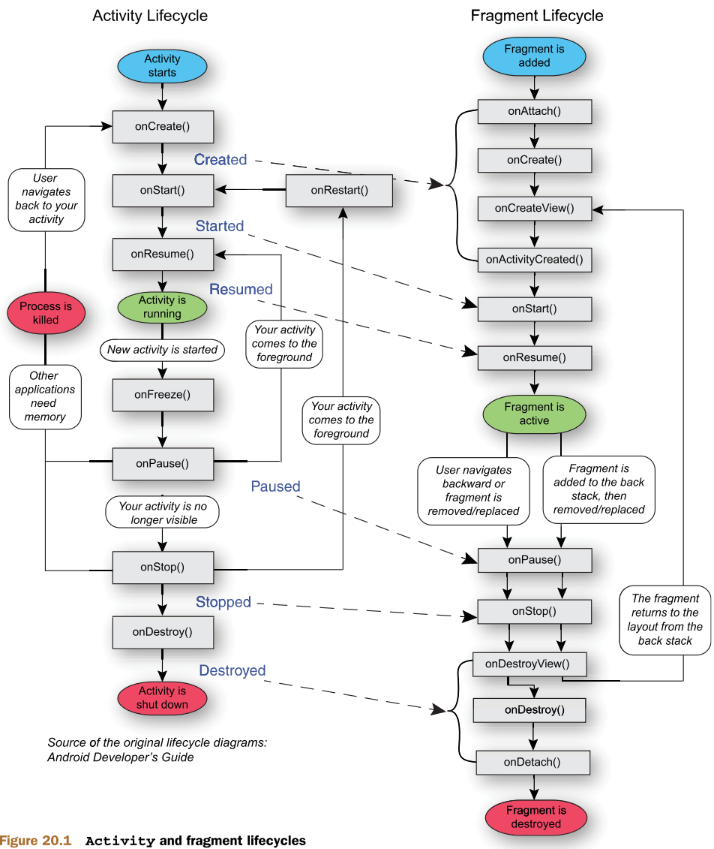
Fragments
Fragments have similar lifecycles as Activities.
ONE Activity is in charge all the time.
The Activity can easily replace a Fragment by an other.
Only the few Fragment methods with special tasks have to be overridden.
The Activity can call methods of an active Fragment.
A Fragment can call methods of its Activity.
Source of diagram: http://baiduhix.blogspot.ch/2015/08/android-how-to-do-findviewbyid-in.html

Slide 21

Thanks for your Attention …
For getting started:
http://developer.android.com/training/index.html
And keep in mind:
A huge community is active in Android programming, you might thus find anwers on the internet on almost any questions around that topic.

